Slide 1




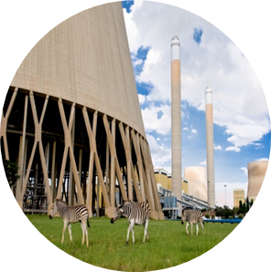

Tutorial C T-pipe junction Steady State Thermomechanical FEM model
By Ofentse Kgoa
kgoaot@eskom.co.za

Slide 2
Introduction
Background:
It is assumed that Tutorial A is completed.
Objectives:
Open an existing FreeCAD project
Prepare CAD geometry for FEM modeling
Perform a longitudinal load calculation
Run a steady state thermomechanical FEM model
Evaluate and analyze the thermomechanical FEM results
Save the FreeCAD project

Slide 3
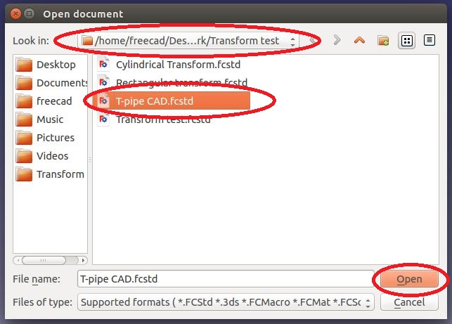
Project start Up
Open an existing project:
To open an existing project, click on <Open a document or import files>
A task dialogue appears, choose the directory the file directory, select the project to be opened and then click on <Open>

Slide 4
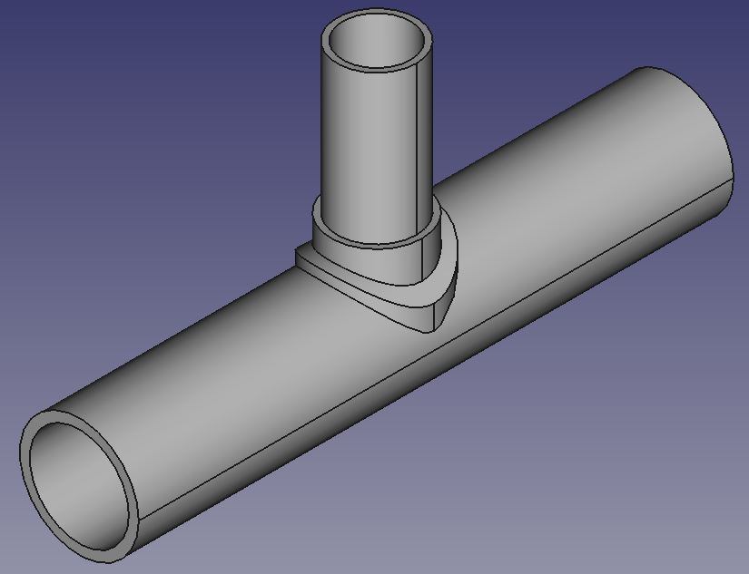
Thermomechanical FEM model (Steady state) Pre-processing
Notes and assumptions:
The thermomechanical model will use the same geometry, material specification and mesh as that used in the static FEM model. Refer to Tutorial B to obtain the Mesh, Material and Boundary constraints information.
The thermomechanical model will have the same boundary conditions as that of the static model with the addition of thermal boundary conditions.
The external surfaces of the branch and shell pipe are insulated, whilst the reinforcement is not insulated. The induced stresses due to this are to be investigated.

Slide 5
Thermomechanical FEM model (Steady state) Pre-processing
Notes and assumptions:
Air is the fluid surrounding the T-pipe with a heat transfer coefficient of 10 W/m²K and at ambient temperature of 300 K. Steam at 725 K flows through the pipe and loses heat to air. The heat transfer coefficient for water is 1000 W/m²K
Heat transfer in the longitudinal and circumferential direction is assumed to be negligible.
A steady state analysis is performed. In a steady state analysis, all variables are independent of time.

Slide 6
Thermomechanical FEM model (Steady state) Pre-processing
Notes and assumptions:
An end cap is not placed on one of the end faces of the shell pipe this is due to the fact that the end cap will not heat up at the same rate as the rest of the T-pipe.
This causes a thermal gradient that induces thermal stresses on the T-pipe. Because the end cap is just an artificial way of applying a longitudinal load on one of the end faces, these induced thermal stresses are not real and affect the accuracy of the results.
The problem can simply be avoided by just calculating and applying the longitudinal load on the end face of the T-pipe.

Slide 7
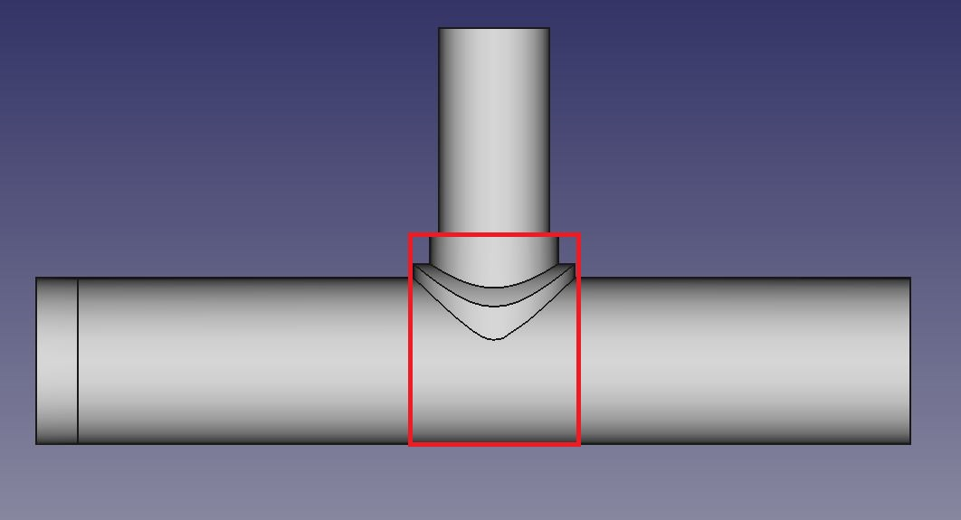
Thermomechanical FEM model (Steady state) Pre-processing
Preparing the geometry:
Pipes are insulated using insulation blankets/cladding that is wrapped around the pipe.
Due to this the external surface area depicted in the picture is the area that is not insulated and it is therefore exposed to the surrounding air.
The branch pipe needs to be cut in order to create selectable surfaces on which a heat flux will be applied to.

Slide 8
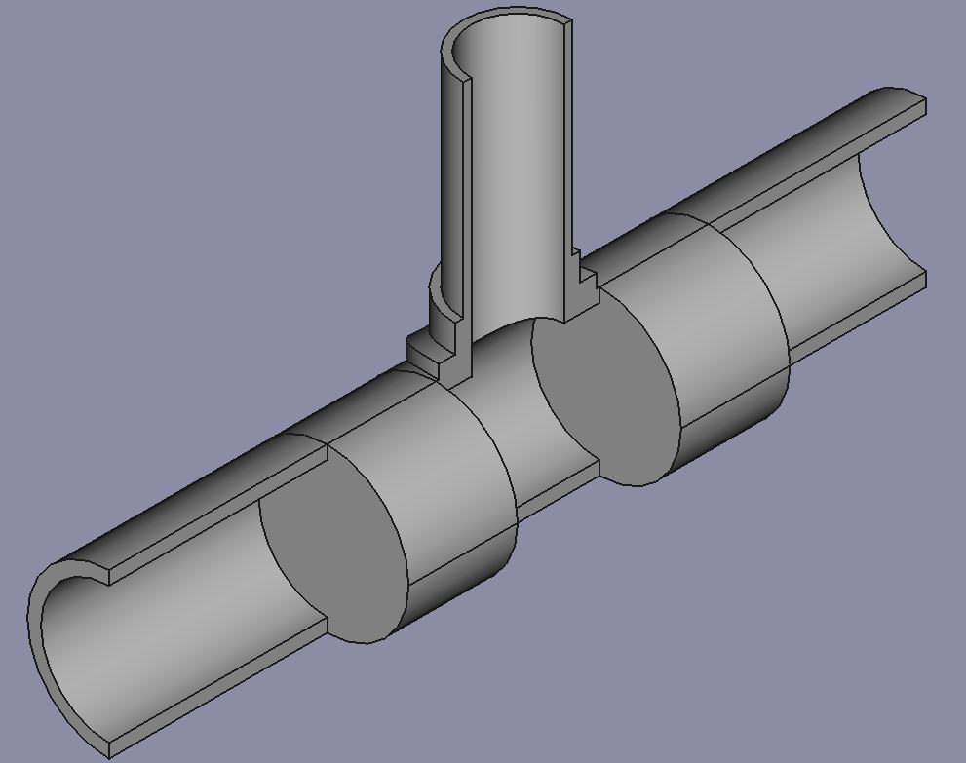
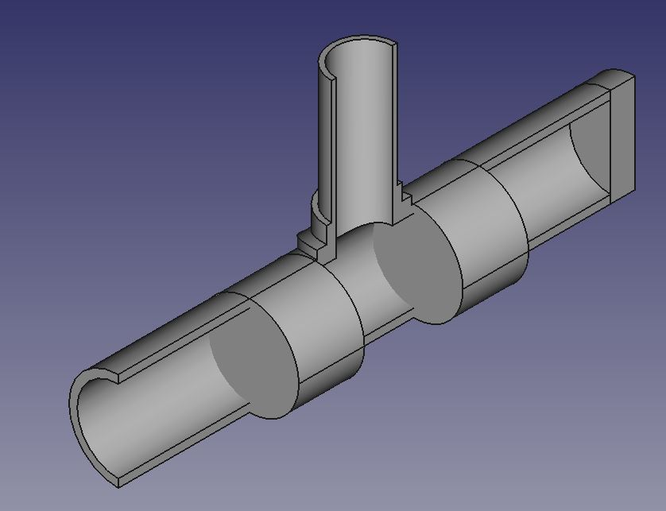
Thermomechanical FEM model (Steady state) Pre-processing
Preparing the geometry:
Create a cylinder of radius 150 mm and a length of 200 mm. Translate this cylinder -150 mm in the Y direction. Rotate this cylinders 90° about the X-axis as indicated in the picture.
Create another cylinder with a radius of 150 mm and a length of 200 mm. Translate this cylinder 350 mm in the Y direction. Rotate this cylinders 90° about the X-axis as indicated in the picture.
Join the two cylinders together using the <Make union of several shapes>.

Slide 9
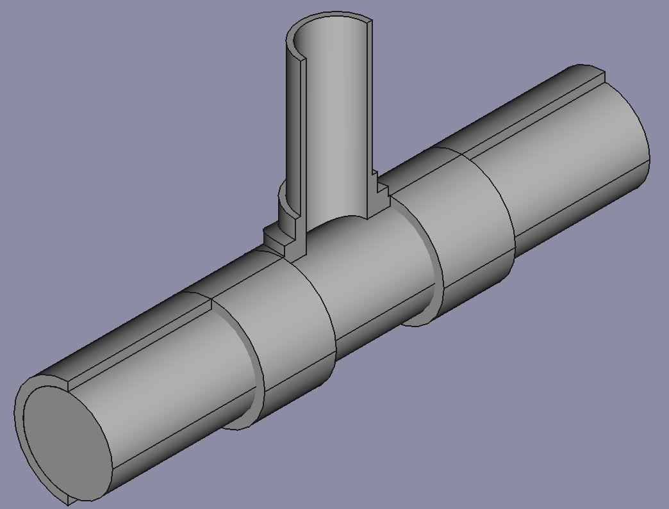
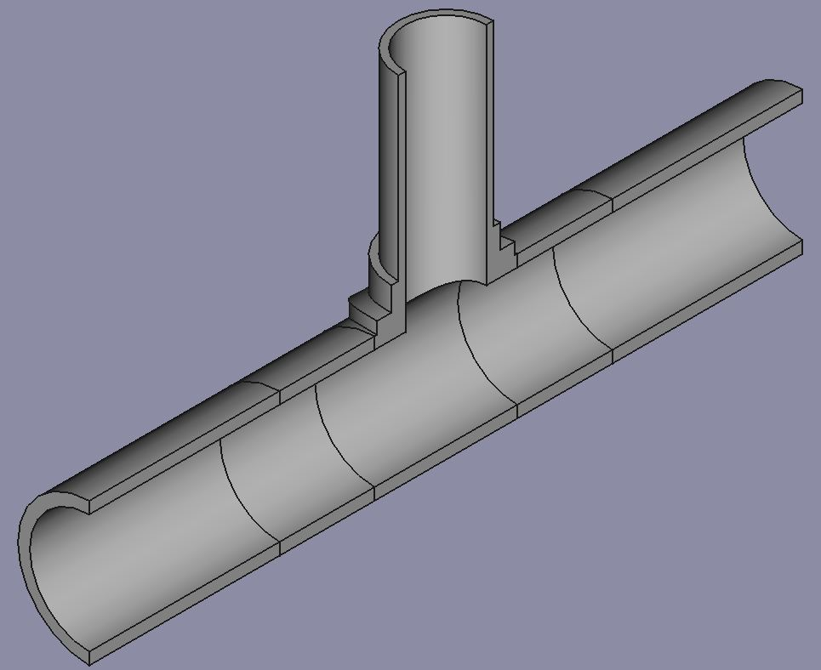
Thermomechanical FEM model (Steady state) Pre-processing
Preparing the geometry:
Create another cylinder of length 1500 mm and radius 125 mm. Rotate and translate the cylinder so that it is similar to that depicted in the picture.
Cut the two cylinders in half so that they are similar to that depicted in the picture.
Join all the parts together with <Make union of several shapes>.

Slide 10
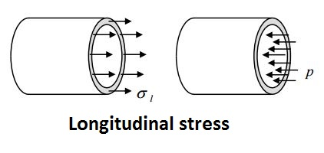
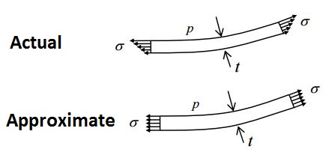
Thermomechanical FEM model (Steady state) Pre-processing
Determining the longitudinal load:
The longitudinal stress on the shell pipe has already been calculated in Tutorial B under “Verification”. This stress will used as a pressure applied to the end face of the shell pipe.
As depicted, the downside of the calculation is loss of accuracy as it assumes that the stress distribution along the thickness of the pipe is uniform.
The longitudinal pressure to be applied to the shell pipe end face is 24.75 MPa (from Tutorial B).

Slide 11
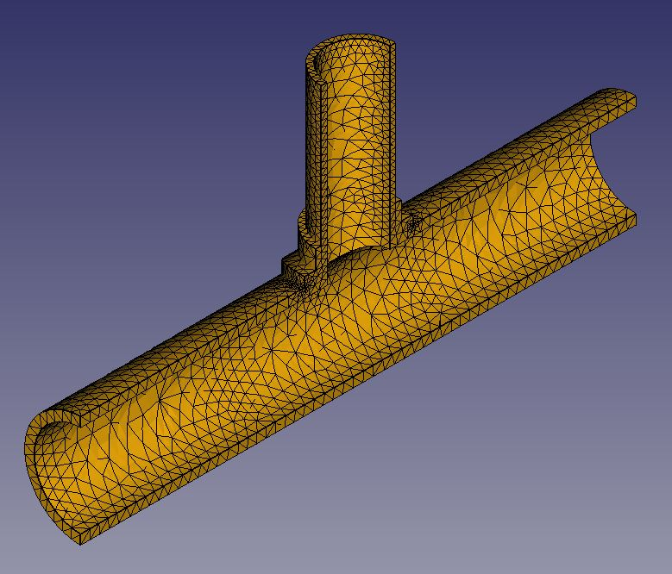
Thermomechanical FEM model (Steady state) Pre-processing
Creating the Mesh:
For all FEM models, a mesh needs to be created.
Refer to Tutorial B which shows how to create a mesh.
The material to be used in the analysis is “Steel-Generic”.
Refer to Tutorial B on how to specify a material.
Material specification:

Slide 12
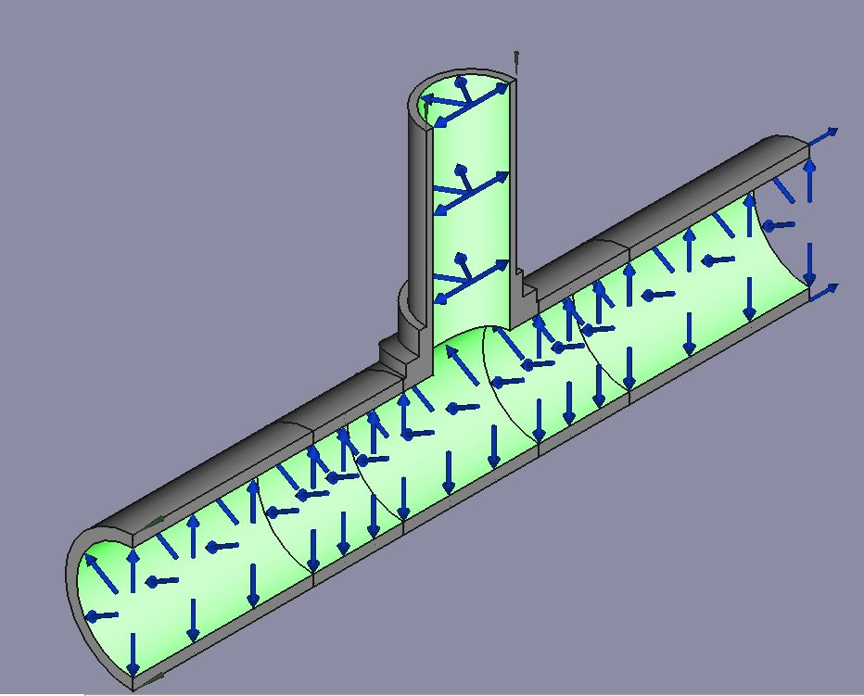
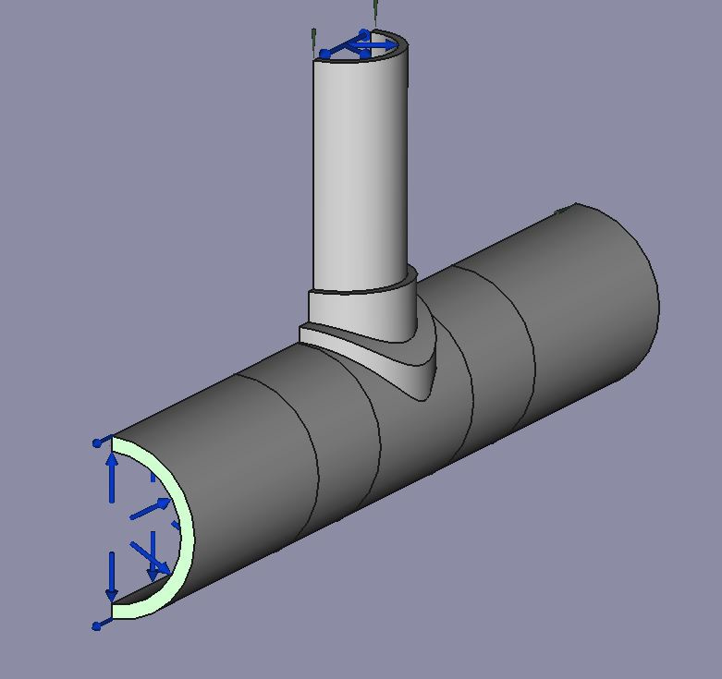
Thermomechanical FEM model (Steady state) Pre-processing
Boundary Conditions:
The T-pipe needs to fixed in the X, Y and Z directions. To do this use the displacement constraint. Refer to Tutorial B for more information.
Add a pressure of 9 MPa to the internal surface of the T-pipe as indicated in the picture.
Add a pressure of 24.75 MPa to the end face of the T-pipe. The direction should be the same as that indicated in the picture.

Slide 13
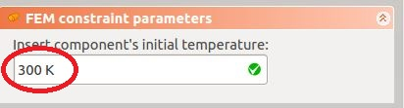

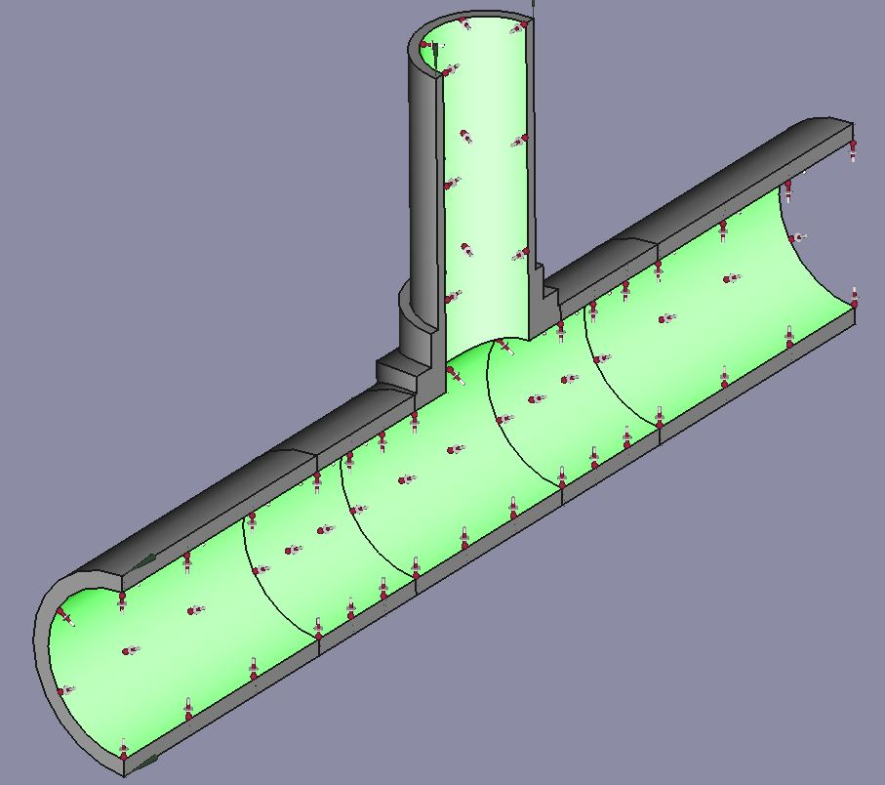
Thermomechanical FEM model (Steady state) Pre-processing
Boundary Conditions:
The initial temperature of the body needs to be specified for all thermomechanical analysis. Click on <Create FEM constraint for initial temperature acting on the body> and enter an initial temperature of 300 K. Note that temperature is always specified in Kelvin [K].
Add a heat flux constraint on the internal surface of the T-pipe with <Create FEM constraint for Heat flux acting on a face>. The ambient temperature should be 725 K and the Film coefficient should be 1000 W/m²K.

Slide 14
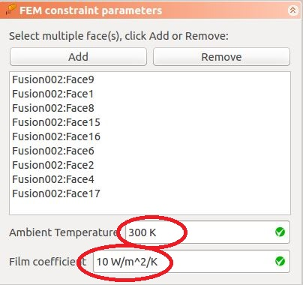
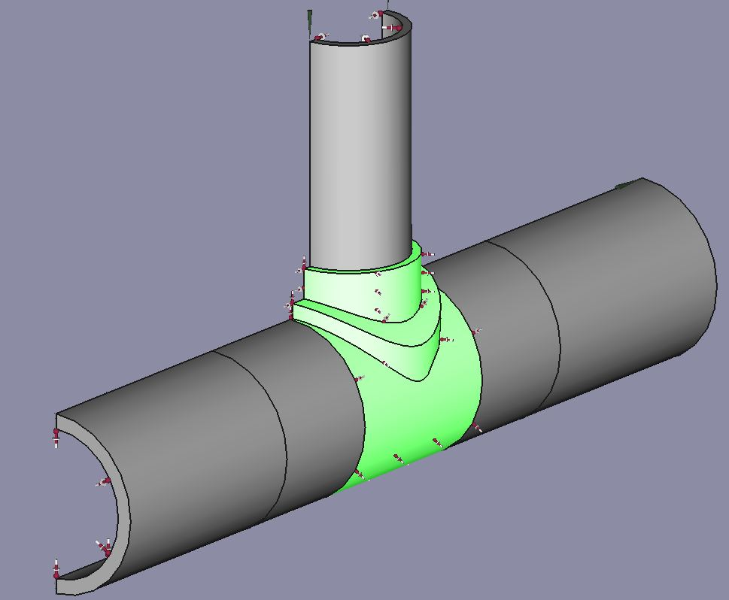
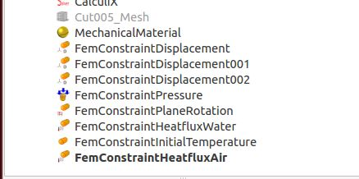
Thermomechanical FEM model (Steady state) Pre-processing
Boundary Conditions :
Add a heat flux constraint on the reinforcement of the T-pipe as indicated in the picture with <Create FEM constraint for Heat flux acting on a face>.
The ambient temperature should be 300 K and the Film coefficient should be 10 W/m²K.
A face with no thermal boundary condition implies that the face is insulated.
A picture showing all the boundary conditions for the model is displayed for reference

Slide 15
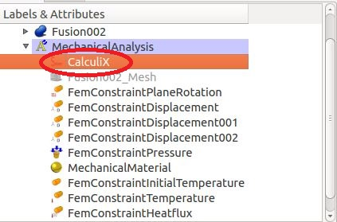
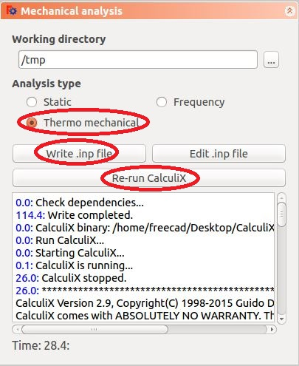
Thermomechanical FEM model (Steady state) Running the solver
Running the analysis:
Double click on <CalculiX> in the object tree view.
Select a Thermomechanical analysis
Write the input file
Run CalculiX

Slide 16
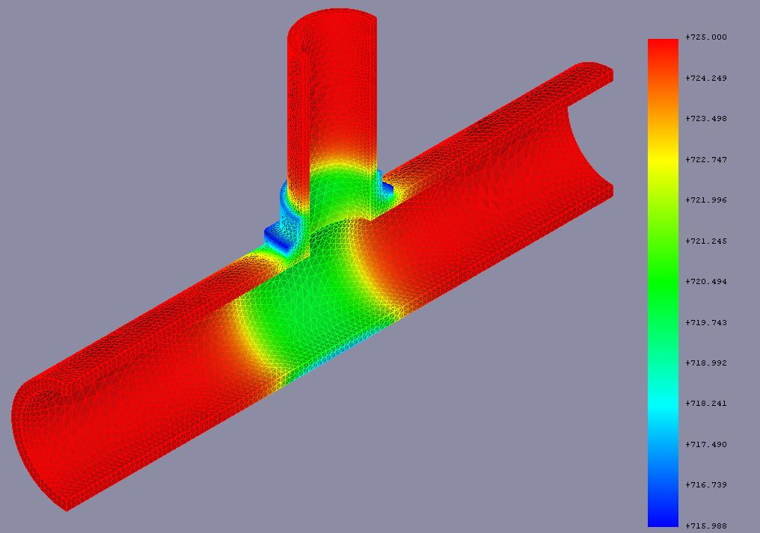
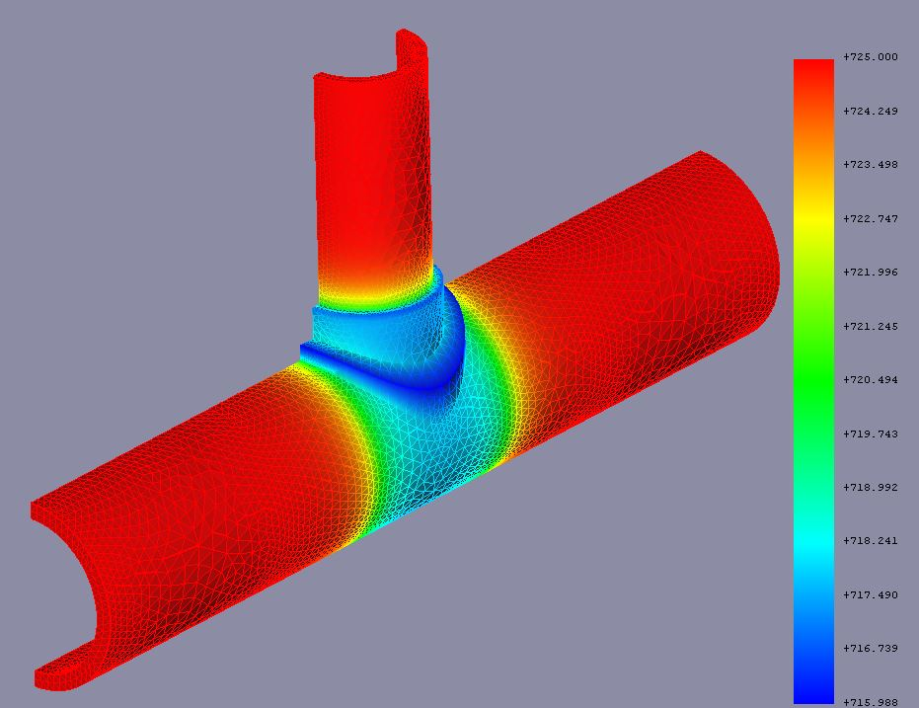
Thermomechanical FEM model (Steady state) Post- processing
Viewing the results:
Create a new pipeline that displays the temperature distribution across the T-pipe section. Remember to hide all other objects that are displayed in the document window.
The temperature distribution (in Kelvin) across the T-pipe is displayed in the pictures.
Other result sets(stress or displacement) can also be viewed with the pipeline.

Slide 17
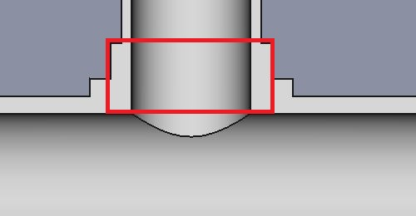
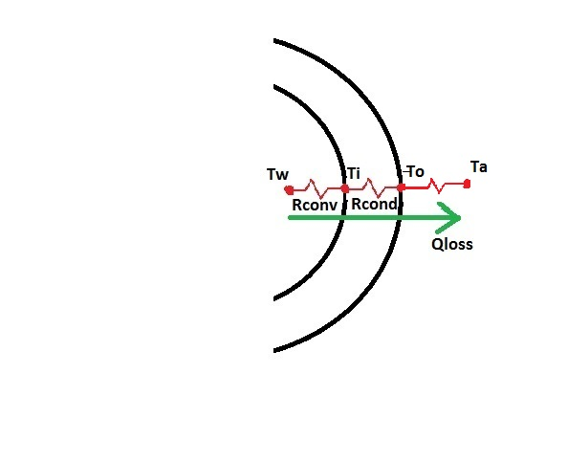
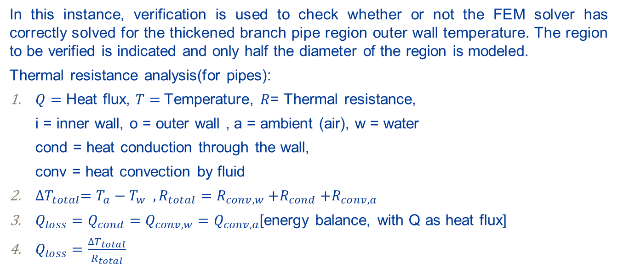
Thermomechanical FEM model (Steady state) Post- processing
Verification:
In this instance, verification is used to check whether or not the FEM solver has correctly solved for the thickened branch pipe region outer wall temperature. The region to be verified is indicated and only half the diameter of the region is modeled.
Thermal resistance analysis(for pipes):
$Q=$ Heat flux, $T=$Temperature, $R$= Thermal resistance,
i = inner wall, o = outer wall , a = ambient (air), w = water
cond = heat conduction through the wall,
conv = heat convection by fluid
${∆T}_{total}=T_{a}−T_{w} ,R_{total}=R_{conv,w}{+R}_{cond}{+R}_{conv,a}$
$Q_{loss}=Q_{cond}=Q_{conv,w}=Q_{conv,a}$[energy balance, with Q as heat flux]
$Q_{loss}=\frac{∆T_{total}}{R_{total}}$

Slide 18
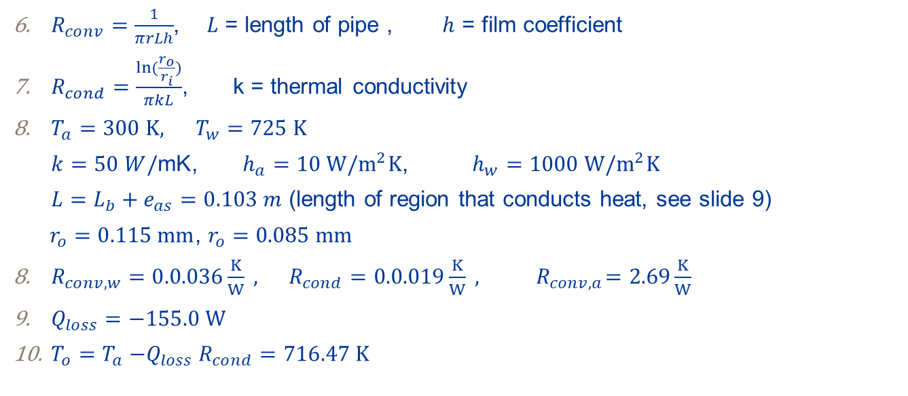
Thermomechanical FEM model (Steady state) Post- processing
Verification:
$R_{conv}=\frac{1}{πrLh}$, $L$ = length of pipe ,$h$ = film coefficient
$R_{cond}=\frac{ln⁡(\frac{r_{o}}{r_{i}})}{πkL}$, k = thermal conductivity
$T_{a}=300 K, T_{w}=725 K$
$k=50 W/\text{mK}$, $h_{a}=10 W/m^{2}K$, $h_{w}=1000 W/m^{2}K$
$L=L_{b}+e_{as}=0.103 m$ (length of region that conducts heat, see slide 9)
$r_{o}=0.115 mm$, $r_{o}=0.085 mm$
$R_{conv, w}=0.0.036\frac{K}{W} , R_{cond}=0.0.019\frac{K}{W} ,{ R}_{conv,a}=2.69\frac{K}{W}$
$Q_{loss}=−155.0 W$
$T_{o}=T_{a}{−Q}_{loss}R_{cond}=716.47 K$

Slide 19
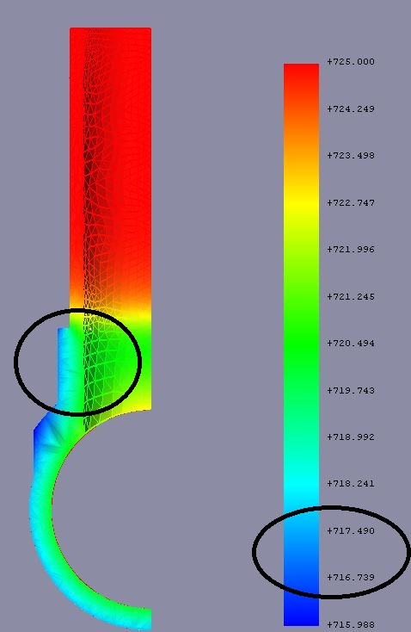
Thermomechanical FEM model (Steady state) Post- processing
Verification:
The clipping plane result pipeline is used for verification.
The outer wall of branch pipe has a temperature in the range of 716.7 -717.5 K as can be seen in the picture. The calculated outer wall temperature of 716.45 K is fairly close to the temperature range.
Furthermore, it can be seen that the rest of the T-pipe (areas excluding the reinforcement) go to a temperature of 725 K (steam temperature), which is to be expected because these regions are insulated on the outside and therefore heat is not lost.
It can now be concluded that the FEM solver has correctly solved for temperatures.

Slide 20
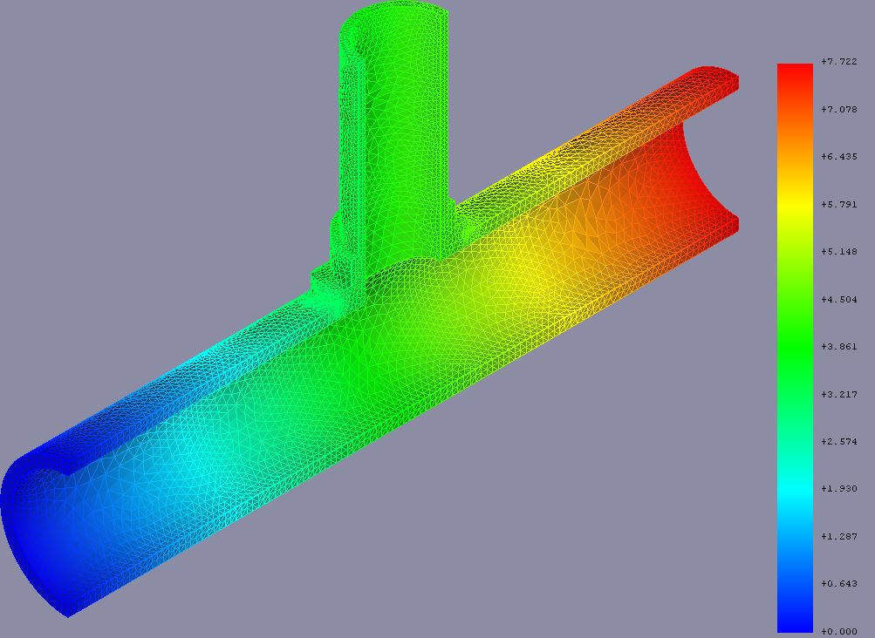
Thermomechanical FEM model (Steady state) Post- processing
Analyzing the results(Displacements):
Now that it has been verified that the temperatures were solved for correctly, we can start analyzing the displacement.
In some cases, the T-pipe may only be allowed a certain amount of displacement due to its support.
Create a pipeline that displays the displacement in the y-direction(axial shell pipe direction) , from this it is found that the maximum displacement in the y-direction is 7.815 mm.
If this displacement is not accounted for or beyond the maximum allowed displacement in the direction, it can induce stresses on the parts and it may lead to failure.

Slide 21
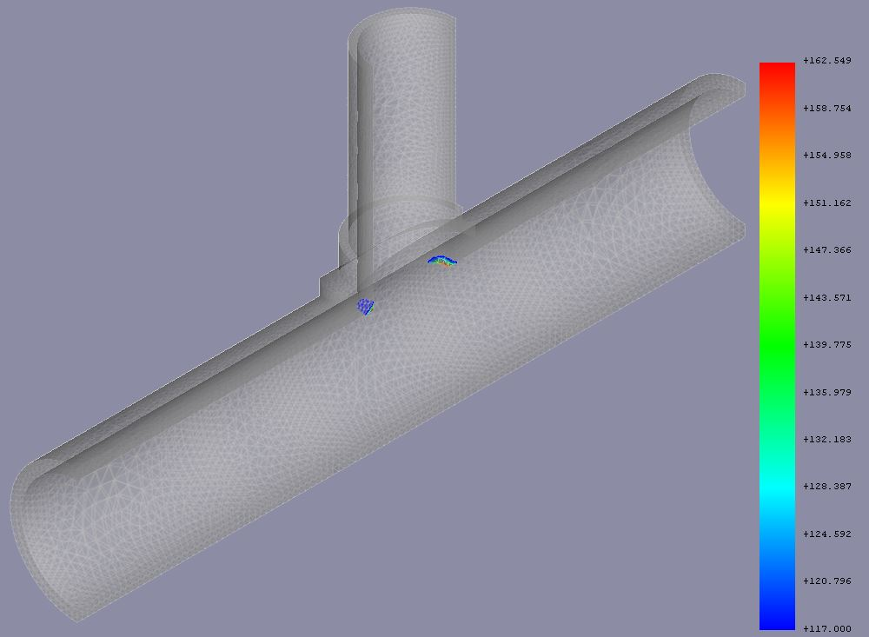
Thermomechanical FEM model (Steady state) Post- processing
Analyzing the results(Stresses):
A von mises stress scalar clip of 117 MPa is created to investigate which regions in the T-pipe experience stresses above the design stress.
It can be seen that the branch and shell pipe junction experiences a stress of 162 MPa which is above the design stress but below the proof strength (175 MPa).
It can be concluded that in the steady state operation of the T-pipe junction, the pipe does not fail.

Slide 22
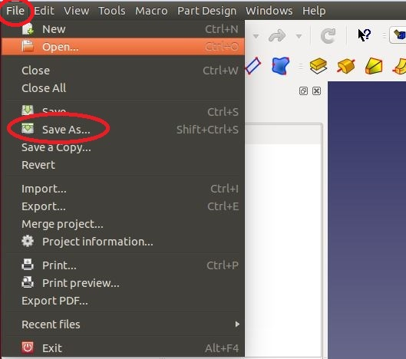
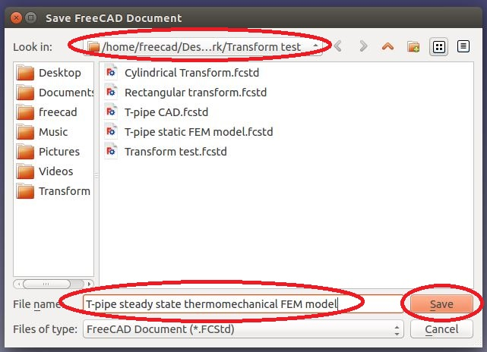
Thermomechanical FEM model (Steady state) Post- processing
Saving the FreeCAD project:
To save the project under a different name, go to File and then click on <Save As>.
A task dialogue appears, choose the file directory, enter the file name and click <Save>.
The project is going to be used for the transient thermomechanical model.

Slide 23

END

