Slide 1
CoreGen Portal Tutorial
John Leidel
Chief Scientist, Tactical Computing Laboratories
ver 2022.09.13

Slide 2
Tutorial Series
Level 0: Introduction to System Architect
Level 1: System Architect Design Concepts and Developing a basic RISC processor
Level 2: Instruction-Level (StoneCutter) Implementation Concepts
Level 3: Advanced Design Concepts
Level 4: System Architect Plugins and Integrating External RTL
CoreGenPortal Tutorial

Slide 3
System Architect Using the CoreGen Portal
Modular, High-Level Design Concepts

Slide 4

Installation
The CoreGen Portal can be installed from source code or from pre-built binaries.
Source Code:
First install CoreGen from https://github.com/opensocsysarch/CoreGen
Next install CGPortal from https://github.com/opensocsysarch/CoreGenPortal
Pre-Built Binaries
Binaries for your platform can be found in the system architect release repo https://github.com/opensocsysarch/SystemArchitectRelease/tree/master/CoreGenPortal/x86_64

Slide 5
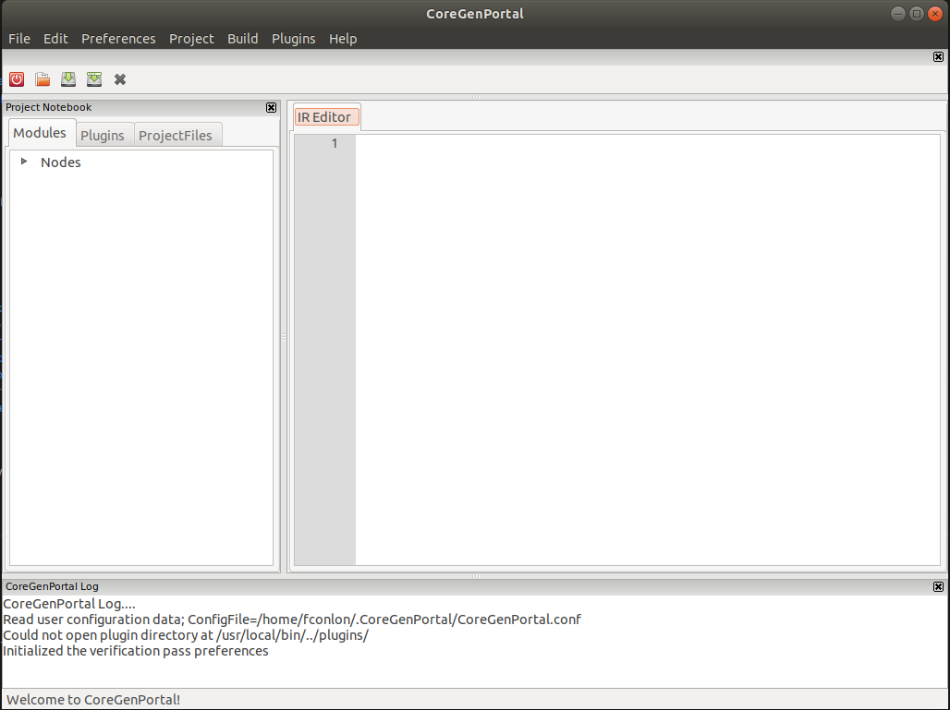
Running the portal
Once you have installed the Portal it can be run from the command line with the commit ‘$ CoreGenPortal’. The window to the right should appear.

Slide 6
Parts of the Portal: Node Tree
The Node Tree will display all of the Nodes in your IR.
The tree can be expanded to show a list of the types of nodes.
The tree will allow you to create new nodes and edit existing nodes

Slide 7
Parts of the Portal: Edit Window
The Edit window will display your IR and SC files.
You IR and SC files can be manually edited and saved using the Edit Window

Slide 8
Parts of the Portal: Log Pane
The Log Pane will display error warning and progress messages
These messages provide information about errors or things that could cause errors

Slide 9
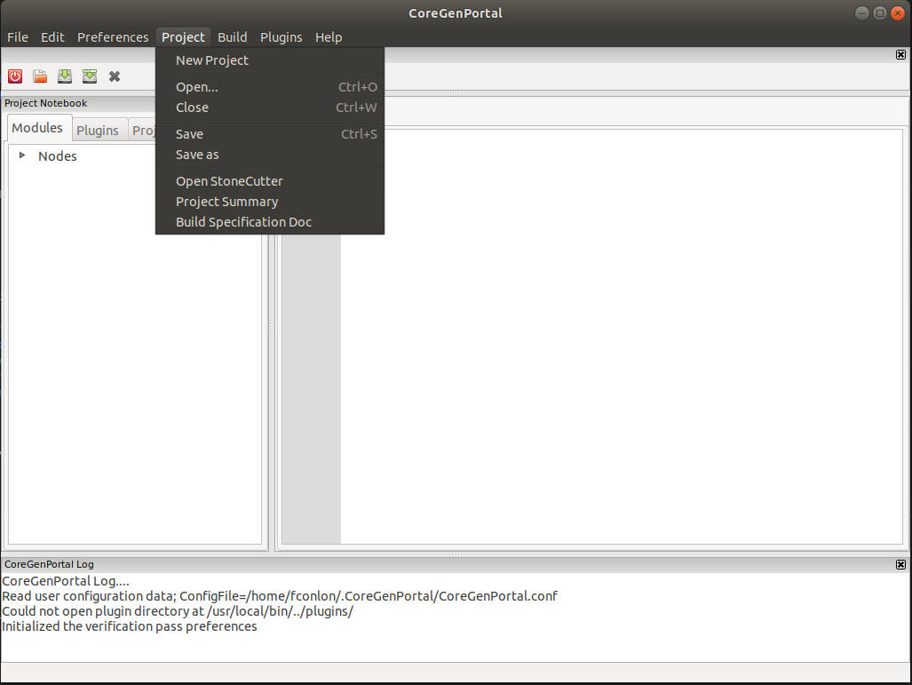
Starting a New Project
Click the Project tab and select new project
This will open a create Project dialogue

Slide 10
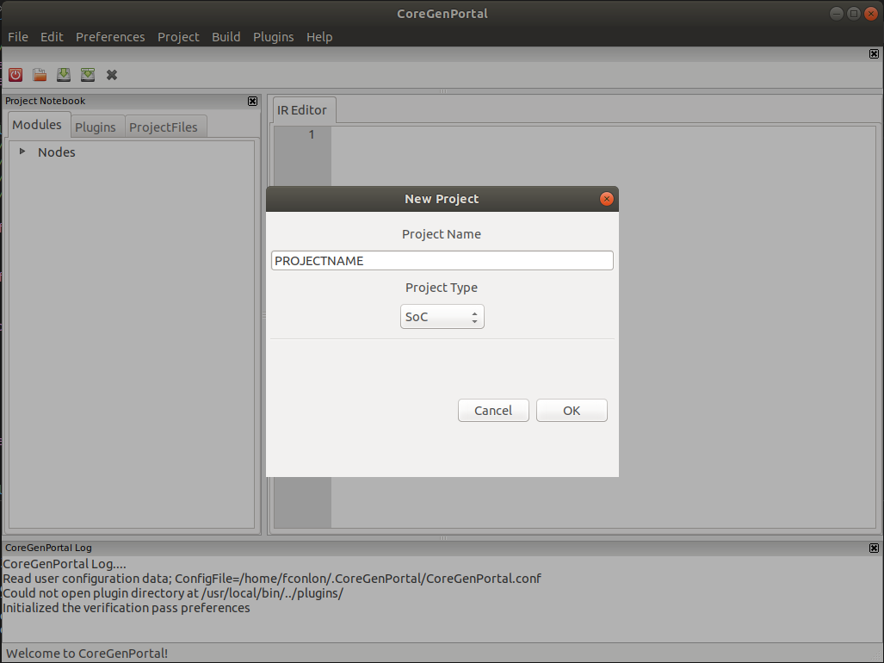
Starting a New Project
The New Project dialogue will allow you to create the name and select the type (SoC, Module Extension, UNK) of the project
Give the project a name, select SoC and click OK

Slide 11
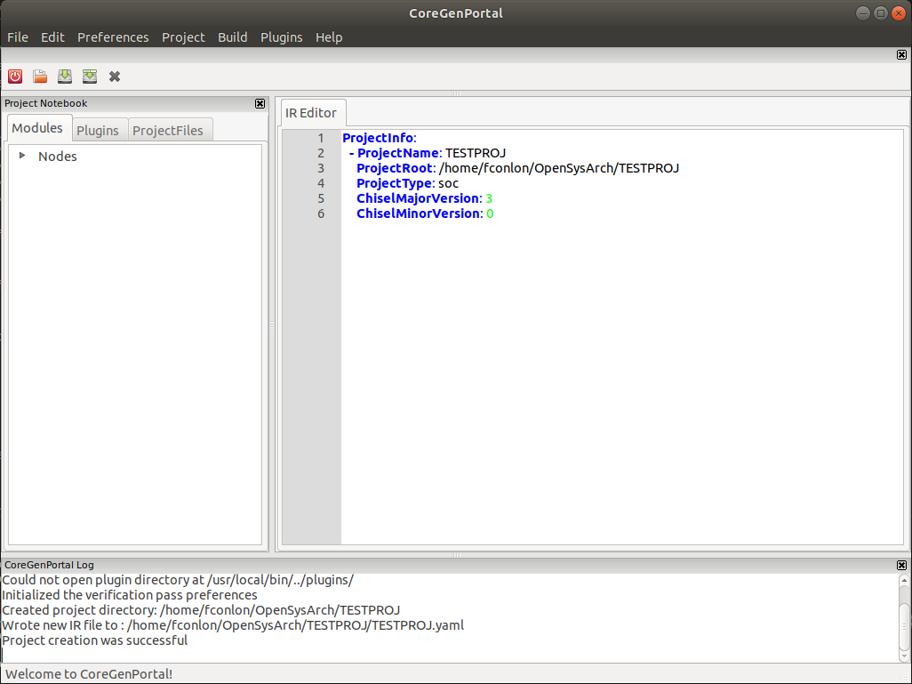
Adding a Node
A new Project with an IR shell will
Click the arrow next to “Nodes” in the Node tree to show a list of types of nodes

Slide 12
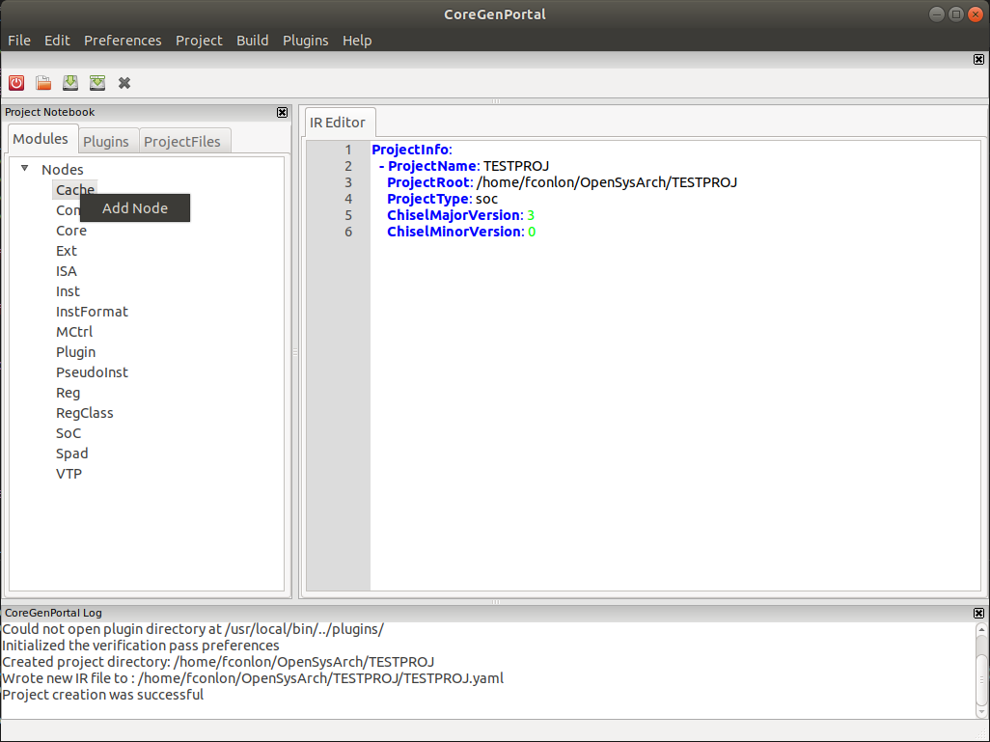
Adding a Node
Clicking the Nodes dropdown arrow will display a list of the types of nodes that can be created.
Right click a type of node and click Add Node to bring up an Add Node dialogue

Slide 13
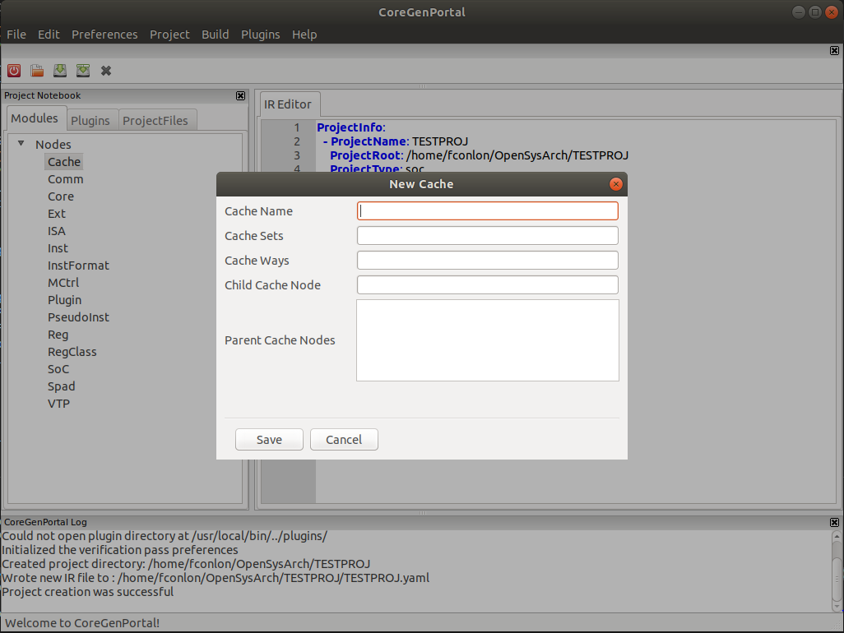
Adding a Node
Clicking Add Node will display a dialogue box with all of the relevant fields for the node type you are trying to create
Try clicking save with all of the fields empty

Slide 14
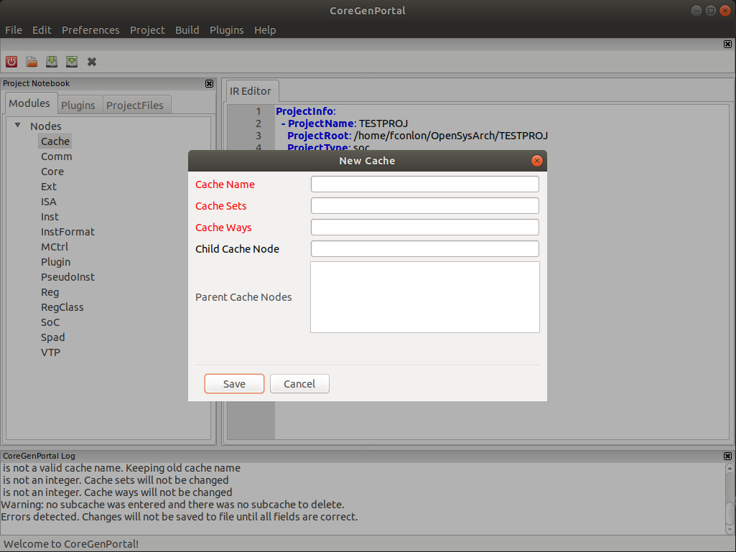
Adding a Node
Clicking save with errors in the save box will highlight the fields that have errors with red
Notice that the Log Pane displays error messages that describe what is wrong with each highlighted box

Slide 15
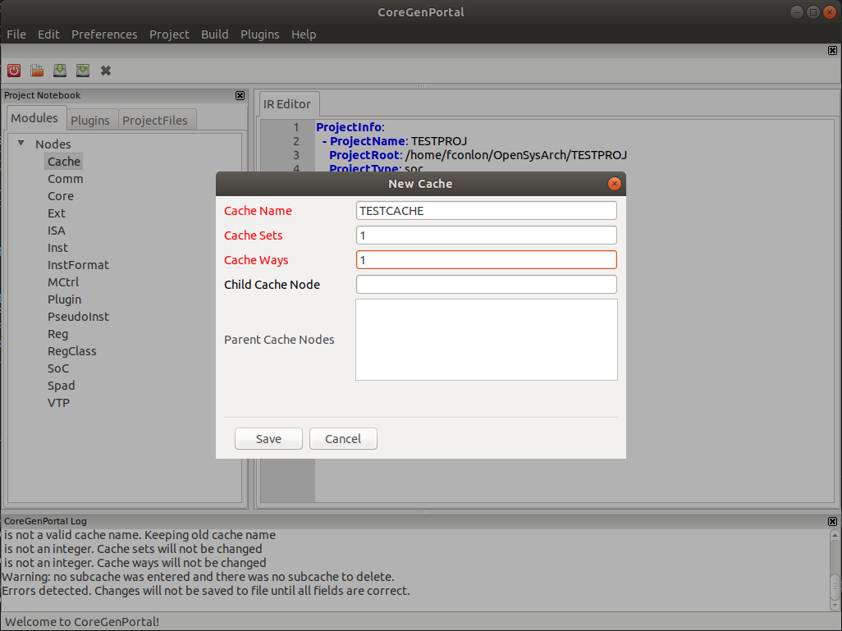
Adding a Node
Enter Cache information into the required boxes and click save
This will write the node to the yaml and add it to the Node Tree

Slide 16
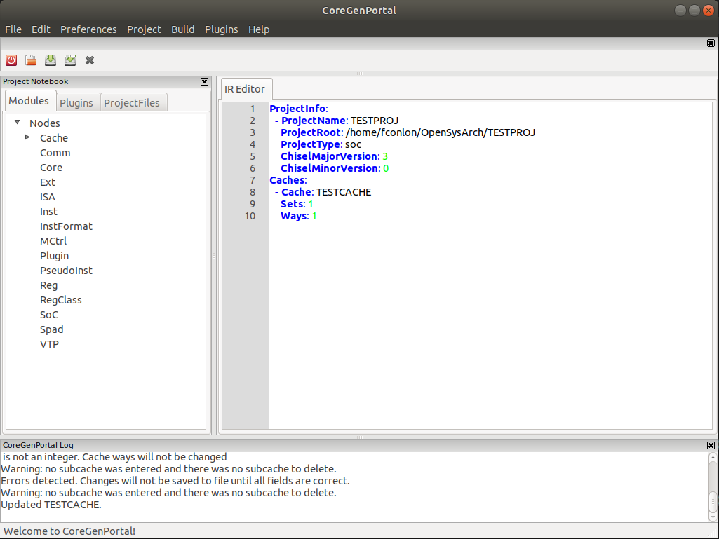
Editing a Node
With a node added you can click on the arrow next to the node type to view all the nodes of that type

Slide 17
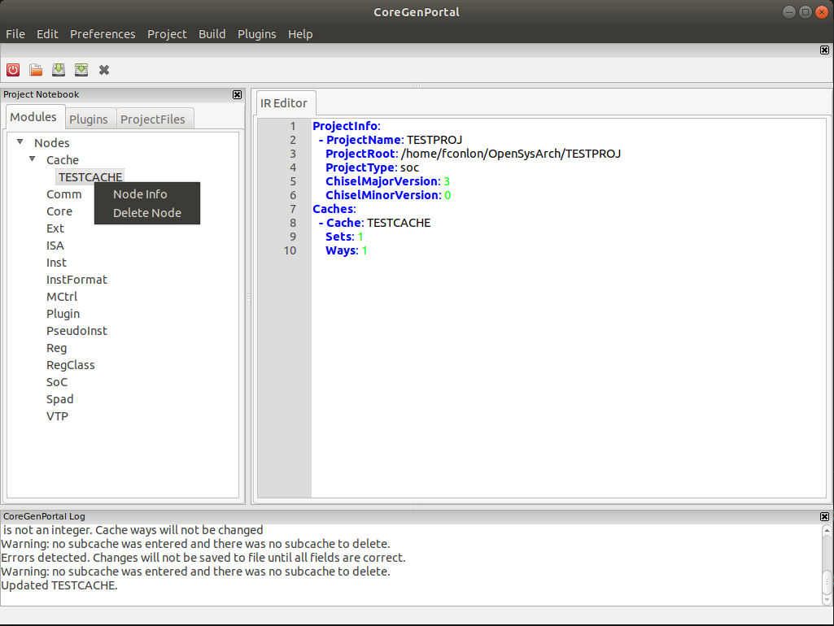
Editing a Node
With the Cache Nodes Tree open, right click the cache that we just created and Select Node Info. This will open a dialogue with editable node information

Slide 18
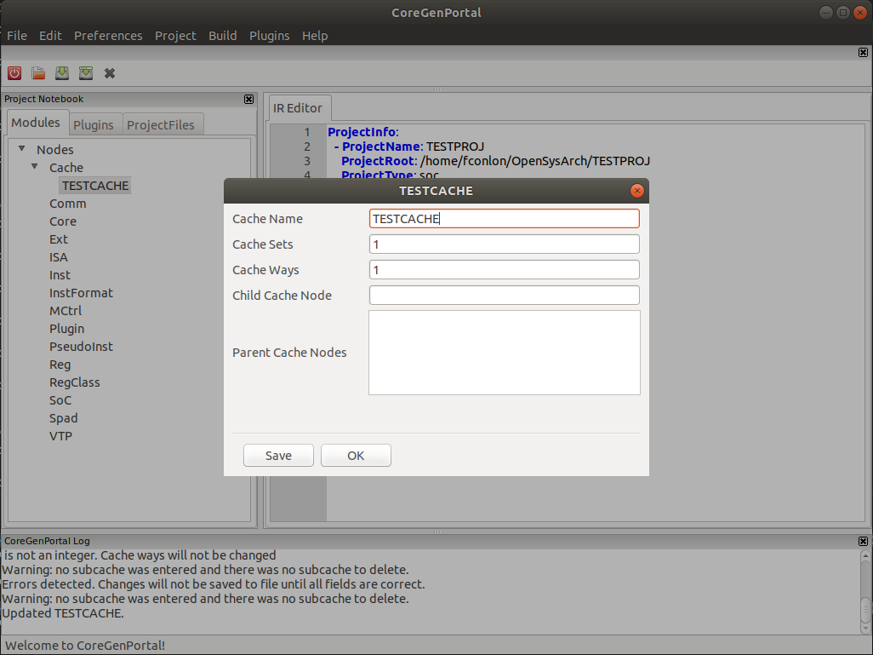
Editing a Node
The Node Info window contains several editable text boxes that display information about the Node
Try entering a non-integer into the sets or ways box and clicking save

Slide 19
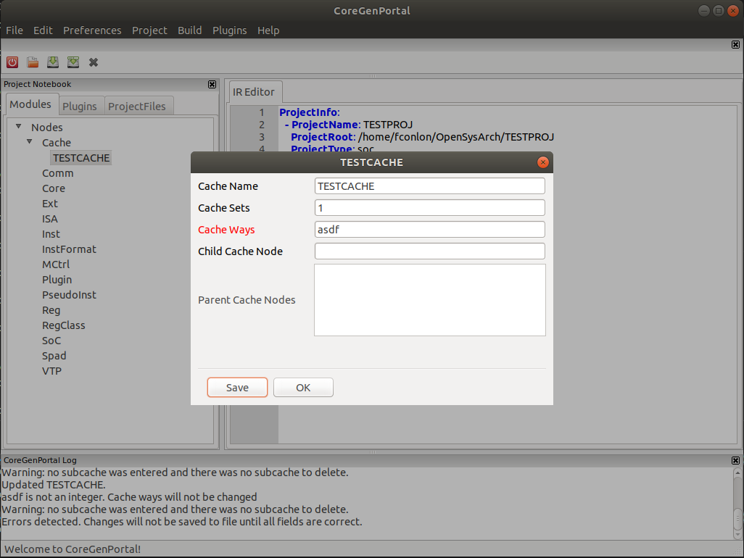
Editing a Node
Just as with the Add Node window, any boxes with invalid information will be highlighted red and an error message describing what is wrong will be added to the Log Pane
Change the non-integer to a new integer and click save

Slide 20
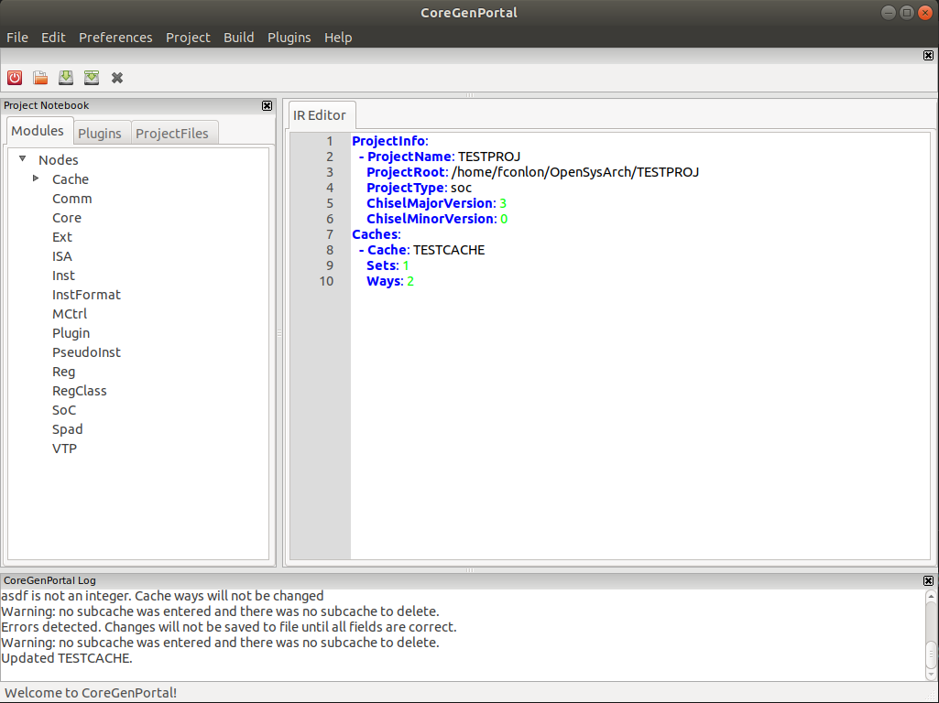
Editing a Node
The Cache Node and IR will automatically be updated and saved when you click save with valid information in all fields

Slide 21
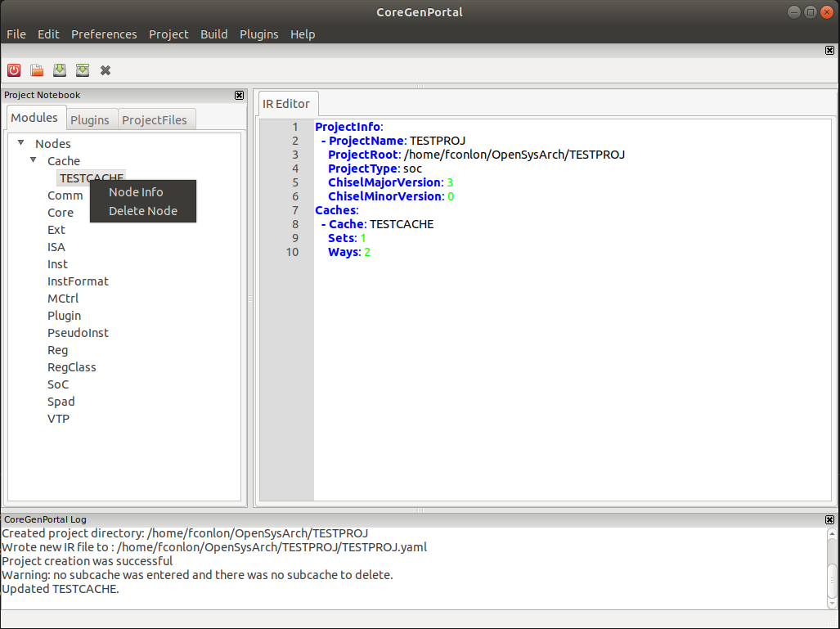
Deleting a Node
Navigate to the node that you would like to delete in the Node Tree then right click it
Select Delete Node from the popup that appears

Slide 22
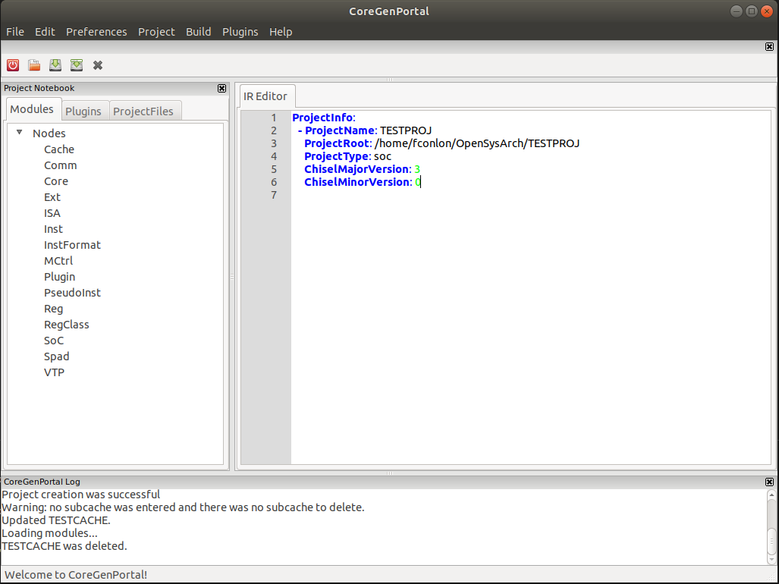
Deleting a Node
The Node will be deleted from the tree and the yaml will be updated

Slide 23
References
Where do I find more info?

Slide 24
Web Links
System Architect Public Web
http://www.systemarchitect.tech/
Documentation
Latest StoneCutter Specification:
http://www.systemarchitect.tech/index.php/stonecutter-language-spec/
Tutorials
http://www.systemarchitect.tech/index.php/tutorials/
https://github.com/opensocsysarch/CoreGenTutorials

Slide 25
Source Code
Main source code hosted on Github:
https://github.com/opensocsysarch
CoreGen Infrastructure
https://github.com/opensocsysarch/CoreGen
CoreGenPortal GUI
https://github.com/opensocsysarch/CoreGenPortal
CoreGen IR Spec
https://github.com/opensocsysarch/CoreGenIRSpec
StoneCutter Language Spec
https://github.com/opensysarch/StoneCutterLanguageSpec
System Architect Weekly Development Releases
https://github.com/opensocsysarch/SystemArchitectRelease

Slide 26
Contact
Issues should be submitted through the respective Github issues pages (see source code links)
Mailing Lists:
http://www.systemarchitect.tech/index.php/lists/
Direct developer contacts
John Leidel: jleidel<at>tactcomplabs<dot>com
David Donofrio: ddonofrio<at>tactcomplabs<dot>com
Ryan Kabrick: rkabrick<at>tactcomplabs<dot>com

