Slide 1
Design Concepts with System Architect: Level 0
John Leidel
Chief Scientist, Tactical Computing Laboratories
ver 2012.09.13

Slide 2
Tutorial Series
Level 0: Introduction to System Architect
Level 1: System Architect Design Concepts and Developing a basic RISC processor
Level 2: Instruction-Level (StoneCutter) Implementation Concepts
Level 3: Advanced Design Concepts
Level 4: System Architect Plugins and Integrating External RTL

Slide 3
System Architect Overview
Modular, High-Level Design Concepts

Slide 4
What is System Architect?
A family of tools, APIs and associated infrastructure to permit users to rapidly develop multi-faceted hardware
Utilizes a combination of modular hardware design reuse principles, object oriented development and dependence analysis techniques (compiler theory) to provide an infrastructure for:
Design & Design Experimentation
High Level Verification
The artifacts generated by a System Architect design flow include:
Chisel HDL and Verilog RTL
C++ cycle-based simulator
LLVM compiler

Slide 5
What is System Architect NOT?
System Architect is not the latest C-to-gates tool
It permits rapid design, verification and reuse
It does not auto-generate hardware based upon application code
System Architect still relies upon the user to utilize reasonable design concepts
System Architect will not auto-generate optimized designs based upon unreasonable inputs
Users need to have a concept of the physical platform (FPGA, ASIC, etc)
System Architect does not currently have a notion of physical layout
The generated output will not include LUT counts, physical design dimensions or power estimates
External FPGA/ASIC tools are required for this level of detail

Slide 6

System Architect Design Flow
The user inputs their design using the GUI or text editor. This includes the design parameters and logic for each instruction
The user then executes verification passes against the design in order to ensure the design is correct and optimal. Users have the option of executing special passes to generate design documentation
The user an now optionally utilize the Chisel HDL to generate the Verilog representation and the C++ simulator. The LLVM compiler can be utilized to drive binary payloads for the C++ simulator
Verilog output can be utilized for downstream synthesis and layout tools
The design input is stored in the CoreGen intermediate representation (IR)
Verilog
The user executes the codegen in order to generate the Chisel HDL and/or the LLVM compiler for the target design
Chisel HDL
Design Input
IR
Verification
Code Generation
C++ Simulator
LLVM Compiler
User

Slide 7
Typical System Architect Design Flows
Rapid ISA Development
Modular Design
Compiler Environment
Rapid development of ISA’s with backend RTL and LLVM compiler as artifacts
Cycle-based simulator that supports immediate experimentation
Rapid design evaluation and prototyping
High level verification of design before synthesis
Multi-module design and integration
Integration with other System Architect designs (sub-designs)
External module integration
Plugin support for custom-modularity
Auto-generated LLVM compiler infrastructure from design parameters
Modern C/C++ frontend support
Other frontends can be supported as well
Re-useable as LLVM mainline continues to develop
Re-spinning entire compiler based on new LLVM versions is automated

Slide 8
System Architect Infrastructure
Verilog
C++ Cycle Sim
YAML
IR
CoreGen Infrastructure
CoreGen Plugin
CoreGen Plugin
CoreGen Plugin
CoreGen Plugin
CoreGen Plugin
CoreGen Plugin
LLVM Source Compiler
Chisel HDL
CGCLI
Command Line Interface
CodeGen
StoneCutter Compiler
SC Input
SC Input
SC Input
SC Input
SC Input
User Interfaces
SC Input
Backend Infrastructure

Slide 9
How does it work?
We input designs in the user-facing tools and generate CoreGen Intermediate Representation (IR)
The IR preserves the natural dependencies within the design
Register classes depend upon registers
Instruction formats depend upon register classes
Instruction sets depend upon instructions
Cores require instruction sets
We execute high level verification “passes” against the IR
Similar in design to traditional compiler passes
Walks the IR dependence graph and derives properties of the design
Reports issues in the design infrastructure, outputs interesting data or optimizes the design infrastructure
Users implement instructions in StoneCutter instruction implementation language
C-like integrated with CoreGen IR to define a single instruction
Optimized by a traditional compiler flow to generate Chisel HDL for a single instruction
Following the high level verification phase, we execute generate downstream code (code generation)
Generates Chisel HDL
Compiled down to Verilog & C++ cycle-based simulator
Generates LLVM compiler for the target design
Example dependence graph from CoreGen design input

Slide 10
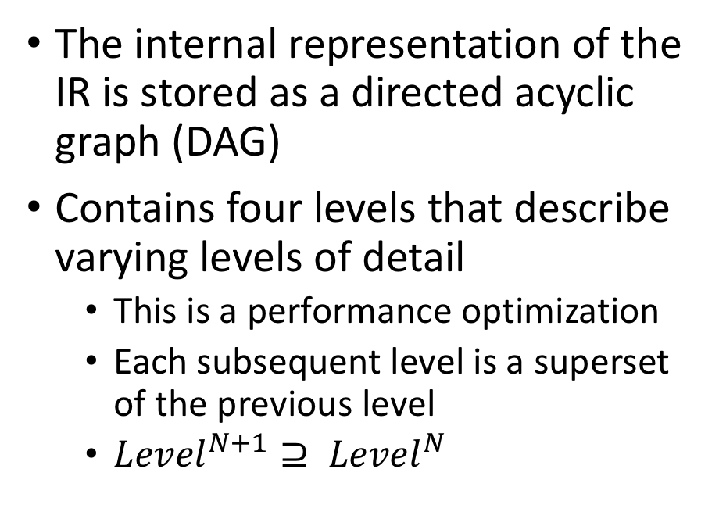
CoreGen IR Passes
Passes can be selectively enabled or disabled by the user (just like a normal compiler)
Four types of passes
Analysis
Analyze the connectivity and the structure of the graph
Reports back the identified state to the user
DOES NOT modify the graph (IR is unchanged)
Optimization
Optimizes connectivity and structure of the graph
Much like Kennedy/Callahan dependence analysis/optimization
MODIFIES the dependence graph (IR is changed)
Data
Generates statistical data/output based upon the structure/content of the graph
EG, outputs a LaTeX specification document based upon the respective ISA
DOES NOT modify the graph (IR is unchanged)
System
Mixtures of each of the aforementioned pass types
Must be manually instantiated by the tools/users
The internal representation of the IR is stored as a directed acyclic graph (DAG)
Contains four levels that describe varying levels of detail
This is a performance optimization
Each subsequent level is a superset of the previous level
${Level}^{N+1}⊇ {Level}^{N}$

Slide 11
CoreGen IR Passes: Example Analysis Passes
RegSafetyPass/RegIdxPass
EncodingCollisionPass
Find inconsistencies between registers within the same register file
Multiple registers with the same index
Registers with missing indicies
Registers with prescribed values > than their bit width
Sub-register fields with overlapping names
Sub-register fields with overlapping bit field definitions
Identifies potential ISA encoding issues
Utilizes all instruction formats within an ISA
Builds a table of every known instruction within the ISA
Initializes a bit vector for every instruction using the encoding (eg, opcode), immediate values and register fields (bitmask)
Examines collisions in the “loaded” encodings

Slide 12
CoreGen IR Passes: Example Data Passes
StatsPass
SpecDoc
Walks the entire dependence graph and collects data about the connectivity of the graph and incidence of the nodes
Reports the number of adjacent dependent nodes for each node in the graph (outdegree)
Reports final counts of the incidence of each node type
Walks the entire dependence graph and collects data about the encoding infrastructure of the ISA and portions of the micro architecture
Outputs a specification document in LaTeX that details each of:
Register Classes
Register Encodings
Subregister encodings (bit fields within register)
Instruction Formats
Instruction Encodings
Master instruction table

Slide 13
CoreGen IR Passes: Example System Passes
SafeDeletePass
ASPSolverPass
Determines whether removing a node from the graph is safe
For example:
”If I remove this register, will I break the dependence graph?”
“If I remove this encoding format, will I break the dependence graph?”
Generally utilized within other tooling, but can be utilized directly by the user
Utilized when an existing analysis pass does not find a specific corner case
Can be used to “programmatically” define new dependence solvers using a specific syntax
Can be utilized as design constraints and/or regression tests to ensure specific functionality/connectivity exists in a design

Slide 14
CoreGen Infrastructure
All hardware modules/units are defined as DAG nodes
Dependence graph between nodes is “lowered” in multiple stages in order to expose increasing levels of complexity
Similar to Open64 notion of multi-dimensional IR
DAG Levels:
Level 0: Basic node connectivity
Level 1: Expands “extension” nodes to contain all their children
Level 2: Expands all communication links
Level 3: Expands all instruction and register encodings
Cache Level
Register Class
Comm Channel
Register
Core
SoC
Instruction
Spads
PseudoInst
VtoP
Encoding
Plugins
ISA

Slide 15
What type of nodes in the CoreGen IR?
SoC Nodes: Defines a top-level system on chip (one per design)
Core Nodes: Defines a single core with associated ISA and dependent nodes
ISA Nodes: Defines an instruction set architecture container
Instruction Format Nodes: Defines an instruction format with all of its sub-fields
Sub-fields have properties that define encoding fields, register fields, immediate value fields, etc
Instruction Nodes: Defines a single instruction based upon a prescribed instruction format.
Ability to define encodings, register classes for register fields, immediate values, etc

Slide 16
What type of nodes in the CoreGen IR (cont)?
Pseudo Instruction Nodes: Defines specific encodings for existing instructions
Ability to define prescribed encoding fields as static (eg, immediate = 0x00)
DOES NOT induce instruction encoding collisions
EG: ”MOV RT, Ra” = “ADD RT, Ra, $0”
Register Class Nodes: Defines a container node with multiple dependent registers. Register indices within a register class cannot overlap
Register Nodes: Defines a single register node with an index, bit width, sub-register fields and attributes (RO, RW, etc)
Encoding Nodes: Define encodings for parent nodes (EG, register encodings)
Cache Nodes: Defines a single cache layer
Can be interconnected into multi-level caches

Slide 17
What type of nodes in the CoreGen IR (cont)?
Communication Channel Nodes: Interconnect multiple nodes via on-chip data+control paths
Multiple topologies supported
Scratchpad Nodes: Represent addressable on-chip scratchpads
Memory Controller Nodes: Represents a basic memory controller with multiple input/output ports
Virtual to Physical Nodes: Handles virtual to physical memory translation
**Extension Nodes: Special node type that permits users to “import” other CoreGen-developed project artifacts into other projects
Accelerators are excellent examples of extensions
**Plugin Nodes: Special node type that represents a third-party templated design
Can contain unlimited number of special properties (not defined by standard CoreGen IR spec)
May also contain custom code generation facilities to output any style of HDL/RTL, etc

Slide 18
CoreGen Plugins
System Architect Project
CoreGen plugins are containers for self-contained extensions
Each plugin is effectively its own template
Bundled as a shared library (can be licensed and distributed outside of System Architect)
These can be:
Cores, ISAs, cache modules, periphery components, etc
Each plugin can drive unique “code generators” to modify their internal HDL state and/or generate the source compiler
Projects can import any number of plugins
DAG analysis works across plugins
Plugin
Plugin
Extension
Extension
Node
Node
Node
Node
Node
Node

Slide 19
CoreGen IR Specification
IR Spec is governed in the same manner as source code development
Changes to the spec must be received in the form of pull requests on Github
Adjacent pull requests (that include all the necessary tests) must also exist in CoreGen library tree
NO changes to the spec are accepted without support in CoreGen
Entire IR spec is documented with examples
Latest revision:
http://www.systemarchitect.tech/index.php/coregenirspec/

Slide 20
What is StoneCutter?
StoneCutter is a high level language designed to describe the implementation of a single instruction
Traditional “C-to-gates” languages/tools were suboptimal given the very large design space
Each instruction is written as a single “function”
StoneCutter’s syntax is loosely based upon “C”. Support for:
All rudimentary data types
Arbitrary bit width data types
All standard arithmetic operations (+,-,*,/,%,^,|,<<,>>)
All standard logical operators
Loops (for, while, do-while)
Flow control (if/else)
StoneCutter can be written inline within the CoreGen YAML IR
The compiled output is Chisel HDL!

Slide 21
StoneCutter Tooling
StoneCutter is compiled, not interpreted or simply translated
StoneCutter compiler is based upon LLVM
Makes heavy use of many traditional LLVM safety and optimization passes
Traditional LLVM compiler passes are augmented with a number of StoneCutter-specific passes
https://llvm.org/Logo.html

Slide 22
StoneCutter Passes
FieldIO
Ensures that read-only fields from an instruction payload are not erroneously written to
InstArg
Ensures instructions are properly using registers as instruction inputs and outputs
InstFormat
Ensures instruction fields are properly used as arguments to operations
IOWarn
Warns the user if the instruction utilizes a register that is outside the normal data path for the respective instruction format
SigMap
Performs global ISA optimization and derives the entire set of signals required as well as the per-instruction signals
PipeBuilder
Constructs inline pipelines of operations

Slide 23
Sample StoneCutter Source
instformat Arith.if(reg[GPR] ra,reg[GPR] rb,reg[GPR] rt,enc opc,
enc func,imm imm)
# Register Class Definitions
regclass GPR( u64 r0, u64 r1, u64 r2, u64 r3, u64 r4, u64 r5, u64 r6, u64 r7, u64 r8, u64 r9, u64 r10, u64 r11,
u64 r12, u64 r13, u64 r14, u64 r15, u64 r16, u64 r17, u64 r18, u64 r19, u64 r20, u64 r21, u64 r22, u64 r23,
u64 r24, u64 r25, u64 r26, u64 r27, u64 r28, u64 r29, u64 r30, u64 r31 )
# Instruction Definitions
def add:Arith.if( ra rb rt imm )
{
rt = ra + rb
}
def sub:Arith.if( ra rb rt imm )
{
rt = ra - rb
}

Slide 24
StoneCutter Language Specification
Language spec is governed in the same manner as source code development
Changes to the spec must be received in the form of pull requests on Github
Adjacent pull requests (that include all the necessary tests) must also exist in StoneCutter (CoreGen) library tree
NO changes to the spec are accepted without support in compiler
Entire language spec is documented with examples
Latest revision:
http://www.systemarchitect.tech/index.php/stonecutter-language-spec/

Slide 25
What now?
Level 1 Tutorial: Describes basic design concepts and walks through the initial definition of a RISC-like design
Level 2 Tutorial: Implementing individual instructions using the StoneCutter language and compiler
Extends the design from Level 1
Level 3 Tutorial: Advanced design and implementation concepts
Extends the work done in Level 2
Level 4 Tutorial: Building external plugins and integrating external RTL
How do we integrate existing IP?

Slide 26
What do you need to continue?
Linux/OSX system with the tools installed
Prebuilt packages are available:
https://github.com/opensocsysarch/SystemArchitectRelease
Text editor
VIM, Emacs, Notepad, etc
For those seeking to use the GUI
Graphics environment (X11, OSX, etc)
Basic knowledge of computer architecture
Basic knowledge of software architecture

Slide 27
References
Where do I find more info?

Slide 28
Web Links
System Architect Public Web
http://www.systemarchitect.tech/
Documentation
Latest IR Specification:
http://www.systemarchitect.tech/index.php/coregenirspec/
Tutorials
http://www.systemarchitect.tech/index.php/tutorials/
https://github.com/opensocsysarch/CoreGenTutorials

Slide 29
Source Code
Main source code hosted on Github:
https://github.com/opensocsysarch
CoreGen Infrastructure
https://github.com/opensocsysarch/CoreGen
CoreGenPortal GUI
https://github.com/opensocsysarch/CoreGenPortal
CoreGen IR Spec
https://github.com/opensocsysarch/CoreGenIRSpec
System Architect Weekly Development Releases
https://github.com/opensocsysarch/SystemArchitectRelease

Slide 30
Contact
Issues should be submitted through the respective Github issues pages (see source code links)
Mailing Lists:
http://www.systemarchitect.tech/index.php/lists/
Direct developer contacts
John Leidel: jleidel<at>tactcomplabs<dot>com
David Donofrio: ddonofrio<at>tactcomplabs<dot>com
Ryan Kabrick: rkabrick<at>tactcomplabs<dot>com

