Slide 1
Design Concepts with System Architect: Power & Hazard Modeling
John Leidel
Chief Scientist, Tactical Computing Laboratories
ver 2022.09.13

Slide 2
Tutorial Series
Level 0: Introduction to System Architect
Level 1: System Architect Design Concepts and Developing a basic RISC processor
Level 2: Instruction-Level (StoneCutter) Implementation Concepts
Level 3: Advanced Design Concepts
Level 4: System Architect Plugins and Integrating External RTL
Power and Hazard Modeling with DHDT & POAR

Slide 3
Overview
Power/Hazard Modeling Tools Overview
POAR Power/Area Modeling
DHDT Power/Hazard Modeling

Slide 4
Power/Hazard Modeling Tools Overview
System Architect Rapid Design Evaluation Tooling

Slide 5
System Architect Power/Hazard Modeling Tools
POAR
DHDT
Coarse grained power and area modeling tool
Utilizes the CoreGen YAML design inputs as the basis for the power/area modeling
Permits user-defined power/area values
External configuration files that outline power/area for specific hardware units
Permits a user-defined constant routing overhead
Process-specific routing overhead
Variety of output formats for further processing/analysis
Fine grained power and hazard modeling tool
Utilizes the CoreGen YAML and the StoneCutter LLVM IR as the basis for the power/hazard modeling
Constructs a graph of all the candidate signals & clocked pipeline stages for each instruction definition/VLIW stage
Permits user-defined power value inputs
Accepts assembly, binary and hex inputs to track power/hazards for individual instructions with accumulated totals
CSV, ASCI output as well as DOT graph outputs for the internal graph structures

Slide 6
What do I use and when?
POAR
“I want to see basic power/area models”
“I want to compare basic power models across designs”
“I want to see basic design area utilization”
“I want to see per instruction power”
“I want to see detailed power models across different process nodes”
”I want to model VLIW instruction hazards”
DHDT

Slide 7
Caveats?
POAR and DHDT are both approximations
They do not consider switching/transient power
They have a finite notion of routing congestion (tool dependent)
They rely upon basic power/area model inputs that are process specific
YOUR model inputs are YOUR responsibility
We seek to maintain tool performance without sacrificing functionality
If you would like new features, submit a Github Issue!

Slide 8
POAR Power/Area Modeling
Coarse Grained Power/Area Modeling

Slide 9
POAR [Power Area Model]
Utilizes the CoreGen design graph input (YAML) to build a graph of included hardware modules
Optionally also uses the signal maps generated by the StoneCutter tool
For all known design nodes, accumulates total power and total area
Approximate model of power: TDP
Approximate model of area: “gates”
Outputs power and area per node type as well as accumulated totals

Slide 10
POAR Info Options
--help : Prints the help menu
--version : Prints the version info
$> poar --help
$> poar --version

Slide 11
POAR Runtime Options
Required:
--design /path/to/CoreGen.yaml : design input
Optional:
--config /path/to/config.yaml : Sets the power/area node configuration
-- sigmap /path/to/sigmap.yaml : Stonecutter-generated signal map
--overhead NN : Sets the constant routing/wire overhead for area calculations
$> poar --design test.yaml
$> poar --design test.yaml --sigmap test_sigmap.yaml
$> poar --design test.yaml --overhead 8.1

Slide 12
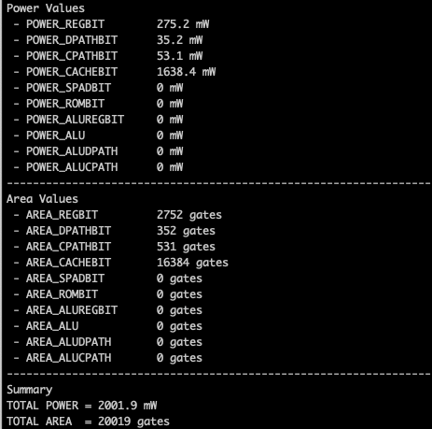
POAR Output Options
Default output is ASCII text printed to the console
Additional output options:
--text : ASCII text output
--yaml : YAML output
--latex : LaTeX output
-- xml : XML output
$> poar --design test.yaml --text
$> poar --design test.yaml --yaml
$> poar --design test.yaml --latex
$> poar --design test.yaml --xml

Slide 13
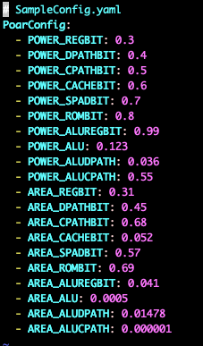
POAR Configuration Options
POWER_REGIBIT: Power per bit in a register
POWER_DPATHBIT: Power per data path bit
POWER_CPATHBIT: Power per control path bit
POWER_CACHEBIT: Power per bit in the cache
POWER_SPADBIT: Power per bit in the scratchpad
POWER_ROMBIT: Power per bit in the internal boot/uCode ROM
POWER_ALUREGBIT: Power per bit in an ALU register
POWER_ALU: Power per ALU bit
POWER_ALUDPATH: Power per ALU data path
POWER_ALUCPATH: Power per ALU control path

Slide 14
POAR Configuration Options cont.
AREA_REGIBIT: Area per bit in a register
AREA_DPATHBIT: Area per data path bit
AREA_CPATHBIT: Area per control path bit
AREA_CACHEBIT: Area per bit in the cache
AREA_SPADBIT: Area per bit in the scratchpad
AREA_ROMBIT: Area per bit in the internal boot/uCode ROM
AREA_ALUREGBIT: Area per bit in an ALU register
AREA_ALU: Area per ALU bit
AREA_ALUDPATH: Area per ALU data path
AREA_ALUCPATH: Area per ALU control path

Slide 15
DHDT Power/Hazard Modeling
Fine Grained Power/Hazard Modeling

Slide 16
DHDT [Deep Hardware Design Tool]
Fine grain power and hazard modeling tool
Fine grain in the scope of System Architect. NOT equivalent to a SPICE model
Utilizes the CoreGen YAML design input and the StoneCutter compiler IR to build an internal graph representation of the target device
Models individual instructions as they execute (traverse the graph) and accumulate per-instruction power & hazarding
Allows users to investigate how individual instructions behave with respect to power utilization (or groups of instructions)
Requires the user to input instruction sequences
Outputs data in ASCII and CSV

Slide 17
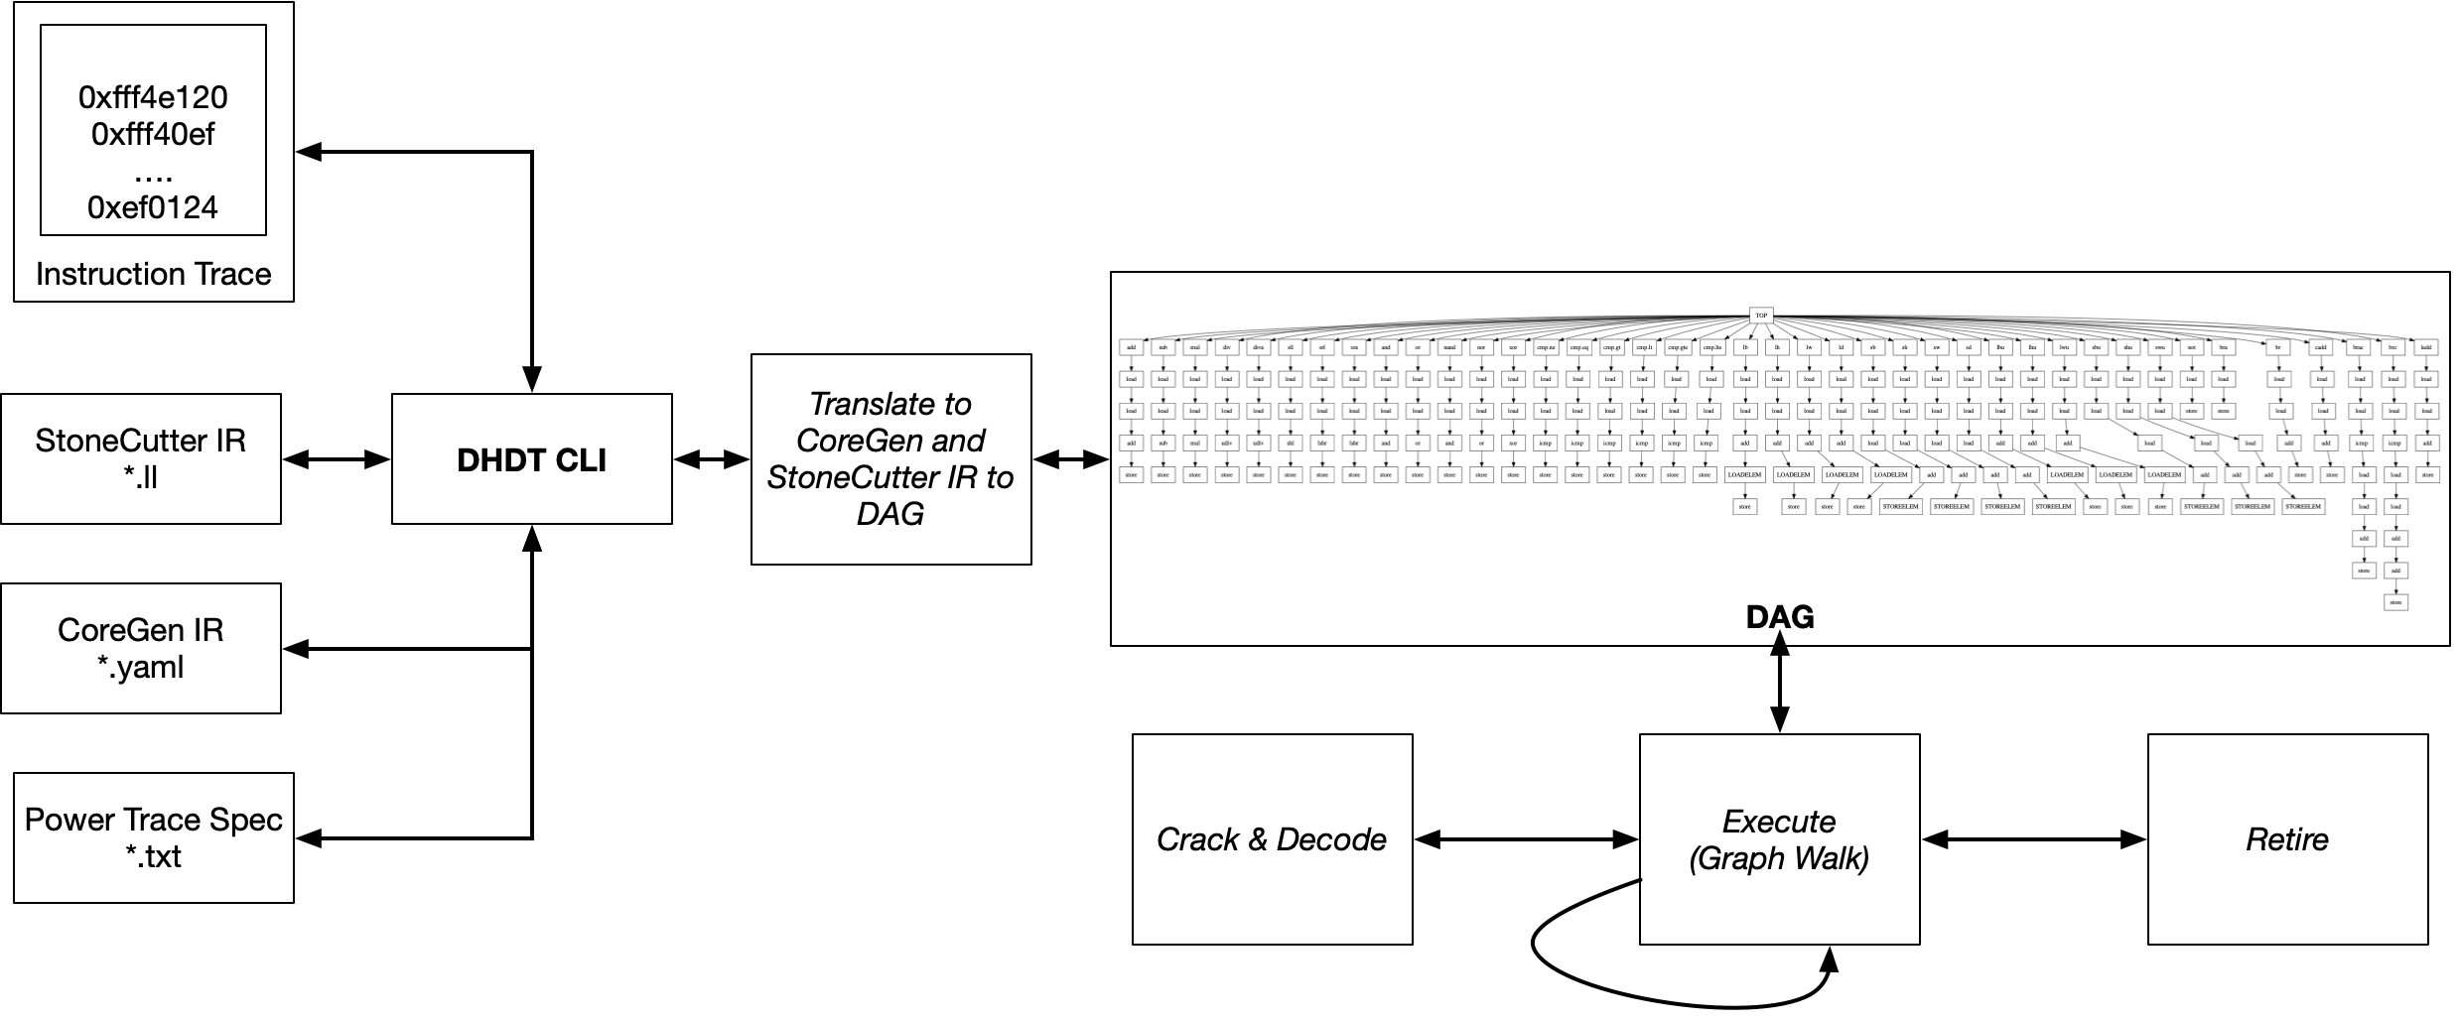
DHDT [Deep Hardware Design Tool]

Slide 18
DHDT [Deep Hardware Design Tool]
DHDT accepts “templates” that describe power values for various hardware subcomponents
Much like POAR, the power values are relative to a process node
DHDT power configuration templates contain much more detailed information
Instruction trace inputs are in three forms (one instruction payload per line):
Assembly: Assembly mnemonics as defined by the CoreGen YAML
Binary: Binary encoded instruction values prefixed with 0b…
Hex: Hex encoded instruction values prefixed with 0x…

Slide 19
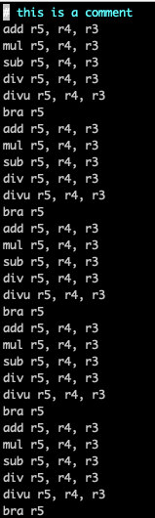
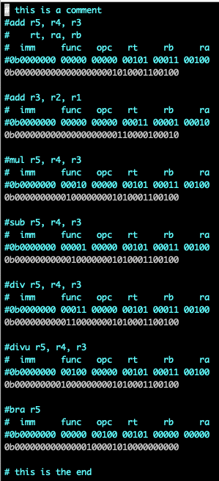
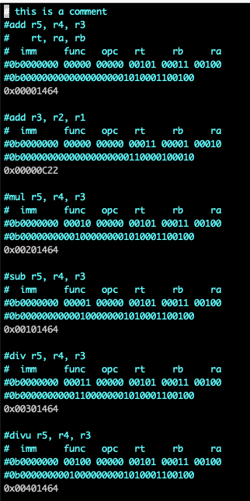
DHDT Instruction Trace Inputs
ASM
Binary
Hex

Slide 20
DHDT Info Options
--help : Prints the help menu
$> dhdt --help

Slide 21
DHDT Execution Options
--coregen /path/to/coregen.yaml: Utilize the target CoreGen IR
--llvm /path/to/stonecutter.ir: Utilize the target StoneCutter LLVM IR
--inst /path/to/trace.inst: Instruction trace input
Execution types:
--hazard : Analyze hazards between instructions
--power : Analyze the power across individual instructions
$> dhdt --coregen ./BasicRISC.yaml --llvm ./BasicRISC.sc.ir --inst test.inst --hazard
$> dhdt --coregen ./BasicRISC.yaml --llvm ./BasicRISC.sc.ir --inst test.inst --power

Slide 22
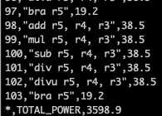
DHDT Graph Options
--dot /path/to/graph.dot : Outputs the internal graph structure to a GraphViz DOT file
This is very handy to investigate idiosyncrasies in the power/hazard output
--output /path/to/output.csv: Outputs the final data to a CSV file
$> dhdt --dot test.dot --coregen ./BasicRISC.yaml --llvm ./BasicRISC.sc.ir --power --inst trace.inst
$> dot -Tpdf test.dot > test.pdf
$> dhdt --coregen ./BasicRISC.yaml --llvm ./BasicRISC.sc.ir --power --inst trace.inst --output out.csv

Slide 23
DHDT Internal ISA Graph

Slide 24
Going from YAML to Power/Hazard Output
Step 1: Use CGCLI to generate a singular StoneCutter source file
Step 2: Compile the StoneCutter file to (optimized) LLVM IR
Step 3: Use DHDT to analyze the power/hazard logic
We highly suggest using a Makefile to automate this process!
$> cgcli --root ./BasicRISC --ir ./BasicRISC/BasicRISC.yaml --stonecutter
$> sccomp -D --keep -O3 ./BasicRISC/RTL/stonecutter/stonecutter.sc
$> dhdt --coregen ./BasicRISC/BasicRISC.yaml --llvm ./BasicRISC/RTL/stonecutter/stonecutter.sc.ll --inst trace.inst --power

Slide 25
What can you do with DHDT?
Example 1: Evaluate a design based upon known power values (using a power template)
Example 2: Evaluate a design against two different power templates that represent different fabs/reticles
Example 3: Evaluate the power of different instruction traces
Example 4: Evaluate two different hardware implementations of the same ISA against the same power template (design trade-off)
Example 5: Evaluate the hazards between multiple instructions

Slide 26
Things to remember…
The DHDT tool has a simple crack/decode interface
When using assembly, DHDT assumes that the CoreGen YAML file has `Syntax` entries for each instruction
The Hex and Binary decode interfaces do not require Syntax interfaces (useful for VLIW stages)
The “simulation” of each instruction payload is rudimentary
We traverse the subgraph for each instruction payload and accumulate the power for each instruction
We do not, however, compute bit-level changes of state while we traverse the graph
The simulation is NOT bit-level accurate (only an approximation)

Slide 27
References
Where do I find more info?

Slide 28
Web Links
System Architect Public Web
http://www.systemarchitect.tech/
Documentation
Latest StoneCutter Specification:
http://www.systemarchitect.tech/index.php/stonecutter-language-spec/
Tutorials
http://www.systemarchitect.tech/index.php/tutorials/
https://github.com/opensocsysarch/CoreGenTutorials

Slide 29
Source Code
Main source code hosted on Github:
https://github.com/opensocsysarch
CoreGen Infrastructure
https://github.com/opensocsysarch/CoreGen
CoreGenPortal GUI
https://github.com/opensocsysarch/CoreGenPortal
CoreGen IR Spec
https://github.com/opensocsysarch/CoreGenIRSpec
StoneCutter Language Spec
https://github.com/opensysarch/StoneCutterLanguageSpec
System Architect Weekly Development Releases
https://github.com/opensocsysarch/SystemArchitectRelease

Slide 30
Contact
Issues should be submitted through the respective Github issues pages (see source code links)
Mailing Lists:
http://www.systemarchitect.tech/index.php/lists/
Direct developer contacts
John Leidel: jleidel<at>tactcomplabs<dot>com
David Donofrio: ddonofrio<at>tactcomplabs<dot>com
Ryan Kabrick: rkabrick<at>tactcomplabs<dot>com

