Slide 1
Computability and Complexity
10-1
Gödel’s Incompleteness
Theorem
Computability and Complexity
Andrei Bulatov

Slide 2
Computability and Complexity
10-2
Proof Systems We Use
Axioms: Logic axioms AX1-AX4 + Non-Logic axioms
Proof rules: modus ponens Φ, Φ→Ψ |− Ψ

Slide 3





Computability and Complexity
10-3
Axioms of Number Theory

Slide 4








Computability and Complexity
10-4
Some Theorems (High School Identities)

Slide 5
Computability and Complexity
10-5
Good Proof Systems
Definition
A proof system with the set of non-logical axioms Δ is said to be
consistent if there is no formula, Φ, such that
Δ |− Φ and Δ |− ¬Φ
Theorem NT1-NT14 is consistent.

Slide 6


Computability and Complexity
10-6
Good Proof Systems
Definition
A proof system with the set of non-logical axioms Δ is said to be
acceptable if Δ is acceptable
Theoremhood
Instance: A proof system with the set of non-logical axioms Δ and
a formula Φ.
Question: Δ |− Φ ?
The corresponding language is:
Theorem If Δ is acceptable, then is acceptable.

Slide 7

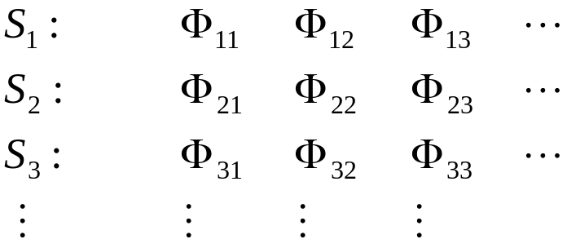



Computability and Complexity
10-7
Proof Idea
Given a formula Φ, let be a list of all sequences
of formulas which end with Φ.
Perform 1st step of an acceptor for
Perform 2nd step of an acceptor for and 1st step of an acceptor for
Perform 3rd step for , 2nd step for and 1st step for
…

Slide 8
Computability and Complexity
10-8
Proof Systems and Models
Let M be a model
Definition
A proof system Δ is sound for M, if every theorem of Δ
belongs to Th(M)
Theorem NT1-NT14 is sound for N.
Definition
A proof system Δ is complete for M, if every sentence from
Th(M) is a theorem of Δ

Slide 9
Computability and Complexity
10-9
Gödel’s Incompleteness Theorem
Theorem
Any acceptable proof system for N is either inconsistent
or incomplete.
Corollary
Any acceptable proof system that is powerful enough (to reason
about N) is either inconsistent or incomplete.

Slide 10
Computability and Complexity
10-10
Proof Idea (we use)
Step 1:
Encode TM descriptions, configurations and computations using natural
numbers
Step 2:
Encode properties of TMs as properties of numbers representing them
Step 3:
Reducing the Halting problem show that Th(M) and its complement are
undecidable
Step 4:
Using the theorem about acceptability of Theoremhood and observing that
Th(M) is acceptable if and only if its complement is, conclude the theorem

Slide 11
Computability and Complexity
10-11
Proof Idea (Gödel used)
Step 1:
Encode variables, predicate and function symbols, quantifiers and first
order formulas using natural numbers
Step 2:
Encode properties of first order formulas (in the vocabulary of number
theory) as properties of numbers representing them
Step 3:
Construct a formula claiming “I am not a theorem in your proof system.”
Step 4:
Observe that if this formula is true (in N), then it is not a theorem in the
proof system and, therefore, the system is incomplete; if it is false, then
there is a false theorem, i.e. the proof system is not sound

Slide 12
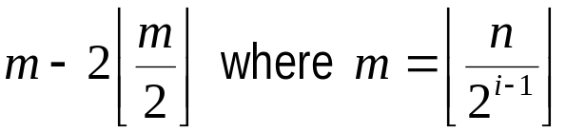
Computability and Complexity
10-12
Computations as Natural Numbers
We design a computable function ϕ that maps TM descriptions,
configurations and computations into N
We know how all these objects can be encoded into 01-strings.
ϕ just outputs the number for which this string is the binary representation
Note that the converse function is also computable, because the ith bit of
the binary representation of a number n can be computed:
Similarly, there is a first order formula Β(X) meaning “the ith bit of X is 1”:
(this is for the last bit)

Slide 13
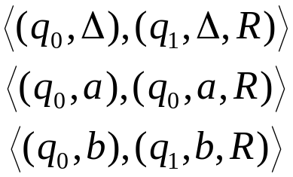


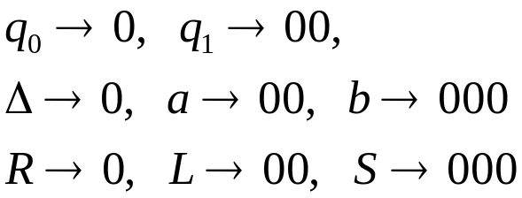

Computability and Complexity
10-13
Example
a|a|R
bΔ|bΔ|RR
Encoding:
01010010101
1010010100101
1010001001000101
Configuration:
0011011001000

Slide 14

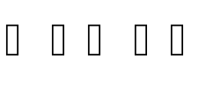
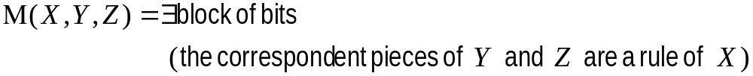
Computability and Complexity
10-14
We construct a formula that, given 3 numbers X, Y and Z, is true
if and only if the machine encoded X moves from the configuration
encoded Y into the configuration encoded Z
→
0011011001000
0010011011000

Slide 15
Computability and Complexity
10-15
Claim 1.
There is a first order formula Γ(X,Y) which is true if and only if Y is a
computation of the TM encoded X
Claim 2.
There is a first order formula Λ(X,Y,Z) which is true if and only if Y is a
computation of the TM encoded X on input Z
Claim 3.
There is a first order formula Φ(X,Y) which is true if and only if Y is a
computation of the TM encoded X and Y ends in a final state
Claim 4.
There is a first order formula Ψ(X,Y) which is true if and only if the TM
encoded X halts on input Y

Slide 16


Computability and Complexity
10-16
Finally, to reduce to Th(N), we define a mapping as follows:
Observe that
This mapping is computable
The obtained formula is a sentence
This sentence is true if and only if T halts on w
QED

