Slide 1
CS344 : Introduction to Artificial Intelligence
Pushpak Bhattacharyya
CSE Dept.,
IIT Bombay
Lecture 6- Soundness and Completeness

Slide 2
Soundness, Completeness &
Consistency
Soundness
Syntactic
World
----------
Theorems,
Proofs
Semantic
World
----------
Valuation,
Tautology
Completeness
*
*

Slide 3
Soundness
    Provability Truth
Completeness
    Truth Provability

Slide 4
Soundness: Correctness of the System
    Proved entities are indeed true/valid
Completeness: Power of the System
    True things are indeed provable

Slide 5
Consistency
The System should not be able to
prove both P and ~P, i.e., should not be
able to derive
F

Slide 6
Examine the relation between
Soundness
&
Consistency
Soundness Consistency

Slide 7
If a System is inconsistent, i.e., can derive
F , it can prove any expression to be a
theorem. Because
F P is a theorem

Slide 8
To show that
F P is a theorem
Observe that
F, P→F ⊢ F
By D.T. F ⊢ (P F ) F; A3
⊢ P
i.e. ⊢ F P

Slide 9
Inconsistency is a Serious issue.
Informal Statement of Godel Theorem:
If a sufficiently powerful system is complete it is inconsistent.
Sufficiently powerful: Can capture at least Peano Arithmetic

Slide 10
Introduce Semantics in Propositional logic
Valuation Function V
Definition of V
V(F ) = F
Where F is called ‘false’ and is one of the two symbols (T, F)
Syntactic ‘false
Semantic ‘false’

Slide 11
V(F ) = F
V(A B) is defined through what is called the truth table
V(A) V(B) V(A B)
T F F
T T T
F F T
F T T

Slide 12
Tautology
An expression ‘E’ is a tautology if
V(E) = T
for all valuations of constituent propositions
Each ‘valuation’ is called a ‘model’.

Slide 13
To see that
(F P) is a tautology
two models
V(P) = T
V(P) = F
V(F P) = T for both

Slide 14
F P is a theorem
F P is a tautology
Soundness
Completeness

Slide 15
If a system is Sound & Complete, it does not
matter how you “Prove” or “show the validity”
Take the Syntactic Path or the Semantic Path

Slide 16
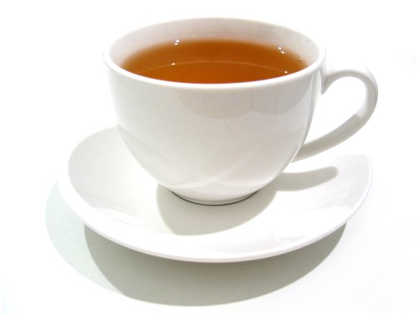
Syntax vs. Semantics issue
Refers to
FORM VS. CONTENT
Tea
(Content)
Form

Slide 17
Form & Content
Godel, Escher, Bach
By D. Hofstadter
painter
musician
logician

Slide 18
Problem
(P Q) (P Q)
Semantic Proof
A B
P Q P Q P Q A B
T F F T T
T T T T T
F F F F T
F T F T T

Slide 19
To show syntactically
(P Q) (P Q)
i.e.
[(P (Q F )) F ]
[(P F ) Q]

Slide 20
If we can establish
(P (Q F )) F ,
(P F ), Q F ⊢ F
This is shown as
Q F hypothesis
(Q F ) (P (Q F)) A1

Slide 21
Q→F; hypothesis
(Q→F)→(P→(Q→F)); A1
P→(Q→F); MP
F; MP
Thus we have a proof of the line we started with

Slide 22
Soundness Proof
Hilbert Formalization of Propositional
Calculus is sound.
“Whatever is provable is valid”

Slide 23
Statement
Given
A₁, A₂, … ,A_{n} + B
V(B) is ‘T’ for all V_{s} for which V(A_{i}) = T

Slide 24
Proof
Case 1 B is an axiom
V(B) = T by actual observation
Statement is correct

Slide 25
Case 2 B is one of A_{i}^{s}
if V(A_{i}) = T, so is V(B)
statement is correct

Slide 26
Case 3 B is the result of MP on E_{i} & E_{j}
E_{i} is E_{i} B
Suppose V(B) = F
Then either V(E_{i}) = F or V(E_{j}) = F
.
.
.
E_{i}
.
.
.
E_{j}
.
.
.
B

Slide 27
i.e. E_{i}/E_{j} is result of MP of two expressions coming before them
Thus we progressively deal with shorter and shorter proof body.
Ultimately we hit an axiom/hypothesis.
Hence V(B) = T

