Slide 1
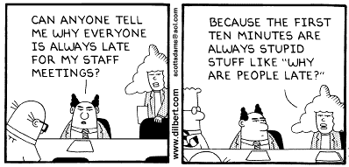

Class 24: Gödel’s Theorem
CS200: Computer Science
University of Virginia
Computer Science
David Evans
http://www.cs.virginia.edu/evans

Slide 2
Big Picture
Much of the course so far:
  Getting comfortable with recursive definitions
  Learning to write a program to do anything
Today:
  Getting uncomfortable with recursive definitions
Monday:
  Convincing you there are some things no one can write a program to do!
19 March 2004
CS 200 Spring 2004

Slide 3
Mechanized Reasoning
19 March 2004
CS 200 Spring 2004

Slide 4
Mechanical Reasoning
Aristotle (~350BC): Organon
  We can explain logical deduction with rules of inference (syllogisms)
  Every B is A
  C is B
  ➔ C is A
  Every human is mortal.
  Gödel is human.
  Gödel is mortal.
19 March 2004
CS 200 Spring 2004

Slide 5
More Mechanical Reasoning
Euclid (~300BC): Elements
  We can reduce geometry to a few axioms and derive the rest by following rules
Newton (1687): Philosophiæ Naturalis Principia Mathematica
  We can reduce the motion of objects (including planets) to following axioms (laws) mechanically
19 March 2004
CS 200 Spring 2004

Slide 6
Mechanical Reasoning
Late 1800s – many mathematicians working on codifying “laws of reasoning”
  George Boole, Laws of Thought
  Augustus De Morgan
  Whitehead and Russell
19 March 2004
CS 200 Spring 2004

Slide 7
All true statements about number theory
19 March 2004
CS 200 Spring 2004

Slide 8
Perfect Axiomatic System
Derives all true
statements, and no false
statements starting from a
finite number of axioms
and following mechanical
inference rules.
19 March 2004
CS 200 Spring 2004

Slide 9
Incomplete Axiomatic System
Derives
some, but not all true
statements, and no false
statements starting from a
finite number of axioms
and following mechanical
inference rules.
incomplete
19 March 2004
CS 200 Spring 2004

Slide 10
Inconsistent Axiomatic System
Derives
all true
statements, and some false
statements starting from a
finite number of axioms
and following mechanical
inference rules.
some false
statements
19 March 2004
CS 200 Spring 2004

Slide 11
Principia Mathematica
Whitehead and Russell (1910– 1913)
  Three Volumes, 2000 pages
Attempted to axiomatize mathematical reasoning
  Define mathematical entities (like numbers) using logic
  Derive mathematical “truths” by following mechanical rules of inference
  Claimed to be complete and consistent
    All true theorems could be derived
    No falsehoods could be derived
19 March 2004
CS 200 Spring 2004

Slide 12
Russell’s Paradox
Some sets are not members of themselves
  set of all Jeffersonians
Some sets are members of themselves
  set of all things that are non-Jeffersonian
S = the set of all sets that are not
members of themselves
Is S a member of itself?
19 March 2004
CS 200 Spring 2004

Slide 13
Russell’s Paradox
S = set of all sets that are not members of themselves
Is S a member of itself?
  If S is an element of S, then S is a member of itself and should not be in S.
  If S is not an element of S, then S is not a member of itself, and should be in S.
19 March 2004
CS 200 Spring 2004

Slide 14
Ban Self-Reference?
Principia Mathematica attempted to resolve this paragraph by banning self-reference
Every set has a type
  The lowest type of set can contain only “objects”, not “sets”
  The next type of set can contain objects and sets of objects, but not sets of sets
19 March 2004
CS 200 Spring 2004

Slide 15
Russell’s Resolution?
Set ::= Set_{n}
Set₀ ::= { x | x is an Object }
Set_{n} ::= { x | x is an Object or a Set_{n - 1} }
S: Set_{n}
Is S a member of itself?
No, it is a Set_{n} so, it can’t be a member of a Set_{n}
19 March 2004
CS 200 Spring 2004

Slide 16
Epimenides Paradox
Epidenides (a Cretan):
“All Cretans are liars.”
Equivalently:
“This statement is false.”
Russell’s types can help with the set paradox, but not with this one.
19 March 2004
CS 200 Spring 2004

Slide 17
Gödel’s Solution
All consistent axiomatic formulations of number theory include undecidable propositions.
(GEB, p. 17)
undecidable – cannot be proven either true or false inside the system.
19 March 2004
CS 200 Spring 2004

Slide 18
Quiz
19 March 2004
CS 200 Spring 2004

Slide 19
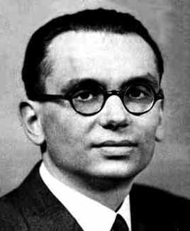
Kurt Gödel
Born 1906 in Brno (now Czech Republic, then Austria-Hungary)
1931: publishes Über formal unentscheidbare Sätze der Principia Mathematica und verwandter Systeme (On Formally Undecidable Propositions of Principia Mathematica and Related Systems)
19 March 2004
CS 200 Spring 2004

Slide 20
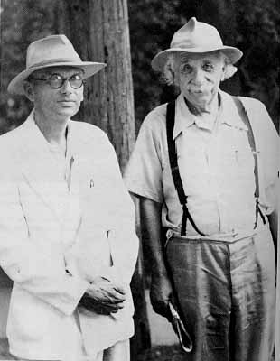
1939: flees Vienna
Institute for Advanced Study, Princeton
Died in 1978 – convinced everything was poisoned and refused to eat
19 March 2004
CS 200 Spring 2004

Slide 21
Gödel’s Theorem
In the Principia Mathematica system, there are statements that cannot be proven either true or false.
19 March 2004
CS 200 Spring 2004

Slide 22
Gödel’s Theorem
In any interesting rigid system, there are statements that cannot be proven either true or false.
19 March 2004
CS 200 Spring 2004

Slide 23
Gödel’s Theorem
All logical systems of any complexity are incomplete: there are statements that are true that cannot be proven within the system.
19 March 2004
CS 200 Spring 2004

Slide 24
Proof – General Idea
Theorem: In the Principia Mathematica system, there are statements that cannot be proven either true or false.
Proof: Find such a statement
19 March 2004
CS 200 Spring 2004

Slide 25
Gödel’s Statement
G: This statement of number theory does not have any proof in the system of Principia Mathematica.
G is unprovable, but true!
19 March 2004
CS 200 Spring 2004

Slide 26
Gödel’s Proof
G: This statement of number theory does not have any proof in the system of PM.
If G were provable, then PM would be inconsistent.
If G is unprovable, then PM would be incomplete.
PM cannot be complete and consistent!
19 March 2004
CS 200 Spring 2004

Slide 27
Finishing The Proof
Turn G into a statement in the Principia Mathematica system
Is PM powerful enough to express “This statement of number theory does not have any proof in the system of PM.”?
19 March 2004
CS 200 Spring 2004

Slide 28
How to express “does not have any proof in the system of PM”
What does it mean to have a proof of S in PM?
  There is a sequence of steps that follow the inference rules that starts with the initial axioms and ends with S
What does it mean to not have any proof of S in PM?
  There is no sequence of steps that follow the inference rules that starts with the initial axioms and ends with S
19 March 2004
CS 200 Spring 2004

Slide 29
Can PM express unprovability?
There is no sequence of steps that follow the inference rules that starts with the initial axioms and ends with S
Yes: (using Scheme-ified Gödel notation)
  (unprovable? x) = (not (provable? x))
  (provable? x) = (exists (y) (proves y x))
  (proves x y) =
  (and (valid-proof-steps x)
  (eq? (apply-proof x initial-axioms) y)))
19 March 2004
CS 200 Spring 2004

Slide 30
Can we express “This statement of number theory”
Yes!
  That’s the point of the TNT Chapter in GEB
We can write turn every statement into a number, so we can turn “This statement of number theory does not have any proof in the system of PM” into a number
19 March 2004
CS 200 Spring 2004

Slide 31
Gödel’s Proof
G: This statement of number theory does not have any proof in the system of PM.
If G were provable, then PM would be inconsistent.
If G is unprovable, then PM would be incomplete.
PM cannot be complete and consistent!
19 March 2004
CS 200 Spring 2004

Slide 32
Generalization
All logical systems of any complexity are incomplete:
there are statements that are true that cannot be proven within the system.
19 March 2004
CS 200 Spring 2004

Slide 33
Practical Implications
Mathematicians will never be completely replaced by computers
  There are mathematical truths that cannot be determined mechanically
  We can build a computer that will prove only true theorems about number theory, but if it cannot prove something we do not know that that is not a true theorem.
19 March 2004
CS 200 Spring 2004

Slide 34
Charge
Next class:
  Does not being able to prove things mechanically have anything to do with not being able compute things?
  What is the equivalent to the Gödel sentence for computation?
19 March 2004
CS 200 Spring 2004

