Slide 1
Kurt Gödel and His Theorems
Naassih Gopee

Slide 2
What I’ll take about
Small events during his lifetime
Completeness theorem
First incompleteness theorem
Second incompleteness theorem

Slide 3
His life…
Excelled in mathematics, languages and religion
During his teens, was influenced by many famous people
Notes:
Kurt studied Gabelsberger shorthand, Goethe's Theory of Colours and criticisms of Isaac Newton, and the writings of Immanuel Kant.

Slide 4
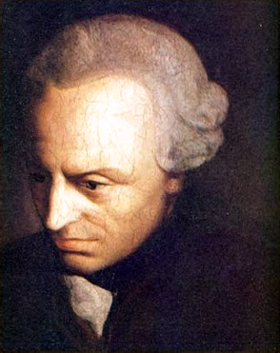
In case you don’t know Kant
German Philosopher
The Critique of Pure reason
Hoped to end an age of speculation where objects outside experience were used to support futile theories

Slide 5
A famous statement by Kant
It always remains a scandal of philosophy and universal human reason that the existence of things outside us ... should have to be assumed merely on faith, and that if it occurs to anyone to doubt it, we should be unable to answer him with a satisfactory proof.(Critique of Pure Reason, 1781)

Slide 6
Gödel’s life continued…
Attended University of Vienna Austria
Joined the Vienna circle
Learned logic from Rudolph Carnap and from Hans Hahn
Adopted mathematical realism and also Platonism
Notes:
At Austria where many of his class was related to physics
(group of freethinkers) + explanation of vienna circle

Slide 7
Some definition…
Mathematical realism:
mathematical entities exist independently of the human mind
Mathematical Platonism:
mathematical entities are abstract
have no spatiotemporal or causal properties
are eternal and unchanging
Notes:
Math realism like realism in general, holds that mathematical entities exist independently of the human mind. Thus humans do not invent mathematics, but rather discover it, and any other intelligent beings in the universe would presumably do the same.
Mathematical Platonism:
is the form of realism that suggests that mathematical entities are abstract, have no spatiotemporal or causal properties, and are eternal and unchanging.

Slide 8
My thoughts…
Human don’t create mathematics, they discover it.
Platonism posits that object are abstract entities
Abstract entities cannot causally interact with physical entities
Where do our knowledge of math come from???
Notes:
our knowledge of concrete, physical objects is based on our ability to perceive them, and therefore to causally interact with them, there is no parallel account of how mathematicians come to have knowledge of abstract objects.

Slide 9
Gödel’s life continued…
Dr.phil under Hahn
Dissertation completeness theorem for first order logic

Slide 10
What is the completeness theorem?
A logical expression:
well-formed first order formula without identity
An expression:
refutable if its negation is provable
valid if it is true in every interpretation
satisfiable if it is true in some interpretation
Notes:
A “logical expression” in Gödel's terminology is a well-formed first order formula without identity.

Slide 11
What is the completeness theorem?
If a formula is logically valid then there is a finite deduction of the formula
Theorem 1:
Every valid logical expression is provable
Equivalently, every logical expression is either satisfiable or refutable
Notes:
The completeness theorem says that if a formula is logically valid then there is a finite deduction of the formula.

Slide 12
What is a deductive system?
A deductive system :
Axioms and rules of inference
Used to derive the theorems of the system
Notes:
also called a deductive apparatus of a formal system)

Slide 13
What is the completeness theorem?
Deductive system for first-order predicate calculus is "complete”
A converse to completeness is soundness
A formula is logically valid if and only if it is the conclusion of a formal deduction.
^{∀M(M⊨T→M⊨φ)} ^{T⊢φ}
If a theory T is consistent, then it should be satisfiable
↔
Notes:
Gödel's completeness theorem says that a deductive system of first-order predicate calculus is "complete" in the sense that no additional inference rules are required to prove all the logically valid formulas.
A converse to completeness is soundness, the fact that only logically valid formulas are provable in the deductive system.

Slide 14
What is soundness?
Provable sentence is valid
Soundness verification is usually easy

Slide 15
Hilbert program
Solution to the foundational crisis of mathematics
Ground all existing theories to a finite, complete set of axioms, and provide a proof that these axioms were consistent
Notes:
Hilbert's program, formulated by German mathematician David Hilbert was a proposed solution to the foundational crisis of mathematics, when early attempts to clarify the foundations of mathematics were found to suffer from paradoxes and inconsistencies.

Slide 16
The Incompleteness theorem
Showed that Hilbert Program was impossible to achieved
Notes:
However, Gödel realized that the Hilbert program was going against his research he made for his dissertation
With the Incompleteness theorem, Gödel showed that most of the goals of Hilbert's program were impossible to achieve, at least if interpreted in the most obvious way.

Slide 17
Some definition…
A consistent theory is one that does not contain a contradiction
Peano Arithmetic is operations than can be done using Peano Axioms
1. Zero is a number
2. If is a number, the successor of is a number
3. zero is not the successor of a number
4. Two numbers of which the successors are equal are themselves equal
5. If a set of numbers contains zero and also the
successor of every number in , then every number is in

Slide 18
The Incompleteness theorem
Any effectively generated theory capable of expressing elementary arithmetic cannot be both consistent and complete.
In particular, for any consistent, effectively generated formal theory that proves certain basic arithmetic truths, there is an arithmetical statement that is true, but not provable in the theory

Slide 19
First Incompleteness theorem
There is always a statement about natural numbers which is true, but which cannot be proven.
There is a sentence that is neither provable or refutable. (Undecidable)
Notes:
For any consistent formal axiomatic system strong enough to express number theory, there is always a statement about natural numbers which is true, but which cannot be proven in the system.

Slide 20
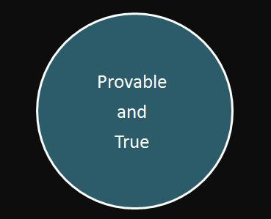
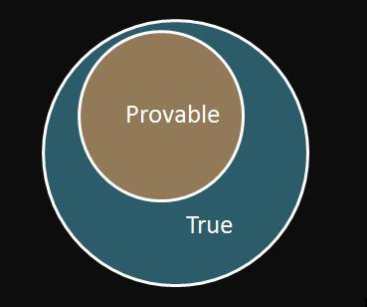
Why Hilbert’s Program doesn’t hold?
Hilbert’s vision required truth and provability to be co-extensive.
Shows provability to be a proper subset of truth.
Notes:
That is to say, there are some truths that cannot be proven.
Gödel showed that diagram 2 was the situation for formal systems sufficiently strong enough to express number theory.

Slide 21
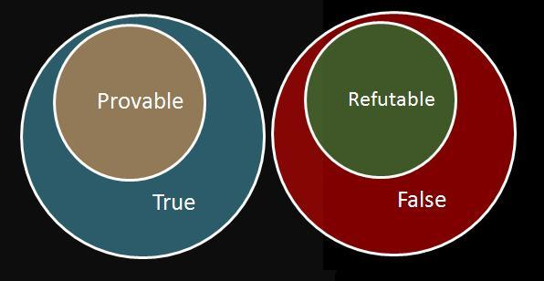
The incompleteness theorem
Incomplete because the sets of provable and refutable sentences are not co-extensive with the sets of true and false statements.
Gödel Incompleteness does not apply in certain cases!
Notes:
All three diagrams indicate this. The second point is that Gödel’s incompleteness theorem only applies to those formal systems sufficiently strong enough to express number theory. There are many formal systems that are complete and consistent (Propositional Calculus and First Order Predicate Calculus are two examples of such systems)

Slide 22
The Second Incompleteness theorem
Any consistent theory powerful enough to encode addition and multiplication of integers cannot prove its own consistency
It is not possible to formalize all of mathematics, as any attempt at such a formalism will omit some true mathematical statements
A theory such as Peano arithmetic cannot even prove its own consistency
There is no mechanical way to decide the truth (or provability) of statements in any consistent extension of Peano arithmetic
Notes:
His second incompleteness theorem stated that any consistent theory powerful enough to encode addition and multiplication of integers cannot prove its own consistency.
An easy consequence of Gödel's incompleteness theorem is that there is no complete consistent extension of even Peano Arithmetic with a recursively enumerable set of axioms, so in particular most interesting mathematical theories are not complete.
A theory such as Peano arithmetic cannot even prove its own consistency, so a restricted "finitistic" subset of it certainly cannot prove the consistency of more powerful theories such as set theory.
There is no algorithm to decide the truth (or provability) of statements in any consistent extension of Peano arithmetic.
(Strictly speaking this result only appeared a few years after Gödel's theorem, because at the time the notion of an algorithm had not been precisely defined.)

Slide 23
Why is the Incompleteness theorem important?
First order logic is complete and higher order logic are incomplete
It also means that mathematics cannot attain the total purity of language
Problems which computers will be unable to compute
Also linked to P=NP
Notes:
Previously he proved that first order logic is complete and higher order logic are incomplete.
It also means that mathematics cannot attain the total purity of language which mathematicians both desired and believed to exist.
Alan Turing showed how this translates to computing. Since any computer operates off a set of instructions, not unlike axioms, there will inevitably be problems (not unlike theorems) which computers will be unable to compute.
That’s why P and NP are sometimes referred to as Gödel lost letters.

Slide 24
My thoughts on the Incompleteness theorem…
Does it make the search of theory of everything impossible?
Since there exist mathematical results that cannot be proven
Then there exist some physical results that cannot be proven
Then probably a limit to reasoning itself

Slide 25
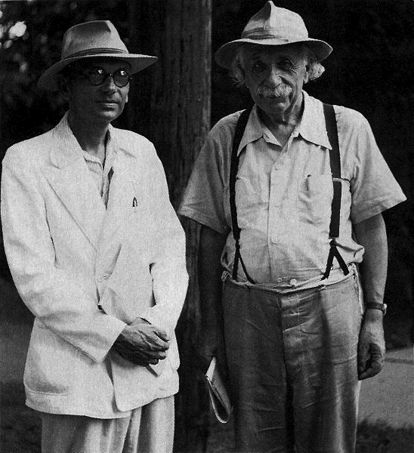
Gödel’s life continued…
Later joined IAS at Princeton
Paradoxical solutions
general relativity
Conspiracy that some of Leibniz theory was suppress(Truth or Paranoid?)
Notes:
In 1951, he demonstrated the existence of paradoxical solutions to Albert Einstein's field equations in general relativity.
He gave this elaboration to Einstein as a present for his 70th birthday
He was also a fan of Leibniz

Slide 26
Gödel’s life continued…
Tried to prove the existence of God in his Gödel's ontological proof – though he did not believe in God
Suffered periods of mental instability and illness
Obsessive fear of being poisoned
Notes:
He had an obsessive fear of being poisoned; he would eat only food that his wife, Adele, prepared for him.
Late in 1977, Adele was hospitalized for six months and could no longer prepare Gödel's food. In her absence, he refused to eat, eventually starving to death.

Slide 27
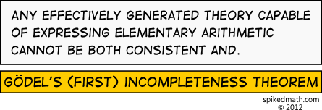
Issues, comment, concerns?

Slide 28
Reference:
http://en.wikipedia.org/wiki/Kurt_Gödel
http://plato.stanford.edu/entries/goedel/
http://en.wikipedia.org/wiki/Consistency
http://en.wikipedia.org/wiki/Peano_arithmetic
http://en.wikipedia.org/wiki/Hilbert's_program
http://godelsproof.wordpress.com/2010/06/28/a-brief-description-of-godels-first-incompleteness-theorem

