Slide 1
Gödel’s Theorem Use, Abuse and proof (from G.E.B)
Sridhar

Slide 2
Why is it significant?
The Use

Slide 3
We're going to get to some statements which, in mathematics, refer to themselves
how does a self come out of things which have no selves?
Gödel
I
within mathematics, there exists an equivalent to self-reference.
these two systems are equivalent.
isomorphism
2+2 = 4
∃ x | x²>x
- p - - q - - - -
….
Atoms,
Proteins, Molecules
….

Slide 4
World of Axiomatic methods
Geometry – only branch in mathematics, which most considered to have sound axiomatic basis.
Euclid’s elements
Undermined deeply rooted preconceptions and demolished ancient hopes.
Godel showed that these axiomatic methods have inherent limitations.
No formal systematization of most important areas of mathematics is attainable.
Notes:
It is not fully ‘negative’
It introduced a new field of study of foundation questions.
Provoked reappraisal of widely help philosophies of mathematics and of philosophies of knowledge in general

Slide 5
David Hilbert
leading advocate of formalism.
formalize one branch of mathematics after the other – Hilbert Program
In 1899 Foundations of Geometry – important work after Euclid.
International congress of mathematicians in Paris in the year 1900
Presented 23 problems facing mathematicians in the new century
“Take any definite unsolved problem … However unapproachable these problems may seem … we have, nevertheless, the firm conviction that their solution must follow by a finite number of purely logical processes .. We hear within us the perpetual call: There is the problem. Seek its solution… in mathematics there is no ignorabimus”
ignoramus et ignorabimus (we do not know, and we shall never know)

Slide 6
David Hilbert
First Problem: Cantor’s continuum hypothesis- there are more real numbers than there are natural numbers, even though there are an infinite number of both
Godel, together with Paul Cohen, proved that the continuum hypothesis can be proved neither true nor false within current set theory - an ignoramibus
Second Problem:The Consistency of the axioms of arithmetic
meaning that there is no statement in the language of the system that can be both proved and disproved in the system - logical contradictions
Working on this became a priority
Paradoxes: Russell’s Paradox
The formal system laid out in Principia Mathematica was sufficient for expressing all the truths of arithmetic; it was also, presumably, consistent.
if it could be shown that PM was complete, as well as consistent, the linchpin of the Hilbert program would have been secured, the crisis posed by the paradoxes overcome
Notes:
proved two theorems in his paper
PM satisfies a property that G¨odel named -consistency (“omega consistency”), it is incomplete, meaning that there is a statement in the language of the system that can be neither proved nor disproved in the system. Such a statement is said to be undecidable in the system.
Incomplete- meaning that there is a statement in the language of the system that can be neither proved nor disproved in the system. Such a statement is said to be undecidable in the system.

Slide 7
Gödel Theorem – Important inferences
Resources of the human intellect have not been, and cannot be, fully formalized, and that new principles of demonstration forever await invention and discovery.
The structure and power of the human mind are far more complex and subtle than any non-living machine yet envisaged.
NO IMMEDIATE PROSPECTS OF REPLACING HUMAN MINDS BY ROBOTS.

Slide 8
Gödel Theorem & Calculating Machine
CM: can be constructed that would match the human brain in mathematical intelligence?
CM: fixed set of directives built into them ~ fixed rules of inference of formalized axiomatic procedure.
CMs: Supply answers to problems by operating in a step-by-step manner, each step being controlled by the built-in directives.
There are innumerable problems in elementary number theory that fall outside the scope of a fixed axiomatic method,
CMs: are incapable of answering, however intricate and ingenious their built-in mechanisms may be and however rapid their operations.
No one machine can be built for solving every problem!

Slide 9
inexhaustible source of intellectual abuses
The Abuse

Slide 10
Gödel Theorem – Wrong inferences
“Gödel’s incompleteness theorem shows that it is not possible to prove that an objective reality exists,”
“By Gödel’s incompleteness theorem, all information is innately incomplete and self-referential,”
“By equating existence and consciousness, we can apply Gödel’s incompleteness theorem to evolution.”
“ An invitation to despair - there are truths which are forever incapable of becoming known”
“ An excuse for mystery-mongering - Mystic intuition must replace cogent proof”
“ It shows the ineluctable limits to human reason”

Slide 11
Gödel
About the Man

Slide 12
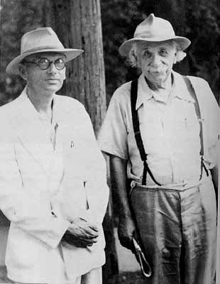
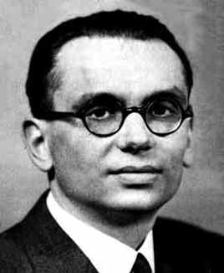
About Godel
Born April 28, 1906 in Brno (now Czech Republic, then Austria-Hungary)
1931: publishes Über formal unentscheidbare Sätze der Principia Mathematica und verwandter Systeme (On Formally Undecidable Propositions of Principia Mathematica and Related Systems)
1939: flees Vienna
Institute for Advanced Study, Princeton
Died in 1978 – convinced everything was poisoned and refused to eat

Slide 13
Some Basics

Slide 14
Some Concepts …
Unprovable
Paradoxes
Axiomatic Systems

Slide 15
Difficult to prove .. Arithmetic
Goldbach’s conjecture, “Every even number greater than 2 is the sum of two primes,”
Twin prime conjecture, according to which there are infinitely many primes p such that p + 2 is also a prime.
Collatz conjecture - states that if we start with any positive natural number n and compute n/2 if n is even, or 3n + 1 if n is odd, and continue applying the same rule to the new number, we will eventually reach 1.

Slide 16
Mechanical Reasoning
Aristotle (~350BC): Organon
We can explain logical deduction with rules of inference (syllogisms)
Every B is A
C is B
➔ C is A
Every human is mortal.
Gödel is human.
Gödel is mortal.
Euclid (~300BC): Elements
We can reduce geometry to a few axioms and derive the rest by following rules
Newton (1687): Philosophiæ Naturalis Principia Mathematica
We can reduce the motion of objects (including planets) to following axioms (laws) mechanically
Late 1800s – many mathematicians working on codifying “laws of reasoning”
George Boole, Laws of Thought
Augustus De Morgan
Whitehead and Russell

Slide 17
pARADOXES

Slide 18
Types
Veridical
produces a result that appears absurd, but is demonstrated to be true nonetheless.
Falsidical
not only appears false but actually is false, due to a fallacy in the demonstration.
Antinomy
reaches a self-contradictory result by properly applying accepted ways of reasoning

Slide 19
Veridical
Three Prisoners problem
Hilbert's paradox of the Grand Hotel,
Schrödinger's cat
Ugly duckling theorem
Zeno’s Pradox

Slide 20
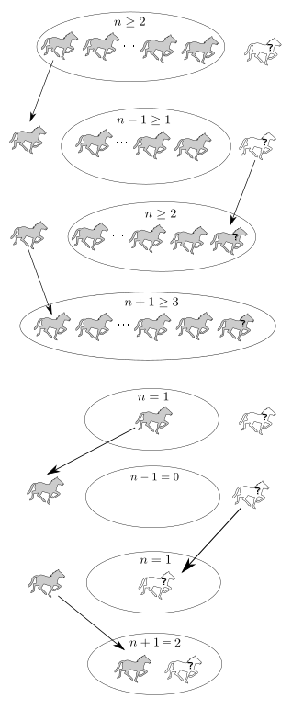
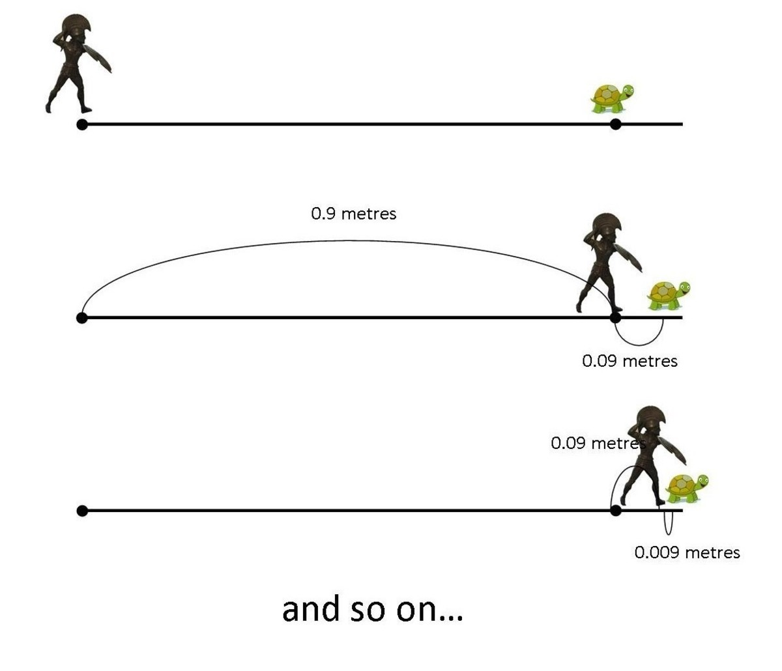







Falsidical
Mathematical Fallacy
Horse Paradox
Achilles and the tortoise
$$a=b$$
$$a^{2}=ab$$
$$a^{2}−b^{2}=ab−b^{2}$$
$$\left(a+b\right)\left(a−b\right)=b(a−b)$$
$$\left(a+b\right)=b$$
$$2b=b$$
$$2=1$$

Slide 21
Russell’s Paradox
Some sets are not members of themselves
set of all Jeffersonians
Some sets are members of themselves
set of all things that are non-Jeffersonian
S = the set of all sets that are not members of themselves
Is S a member of itself?
If S is an element of S, then S is a member of itself and should not be in S.
If S is not an element of S, then S is not a member of itself, and should be in S.

Slide 22
Russell’s Resolution
Principia Mathematica attempted to resolve this paragraph by banning self-reference
Every set has a type
The lowest type of set can contain only “objects”, not “sets”
The next type of set can contain objects and sets of objects, but not sets of sets
Resolution
Set ::= Sent
Set₀ ::= { x | x is an Object }
Set_{n} ::= { x | x is an Object or a Set_{n - 1} }
S: Set_{n} , Is S a member of itself?
No, it is a Set_{n} so, it can’t be a member of a Set_{n}

Slide 23
EpimenideS/LIAR Paradox
Epimenides was a Cretan who made one immortal statement.
"All Cretans are liars . “
"This statement is false "
Russell’s types can help with the set paradox, but not with this one.
Notes:
Last statement which rudely violates the usually assumed dichotomy of statements into true and false

Slide 24
Axiomatic Systems

Slide 25
Axiomatic Theories
A typical axiomatic theory consists of the following information:
A collection of symbols, which I will denote in boldface
For example: 0, =, Ɐ, Ǝ, ᴧ, ᴠ, ¬, a, ‘
A set of syntax rules dictating which strings of characters form valid statements (nothing here about what’s true or false)
For example: If A and B are valid statements, so are
(A ᴧ B), (A ᴠ B), and ¬(A)

Slide 26
Axiomatic Theories
A list of axioms – statements that are true and do not require proof. For example: Ɐa:(0+a=a) and Ɐa:(0·a=0)
A list of “rules of inference” – specific rules by which one may manipulate true statements to obtain new true statements.
For example: The string “¬¬” may be deleted from any theorem or added to the beginning of any theorem.
A “proof” is a list of statements, each of which is either an axiom or the result of applying a rule of inference to one or more previous lines.
A “theorem” is a non-axiom statement that is the last line of a proof.

Slide 27
Perfect Axiomatic System
Derives all true
statements, and no false
statements starting from a
finite number of axioms
and following mechanical
inference rules.

Slide 28
Incomplete Axiomatic System
Derives
some, but not all true
statements, and no false
statements starting from a
finite number of axioms
and following mechanical
inference rules.
incomplete
Notes:
A formal system is said to be complete if for each sentence A in its language, either A or its negation, not-A, is provable; and is said to be incomplete if that does not hold, i.e. for some sentence A, both A and not-A are unprovable.

Slide 29
Inconsistent Axiomatic System
Derives
all true
statements, and some false
statements starting from a
finite number of axioms
and following mechanical
inference rules.
some false
statements

Slide 30
Whitehead and Russell
Principia Mathematica
Three Volumes, 2000 pages
logical foundation for mathematics
Attempted to axiomatize mathematical reasoning
system of axioms
Define mathematical entities (like numbers) using logic
Derive mathematical “truths” by following mechanical rules of inference
rules of reasoning
Claimed to be complete and consistent
All true theorems could be derived
No falsehoods could be derived
Notes:
in the form of a (far from transparent) and within which all of the mathematics known at the time could be formulated and proved.

Slide 31
True vs Provable

Slide 32
Truth Vs Provability
Refer to Intro.pdf

Slide 33
Gödel’s Theorem
The Incompleteness Theorems

Slide 34
First Incompleteness
Any consistent formal system F within which a certain amount of elementary arithmetic can be carried out is incomplete; i.e., there are statements of the language of F which can neither be proved nor disproved in F
.

Slide 35
First Incompleteness
For any consistent system F within which a certain amount of elementary arithmetic can be carried out, the consistency of F cannot be proved in F itself.

Slide 36
In the Principia Mathematica system, there are statements that cannot be proven either true or false.
In any interesting rigid system (or sufficiently powerful formal system) there are statements that cannot be proven either true or false.
All logical systems of any complexity are incomplete: there are statements that are true that cannot be proven within the system.

Slide 37
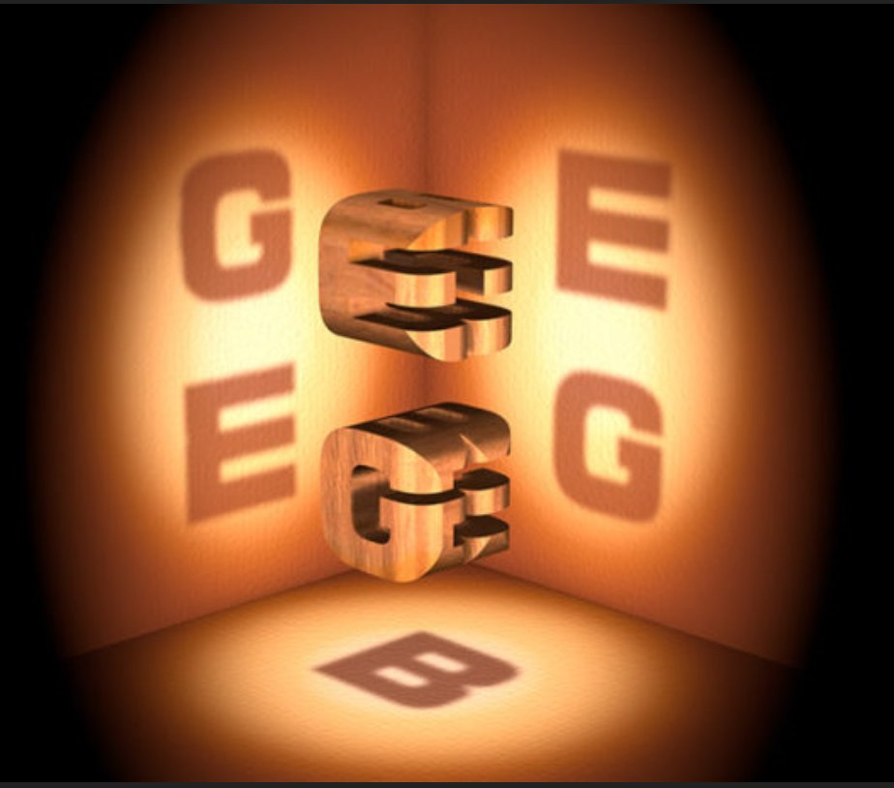
The Proof
Based on Douglas Hofstadter’s Gödel, Esher, Bach: As Eternal Golden Braid.

Slide 38
General Idea
Theorem: In the Principia Mathematica system, there are statements that cannot be proven either true or false.
Proof: Find such a statement
prove something by assuming the opposite, and then finding a contradiction
Gödel’s Statement G: This statement of number theory does not have any proof in the system of Principia Mathematica.
G is unprovable, but true!
If G were provable, then PM would be inconsistent.
If G is unprovable, then PM would be incomplete.
PM cannot be complete and consistent!
Turn G into a statement in the Principia Mathematica system
Is PM powerful enough to express “This statement of number theory does not have any proof in the system of PM.”?

Slide 39
General Idea
How to express “does not have any proof in the system of PM”
What does it mean to have a proof of S in PM?
There is a sequence of steps that follow the inference rules that starts with the initial axioms and ends with S
What does it mean to not have any proof of S in PM?
There is no sequence of steps that follow the inference rules that starts with the initial axioms and ends with S
Can we express “This statement of number theory”
DRH Approach:
Gödel Numbering:
Theoremhood
Arithmoniquing: Take the Gödel number of the entire sentence, and replace all occurrences of a free variable with that number - substitution of all free variables in the string with its own Gödel number
Use Arithmoniquing to write G.

Slide 40
Proof in detail

Slide 41
Typographical Number Theory (TNT)
Hofstadter’s own NT. TNT.
Expresses everything in terms of a few simple symbols
standard mathematical symbols such as +(plus), * (times), and =(equals).
variables, represented by the letter a followed by primes: a, a', a'', etc.
standard logical symbols such as ~ (not), V (or), E (there exists) and A (for all).
numbers, which are represented by the two symbols 0 (meaning zero) and S (meaning "the successor of"); so we count 0, S0, SS0, SSS0, and so on.
we cannot express negative numbers or fractions
"statements" are written as "strings"; that is, simple combinations of our allowed symbols.
~Ea:a*a=SS0
there does not exist any number a, such that a times a is two - there is no square root of two
this happens to be a true statement.
If we replace the SS0 with SSSS0, we still have a perfectly fine TNT string, although it now happens to stand for a false statement.
We have covered the language. Now for formal system, it needs two things: axioms, and ways of deriving theorems from axioms

Slide 42
5 Axioms of TNT
Axiom 1: Aa:~Sa=0
"For all numbers a, it is not true that the successor to a is zero” or, more concisely, there are no negative numbers.
Axiom 2: Aa:(a+0)=a
“For all numbers a, a plus 0 = a”
Axiom 3: Aa:Aa':(a+Sa')=S(a+a’)
"For all numbers a and a', a plus the successor to a' equals the successor to a plus a’” or, in conventional algebraic notation, "a + (a' + 1) = (a + a') + 1"
Axiom 4: Aa:(a*0)=0
"For all numbers a, a times zero equals zero"
Axiom 5: Aa:Aa':(a*Sa')=((a*a')+a)
"For all numbers a and a', a times the successor to a' equals a times a', plus a“ or, in conventional algebraic notation, "a * (1+a') = (a*a') + a". For instance, if you know what 5*263 is, you can bet that 5*264 will be five higher.

Slide 43
Rules of TNT
Rules allow you to transform one string into another
There are 12+ rules. Lets just look at few of them.

Slide 44
The ‘awesome’ power of TNT
there is no TNT symbol for "perfect square" or "prime number." However, we can translate the statements "4 is a perfect square" and "5 is a prime number" into TNT
Ea:(a*a) = SSSS0
there is some number that multiplies by itself to create four.
~Ea:Ea':(SSa*SSa') = SSSSS0
there are no two numbers, such that if you add two to each of them and then multiply them, you get five.
Advanced mathematical constructs are always built out of the basic operations of addition and multiplication!
TNT expresses number theory
Any statement you can make about natural numbers—no matter how complex, no matter how long, no matter how bizarre—can be written in a TNT string.
If such a statement is true, its TNT string can be derived as a theorem from the axioms. If the statement is false, we can derive its negation from the axioms. (Meaning, the same string with a ~ symbol in front of it.)

Slide 45
Gödel's Theorem: The Very End of the Proof
Critical Step: Take “Sentence G” and translate it into a TNT-string.
Sentence G: This statement is not a theorem of TNT.
If sentence G is false, then it is a theorem of TNT. Then we have a valid theorem which is false.
if it is true, then it is not a theorem of TNT. Which means that sentence G is true, but it is not provable within TNT.
That is Gödel's "incompleteness."
He showed that TNT, although it may be perfectly consistent and always correct, cannot possibly prove every true statement about number theory; there is always something which is true, which the system cannot prove.
So we're done!
Except that ………….
TNT makes statements about numbers, and sentence G is a statement about a statement (itself).
writing a TNT-string for "100 is a power of 10" might be very difficult, it seems reasonable to grant that it's possible
translating sentence G into TNT seems Impossible!

Slide 46
Facts till now
1. if we could translate sentence G into TNT, we would have defeated TNT.
2. there is no way to translate sentence G into TNT as we have formulated it
The beauty of Gödel's proof: “ he found a way to talk about statements in a language that was only meant to discuss numbers.”

Slide 47
Gödelized TNT: Gödel Numbering
Simple change to TNT.
NOT changing the axioms, NOT changing the Rules. ONLY change the symbols.
Going to replace each symbol with a three-digit number.
So instead of 0, we will write 666; instead of S, 123; instead of =, 111; and so on.
numbers are chosen completely arbitrarily
every number has three digits
no two numbers are the same.
So TNT now starts to look much uglier.
TNT statement: ~Ea:a*a=SS0
Gödelized: 223333262636262236262111123123666
TNT rule: The string ~~ can be deleted wherever it appears in any string.
Gödelized: The string 223223 can be deleted wherever it appears in any string.
REMEMBER: nothing has changed. The two systems are completely interchangeable
Notes:
Gödel

Slide 48
Gödelized TNT: Number About Numbers
in our new notation, every string is a number.
Because of this, we can change the form of our rules
from typographical manipulations to mathematical functions
REMEMBER: still nothing has changed.
our original TNT string-manipulation rules have been turned into mathematical functions, but our new system is still exactly the same as the old, just written differently
But, Something interesting has happened.
strings about numbers → numbers about numbers
123666112666111123666 means "1+0=1";
123666111666, which means "1=0"
RECALL:
Gödel's proof required us to write a TNT string about a TNT string.
impossible, because TNT strings are only about numbers.
Gödel notation is a step in the right direction, since it blurs the distinction between numbers and statements

Slide 49
Gödelized TNT: Comparing 3 Systems
Mathematical Logic | TNT | Gödel-numbered TNT
An axiom is an "obvious" statement about natural numbers. | An axiom is a statement string | An axiom is a number
A rule of production is a logical way to work with axioms. | A rule of production is an allowed string-manipulation mechanism. | A rule of production is an allowed mathematical function.
The theorems you produce are new statements about natural numbers. | The theorems you produce are new strings. | The theorems you produce are new numbers.
True
valid theorem
123666112666111123666 means "1+0=1";
123666111666, which means "1=0"
False
Not a valid theorem

Slide 50
Gödelized TNT: Theoremhood
New property of natural numbers. Theoremhood.
Every number either has it, or doesn’t
A number has theoremhood if it corresponds to a valid theorem of TNT—or, in other words, to a true statement about numbers.
A number has theoremhood if it is possible to create that number from our small set of axiom-numbers, by the application of our small set of function-rules.
It is possible to take certain numbers, apply certain functions to them, and arrive at the number."
Saying "this number has theoremhood" is kind of like saying "this number is a perfect square" or "this number is prime“

Slide 51
Gödelized TNT: Sleight of Hand
Start off with a true fact, and write it three different ways: in terms of math, in terms of TNT, and in terms of Gödelized TNT.
"Zero equals zero" is true.
The string 0=0 is a valid TNT theorem (ie can be derived from axioms).
The Gödel number 666111666 has the theoremhood property.
Remember, we're assuming that TNT represents every possible mathematical statement, no matter how complex
it can handle this one: we could take the sentence "666111666 has theoremhood," and translate it into TNT!
i.e., "666111666 has theoremhood" is a mathematical statement, which can be translated into TNT.
In general: it is possible to write a TNT string which says that another TNT string is (or is not) a valid theorem.
The resulting string would presumably be true, leading us to the following claim
"666111666 has theoremhood" is true.
The TNT string for "666111666 has theoremhood" is a valid TNT theorem.
The Gödel number for the TNT string for "666111666 has theoremhood," has theoremhood property
Notes:
I never took a string like "666111666 has theoremhood" and translated it into TNT. I simply asserted that it is possible to translate that string, because that string is a mathematical statement, and we are assuming that TNT can express all mathematical statements.

Slide 52
Sentence G in TNT
we know that the following sentences could all be written in TNT.
5 is not a theorem of TNT.
10 is not a theorem of TNT.
123666111666 is not a theorem of TNT.
All we need to do is find such a sentence with the following peculiarity: the number that it talks about, happens to be the Gödel number of the sentence itself.!
Is that so hard?
Actually, it's impossible .. Why?
The number 1 is "S0" in TNT, or 123666 in Gödelized TNT.
Similarly, the Gödel number for 10 is 123123123123123123123123123123666 .
In general, the Gödel number for any number, is much bigger than the number itself!
So if you wrote down the sentence "10 is not a theorem of TNT," its Gödel number would definitely not be 10, it would be much bigger...and so for any number. A TNT string cannot possibly be big enough to "contain" its own Gödel number.

Slide 53
Sentence G in TNT
Sentence G will not contain its own Gödel number explicitly, but will instead refer to it indirectly.
Ex: we can refer to "10" as "5*2", which has a much lower Gödel number.
Sentence G has to have some very clever, indirect reference to its own Gödel number.
Clever Method: "Arithmoquining"

Slide 54
Arithmoquining
Start with a simple mechanism for writing a TNT sentence about another TNT sentence.
Arithmoquining
You start with any sentence that has a free variable, which we'll call a.
To arithmoquine the sentence, you take the Gödel number of the entire sentence, and replace all occurrences of the variable a with that number
start with the sentence a=S0.
The Gödel number of this expression is 262111123666;
so arithmoquining, we get "262111123666=1".
arithmoquining gives us a generalized way to write one TNT statement about another TNT statement.

Slide 55
Arithmoquining
Arbitrary Sentence with free variable | Arithmoquining | Shortened
T: a = S0 | A: The Gödel number of Sentence T is 1. | A: Sentence T is 1
T: a = SS0 * a - SSSS0 | A: The Godel number of Sentence T is 2 times Godel number of sentence T minus 4. | A: Sentence T is 2 times sentence T minus 4.
A: "a=SS0*a-SSSS0" is 2 times "a=SS0*a-SSSS0" minus 4.
We still definitely do not have a sentence about itself, which is what we need in order to write sentence G.

Slide 56
Writing Sentence G
Remember the Problem: write a sentence that says "I am not a theorem";
you have the basic tool, which is arithmoquining to write a sentence about another sentence.
Attempt-1
T: a is not a valid TNT theorem-number.
A: Sentence T is not a valid TNT theorem-number.
Attempt-2
T: The arithmoquine of a is not a valid TNT theorem-number.
A: The arithmoquine of Sentence T is not a valid TNT theorem-number.
So sentence A, which is the arithmoquine of sentence T, is also about the arithmoquine of sentence T. In other words, it's about itself!
G: The arithmoquine of "The arithmoquine of a is not a valid TNT theorem-number" is not a valid TNT theorem-number.

