Slide 1
Build Your Own Private Cloud Infrastructure
Elastic Utility Computing Architecture Linking Your Programs To Useful Systems

Slide 2
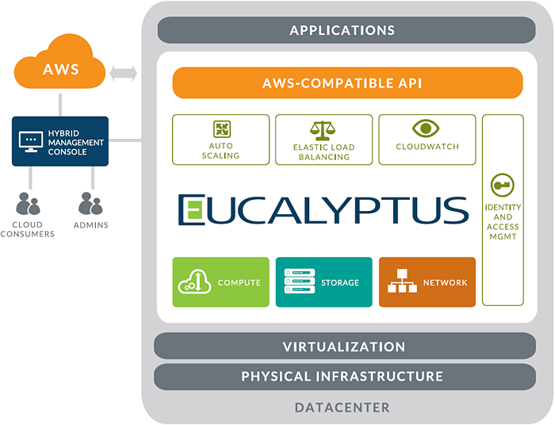
EUCALYPTUS In a NUTSHELL
On-premise IaaS software
Runs on top of Linux on your own hardware
Numerous control components work together with nodes (virtual hosts) to create a cloud
Commodity hardware focus; abstracts away physical infrastructure into a service-orientated platform
Open Source
Freely available
downloads.eucalyptus.com
Subscription-based business model
Support tiers with global coverage
Subscription-only add-ons
First software release in 2008
Incorporated in 2009

Slide 3
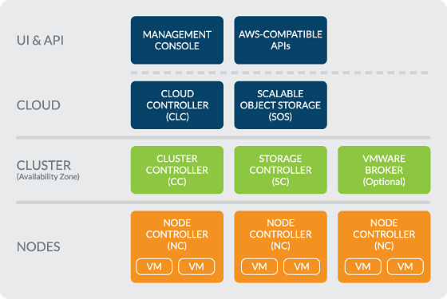
The Architecture

Slide 4
Components and their Tasks
CLC (Cloud Controller) ⇒ It controls the Cloud (Frontend)
Walrus ⇒ It manages virtual machine images
SC (Storage Controller) ⇒ It manages storage volumes
CC (Cluster Controller) ⇒ It manages netwoking
NC (Node Controller) ⇒ It controls Hypervisors

Slide 5
Components of Eucalyptus
Node Controller controls the execution, inspection,and terminating of VM instances on the host where it runs.
Cluster Controller gathers information about and schedules VM execution on speciﬁc node controllers, as well as manages virtual instance network.

Slide 6
Components continued..
Storage Controller (Walrus) is a put/get storage
service that implements Amazon’s S3 interface, pro-
viding a mechanism for storing and accessing virtual
machine images and user data.
Cloud Controller is the entry-point into the cloud
for users and administrators. It queries node man-
agers for information about resources, makes high-
level scheduling decisions, and implements them by
making requests to cluster controllers.

Slide 7
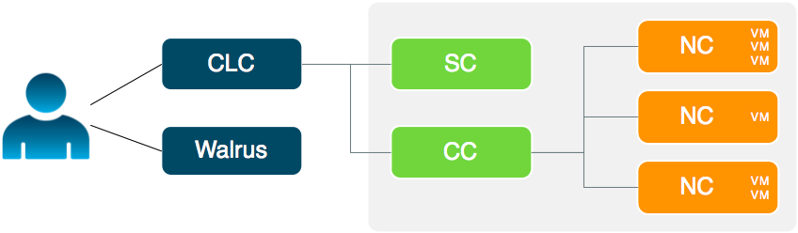
Overview of Operations

Slide 8
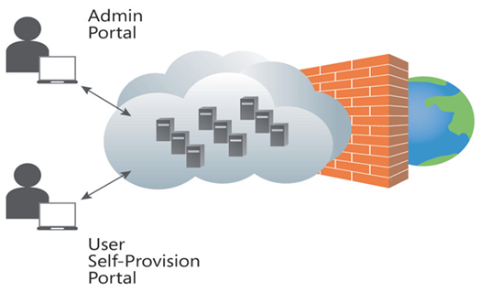
Definition of Private Cloud
Private cloud is a cloud infrastructure operated solely for a single organization, whether managed internally or by a third-party and hosted internally or externally.

Slide 9
Public versus private?
Public cloud gives you CONVENIENCE
Private cloud gives you CONTROL
The price you pay:
Unpredictable cost & margin impact
No control over uptime, performance, security
The price you pay:
Managing your own infrastructure
CAPEX
Scale limited to the size of your private cloud
Hybrid cloud gives you FLEXIBILITY

Slide 10
VIRTUALIZATION
A virtual machine (VM) is a software implementation of a machine (i.e., a computer) that executes programs like a physical machine. A hypervisor provides a uniform abstraction of the underlying physical machine.
Multiple VMs can execute simultaneously on a single hypervisor. Eucalyptus deploys instances (i.e., virtual machines) on a hypervisor.
Eucalyptus can use either xen or kvm hypervisors. To interact with them, Eucalyptus employs libvirt virtualization API.

Slide 11
WHY A PRIVATE CLOUD?
Deliver the benefits of public cloud on-premise
Cost
Control
Performance
Security
Give the innovators easy access to resource by removing traditional infrastructure barriers.

Slide 12
USE CASE Details
Nokia – 100,000 cores and counting. Aggressively reducing time to market and increasing pace of the R&D cycle. Hardware utilization up to 90% from 40%
Intel – 200 nodes in Hadoop testing
Large US retailer – moving AWS workloads off-prem
US customer – building hotel media solution with Euca included
Lincoln Financial Group – internal self-service cloud for financial platforms
Infomedia – ”AWS is plan A, Euca is plan B”

Slide 13
Requirements
All the components must be installed in the physical machines.
CPU may be either Inter or AMD of dual core processors with minimum 2GHz clock speed.
Operating system must be Centos 6 or RHEL 6. Eucalyptus supports x64 architecture only.
Each NC needs a minimum of 4 GB RAM and machine needs 30GB of storage.
Each components must have at least one NIC (Network Interface Card) for base deployment.

Slide 14
Pre-Installation considerations
Understand the architecture.
Normal or HA
Understand the cloud, cluster and node components placement.
Planning the network modes.
Planning the features
Configuring the dependencies

Slide 15
Installation
Use the FASTSTART automated installation ISO Image with Centos and KVM (hypervisor) preconfigured.
Centos is an open source linux distribution and is the preferred distro by Eucalyptus systems.
We’ll boot the machines with faststart iso from the usb and create partitions for the installation

Slide 16
Configuration and Start-up
Cloud In A BOX - Configuration
Assign the machine a hostname for identification, the private IP address for the node controller.
Assign the range of IP addresses, for the virtual machines.
Use authentication credentials after the the setup to login to the Eucalyptus Dashboard.

Slide 17
Launch VM instance
Create Instances from the eucalyptus Dashboard
Assign Image for the instance, setup hardware configuration to use.
Assign Key pair to use for ssh authentication and access.
After creation, access the vm instance using ssh by
Command : ssh –key mykey.private <username>@<ip address
Now instances can be used for various purposes such as a cloud storage or a virtual web server.

Slide 18
We’ll Discuss the rest in the Hand’s on Session…
Thank You

