Slide 1


Please send us feedback@bimserver.org
BIMserver.org

Slide 2
Start with the introductions…
2
Thursday, November 18, 2010

Slide 3
We are not software vendors!
(and do not want to be)
3
Thursday, November 18, 2010

Slide 4
Open Source BIMserver:
Open source software to change a regular (internet)computer into a BIMserver.
4
Thursday, November 18, 2010

Slide 5
How does it look?
5
Thursday, November 18, 2010

Slide 6
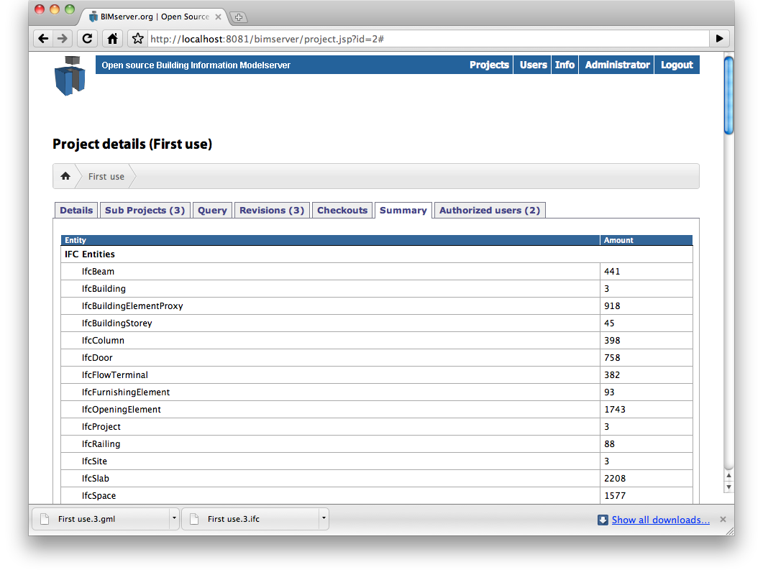
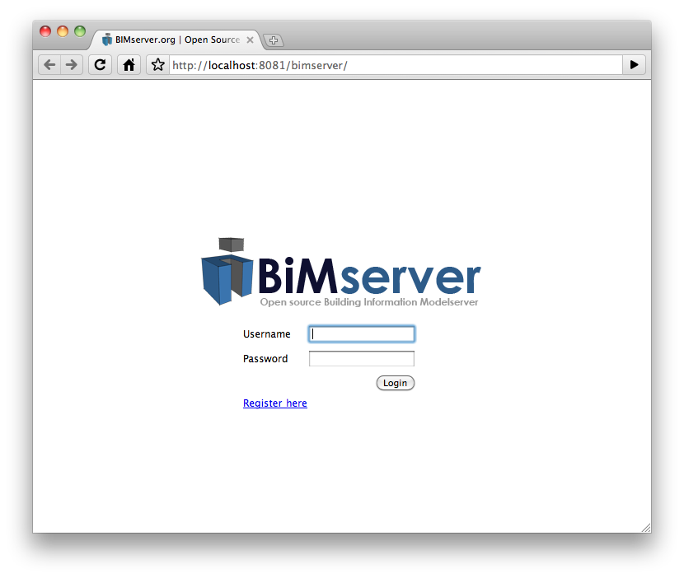
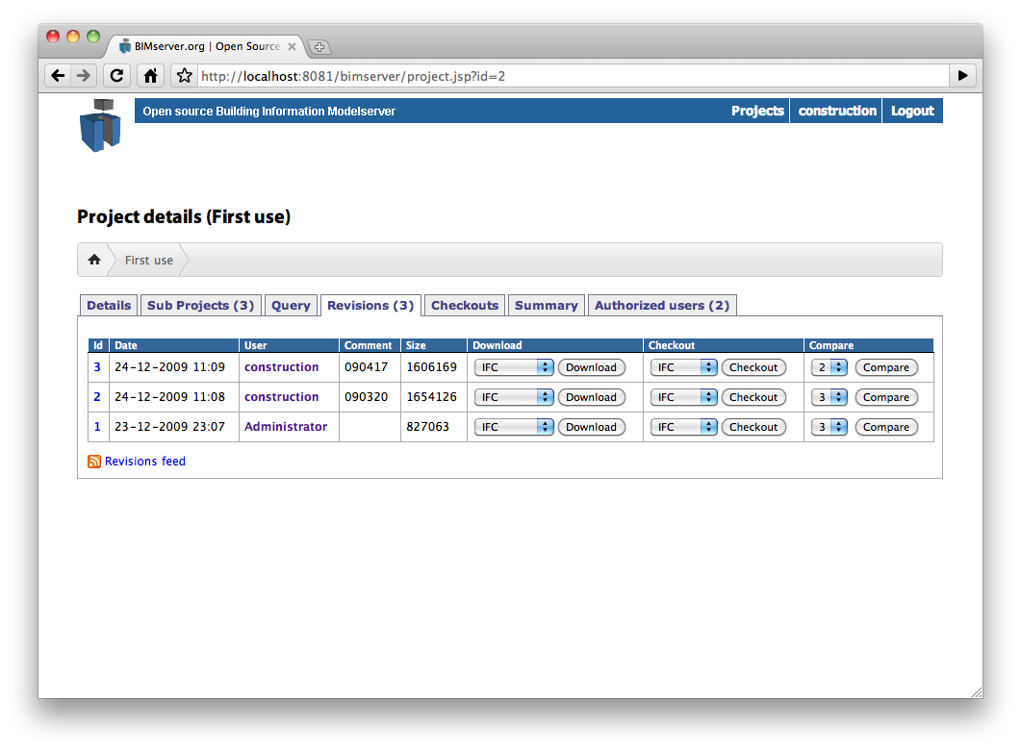
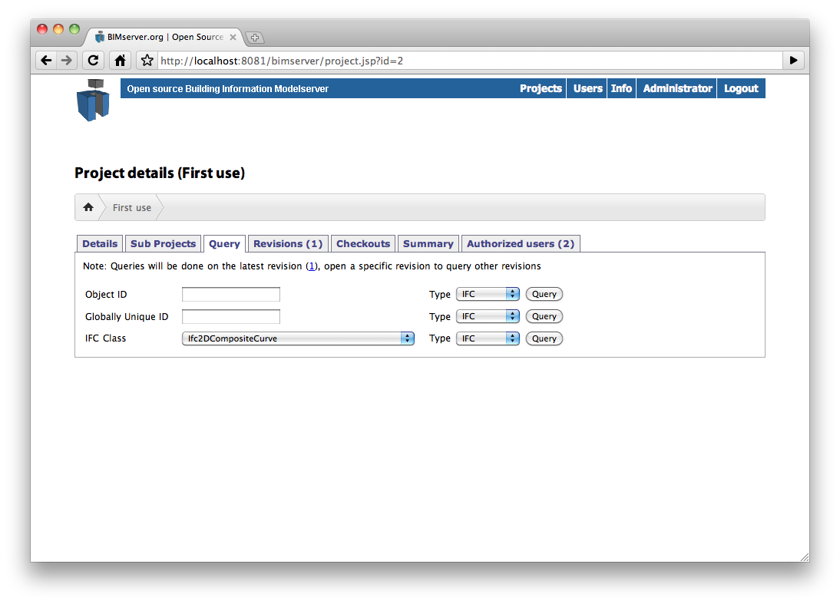
Depends on your view…….
6
Thursday, November 18, 2010

Slide 7
What kind of features does the BIMserver have?
7
Thursday, November 18, 2010

Slide 8
The most valued ones…
Merging IFC (sub)models
Early warning system (concurrent engineering)
User management and authorisation
(configurable) Simple queries/filters
Rules checker
Version management – revision management
Change finder (basic)
Online viewer (WebGL - beta)
Clash detection (serverside; basic)
Change alert / notification (rss)
More on www.bimserver.org/features/
8
Thursday, November 18, 2010
Notes:
Snel doorklikken naar de volgende sheet!!

Slide 9
But also:
Objects stored in database (no file storage)
Open source (GNU GPL v3)
Different interfaces (user, rest, soap, etc..)
(configurable) Export formats (CityGML, Collada, Google Earth, ifcXML, etc..)
‘Unlimited’ users, projects en objects.
Branching
GeoBIM export (geobim.org)
Model summary
Data checking on import (in development)
Rich internal object model / application logic (ecore)
More on: www.bimserver.org/features/
9
Thursday, November 18, 2010
Notes:
Snel doorklikken naar de volgende sheet!!

Slide 10
Tools / plugins
Revit plugin
Client viewer
Linking DMS and Workflow (Alfresco)
And more…
10
Thursday, November 18, 2010

Slide 11
Work in progress
Rule language
Real time stuff
Improve difference finder (dep. on IFC export quality of commercial vendors)
Intense documentation
Other export formats (3D-PDF, OSG, etc…)
Parsers to import data (Collada, CityGML etc.)
Connecting to other initiatives (osBIM, BuildingSMART, COBIE, etc.)
Etc…
11
Thursday, November 18, 2010

Slide 12
License issues
Yes, you can use it in commercial projects.
Yes, you can interface to it from your own software system.
Yes, you may create derived software products, but when you distribute them, the GPLv3 stays on.
In doubt? Contact us: license@bimserver.org
14
11/18/10

Slide 13
Some design principles
IFC that go in, stay in. For ever.
A modelserver doesn’t change your data. Never ever.
It’s a modelserver; not an model analyzer.
15
11/18/10

Slide 14
Keep you posted!?
Mailinglists; factsheet; wiki; etcetera:
Website: www.bimserver.org
16
Thursday, November 18, 2010

Slide 15
Also handy:
http://breakfast.bimserver.org
In Dutch, but screencasts speak for themselves….
17
Thursday, November 18, 2010

Slide 16
Closing remarks
18
Thursday, November 18, 2010

Slide 17
Don’t call us and say:
“when you build this feature wé are going to use your software”
We are NOT softwarevendors!
19
Thursday, November 18, 2010

Slide 18
This is not a hype……
This is boring software that makes your life better.
(when it was a hype, the userinterface would be better)
20
Thursday, November 18, 2010

Slide 19
This is not a “next big thing”
This is boring software that just works!
21
Thursday, November 18, 2010

Slide 20
It’s free!
Try it!
Use it!
22
Thursday, November 18, 2010

Slide 21
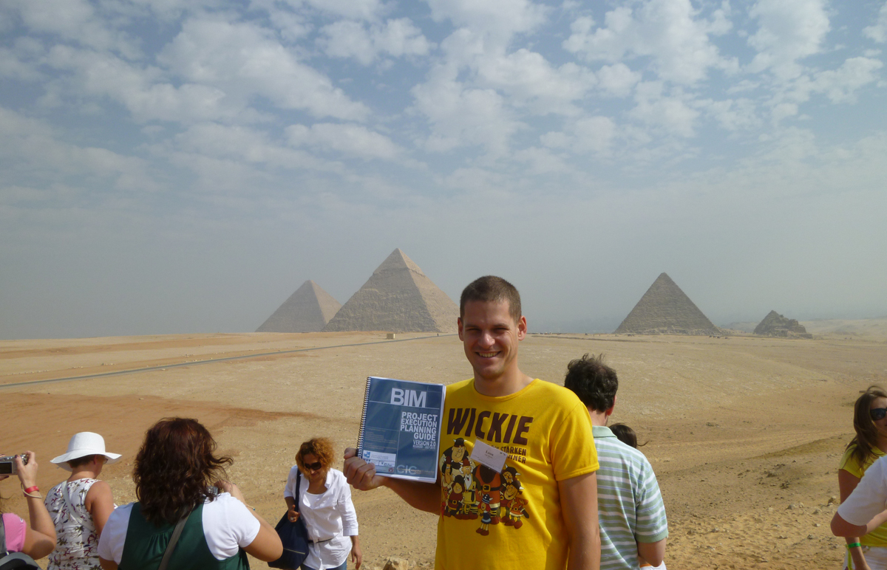
Leon.vanBerlo@tno.nl
Twitter: @berlotti
Skype: berlotti
+31 (0) 15 – 276 3106
www.bimserver.org
feedback@bimserver.org
Twitter: @bimserver
23
Thursday, November 18, 2010

