Slide 1
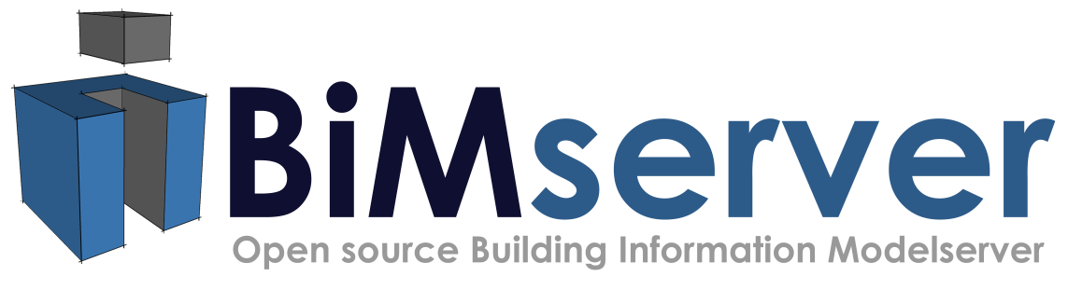




Towards an Open Building Information Model Server
-Report on the progress of an open IFC framework
Jakob Beetz, Ruben de Laat, Léon van Berlo, Pim van den Helm
Presentation CIB W78 Cairo

Slide 2
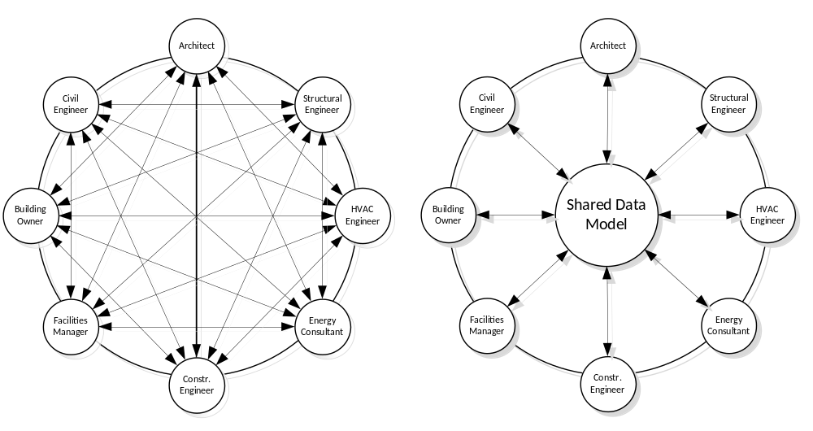
The BIM promise (conceptual)

Slide 3
Why are we not there yet?
There are political/commercial reasons for the lack of use of Open BIM standards (IFC) [Howard and Björk 2008], [Kiviniemi et al 2008]
Versioning on model level necessary: Multi-stakeholder projects cannot be handled on a document basis
Technical issues with IFC (GUID etc)

Slide 4
Why are we not there yet?
Many authors emphasize the need for model servers as a key success factor [Hannus et al 2003], [Froese 2003]
Need for lower thresholds:
  Get many users to use an open standard, to achieve this:
  Get many (SME) developers to implement an open standard
  simplify (inherently complex) domain models through Query languages / Partial model extractions [Adachi 2003], IDM, MVD

Slide 5
Existing work
Few commercial tools, often targeted at other industries [EDM/Jotne], [EUROSTEP]
BLIS/IMSrv/SABLE initiatives were promising but have been discontinued [Adachi 2002], [Houbaux 2003], [Kiviniemi et al 2005]
Various disconnected (developer) toolboxes, meta-model mappings and persistency approaches [Arnold and Podehl, 1999], [Lubell et al 2004], [Krause and Kaufmann 2007], [Bonsma TNO IFCEngine], [Nour 2009]
Traditional Object-Relational Mapping (ORM) seems not feasible (too many tables/ maintenance overhead) [others and us]

Slide 6
Aims of the project
With bimserver.org we would like …
to create an Open development platform for reuse
  minimize burden of low-level operations (schema, population I/O)
  provide reliable persistency
to create a framework for R&D projects and applications (merges, clash detection, MVD, IDM …)
to provide an easy entry into work processes based upon shared models for a broad audience of industry practitioners

Slide 7
Our approach
  Based on Model Driven Architecture (MDA)
  Meta model layer based on OMG standards (UML/XMI); concrete: Eclipse Modeling Frameworks (EMF)
  generate code / structure from model where possible
  STEP early binding in Java (n.a. yet: procedural/rules)
  easy to adapt for new model revisions
  broaden spectrum of available methods / tools
  provide tool chain on intermediate layers, instead of monolithic
  only few work-arounds in mapping EXPRESS->EMF necessary (simple type boxing, inverse relations, tristate for NULL values)

Slide 8
Our approach (contd.)
Key-value database mapping persistency strategy:
  flexible, extendable
  limitations on disk, not in memory
  concrete technology choice: BerkeleyDB; also: transactional
Object IDs beyond IfcRoot: based on user, project, revision

Slide 9
Our approach (contd.)
Incremental revisioning, nothing is lost, go back in time, branch
Provide service layers (“actions” on database)
Expose through accepted interfaces (SOAP,WSDL), REST(WADL)
Modularized architecture, extendable (e.g. geometry engine external/swappable )
Multi-platform (Win32, Mac Unix, Linux)

Slide 10
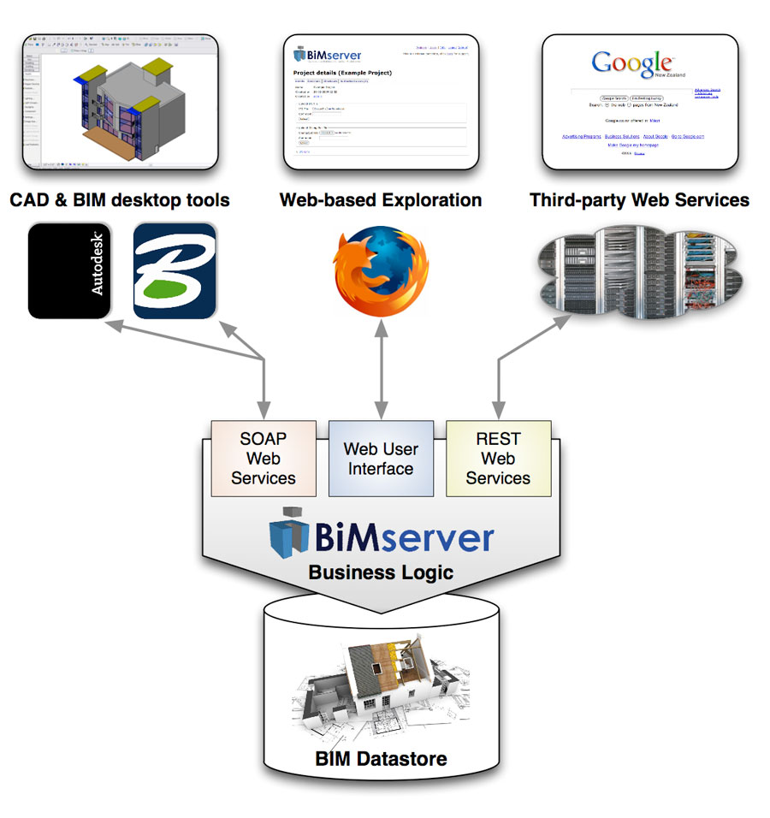
Architecture (general)

Slide 11
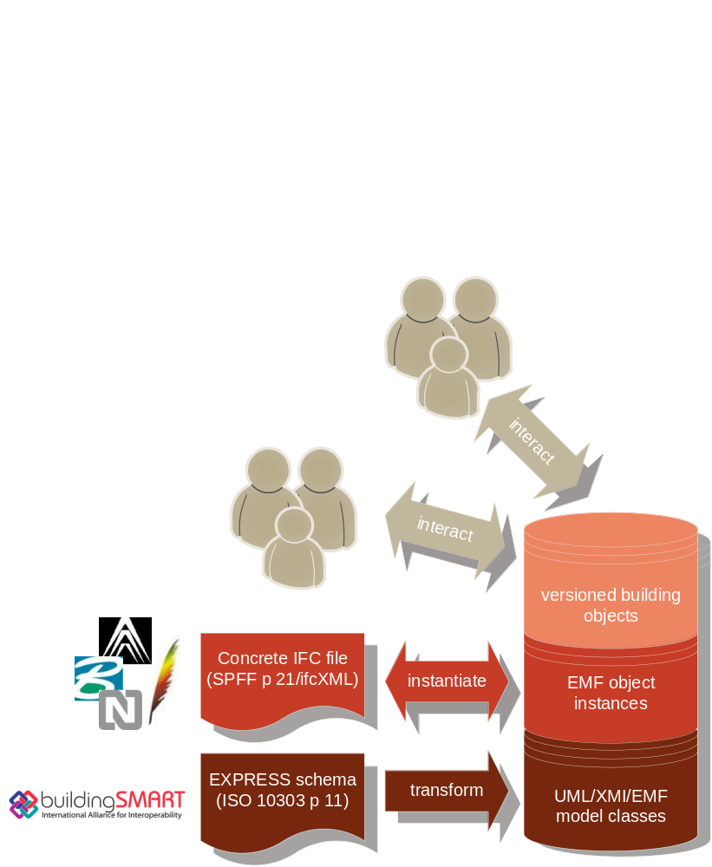
Architecture (technical)

Slide 12
Architecture
Clients
UserInterface (web, ifc, rest-ish)
SOAP Stack
Interface (ServiceInterface)
Service Layer
Interface (BimServerStore)
Column Oriented Database
Other Database Types
Interface (ColumnDatabase)
Other Database
(IFC-File Based, OODB)
BerkeleyDB
Other CODB's
(Hbase, SimpleDB, BigTable)

Slide 13
Sub-project merging
Main project
Architecture
Structural
Roof
Foundation
HVAC

Slide 14

Sub-project merging: initial check-in
Main project
Architecture
1
Structural
Roof
Foundation
HVAC

Slide 15
Main project
1
Architecture
1
Structural
Roof
Foundation
HVAC

Slide 16
Main project
1
1
Architecture
1
Structural
Roof
Foundation
HVAC

Slide 17

Main project
1
1
Architecture
1
Structural
Roof
Foundation
1
HVAC

Slide 18
Main project
1
1
Architecture
1
Structural
Roof
1
Foundation
1
HVAC

Slide 19
Main project
1
1
1
Architecture
1
Structural
1
2
2
Roof
Foundation
1
HVAC

Slide 20
Main project
1
1
1
2
2
Architecture
1
Structural
1
Roof
Foundation
1
HVAC

Slide 21


Main project
1
1
1
2
2
Architecture
1
1
2
Structural
1
Roof
Foundation
1
HVAC

Slide 22


Main project
1
1
1
2
2
3
Architecture
1
2
Structural
1
Roof
Foundation
1
HVAC

Slide 23
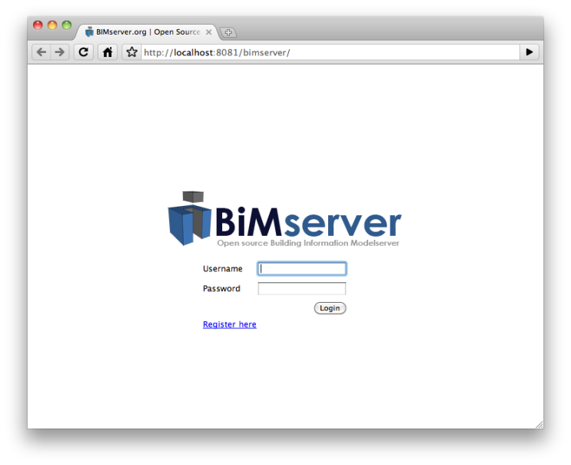
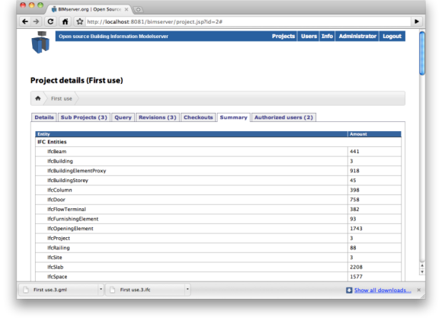
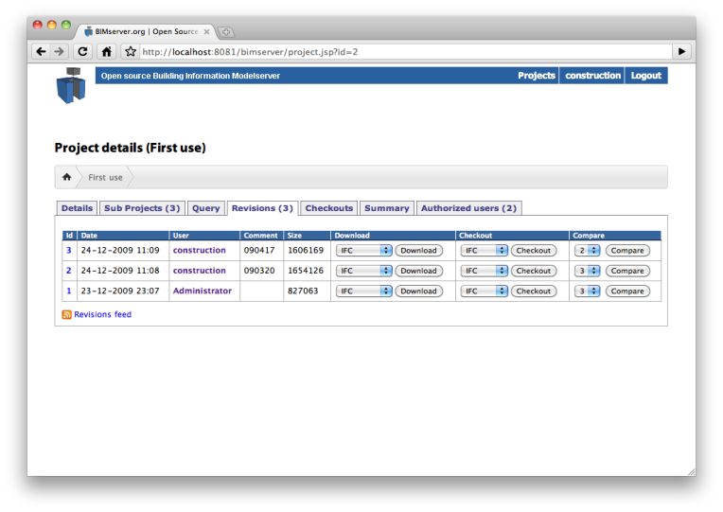
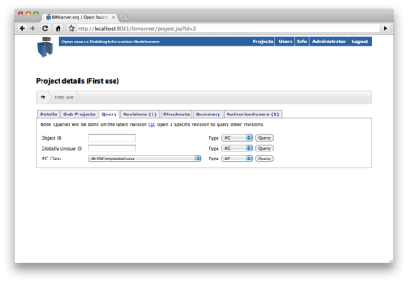
End-user software and Reference client
intuitive one-click installation (JAR, no configuration necessary)
immediate, setup of users, projects, access rights
complete with revisions and logs
navigate models in browser
see also http://www.bimserver.org/documentation/screenshots/

Slide 24
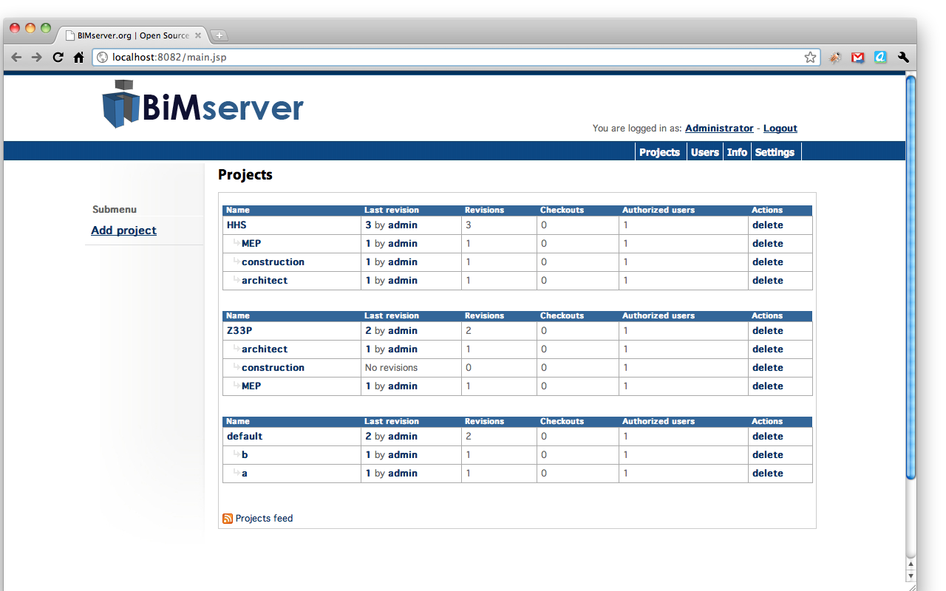

Slide 25
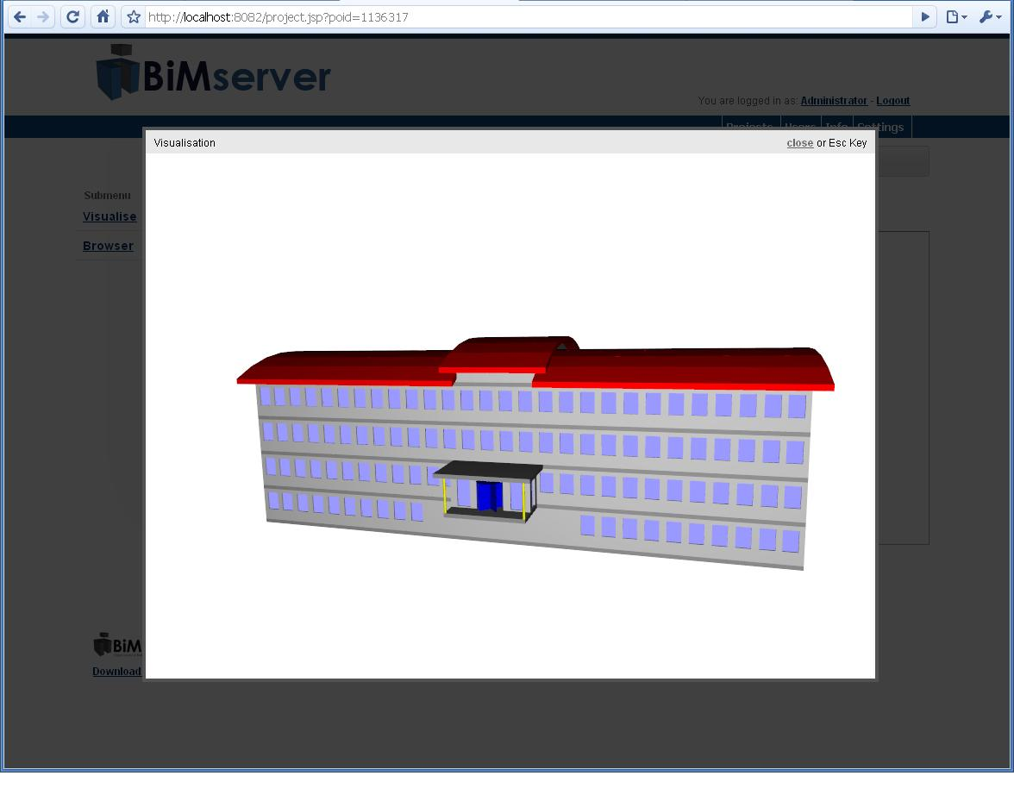

Slide 26
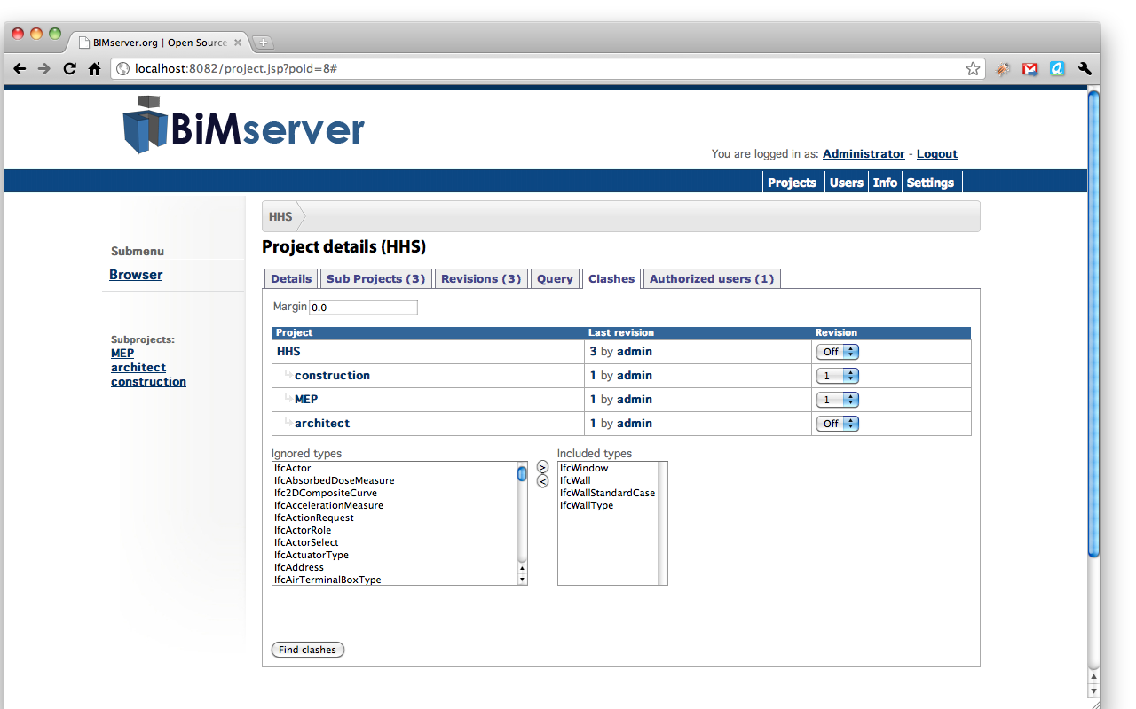

Slide 27
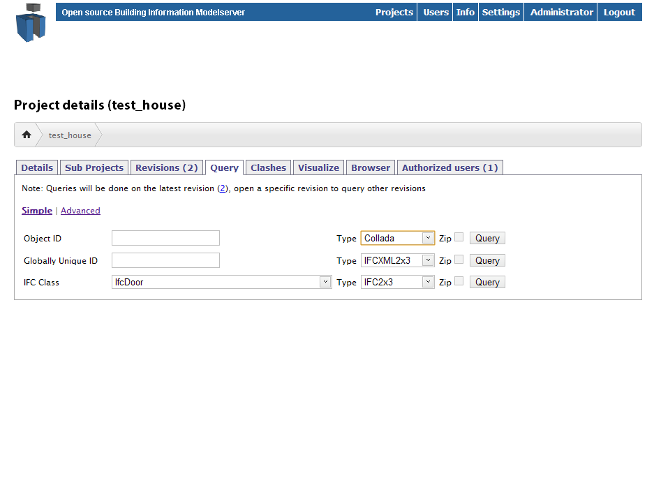

Slide 28
Advanced query example
public class Query implements QueryInterface {
private IfcDatabase<Long> model;
private PrintWriter out;
@Override
public void query(IfcDatabase<Long> model, PrintWriter out) {
List<IfcBuildingStorey> stories = model.getAll(IfcBuildingStorey.class);
Map<Float, IfcBuildingStorey>orderedStories = new TreeMap<Float, IfcBuildingStorey>();
for (IfcBuildingStorey storey : stories) {
orderedStories.put(storey.getElevation().getWrappedValue(), storey);
}
if (orderedStories.size() > 1) {
IfcBuildingStorey firstFloor = stories.get(1);
for (IfcRelContainedInSpatialStructure rel : firstFloor.getContainsElements()) {
for (IfcProduct product : rel.getRelatedElements()) {
if (product instanceof IfcDoor) {
IfcDoor ifcDoor = (IfcDoor)product;
        if (ifcDoor.getOverallHeight().getWrappedValue() > 2) {
        out.println(ifcDoor.getName().getWrappedValue()+
        " " + ifcDoor.getOverallHeight().getWrappedValue());
        }
}
}
}
}
}
}

Slide 29
User feedback
Few hundred subscribers on google development and user lists from around the world
active community for extensions, custom tailoring, bug-tracking
experimental installation experiences of end-users (engineering/architectural offices, BIM consultants/project hosting, education)
BIMserver Breakfast and other events
feed-back largely encouraging
‘some’ remarks on UI
lots of feature requests (most on documentation)

Slide 30
Summary
Proposal of an Open (GPL3), modular, scalable IFC model server platform
User management, (sub-) model versioning, transactions
can handle real-world model sizes (HITOS etc.)
multiple I/O conversion mechanisms (ifcXML, Collada, KMZ, WebGL, CityGML, … more to come)
Clash detection [van den Helm et al 2010]
several on-going extension projects
good user/developer feedback

Slide 31
Future work
Refinement of diff/merge mechanisms
More finely grained access rights (on objects, even props?)
Extended queries and filters (IDM/MVD), spatial queries
Distribution/Federation ? (use REST)
Integration/extension with other projects: TNO’s PMO, ifcOWL (semanticbimserver.org on Sesame/Joseki?)
simplified UI for reference client (contradiction with all of the above?)
… and whatever end-users would like to see or you would like to contribute

Slide 32
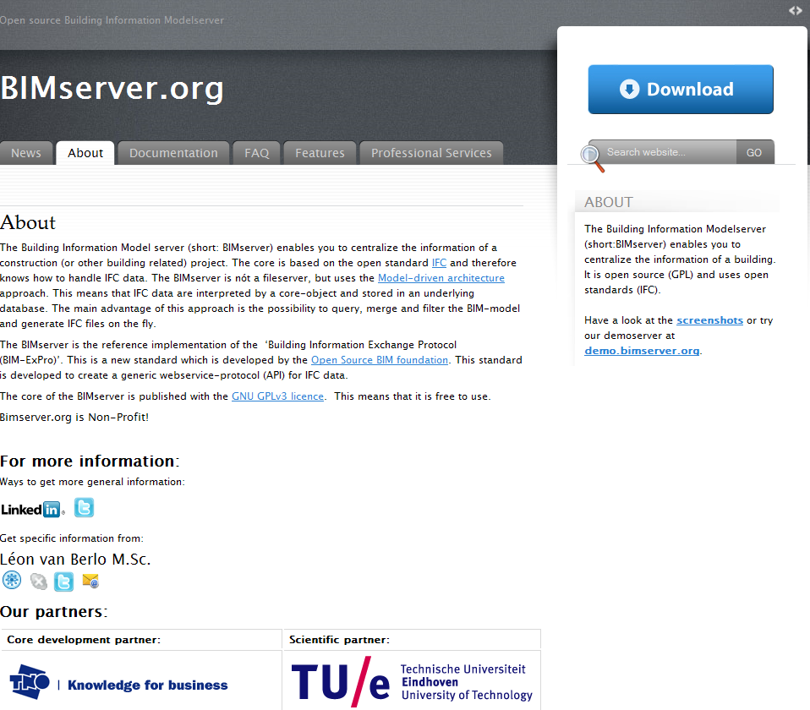
Thank you!
Please join us!

