Slide 1


Mosaic Art Using Pyraminx: Patterns and Symmetry computer vision
Department of Information Technology
V R Siddhartha Engineering College
B.Tech in Information Technology
Major Project Review Presentation
Presented by
ANKEM AMARNATH-(228W1A1269)
Jagannadham Sri Bhargav -(228W1A1291)
Under the guidance of
Mrs P.Ramadevi (phd)Asst.Prof

Slide 2
Agenda:
Introduction and Problem Statement
Objectives and Outcomes of the Project
Literature review and Summary
Dataset and Requirements
Algorithms used in the Project
Architecture/Project flow diagram
Implementation steps and Execution
Results Obtained
Result analysis with charts
Conclusion and Future work
References

Slide 3
Introduction and Problem Statement
Introduction:
The Pyraminx Mosaic Art Generator is a specialized tool that converts any digital image into a blueprint for a physical mosaic. Unlike standard pixel art, this project uses equilateral triangles and is strictly limited to the four colors of a Pyraminx puzzle. . It’s designed for "cubing" artists who want to build massive installations using hundreds of physical puzzles.
Computers usually calculate color distance using the Euclidean formula in RGB space, which doesn't match how humans see. This project uses the CIE Lab color space and the CIEDE2000 algorithm.
Computers usually calculate color distance using the Euclidean formula in RGB space, which doesn't match how humans see. This project uses the CIE Lab color space and the CIEDE2000 algorithm.

Slide 4
Introduction and Problem Statement
Problem Statement:
The main objective of your project is to provide a complete, end-to-end technical pipeline for transforming digital photographs into large-scale, physical Pyraminx mosaic installations.
The system uses advanced image processing specifically CIEDE2000 perceptual color science and edge-aware sampling to convert a standard 16-million-color image into a 4-color triangular grid. The objective here is to maintain the "soul" and recognizability of the subject despite the extreme constraints of the Pyraminx palette.
The ultimate goal is to build it. The project automates the creation of a segmented PDF manual.

Slide 5
Objectives and Outcomes:
Objectives:
To bridge the gap between digital design and physical construction by automatically generating segmented, coordinate-labeled assembly manuals.
To overcome the limitations of a strict 4-color palette by utilizing the CIEDE2000 algorithm in the CIE Lab color space, ensuring the output is visually accurate to human perception.
Outcomes:
A fully functional, responsive interface allowing users to upload images, adjust triangle density, and preview results in real-time.
A dynamic PDF generator that produces multi-page building instructions, including a master grid map and individual segment sheets

Slide 6
Literature Survey:
Paper Author name | Year | Algorithms | Work Done | Dataset used | Study area | Conclusion | Limitations
Lars Doyle, Forest Anderson, Ehren Choy, David Mould | 2019 | Simple Linear Iterative Clustering (SLIC) | Developed an algorithm for generating 3D pebble mosaic. | User will give an image | Computer Graphics,Image Processing, Non-PhotorealisticRendering (NPR) | The proposed method effectively produces realistic pebble mosaics by aligning tile shapes with image features. | Computationally expensive due to solving multiple Laplace equations.
Da-Xing Zeng, Ming Li, Juan-Juan Wang, Yu-Lei Hou, Wen-Juan Lu, Zhen Huang​ | 2018 | Various Rubik’s Cube reduction algorithms​ | Analyzed the historical evolution of the Rubik’s Cube. | User will give an image | Mechanical Engineering, Artificial Intelligence, Robotics | The Rubik’s Cube has potential applications beyond a simple puzzle​ | The study does not provide experimental validation for proposed applications and mainly focuses on theoretical perspectives​.
Boris A. Glazer | 2018 | Block-based image matching Color matching using overall color brightness distribution | Developed a photomosaic generation software that converts a large image into a mosaic of smaller images | Userdefined image libraries | Image Processing, Computer Graphics | Mazaika produces high-quality, visually accurate photomosaics | Quality depends heavily on the size and diversity of the image database

Slide 7
Paper Author name | Year | Algorithms | Work Done | Dataset | Study area | Conclusion | Limitations
Yaodong He, Jianfeng Zhou, Shiu Yin Yuen​ | 2018 | Clustering-Based Evolutionary Programming (CEP), Narasimham’s Algorithm, | Developed a novel evolutionary algorithm (CEP) for generating photomosaic images. | photomosaic tile databases | Image Processing, Evolutionary Computation, Photomosaic Generation | CEP significantly outperforms otherstate of the art algorithms in terms of visual quality and computation time​. | The study was limited by the availability of public algorithms such as Andrea software and Mozaika software
Nikolay Nachev, Ulrike Bergmann, Christopher Seward | 2017 | Generative Adversarial Networks | Proposed a novel method GANosaic for generating photomosaics using deep learning | Texture datasets used for GAN training | Deep Learning, Computer Vision | GANosaic demonstrates that deep generative models can replace traditional tile databases | Requires pre-training of GAN models, which is computationally expensive
Nikolay Jetchev, Urs Bergmann, Calvin Seward | 2017 | Periodic Spatial Generative Adversarial Network (PSGAN) | Proposed GANosaic, a new method for generating seamless mosaics using PSGAN. | User will give an image | Image Processing, Computer Vision, | GANosaic effectively generates high-quality mosaicS. | Computationally expensive due to gradient-based optimization.

Slide 8


Dataset and requirement specifications:
Datasets:
Any image given by the user
Requirements:
Backend:Python programming environment.
Libraries: OpenCV, math ,numpy
web Framework:Flask
Frontend:HTML,CSS,javaScript

Slide 9
Algorithms used in the Project:
Algorithm:Multi-Stage Signal Conditioning
input:User given input
Step 1:The algorithm calculates the average color of the image and shifts it toward neutral gray to remove unwanted color casts.
Step 2: It analyzes the image's mean luminance. If the image is too dark or too bright, it applies a power-law transformation to bring the mid-tones into a target range.
Step 3: CLAHE (Contrast Limited Adaptive Histogram Equalization) The image is converted to the CIE Lab color space. CLAHE is applied specifically to the "L" (Lightness) channel to boost local contrast without amplifying noise. Output: A standardized, high-contrast BGR image that provides a clear "signal" for the quantization engine.

Slide 10
Algorithms used in the Project:
Algorithm:Non-Orthogonal Geometric Tiling
Input:User given input
Step 1: Calculate the triangle height Hbased on the user-selected side length S using the formula: H = S × √3 / 2.
Step 2: Determine the grid bounds to ensure the mosaic fits perfectly within the physical dimensions of a puzzle set.
Step 3: Iterate through the grid. For each cell, determine the triangle's orientation (upward or downward) based on whether the sum of the current row + column index is even or odd.
Step 4: Generate the precise vertex coordinates for each triangle to create a continuous mesh without gaps.
Output: A collection of triangular "masks" that map specific pixel regions of the original image to the mosaic grid.

Slide 11
Algorithms used in the Project:
Algorithm: Perceptual Color Quantization (CIEDE2000)
Input: User given input
Step 1: Convert the sampled BGR color into the CIE Lab color space, which separates color into Lightness (L), Green-Red (a), and Blue-Yellow (b).
Step 2: Compare the target color against the fixed Pyraminx palette (Red, Blue, Green, Yellow).
Step 3: Apply the CIEDE2000 formula, which adds complex "correction factors" for how humans perceive hue shifts in blue regions and how we are more sensitive to changes in brightness than in saturation.
Step 4: Select the palette color with the minimum Delta E.
Output: A single color from the 4-color Pyraminx set that is a "perceptual" match, even if it isn't a mathematical RGB match.

Slide 12
Algorithms used in the Project:
Algorithm: Logistical Blueprinting
Input: User given input
Step 1: Segment the high-resolution mosaic into a user-defined grid .
Step 2: Assign coordinate labels to each segment using an Excel-style alphanumeric system.
Step 3: Calculate the total bill of materials, determining exactly how many individual triangles of each color are needed and how many physical Pyraminx units must be purchased.
Step 4: Render a multi-page PDF where Page 1 is the Master Key and subsequent pages are individual, high-resolution build sheets for each section.
Output: A printable, step-by-step assembly manual for building the physical mosaic.

Slide 13



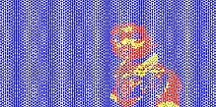
Architecture diagram:
Select image type
Validate file path and options
Compute printable area from page size and margins
Load image and convert to
RGB by using Colour-space
convert
User Browser
Grid planning
Image preparation
Pdf mosaic representation
Map each pixel/region to the nearest palette color using the CIEDE2000 Perceptual Difference Algorithm.
For each triangle cell, collect pixels inside the cell Choose a representative color index
Output
Tile Assignment
Colour quantization

Slide 14
Implementation steps and Execution:
Environment: The project operates in a Python 3 backend environment using the Flask web framework, allowing for a seamless bridge between a high-performance image processing engine and a browser-based user interface. It leverages OpenCV and NumPy as its primary computational powerhouses to handle complex geometric and chromatic transformations.
Data Pipeline: The pipeline follows a rigorous flow: it standardizes raw images through signal conditioning, maps them onto a non-orthogonal triangular grid, and performs perceptual color quantization.
Hardware Acceleration: Performance is optimized through NumPy’s vectorized matrix operations, which allow the CPU to process thousands of triangle coordinates and color distances in parallel rather than sequentially.

Slide 15
Implementation steps and Execution:
Optimization Strategy: The project employs a 70/30 Edge-to-Center weighted sampling strategy to prioritize the structural bones of an image over its homogeneous regions. This is combined with the CIEDE2000 color difference formula, which optimizes the final selection to match how humans actually perceive color rather than just relying on raw mathematical distance.
Evaluation Metric: Success is measured by a Color Fidelity score, which calculates the average perceptual distance in the CIE Lab color space between the original photo and the 4-color mosaic.
Overfit Prevention: To prevent the algorithm from overfitting to specific lighting conditions or digital noise, we use Bilateral filtering and Adaptive Signal Conditioning.

Slide 16

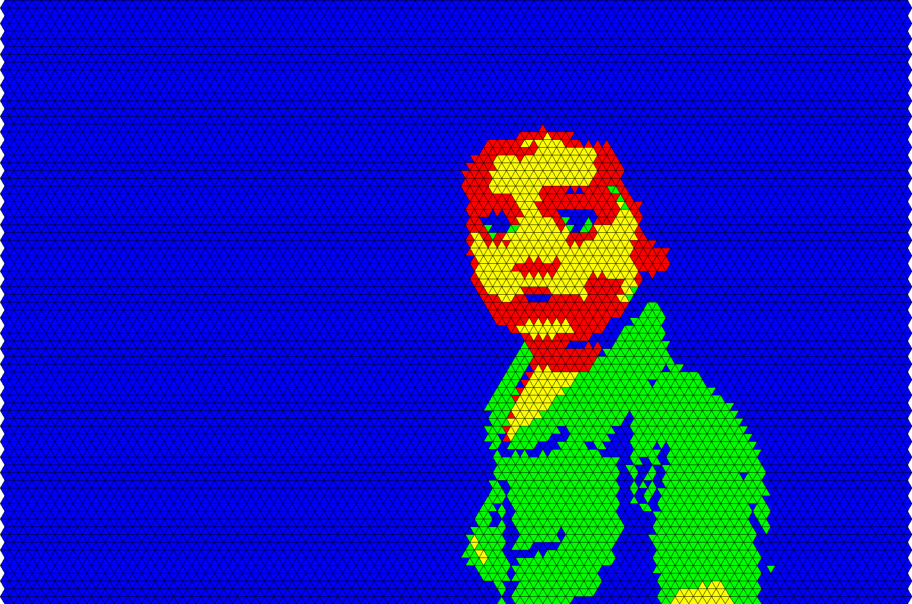
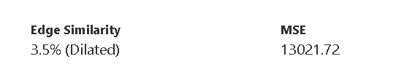
Results Obtained:

Slide 17

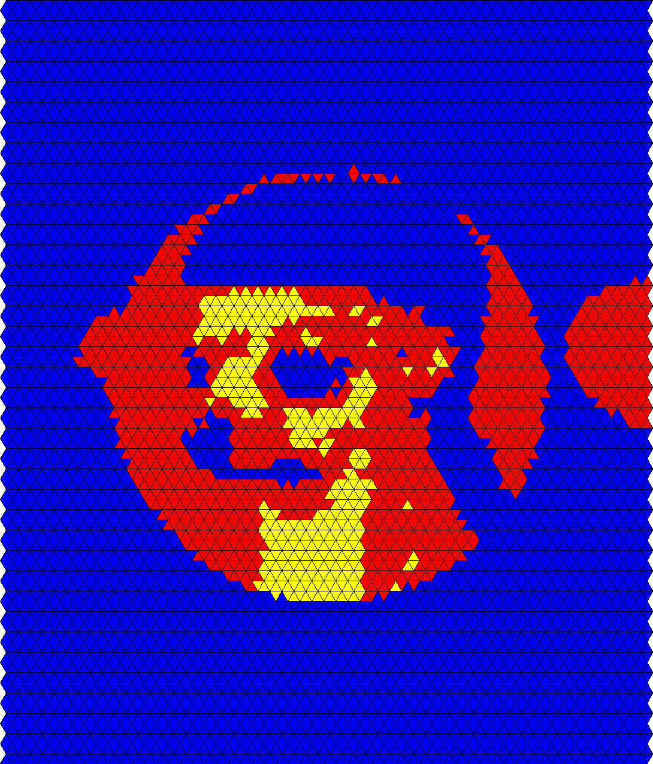
Results Obtained:

Slide 18
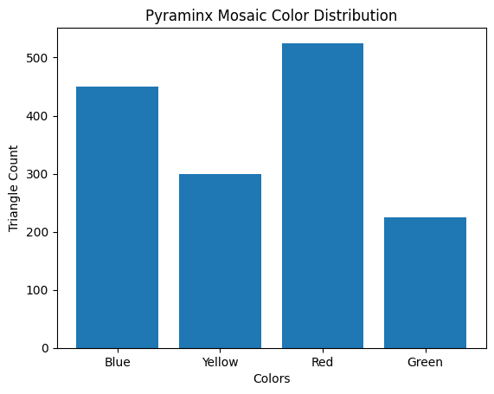
Result analysis with charts:
Total Triangle Count: 1,500 triangles (450 + 300 + 525 + v 225).
X-Axis : colors
Y-Axis : Triangle count

Slide 19
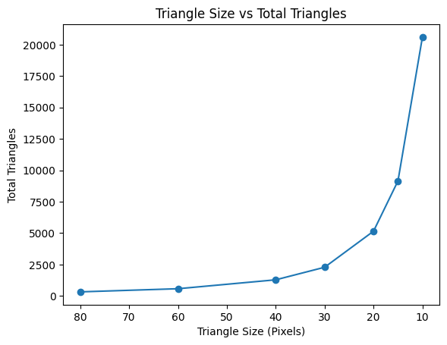
Result analysis with charts:
The relationship between Triangle Size (X-axis) and Total s Pyraminx Units (Y-axis).

Slide 20
Conclusion and Future work:
the gap between digital design and physical construction, allowing artists to manage the assembly of hundreds of puzzles
The project successfully demonstrates that high-fidelity mosaic art is possible under extreme constraints by utilizing CIEDE2000 perceptual color science and 70/30 edge-aware sampling, ensuring that the soul and structural integrity of an image are preserved even when reduced to a 4-color triangular grid.
Planned upgrades include implementing GPU acceleration to handle 4K image processing in real-time and integrating machine learning models to intelligently prioritize facial features and textures, further improving recognizability at very low resolutions.
Future versions will expand the system's modularity to support additional puzzle types, such as the standard 6-color Rubik’s Cube and the complex 12-color Megaminx, transforming the generator into a universal suite for all types of twisty-puzzle installations.

Slide 21
References:
[1] Doyle, L., Anderson, F., Choy, E., & Mould, D. “Automated pebble mosaic Stylization of images.” arXiv preprint arXiv : 1902.02806 (2019).
[2] Zeng, D.-X., Li, M., Wang, J.-J., Hou, Y.-L., Lu, W.-J., & Huang, Z. “Overview of Rubik’s Cube and Reflections on Its Application in Mechanism.” Chin. J. Mech. Eng. 31, 77 (2018).
[3] Mazaika Photomosaic Software, 2018. Available at: http://www.mazaika.com/
[4] He, Y., Zhou, J., & Yuen, S. Y. “ composing photomosaic images using clustering-based evolutionary programming . “ arXiv preprint arXiv:1804.02827 (2018) .
[5] N. Nachev, U. Bergmann, and C. Seward, “GANosaic: Mosaic creation with generative texture manifolds,” in Proceedings of the 31st Conference on Neural Information Processing Systems (NIPS) – Workshop on Machine Learning for Creativity and Design, 2017.

Slide 22
References:
[6] Jetchev, N., Bergmann, U., & Seward, C. “GANosaic: Mosaic Creation with Generative Texture Manifolds.” 31st Conference on Neural Information processing systems (NIPS) , working on machine learing for creativity and Design (2017) .

Slide 23
Thank You

