Slide 1


Anti-MRSA compounds toxicity screen
Alexandra Vaideanu, Ireno Demmangngewa, Andreas Schatzlein
2021/02/19

Slide 2
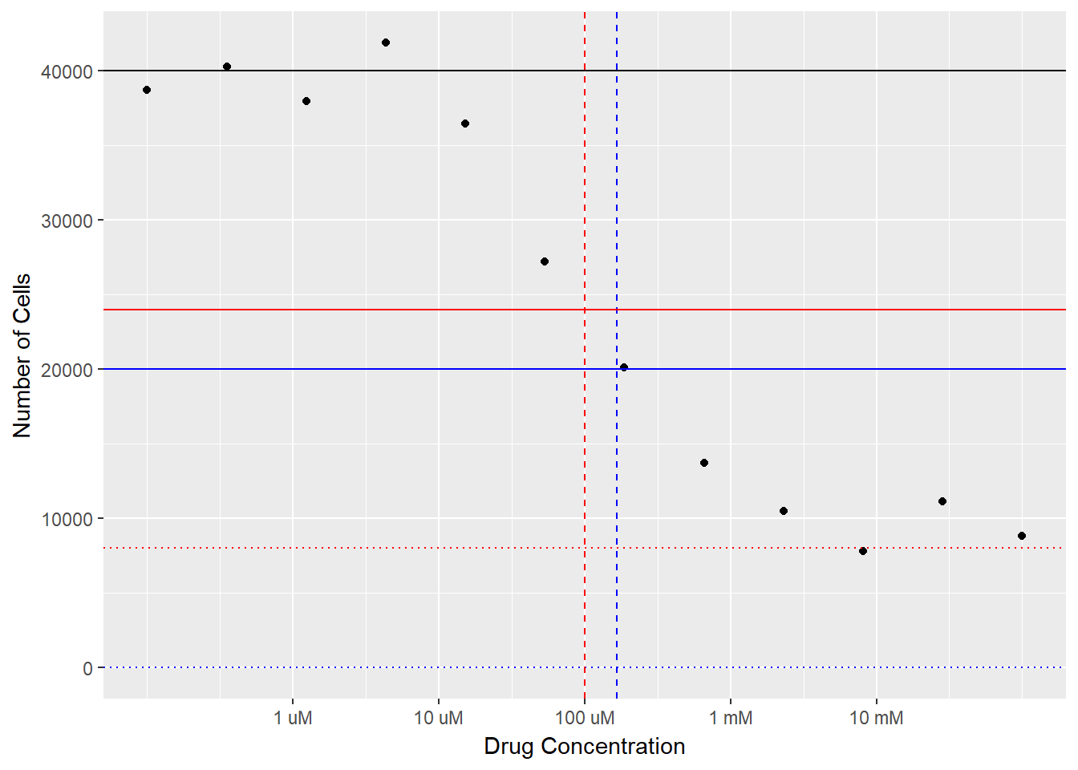
Dose-response curves
Plot concentration vs. response and fit a dose-response curve
4-parameter logistic model: y = A1 + (A2-A1)/(1 + 10^((LOGx0-x)*p)); parameters: maximum effect, minimum effect, EC50 and Hill slope
EC50 – 50% of measured effect corresponding concentration
CC50 = IC50 = concentration at which viability is reduced to 50%
Compounds dosed from 32ug/mL, dilution factor 2, 10 points
MIN
EC50
IC50
MAX
HILL SLOPE

Slide 3
Tamoxifen
EC50 11.12137 ± 0.4405 ug/mL
CC50 = IC50 11.03052 ug/mL
CO-ADD 9 ± 2 ug/mL

Slide 4
821
EC50 0.69652 ± 0.22329 ug/mL
CC50 = IC50 1.65386 ug/mL

Slide 5
822
EC50 1.0829 ± 0.34209 ug/mL
CC50 = IC50 2.86962 ug/mL

Slide 6
861
EC50 7.00751 ug/mL
Failed fit
CC50 = IC50 = N/A

Slide 7
862
EC50 4.75561 ± 2.1107 ug/mL
CC50 = IC50 = N/A

Slide 8
865
EC50 1.38599 ± 0.17519 ug/mL
CC50 = IC50 = 2.07449 ug/mL

Slide 9
869
EC50 3.10563 ± 0.80952 ug/mL
CC50 = IC50 = 13.74394 ug/mL

Slide 10
870
EC50 1.70693 ± 0.24024 ug/mL
CC50 = IC50 = 3.55117 ug/mL

Slide 11
871
EC50 1.96125 ± 0.61153 ug/mL
CC50 = IC50 = 5.54007 ug/mL

Slide 12
Classification as per CO-ADD protocol
Compound | CC50 | CC50≤32 ug/mL | Dmax ≥ 50%
tamoxifen | 11.03052 | yes | 97.82251
821 | 1.65386 | yes | 83.94502
822 | 2.86962 | yes | 91.64497
861 | N/A | no | 38.97623
862 | N/A | no | 42.00368
865 | 2.07449 | yes | 77.8972
869 | 13.74394 | yes | 61.12395
870 | 3.55117 | yes | 75.46579
871 | 5.54007 | yes | 74.52116

Slide 13
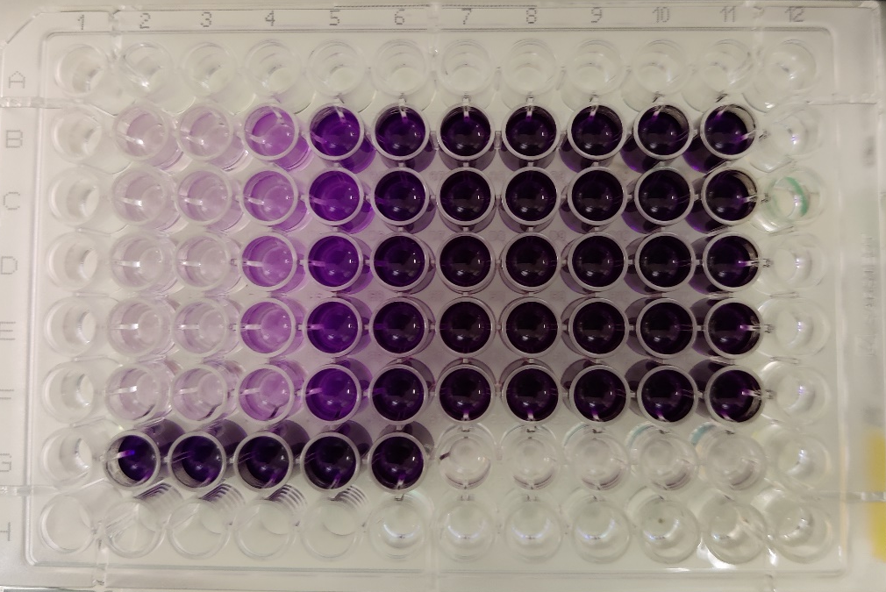
MTT vs. Resazurin
Reagents similar costs
Similar mechanism
Fluorescence more sensitive, more specialized equipment, black plates, more expensive; MTT visually easy to classify
Both reagents spectra could interfere with compounds abs/fluorescence (media phenol fluorescence)
For non-adherent cells such as HEK293 resazurin is more practical – less washing/removing steps; shorter period assays
EC50 20.32236 ± 3.41817 ug/mL
CC50 = IC50 = 19.74138 ug/mL
CO-ADD 9 ± 2 ug/mL

Slide 14
Further work
Quantify variability, more comprehensive statistical analysis, group by operator
Transfer analysis to R – reproducible (at least computationally)
Thank you Reno and thank you for listening!

