Slide 1

OSA Series 2:
Can we escape flatland?
NEU compounds came back potent despite having higher than usual Fsp3 for OSA series 2
That is rather exciting so let's get to looking!

Slide 2
Not so fast....
Enamine company has tons of novel and fun ways to get us out of flatland so lets look there.
However many of the reagents offered push prices of 120 USD per milligram!
So I looked elsewhere

Slide 3
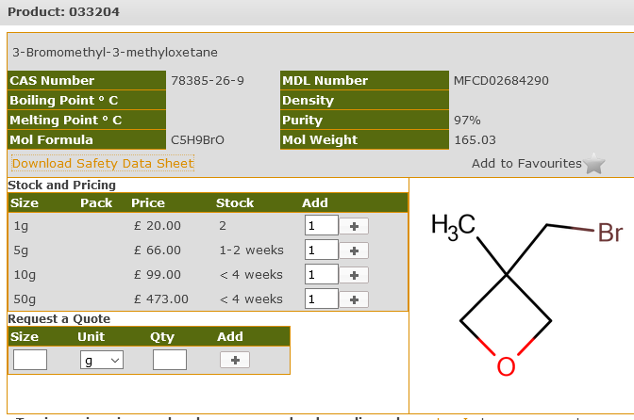
Fsp3 on the cheap and fast
Oxetanes have dropped in price in recent years so likely a good way to test things out:

Slide 4
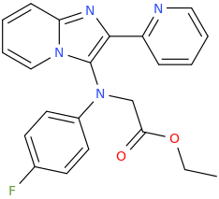
Ester prodrug?
Ethyl bromoacetate is a common lab reagent and should just attach to our N-spaced core (DMK 166-1) via normal nucleophilic substitution
Could then cleave ester with aqueous potassium carbonate or send compound for eval as ethyl ester prodrug

Slide 5
Insights from a related class
Mat found a paper that said that 7-methyl imidazo[1,2-a]pyridine compounds shown to have anti kinetoplastid activity
(10.1039/D0MD00353K)
Most potent compound had a cyclopentylamine substituent

Slide 6
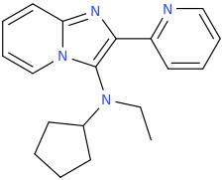
Cyclopentyl isonitrile is easily made from cyclopentylamine

