Slide 1
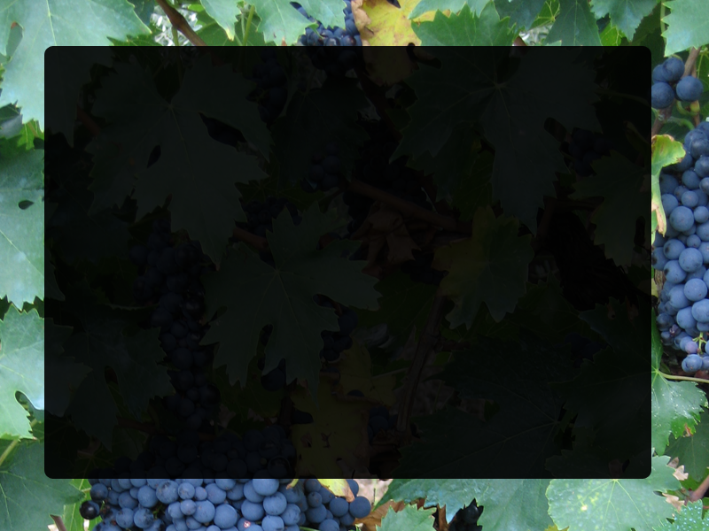
Proposed OSA S2 compounds
October 2020
Anthony “Mandrake” Sama
(I used grapes as the background because MRSA is described as grape clusters under a SEM)

Slide 2
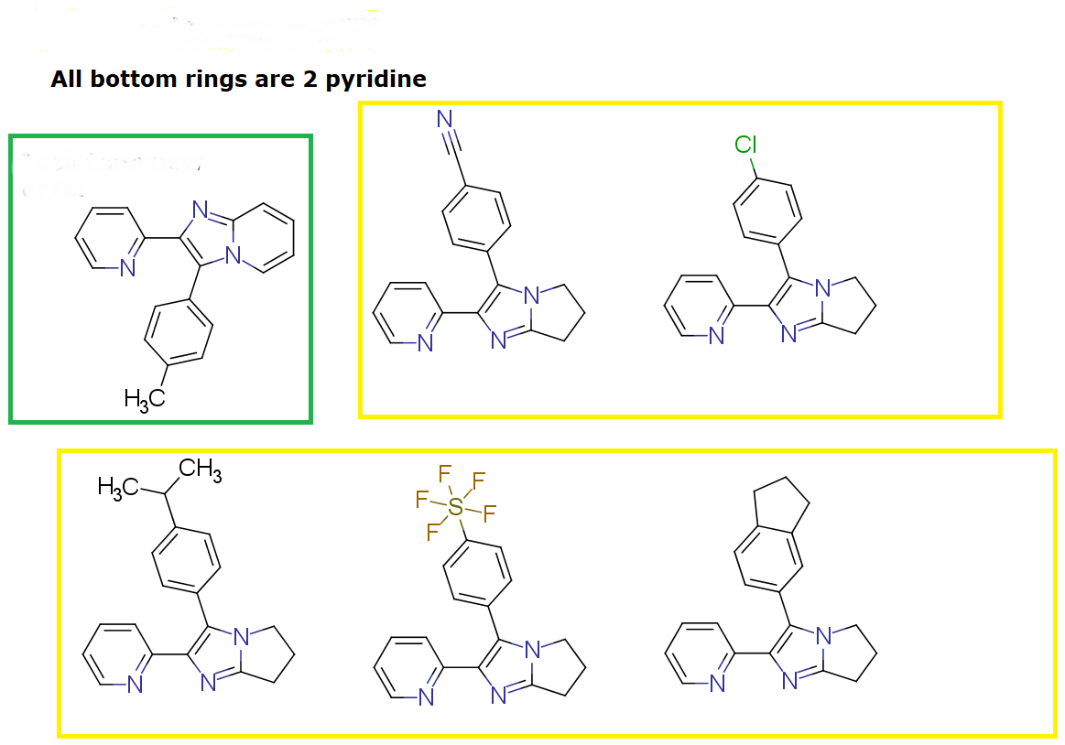
Group one (exploration of para substituents)

Slide 3
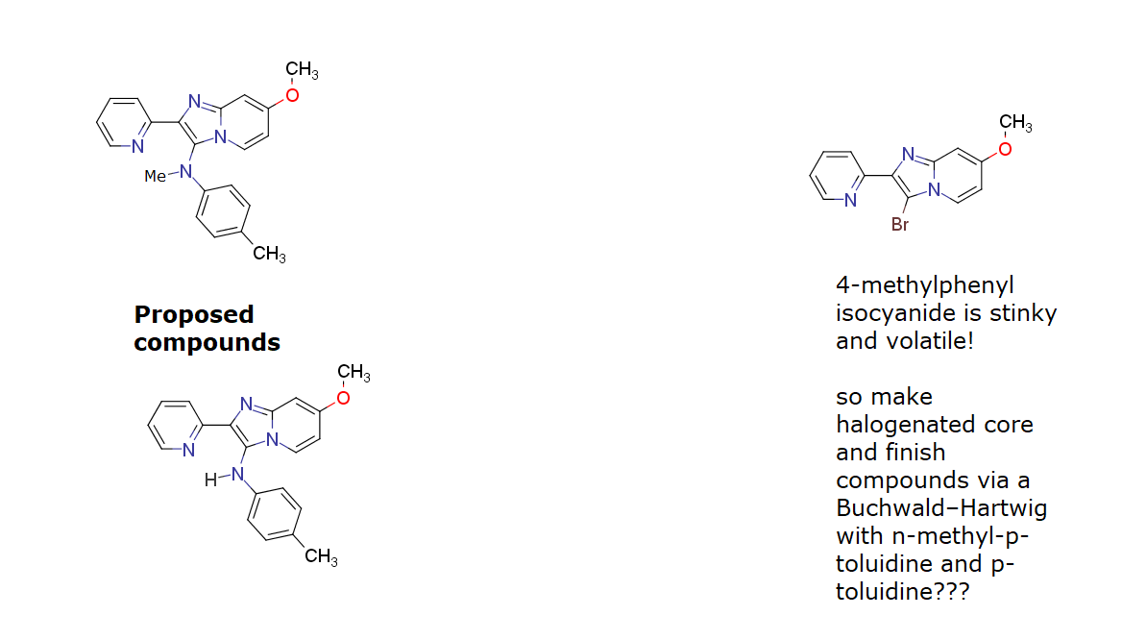
Group 2 (hybrid of Ben and Dana's compounds)

Slide 4
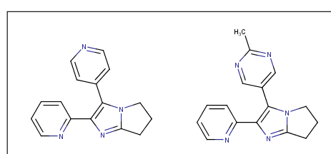
Group 3 (Misc)

