Slide 1

Linux Workshop
“DUDE, who broke my Linux server???”
Please take a seat and introduce yourself to your team.
We will start breaking things shortly!
Notes:
Good morning! We’ll just give you a few more minutes to get settled and we’ll start
1

Slide 2
Disclaimer
This Workshop are designed to test skills through light-hearted but realistic situations.
Names, characters, businesses, places, events and incidents are used in a fictitious manner. Any resemblance to actual persons, living or dead, or actual events is purely coincidental and unintentional.
If you have completed this scenario before, by staying in the room you are legally obligated to not ruin the fun for others
Notes:
Hello! Good morning. Welcome to Gameday.
The characters and themes are fictitious!
GameDay is a learning exercise designed to better familiarize players with the AWS environment and challenge them to come up with ways to solve problems based on the AWS resources they have available to them. We focus on putting participants into ambiguous situations and seeing what they can come up with. The path that GameDay participants take is open ended and therefore offers an opportunity to learn about AWS best practices, new AWS services, and AWS architecture patterns in a risk free environment.
EMBRACE THE AMBIGUITY
We are purposely not giving you a lot of information to start the day out.
Embrace this. See what new things you can learn either on your own or from your teammates. Ask questions, try new things, work with people you’ve never worked with before.
2

Slide 3
Meet your Coaches/Neckbeards
Ryan Price
Justin DeBo
Ryan Gass
Notes:
These folks will be available to hop into rooms and provide cheat codes (I mean assistance)
3

Slide 4

New Hire Orientation
Notes:
4

Slide 5
Agenda
Checkpoint 2
Welcome!
Food
>
!
&
Break (Ya Right)
*
^
}
Kickoff
Checkpoint 1
Wrap Up
Notes:
It is a big day, so let’s go through this quickly.
5

Slide 6
Why Linux?
The overwhelming majority of production workloads run on some flavor of Linux
CLI commands & shell scripts are already a part of your everyday life as a developer, and you will be a better developer for embracing them
Having a better understanding of an OS significantly improves your ability to debug your own software
Eerily similar to the UNIX OS many of you use every day
One million other reasons that none of us have time for today
Notes:
Hello! Good morning. Welcome to Gameday.
The characters and themes are fictitious!
GameDay is a learning exercise designed to better familiarize players with the AWS environment and challenge them to come up with ways to solve problems based on the AWS resources they have available to them. We focus on putting participants into ambiguous situations and seeing what they can come up with. The path that GameDay participants take is open ended and therefore offers an opportunity to learn about AWS best practices, new AWS services, and AWS architecture patterns in a risk free environment.
EMBRACE THE AMBIGUITY
We are purposely not giving you a lot of information to start the day out.
Embrace this. See what new things you can learn either on your own or from your teammates. Ask questions, try new things, work with people you’ve never worked with before.
6

Slide 7

Technical overview
Notes:
Well, I guess our CEO had something very important to handle.
My name is Danny, I’m on the DevOps team at Unicorn Rentals, or was until the recent layoffs.
Unfortunately I was let go, but the last task of my severence package is to train you up on Unicorn.Rentals infrastructure so you can begin work.
We have an application that we built, and we spent hours upon hours preparing a diagram which demonstrates its capabilities, services used, and functionality.
7

Slide 8
Technical Overview
SSH
Your Laptop
Your Team’s Server
Notes:
This is the diagram we came up with, and we’re really proud of it. You should feel pretty confident and ready to hit the ground running.
We have a client application and they talk to servers on the cloud.
There is a runbook as well which contains everything you need to know. We recently found it propping up one of the legs of the foosball table in the common area, but we are sure it’s still up-to-date.
Be vague.
8

Slide 9
Technical Overview
Connect to your team’s Linux Server via your preferred SSH tooling
  Windows: Putty, Git Bash
  Mac: Terminal
  Linux, WSL: Also terminal
Notes:
This is the diagram we came up with, and we’re really proud of it. You should feel pretty confident and ready to hit the ground running.
We have a client application and they talk to servers on the cloud.
There is a runbook as well which contains everything you need to know. We recently found it propping up one of the legs of the foosball table in the common area, but we are sure it’s still up-to-date.
Be vague.
9

Slide 10

Scoring points
Notes:
Welcome, everyone, to Unicorn Rentals, our hot new startup! You are here to support us as we take our application to the next level.
This is your new hire orientation and will be a very light introduction to our company’s culture and infrastructure.
We hope you enjoy your first day!
10

Slide 11
Scoring
Points will be awarded as players progress through the challenges
In this version of the workshop, all points monotonically increment over time once a challenge is completed
Keep an eye on the score board to monitor the scores!
Notes:
11

Slide 12
Scoring
Points will be awarded as players progress through the challenges
Some points will accrue statically, while others will increment (or decrement) as services continue to run successfully (or break)
Keep an eye on the score board to monitor scoring events
Notes:
12

Slide 13
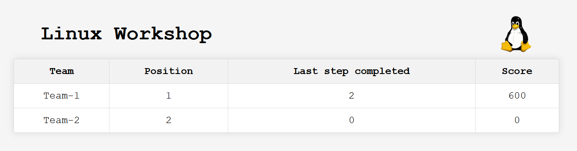
Score Dashboard
The score dashboard will be viewable on the main monitor throughout the event
Notes:
13

Slide 14

Participating
Notes:
Welcome, everyone, to Unicorn Rentals, our hot new startup! You are here to support us as we take our application to the next level.
This is your new hire orientation and will be a very light introduction to our company’s culture and infrastructure.
We hope you enjoy your first day!
14

Slide 15
Helpful commands
pwd
  Tells you what directory you’re currently in – don’t get lost!
tree .
  Pretty-prints a tree hierarchy of the directory you’re in. Helpful to show all files & folders under your current location
less <text_file>
  Opens a text file for reading (not editing). Quit by hitting “q”
[ nano | vim ] <text_file>
  Opens a file for reading and editing. nano is easier to use, vim is for tryhards.
Notes:
Speed: If you’re serving unicorns in 25 seconds, then something is wrong.
Traffic: We’re not actually GA yet, so we don’t anticipate much traffic, you never know though.
Costs: Want to minimize costs as your building out your infrastructure, if you spin up too many instances you’re going to be pay for it.
15

Slide 16
RTFM
Read the READMEs
  Instruction files (step_*.md) for each step will appear in your server's home directory (~) as previous steps are completed.
  Instructions will only provide guidance on WHAT needs to happen. Google/DuckDuckGo/StackOverflow can provide guidance on HOW it needs to happen
Notes:
Speed: If you’re serving unicorns in 25 seconds, then something is wrong.
Traffic: We’re not actually GA yet, so we don’t anticipate much traffic, you never know though.
Costs: Want to minimize costs as your building out your infrastructure, if you spin up too many instances you’re going to be pay for it.
16

Slide 17
Do
Use SSH to connect to instances
Try new things
Read the READMEs
Get help when you need it!
Don’t
Get disheartened – we’re all here to have fun & learn!
Eat the last bit of food
Try to break the game… yet
Notes:
Speed: If you’re serving unicorns in 25 seconds, then something is wrong.
Traffic: We’re not actually GA yet, so we don’t anticipate much traffic, you never know though.
Costs: Want to minimize costs as your building out your infrastructure, if you spin up too many instances you’re going to be pay for it.
17

Slide 18

The coaches should have given you your server’s address.
So now, SSH to your server and get started!
Username: appuser
Password: appuser
Port: 2332
Good luck!
Notes:
Hashes are handed out, operator starts game.
18

