Slide 1
GIT @ OSAA
GIT for beginners
Especially the OSAA.LASER crew.

Slide 2
Why GIT?
Distributed in stead of centralized =>
Crazy-fast most operations are local
Easy to delegate responsibility.
Disconnected operation is default and easy.
Merging is much easier and works a lot better than just about any other system.
Easy to give everybody read access and pull changes from those that have contributions.

Slide 3
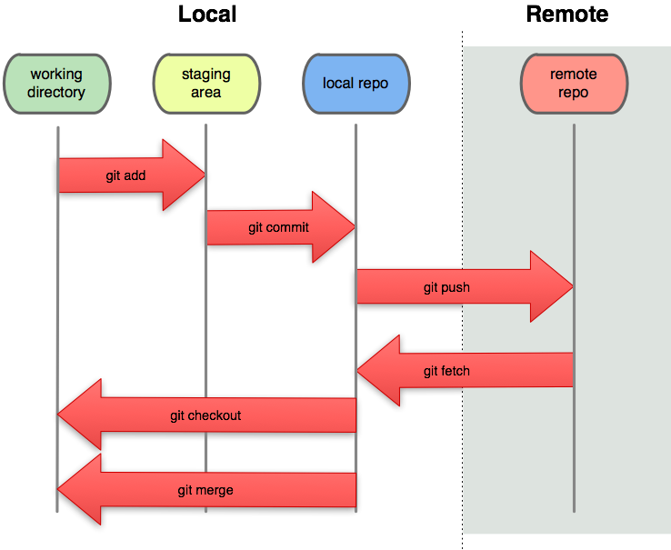
GIT workflow

Slide 4
And now: A demo
Run:
git clone git@github.com:dren-dk/OSAA.LASER.git
Fix a bug, commit, tig, push
... Profit!

Slide 5
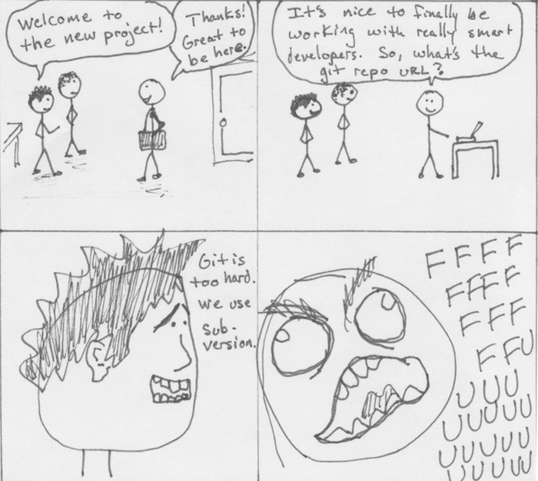
GIT isn't hard

Slide 6
RTFM
Svn users: http://git.or.cz/course/svn.html
Everybody: http://gitready.com/
Heathens: http://whygitisbetterthanx.com/

