Slide 1


Input for Deployment Options update to docs.starlingx.io

Slide 2
Deployment Options – Glossary
Controller Node / Function
Runs Cloud Control Functions for managing Cloud Resources,
Runs all OpenStack Control Functions; e.g for managing Images, virtual Volumes, Virtual Networks and Virtual Machines,
Can be part of a 2-node HA Control Node Cluster for running Control Functions either Active/Active or Active/Standby.
Compute ( & Network ) Node / Function
Hosts Applications in Virtual Machines using Compute Resources (CPU, Memory & Disk),
Runs Virtual Switch for realizing virtual networks,
Provides L3 Routing and NAT Services.
Storage Node / Function
Contains a set of Disks (SATA, SAS, SSD and.or NVME),
Runs CEPH Distributed Storage Software,
Part of a HA multi-node CEPH Storage Cluster supporting a replication factor of 2 or 3, Journal Caching and Class Tiering,
Provides HA Persistent Storage for Images, Virtual Volumes (Block Storage) and Object Storage.
All-In-One Controller Node
A single physical node which provides a Controller Function, Compute Function and Storage Function.
L2 Switches and L2 Networks
Physical L2 Switches are not shown in Deployment Diagrams; only the L2 networks they realize are shown,
A single physical switch may realize multiple L2 networks.
OAM Network (Controller Nodes Only)
The network on which all external StarlingX Platform APIs are exposed,
i.e. REST APIs, Web Server (Horizon), SSH, SNMP.
Typically 1GE
Management Network (All Nodes)
A private network (i.e. not connected externally) used for
Internal OpenStack / StarlingX monitoring and control, and
VM I/O access to storage cluster.
Typically 10GE
Data Network(s) (Compute & AIO Nodes Only)
Networks on which the OpenStack / Neutron Provider Networks are realized, and
subsequently the VM Tenant Networks.
IPMI Network (All Nodes)
An optional network on which IPMI interfaces of all nodes are connected,
It must be L3/IP reachable from the controller’s OAM Interfaces.
PxeBoot Network (All Nodes)
( not shown in diagrams to reduce clutter )
An optional network for controllers to network boot other nodes over;
by default, controllers network boot other nodes over the management network,
This network is required for a variety of special case situations
management network must be ipv6 for some reason,
ipv6 does NOT support pxeboot, therefore ipv4 pxeboot network must be configured
management network must be vlan tagged for some reason,
most server’s bios do not support pxebooting over tagged network, therefore an untagged pxeboot network must be configured,
management network must be shared across regions
but individual regions’ controllers want to only network boot nodes of their own region, therefore separate per-region pxeboot networks must be configured
Infra Network (All Nodes)
( not shown in diagrams as this is deprecated )
A deprecated optional network that was historically used for access to the storage cluster.
Node Interfaces
All Nodes’ Network Interfaces in Deployment Diagrams can, in general, optionally be either:
Untagged single port,
Untagged two port LAG,
Optionally split between redundant L2 Switches.
VLAN on either single port or two port LAG.

Slide 3

All-In-One – Simplex
Cloud Owner’s OAM Network
Public Network
data network(s)
controller-0 < compute > < storage >
oam network
Cloud Owner’s IPMI Network
See Notes
Notes:
A single physical server providing all 3x Cloud Functions (Controller, Compute and Storage),
Provides no protection against an overall server hardware fault,
i.e. there may be hardware component protection if, for example, HW RAID or 2x Port LAG is used in the deployment.
Provides a solution where only a small amount of Cloud Processing / Storage power is required, and protection against overall server hardware faults is either not required or done at a higher level,
Provides a solution where cloud technologies can be used to deploy and consolidate multiple diverse Application types onto a single physical server. e.g.
consolidating legacy applications that must run standalone on a server by using multiple virtual machines on a single physical server,
consolidating legacy applications that run on different Operating Systems or different distributions of Operating Systems or different versions of Operating Systems by using multiple virtual machines on a single physical server.

Slide 4
All-In-One – Duplex
Cloud Owner’s OAM Network
Public Network
data network(s)
controller-0 < compute > < storage >
oam network
controller-1 < compute > < storage >
management network
Cloud Owner’s IPMI Network
See Notes
Notes:
Two physical servers; both running all 3x Cloud Functions (Controller, Compute and Storage),
HA Services run on the Controller Function across the two physical servers in either Active/Active or Active/Standby mode,
Storage Function runs on top of LVM on single second disk, DRBD-sync’d between servers,
Virtual Machines are scheduled on both Compute Functions,
On overall server hardware fault,
all Controller HA Services go Active on remaining healthy server,
all Virtual Machines are recovered on remaining healthy server.
Provides a solution where only a small amount of Cloud Processing / Storage power is required, and protection against overall server hardware faults is required,
Provides a solution where cloud technologies can be used to deploy and consolidate multiple diverse Application types onto a protected pair of physical servers. e.g.
consolidating legacy applications that must run standalone on a server by using multiple virtual machines on a single pair of physical servers,
consolidating legacy applications that run on different Operating Systems or different distributions of Operating Systems or different versions of Operating Systems by using multiple virtual machines on a single pair of physical servers.

Slide 5
All-In-One – Duplex + up to 4 Computes
Cloud Owner’s OAM Network
Public Network
data network(s)
compute-0
controller-0 < compute > < storage >
compute-1
oam network
...
controller-1 < compute > < storage >
compute-3
management network
Cloud Owner’s IPMI Network
See Notes
Notes:
Extending the Capacity of the AIO-Duplex Deployment
Up to 4x Compute Nodes can be added to the AIO-Duplex Deployment
limited to 4x Compute Nodes as the Controller Function on the AIO Controllers has only a portion of the processing power of the overall server
Virtual Machines can be scheduled on either of the AIO Controller Nodes and/or the Compute Nodes,
Allows a capacity growth path for someone starting with an AIO-Duplex deployment.

Slide 6
Small Standard
Cloud Owner’s OAM Network
Public Network
data network(s)
compute-0
controller-0 < storage >
compute-1
oam network
...
controller-1 < storage >
compute-7
management network
Cloud Owner’s IPMI Network
See Notes
Notes:
A 2x Node HA Controller / Storage Cluster managing a small (up to 7) pool of Compute Nodes,
the limit on the size of the Compute Node Pool is due to the capacity of the Storage Function in this deployment option,
this deployment option does provide a growth path to the full Standard solution with an independent CEPH Storage Cluster.
The 2x Node HA Controller / Storage Cluster:
HA Services run across the Controller Nodes in either Active/Active or Active/Standby mode,
Storage Function runs on top of LVM on single second disk, DRBD-sync’d between Control Nodes,
On overall Controller Node failure, all Controller HA Services go Active on remaining healthy Controller Node,
On overall Compute Node failure, Virtual Machines on failed Compute Node are recovered on remaining healthy Compute Nodes,

Slide 7
Standard
Cloud Owner’s OAM Network
Public Network
data network(s)
compute-0
controller-0
storage-0
compute-1
oam network
...
storage-1
controller-1
...
compute-99
management network
Cloud Owner’s IPMI Network
See Notes
Notes:
The Standard Starlingx Deployment Option with independent Controller, Compute and Storage Nodes,
Provides the maximum capacity for a single region deployment,
a growth path is supported to a multi-region deployment option by adding a secondary region.
A 2x Node HA Controller Cluster, with HA Services running across the Controller Nodes in either Active/Active or Active/Standby mode,
A pool of up to 100 Compute Nodes for hosting virtual machines and virtual networks,
A 2-9x Node HA CEPH Storage Cluster for hosting virtual volumes, images and object storage
supports a replication factor of 2 or 3,
Storage Nodes are deployed in replication groups of 2 or 3, and replication of objects are done strictly within the replication group i.e.
up to 4 groups of 2x Storage Nodes
or
up to 3 groups of 3x Storage Nodes.

Slide 8
Standard with Bare Metal
Cloud Owner’s OAM Network
Public Network
data network(s)
ironic-provisioning-net
ironic-provisioning-net
compute-0
bare-metal-0
controller-0
bare-metal-1
storage-0
compute-1
oam network
...
...
storage-1
controller-1
...
compute-99
bare-metal-N
management network
Cloud Owner’s IPMI Network
See Notes
Notes:
End User Applications can be deployed on Bare Metal Servers (instead of Virtual Machines) by configuring OpenStack Ironic and deploying a pool of 1 or more Bare Metal Servers,
As part of configuring OpenStack Ironic in StarlingX
an ironic-provisioning-net tenant network must be identified as the boot network for Bare Metal nodes,
an additional untagged physical interface must be configured on Controller Nodes and connected to the ironic-provisioning-net tenant network. The OpenStack Ironic tftpboot server will PXE boot the Bare Metal Servers over this interface.
Bare Metal Servers are deployed as shown
they must be connected to IPMI for OpenStack Ironic control, and
they must have their untagged physical interface, over which they support PXE booting, connected to the ironic-provisioning-net tenant network.
NOTE
Bare Metal Servers are NOT running any OpenStack / StarlingX software; they are running end user applications (i.e. Glance Images),
Bare Metal Servers are NOT to be connected to the internal management network.

Slide 9

Public Network
Multi-Region
Cloud Owner’s OAM Network
Primary Region
shared services
data network(s)
glance
keystone
cinder
compute-0
controller-0
storage-0
compute-1
oam network
...
storage-1
controller-1
...
compute-99
management network
Secondary Region
Secondary Region
data network(s)
data network(s)
compute-0
compute-0
controller-0
storage-0
controller-0
compute-1
compute-1
oam network
...
storage-1
oam network
...
controller-1
...
controller-1
compute-99
compute-99
management network
management network
See Notes
Notes:
A Multi-Region Deployment consists of a Primary Region and 1-4 Secondary Regions all co-located locally,
enables increased cloud capacity over the single region’s 100 compute node limit,
An OpenStack Region == generally a full cloud deployment (Control, Compute [& Storage] Functions) but it may share some services with another Region,
Primary Region contains all services,
Secondary Region shares/uses Keystone Service in the Primary, and OPTIONALLY shares/uses Glance and Cinder Services in the Primary.
Horizon on the Primary Region can be used as a single point of management; using Horizon’s Region selection to switch between Region context,
NOTE that ALL Regions share the same L2 Management Network,
NOT shown in diagram, but ALL Regions must configure a separate PXE Boot Network for network booting their respective nodes,
The Primary Region must be a Standard Deployment,
Secondary Regions can be AIO-Duplex, AIO-Duplex + Computes, Small Standard or Standard Deployments.

Slide 10
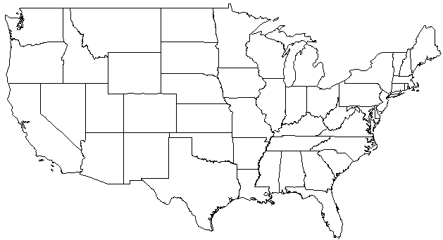
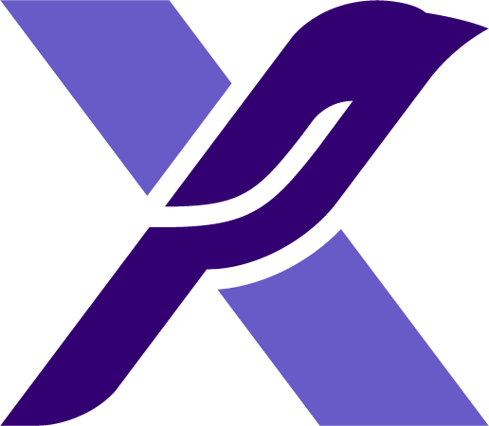
Public Network
Distributed Cloud
Cloud Owner’s OAM Network
Central Cloud
orchestrated services
data network(s)
synchronized services
shared services
stx-fault
stx-update
stx-distcloud
compute-0
glance
controller-0
cinder
storage-0
keystone
compute-1
oam network
...
storage-1
controller-1
...
compute-99
management network
Edge Cloud
data network(s)
Edge Cloud
Private L3 Network
data network(s)
compute-0
controller-0
storage-0
compute-0
compute-1
controller-0
oam network
...
storage-1
compute-1
controller-1
...
oam network
...
compute-99
controller-1
compute-99
management network
See Notes
management network
Notes:
A Distributed Cloud Deployment is a geographically dispersed multi-region deployment with additional orchestration and synchronization services across regions,
NOTE that the Management Networks of the Central Cloud and the Edge Clouds are separate L2 Networks but are connected via a Private L3 Network
Private is specified here because, in this initial release of Distribute Cloud, the inter-region communications over this network are not secured,
Keystone Services are synchronized from the Central Cloud across all Edge Clouds; providing common Identity Management across all Edge Clouds,
Edge Clouds’ Glance Services are partially shared but with caching, i.e.
Glance Images are generally managed at Central Cloud,
Edge Cloud Glance retrieves images from Central Cloud’s Glance, but caches the image such that the cached image can be used, without the latency of image transfer, on subsequent uses of that image,
Cinder is strictly an OPTIONAL shared service,
Horizon on the Central Cloud can be used as a single point of management; using Horizon’s Region selection to switch between Edge Cloud context,
StarlingX Orchestrated Services
stx-fault provides aggregated Edge Cloud Fault Data at the Central Cloud,
stx-update provides Patch Orchestration across all Edge Clouds, providing a single step to deploy a patch across all Edge Clouds and all Nodes in each Edge Cloud.
StarlingX Synchronization also provides some miscellaneous synchronization of Nova, Neutron and Cinder resources and quotas.

Slide 12
Title
First level
Second level
Third level
Fourth level

