Slide 1
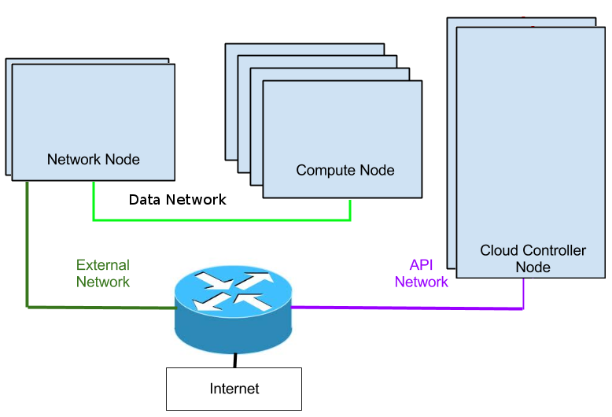
Management Network
mysql server
rabbitmq-server
nova-api
nova-scheduler
nova-conductor
keystone-all
neutron-server
glance-api
glance-registry
neutron-*-plugin-agent
neutron-l3-agent
neutron-dhcp-agent
nova-compute
neutron-*-plugin-agent

