Slide 1

Mapping Heritage in Ireland
Anne-Karoline Distel
(b-unicycling)

Slide 2
Short bio
Born in East Germany aka GDR
Keen interest in history and playing music
Moved to Ireland in Dec 2016
Member of Kilkenny Archaeological Society (KAS) in March 2017 – started mapping heritage features
Member of OSM Ireland since spring 2020

Slide 3
Mapping activity
Mapped heritage features like graveyards, castles, ringforts from satellite view
In more detail after visiting sites
Tried to use OSM or uMap whereever possible with KAS projects

Slide 4
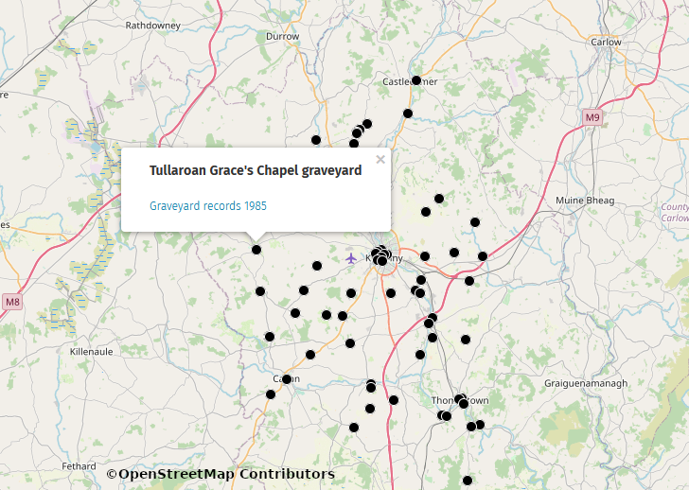
Graveyard Digitization Project
Locations of graveyards in Co. Kilkenny which
KAS holds records for

Slide 5
Fieldnames
> Used as a locating device by farmers before the age of mobile phones and GPS
contain information about crops grown (“Rye Field”), geological characteristics (“Stony Field”), ownership (“Purcell's Field), historical structures (“Chapel Field”) etc, often still in the Irish language

Slide 6
Fieldname collecting using OSM
went from farmhouse to farmhouse with a friend from KAS who introduced me
brought my laptop & asked farmers for their fieldnames
added fields and names there and then – could show farmers results immediately

Slide 7
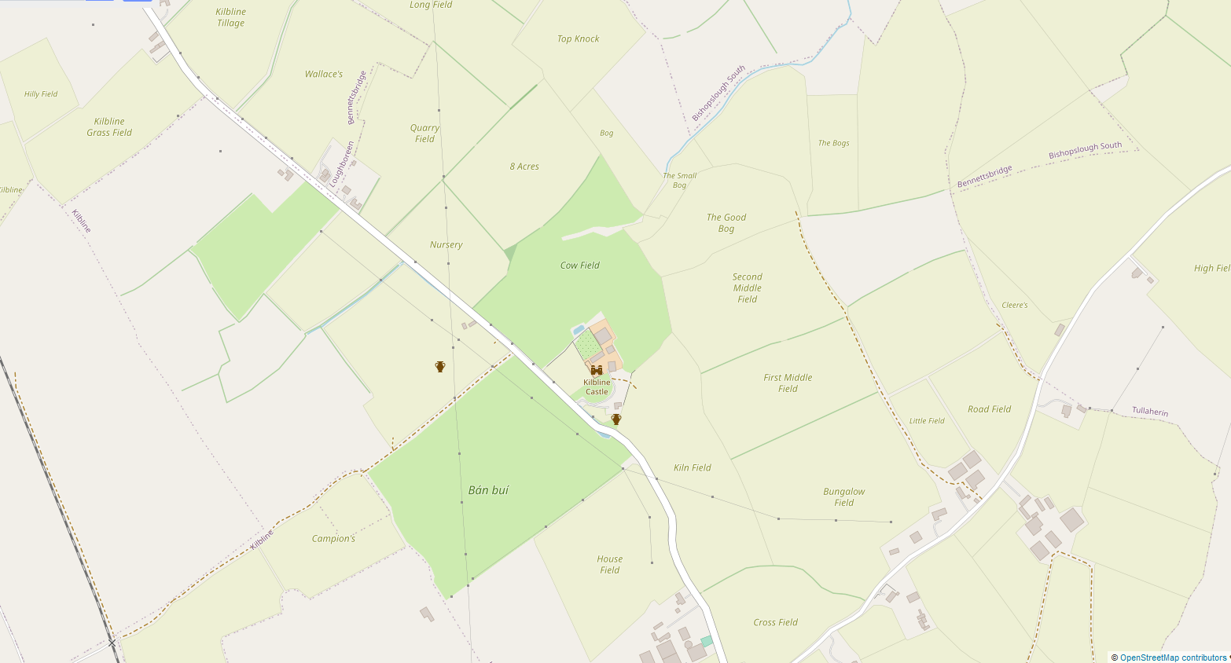
Fieldnames collected around Kilbline

Slide 8
And then came COVID...
COVID put stop to visiting people
Sent out fieldpapers to neighbouring farmers without much success, because they don't know me, don't know what OSM is etc.
Contacted another KAS member to ask for her fieldnames – very obliging and interested

Slide 9
A new mapper
Had made videos about collecting fieldnames using fieldpapers and uploaded to YouTube
Told her (in her late 60s?) about the videos
she taught herself OSM and fieldpapers using my tutorials
Has collected and is still collecting in her neighbourhood

Slide 10
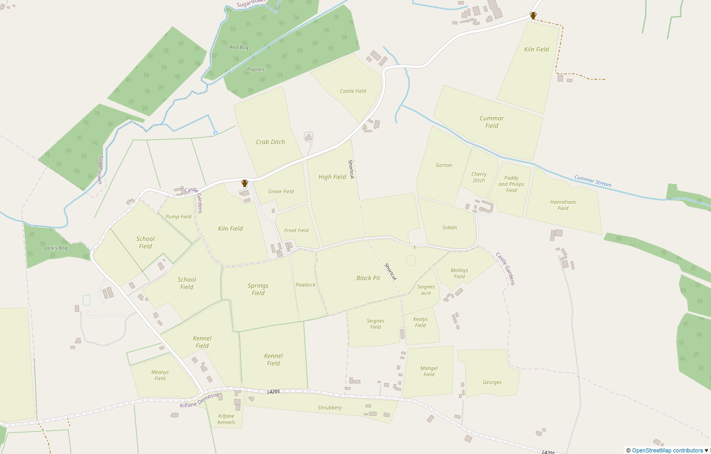
Some fieldnames collected by kkseakale

Slide 11
And another new mapper
Friend who had taken me to neighbouring farmers has started mapping as well after following my tutorials
Both female and 60+ - not your usual mapping demographic

Slide 12
YouTube tutorial series
Inspired and motivated, decided to start a series of YT tutorials for historically interested people in January 2021
  To keep myself and others busy during lockdown
  To get people in touch with their local heritage
  To promote OSM to a new audience

Slide 13
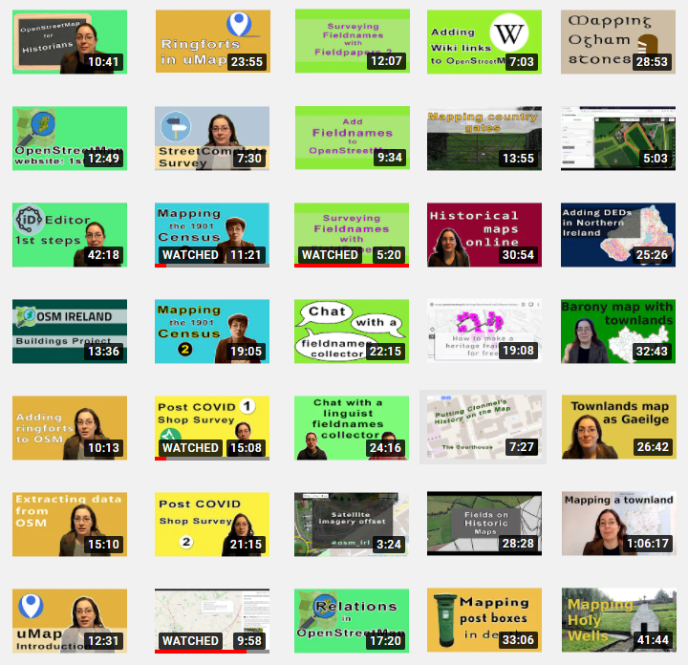

Slide 14
Topics
Generally, have to explain the concept of OpenData and OpenSource:
OSM
uMap (good way to introduce people to OSM without having to fear accidental vandalism)
overpass-turbo (to give examples for OpenData)
fieldpapers (enables surveying during lockdown)
mapillary

Slide 15
Tag proposals
Noticed lack of appropriate tags for certain heritage features
Some very specific for Ireland, others applicable in other European countries
Started proposals for new tags to enable mapping of things not mapped at all (guard stones) or to tidy up already mapped features (holy wells)

Slide 16
Facebook page
https://www.facebook.com/OSMForHistoryBuffs
created Facebook page to enable communication with (future) mappers, bc not everyone has a gmail account
Enable debate about proposed tags within a group of mappers that will use them (hopefully)
To enable sharing by individuals and historical societies

Slide 17
Feedback
Feedback from long standing mappers is good and encouraging.
The odd new mapper will report back and share their work or thoughts
Built up reputation within few weeks and now am expected to do more videos and proposals

Slide 18
In conclusion
Important to give concrete examples for use of OSM rather than talking about abtract ideas like OpenData and OpenSource.
Be relatable and approachable.
Still long way to go to spread the word about OSM within general public.

Slide 19
Thank you!
Danke vielmals &
Go raibh míle maith agaibh.

