Slide 1
Maperitive
Making Your Own Maps by Igor Brejc

Slide 2
Contents
Goals
Main features and capabilities
Challenges
Future plans
Experimental stuff

Slide 3
Maperitive & Me
Living in Maribor, Slovenia
Professional software developer
Long-running love for cartography
Joined OSM in 2007
OSM speciality: hiking

Slide 4
Why Maperitive?
Started as Srtm2Osm, Kosmos
Existing solutions (Mapnik, Osmarender) lacking simplicity of use, immediacy and interactivity
Wanted to have my own project to play with
Kosmos needed a total overhaul (including a more googleable name)

Slide 5
Goals For Maperitive
Simple to use...
… and yet powerful enough...
… to produce professional-looking maps
Single-stop shop for making OSM maps
Things should work out of the box
  Convention over configuration

Slide 6
Main Features
Rendering rules (special DSL)
Embedded command-line interface
  Scripting
Web maps integration (browser-like)
Integration with SRTM + custom DEMs
  Contours, hillshading, hypsometric coloring
Web map tiles generator
Exporting to bitmap and SVG

Slide 7
Rendering Rules
Specify features (what to render?)
boundary country : boundary=administrative
AND (admin_level=2 OR admin_level=4)
AND NOT natural=coastline
Specify rules (how to render?)
target : aeroway line*
define
min-zoom : 9
line-color : #9D9595
if : aeroway line runway
define
line-width : 9:1;10:1;11:2;13:6;15:20
else
define
line-width : 9:1;11:1;13:3;15:10
draw : line

Slide 8
Commands And Scripts
Everything is available through the command line
Common functions also through the GUI
81 commands currently available
clear-map
set-setting name=map.decoration.grid value=False
use-script-dir
use-ruleset location=dublin.mrules
load-source Dublin.osm.bz2
bounds-set -6.65831251676464,53.3270920303852,
-6.3469551584,53.5082149
export-svg file=extra\Dublin-NW-illustrator.svg
zoom=16 compatibility=illustrator
ai-autorescale=true

Slide 9
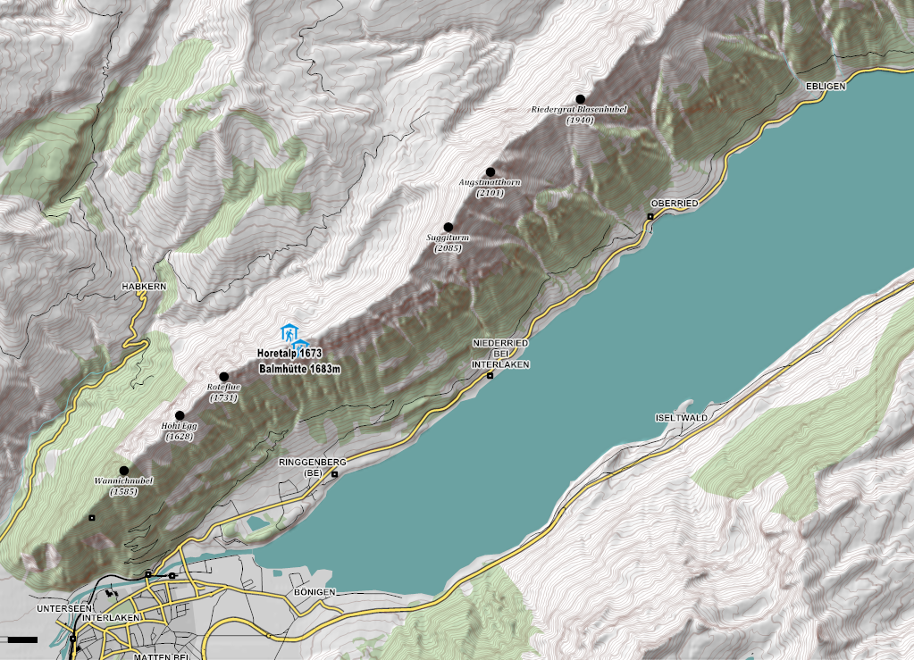

Slide 10
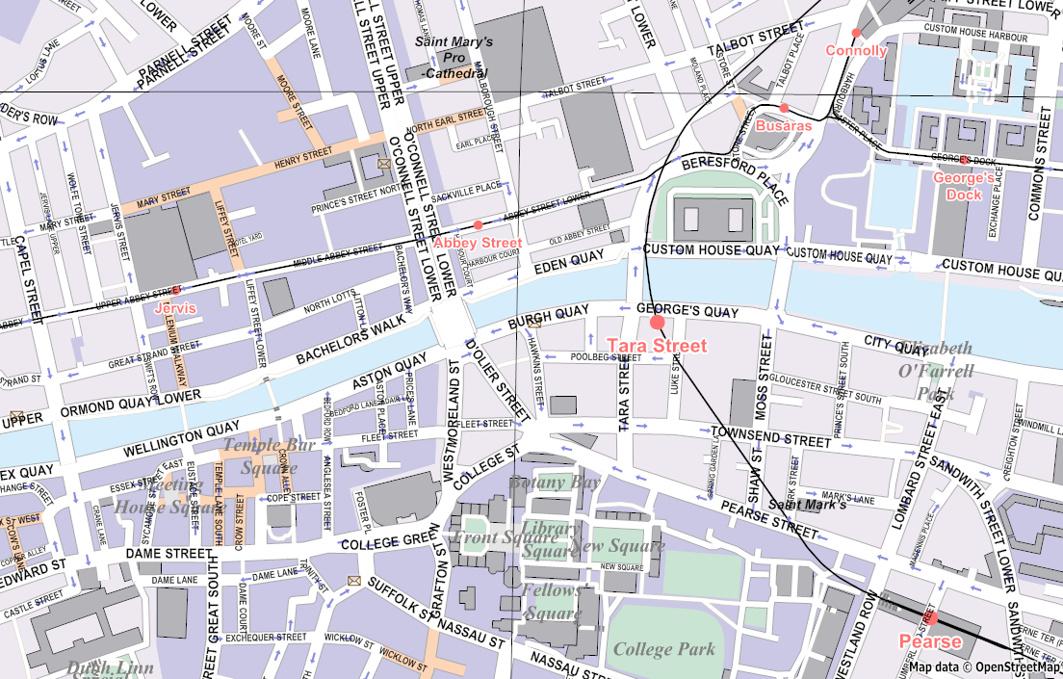

Slide 11
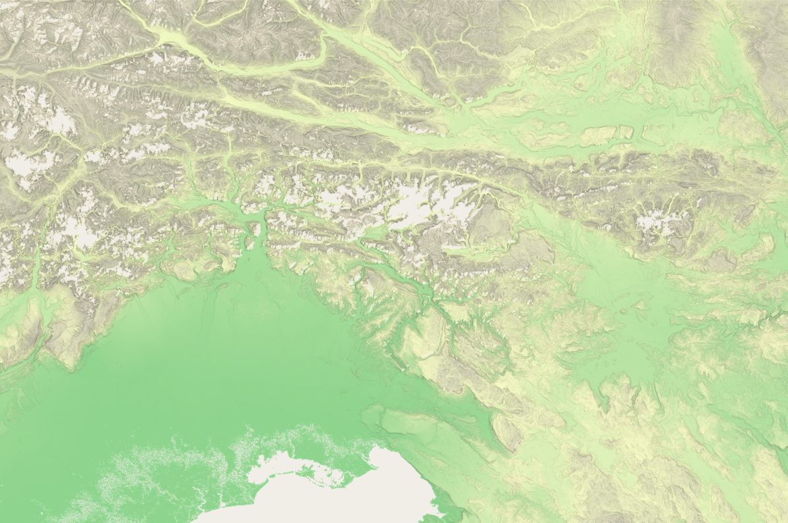

Slide 12
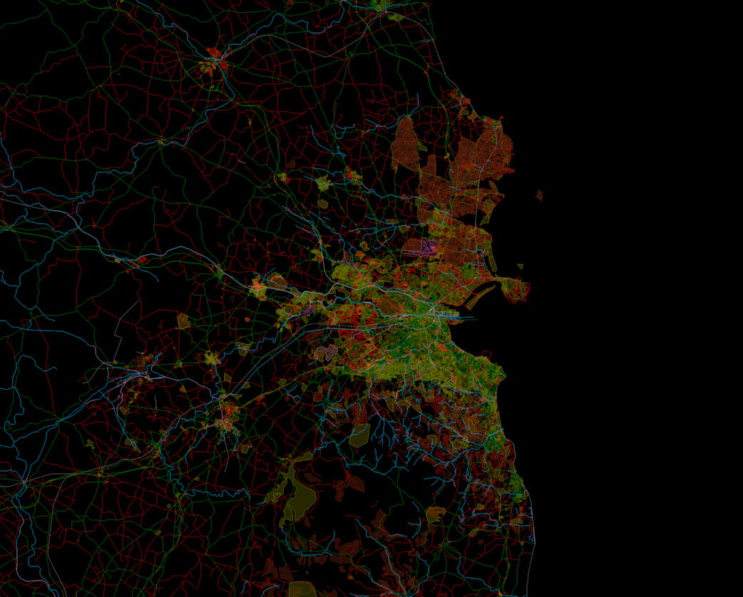

Slide 13
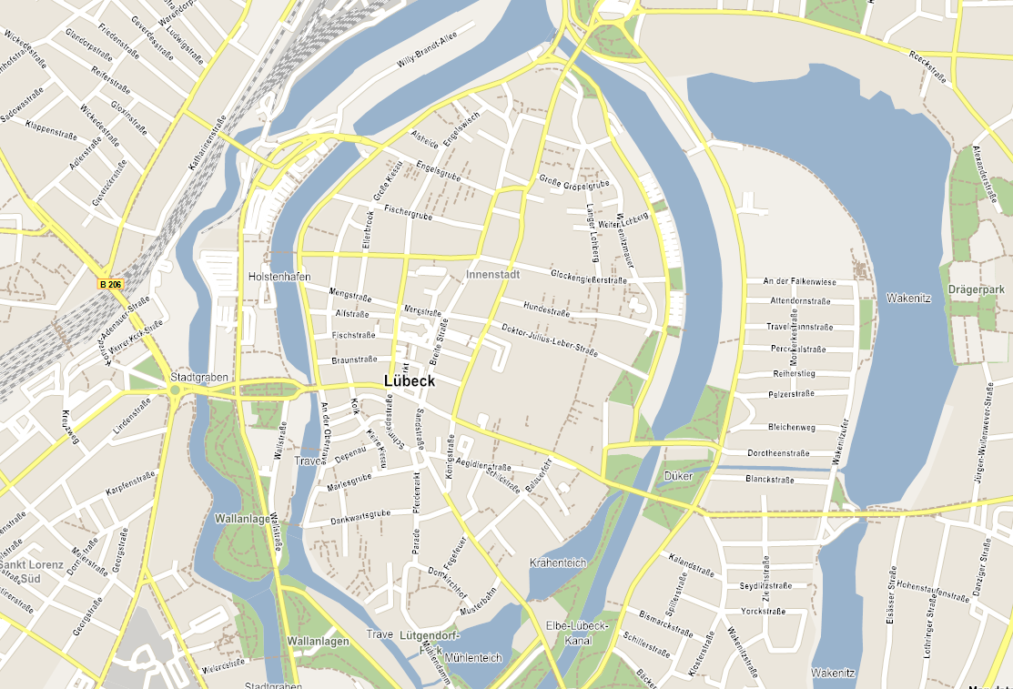

Slide 14
Challenges & Future Plans
Interactivity vs quality vs quantity
  Render quickly
  Render with quality
  Render big maps with lot of data
Database support (PostGIS, spatialite)
Using Direct2D for rendering

Slide 15
Challenges & Future Plans
How to extract info from data?
Poor support for OSM relations
OSM data is raw data – it needs preprocessing before rendering
Example: bus route relations
  Multiple ways in a relation
  Multiple relations in a way
  Rendering a bus map without loss of information
Example: OSM Mapnik map & transparent boundaries
  Inconsistent rendering because several admin levels are rendered separately one atop the other

Slide 16
Challenges & Future Plans
Possible solutions:
Transforming raw OSM data into more advanced data structures (like networks, graphs)
More advanced toolset for data analysis and synthesis
Perhaps even a new file storage format for these transformations
  Or storing it into DB
Python for scripting
Extensibility (plug-ins)

Slide 17
Challenges & Future Plans
Map labeling improvements
  Detecting overlaps, duplicates
  Repeating labels for long streets
  Abbreviations
Support for shapefiles, GeoTIFFs
Other projections, rotating the map
Headless mode – no GUI
Multi-core tiles generation
Maperitive Remote – REST WS
GUI improvements
Map drawing editor?

Slide 18
Experimental
3D map export in COLLADA format
Export to RaphaelJS

Slide 19
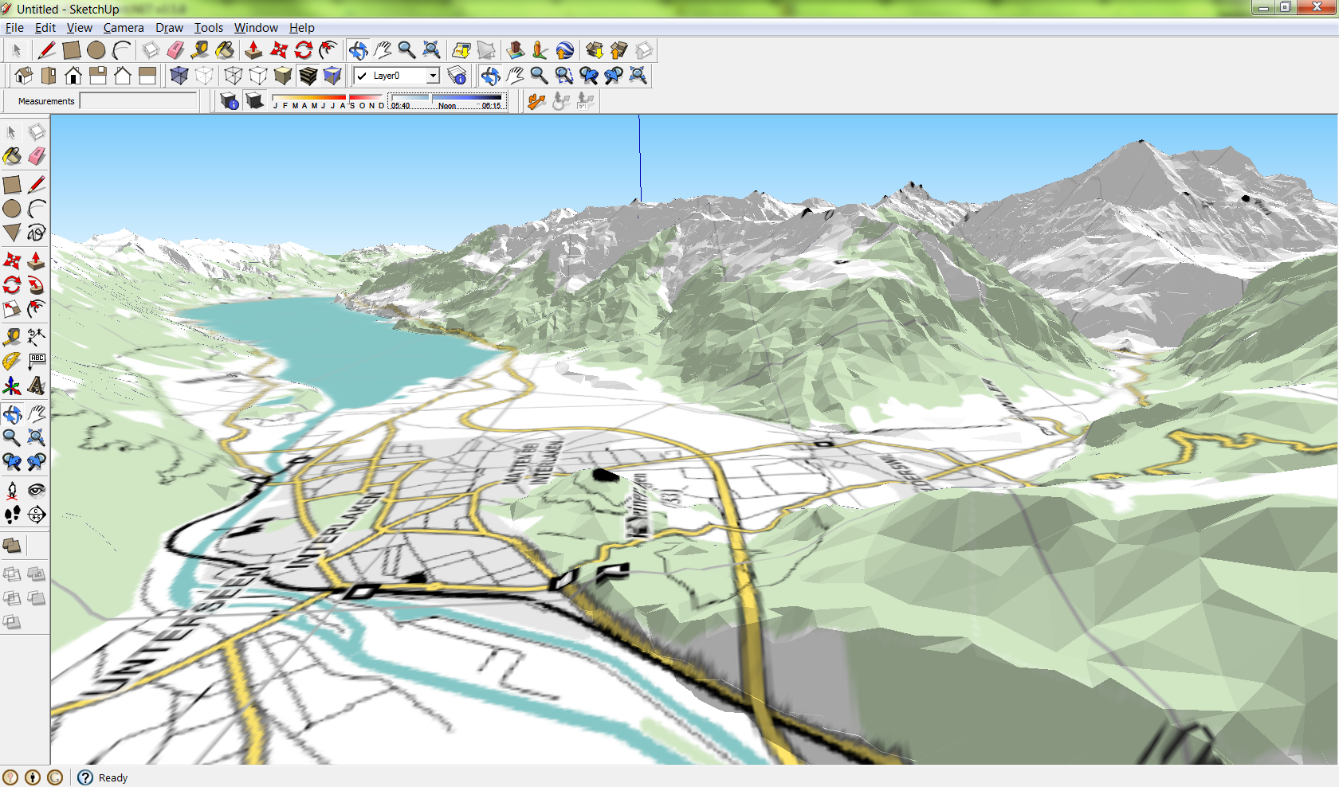

Slide 20
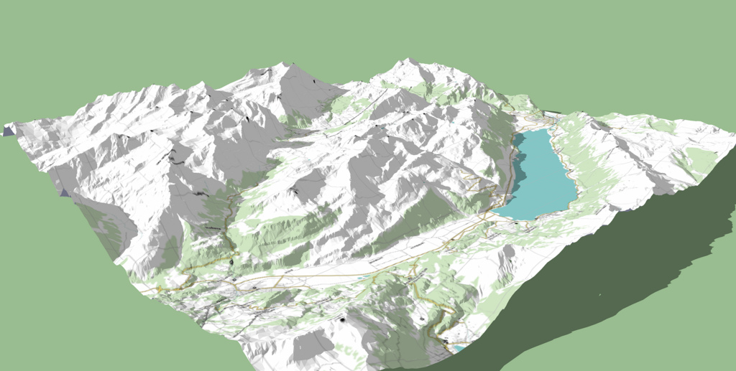

Slide 21
Discussion...

