Slide 1
OSM buildings from ordinary photos
Vladimir Elistratov
osm.org/user/vvoovv

Slide 2
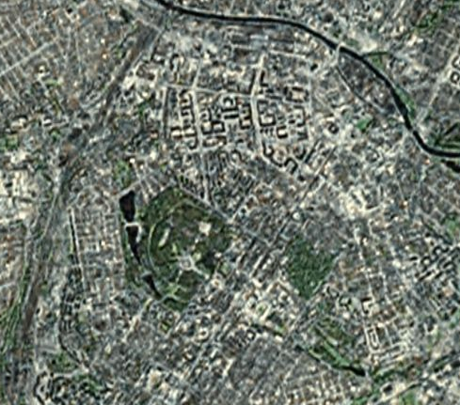
Problem
High resolution imagery is not everywhere available

Slide 3
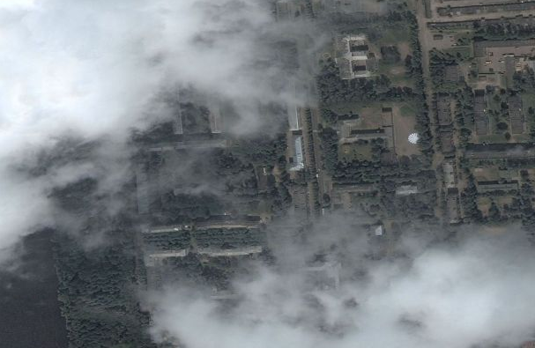
Problem
Some parts of high resolution imagery may be vague or hidden by clouds

Slide 4
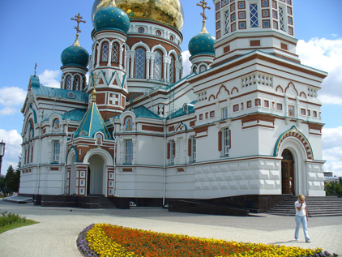
Problem
Some buildings have too complicated structure

Slide 5
Initial approach
Bundler from the University of Washington
http://phototour.cs.washington.edu/bundler/
Bundler is a structure-from-motion (SfM) system for unordered image collections. Bundler takes a set of images, image features, and image matches as input, and produces a 3D reconstruction of camera and (sparse) scene geometry as output.

Slide 6
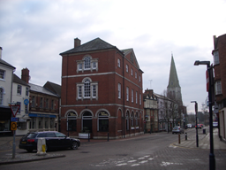
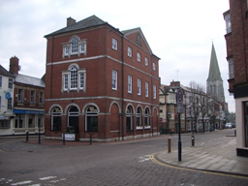
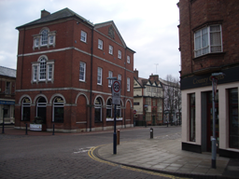
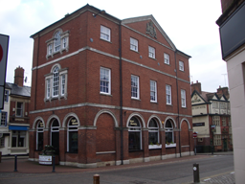
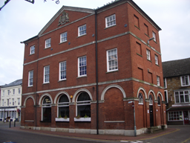
Bundler: basic principles
Take a set of images

Slide 7
Bundler: basic principles
Find features on each image
Find matches between the image features
Perform “bundler adjustment” to get 3D reconstruction of cameras and (sparse) scene geometry as output
Optionally: use Clustering Views for Multi-view Stereo (CMVS) to get more or less dense set of points in 3D space

Slide 8
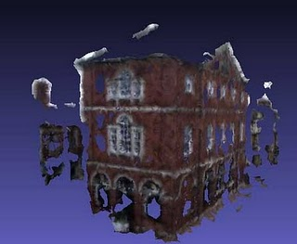
Bundler: results
5 pictures:

Slide 9
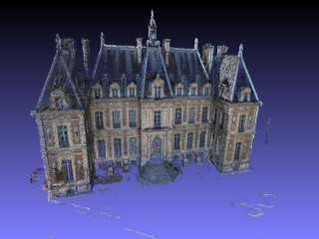
Bundler: results
251 pictures

Slide 10
osm-bundler
http://code.google.com/p/osm-bundler/

Slide 11
Bundler: conclusion
Unreliable, often one gets just a mess
The more pictures the more time it takes
More a tool for researchers than for an ordinary OSMer
Getting 2D building outline from 3D points is a separate task
3D reconstruction is excessive, 2D building outline is enough

Slide 12
Final approach: Google Sketchup plugin
Install Google Sketchup
Install OSM Google Sketchup Plugin following the link from http://wiki.osm.org/Google_Sketchup_Plugin
Learn how to use basic functions of Sketchup
Learn how to use photo matching feature of Sketchup

Slide 13
Google Sketchup plugin for OSM
Photo Matching in Google Sketchup allows manual 3D building reconstruction from 1-2 pictures
Based on the projective geometry laws

Slide 14
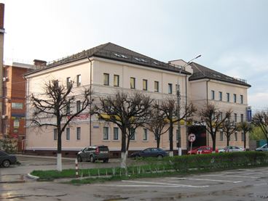
Google Sketchup plugin for OSM
Take a picture from building angle
The picture must not be cropped!!!

Slide 15
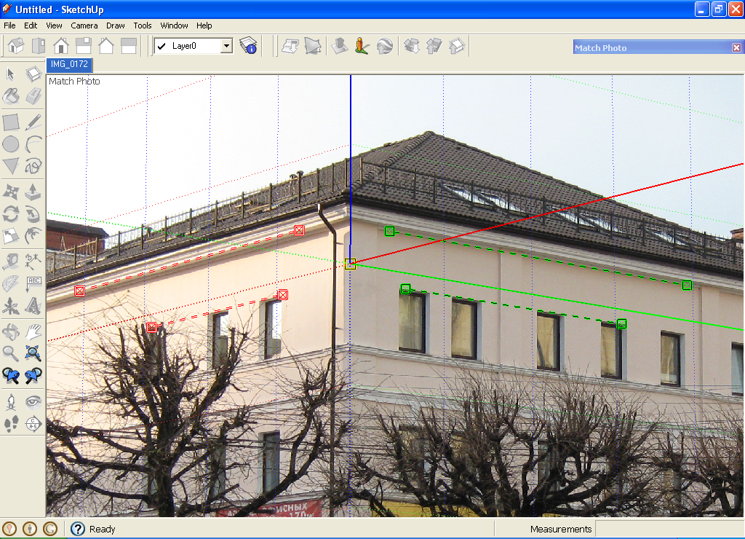

Slide 16
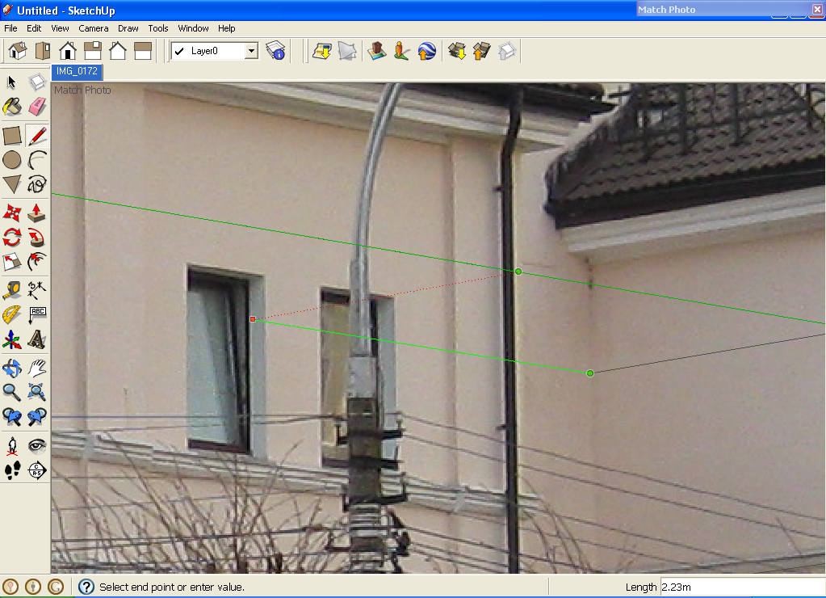

Slide 17
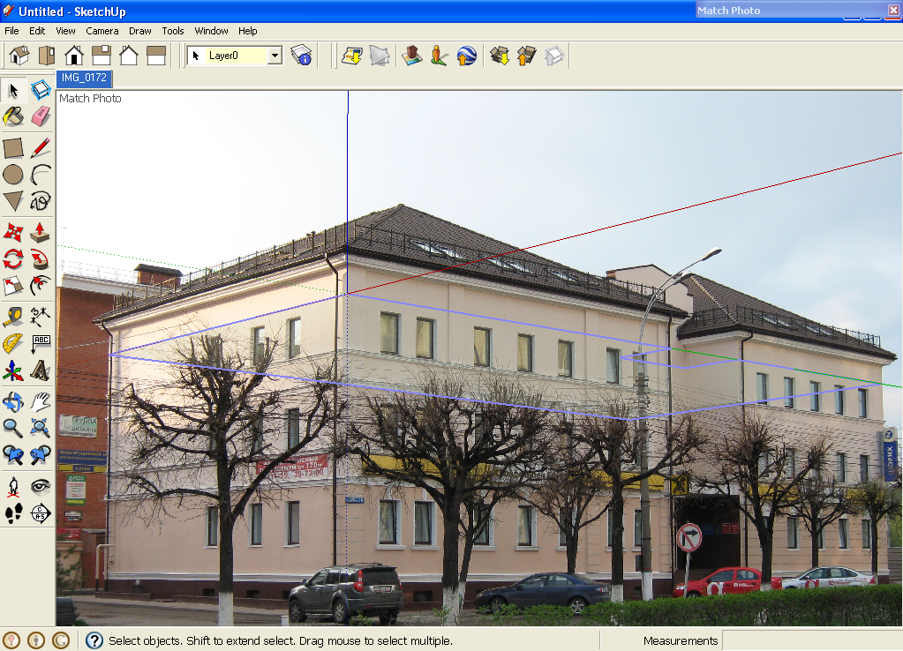

Slide 18
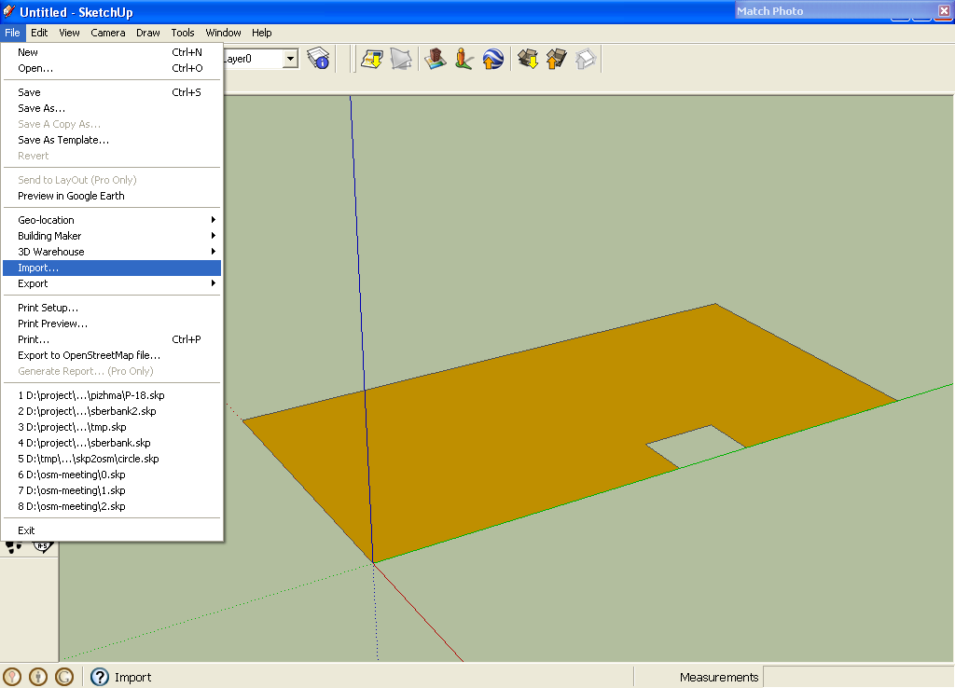

Slide 19
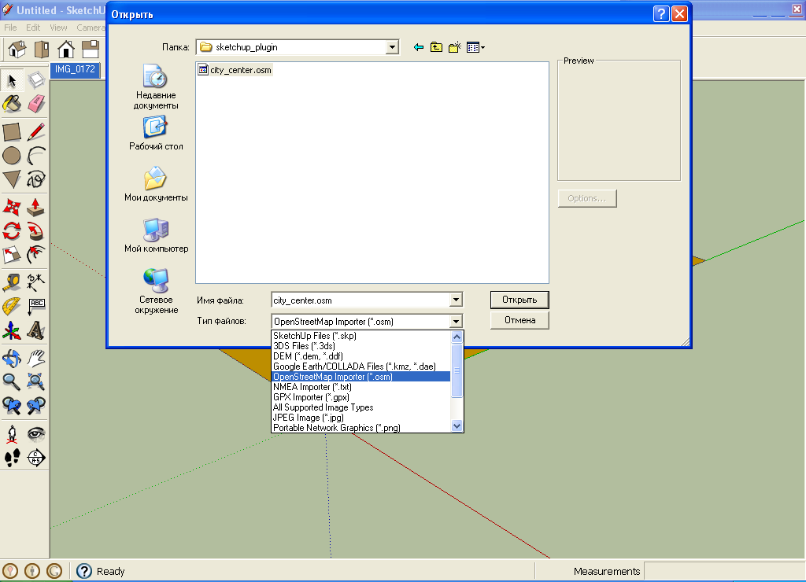

Slide 20
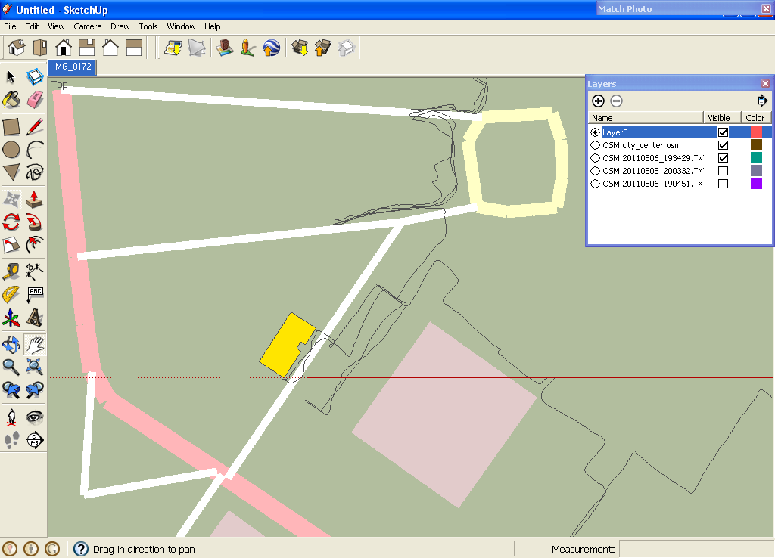

Slide 21
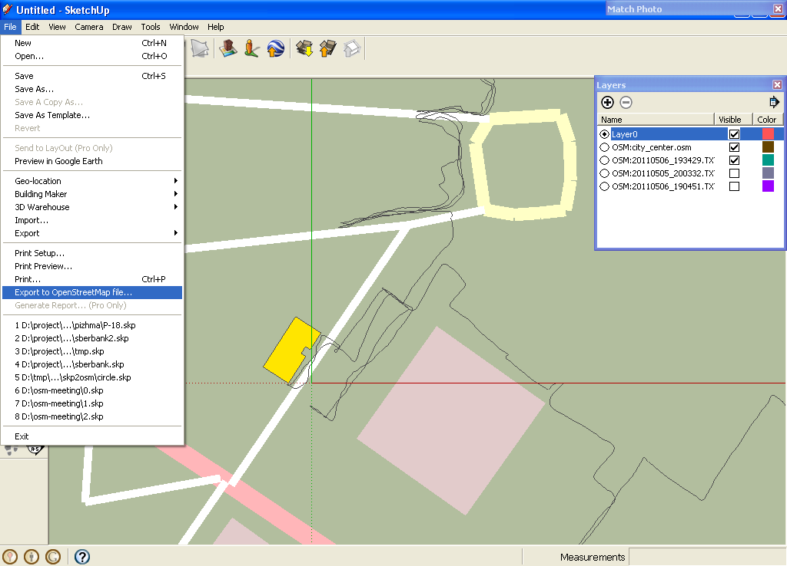

Slide 22
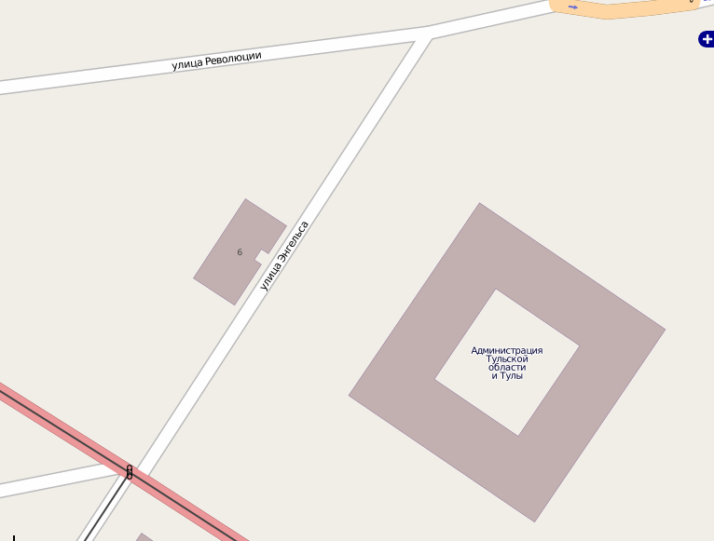
That’s it!

Slide 23
Google Sketchup plugin for OSM
http://wiki.osm.org/Google_Sketchup_Plugin

