Slide 1

Don't make me think!
Usability of VGI editors: are they easy to learn?
Dr Kate Jones & Dr Patrick Weber
@petzlux , #jiscg3
Portsmouth University &
University College London
Notes:
Fundamental challenges with digital maps
Usability Engineering – few concepts
A user-centred design for OSM
Getting to the masses

Slide 2
Usable geoweb applications are hard
GI concepts are multiple, novel and complex, resulting in a high cognitive load
  Applications need to minimise and support users cognitive load
  Traditional GIS applications are hard to use
Geoweb applications becoming ubiquitous,
  Entering wide consumer space of non GI experts
  Offer more and more advanced concepts, functionalities
  (navigation, spatial queries, thematic formatting, spatial edits)

Slide 3
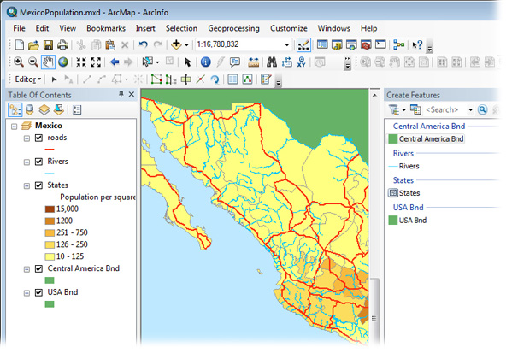

Slide 4
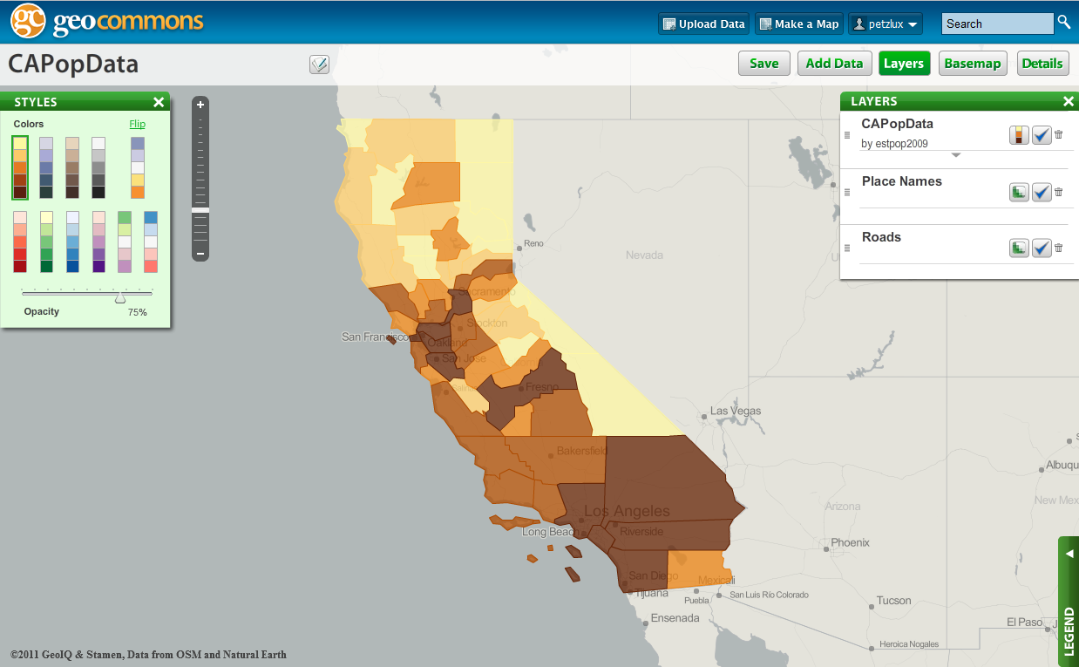

Slide 5
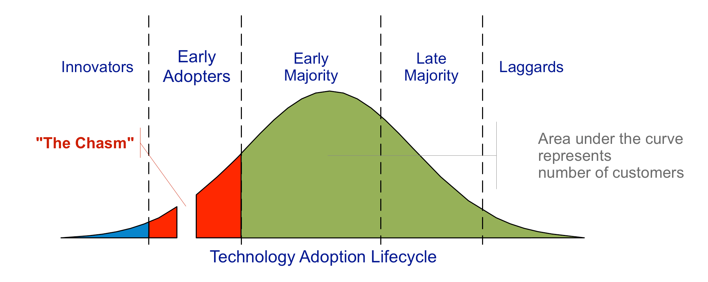
Crossing the Chasm: how to move from enthusiast contributors to mass participation?
Of all users registering an OSM account, only 35% go on to make at least one edit to the database! (source: http://neis-one.org)

Slide 6

Child of Ten Test (Al Gore 1998)
Ideal universal usability

Slide 7
“Usability” is a quality attribute that assesses how easy user interfaces are to use.
“Usability engineering” refers to methods for improving ease-of-use during the design process.
Usability is defined by 5 quality components:
* Learnability: How easy is it for users to accomplish basic tasks the first time they encounter the design?
* Efficiency: Once users have learned the design, how quickly can they perform tasks?
* Memorability: When users return to the design after a period of not using it, how easily can they reestablish proficiency?
* Errors: How many errors do users make, how severe are these errors, and how easily can they recover from the errors?
* Satisfaction: How pleasant is it to use the design?

Slide 8
Usability of OSM & Potlatch 2 for contributing geodata
Ten users were asked to complete a set of predefined tasks whilst THINKING ALOUD.
  Participants without any previous online editing experience were chosen.
  Data collected: Screen/Audio recording + eye tracking, pre/post questionnaires + observer
  10 participants, ~12 hours of video to analyse

Slide 9
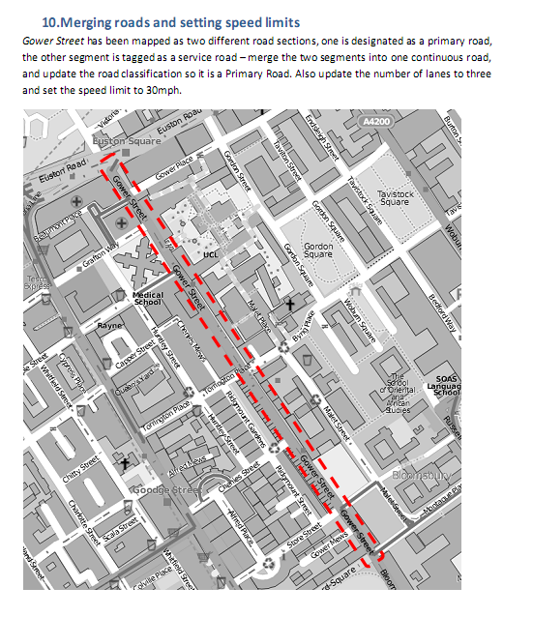
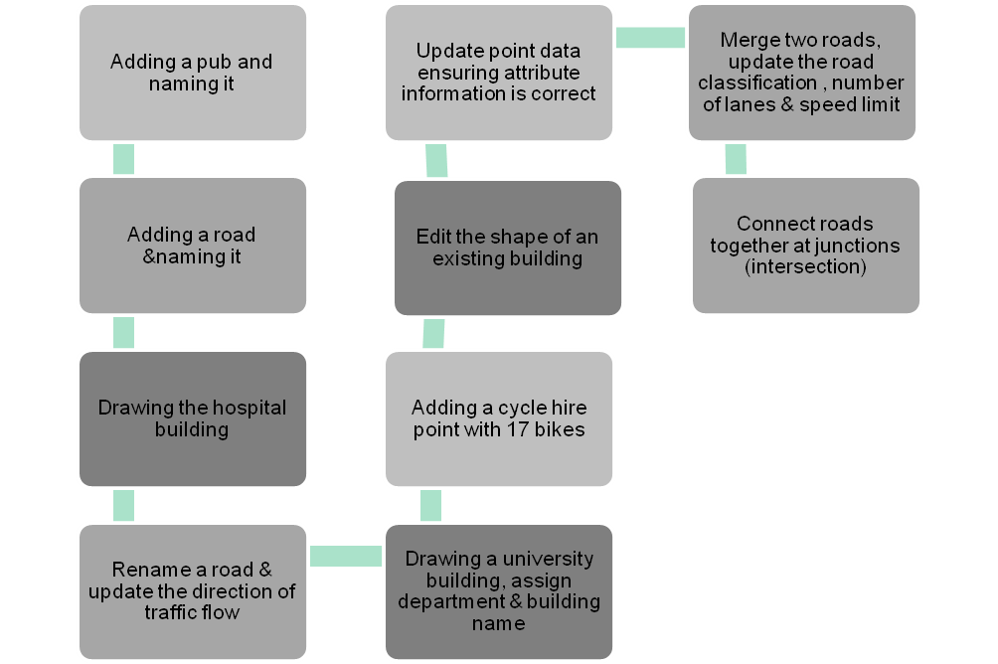
Description of the common tasks required of users
  Building up and repetition of complexity:
    Adding + Editing Points, Lines, Areas + attributes
Key
Point Objects
Line Objects
Area/polygon Objects

Slide 10
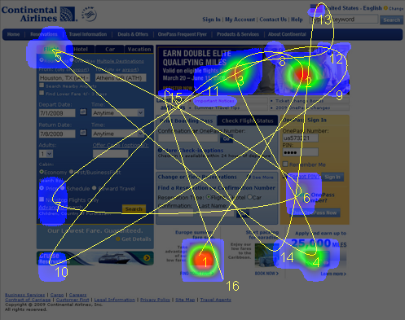
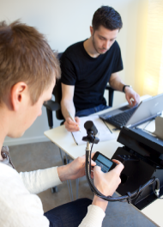
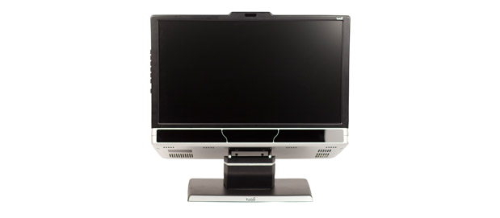
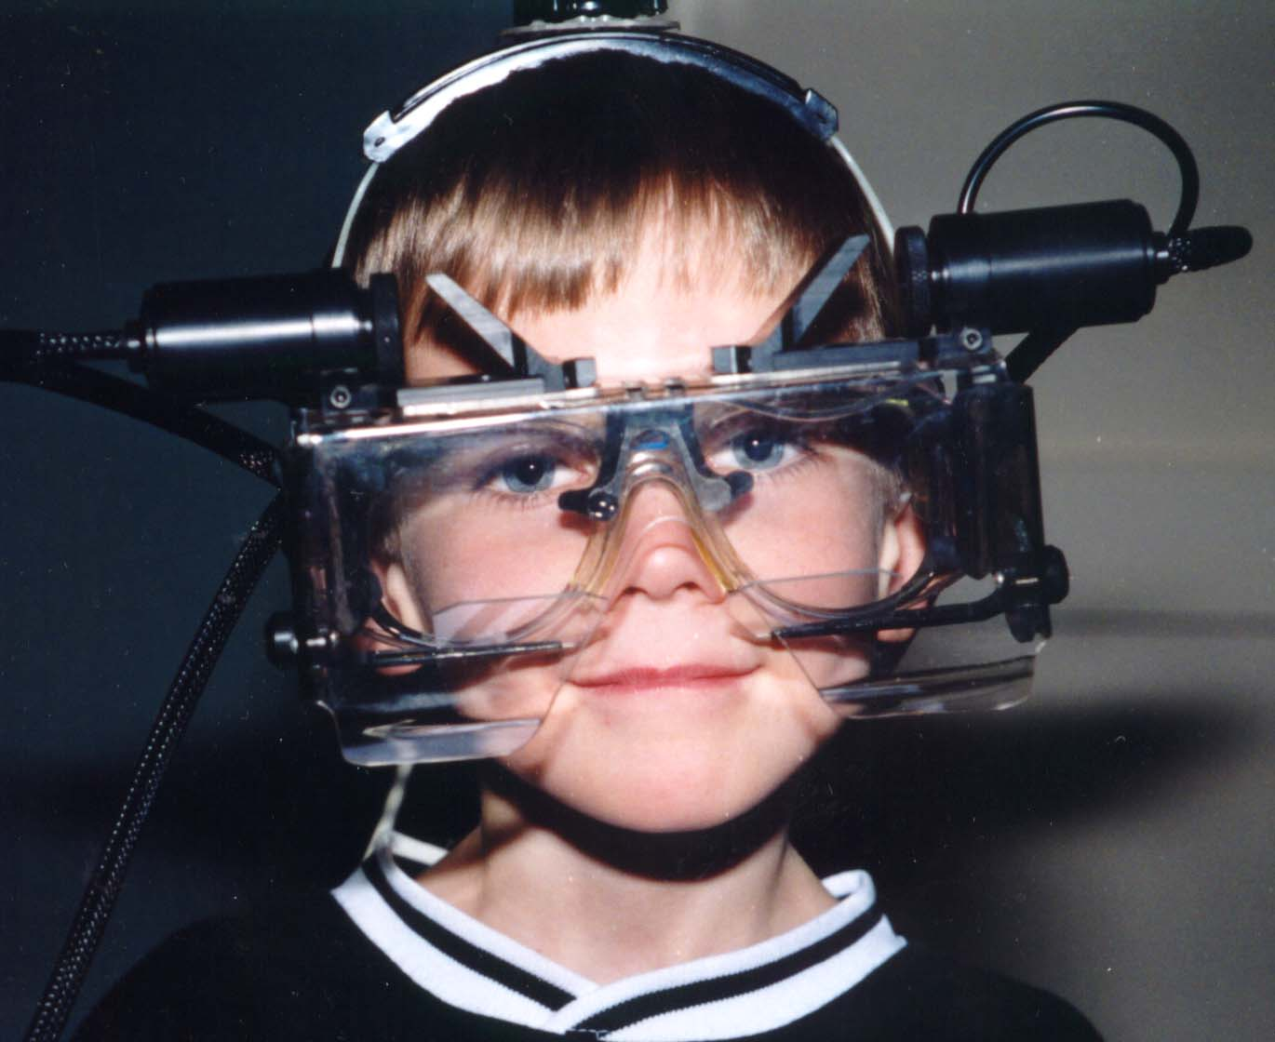
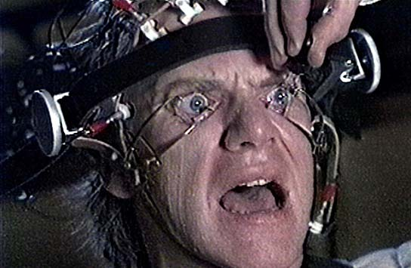
Notes:
Not really necessary, nice to have but can do a LOT! Of usability analysis without
Now not invasive, equipment integrated in lcd screens, can also be used on mobile apps. Rich data

Slide 11
NIELSEN HEURISTICS
A Framework for analysis of results

Slide 12
Nielsens heuristics:
  10 classes of usability issues that are commonly encountered with specific improvement recommendations
  we only touch here on a few of these, will be developed more comprehensively in the future
Notes:
http://www.useit.com/papers/heuristic/heuristic_list.html
These are ten general principles for user interface design. They are called "heuristics" because they are more in the nature of rules of thumb than specific usability guidelines.
Visibility of system status
The system should always keep users informed about what is going on, through appropriate feedback within reasonable time.
Match between system and the real world
The system should speak the users' language, with words, phrases and concepts familiar to the user, rather than system-oriented terms. Follow real-world conventions, making information appear in a natural and logical order.
User control and freedom
Users often choose system functions by mistake and will need a clearly marked "emergency exit" to leave the unwanted state without having to go through an extended dialogue. Support undo and redo.
Consistency and standards
Users should not have to wonder whether different words, situations, or actions mean the same thing. Follow platform conventions.
Error prevention
Even better than good error messages is a careful design which prevents a problem from occurring in the first place. Either eliminate error-prone conditions or check for them and present users with a confirmation option before they commit to the action.
Recognition rather than recall
Minimize the user's memory load by making objects, actions, and options visible. The user should not have to remember information from one part of the dialogue to another. Instructions for use of the system should be visible or easily retrievable whenever appropriate.
Flexibility and efficiency of use
Accelerators -- unseen by the novice user -- may often speed up the interaction for the expert user such that the system can cater to both inexperienced and experienced users. Allow users to tailor frequent actions.
Aesthetic and minimalist design
Dialogues should not contain information which is irrelevant or rarely needed. Every extra unit of information in a dialogue competes with the relevant units of information and diminishes their relative visibility.
Help users recognize, diagnose, and recover from errors
Error messages should be expressed in plain language (no codes), precisely indicate the problem, and constructively suggest a solution.
Help and documentation
Even though it is better if the system can be used without documentation, it may be necessary to provide help and documentation. Any such information should be easy to search, focused on the user's task, list concrete steps to be carried out, and not be too large.

Slide 13
Match between system and the real world
The system should speak the users’ language, with words, phrases and concepts familiar to the user, rather than system-oriented terms.
Follow real-world conventions, making information appear in a natural and logical order.
Notes:
Give here example of search functionality and zoom function placements in Potlatch
Designation tag, what is this?
If user doesnt know, then need to provide consistent help and explanations.

Slide 14
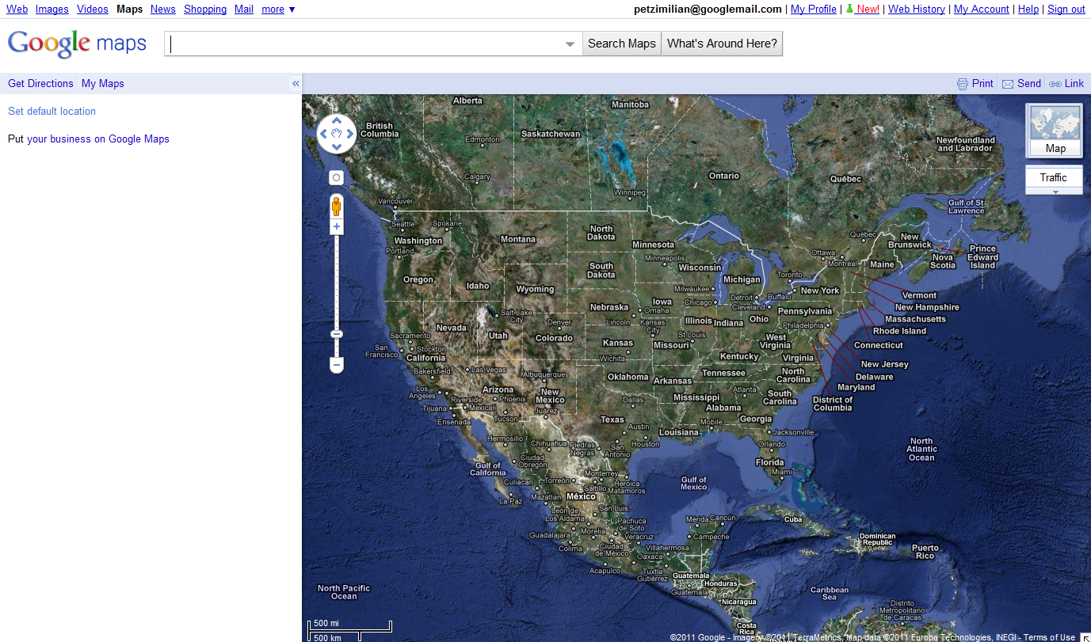

Slide 15
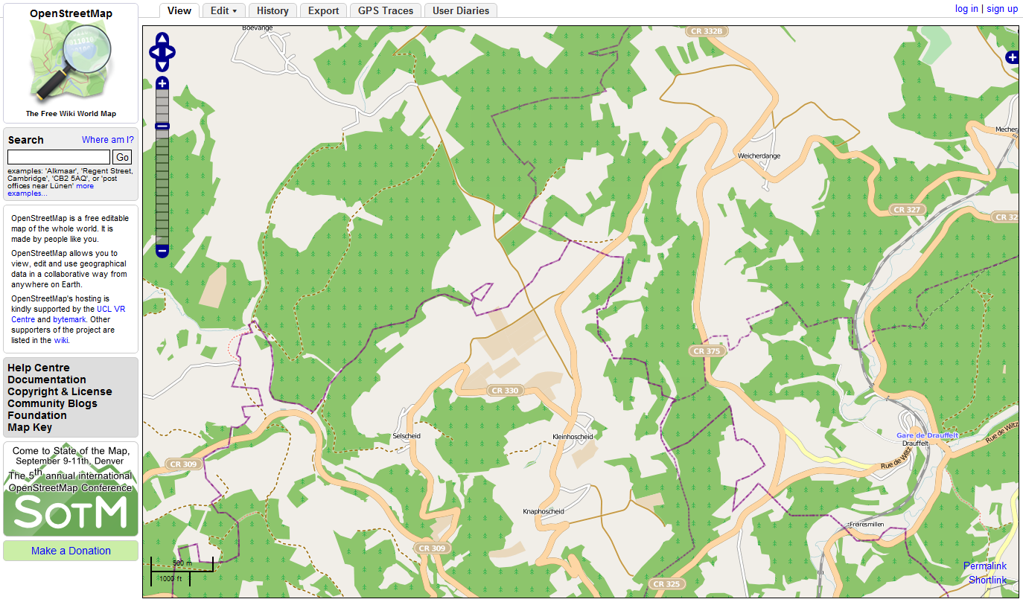

Slide 16
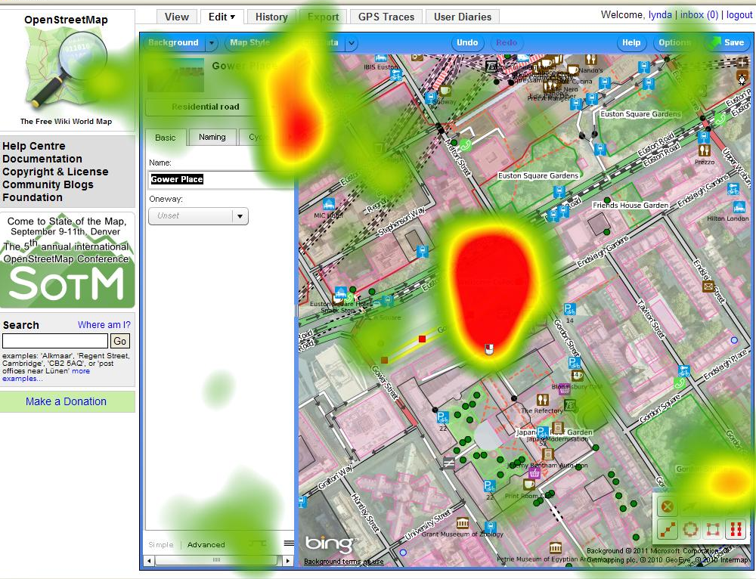
Where is the zoom?
“..not sure if I am missing the obvious Zoom and Pan functions…Aaaghhh there they are, small and hidden”
[P10, 31:40].
Notes:
Convention of zoom functionality in top left corner of map display. Not even consistent across OSM, In View it is in the top left.

Slide 17
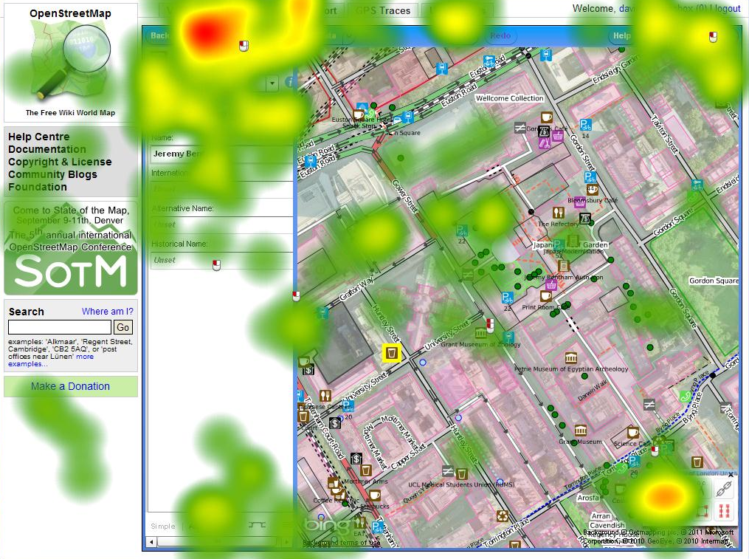
“…Am I supposed to click somewhere to save this. Ummm it should have a save right….! Aghh top right ...weeeee!” [P03: began searching at 10:51 found it at 11:03 seconds]
and
“…[I was] not expecting it to be in top right-hand corner… I suppose” [P06 27:14]
Notes:
One user did not save any edits at all and only 3 users saved edits 11 times (at the end of every task, see Figure 9). On average, participants saved edits 6 times.
Save function not very explicit, ie concept that edits need to be saved

Slide 18
User control and freedom
Users often choose system functions by mistake
Need a clearly marked “emergency exit” to leave the unwanted state
Support undo and redo.
Error prevention
Even better than good error messages is a careful design which prevents a problem from occurring in the first place.

Slide 19
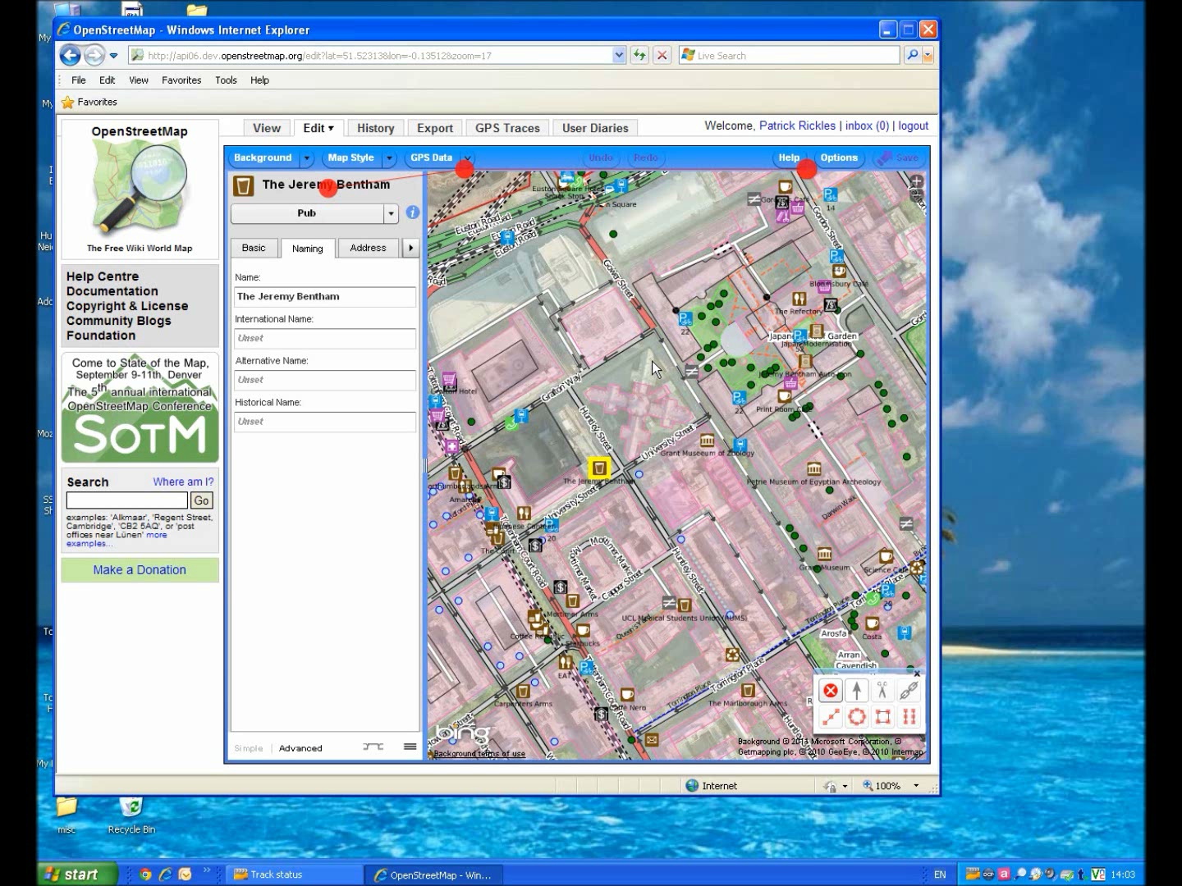

Slide 20
Interaction between cartography, selection process
and density of mapped features:
“there is a lot of clutter there….” [P03 11:44].
“Even though I know this area, this visualisation is making it difficult for me to find things“ [P06 30:28]
“oh my gosh it’s hard to know where to click so you don't impact what is there already!" [P08 37:50].
“oops I just moved the anatomy building, did not mean to do that!“ [P06: 31:42]. This participant then stated
“…Soon there will be so many objects in the map I will not find an area that I can use to pan” [P06: conversation post experiment].

Slide 21
Recognition rather than recall
Flexibility and efficiency of use
Make objects, actions, and options visible.
The user should not have to remember information from one part of the dialogue to another.
Instructions for use of the system should be visible or easily retrievable whenever appropriate.
Accelerators—unseen by the novice user—may often speed up the interaction for the expert user such that the system can cater to both inexperienced and experienced users.

Slide 22
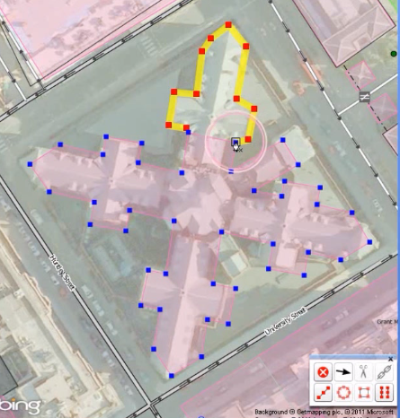
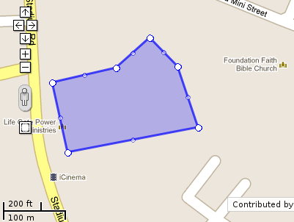
Keyboard shortcuts vs. User Interface Elements
Notes:
There are keyboard shortcuts provided by Potlatch, but these are only documented in the online help. The specific keyboard shortcut for adding nodes to an existing way were almost universally not discovered by the participants.
Some participants then found the Merge functionality in the edit toolbar in the bottom-right, and believed they could merge the two building polygons. Unfortunately, the merge functionality only works on two lines connected at their end-points (there was no UI feedback to indicate why merging two polygons would not work).

Slide 23
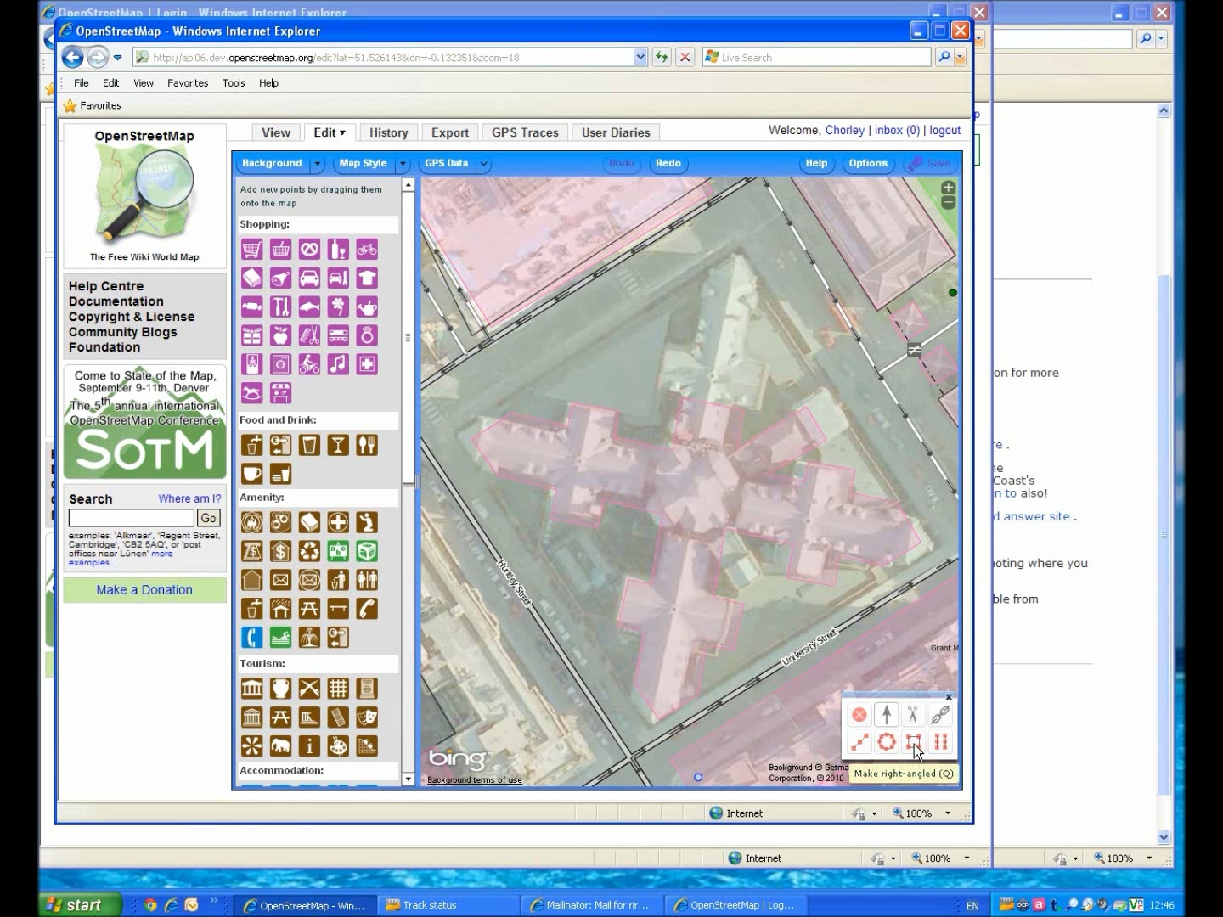

Slide 24
GOOGLE MAP MAKER & POTLATCH
Comparison between

Slide 25
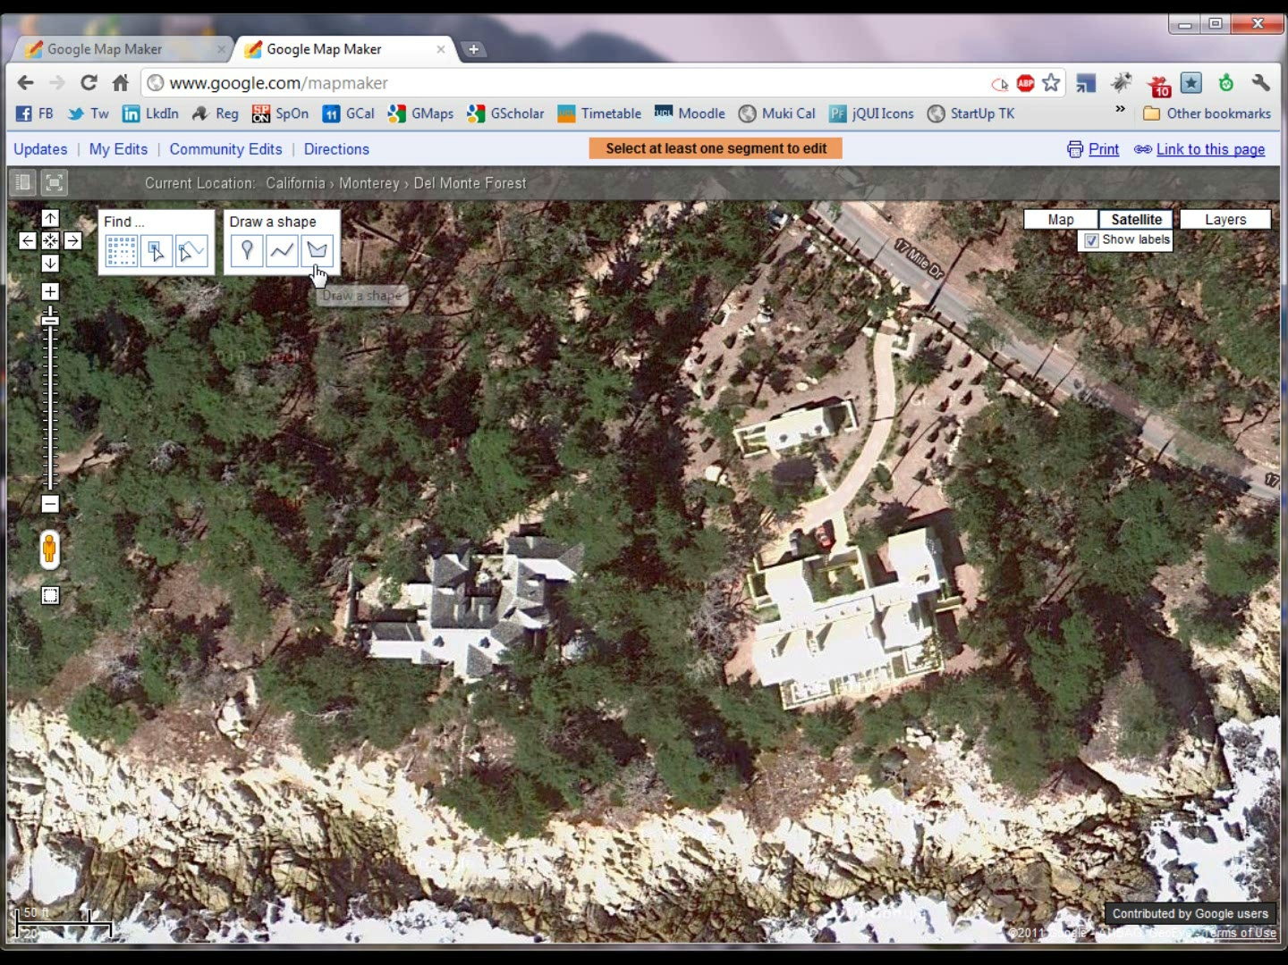

Slide 26
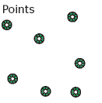
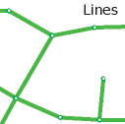
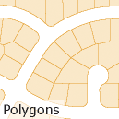
Consistency of concepts and terminologies
ESRI | OSM | Google Map Maker
Point | Node | Point
Line | Way | Line
Polygon | Closed Way (area=yes) | Shape
Notes:
Connected to previous points about speaking language of users, how to find a relevant, understandable, consistent and known vocabulary for geo concepts.
Make point here as well that there was a lot of confusion in experiments when users were drawing a building footprint (area, polygon, shape), and then were still confronted with way related options.

Slide 27
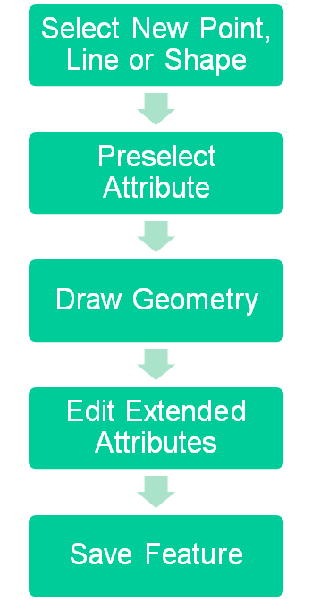
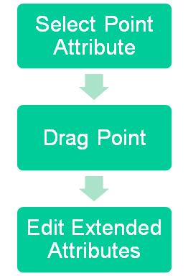


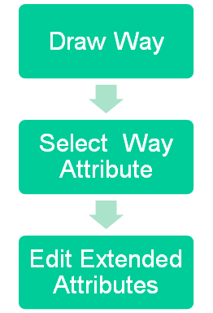
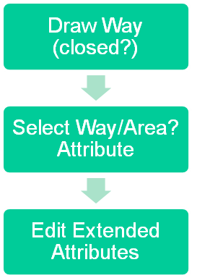

Conceptual Editing Processes
Google Map Maker
Potlatch

Slide 28
CONCLUSIONS

Slide 29
Post Experiment Survey Results
No clear consensus on questions related to ease of learning and user satisfaction
  They neither agreed or disagreed with statements related to learnability & satisfaction
  In HCI literature tendency is for users to blame themselves
Users disagreed with statements related to ease of use
    But they really liked drag and drop

Slide 30
Conclusions: Continuum of editors
Google Map Maker
Novice Expert
?
Mapzen
Potlatch 2
Merkaator
JOSM

Slide 31
Conclusions
Developing usable applications that incorporate advanced GI concepts is possible
But necessitates constant feedback loop of usability evaluation
Usability testing can be done easily, but needs time and analysis
Future work:
  More robust indepth data analysis from experiment
  Detailed comparison of other geoweb interfaces vs trad GIS interfaces
  Comparison of different devices: desktop/mobile/tablet

Slide 32


Thanks go to: Dr Muki Haklay, Prof Angela Sasse, Charlene Jennet
Contact: Dr Catherine Jones & Dr. Patrick Weber
www.spatialknowledge.eu Research blog
www.jiscg3.blogspot.com JiscG3 project
Kate.jones@port.ac.uk
p.weber@ucl.ac.uk
@petzlux

Slide 33
Usability evaluation is not hard!
Material needed: Quiet Room with a PC (or other device if that is where your app is running on)
Get hold of some representative users, preferably novices.
Ask the users to perform representative tasks with the design.
Observe what the users do, where they succeed, and where they have difficulties with the user interface. Shut up and let the users do the talking.

Slide 34
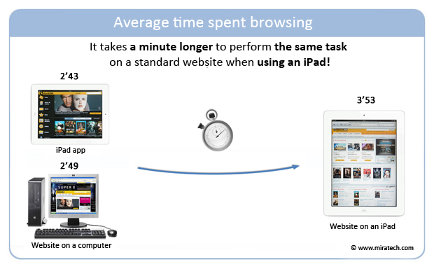
http://www.miratech.com/blog/user-testing-iPad-vs-computer.html
Notes:
Some great content in here: http://www.miratech.com/blog.php

