Slide 1



OSMonto
An Ontology for
OpenStreetMap tags
Gregor Horsinka
with
M. Codescu, O. Kutz, T. Mossakowski, R. Rau
Research Center on Spatial Cognition (SFB/TR 8)
DFKI GmbH Bremen
Dpt. of Geography, University of Bremen
16.07.2011, Vienna, Austria, SotM-EU

Slide 2
Outline
Motivation
Related Work
Ontologies
OSMonto
Applications: DO-ROAM
Conclusions

Slide 3
Motivation
Hierarchical representation of OSM tags
Provides a better overview (via tools like Protégé) and aims towards automatic maintenance
Ontological semantics via mappings: different versions or semantically related tags can be united
Ease access to the tags for search and navigation in an OSM map (DO-ROAM)

Slide 4
Related Work
Taginfo (http://taginfo.openstreetmap.org/)
Tagwatch (http://tagwatch.stoecker.eu/)
OSM wiki (http://wiki.openstreetmap.org/wiki/Map_features)

Slide 5
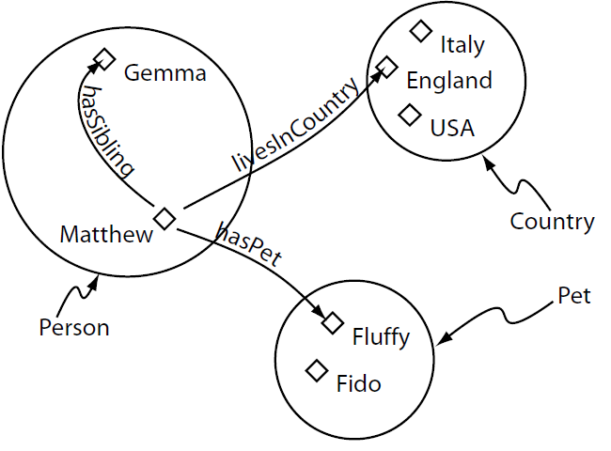
Ontologies
Capture knowledge about some domain by describing its concepts and the relationships between them
Wide range of applications in computer science

Slide 6
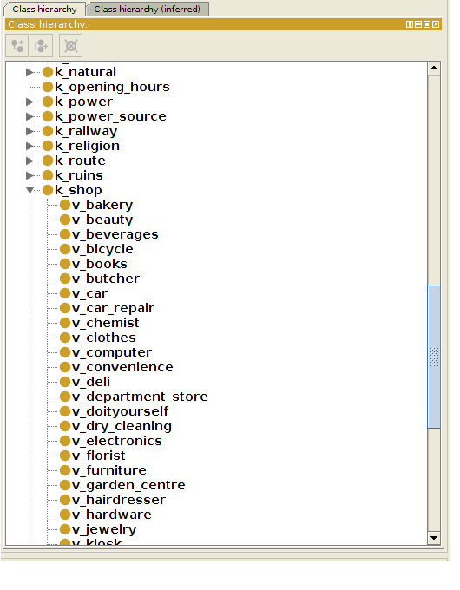
OSMonto
OSM tags are of form
< tag k = “key” v = ”value”>
Keys become superconcepts of their values
Some tags can be used only in presence of other tags => roles
Dynamic aspect: OSM community can introduce new tags or modify existing ones
Threshold for selecting a tag as relevant => errors are reduced
http://wiki.openstreetmap.org/wiki/OSMonto

Slide 7
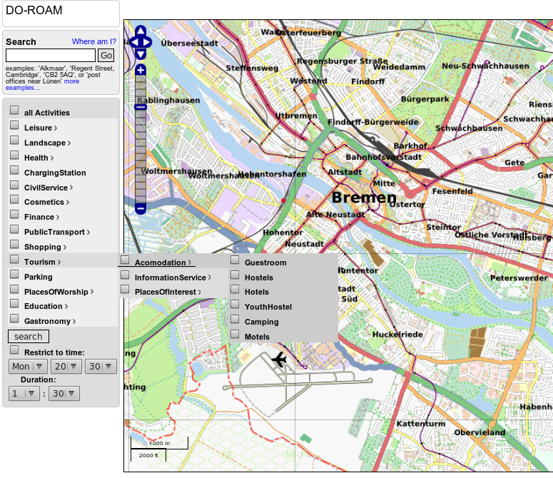
DO-ROAM
focus on usability
evolving set of activities organized as an ontology related to OSMonto
linguistic analysis (synonyms for now) for free text search
OpenStreetMap data: open source, constantly developing, sometimes better than Google Maps; partly language-agnostic

Slide 8
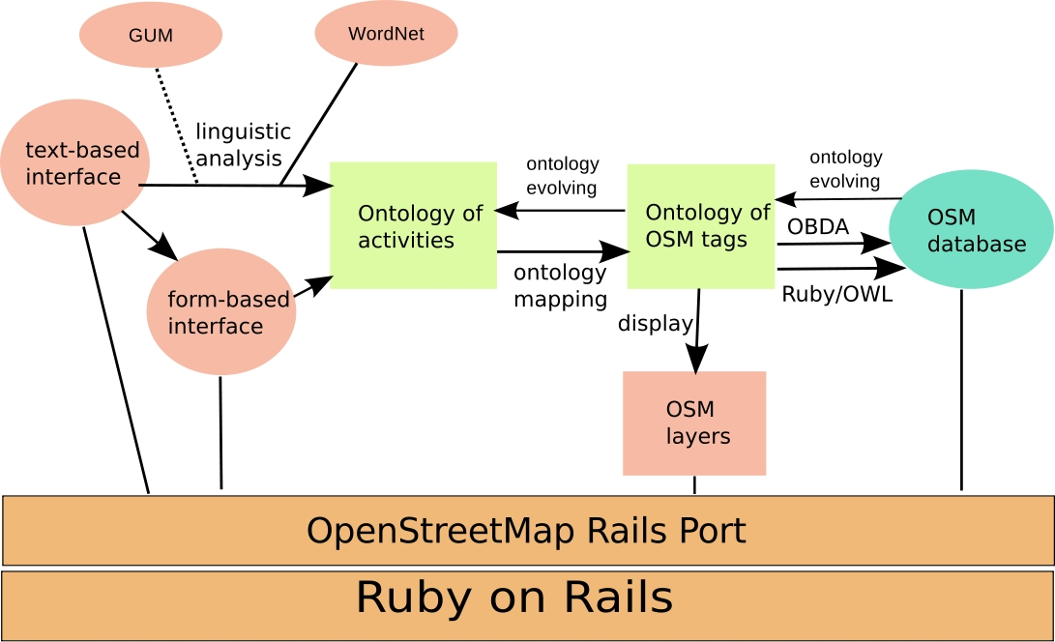
General Tool Architecture

Slide 9
Route Planning System

Slide 10
Conclusions and future work
OSMonto provides structure for OSM tags and means of adding additional semantics to them
Reference for the OSM community and possible insights on how to extend and structure OSM tags
Extend ontology with more roles and concepts to allow to infer missing information using OBDA (restaurant with chinese name or in China Town -> Chinese cuisine)

