Slide 1
Integration of OpenStreetMap into ArcGIS
Al Pascual

Slide 2
What’s ArcGIS for OpenStreetMap?

Slide 3
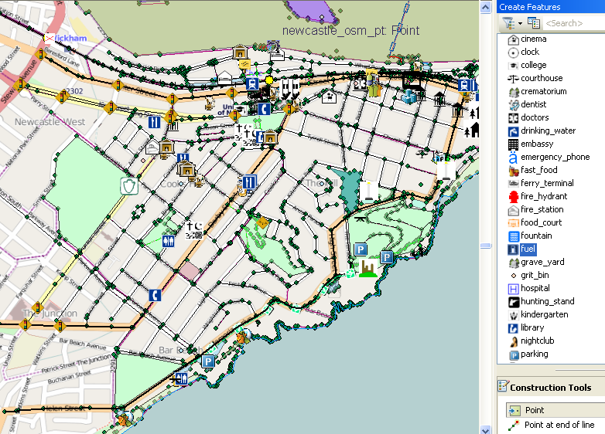

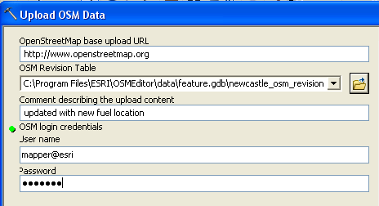
ArcGIS Editor for OpenStreetMap
Edit OpenStreetMap using the rich editing experience of ArcGIS
Download portion of OSM to local geodatabase.
Editing experience leveraging ArcGIS templates.
Uploading change sets to OSM

Slide 4
Road Ahead – ArcGIS Editor for OpenStreetMap
Version 1.1 released April
Version 2.0 alpha released now
Download: http://esriurl.com/OSMEditor

Slide 5
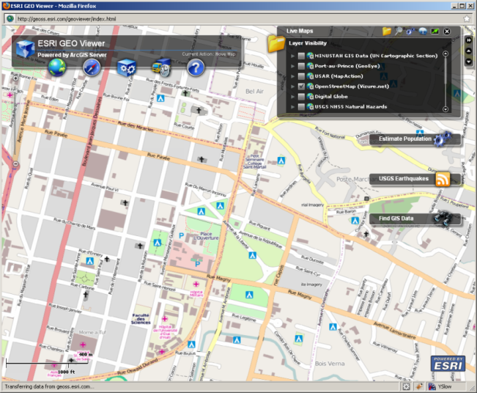
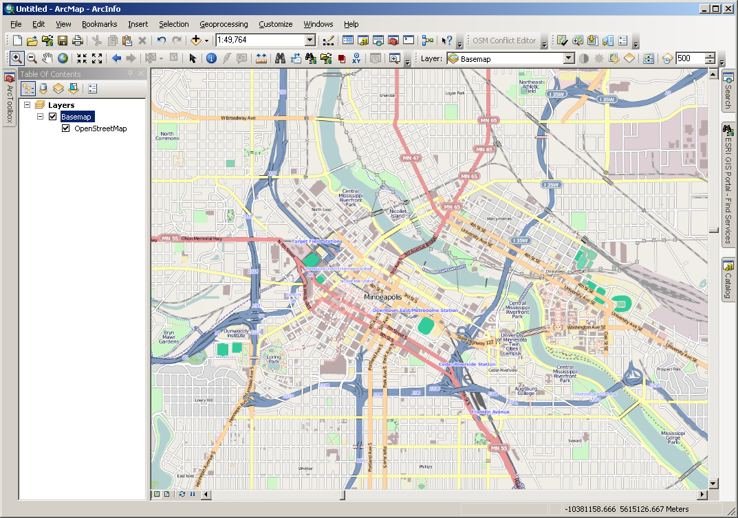
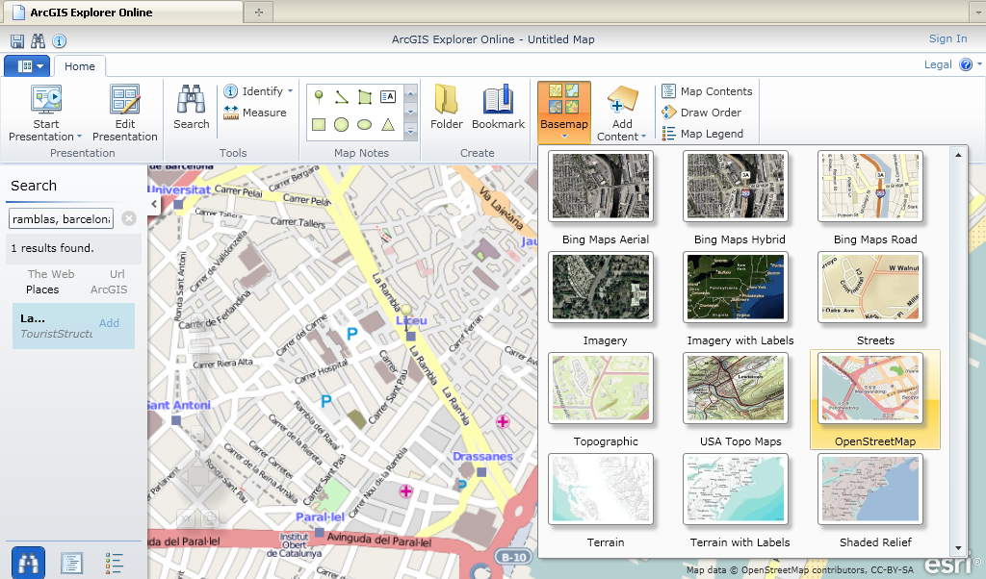
OpenStreetMap in ArcGIS
Flex Viewer
ArcGIS Desktop
ArcGIS Explorer Online
Notes:
Here we see OSM tiles served to ArcGIS Explorer Online, a free web application. The tiles are served mainly from University College London, where researchers are both OS developers and one of the 28 ESRI Development Centers (or EDCs) around the world. Once again, everything is mixed: shades of grey. The ESRI web platform brings OSM data to a wider audience and the OSM data adds value to the platform.

Slide 6







OpenStreetMap in ArcGIS Server 10
Web Browsers
Desktop
Mobile Devices
Feature
Service

Slide 7

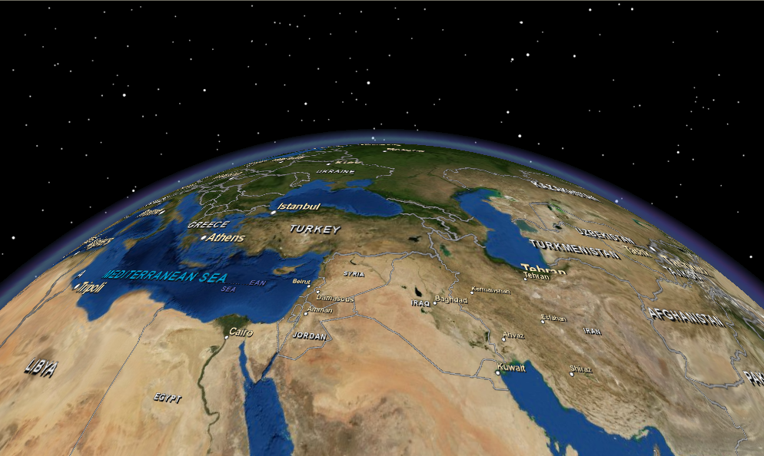
Worldwide, shared data…
Free to take & use
Free to find & give

Slide 8
Improvements.
  Quickly set up an ArcGIS Server feature service to allow users to edit a particular part of OSM
  Edit the OSM map using a variety of clients – mobile, web, desktop
  Performance Enhancements

Slide 9
Demo
Desktop
Web

Slide 10
Desktop demo

Slide 11
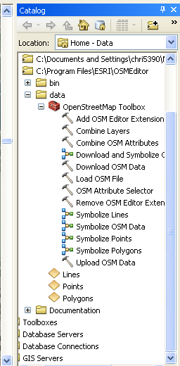

ArcGIS Editor for OpenStreetmap
Download and Symbolize

Slide 12
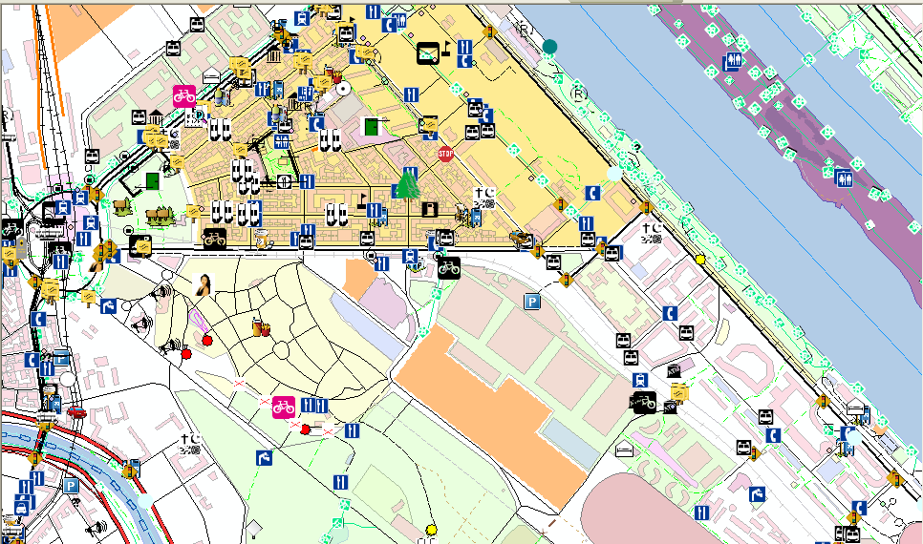
ArcGIS Editor for OpenStreetmap

Slide 13
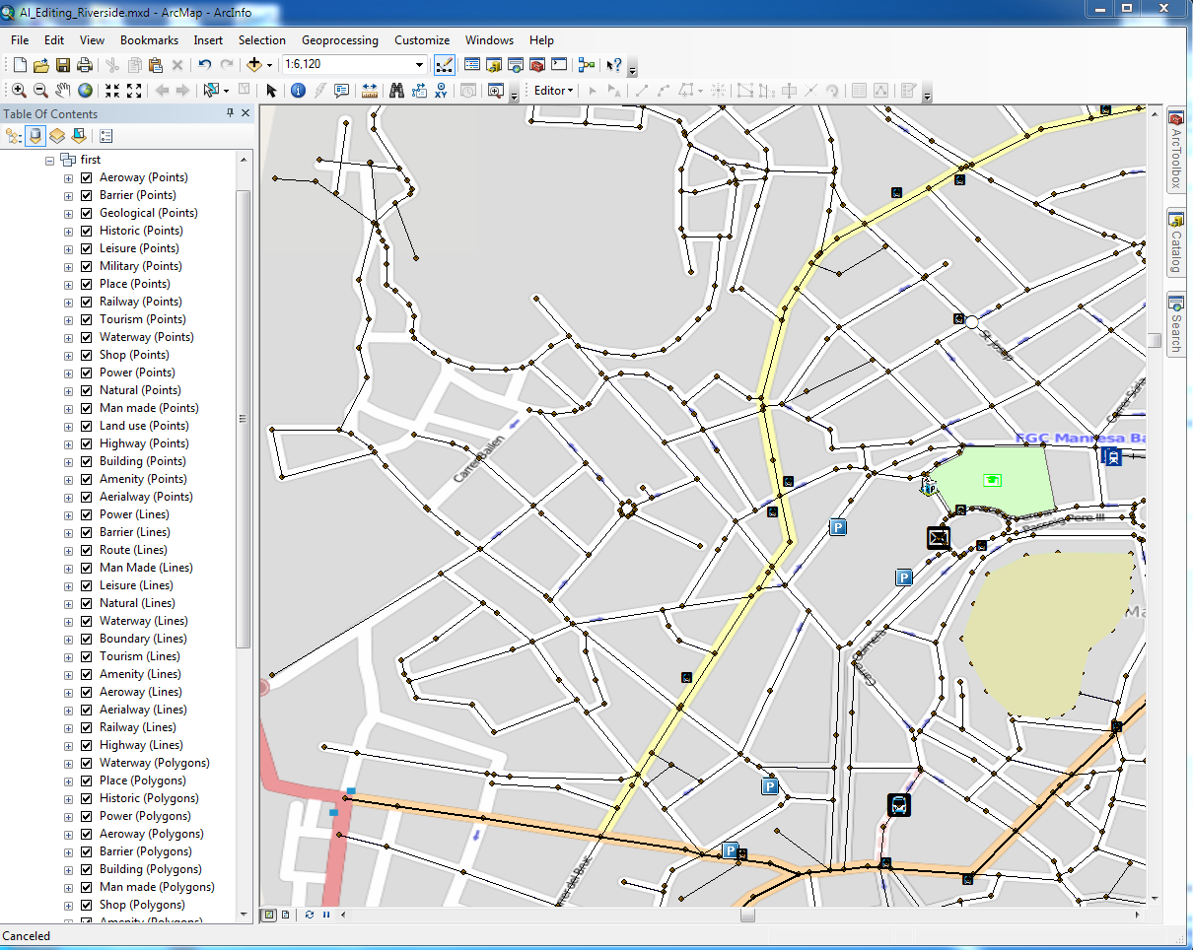
ArcMap and OSM
Map data (c) OpenStreetMap (and) contributors, CC-BY-SA

Slide 14
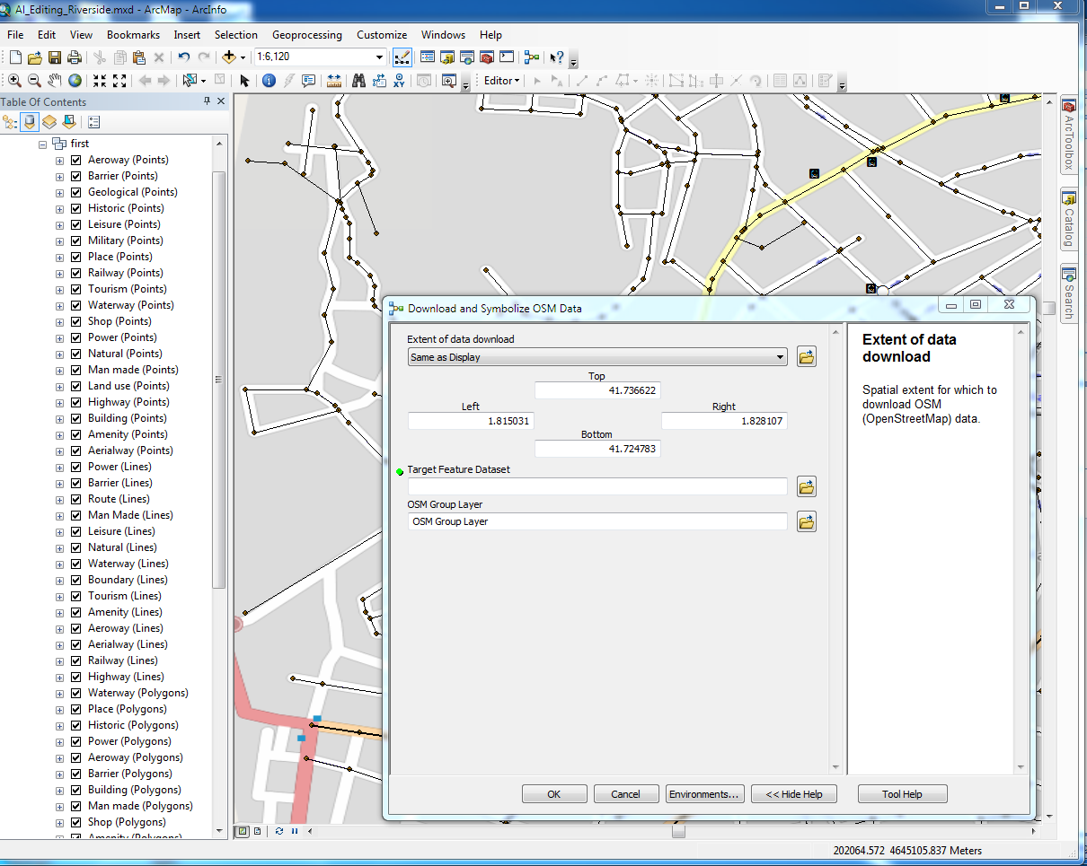
Downloading OSM data
Map data (c) OpenStreetMap (and) contributors, CC-BY-SA

Slide 15
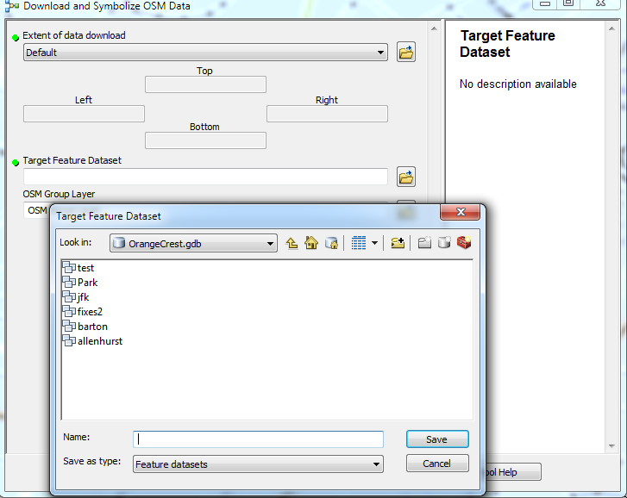
Selecting a Feature Class
Map data (c) OpenStreetMap (and) contributors, CC-BY-SA

Slide 16
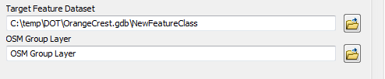
Creating a Feature class
Map data (c) OpenStreetMap (and) contributors, CC-BY-SA

Slide 17
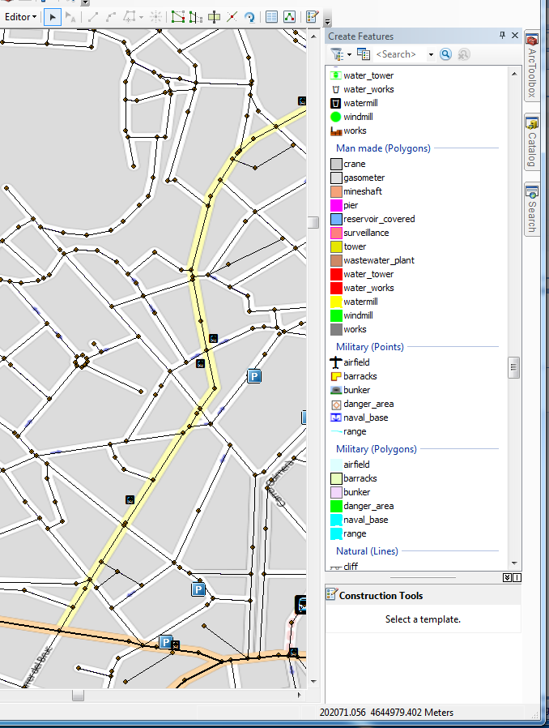
Editing OSM Data in ArcMap
Map data (c) OpenStreetMap (and) contributors, CC-BY-SA

Slide 18
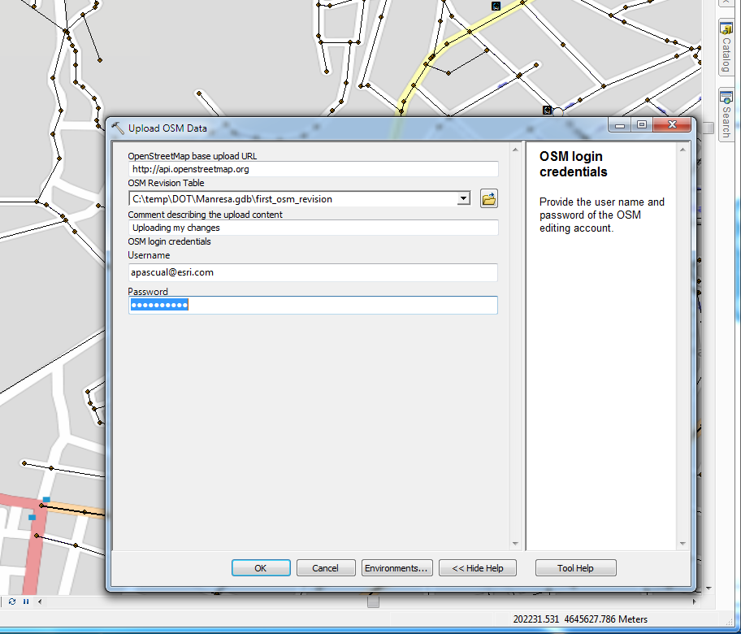
Uploading a Feature Class
Map data (c) OpenStreetMap (and) contributors, CC-BY-SA

Slide 19
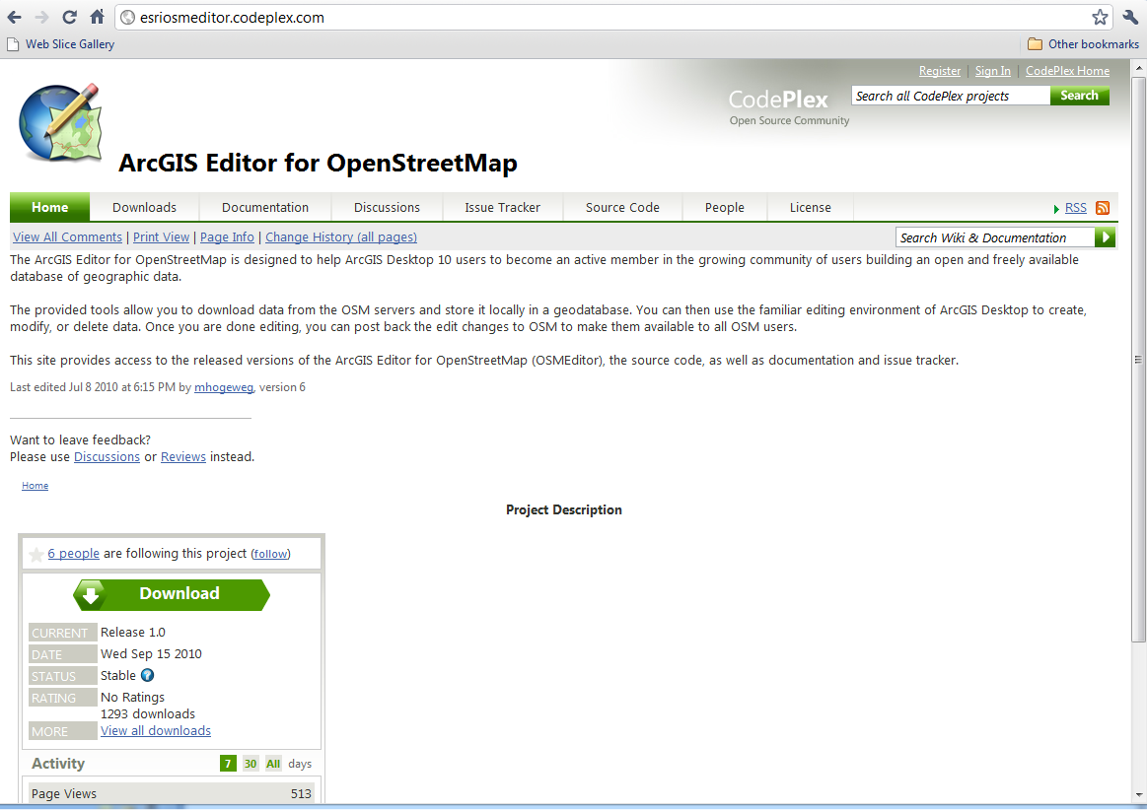
Where to Download?
http://esriosmeditor.codeplex.com

Slide 20
ArcGIS Server 10

Slide 21
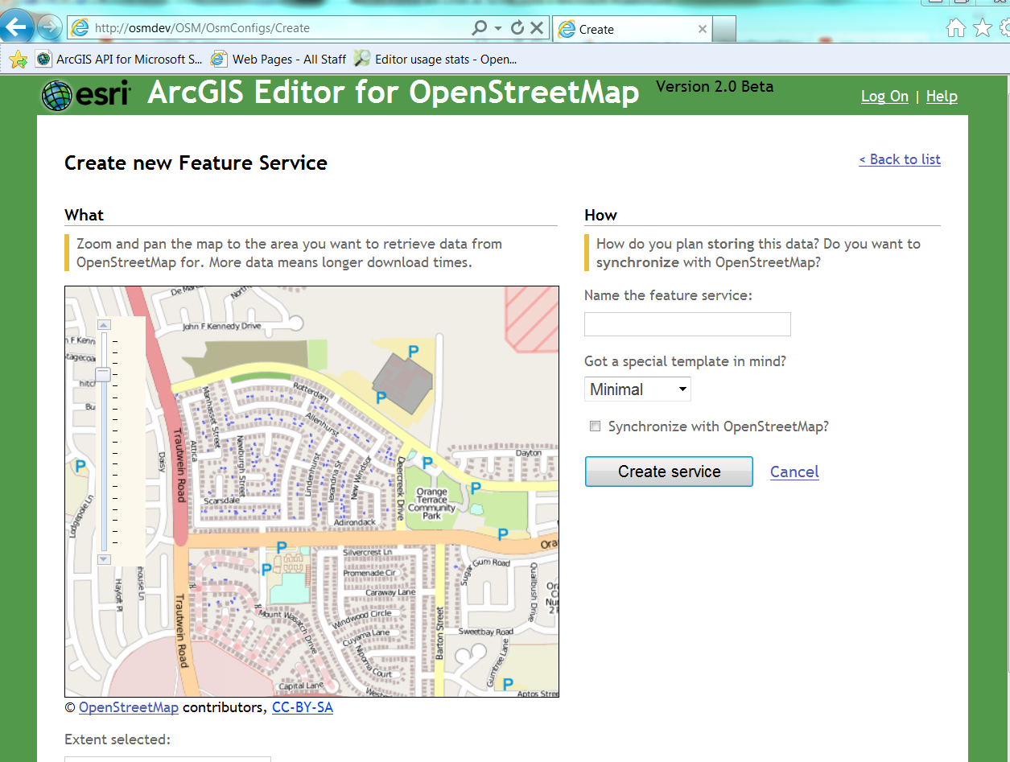

Slide 22
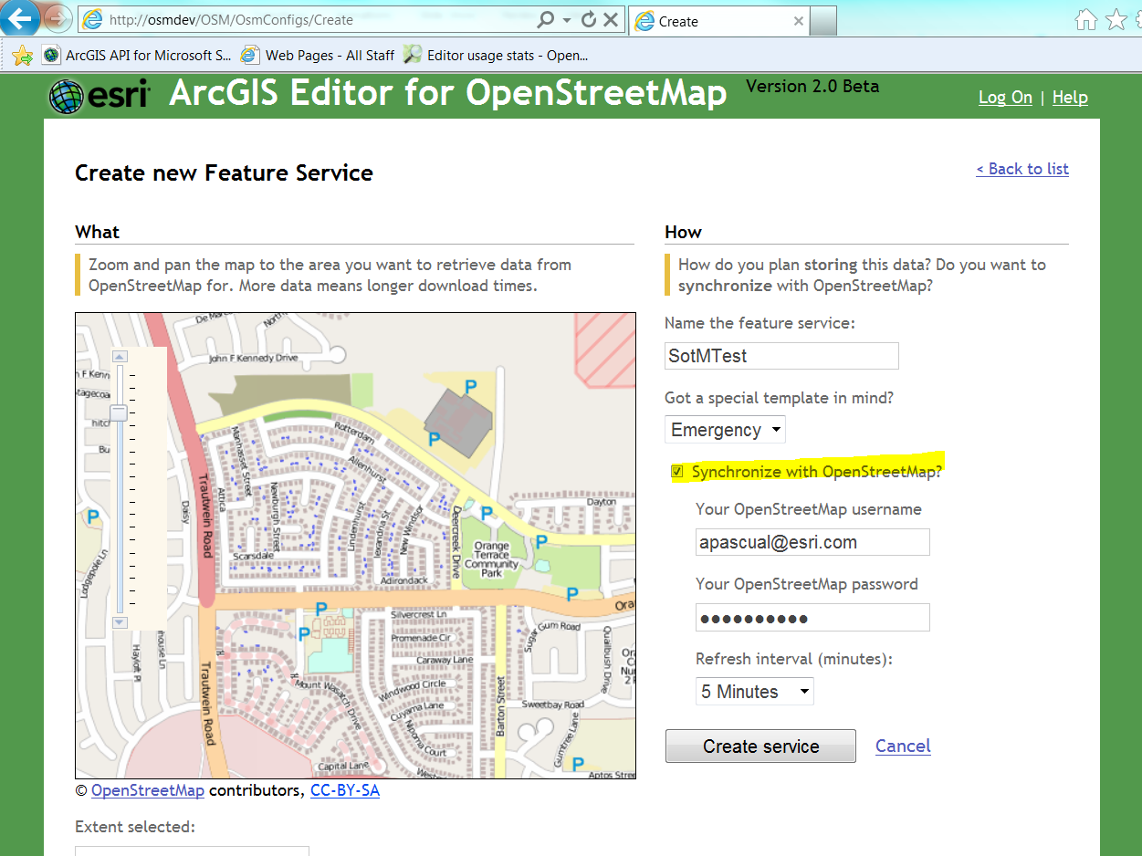

Slide 23
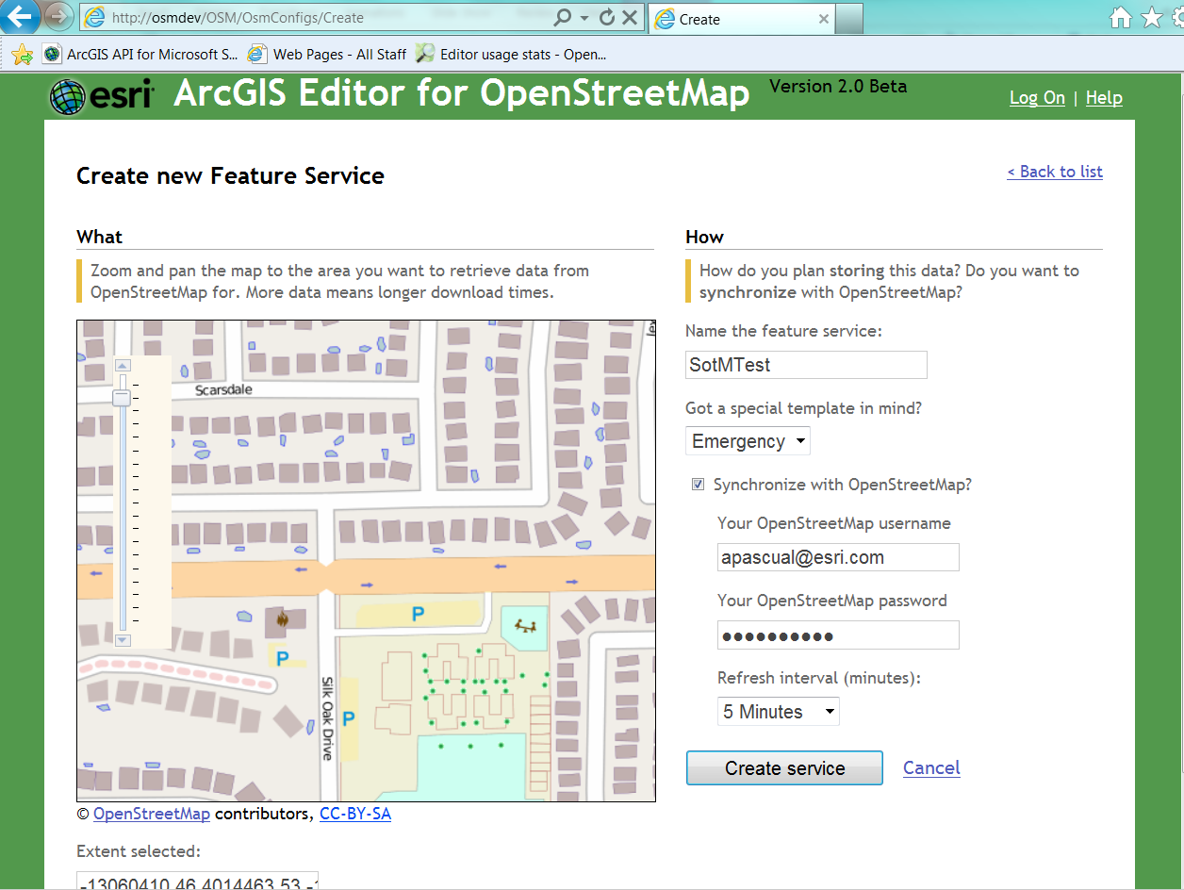

Slide 24
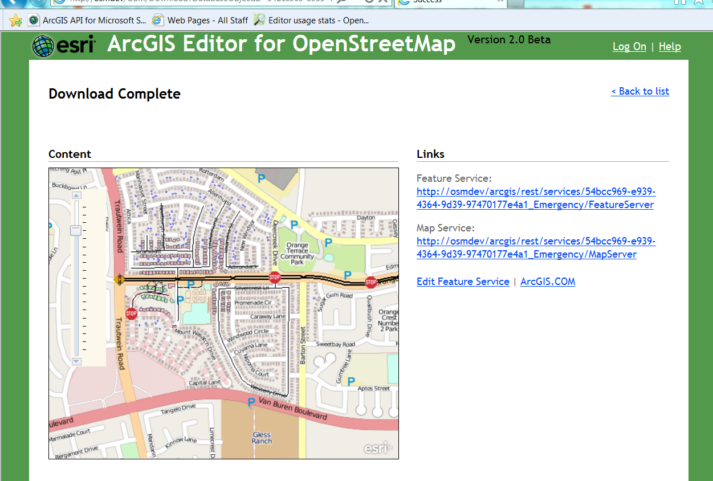

Slide 25
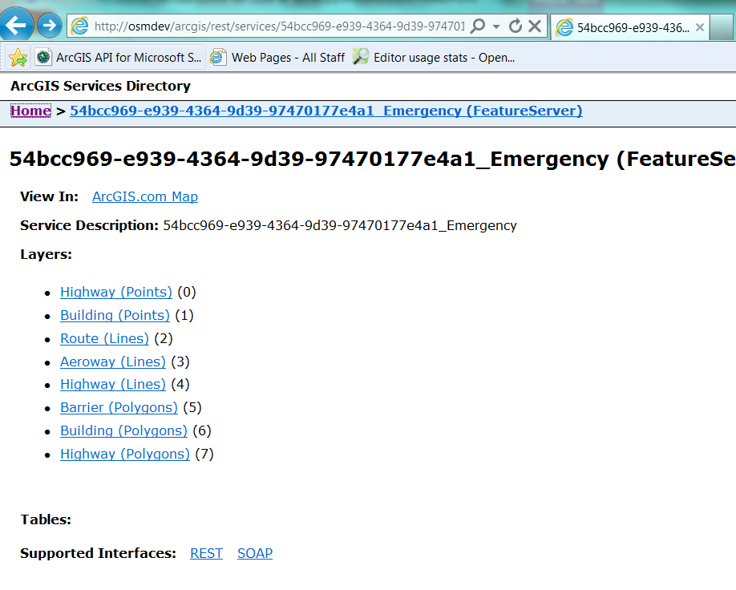

Slide 26
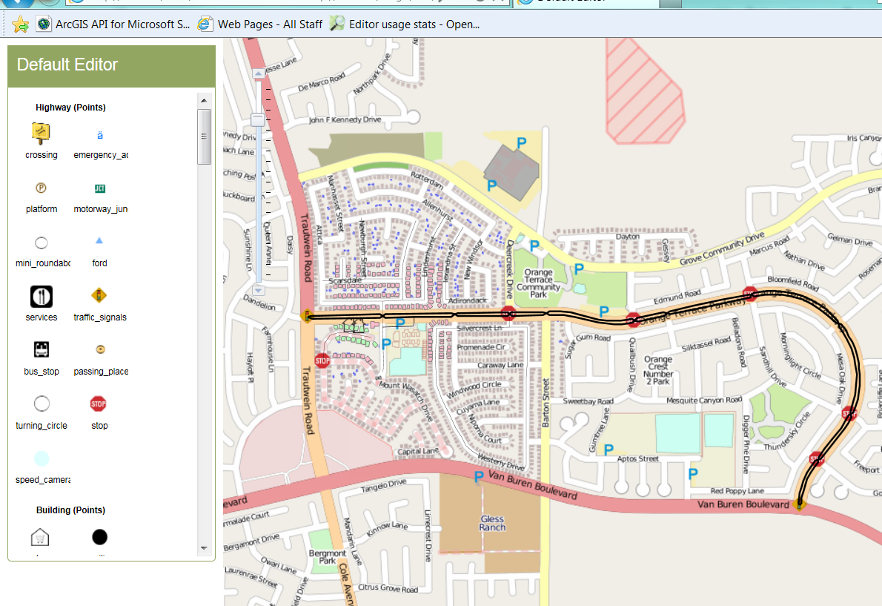

Slide 27
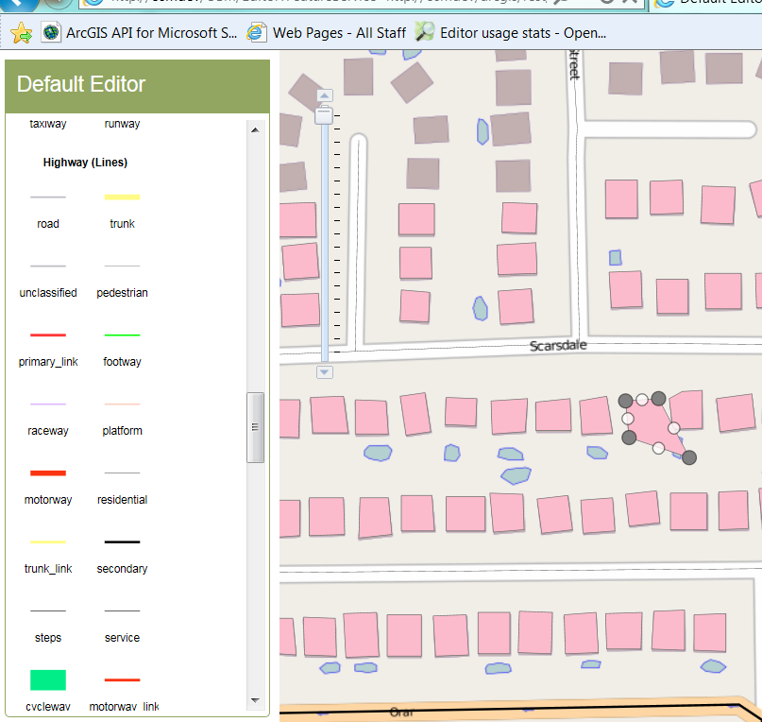

Slide 28
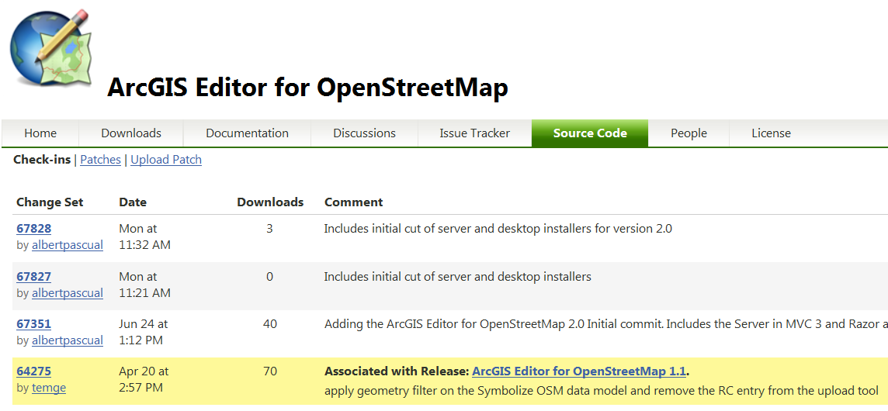
All source Code uploaded and up to date

Slide 29
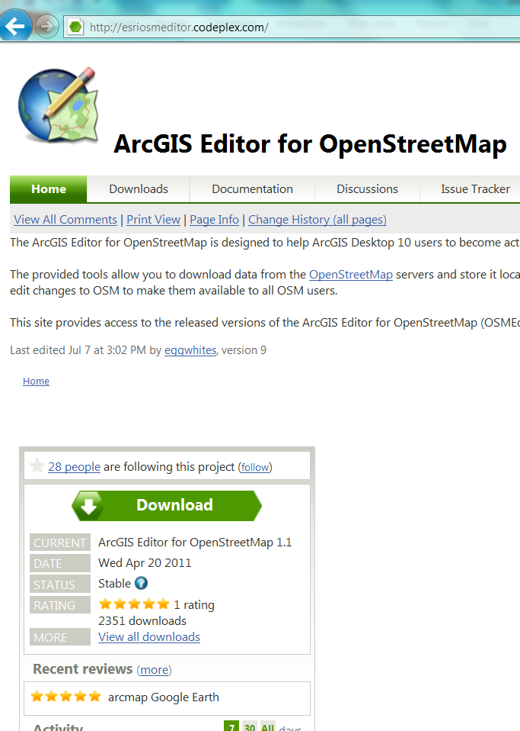
Installer for 1.1 available as well

Slide 30
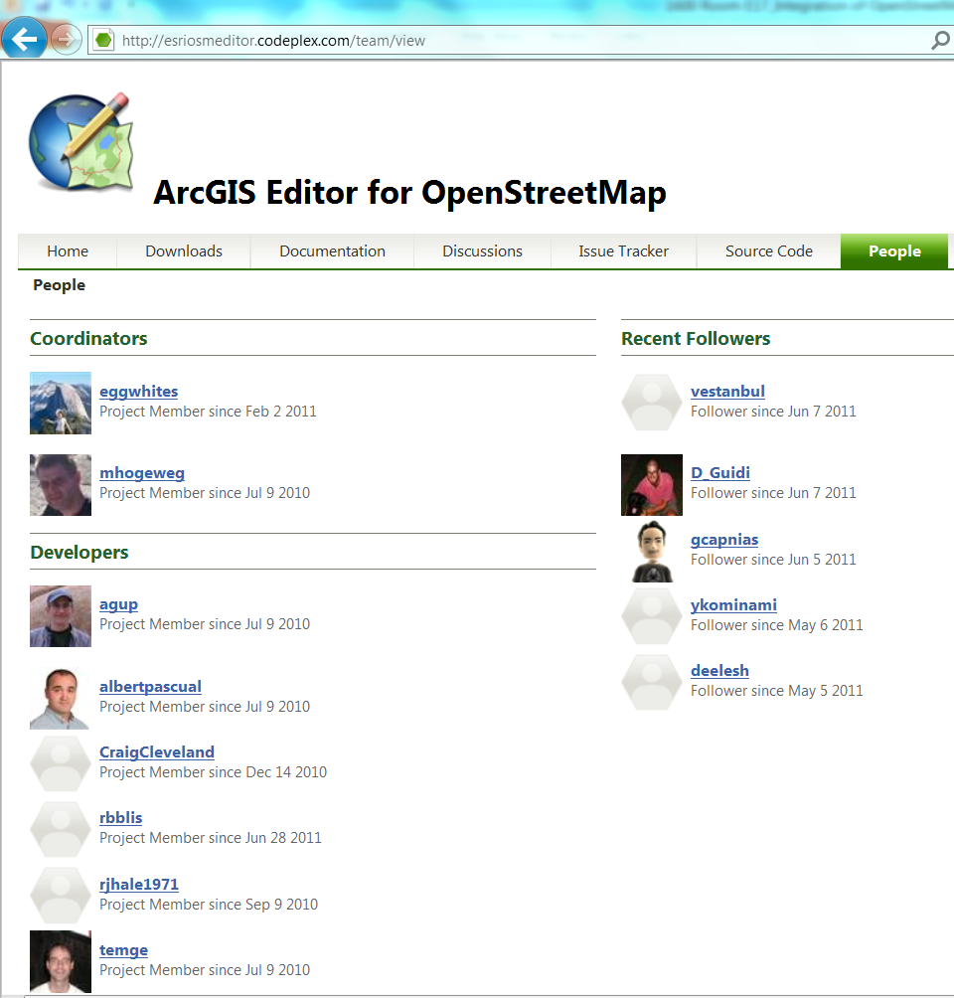

Slide 31
Contribute
http://esriosmeditor.codeplex.com/

