Slide 1
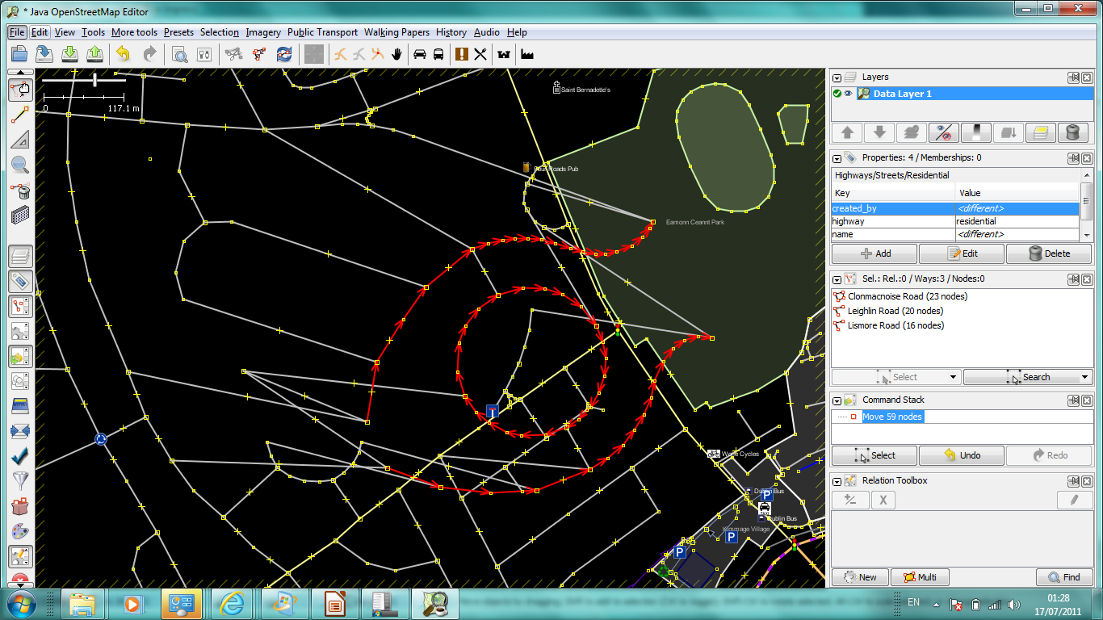
True Offset Process
or “How to stop tracers from breaking your stuff”

Slide 2

Servus!
Dermot McNally
Irish mapper
Co-founder Directski.com
Co-founder Dobini

Slide 3
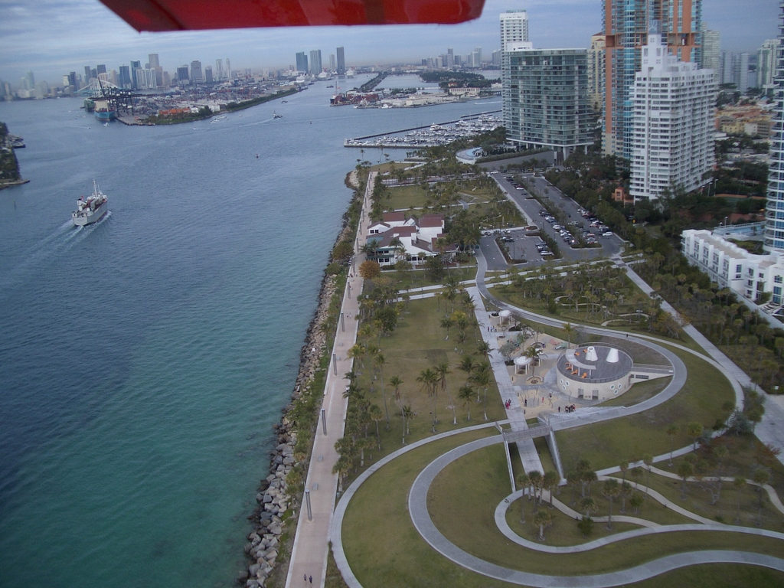
Tracing from Aerial Imagery
Simple
Can be more accurate than GPS surveys
Lends itself to large scale mapping sessions
Popular
You don't have to go and survey it yourself
CC James Good (Flickr)

Slide 4
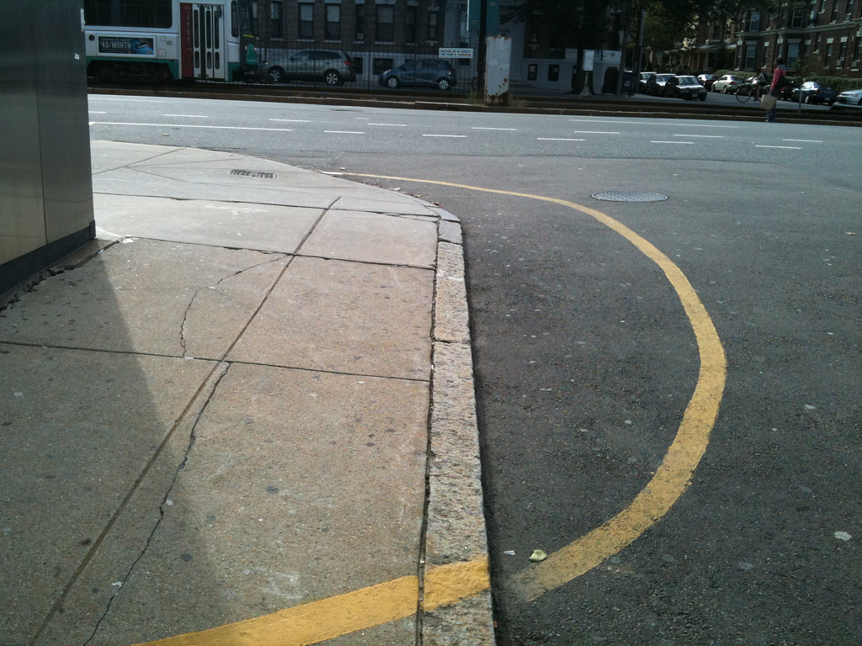
Snags of Tracing from Imagery
You don't have to go and survey it yourself
Calibration can be off (up to 30m)
Mappers often (mostly?) don't know editors can correct offsets. So the existing editor functionality isn't being used
Those who do may not know that there is an offset
Those who understand can't always quantify the offset
Those who correct the offset do so manually each time
The result: inconsistent alignment (surveyed V traced)
Even a prospect of edit wars
CC kbrookes (Flickr)

Slide 5

Offset? What Offset?
Is your local imagery well-aligned? Lucky you!
On Bing, much imagery at least as accurate as GPS...
...but some is off by as much as 30m
Errors on that scale are really detrimental to the map
Ideal solution would be to fix back at imagery provider
But no back channel for that and non-critical for providers
So checking and correcting offset essential when tracing
CC Darren Hester (Flickr)

Slide 6
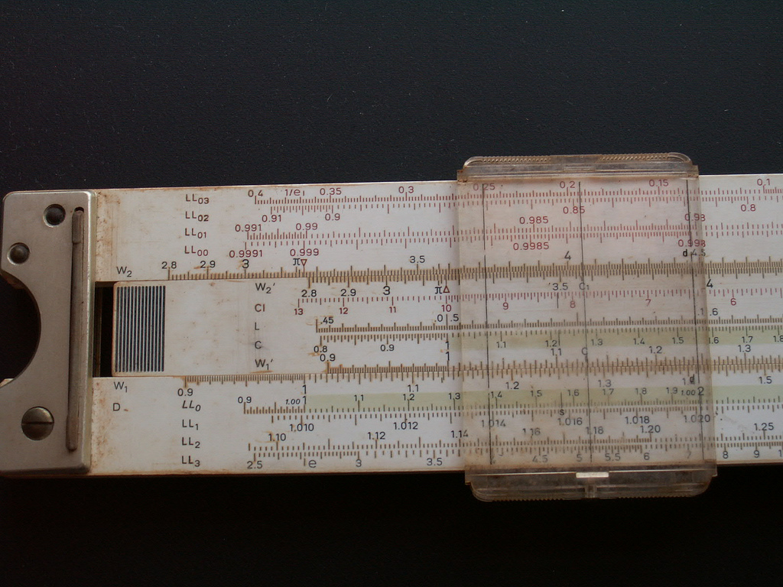
The Right Thing (today)
Realise that imagery can be inaccurate
Realise that your editor can correct the offset
Be able to quantify the offset (GPS trace? Existing data?)
Notice when editing moves to an area of different offset
Use editor function to adjust imagery (manual, bookmark)
Editor supports bookmarking? Better consistency
Watch for clues that offset has changed (new imagery...)
Only one of these steps must fail to break the map
CC James Good (Flickr)

Slide 7
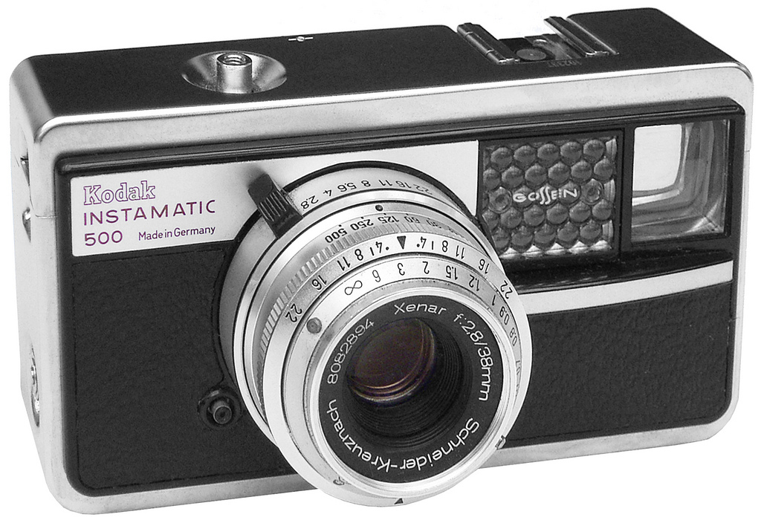
The Right Thing (with True Offset)
Realise that imagery can be inaccurate (or remain ignorant)
Realise that your editor can correct the offset (or remain ignorant)
With luck, somebody else has quantified the offset
Editor sees when you move to an area of different offset
Editor looks up offset from True Offset Web-service and adjusts imagery (a better, shared bookmark)
All mappers use same offsets. Even better consistency
Users must still watch for clues that offsets have changed – but once one mapper updates True Offset, everybody benefits.
The vision: The editor just fixes the offset without user involvement – overriding this becomes the exception, not the rule
CC alf sigaro (Flickr)

Slide 8
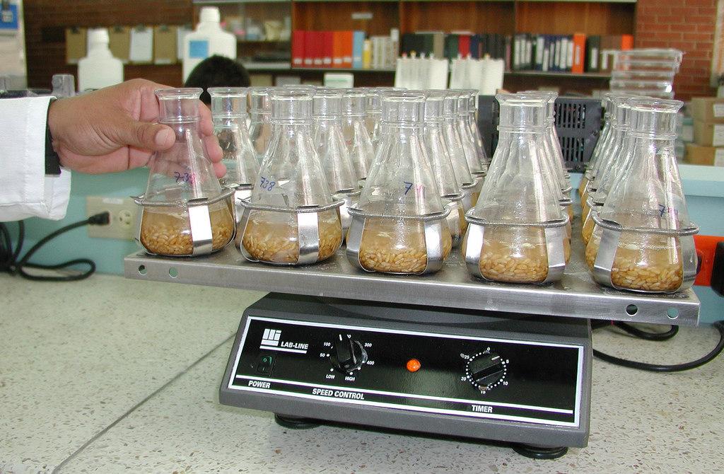
The Science Bit
Offsets for defined areas are stored “somewhere” (OSM)
Offset tagging identifies data provider, applicable zoom range and simple x/y error expressed in degrees
Editors look up a web service querying on a test lat/long (normally centre of edit window)
Avoid too many lookups by returning a bbox of applicability with all responses – fresh lookups required only when user moves outside this bbox
Deployed and working on dev server
http://wiki.openstreetmap.org/wiki/True_Offset_Process
CC CIMMYT (Flickr)

Slide 9
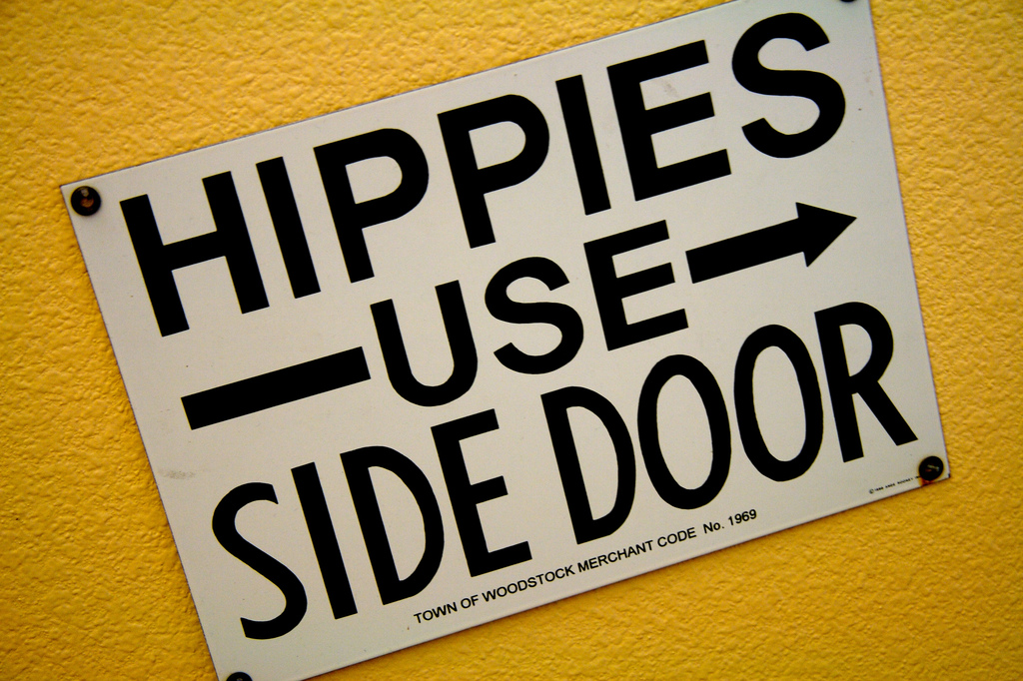
Boo! Get a Haircut!
It doesn't handle rotation, non-uniform scaling, the effect of big hills etc. (then again, neither do the editors)
Offsets can change and invalidate our stored bookmark – but that's true of the personal bookmarks we have today and it needs only one mapper to fix True Offset
Area-based setting of offsets likely to be less flexible than control points in the long run. True Offset web service is agnostic on this point and could support either system or a mix.
It can never work so there's no point trying. But hey, this is OSM and we tend not to let that problem worry us too much.
CC Jeremy Brooks (Flickr)

Slide 10

A note on Editor Workflow
In an ideal world, editors would just fix the error silently
In practice, it may be important to tell users an offset has been applied (or ought to be applied, and request consent)
Having True Offset support that only works if you know it's there offers very low value – the big gain is that less advanced users will no longer trace unadjusted imagery.
CC Red~Cyan (Flickr)

Slide 11
Questions? dermot@dobini.com

