Slide 1
OpenTrail: augmented reality for walkers
Nick Whitelegg
Maritme and Technology Faculty
Southampton Solent University

Slide 2

Alternative navigation
The traditional map has been the usual way to navigate in the countryside
However, with new web and mobile technology, need it be the only way?
What about augmented reality?

Slide 3
Background: OpenTrailView (OTV)
Presented at SOTM Girona 2010
Google StreetView-like application for footpaths
Users take a series of photo shots at key locations, stitch them into a panorama, and upload
GPS track with timestamps used to place the panoramas
See opentrailview.org

Slide 4
OTV: barrier to entry
Take-up of user contributions to OTV a little slow
Likely to be the barrier to entry: taking panoramic photos, stitching them together and uploading to the site requires significant effort
OpenTrailView remains active, but in view of this issue, other areas are being explored...

Slide 5
Augmented reality
Real-world, as seen through the phone's camera feed, is "augmented" with geographical data
Common use: overlaying POIs on camera feed for navigation or "live city guide" e.g. Wikitude [1]
Potential use for countryside navigation

Slide 6
OpenTrail
Android app for countryside navigation
Shows Freemap (free-map.org.uk) maps by default, or out-of-copyright Ordnance Survey maps from ooc.openstreetmap.org
Augmented-reality view as prototype

Slide 7

OpenTrail and AR: how does it work?
Components:
  Camera feed from phone
  OpenStreetMap data overlaid on feed
  Freely available height data (e.g. Ordnance Survey Land-Form PANORAMA) [2] used to adjust OSM data for height

Slide 8
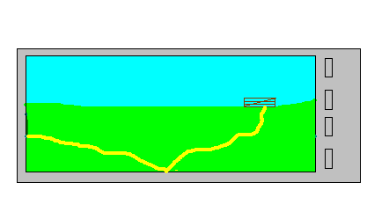
Intended AR view of OpenTrail

Slide 9
OpenTrail and OSM data
Local OSM server setup on free-map.org.uk
Delivers data from PostGIS within a given bounding box in a format optimised for rendering (ways contain coordinates)
e.g.
<rdata>
<projection>epsg:3785</projection>
<way>
<point x="-85640.13" y="6629853.55"/>
<point x="-85689.09" y="6629937.75"/>
<point x="-85722.33" y="6629999.99"/>
<tag k="highway" v="path" /> ...

Slide 10
Delivering OSM data to the device
World divided into approx 5km x 5km tiles (5000x5000 “metres” in selected projection)
When walking and you enter a new tile, OSM data is downloaded and cached on the phone
This data will be used for overlaying on the camera feed
Cache used next time you're in the area

Slide 11
Height data
Ideally, height data needs to be accounted for
If there's a hill in the way, it would be desirable to overlay the OSM data on the slope of the hill, rather than “burrowing into the hill”...

Slide 12
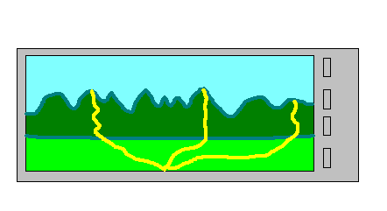
OpenTrail and height data

Slide 13
Height data
Facility implemented but not yet “switched on”
As part of the OpenData package, the Ordnance Survey provide the Land-Form PANORAMA dataset [2]
Globally, NASA SRTM[3] or other national datasets could be used
Gridded heights at 10m intervals
To obtain the height of an arbitrary point on earth (e.g. within the course of a footpath), bilinear interpolation is used

Slide 14
How is the AR done?
We need to know our current position and the device orientation
Obtain GPS position using the Location APIs[4]
Use the Android Sensor API [5] to obtain the orientation of the device (bearing and pitch) expressed as a rotation matrix
This matrix represents the rotation from the phone in standard orientation to the actual orientation

Slide 15
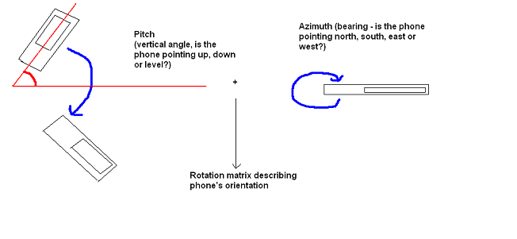
Phone orientation

Slide 16
Rendering the data
OpenGL [6] is used to render the map data on the device
OpenGL defines a "modelview matrix" [7] which describes the relation between the 3D world and our current view of it
The matrix returned from the sensor API can thus be used as the modelview matrix

Slide 17
Current issues
In tests the following appear to be the main issues:
Inaccuracies in OSM data
Instability of compass
  Exponential smoothing [8] [9] mitigates this
Inaccurate horizontal field-of-view angle

Slide 18
Inaccurate horizontal field-of-view angle
Android 2.2+ has an API call for obtaining HFOV [10]
HFOV needs to be accurate to equate the OpenGL perspective with the real world using GLU.gluPerspective()
However Android 2.1 (the test environment) does not :-(
Worse, no published specs for HFOV, focal length, etc, by device manufacturer
Manual calibration will be necessary

Slide 19

Issues with data overlay
Currently, a view showing the camera feed is overlaid on the OpenGL view (yes, that way round! [11] )
However a Google employee has stated that this is not guaranteed to work [12]
Two possible solutions:
  Use a single SurfaceView to render camera feed and OpenGL data (tricky, requires low level APIs)
  Render the camera feed as a texture on the GLSurfaceView (tricky again and slow as camera feed not in RGB format, needs converting)
Hope to have one of these done for Denver! :-)

Slide 20
Downloading OpenTrail
Considered “researchware” at the moment until issues resolved, so available as source only
Source (GPL) in SVN at
  http://www.free-map.org.uk/svn/freemap/android/opentrail
APK for basic version (map only, no AR, UK-orientated) at
  http://www.free-map.org.uk/downloads/android/opentrail.apk

Slide 21
Demo
Data for Vienna pre-downloaded to the test device
If there is interest I can arrange a demo in the Resselpark
Disclaimer: untested outside UK but “ought to” work :-)

Slide 22
References
[1] Wikitude (n.d) "Wikitude" (online) Available: http://www.wikitude.com/en/, last accessed 6/6/11
[2] Ordnance Survey (2011) "Land-Form PANORAMA - small-scale height data of Great Britain",(online) Available: http://www.ordnancesurvey.co.uk/oswebsite/products/land-form-panorama/index.html, last accessed 6/6/11
[3] NASA (2009) "Shuttle Radar Topography Mission", (online) Available: http://www2.jpl.nasa.gov/srtm/, last accessed 6/6/11
[4]] Google (2011) "Location and Maps" (online), Available: http://developer.android.com/guide/topics/location/index.html, last accessed 6/6/11
[5] Google (2011) "SensorManager" (online), Available: http://developer.android.com/reference/android/hardware/SensorManager.html, last accessed 6/6/11
[6] Khronos Group (1997) "OpenGL - The Industry Standard for High Performance Graphics" (online), Available: http://www.opengl.org/, last accessed 6/6/11
[7] Neider, J., Davis, T. and Woo, M. (1994) "OpenGL Programming Guide" Chapter 3, (online) available: http://fly.cc.fer.hr/~unreal/theredbook/chapter03.html, last accessed 6/6/11
[8] Haseman, C. (2009) “Augmented Reality on Android: Using GPS and the Accelerometer” (online), Available: http://www.devx.com/wireless/Article/43005/0/page/2, last accessed 10/7/11
[9] Andreasson, M. (2010) “Technical: Orientation sensing in Photos Around” (online), Available: http://photosaround.mandreasson.com/2010/05/technical-orientation-sensing-in-photos.html, last accessed 10/7/11
[10] Google (2011) “Camera.Parameters” (online), Available: http://developer.android.com/reference/android/hardware/Camera.Parameters.html, last accessed 10/7/11
[11] Henze, N. (2009) "Things about stuff: Camera image as an OpenGL texture on top of the native camera viewfinder" (online), Available: http://nhenze.net/?p=172, last accessed 10/7/11
[12] Hackborn, D. (2009) “Two surface views in a FrameLayout”, thread in android-developers newsgroup (online), Available: http://groups.google.com/group/android-developers/browse_thread/thread/08e7df2e96a7973d, last accessed 10/7/11

