Slide 1
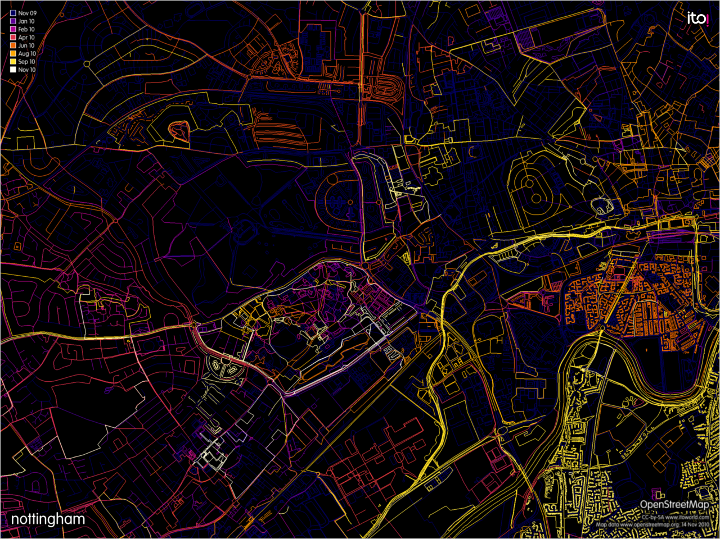
Potlatch2 – Editing for the Masses
Andy Allan
www.gravitystorm.co.uk
www.opencyclemap.org

Slide 2
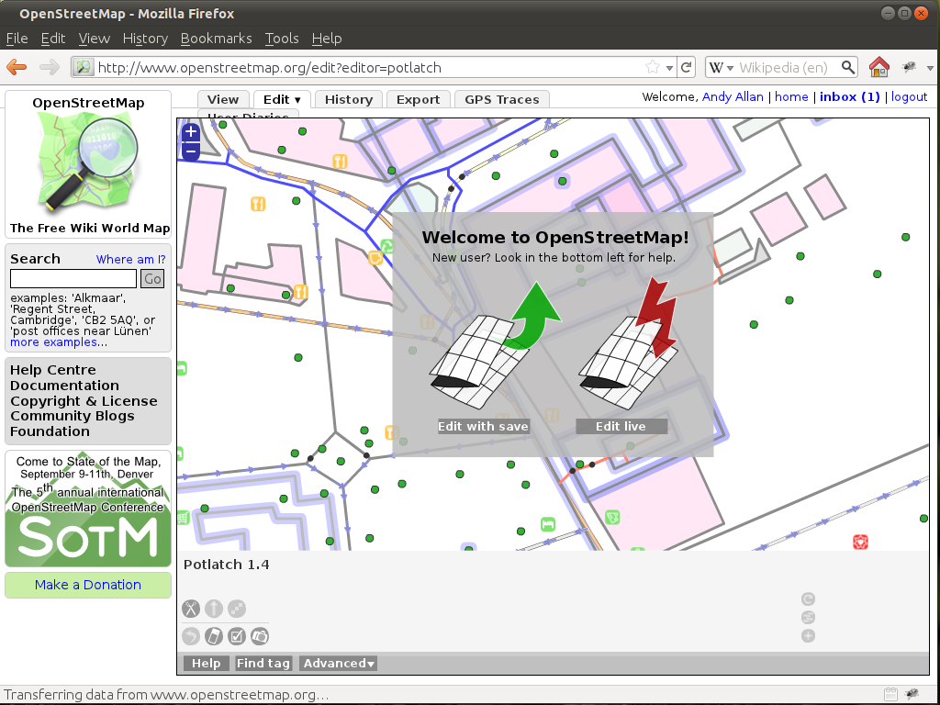

Slide 3
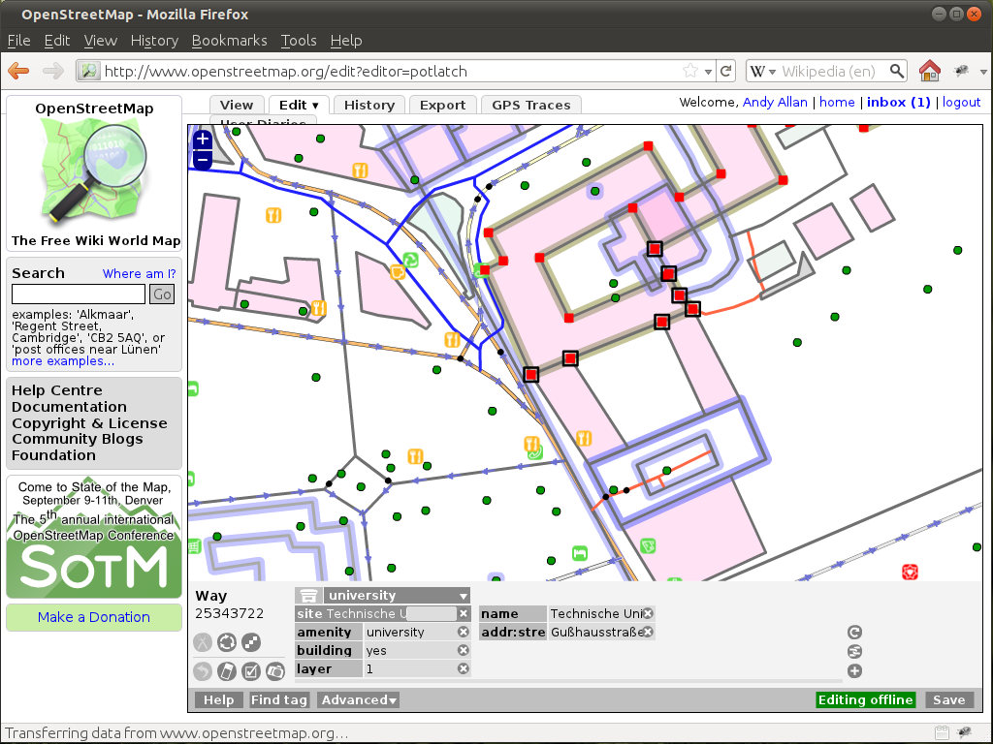

Slide 4
Simple things should be simple,
complex things should be possible.
– Alan Kay

Slide 5
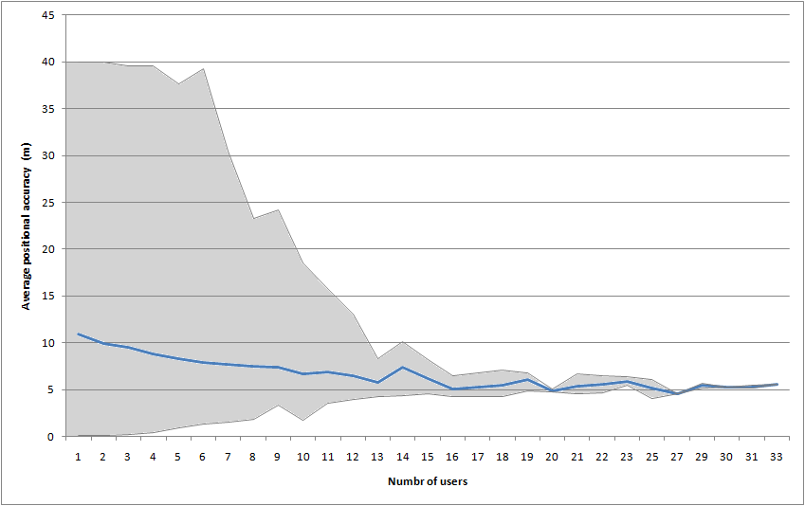

Slide 6
30,717 different users saved data
increasing ~1,800 per week
2nd Most Widely used editor ever
(behind P1)
3rd most Heavily used editor ever
(behind JOSM and P1)
– as of 21st June 2011

Slide 7
Run down of features

Slide 8
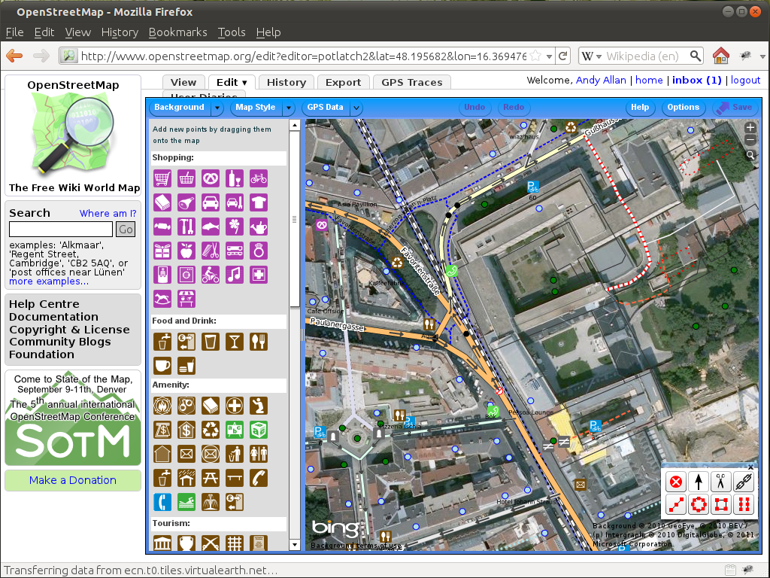

Slide 9
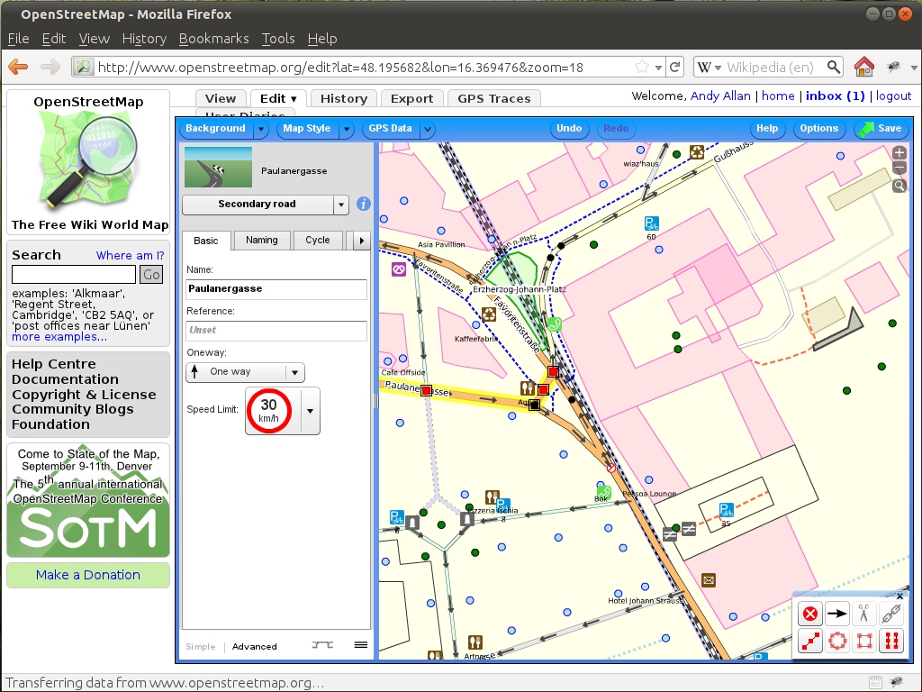

Slide 10
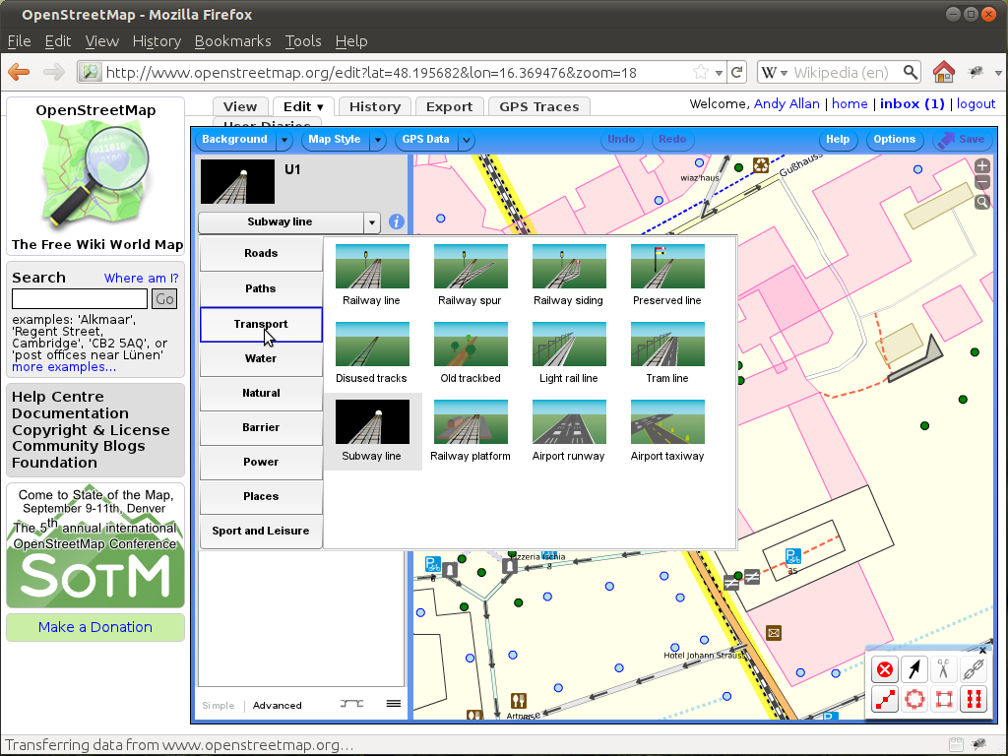

Slide 11
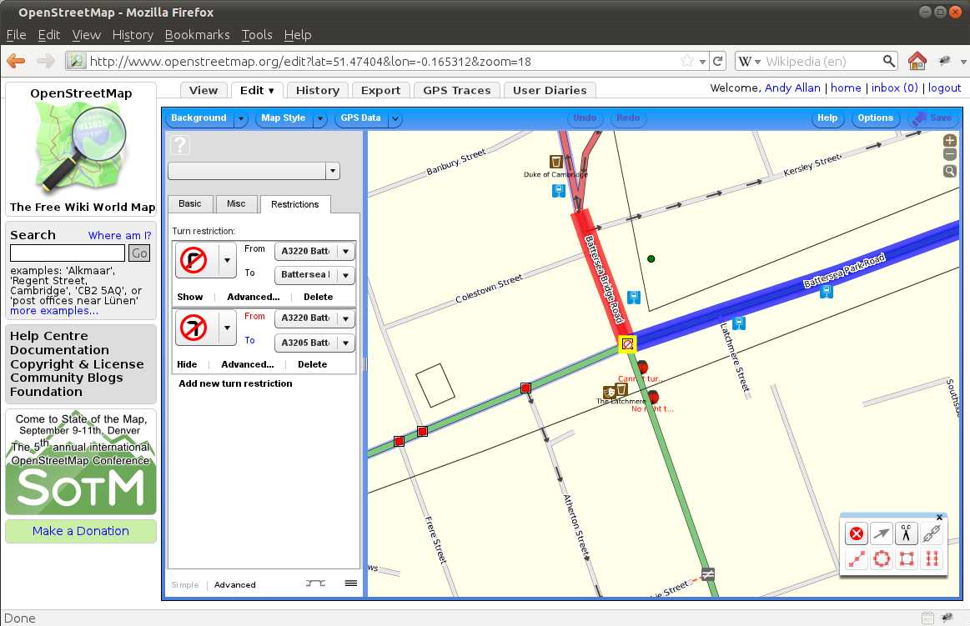

Slide 12
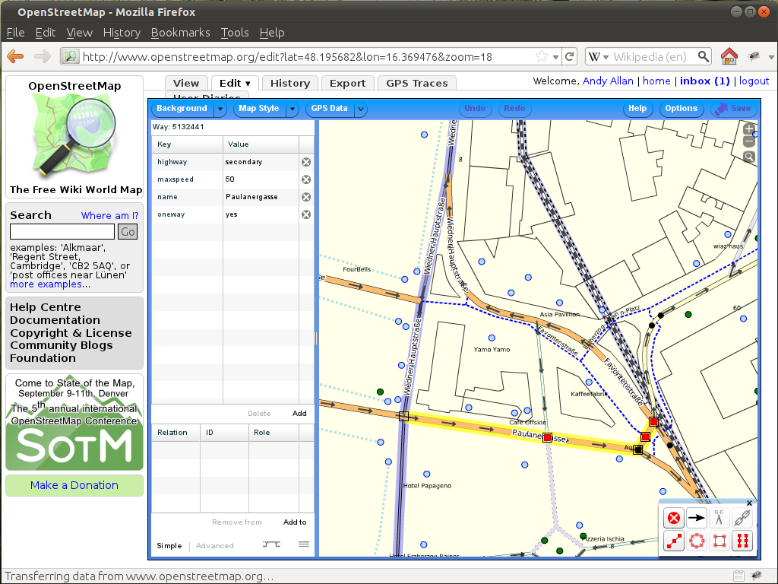

Slide 13
Halcyon and MapCSS

Slide 14
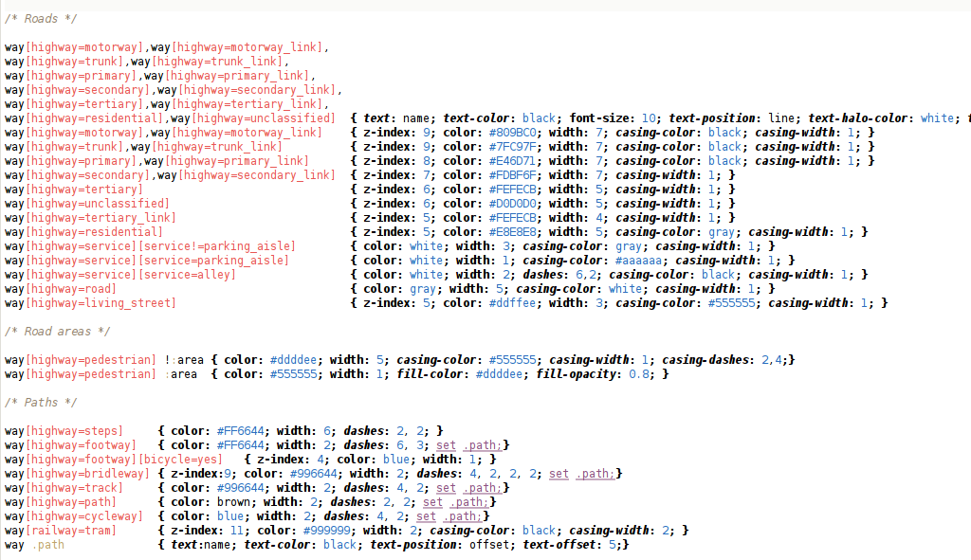

Slide 15
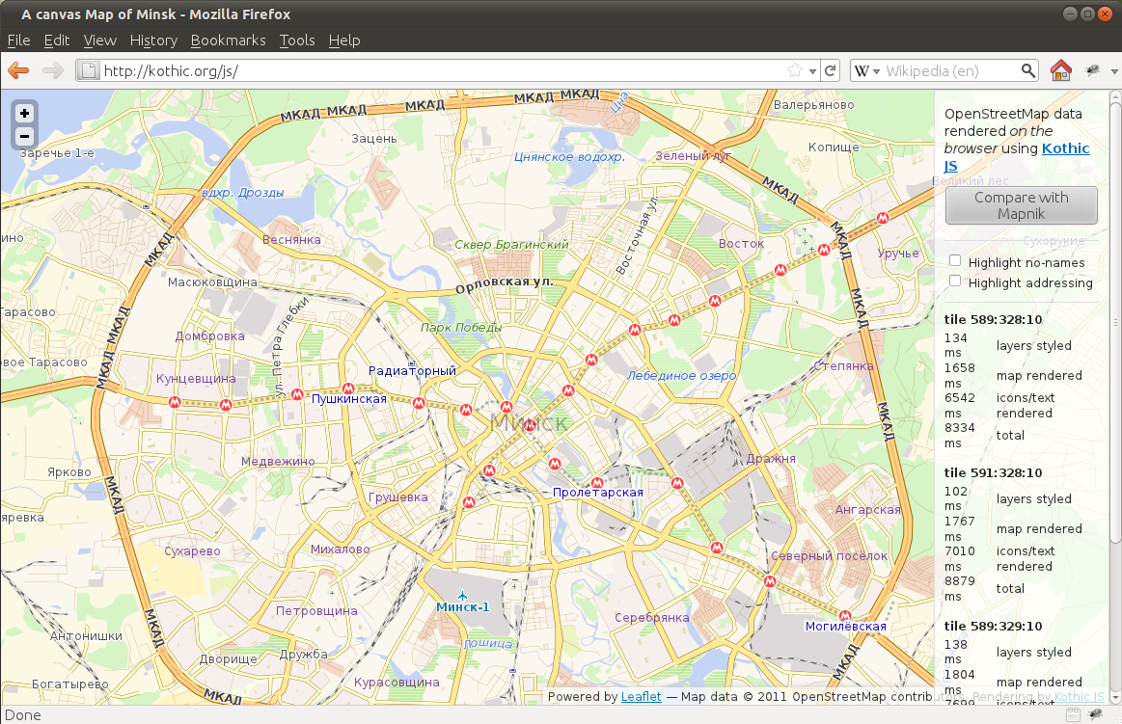

Slide 16
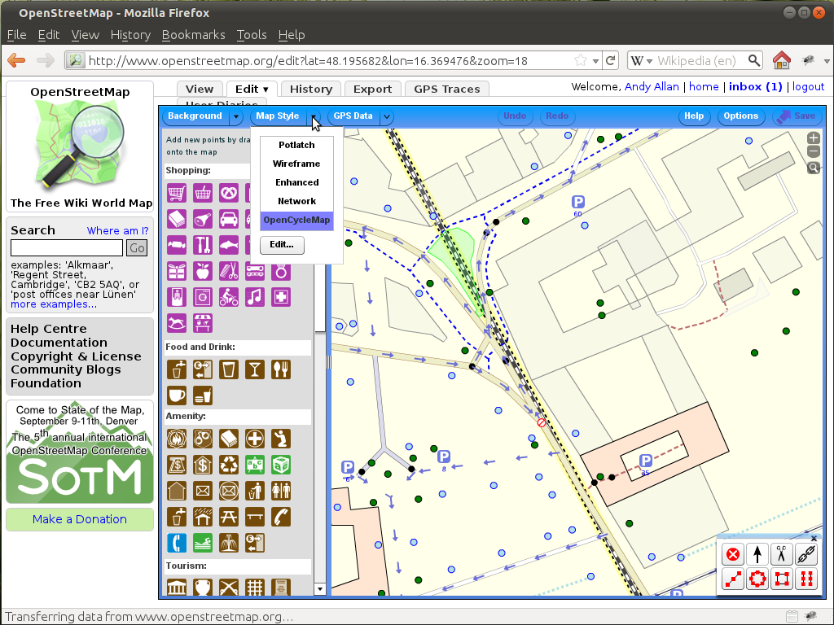

Slide 17
Closing the Feedback loop

Slide 18
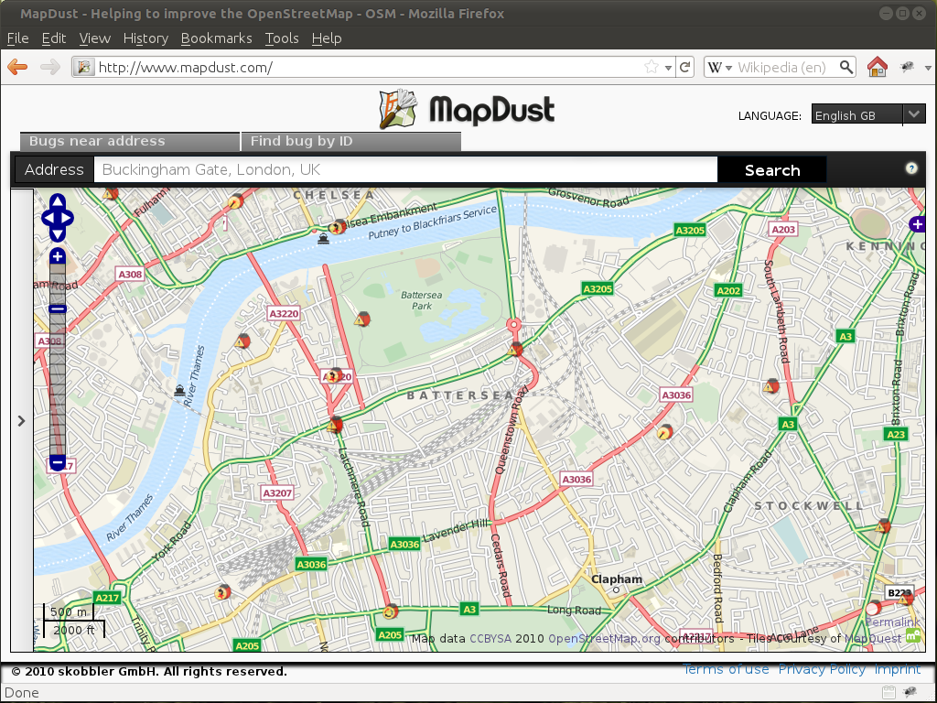

Slide 19
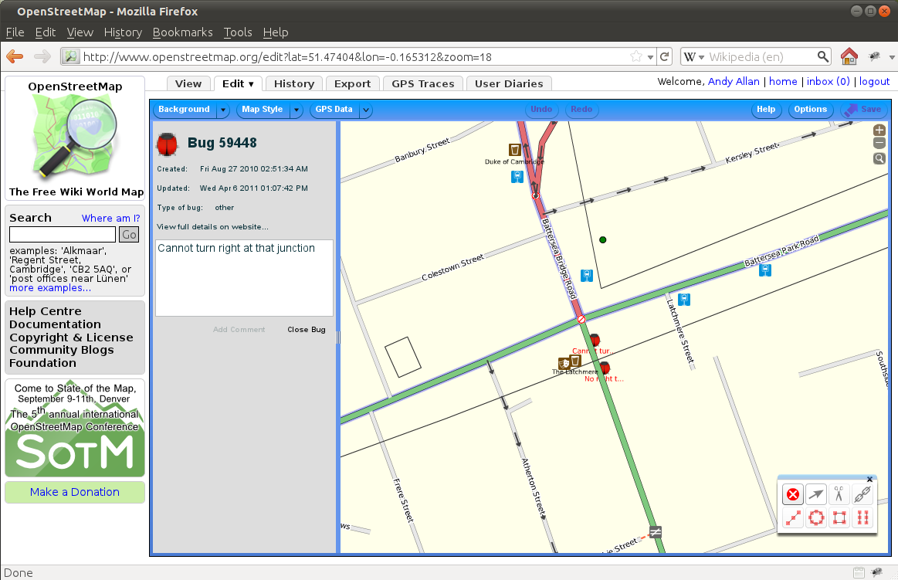

Slide 20
Alternatives to Bulk Imports

Slide 21
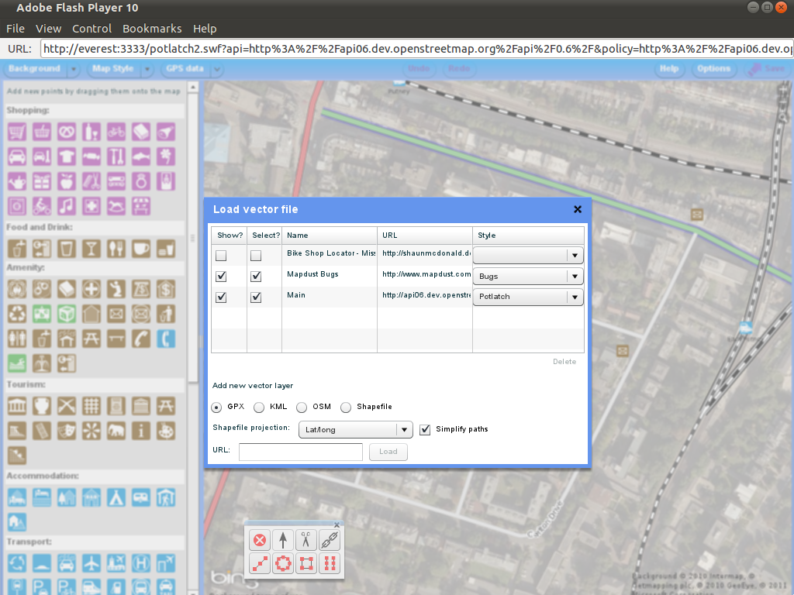

Slide 22
Deploy Custom Instances

Slide 23
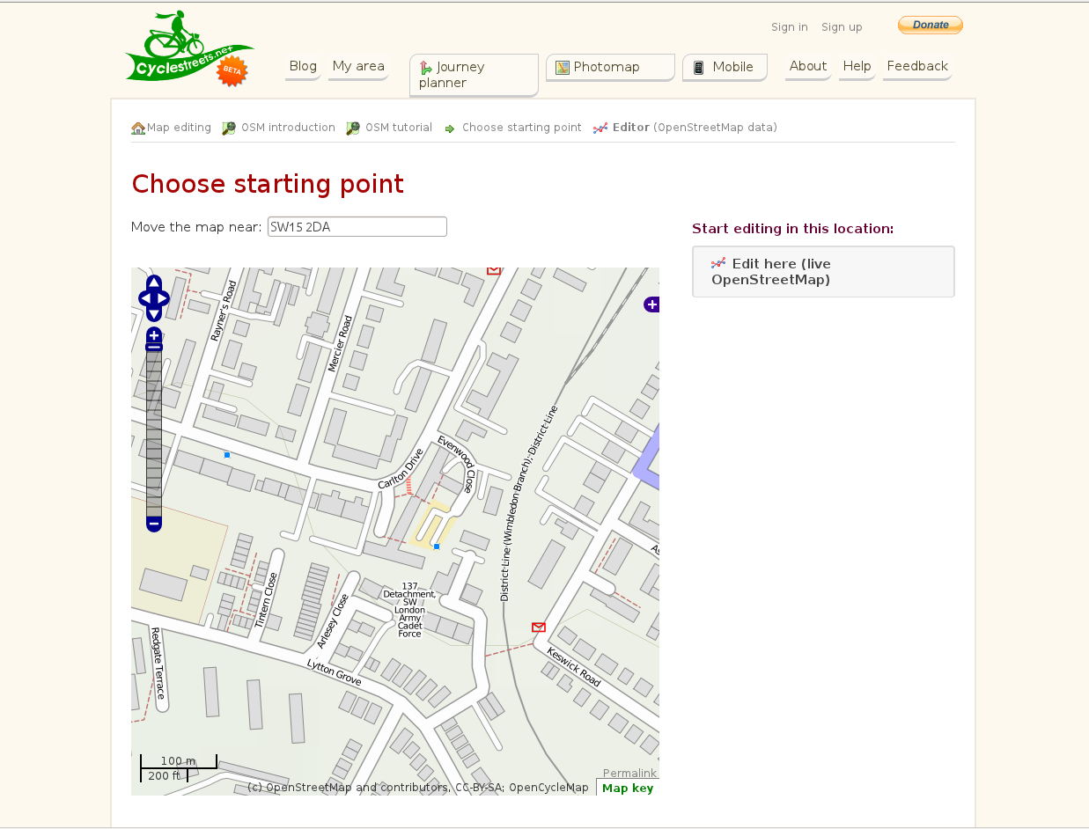

Slide 24
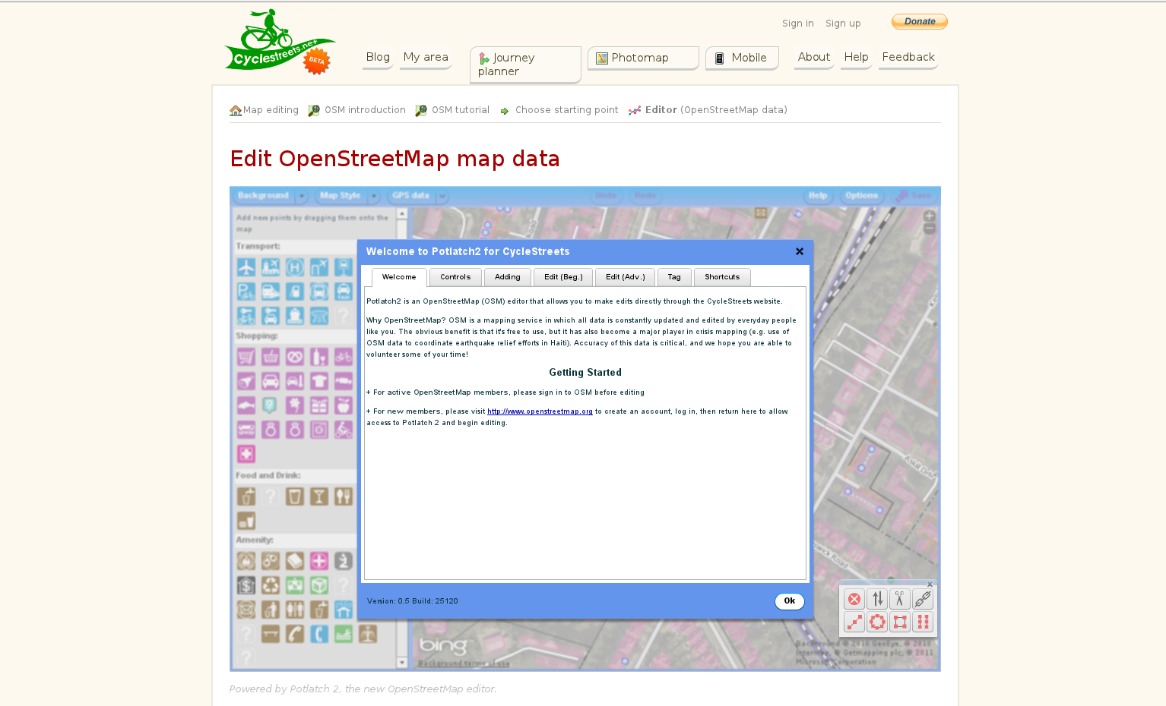

Slide 25
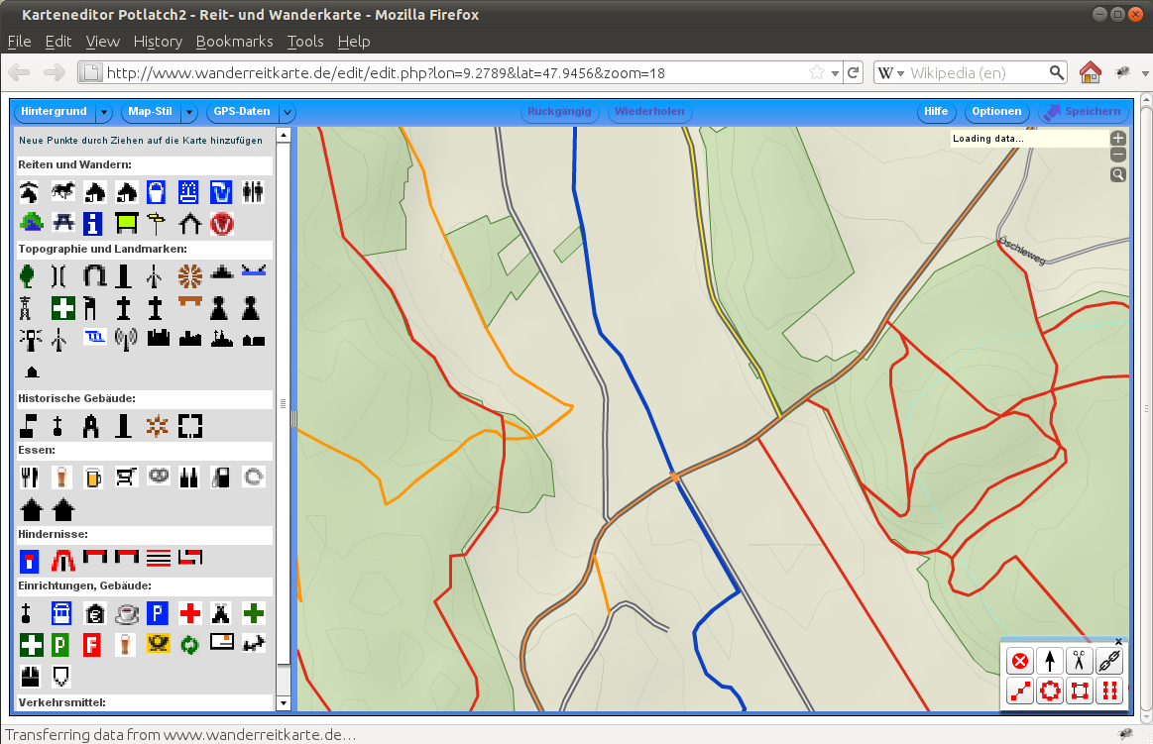

Slide 26
UI Feedback – UCL visits

Slide 27
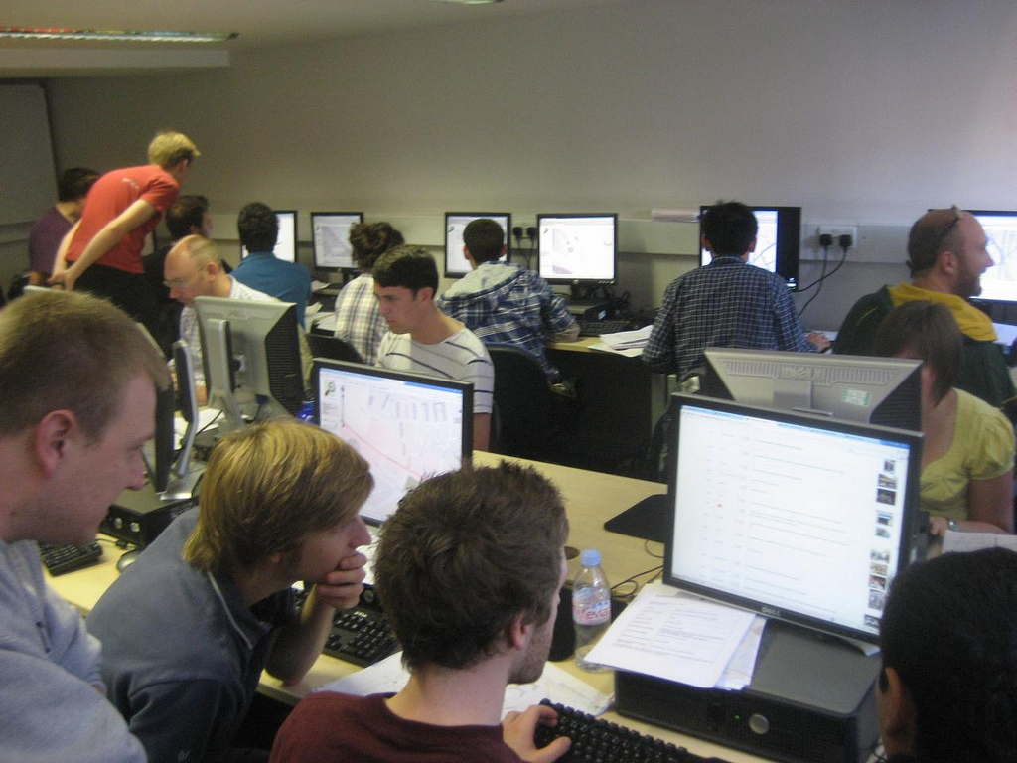

Slide 28
Development basics

Slide 29
potlatch-dev@openstreetmap.org
fork us at https://github.com/systemed/potlatch2.git
wiki.openstreetmap.org/wiki/Potlatch2

Slide 30
We need your help!

Slide 31
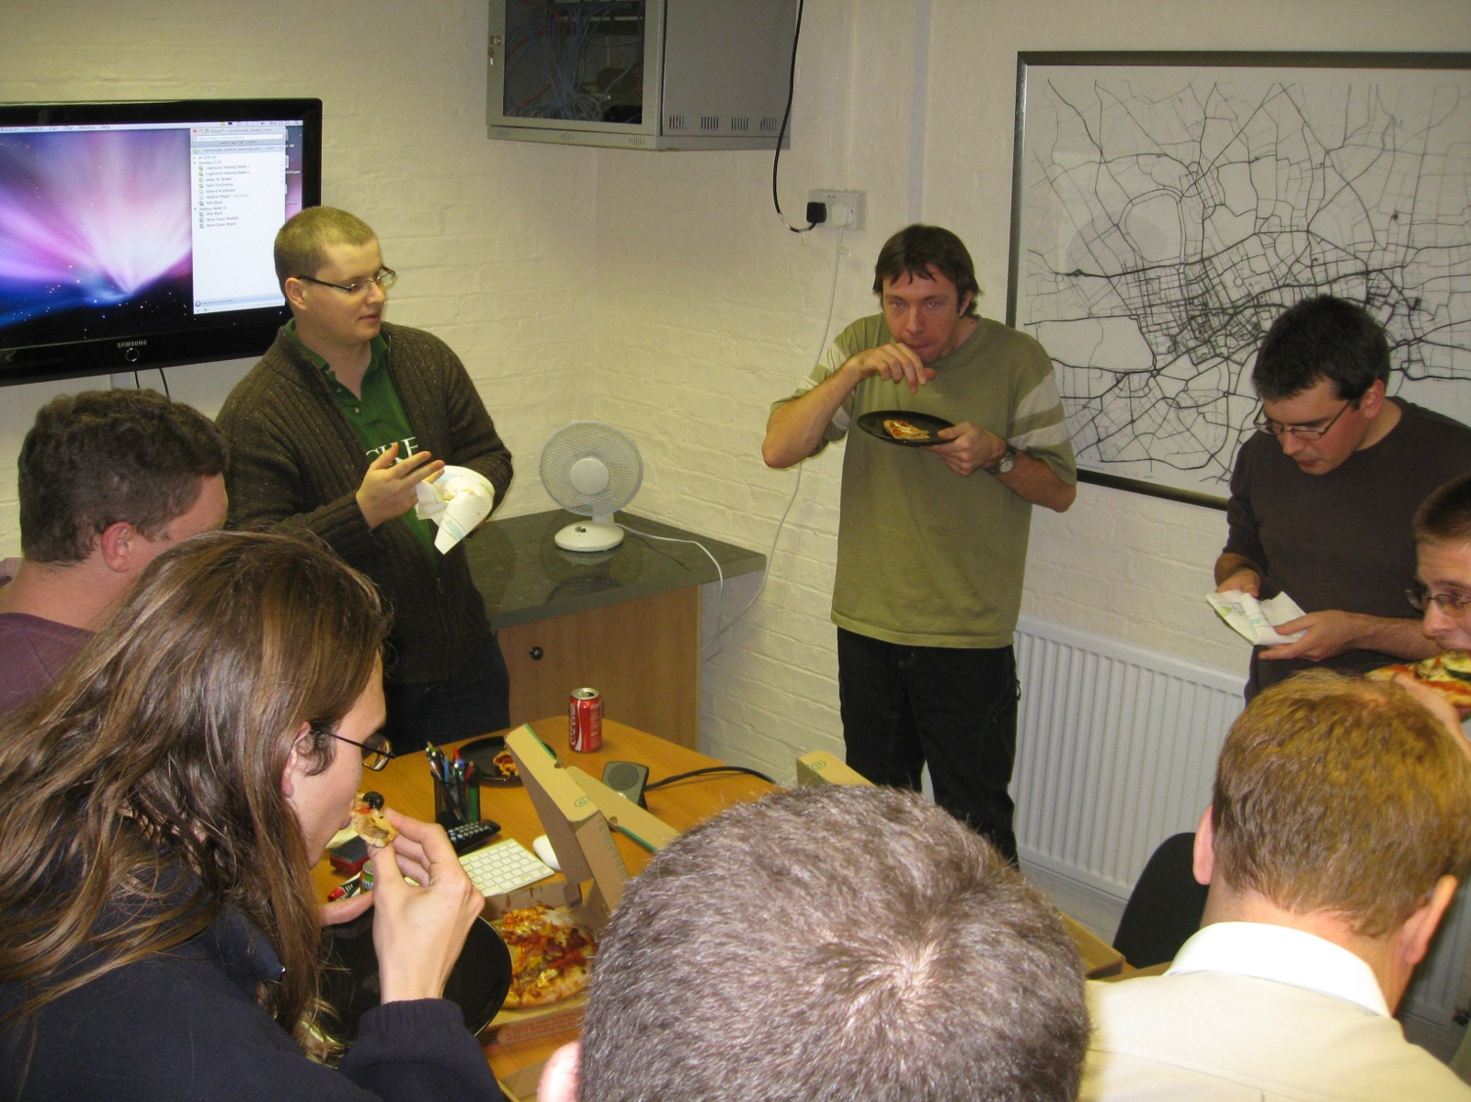
YOU?

Slide 32
Documentation

Slide 33
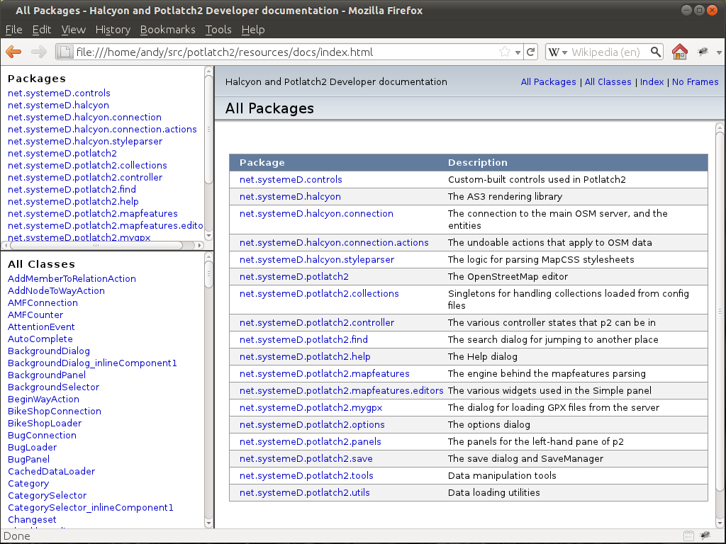

Slide 34
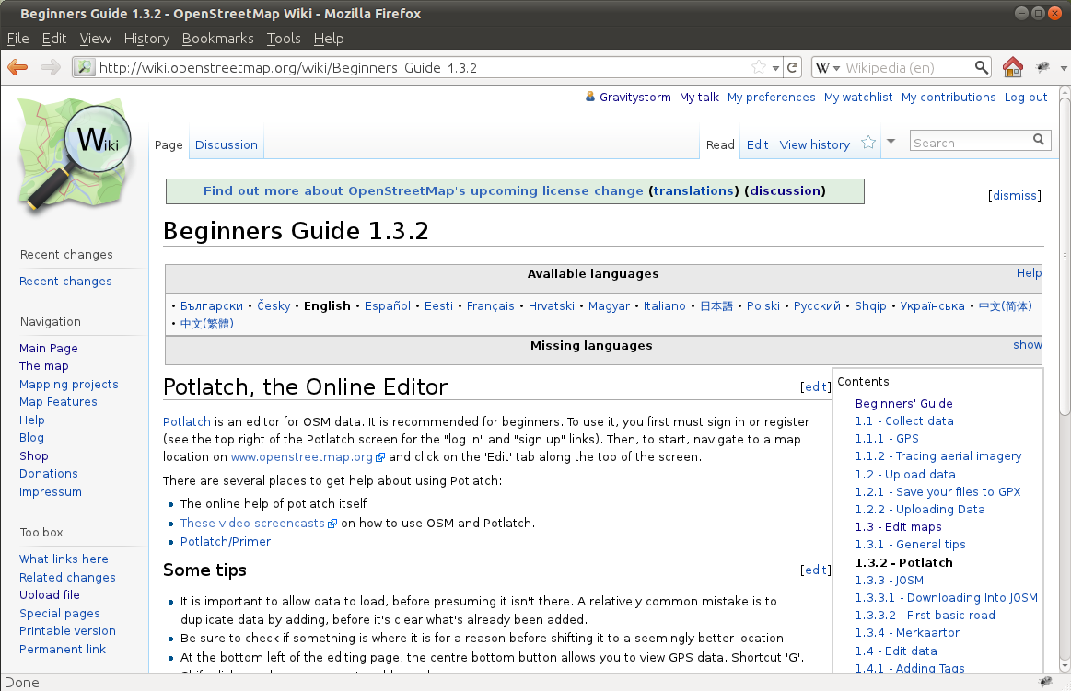

Slide 35
Thank You!
Andy Allan
www.gravitystorm.co.uk
www.opencyclemap.org

