Slide 1
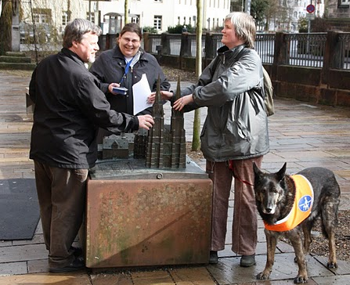
OpenStreetMap for Blind Users
State of the Map Europe
Vienna, July 2011
Dipl.-Ing.
Annette Thurow

Slide 2
Agenda
Just a map on the internet
Usecases on geodata
Accessibility
Map Accessibility
Basic needs of blind or visually impaired users
Replacing visual information
How much information?
The largest text adventure in is the world
Look and Listen Map
Features
Future ideas
Another project: Haptorender
Team members wanted: LoroDux
We need support
Contact

Slide 3
Just a map on the internet!
There are many online maps and routing websites, even with OSM content
Not a single one of them is accessible for use with braille display and/or screenreader
The user group are Blind travellers, pupils and students, but also visually impaired persons, and sighted persons sharing information
Working title is „Look and Listen Map“.

Slide 4
Usecases on geodata
Get an overview of an area
Find landmarks
Get to know relative positions of objects
Prepare a route
Share information with somebody else
Mark objects or routes for later referral
→ For blind persons?

Slide 5
Accessibility
Accessibility means, that you can access information and functionality regardless of your disability.
Accessibility means, you can do it on your own.
Accessibility means, you have the same amount and quality of functionality
Accessiblility means, you can word efficiently.
Accessibility is not reached when a screenreader works on a webpage!

Slide 6
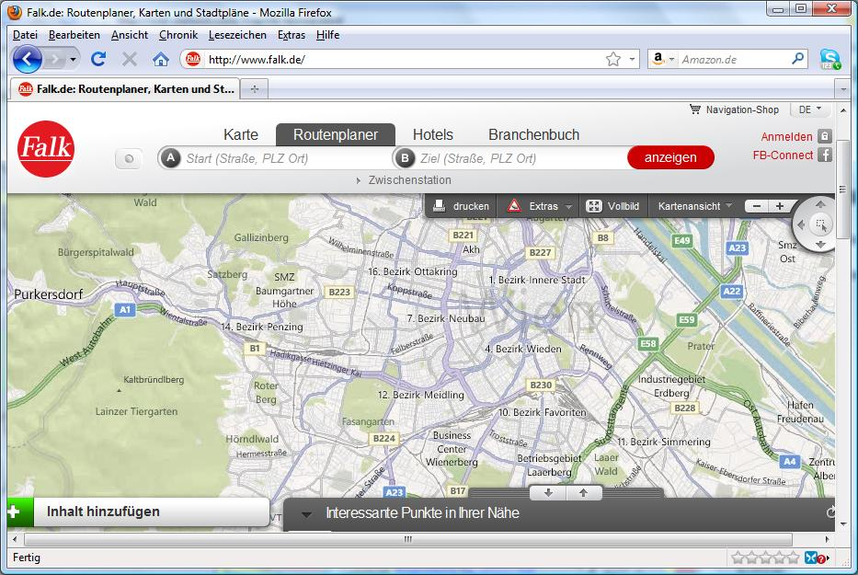
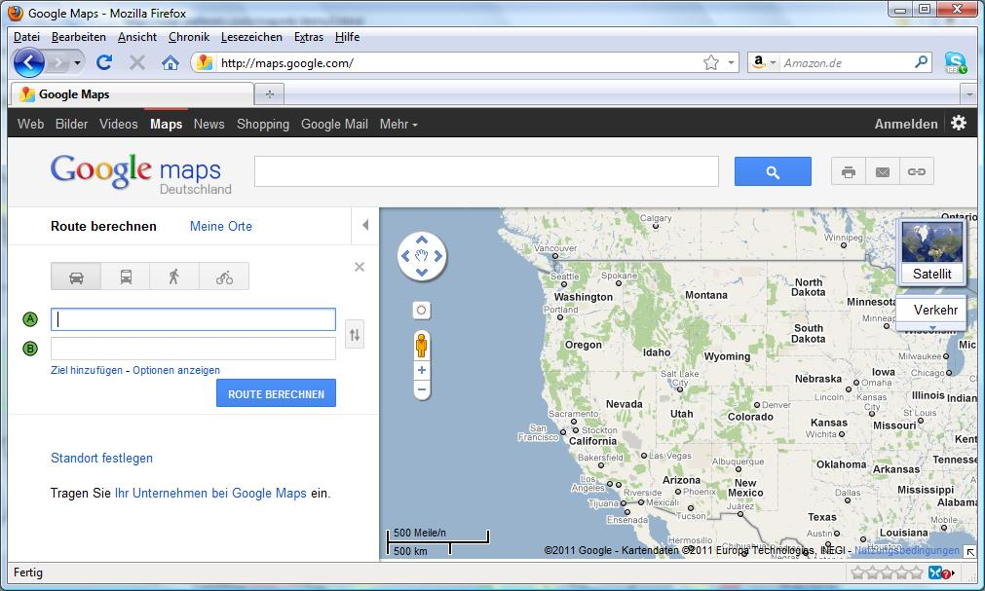
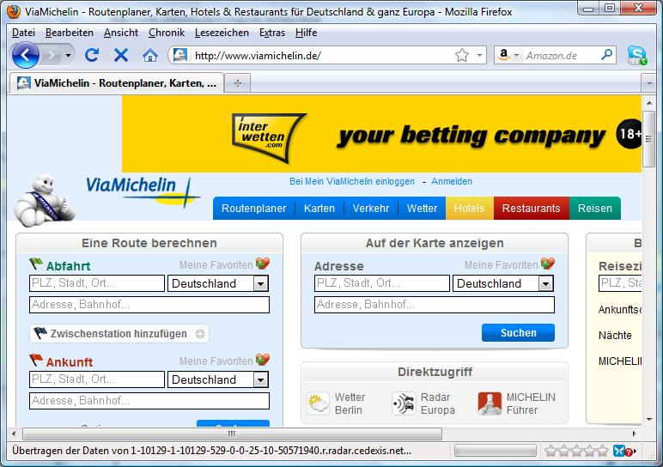
Map accessibility?
No!

Slide 7
Basic needs of blind or visually impaired users
Choice of colors and font size (save for later use)
Sound and/or braille output
Well structured website navigation, use text efficiently:
  Start lines with most meaningful content
  Use smart names for hyperlinks
Map navigation without mouse:
  Zoom, pan, center.
Add information of special interest
  Tactile models or maps
  Tactile paving
  Traffic signals with sound

Slide 8
Replacing visual information
Transfer visual information like you can explain it on the phone:
  „Hamburg is a large city in northern Germany. Bremen is to the west and Hannover is to the south of Hamburg.“
Use different landmarks, e.g.:
  Don't only name streets to turn into, also count crossed service ways

Slide 9
How much information?
On one hand, screenreaders are so time consuming, but on the other hand, blind persons need even more text information!?
Our solution:
A tree view!

Slide 10
(Show tree view on file system)

Slide 11
The largest text adventure in is the world
Project's working title is „look and listen map“.
Won a price in the competion for project ideas about open data/open knowledge „Wissenswert“ of Wikimedia Germany 2010.
Goal: a fully accessible routing and map website with OSM data, including exploration mode: „Walk around in the real map like in a text adventure“.

Slide 12
Look and Listen Map
Project status:
  Project planning finished
  programmer found
  need more money

Slide 13
Features
Run on any device with browser (including mobile devices)
Internationalization (Languages, units)
User login for stored preferences, locations, routes
Export to navigation devices/tools (LoroDux, Loadstone, Kapten etc.)
Visual map to share information with sighted persons
Take-a-walk mode for free map exploration

Slide 14
Future ideas
Include public transportation in routing
3D tactile maps (Projekt Haptorender)
  Offer download of 3D data for tactile maps
  or include a shop to order tactile maps
  Use braille writing and add a legend for abbreviations
Rendevous functionality:
  Two users with mobile devices want to meet, server recommends to routes to optimized meeting point.

Slide 15
Another project: Haptorender
Haptorender is a project to produce tactile maps with OSM data.
  Templates of traditional handcrafted tactile maps are available
  Font can already be changed to Braille easily
  To do:
    Decide what's in the map and what not
    Choose 3D texture styles for tags
    Create .stl 3D machine format from OSM data
    Automatic abbreviations on the map and automatic legend creation

Slide 16
(Show tactile map on document camera)

Slide 17
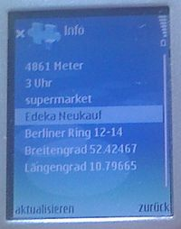
Team members needed:LoroDux
Project LoroDux:
A graphics-free navigation solution on JavaME
Used by blind persons with screen reader
Geocaching mode works fine
Todo:
  Minor bugfixing needed (small tasks!)
  Implement routing
  Maybe switch to OSM binary file format

Slide 18
We need support
Really cool projects: 3D, augmented reality!
Well approved requirements available
Small or large tasks to share
Sponsors wanted
Cooperation / integration with other OSM projects wanted
Target user group really needs this!
Join „OSM for the Blind“!

Slide 19
Contact
Questions?
Visit us in the wiki http://wiki.osm.org/wiki/for_the_blind
Subscribe to the mailing list
accessibility@openstreetmap.org
blindennavigation@lists.openstreetmap.de
Annette.Thurow@gmx.de
Donate to the projects on www.fossgis.de

