Slide 1

MVP OSM a tool that allows to individuate the areas of high activity based on level of detail
Maurizio Napolitano <napo@fbk.eu>
SoNet Group– http://sonet.fbk.eu

Slide 2
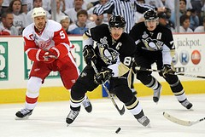

OpenStreetMap like a game
Who are the best players?
Who are the Most Valuable Players?
Images from:http://www.flickr.com/photos/sully_aka__wstera2

Slide 3

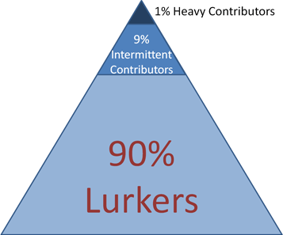


The 90-9-1 Principle
MVP!!!
Jakob Nielsen's Alertbox, October 9, 2006 inShare68
Participation Inequality: Encouraging More Users to Contribute
http://www.useit.com/alertbox/participation_inequality.html 1-9-90

Slide 4
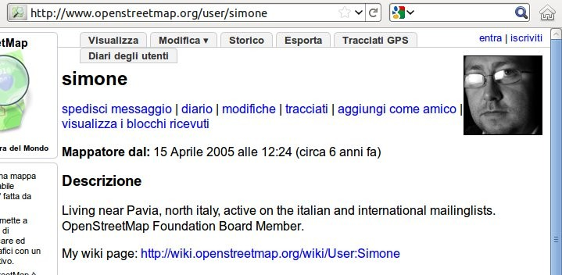
How find?
Common Sense:
a user is a good player if gives many contributions to the map
a test with an italian user

Slide 5
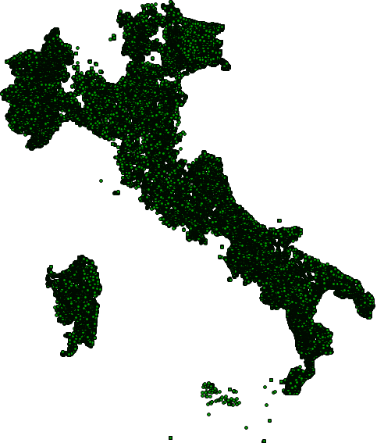
Nodes created by simone
?
?
?
?
?
The complete Italy???

Slide 6

… he is also a “data” importer ...
[...]
I'm the prime guilty for the import of
the italian internal borders between
municipalities, provinces,
regions, and country
[…]
http://wiki.openstreetmap.org/wiki/User:Simone#Data

Slide 7
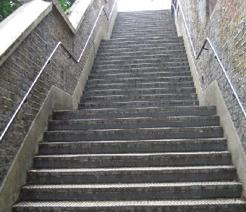
Solution
Restrict the query only to some details,
those requiring
Local knowledge
Experience
Recognition
A good example:
step_count=*
44 keys selected

Slide 8
Keys ...
abandoned
access
access:bicycle
access:bus
access:foot
access:hgv:max_length
access:motorcar
amenity
bicycle
bicycle:backward
dispensing
disused
drinkable
embankment
foot
foot:backward
footway
hiking
horse
incline
oneway
recycling:batteries
recycling:cans
recycling:clothes
recycling:engine_oil
recycling:glass
recycling:paper
recycling:plastic
recycling:plastic_bottles
recycling:plastic_packaging
recycling:scrap_metal
recycling:white_goods
recycling:wood
step.condition
step_count
step.height
step.length
surface
surface.material
traffic_calming
traffic_sign
trail_visibility
visibility

Slide 9
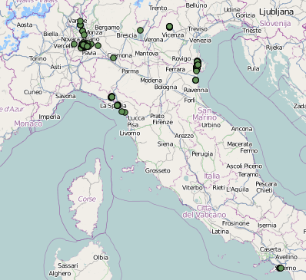
this is the new result
Locations:
Personal life (family, vacancy, work)
OSM life (mapping party, short journeys ...)

Slide 10
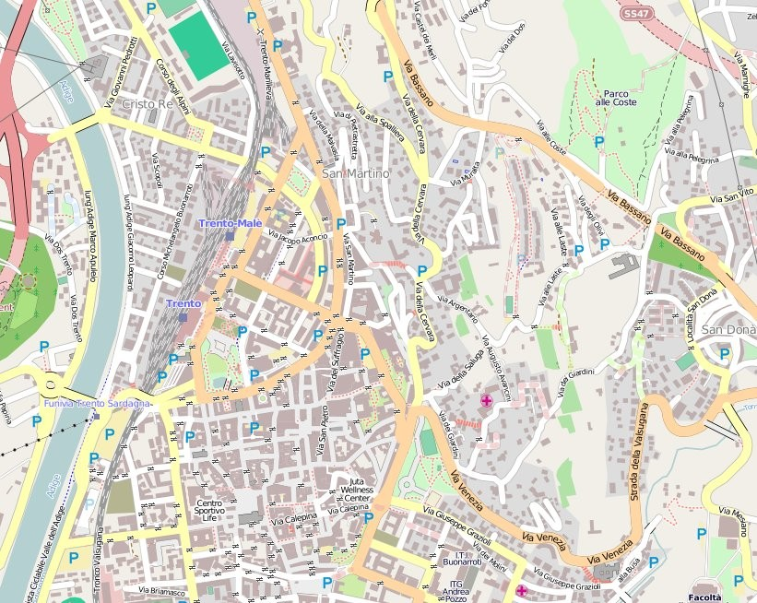

The “pet location” concept
have a great care for a location as well as a lovable pet
http://matt.dev.openstreetmap.org/owl_viewer/

Slide 11
Pet location vs Mapping Party
You will always find a mailbox that isn't mapped
Edoardo Marascalchi
italian osm mapper
frequency of update
...but there is always a little bit of noise

Slide 12
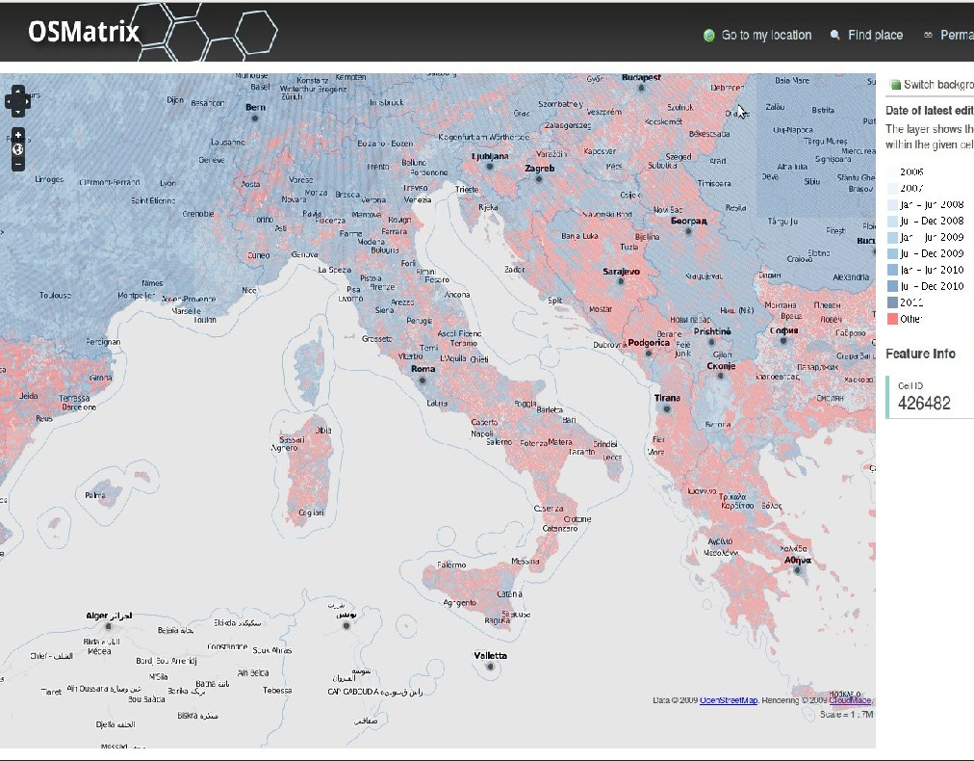
Like in OSMatrix
Date of
last edit
Linus Law
"given enough eyeballs,
all bugs are shallow"
Eric Raymond
http://koenigstuhl.geog.uni-heidelberg.de/osmatrix/

Slide 13
Crowd Quality concept
attempts to quantify the ‘collective intelligence of the crowd
generating data’ in a spatio-temporal context.
User quality
Local knowledge,
Experience and Recognition
Feature quality
Like a MVP player
How many different users contributed to a feature?
How has a feature developed over time?
"The impact of crowdsourcing on spatial data quality indicators"
M. van Exel, E. Dias, S. Fruijtier - 2010

Slide 14
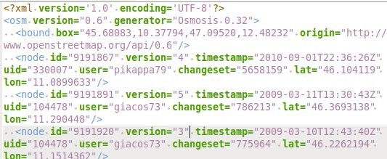
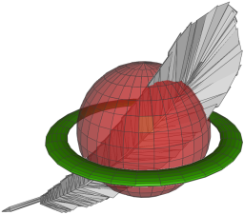


How MVP OSM works
osm xml
spatialite
spatialite_osm_raw
python
sql
differet vectors
for a gis analysis
https://github.com/napo/mvp-osm

Slide 15
The imported tables structure
spatialite_osm_raw -o map.osm -d database.sqlite
osm_relation_way_refs
osm_relations osm_way_node_refs
osm_node_tags osm_way_tags
osm_nodes
osm_ways
osm_relation_node_refs
osm_relation_relation_refs
osm_relation_tags
[...]
GEOMETRY (points)

Slide 16
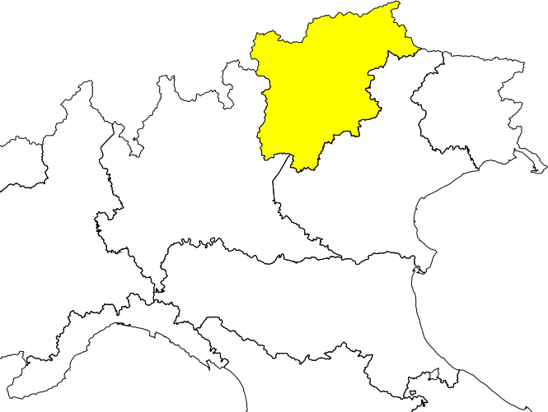
An example with Trentino Alto Adige

Slide 17
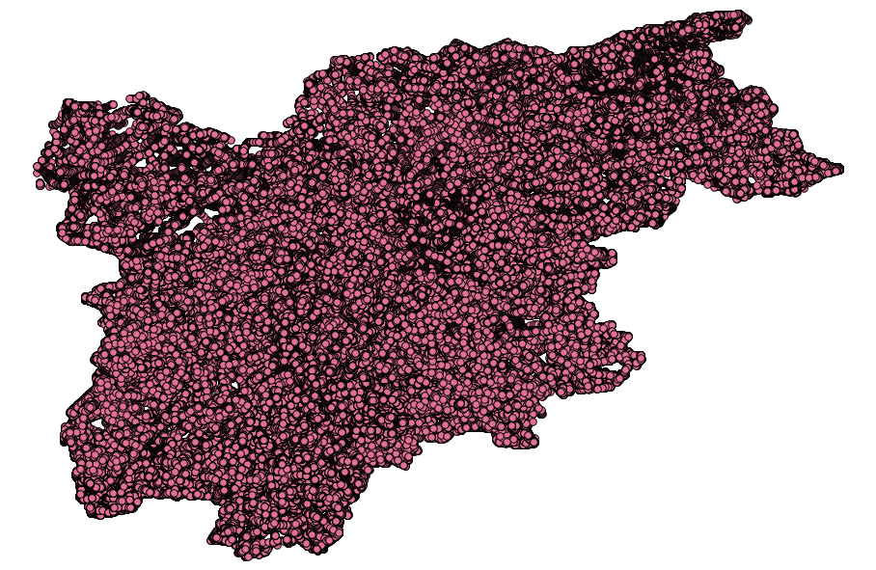
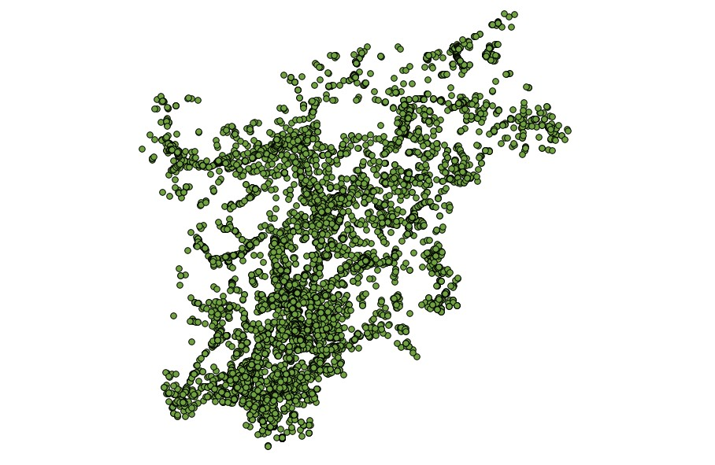
STEP 1/3 – find the points
Query to extract the details
1253 users contributed to this map.
2465872 points
600 users match the query
13675 points

Slide 18
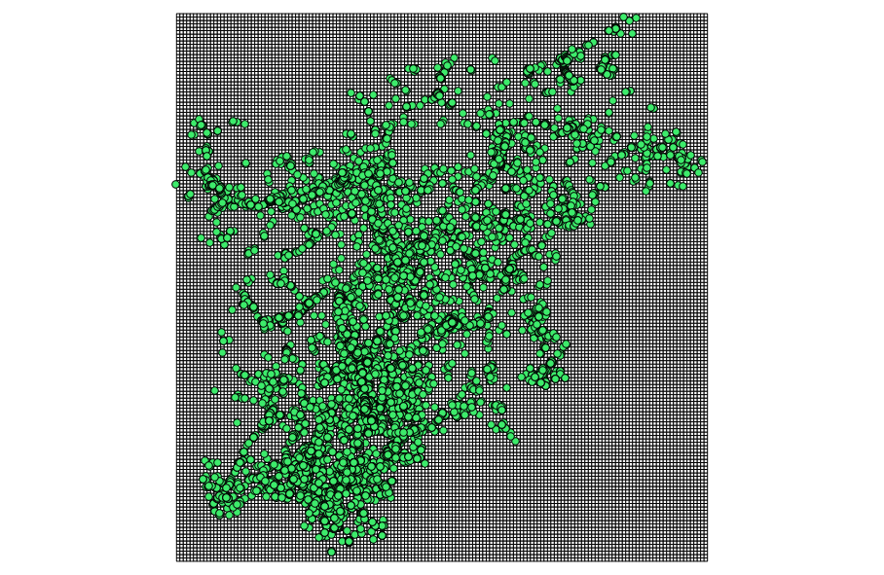
STEP 2/3 - Density
create a grid ...
1 km
1 km
(in this case)

Slide 19
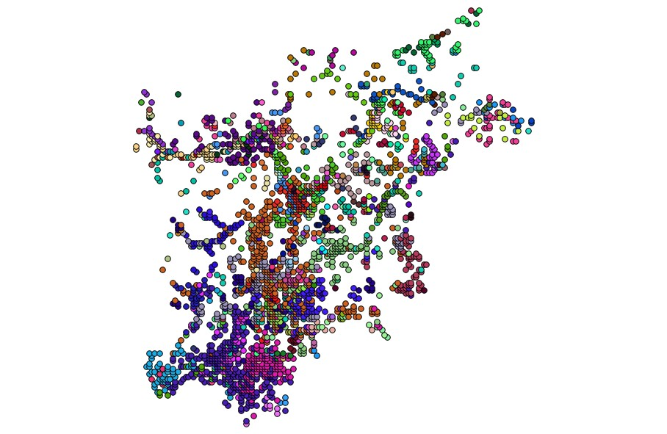
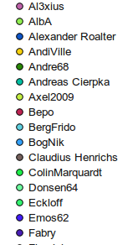
STEP 2/3 - Density
... calculate the data density for each user
2.444 cells
this operation calculate only the users active over the past 3 months
In this case 147 users

Slide 20
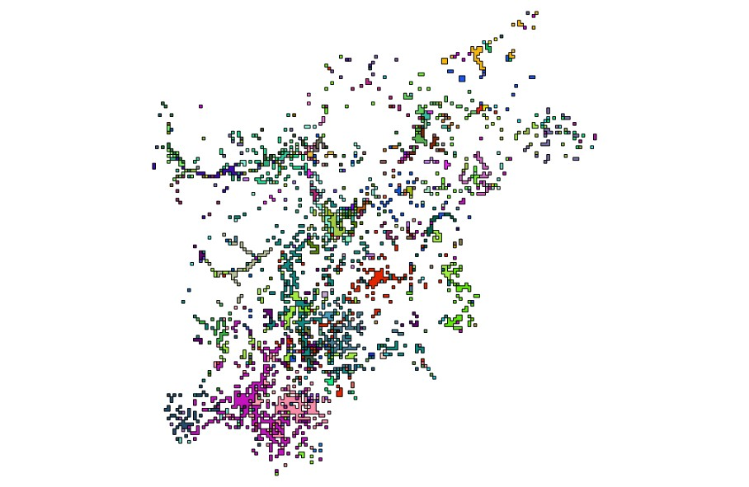
STEP 3/3 - cluster
cluster the data for each user by distance

Slide 21
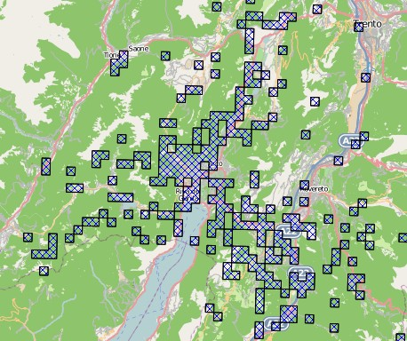
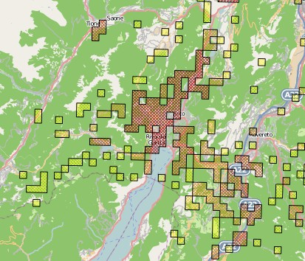
Data Analisys (1/2)
Pet location for a user (1) and where is the most activity (2)

Slide 22
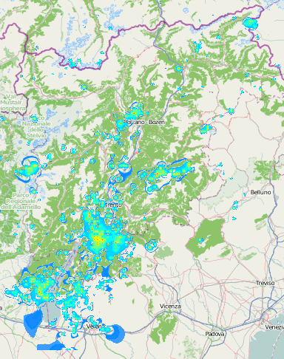
Data analisys 2/2
heat map of the locations

Slide 23
End
Thanks for the attention
Special thanks to Alessandro Furieri
(spatialite head developer)
for the support
Attribution 3.0 Unported

