Slide 1

The Free Wiki World Map
Frederik Ramm
ramm@geofabrik.de
24C3
Berlin, 29 December 2007

Slide 2
If you want
SEX
you're in the wrong room.
Sex is in room 1.
Notes:
just in case someone reads this after the event – the organizers had scheduled a talk on online dating and sexual fulfillment, titled “sex 2.0”, in the same slot but another room ;-)

Slide 3
What is OpenStreetMap?
Wiki-style world map of everything
CC-BY-SA licensed
Started in the UK, 3 years ago
20k registered users (10% active),
175m GPS points

Slide 4
Why do we do it?
UK motif: Ordnance Survey lording it over
General idea: cool things can be done with proper geodata
Collecting data is fun
Political aspect: maps == power

Slide 5
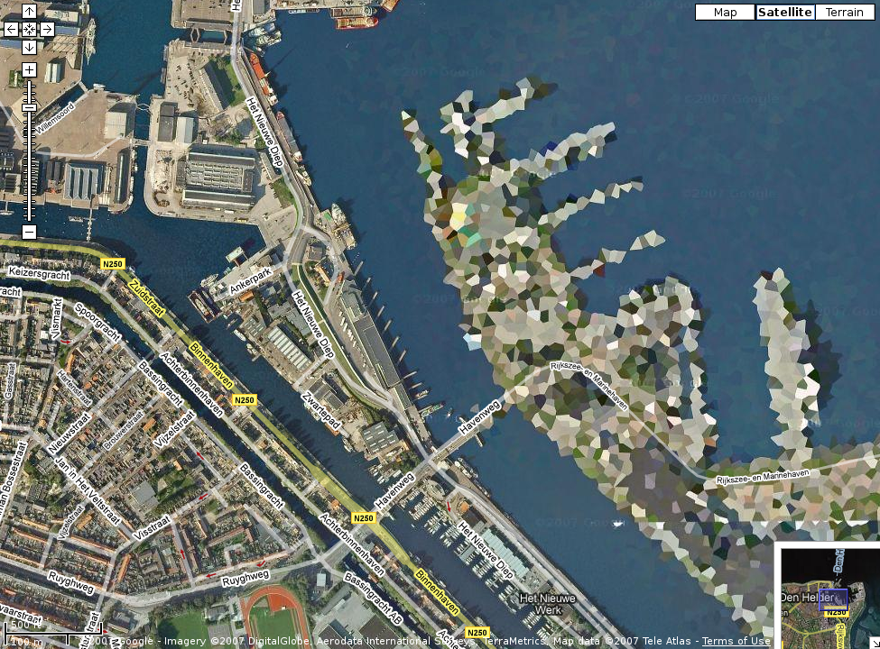

Slide 6
Political aspect: Maps == Power
History is full of examples
Mapping the planet is an area of natural monopoly and we don't want THEM to have it.
Monopoly fears not far-fetched: Teleatlas and Navteq takeovers
Notes:
History is full of examples where maps were created or manipulated in order to uphold or gain power.
In today's world, control of navigation data means control of traffic flow.

Slide 7
The OpenStreetMap Spirit
Very little rules – no project management
“brutally pragmatic”
broad community participation: “we have unlimited free labour”
“GIS standardophobia”
Notes:
free-form tagging – Germans always want strict rules!
GIS standards are often head-strong, complex; difficult for the masses to work with (think army of school children!)

Slide 8
What have we got?
Notes:
Good, self-made coverage of UK, Germany, some other places in Europe
Imported data for US (TIGER) and the Netherlands
Some areas drawn from aerial imagery (Yahoo deal)
Better than commercial in some areas (more detail, more current)

Slide 9
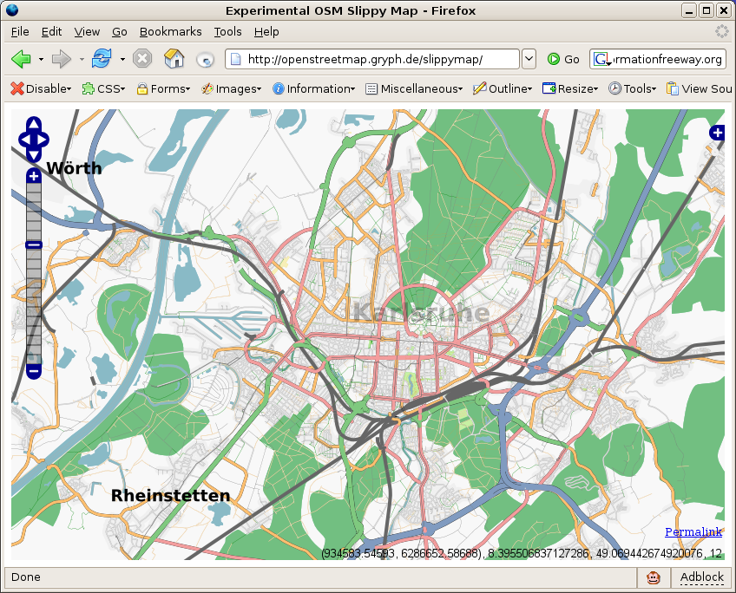

Slide 10
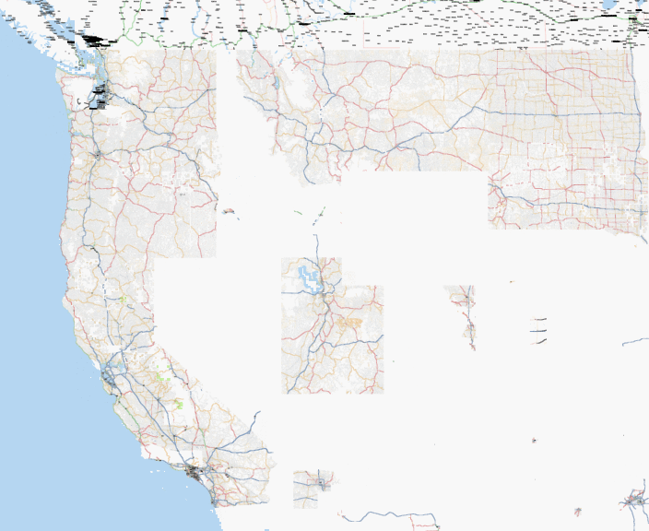

Slide 11
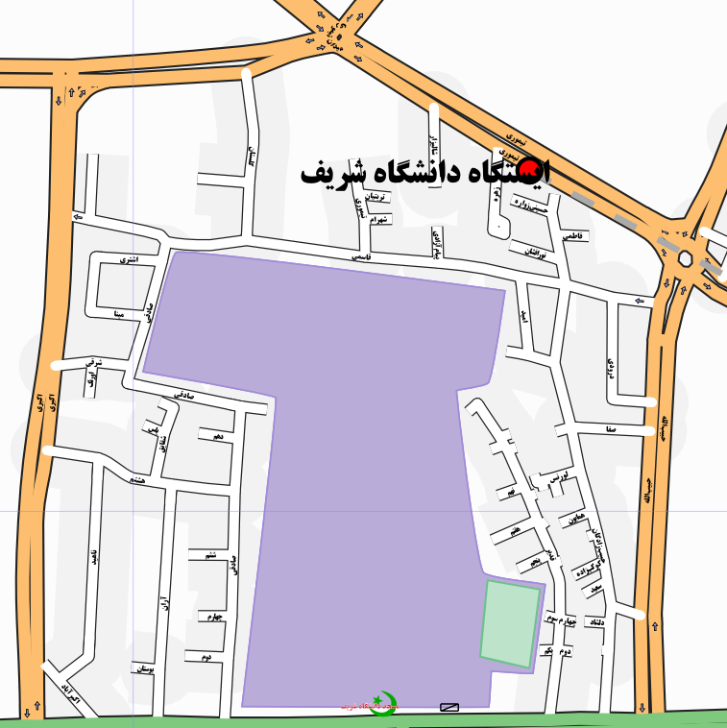

Slide 12
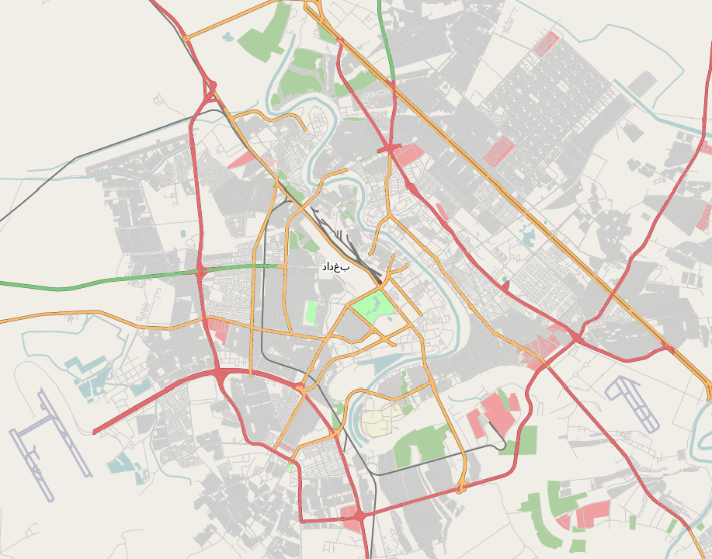

Slide 13
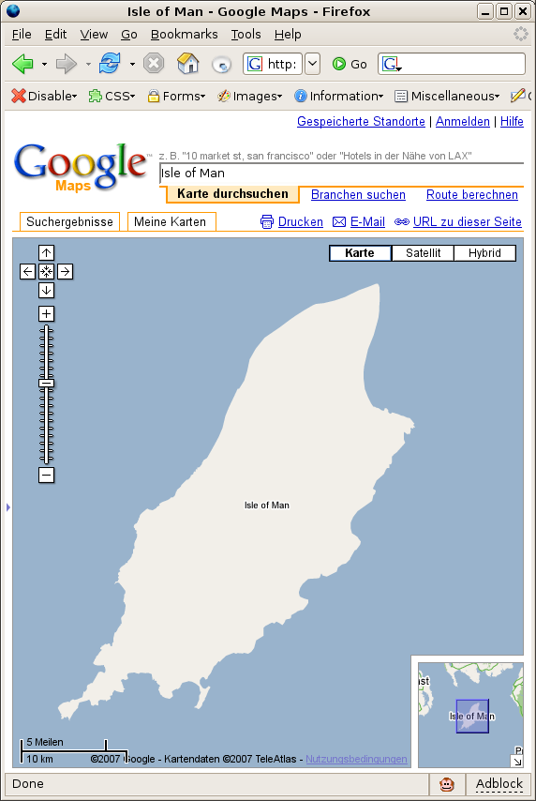
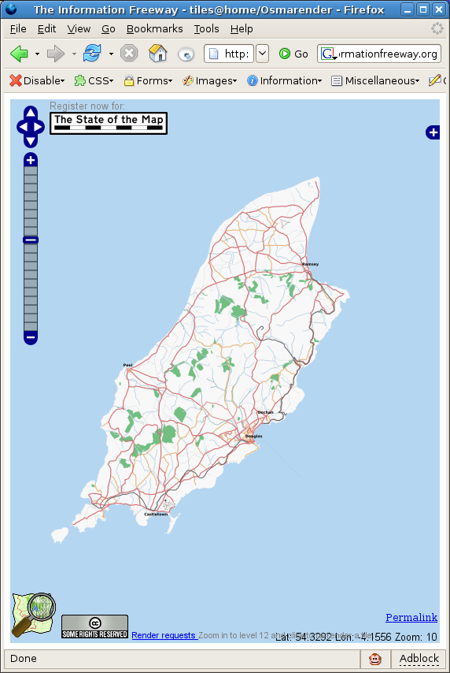

Slide 14
How does it work?
Notes:
Collect a GPS track (make notes)
Prepare track in Editor
Upload
Centralised post-processing (rendering of tiles,
index generation)

Slide 15

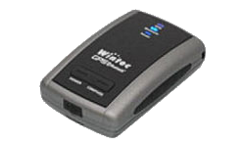
How does it work?
+

Slide 16
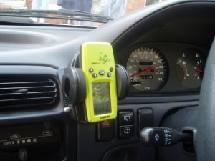
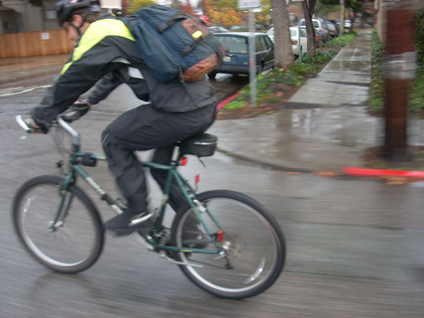
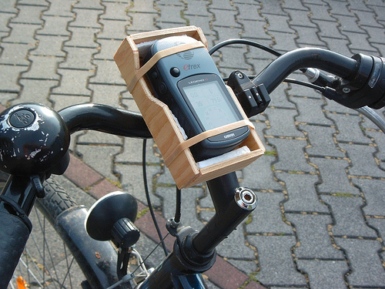
How does it work?

Slide 17
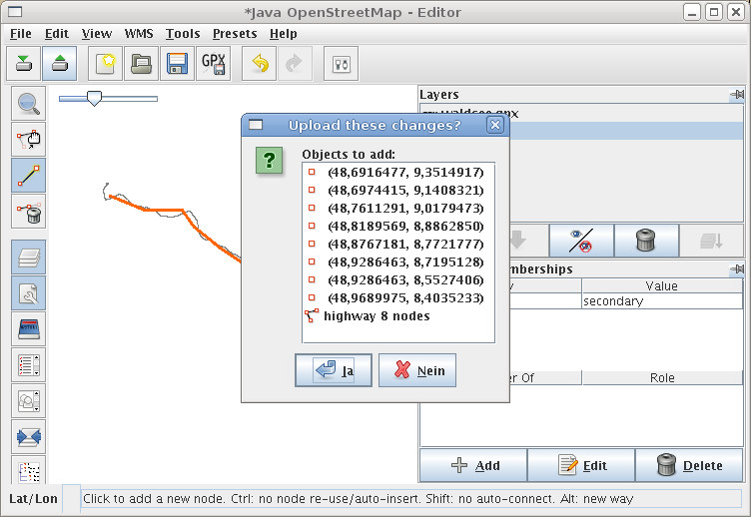
How does it work?

Slide 18
Data model
Trackpoints

Slide 19
Data model
Nodes

Slide 20
Data model
Ways
highway = residential
name = Schillerstraße
oneway = true
highway = secondary
name = Kaiserallee
Tags
Notes:
“tags” being somewhat of a misnomer since they are key=value while today the word is usually reserved for something one-dimensional!

Slide 21
Maps == power revisited: abuse
“Result-oriented vandalism”:
Don't like lorries in your backyard?
Classify the road as a gravel track
and they'll go away!

Slide 22
Power and abuse
first edit wars (Cyprus)
hard to deal with these and not be drawn into conflict – lessons might be learned from Wikipedia
technical challenges (revision history – but everything is linked!)
Notes:
We try to give everyone the map they want but what if someone doesn't want someone else to get their map? Also, which is “official”?

Slide 23
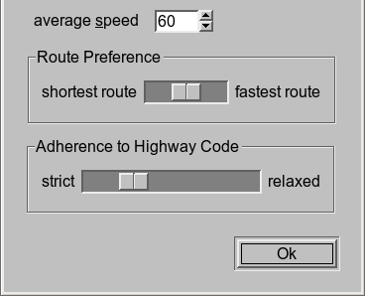
Why is it cool?
People can get the maps they want or need
Custom routing:

Slide 24
Why is it cool?
Mapping the planet means physical exercise for Hackers ;-)
You get the source!
Notes:
full planet file is dumped every week (except history)

Slide 25
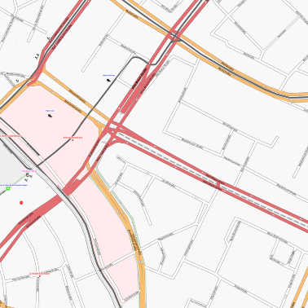

Slide 26
Heartbeat animation / idea and script by Barry Crabtree.

Slide 27
Nightfall animation / idea and script by Barry Crabtree.

Slide 28
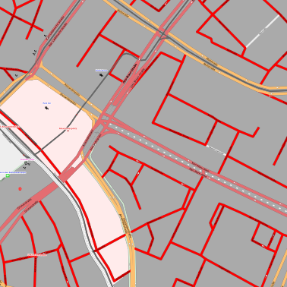

Slide 29
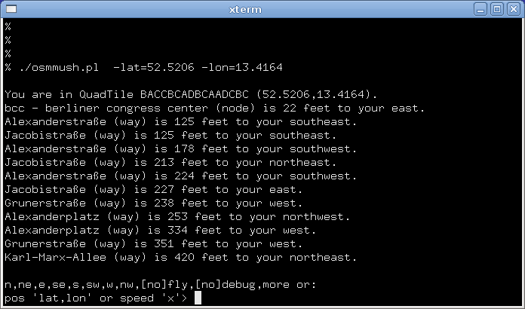
Notes:
A simple MUSH that automatically downloads OSM data.

Slide 30

Thanks! – Questions?
Frederik Ramm
ramm@geofabrik.de
GEOFABRIK

Slide 31
Non-sponsored ad ;-)
Buy our book (out February 2008)
Frederik Ramm, Jochen Topf:
OpenStreetMap
Lehmanns Verlag, Hamburg

Slide 32
The following two slides are not a planned part of the presentation but may be used if the topics come up.

Slide 33
License Issues
CC-BY-SA unsuitable for geodata
OSM not licensor – cannot give authoritative answers on license questions
remixing with stuff from other free sources difficult
Notes:
This is an optional slide to be used if there's time to waste.

Slide 34
The OSM Toolchain
Editors
Data Base
Renderers
Viewers
Potlatch
(Flash)
API
(Rails)
tiles@
home
Google
tiles
JOSM
(Java)
osmarender,
pdfatlas,
...
Slippy
Map
(Open
Layers)
holy
MySQL
...
Mapnik
Google
tiles
planet
dump
Notes:
Optional diagram to be used if people want more details.

