Slide 1
OpenStreetMap
  What, Why, and How
  by Blars Blarson

Slide 2
OpenStreetMap
What is OpenStreetMap?
Why does OpenStreetMap exist?
How do I use OpenStreetMap?
How can I help OpenStreetMap?

Slide 3
What is OpenStreetMap?
Web Map
Database of map vector data
Free license
  Currently CC-by-SA
  Future open data licence
Editable by users Wiki-Style
GPX track archives

Slide 4
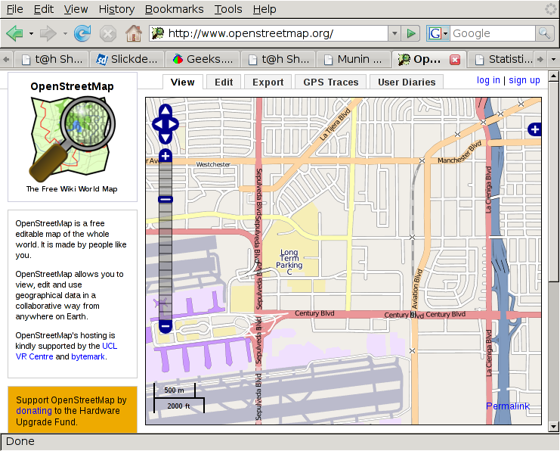

Slide 5
Why does OpenStreetMap exist?
Most other maps are non-free
  free-as-beer but not free-as-liberty
Vector data for custom maps is difficult to obtain
Users can improve the map
Fast updates
Commercial maps have intentional errors
Many areas of the world are mapped poorly
Specialty maps
Innovative uses

Slide 6
How do I use OpenStreetMap?
http://www.openstreetmap.org/
http://informationfreeway.org/
http://wiki.openstreetmap.org/
http://planet.openstreetmap.org/
http://downloads.cloudmade.com/
http://lists.openstreetmap.org/
irc://irc.oftc.net/#osm

Slide 7
Existing OpenStreetMap maps
Mapnik layer
Tiles@Home Layer
  Maplint overlay
CycleMap layer
NoName layer
Maps for Garmin GPS
Routing
Local map servers

Slide 8
Making Custom Maps
Mapnik
OsmaRender
  creates .svg files that can be rendered to .png
Doing a Restaurant Map
  http://wiki.openstreetmap.org/wiki/Restaurant_guide
mkgmap

Slide 9
Editing the map
Potlatch – aka the edit tab
  Requires flash
  has problems with slow net connections or server
JOSM – offline editor
  requires java
  uses a lot of memory
Merkaartor

Slide 10
Getting the data
Weekly planet dumps
  5 GB bzip2
  100 GB xml file
Daily, Hourly, and Minute change files
Various extracts
API, ROMA, TRAPI, and XAPI

Slide 11
OpenStreetMap data sources
Data collected with GPS units
Public-domain
  TIGER census maps of the US
“local knowledge”
Out-of-Copyright maps
Donated data
  AND data for the Netherlands
  Canadian Government data

Slide 12
OpenStreetMap data sources
Appropriately Licensed imagery
  Landsat
  Yahoo imagery
Do NOT use copyright maps or data sources
  without proper permission

Slide 13
OpenStreetMap
Started in 2004 by Steve Coast
Most servers located at UCL in London
API upgrade planned for March 20-21
Over $22,500 raised in 3 days for new server in early February
  Goal was $15,000
90,000 registered users
OSM Foundation

Slide 14
How to contribute
Create GPX traces
  Walking, biking, or driving
  Notes with paper, voice recording, or camera
Edit the map
Write software
Tiles@Home client
Join the OSM Foundation
Donate money
Host servers

Slide 15
Technical details
nodes, ways, and relations
  nodes are positions with optional tags
  ways are sorted lists of nodes with tags
    also used for areas
  relations are lists of members with roles and tags
tags are strings
  key and value
  users can define new features
  See the “Map Features” wiki page

Slide 16
Technical details
external interface is XML
main database is MySQL
server is ruby-on-rails
programs in ruby, Java, perl, python, C, mumps, flash

