Slide 1



Drug Repurposing
Reactions,
Network
A
B
Evidence
1
2
Ontology,
Phenotype sharing

Slide 2
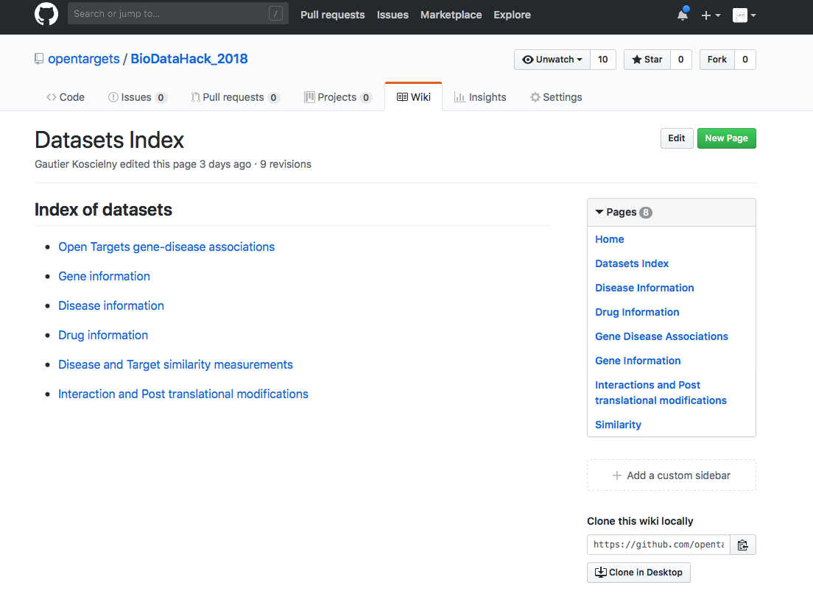
https://github.com/opentargets/BioDataHack_2018

Slide 3
Things to think about
How to rank different opportunities e.g. scores on evidence, distance, etc.
How to display the opportunities?
Positive controls (we provide some literature examples)
How to assess unmet need e.g. incidence, drugs already available, standard of care (we don’t provide data for this)

