Slide 1
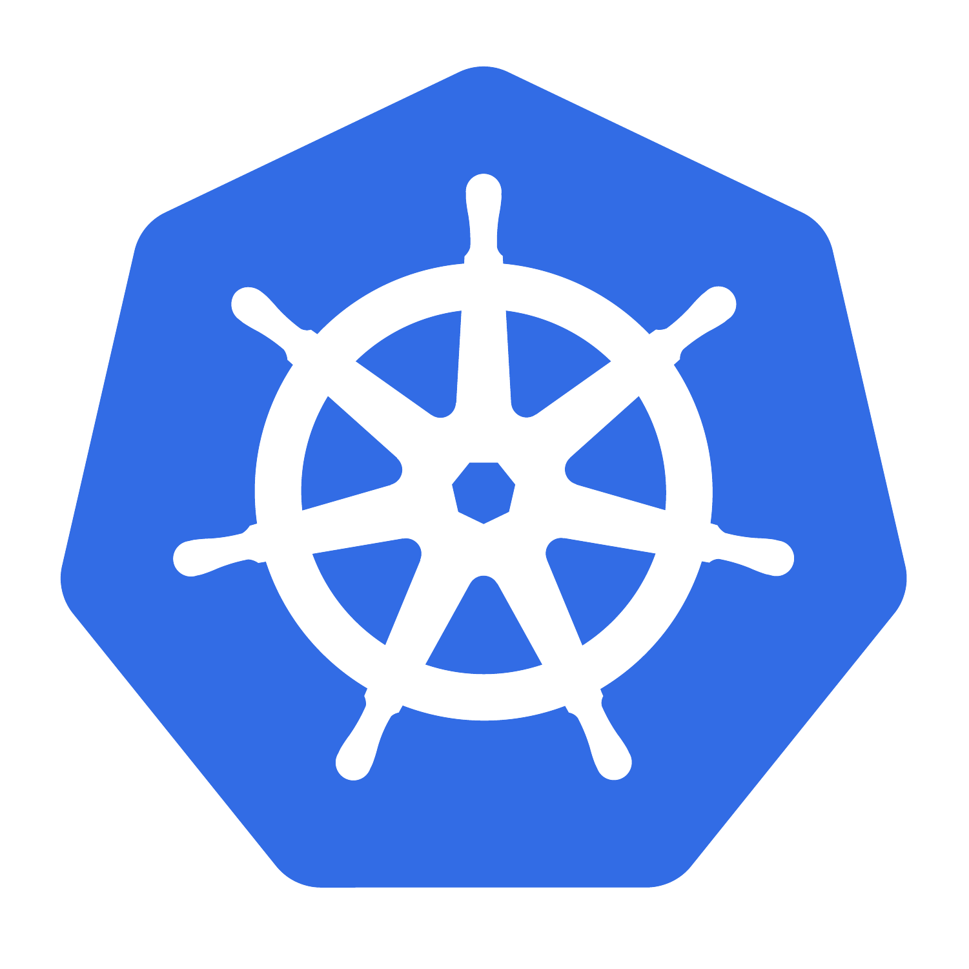

Kubernetes & OpenStack Distributions
Prakash Ramchandran
V1.0 /Oct-2-2020

Slide 2
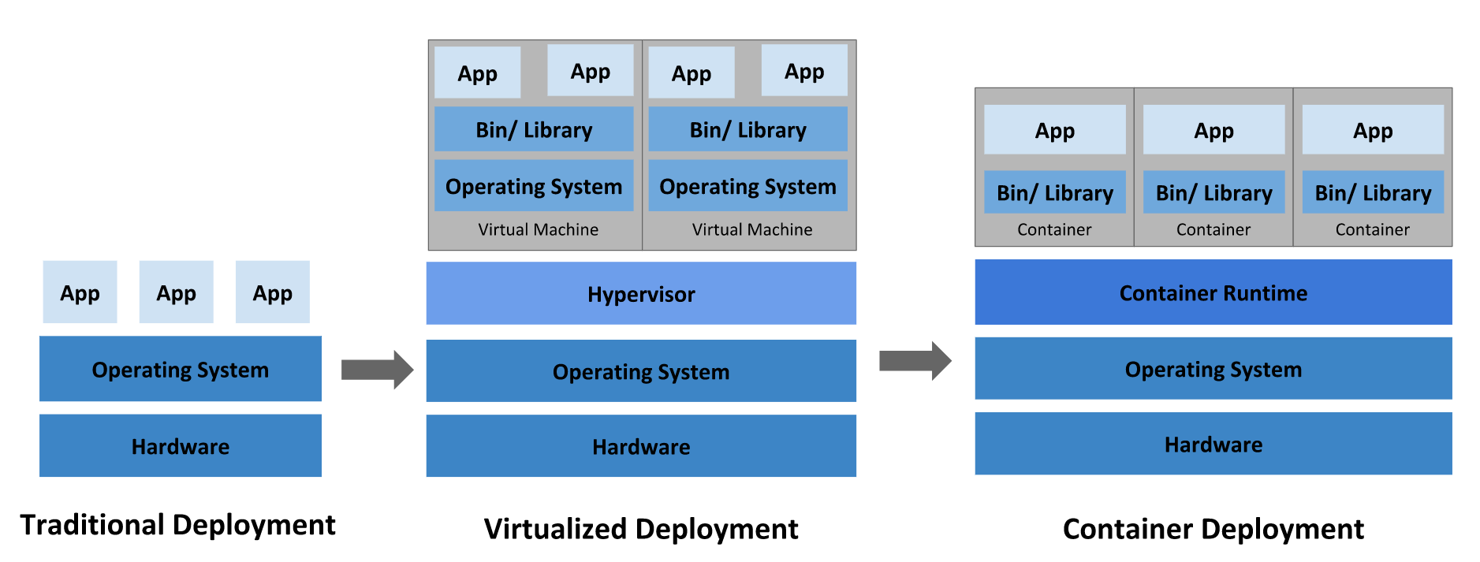
What is Kubernetes? Container Orchestrator?
applications on physical servers | Applications in Virtual machines | Application in Containers
Cluster of Processes | Cluster of VMs | Clutser of Containers
OS is Manager of App Process on the Hardware –Monolithic Apps | OpenStack is Manager of VM, KVM+ host OS & Guest OS in VM is App Manager–Virtual Apps | Kubernetes is Manager of PoDs, Container and Apps. Containerized-Apps

Slide 3
Why do we need OpenStack/Kubernetes?
Characteristics | Manage using OS, Phy. Server | Manage using Os8 – vanilla VMs | Manage using K8s vanilla Containers
Apps(monoliths, C/S, 3T C/S), CA,CAN | 1-5 Apps / server | 1-10 VMs / server, 1 App per VM | 1-100 Container/ server, 1 app/Cntr
Security | Inter-app risk | Secure VMs | Inter-app-risk
Resource Usage | Under utilized | Better utilized | Optimum
Scalability | Vertical (limited) | +Horizontal good | Both good
Guest OS or Light weight Process | No | Yes OS | Yes Process
Hypervisor | No | Yes | May be Yes/No
BareMetal OS | No | Yes | Yes
Updatable Apps | Limited with large app disruptions | Better per VM app basis | Even better at app comp. basis
Update OS | Not Live | Possible Live | Possible Live
Update FW | Need Reboots | Needs VM Reboot | Need Restart Cntr
Glossary:
OS – Operating System
Os8 – OpenStack
K8s - Kubernetes

Slide 4
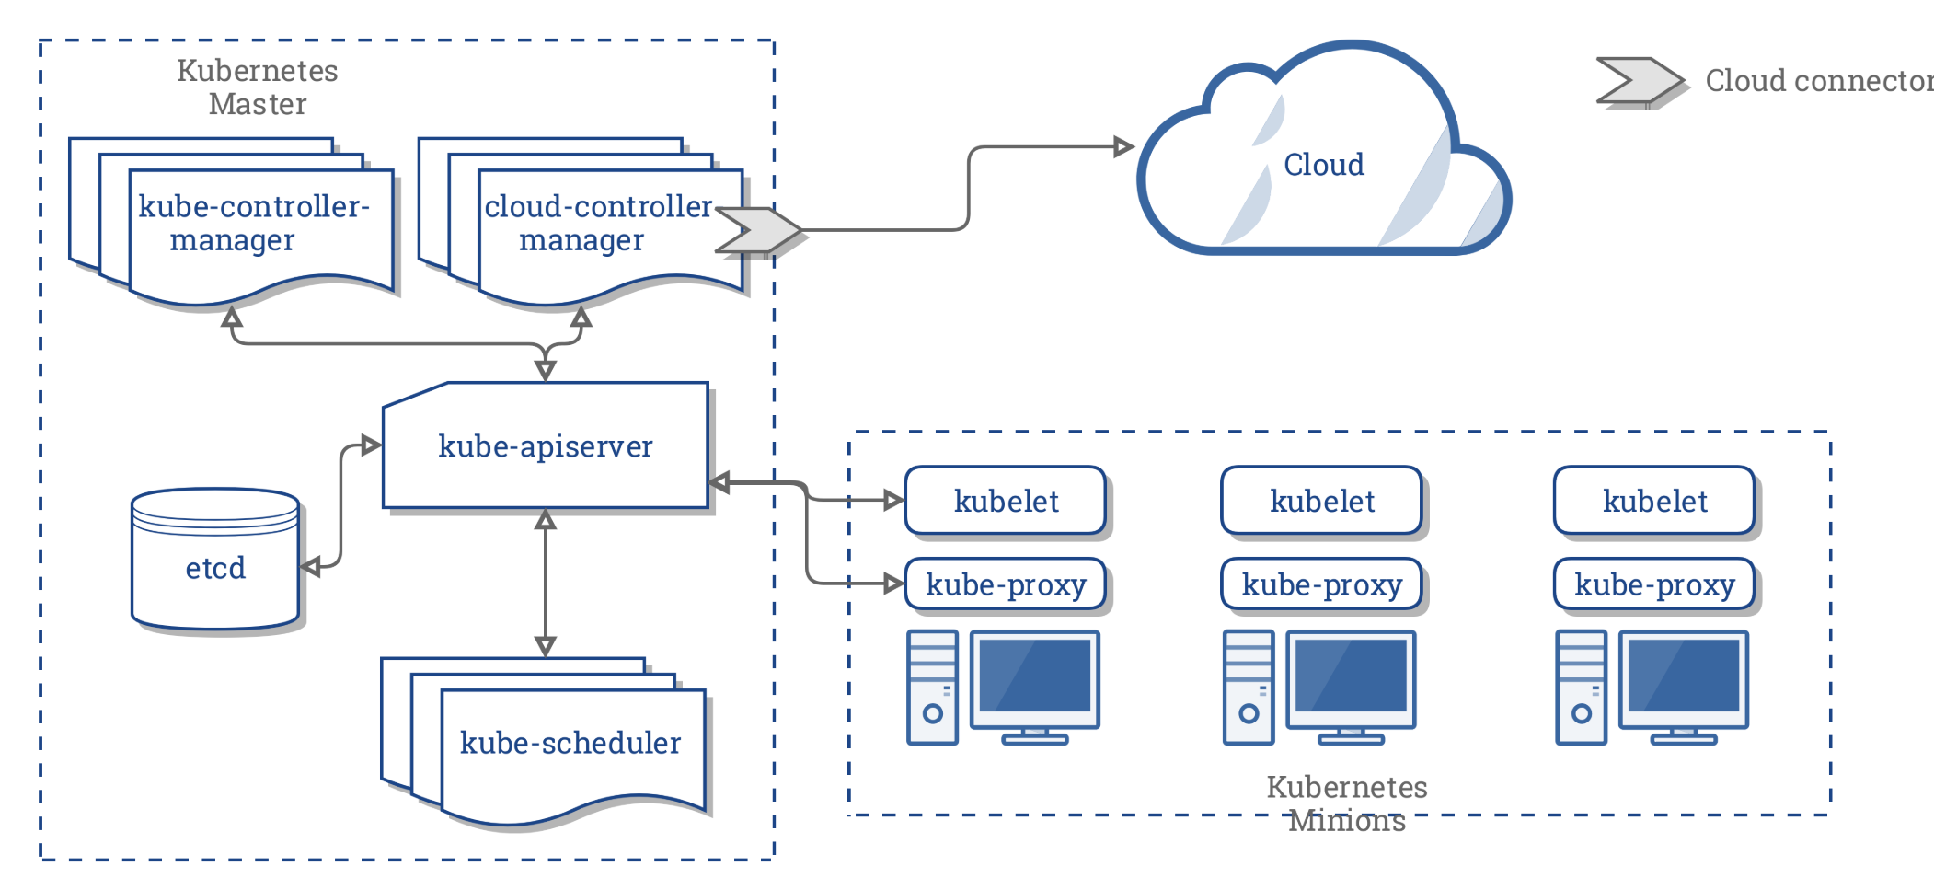
From Container Orchestration Engine to Operating System of Cloud
Kubernetes Component View
K8S Integrated Cloud View
Cloud Controller Manager (Ext) | Amazon, Google, OpenStack, Azure
Kube Controller Manager (Main) | KubeVirt to manage VMs!!!
Kube-API Server | Standard APIs only
Kube Scheduler | Task Scheduler
etcd | The Config Store
kubelet | Cli for Node mgmt.
Kube-proxy | Enables external access to apps on cluster
Nodes | BM or VM host
Orchestrator is a System that deploys and manages Application. It can deploy your application, scale it, self-heal it when things break & perform rolling updates and rollbacks.

Slide 5

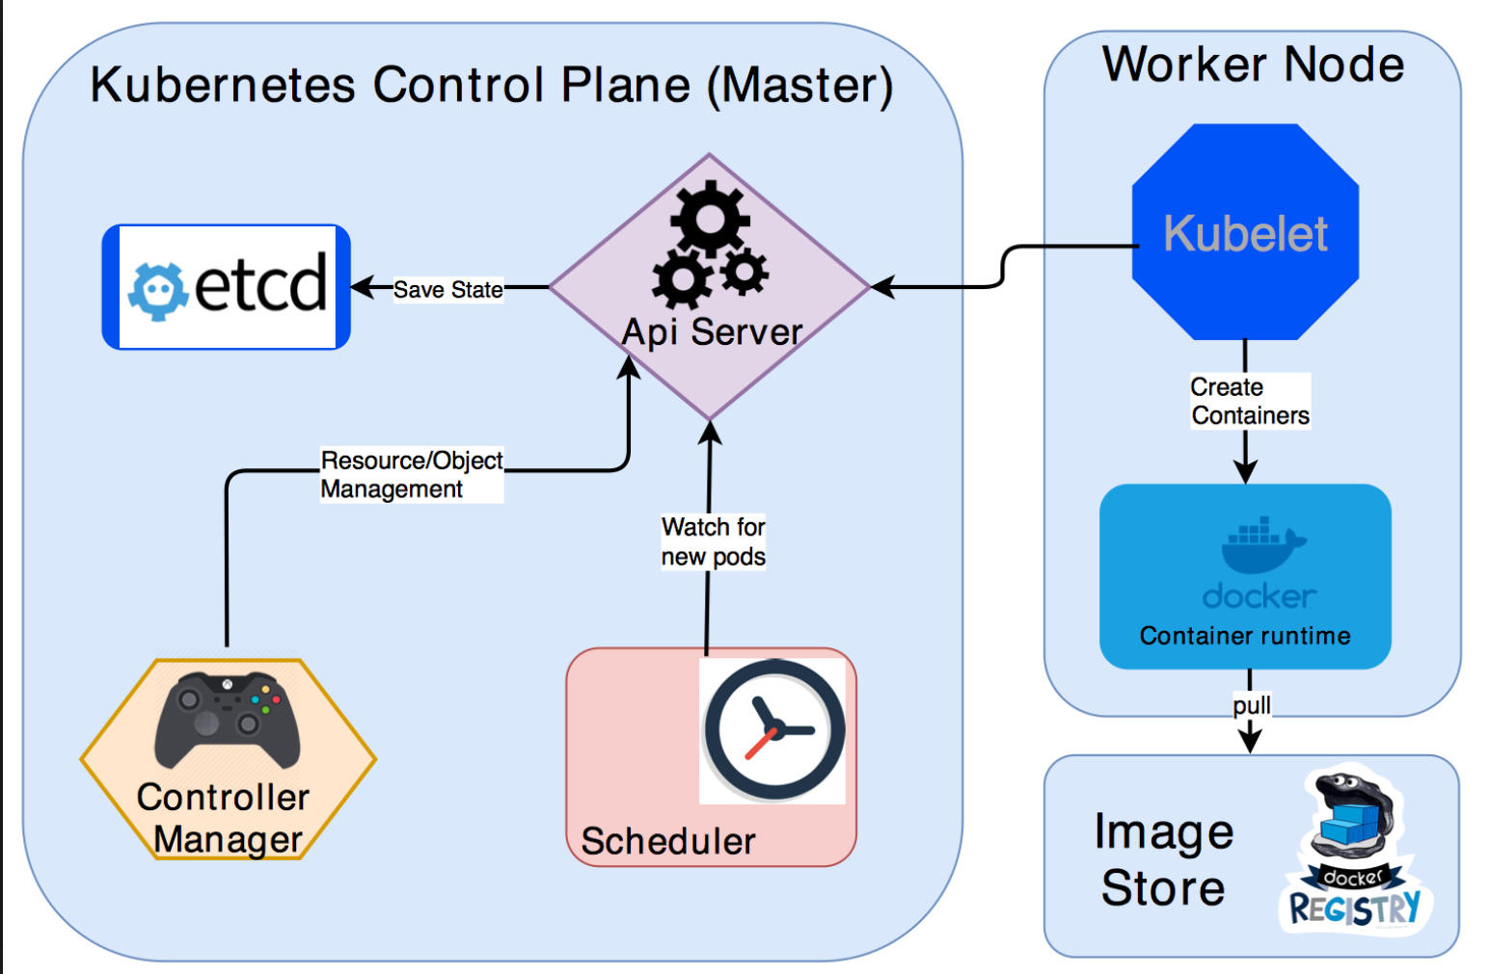
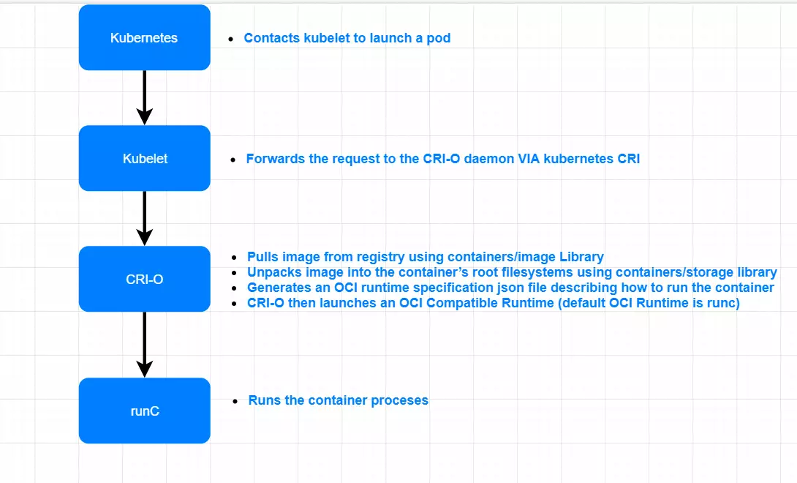
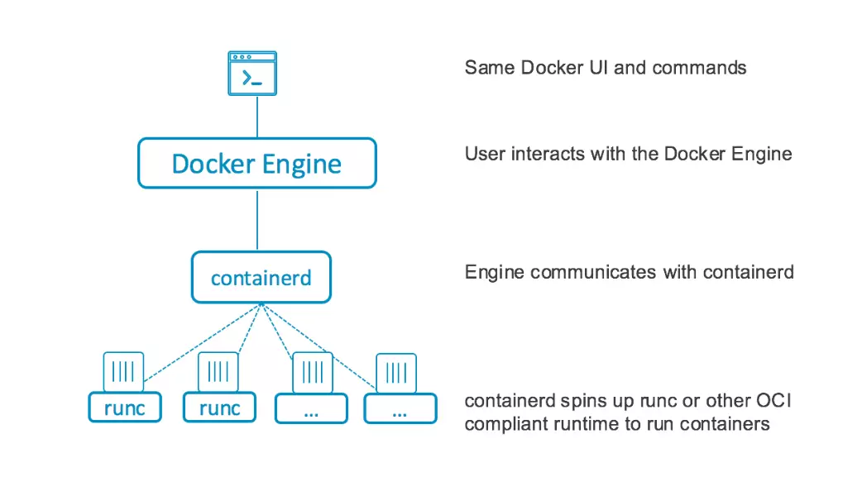


Kubernetes Components for OCR/CRI-O vs. Docker
Container Runtimes Options
K8s POD Management
PoDs are mortal and VMs are immortal. To run VM as containers you will need KubeVirt as workload controller. https://kubevirt.io/2020/KubeVirt-Architecture-Fundamentals.html

Slide 6
Kubernetes APIs
Group Core | Version V1 | Kind Container
Containers are only ever created within the context of a Pod. This is usually done using a Controller. See Controllers: Deployment, Job, or StatefulSet
Appears In:PodSpec [core/v1]
Workloads are objects you use to manage and run your containers on the cluster
Discovery & LB resources are objects you use to "stitch" your workloads together into an externally accessible, load-balanced Service.
Config & Storage resources are objects you use to inject initialization data into your applications, and to persist data that is external to your container.
Cluster resources objects define how the cluster itself is configured; these are typically used only by cluster operators.
Metadata resources are objects you use to configure the behavior of other resources within the cluster, such as HorizontalPodAutoscaler for scaling workloads.

Slide 7
Workloads
Workloads resources are responsible for managing and running your containers on the cluster. Containers are created by Controllers through Pods. Pods run Containers and provide environmental dependencies such as shared or persistent storage Volumes and Configuration or Secret data injected into the container.
The most common Controllers are:
Deployments for stateless persistent apps (e.g. HTTP servers).
StatefulSets for stateful persistent apps (e.g. databases).
Jobs for run-to-completion apps (e.g. batch Jobs).

Slide 8
Discovery & LB / Service APIs
Service API resources are responsible for stitching your workloads together into an accessible Loadbalanced Service. By default, Workloads are only accessible within the cluster, and they must be exposed externally using a either a *LoadBalancer* or *NodePort* Service. For development, internally accessible Workloads can be accessed via proxy through the api master using the kubectl proxy command.
Common resource types:
Services for providing a single ip endpoint loadbalanced across multiple Workload replicas
Ingress for providing a https(s) endpoint http(s) routed to one or more *Services*.

Slide 9
Metadata
Metadata resources are responsible for configuring behavior of your other Resources within the Cluster.
Common resource types:
HorizontalPodAutoscaler (HPA) for automatically scaling the replicacount of your workloads in response to load.
PodDisruptionBudget for configuring how many replicas in a given workload maybe made concurrently unavailable when performing maintenance.
Event for notification of resource lifecycle events in the cluster.

Slide 10
Config & Storage
Config and Storage resources are responsible for injecting data into your applications and persisting data externally to your container.
Common resource types:
ConfigMapsfor providing text key value pairs injected into the application through environment variables, command line arguments, or files
Secrets for providing binary data injected into the application through files
Volumes for providing a filesystem external to the Container. Maybe shared across Containers within the same Pod and have a lifetime persisting beyond a Container or Pod.

Slide 11
Cluster & Nodes
Cluster resources are responsible for defining configuration of the cluster itself, and are generally only used by cluster operators.
Registration
Namespace
Configmap
Role Binding
Node
Specs
state
Sub-project (Multi-Cluster Management)
Cluster API is a Kubernetes sub-project focused on providing declarative APIs and tooling to simplify provisioning, upgrading, and operating multiple Kubernetes clusters.

Slide 12
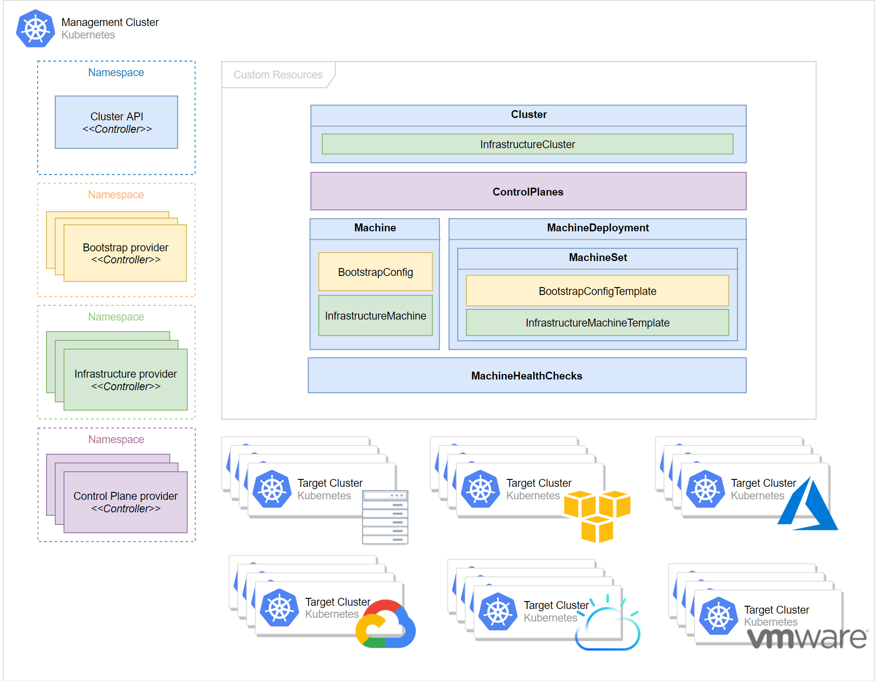
Cluster-API (Concept)

Slide 13
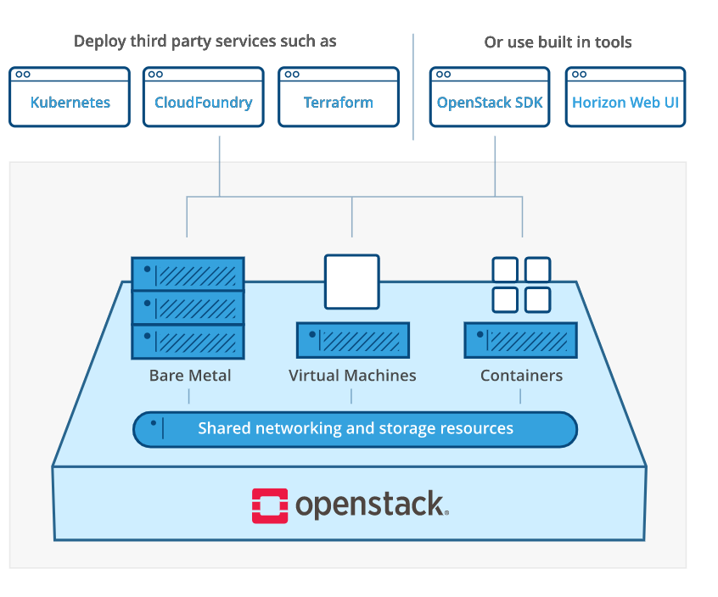
Integrated OpenStack APIs
Compute Service (Nova) | API Reference
Object Storage(swift) | API Reference
Networking Service (neutron) | API Reference
Container Infrastructure Management service (Magnum) | API Reference
Containers service (zun) | API Reference
BareMetal Service (Ironic) | API Reference
Bare Metal Storage (Cinder) | API Reference
Identity Service (keystone) | API Reference
Image Service (Glance) | API Reference
Orchestration Service (heat) | API Reference
Shared File System (manila) | API Reference
All others Ussuri version (Refer) | https://docs.openstack.org/ussuri/api/

Slide 14



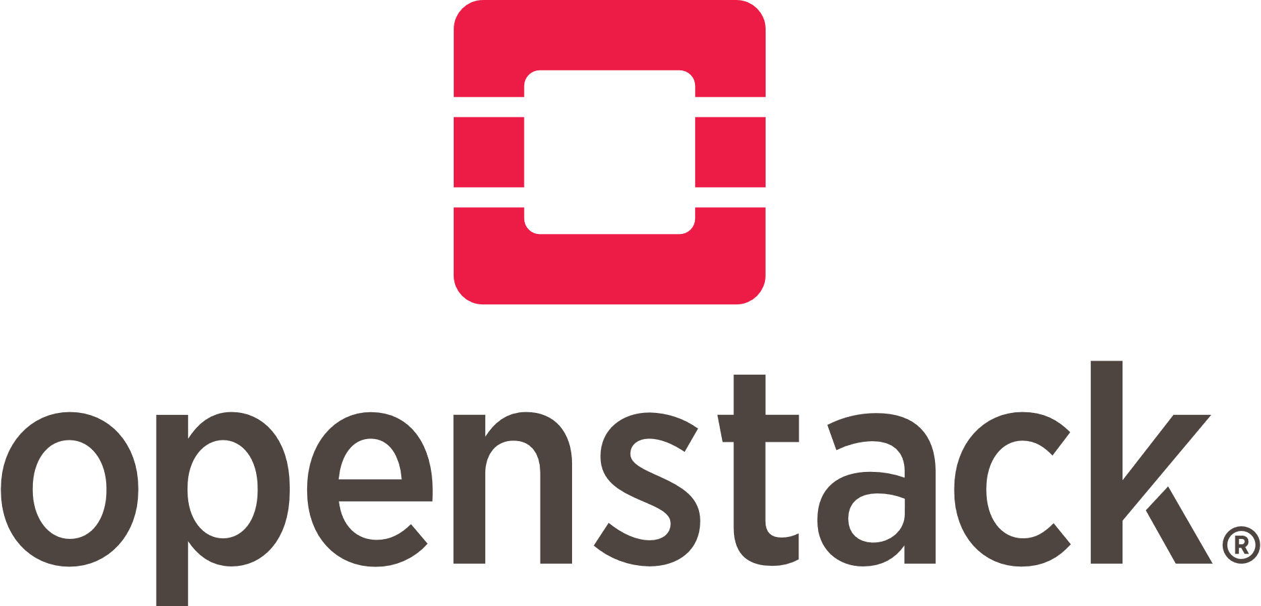
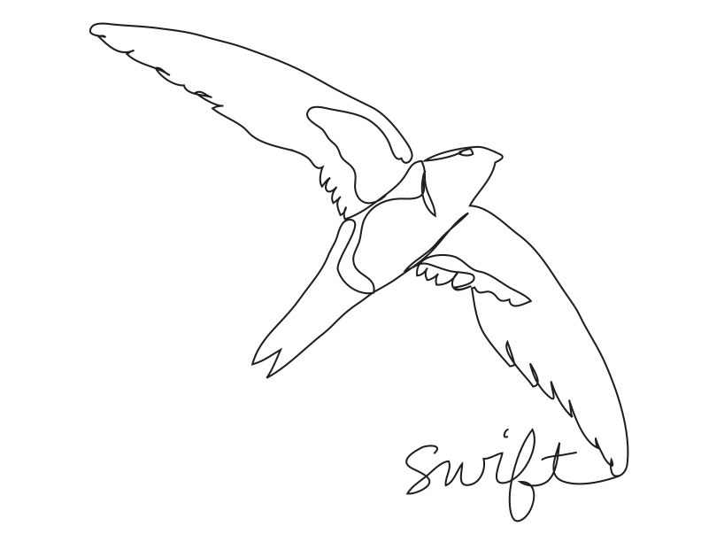
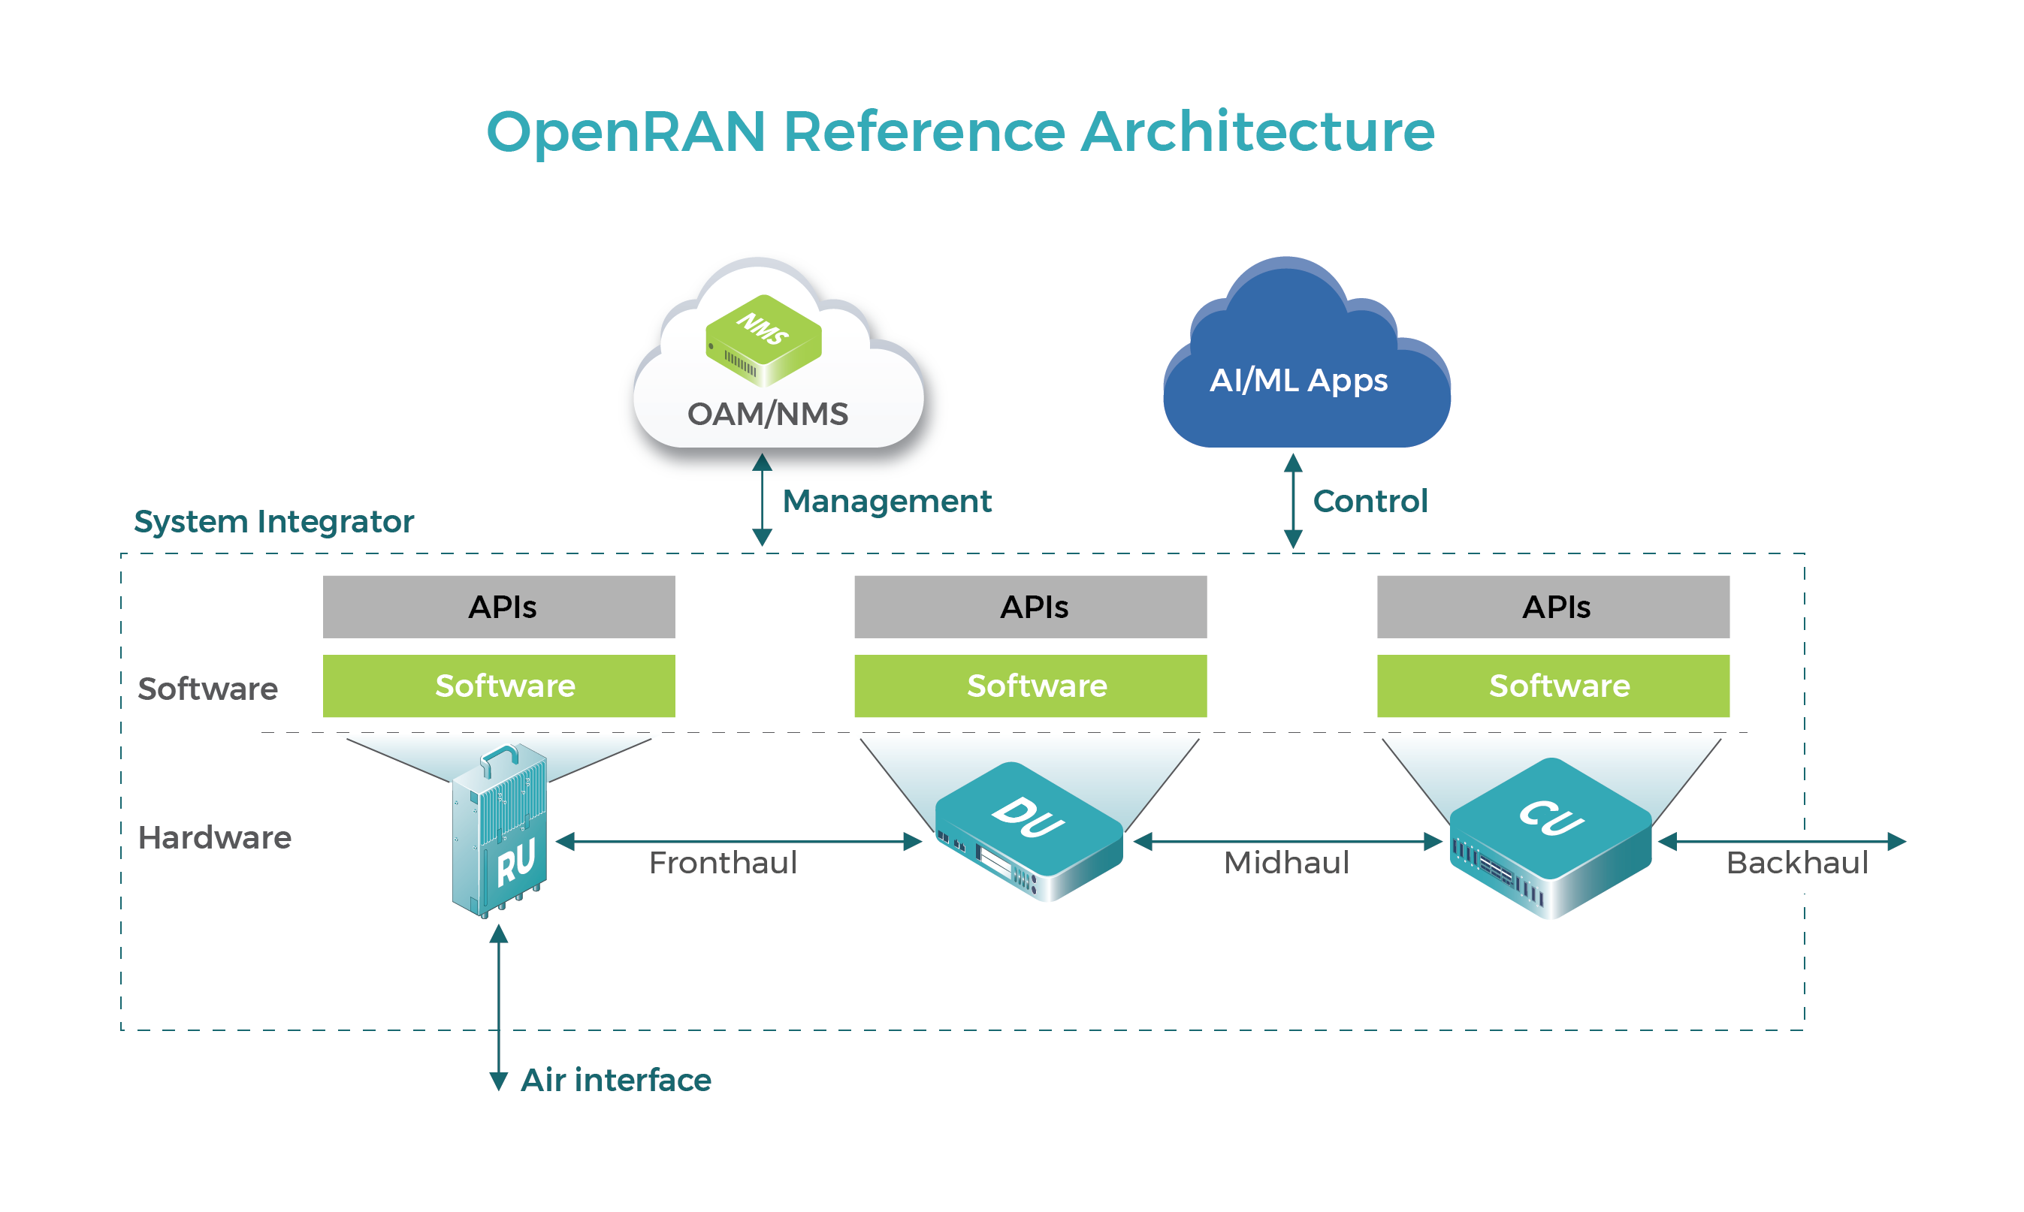


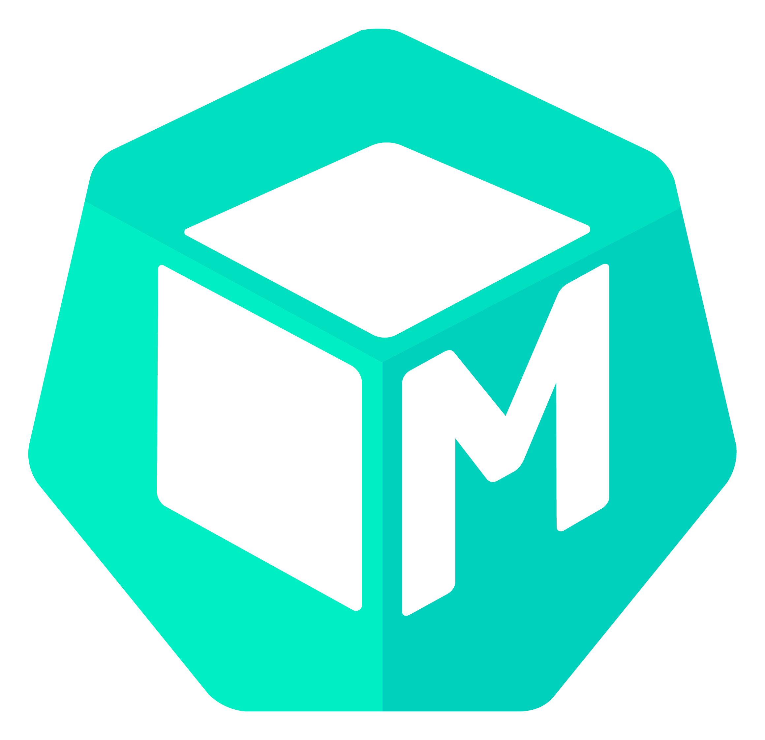
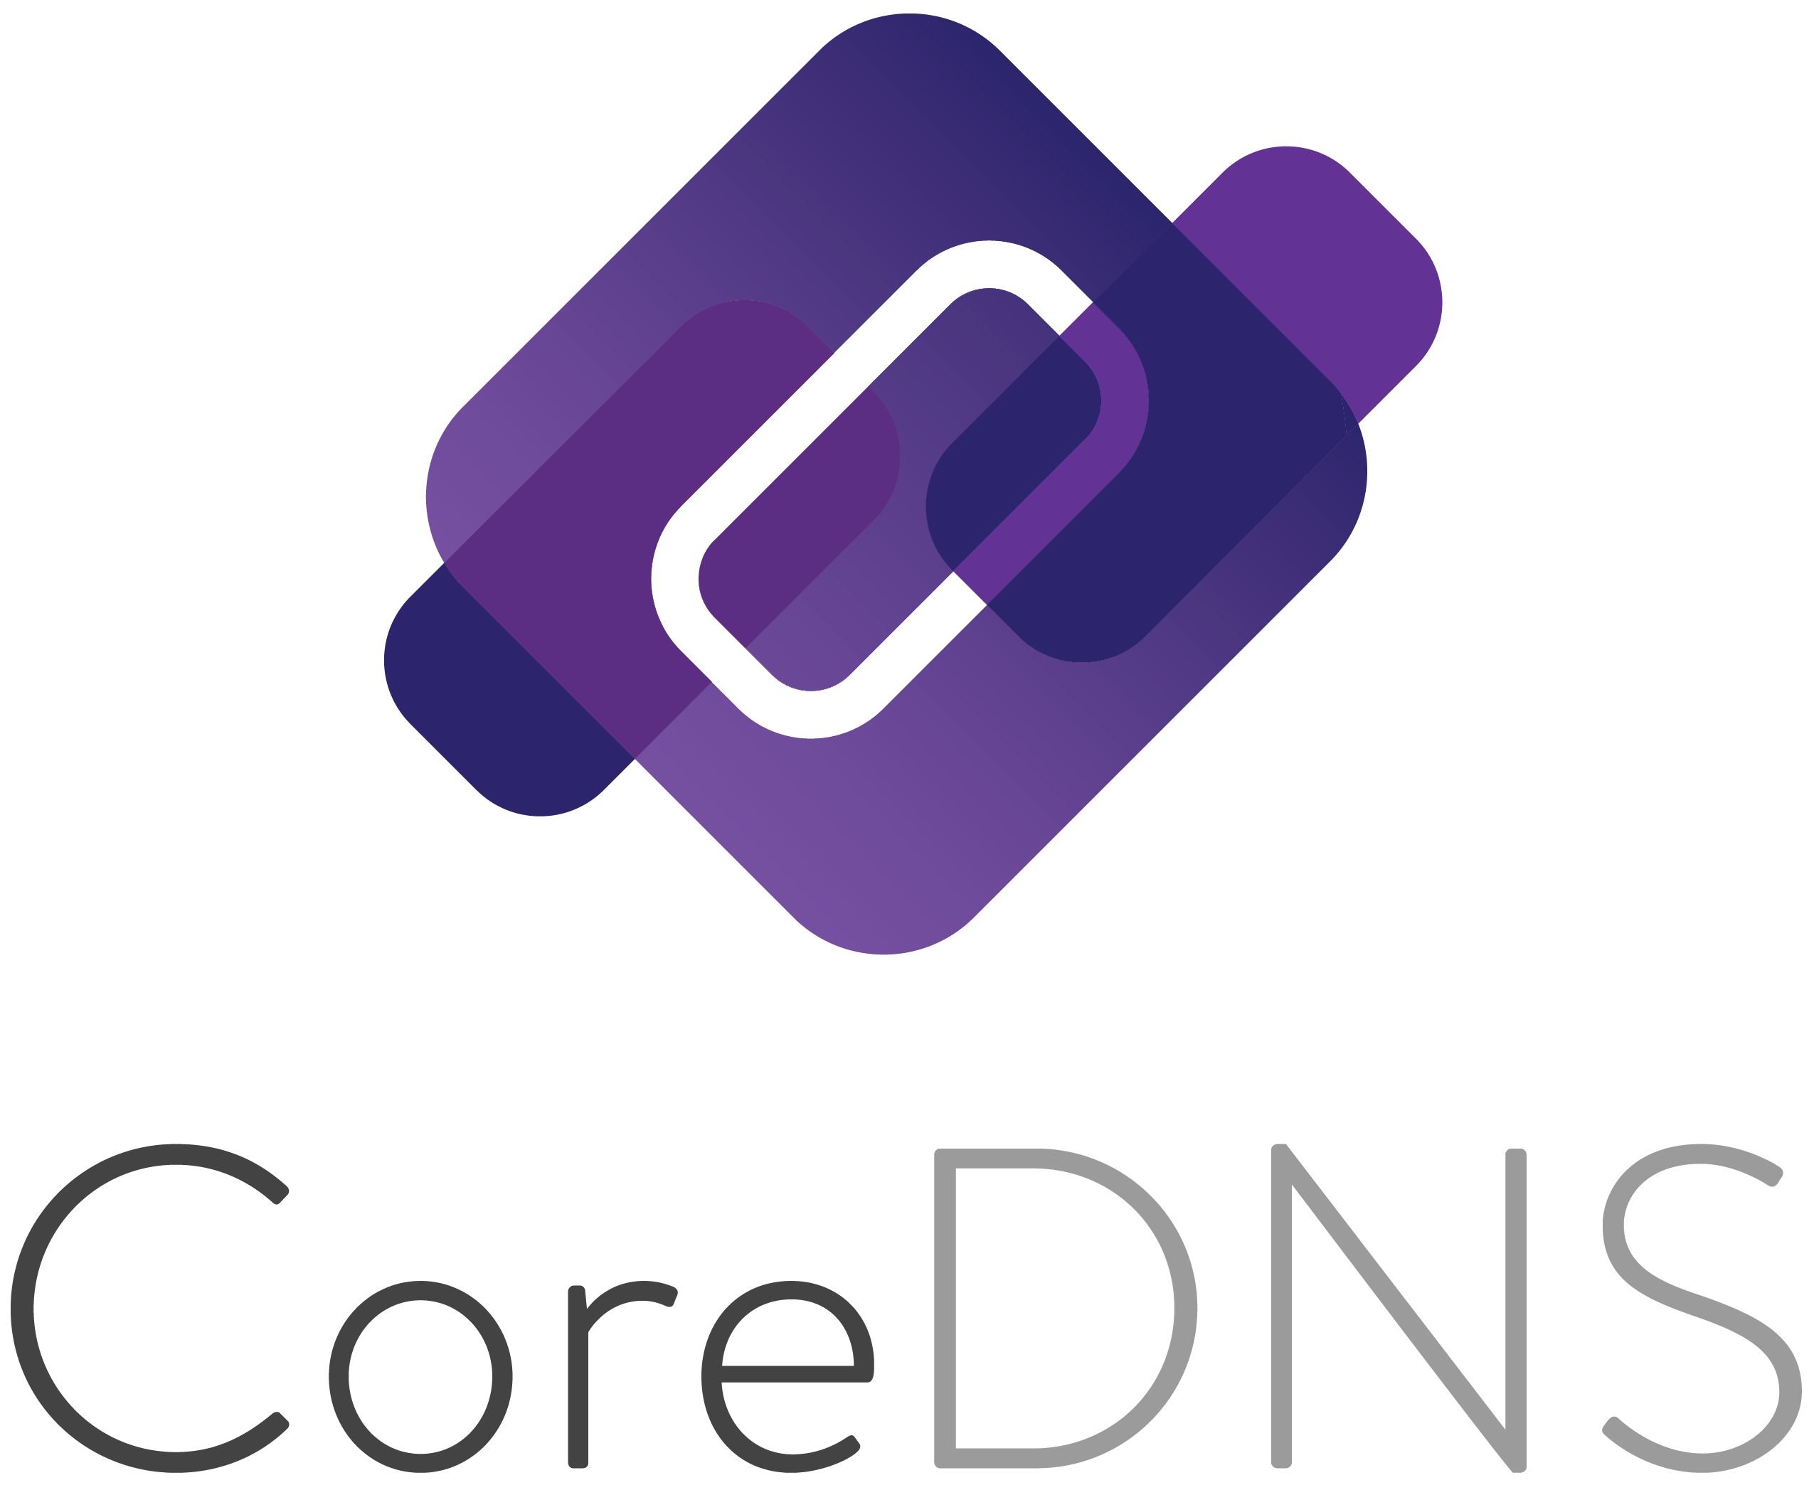
Key Components of K8s

Slide 15
60+ official k8s Distros
Refer https://docs.google.com/spreadsheets/d/1LxSqBzjOxfGx3cmtZ4EbB_BGCxT_wlxW_xgHVVa23es/edit#gid=0
Software certification of k8s Conformance is key
https://kubernetes.io/blog/2017/10/software-conformance-certification/
Sonobuoy is the current tool to manage conformance testing
https://github.com/cncf/k8s-conformance/blob/master/instructions.md
You can use binary release available
Conformance is governed by Architecture SIG https://github.com/kubernetes/community/tree/master/sig-architecture
Test SIG guides the testing mechanisms https://github.com/kubernetes/community/tree/master/sig-testing
Conformance working group - develops process and policy for the certification program - https://github.com/cncf/k8s-conformance
Add your k8s to list - https://github.com/cncf/k8s-conformance
Kubeadmin also supports other LCM aspects like bootstrap tokens and cluster upgrades

Slide 16
Kubeadm your installer and its suit spots
Kubeadm tool is good for following purpose
A simple way for you to try out Kubernetes, possibly for the first time.
A way for existing users to automate setting up a cluster and test their application.
A building block in other ecosystem and/or installer tools with a larger scope.
You can install kubeadm on various machines:
your laptop, a set of cloud servers, a Raspberry Pi, and more
Whether you're deploying into the cloud or on-premises, you can integrate kubeadm into provisioning systems such as Ansible or Terraform
Kubeadm comes with other tools like k8sAPIs servers , kubelet, kubectl & kubeproxy and must verify the support rules for version skew matches to successfully install them https://kubernetes.io/docs/setup/release/version-skew-policy/#supported-versions

Slide 17
Q&A

Slide 18
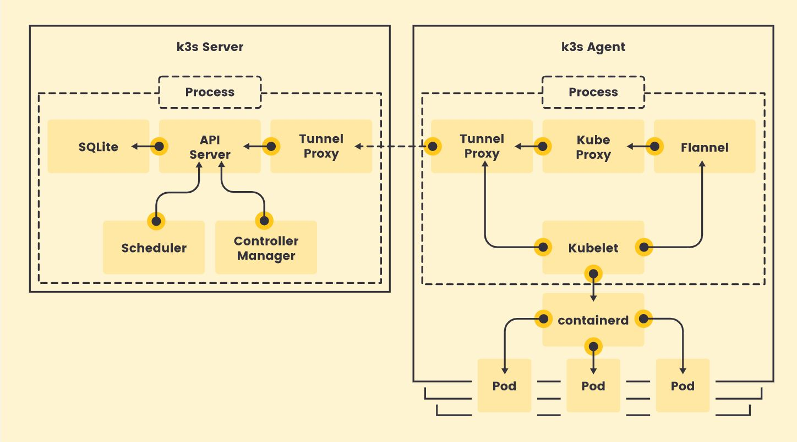
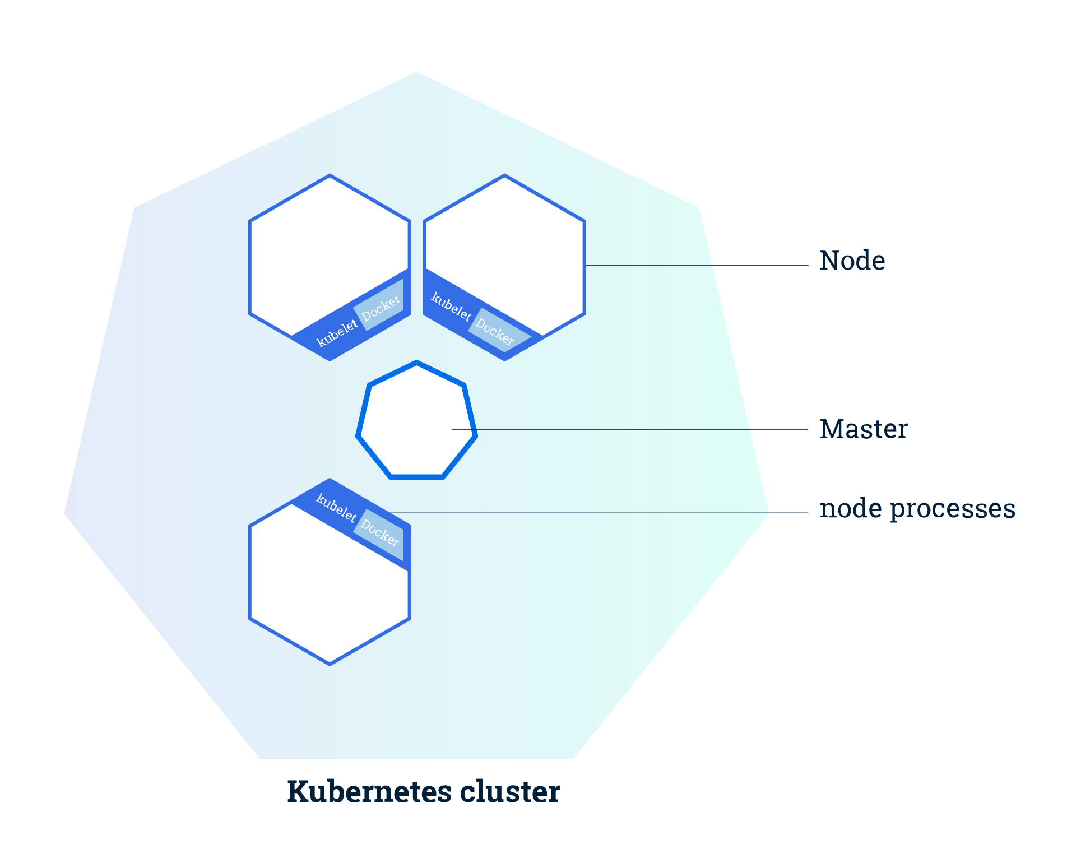
Kubernetes APIs & Cluster APIs
K8s Distro (K3S) View
Node - VM or BM Host with Run Time

Slide 19
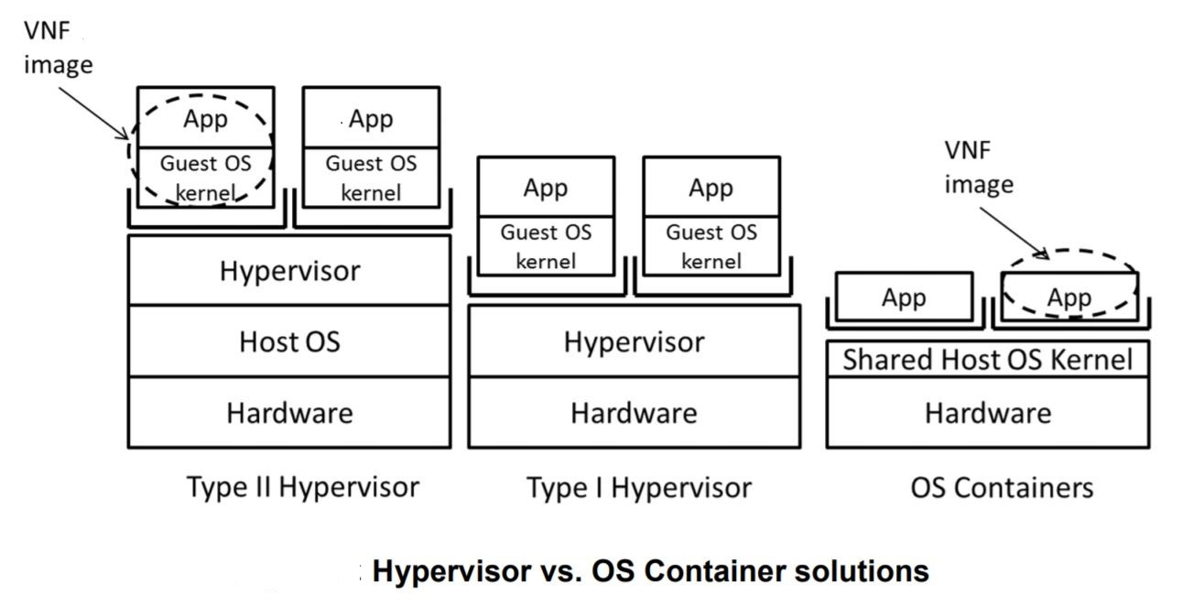
Telco NF Virtualization Terminology (VIM/CIM-IaaS/CaaS) (VNF/CNF)+(AF)/VNFM/CNFM/NFVO

