Slide 1



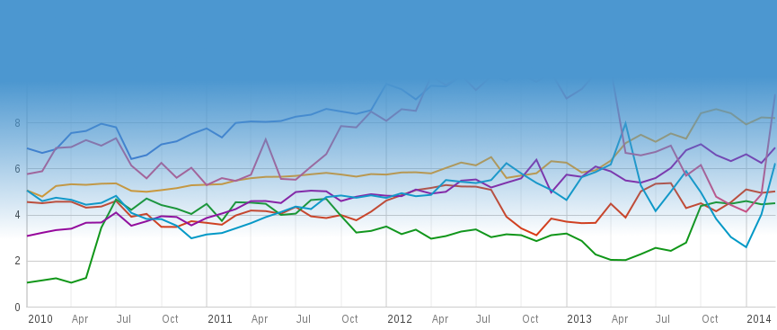
MeasurementLab.net
@NewAmerica
@OTI
@MeasurementLab
The M-Lab Story
Independent, Public Interest,
Network Performance Measurement
Chris Ritzo
Senior Technologist & Project Manager, Measurement Lab
critzo@opentechinstitute.org

Slide 2


Slide 3
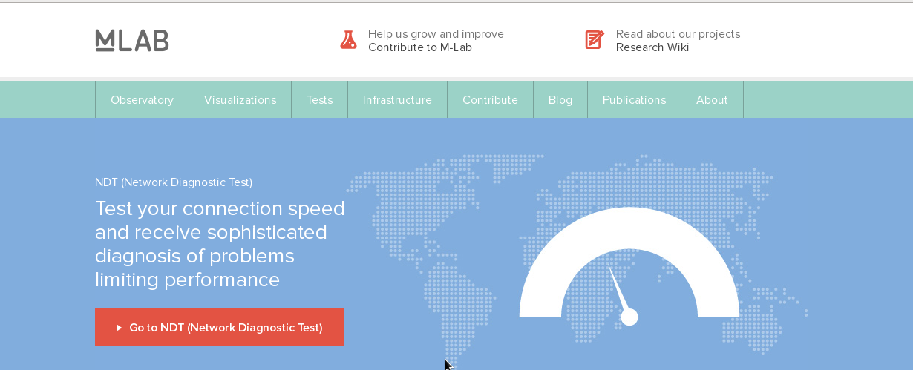
MeasurementLab.net

Slide 4



MeasurementLab.net

Slide 5
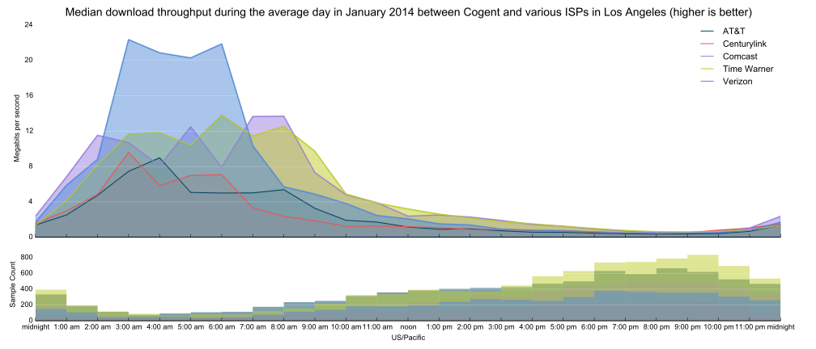
ISP Interconnection and its Impact on Consumer Internet Performance
http://www.measurementlab.net/static/observatory/M-Lab_Interconnection_Study_US.pdf
MeasurementLab.net

Slide 6
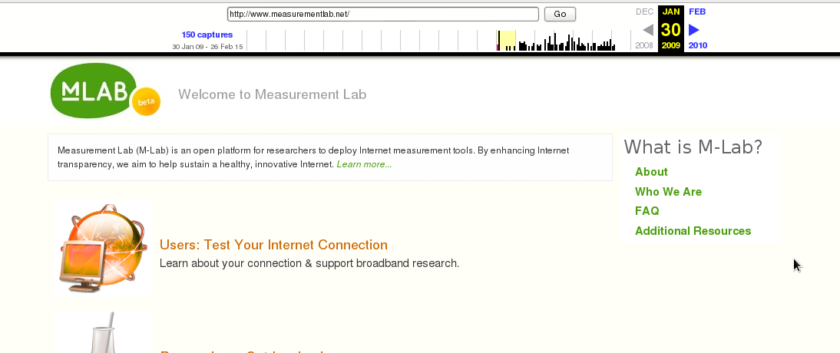
MeasurementLab.net

Slide 7
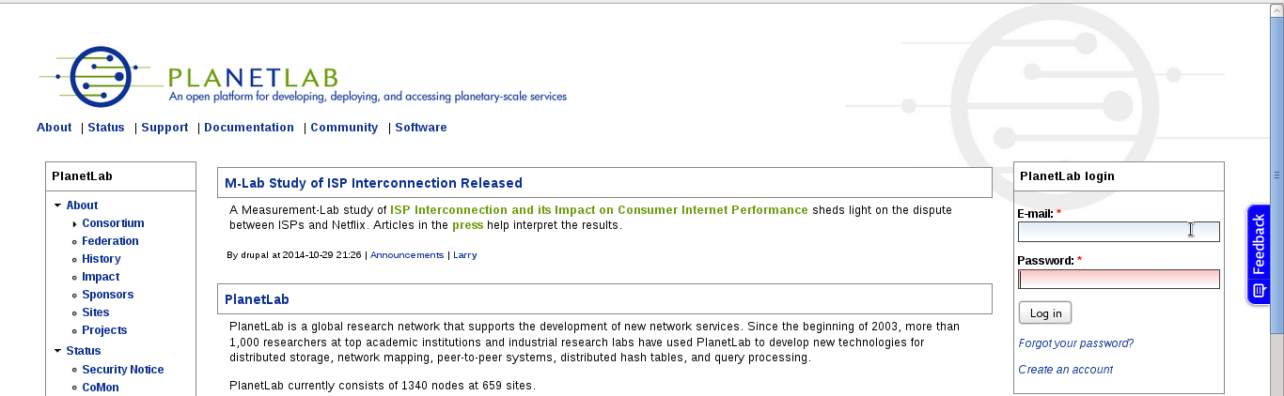
MeasurementLab.net
planet-lab.org

Slide 8
MeasurementLab.net
@NewAmerica
@OTI
@MeasurementLab
The M-Lab Story
Independent, Public Interest,
Network Performance Measurement
Chris Ritzo
Senior Technologist & Project Manager, Measurement Lab
critzo@opentechinstitute.org

Slide 9
Be part of M-Lab.
Support open Internet Measurement.
MeasurementLab.net
How to get involved:
  Run NDT : http://measurementlab.net/tools/ndt
  Use our data, tools and open visualizations :
  http://measurementlab.net/observatory
  Use NDT as your speedtest, or integrate our tests and data into your applications
  Make a contribution to support M-Lab

Slide 10
MeasurementLab.net
@NewAmerica
@OTI
@MeasurementLab
The M-Lab Story
Independent, Public Interest,
Network Performance Measurement
Chris Ritzo
Senior Technologist & Project Manager, Measurement Lab
critzo@opentechinstitute.org

