Slide 1
Modeling Water Problems using Zeppelin, Spark, R and System ML
June 2016
P.S. “Arvind” Aravind
(psaravind@us.ibm.com)
IBM Analytics
(http://www-01.ibm.com/software/data/services/stampede.html)

Slide 2
Agenda
Water Problems in Big Cities– Implications and Causes (10 Mins)
Water Problems in New York City (10 Mins)
Data Sources For Modeling Water Problems (10 Mins)
Fast Data Analytics Technologies For Modeling Water Problems (10 Mins)
Demonstration of Modeling Water Problems using New York City Data Sources (60 Mins)
Q & A (15 Mins)
Notes:
2

Slide 3
Agenda
Water Problems in Big Cities– Implications and Causes (10 Mins)
Water Problems in New York City (10 Mins)
Data Sources For Modeling Water Problems (10 Mins)
Fast Data Analytics Technologies For Modeling Water Problems (10 Mins)
Demonstration of Modeling Water Problems using New York City Data Sources (60 Mins)
Q & A (15 Mins)
Notes:
3

Slide 4
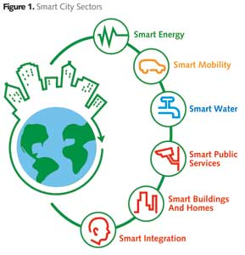
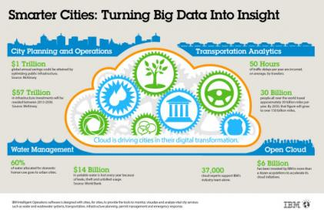
Water efficiency enhances People’s Life
Water efficiency analytics enhances performance of city water systems, improving the longevity of infrastructure while saving energy and reducing water loss.

Slide 5

What are the Typical Reasons for Water related problems ?
No Water
Water Quality
Hardness (measure of dissolved calcium and magnesium)
Dirty, Cloudy or Milky, Rusty Brown Color
Contains particles, insects or worms
Contains grease, oil, or gasoline
Bad smell or taste
Chlorine odors
Fluoride levels
Water Pressure High/Low
Illness caused by drinking water
Building/Neighborhood

Slide 6
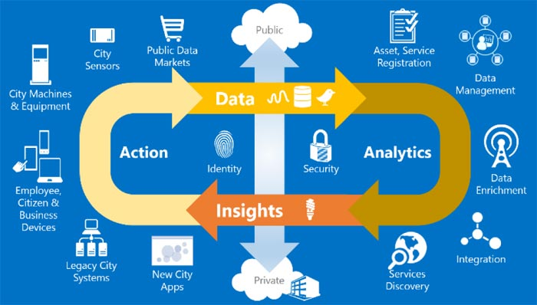
How Analytics can help in addressing Water Problems ?
Correlating disparate Data Sources easily
Help in Potential Cause Analysis based on area, timing, building types etc.
Prediction of Areas/Timing with potential of more Water problems
Prediction of sudden Spikes ahead of time using near real time data
Influencing efficient use of Water Management
Better Service and Improved People’s Lifestyle

Slide 7
Agenda
Water Problems in Big Cities– Implications and Causes (10 Mins)
Water Problems in New York City (10 Mins)
Data Sources For Modeling Water Problems (10 Mins)
Fast Data Analytics Technologies For Modeling Water Problems (10 Mins)
Demonstration of Modeling Water Problems using New York City Data Sources (60 Mins)
Q & A (15 Mins)
Notes:
7

Slide 8
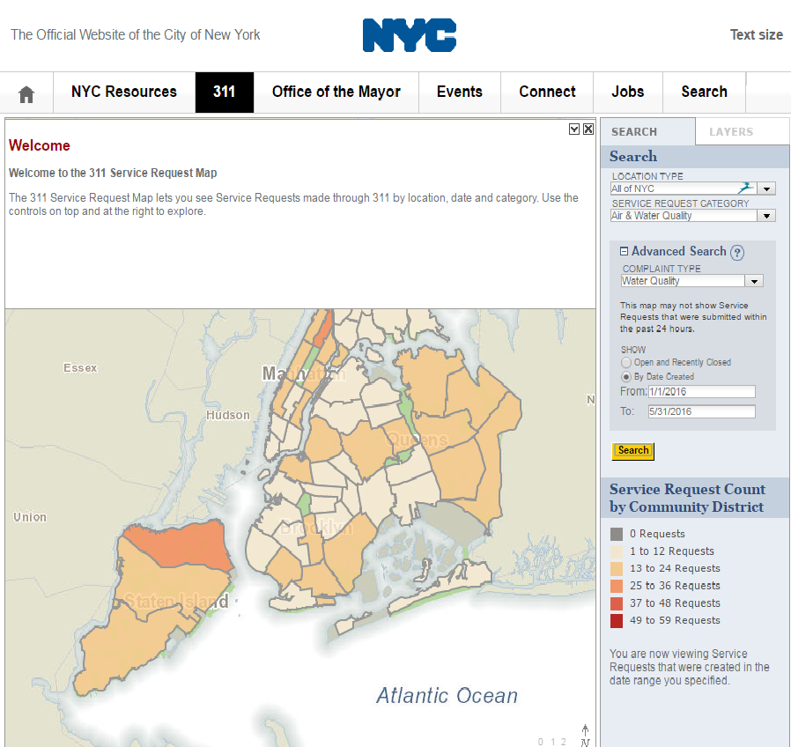
Water Complaints in New York City

Slide 9
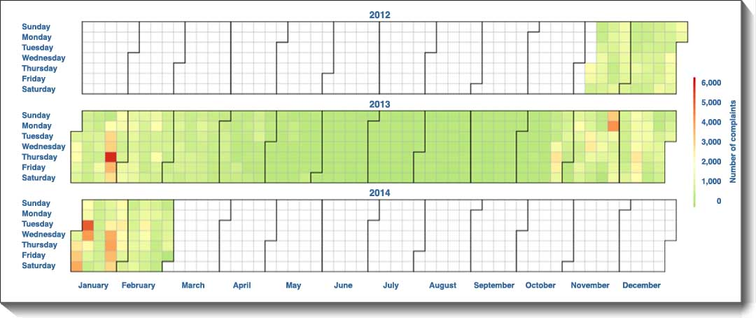
Weekly Water Complaints in Manhattan for a Year
Notes:
*Luis*
Spark SQL – Interactive Analytics
Query your structured data sets with SQL or other dataframe APIs.
Use BI tools to connect and query via JDBC or ODBC.
Interactive querying of very large data sets is a no-brainer, it’s one of the most important value adds enabled by Spark, versus Hadoop. The more interactive or the more iterative it is, the greater the performance improvement
Spark Streaming
Process live streams of data (IoT, Twitter, Kafka, etc.) with the Spark engine to drive some action or be outputted in batches to various data stores
Implementing near-realtime stream event processing (e.g. fraud / security detection)
Mllib – Machine Learning
Processing machine learning algorithms in areas such as clustering, classification, etc. Applicability in sentiment analysis, predictive intelligence, segmentation, modeling, etc.
Building and deploying rich analytics models (e.g. risk metrics)
GraphX (graph)
Represent and analyze systems represented by nodes and interconnections between them – transportation, person relationships, etc.
Allows you to perform operations on the graph to determine relationships e.g. behavior propensity, churn and fraud detection as examples
Data Processing and Integration
Existing data processing workloads done much faster
Coding that is simplified e.g. 3 lines of code instead of 6 pages in traditional programming

Slide 10
Agenda
Water Problems in Big Cities– Implications and Causes (10 Mins)
Water Problems in New York City (10 Mins)
Data Sources For Modeling Water Problems (10 Mins)
Fast Data Analytics Technologies For Modeling Water Problems (10 Mins)
Demonstration of Modeling Water Problems using New York City Data Sources (60 Mins)
Q & A (15 Mins)
Notes:
10

Slide 11

Data Source 1 : Complaint Data
Water Complaints
Lat/Long, Address and Zip Code of complaint
Every Incident is Recorded with date and time
Notes:
*Luis*
Spark SQL – Interactive Analytics
Query your structured data sets with SQL or other dataframe APIs.
Use BI tools to connect and query via JDBC or ODBC.
Interactive querying of very large data sets is a no-brainer, it’s one of the most important value adds enabled by Spark, versus Hadoop. The more interactive or the more iterative it is, the greater the performance improvement
Spark Streaming
Process live streams of data (IoT, Twitter, Kafka, etc.) with the Spark engine to drive some action or be outputted in batches to various data stores
Implementing near-realtime stream event processing (e.g. fraud / security detection)
Mllib – Machine Learning
Processing machine learning algorithms in areas such as clustering, classification, etc. Applicability in sentiment analysis, predictive intelligence, segmentation, modeling, etc.
Building and deploying rich analytics models (e.g. risk metrics)
GraphX (graph)
Represent and analyze systems represented by nodes and interconnections between them – transportation, person relationships, etc.
Allows you to perform operations on the graph to determine relationships e.g. behavior propensity, churn and fraud detection as examples
Data Processing and Integration
Existing data processing workloads done much faster
Coding that is simplified e.g. 3 lines of code instead of 6 pages in traditional programming

Slide 12
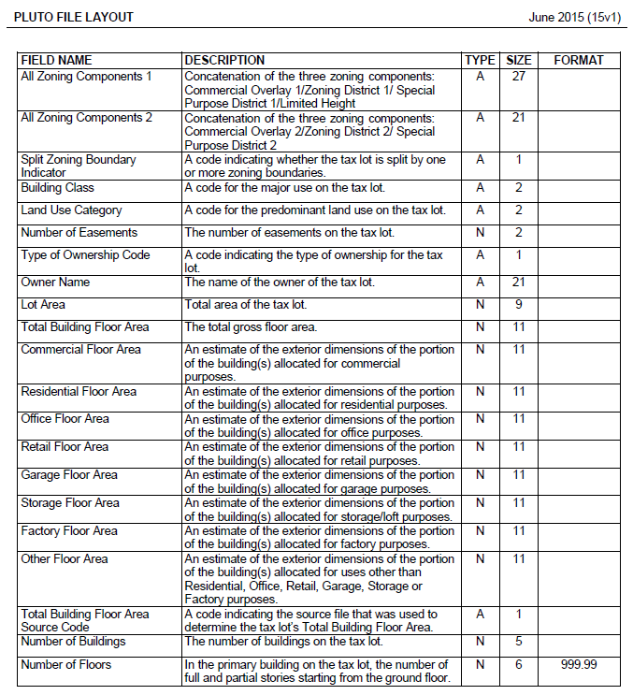
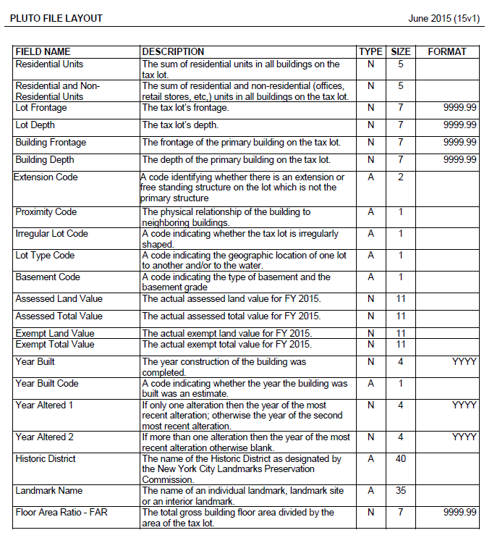
Data Source 2 : Building Characteristics Data (Pluto Data)
Notes:
*Luis*
Spark SQL – Interactive Analytics
Query your structured data sets with SQL or other dataframe APIs.
Use BI tools to connect and query via JDBC or ODBC.
Interactive querying of very large data sets is a no-brainer, it’s one of the most important value adds enabled by Spark, versus Hadoop. The more interactive or the more iterative it is, the greater the performance improvement
Spark Streaming
Process live streams of data (IoT, Twitter, Kafka, etc.) with the Spark engine to drive some action or be outputted in batches to various data stores
Implementing near-realtime stream event processing (e.g. fraud / security detection)
Mllib – Machine Learning
Processing machine learning algorithms in areas such as clustering, classification, etc. Applicability in sentiment analysis, predictive intelligence, segmentation, modeling, etc.
Building and deploying rich analytics models (e.g. risk metrics)
GraphX (graph)
Represent and analyze systems represented by nodes and interconnections between them – transportation, person relationships, etc.
Allows you to perform operations on the graph to determine relationships e.g. behavior propensity, churn and fraud detection as examples
Data Processing and Integration
Existing data processing workloads done much faster
Coding that is simplified e.g. 3 lines of code instead of 6 pages in traditional programming

Slide 13
Data Source 3 : American Community Survey Data
Notes:
*Luis*
Spark SQL – Interactive Analytics
Query your structured data sets with SQL or other dataframe APIs.
Use BI tools to connect and query via JDBC or ODBC.
Interactive querying of very large data sets is a no-brainer, it’s one of the most important value adds enabled by Spark, versus Hadoop. The more interactive or the more iterative it is, the greater the performance improvement
Spark Streaming
Process live streams of data (IoT, Twitter, Kafka, etc.) with the Spark engine to drive some action or be outputted in batches to various data stores
Implementing near-realtime stream event processing (e.g. fraud / security detection)
Mllib – Machine Learning
Processing machine learning algorithms in areas such as clustering, classification, etc. Applicability in sentiment analysis, predictive intelligence, segmentation, modeling, etc.
Building and deploying rich analytics models (e.g. risk metrics)
GraphX (graph)
Represent and analyze systems represented by nodes and interconnections between them – transportation, person relationships, etc.
Allows you to perform operations on the graph to determine relationships e.g. behavior propensity, churn and fraud detection as examples
Data Processing and Integration
Existing data processing workloads done much faster
Coding that is simplified e.g. 3 lines of code instead of 6 pages in traditional programming

Slide 14
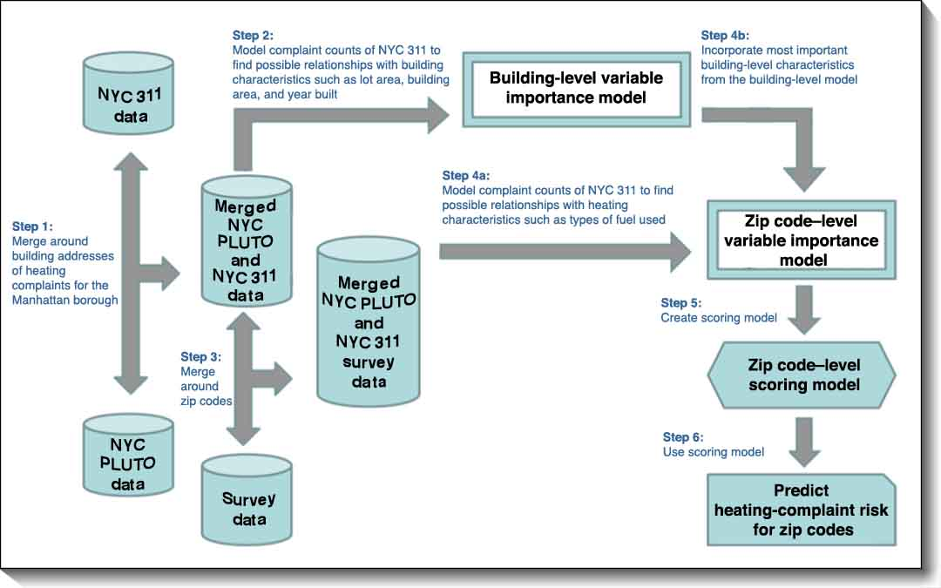
Approach For Modeling
Step 4a:
Model complaint counts of NYC 311 to find possible relationships with water characteristics such building location, zip code etc
Predict
Water complaint risk
for zip codes
Notes:
*Luis*
Spark SQL – Interactive Analytics
Query your structured data sets with SQL or other dataframe APIs.
Use BI tools to connect and query via JDBC or ODBC.
Interactive querying of very large data sets is a no-brainer, it’s one of the most important value adds enabled by Spark, versus Hadoop. The more interactive or the more iterative it is, the greater the performance improvement
Spark Streaming
Process live streams of data (IoT, Twitter, Kafka, etc.) with the Spark engine to drive some action or be outputted in batches to various data stores
Implementing near-realtime stream event processing (e.g. fraud / security detection)
Mllib – Machine Learning
Processing machine learning algorithms in areas such as clustering, classification, etc. Applicability in sentiment analysis, predictive intelligence, segmentation, modeling, etc.
Building and deploying rich analytics models (e.g. risk metrics)
GraphX (graph)
Represent and analyze systems represented by nodes and interconnections between them – transportation, person relationships, etc.
Allows you to perform operations on the graph to determine relationships e.g. behavior propensity, churn and fraud detection as examples
Data Processing and Integration
Existing data processing workloads done much faster
Coding that is simplified e.g. 3 lines of code instead of 6 pages in traditional programming

Slide 15
Agenda
Water Problems in Big Cities– Implications and Causes (10 Mins)
Water Problems in New York City (10 Mins)
Data Sources For Modeling Water Problems (10 Mins)
Fast Data Analytics Technologies For Modeling Water Problems (10 Mins)
Demonstration of Modeling Water Problems using New York City Data Sources (60 Mins)
Q & A (15 Mins)
Notes:
15

Slide 16
Fast Data Analytics Stack for developing Analytics in an Agile and iterative way
Notebook/Workbench
Batch Processes/ Workflows
Reports
Online Applications
APIs
SQL
Java
Scala
Python
R
Application Component Frameworks
SQL Components
Graph Components
Streaming Components
Modeling Components
Spark SQL
Spark GraphX
Spark Streaming
Spark MLLib
System ML
Spark R
Spark ML Pipeline
Distributed Processing Frameworks
Spark Core
Resource Management
Mesos
Standalone
Yarn
Persistence Storage
HDFS
S3
Swift
SAN
Others
Fast Data Analytics Stack
Notes:
16
16

Slide 17
Technology Stack Used for This Demonstration
Zeppelin Notebook
Batch Processes/ Workflows
Reports
Online Applications
APIs
SQL
Java
Scala
Python
R
Application Component Frameworks
SQL Components
Graph Components
Streaming Components
Modeling Components
Spark SQL
Spark GraphX
Spark Streaming
Spark MLLib
System ML
Spark R
Spark ML Pipeline
Distributed Processing Frameworks
Spark Core
Resource Management
Mesos
Standalone
Yarn
Persistence Storage
HDFS
S3
Swift
SAN
Others
Fast data Analytics Stack
Notes:
*Luis*
Spark SQL – Interactive Analytics
Query your structured data sets with SQL or other dataframe APIs.
Use BI tools to connect and query via JDBC or ODBC.
Interactive querying of very large data sets is a no-brainer, it’s one of the most important value adds enabled by Spark, versus Hadoop. The more interactive or the more iterative it is, the greater the performance improvement
Spark Streaming
Process live streams of data (IoT, Twitter, Kafka, etc.) with the Spark engine to drive some action or be outputted in batches to various data stores
Implementing near-realtime stream event processing (e.g. fraud / security detection)
Mllib – Machine Learning
Processing machine learning algorithms in areas such as clustering, classification, etc. Applicability in sentiment analysis, predictive intelligence, segmentation, modeling, etc.
Building and deploying rich analytics models (e.g. risk metrics)
GraphX (graph)
Represent and analyze systems represented by nodes and interconnections between them – transportation, person relationships, etc.
Allows you to perform operations on the graph to determine relationships e.g. behavior propensity, churn and fraud detection as examples
Data Processing and Integration
Existing data processing workloads done much faster
Coding that is simplified e.g. 3 lines of code instead of 6 pages in traditional programming

Slide 18

Apache Spark
Spark Core
Spark Streaming
Stream Processing
Micro-batch event processing for near real-time analytics
Process live streams of data (IoT, Twitter, Kafka)
No multi-threading or parallel processing required
Near real-time data processing & analytics
MLlib (machine learning)
Machine Learning
Predictive and prescriptive analytics, and smart application design, from statistical and algorithmic models
Algorithms are pre-built
Fast and easy to deploy algorithms
Spark SQL
Unified Data Access
Query your structured data sets with SQL or other dataframe APIs
Data mining, BI, and insight discovery
Get results faster due to performance
Fast, familiar query language for all data
Log processing
Graph Analytics
TBD
GraphX
Represent data in a graph
Represent/analyze systems represented by nodes and interconnections between them
Fast and integrated graph computation
SparkR
Support for R
Explore and Analyze Data using R syntax
SQL like syntax using R
Machine Learning (using MlLib)
Data Processing & Machine Learning using R syntax
Notes:
*Luis*
Spark SQL – Interactive Analytics
Query your structured data sets with SQL or other dataframe APIs.
Use BI tools to connect and query via JDBC or ODBC.
Interactive querying of very large data sets is a no-brainer, it’s one of the most important value adds enabled by Spark, versus Hadoop. The more interactive or the more iterative it is, the greater the performance improvement
Spark Streaming
Process live streams of data (IoT, Twitter, Kafka, etc.) with the Spark engine to drive some action or be outputted in batches to various data stores
Implementing near-realtime stream event processing (e.g. fraud / security detection)
Mllib – Machine Learning
Processing machine learning algorithms in areas such as clustering, classification, etc. Applicability in sentiment analysis, predictive intelligence, segmentation, modeling, etc.
Building and deploying rich analytics models (e.g. risk metrics)
GraphX (graph)
Represent and analyze systems represented by nodes and interconnections between them – transportation, person relationships, etc.
Allows you to perform operations on the graph to determine relationships e.g. behavior propensity, churn and fraud detection as examples
Data Processing and Integration
Existing data processing workloads done much faster
Coding that is simplified e.g. 3 lines of code instead of 6 pages in traditional programming

Slide 19

R
An interpreted language
Open-source implementation of the S language (1976)
Best suited for statistical analysis and modeling
Data exploration and manipulation
Descriptive statistics
Predictive analytics and machine learning
Visualization
+++
Can produce “publication quality graphics”
State of the art algorithms
Statistical researchers often provide their methods as R packages
New techniques available without delay
Commercial packages usually behind the curve
4700+ packages as of today
Active and vibrant user community

Slide 20
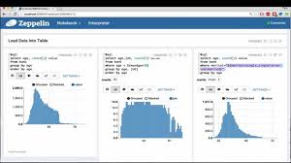
Apache Zeppelin
A web based Notebook
Supports multiple programming paradigms within a single Notebook instance
Dynamic Form generation
Supports other technologies apart from Spark – Flink, Hive, etc.
We’ll use PR 208 of Zeppelin for R Interpreter (https://github.com/apache/incubator-zeppelin/pull/208)
Notes:
*Luis*
Spark SQL – Interactive Analytics
Query your structured data sets with SQL or other dataframe APIs.
Use BI tools to connect and query via JDBC or ODBC.
Interactive querying of very large data sets is a no-brainer, it’s one of the most important value adds enabled by Spark, versus Hadoop. The more interactive or the more iterative it is, the greater the performance improvement
Spark Streaming
Process live streams of data (IoT, Twitter, Kafka, etc.) with the Spark engine to drive some action or be outputted in batches to various data stores
Implementing near-realtime stream event processing (e.g. fraud / security detection)
Mllib – Machine Learning
Processing machine learning algorithms in areas such as clustering, classification, etc. Applicability in sentiment analysis, predictive intelligence, segmentation, modeling, etc.
Building and deploying rich analytics models (e.g. risk metrics)
GraphX (graph)
Represent and analyze systems represented by nodes and interconnections between them – transportation, person relationships, etc.
Allows you to perform operations on the graph to determine relationships e.g. behavior propensity, churn and fraud detection as examples
Data Processing and Integration
Existing data processing workloads done much faster
Coding that is simplified e.g. 3 lines of code instead of 6 pages in traditional programming

Slide 21

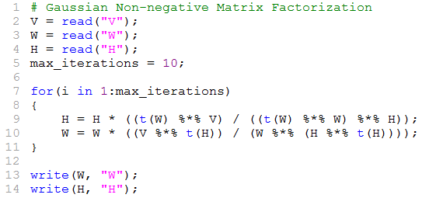
Apache SystemML
A Distributed machine Learning Platform
Supports multiple run time – Spark, Hadoop MR, Single Node
Users can create Custom Algorithms using R like syntax
Optimize Performance of Algorithms automatically depending on the choice of Platform
Notes:
*Luis*
Spark SQL – Interactive Analytics
Query your structured data sets with SQL or other dataframe APIs.
Use BI tools to connect and query via JDBC or ODBC.
Interactive querying of very large data sets is a no-brainer, it’s one of the most important value adds enabled by Spark, versus Hadoop. The more interactive or the more iterative it is, the greater the performance improvement
Spark Streaming
Process live streams of data (IoT, Twitter, Kafka, etc.) with the Spark engine to drive some action or be outputted in batches to various data stores
Implementing near-realtime stream event processing (e.g. fraud / security detection)
Mllib – Machine Learning
Processing machine learning algorithms in areas such as clustering, classification, etc. Applicability in sentiment analysis, predictive intelligence, segmentation, modeling, etc.
Building and deploying rich analytics models (e.g. risk metrics)
GraphX (graph)
Represent and analyze systems represented by nodes and interconnections between them – transportation, person relationships, etc.
Allows you to perform operations on the graph to determine relationships e.g. behavior propensity, churn and fraud detection as examples
Data Processing and Integration
Existing data processing workloads done much faster
Coding that is simplified e.g. 3 lines of code instead of 6 pages in traditional programming

Slide 22

IOP – IBM Open Platform with Apache Hadoop
Fully Open Source Distribution of Big Data Platform
Packages different types of Big data Technologies within single Distribution – Hadoop, Spark, Kafka, Solr, etc.
Compliant to industry standard for Big Data Platform - ODPi : The Open Ecosystem of Big Data (https://www.odpi.org/)
Notes:
*Luis*
Spark SQL – Interactive Analytics
Query your structured data sets with SQL or other dataframe APIs.
Use BI tools to connect and query via JDBC or ODBC.
Interactive querying of very large data sets is a no-brainer, it’s one of the most important value adds enabled by Spark, versus Hadoop. The more interactive or the more iterative it is, the greater the performance improvement
Spark Streaming
Process live streams of data (IoT, Twitter, Kafka, etc.) with the Spark engine to drive some action or be outputted in batches to various data stores
Implementing near-realtime stream event processing (e.g. fraud / security detection)
Mllib – Machine Learning
Processing machine learning algorithms in areas such as clustering, classification, etc. Applicability in sentiment analysis, predictive intelligence, segmentation, modeling, etc.
Building and deploying rich analytics models (e.g. risk metrics)
GraphX (graph)
Represent and analyze systems represented by nodes and interconnections between them – transportation, person relationships, etc.
Allows you to perform operations on the graph to determine relationships e.g. behavior propensity, churn and fraud detection as examples
Data Processing and Integration
Existing data processing workloads done much faster
Coding that is simplified e.g. 3 lines of code instead of 6 pages in traditional programming

Slide 23
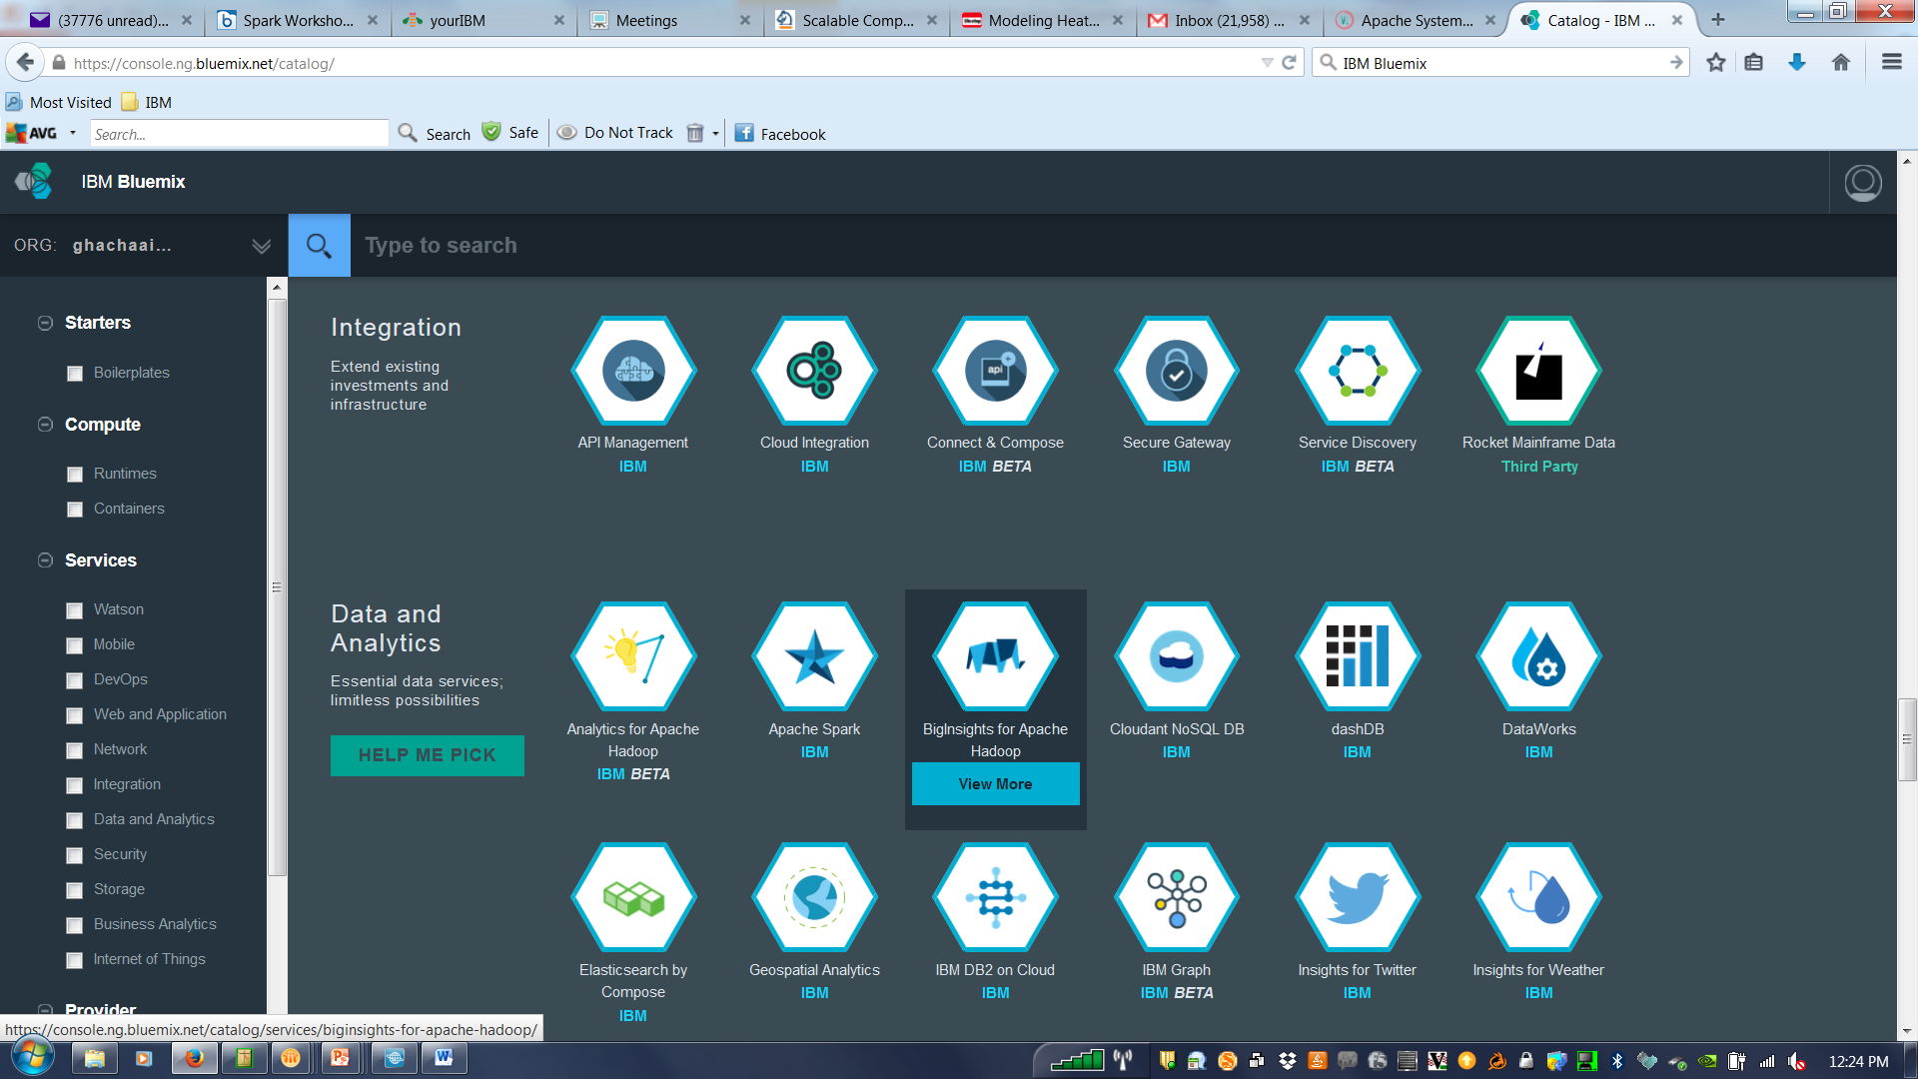
BigInsights for Apache Hadoop in IBM Bluemix
Managed cloud service with 100% open source Apache Hadoop through the IBM Open Platform.
Includes Ambari, YARN, Spark, Knox, HBase, Hive, Solr, and an encrypted HDFS
High value Hadoop analytics features such as Big SQL, BigSheets, Text Analytics, Big R, and Machine Learning to gain insight faster.
Key components of the platform, including the infrastructure, are proactively monitored by a 24x7 cloud operations team.
Free Trial available for 30 days
Notes:
*Luis*
Spark SQL – Interactive Analytics
Query your structured data sets with SQL or other dataframe APIs.
Use BI tools to connect and query via JDBC or ODBC.
Interactive querying of very large data sets is a no-brainer, it’s one of the most important value adds enabled by Spark, versus Hadoop. The more interactive or the more iterative it is, the greater the performance improvement
Spark Streaming
Process live streams of data (IoT, Twitter, Kafka, etc.) with the Spark engine to drive some action or be outputted in batches to various data stores
Implementing near-realtime stream event processing (e.g. fraud / security detection)
Mllib – Machine Learning
Processing machine learning algorithms in areas such as clustering, classification, etc. Applicability in sentiment analysis, predictive intelligence, segmentation, modeling, etc.
Building and deploying rich analytics models (e.g. risk metrics)
GraphX (graph)
Represent and analyze systems represented by nodes and interconnections between them – transportation, person relationships, etc.
Allows you to perform operations on the graph to determine relationships e.g. behavior propensity, churn and fraud detection as examples
Data Processing and Integration
Existing data processing workloads done much faster
Coding that is simplified e.g. 3 lines of code instead of 6 pages in traditional programming

Slide 24
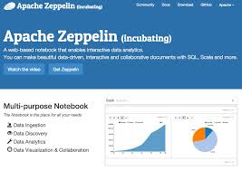
Technology Specific Details
Spark –
Spark 1.5.2
Spark Core, Spark MlLib, SparkSQL, SparkR
Apache
SystemML 0.9
Running on Spark
Zeppelin
Zeppelin 0.5.5
We’ll use PR 208 of Zeppelin for R Interpreter (https://github.com/apache/incubator-zeppelin/pull/208)
IBM Open Data Platform for Apache Hadoop (IOP)
IOP 4.1
HDFS, Yarn, Hive Metastore and Spark
IBM Bluemix
BigInsights for Apache Hadoop in IBM Bluemix
A cluster with 3 Data Nodes and 4 Management Nodes

Slide 25
The Overall Deployment Architecture with Key Components
User Browser
Edge Management Nodes
Zeppelin Process
Spark Driver
R
System ML
Management Nodes
Yarn Master
HDFS Name Node
Hive Server 2
Hive Meta Store
Slave Nodes
Spark Slave Process
HDFS Data Node
Yarn
Spark Slave Process
HDFS Data Node
Yarn
Spark Slave Process
HDFS Data Node
Yarn
IOP
IBM Bluemix
Notes:
*Luis*
Spark SQL – Interactive Analytics
Query your structured data sets with SQL or other dataframe APIs.
Use BI tools to connect and query via JDBC or ODBC.
Interactive querying of very large data sets is a no-brainer, it’s one of the most important value adds enabled by Spark, versus Hadoop. The more interactive or the more iterative it is, the greater the performance improvement
Spark Streaming
Process live streams of data (IoT, Twitter, Kafka, etc.) with the Spark engine to drive some action or be outputted in batches to various data stores
Implementing near-realtime stream event processing (e.g. fraud / security detection)
Mllib – Machine Learning
Processing machine learning algorithms in areas such as clustering, classification, etc. Applicability in sentiment analysis, predictive intelligence, segmentation, modeling, etc.
Building and deploying rich analytics models (e.g. risk metrics)
GraphX (graph)
Represent and analyze systems represented by nodes and interconnections between them – transportation, person relationships, etc.
Allows you to perform operations on the graph to determine relationships e.g. behavior propensity, churn and fraud detection as examples
Data Processing and Integration
Existing data processing workloads done much faster
Coding that is simplified e.g. 3 lines of code instead of 6 pages in traditional programming

Slide 26
Agenda
Water Problems in Big Cities– Implications and Causes (10 Mins)
Water Problems in New York City (10 Mins)
Data Sources For Modeling Water Problems (10 Mins)
Fast Data Analytics Technologies For Modeling Water Problems (10 Mins)
Demonstration of Modeling Water Problems using New York City Data Sources (60 Mins)
Q & A (15 Mins)
Notes:
26

Slide 27
Agenda
Water Problems in Big Cities– Implications and Causes (10 Mins)
Water Problems in New York City (10 Mins)
Data Sources For Modeling Water Problems (10 Mins)
Fast Data Analytics Technologies For Modeling Water Problems (10 Mins)
Demonstration of Modeling Water Problems using New York City Data Sources (60 Mins)
Q & A (15 Mins)
Notes:
27

Slide 28
Thank You

