Slide 1
Discussion: Text Clustering
Zhishuai Kuo
Lab of Granular Computing

Slide 2
Experiments
1. Decision tree (Done)
(Human activity recognition with smartphones)
2. K-means (Done)
(Iris data, Human activity recognition with smartphones)
3. Text clustering based on K-means (To be done)

Slide 3
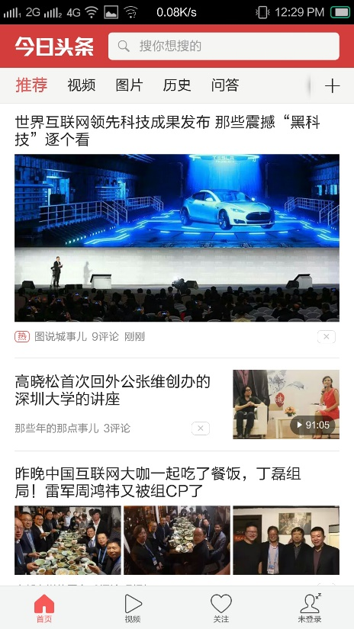


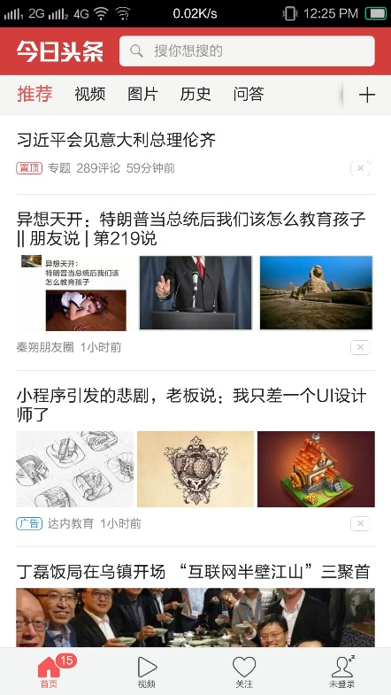

Possible application
Automatic document organization, topic extraction, fast information retrieval or filtering
Analyses users’ behavior, interest and current psychological state
Notes:
naive bayes
stock

Slide 4
Objectives
1. Cluster texts according to their topic
2. Analyse user behavior and psychological state

Slide 5
Preparation
1. Get http packets in adroid and linux operating system
(1) Adroid os: adb (http://adbdriver.com/downloads/)
(2) Linux os: BPF
(https://github.com/iovisor/bcc/blob/master/INSTALL.md)
2. Get the text content of a webpage
(http://blog.csdn.net/orthocenterchocolate/article/details/38665937)
3. Chinese tokenization: NLPIR
(http://ictclas.nlpir.org/newsdownloads?DocId=389)

Slide 6


Preparation
1.

Slide 7
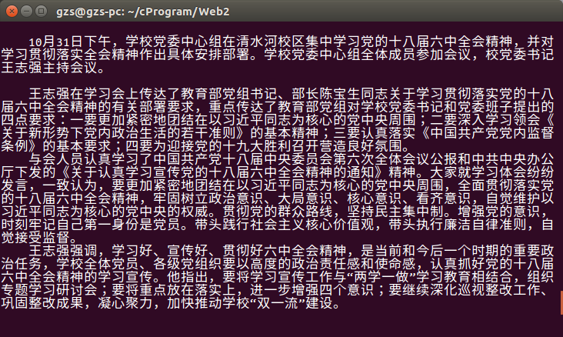
Preparation
2.

Slide 8
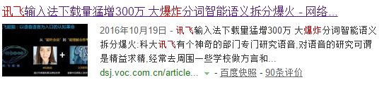
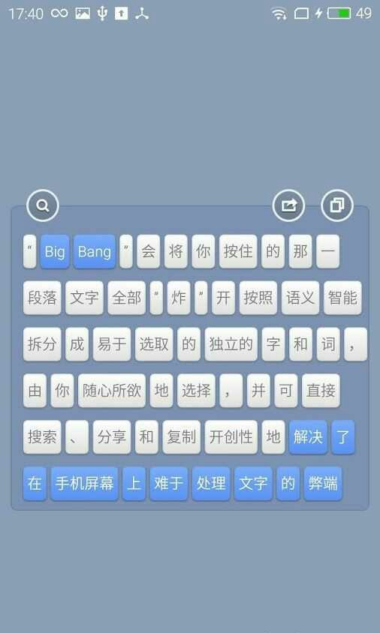
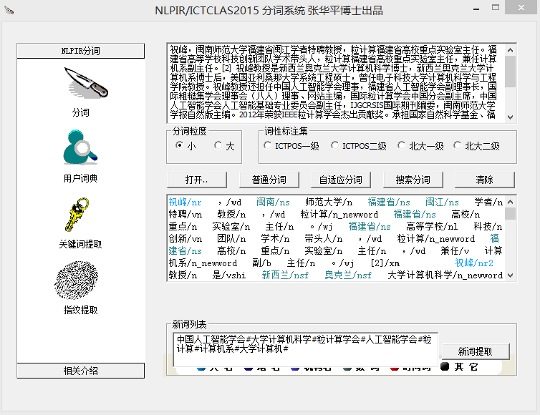
Preparation
3.

Slide 9


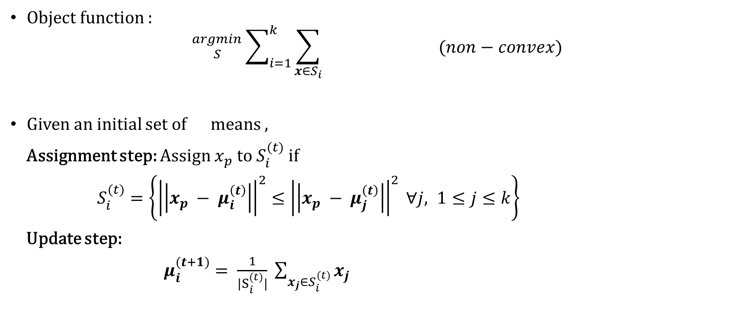
Review the k-means algorithm
Object function :
$${}_{S }^{argmin}{ \sum_{i=1}^{k}{\sum_{x∈S_{i}}{ }}} (non−convex)$$
Given an initial set of means ,
Assignment step: Assign $x_{p}$ to $S_{i}^{(t)}$ if
$S_{i}^{(t)}=\left\{{\left|\left|x_{p} − μ_{i}^{\left(t\right)}\right|\right|}^{2}≤{\left|\left|x_{p} − μ_{j}^{\left(t\right)}\right|\right|}^{2} ∀j, 1≤j≤k\right\}$
Update step:
$μ_{i}^{(t+1)}= \frac{1}{|S_{i}^{(t)}|} \sum_{x_{j}∈S_{i}^{(t)}}{x_{j}}$
$${\left|\left|x − μ_{i}\right|\right|}^{2}$$
k
$$μ_{1}^{(1)}, …, μ_{k}^{(1)}$$

Slide 10
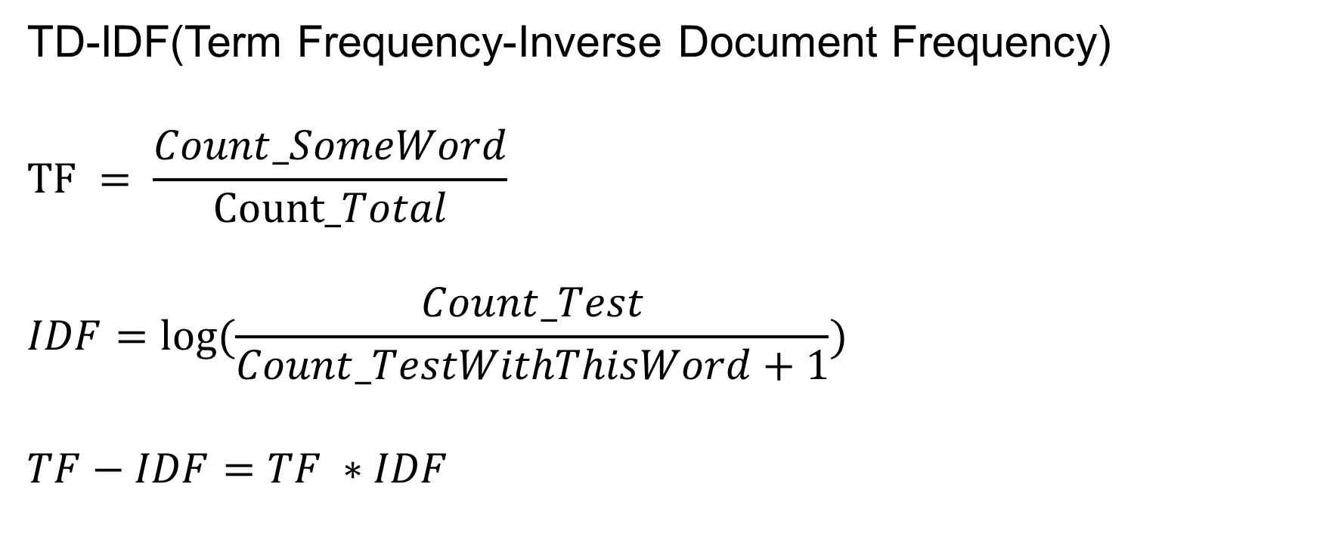
Feature selection
TD-IDF(Term Frequency-Inverse Document Frequency)
$$TF = \frac{Count_SomeWord}{Count_Total}$$
$$IDF=log⁡(\frac{Count_Test}{Count_TestWithThisWord+1})$$
$$TF−IDF=TF ∗IDF$$
Notes:
no low frequency, no high frequency

Slide 11
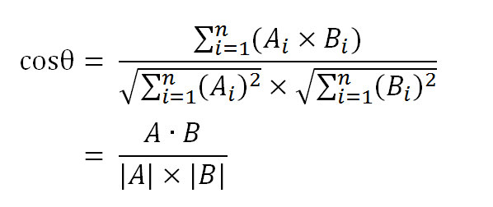
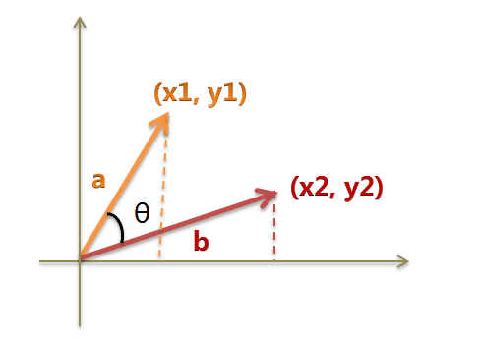
Measurement of similarity: cosine similartity
Notes:
why cosine similarity?
1. e.g. (1) rate (3, 3), (5, 5) (2) user value (3, 3) (50, 50)
2. sparse?
3. projecting the data onto the surface of the unit sphere
4. efficent, especially for sparse vectors, as only the non-zero dimensions need to be considered
libsvm
libnear

Slide 12
Example
Sentence A：我喜欢看电视，不喜欢看电影。
Sentence B：我不喜欢看电视，也不喜欢看电影。
Step1: Tokenization
Sentence A: 我/喜欢/看/电视，不/喜欢/看/电影。
Sentence B: 我/不/喜欢/看/电视，也/不/喜欢/看/电影。
Step2: List all the words involved
我，喜欢，看，电视，电影，不，也。
Step3: Calculate the frequency of every word in each sentence
Sentence A：我 1，喜欢 2，看 2，电视 1，电影 1，不 1，也 0。
Sentence B：我 1，喜欢 2，看 2，电视 1，电影 1，不 2，也 1。
Step4: The feature vector
Sentence A：[1, 2, 2, 1, 1, 1, 0]
Sentence B：[1, 2, 2, 1, 1, 2, 1]

Slide 13
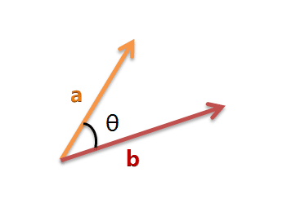

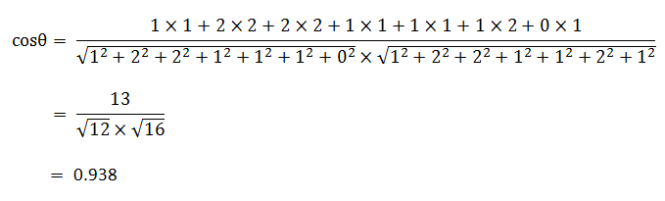
Example
Step5: Calculate the cosine similarity
Sentence A：[1, 2, 2, 1, 1, 1, 0]
Sentence B：[1, 2, 2, 1, 1, 2, 1]

Slide 14
General procedures
1. Tokenization
2. Stemming and lemmatization
(e.g. tokenization and tokenizing)
3. Removing stop words and punctuation
4. Computing term frequencies or TF-IDF
5. Clustering

Slide 15
Disccusion
1. Plan
(1) Select first N key words with TF-IDF from some corpus
(2) Map every text into a feature vector
(3) Cluster with K-means
An example of C++ code:
(http://www.cnblogs.com/phinecos/archive/2008/09/06/1285646.html)
Notes:
1. (1) how to choose N?
(2) key words from some set, cluster training dataset from the same set?

Slide 16
Discussion
2. Supervised or unsupervised (Clustering or classifying)
3. Why cosine similarity
4. Analysis of current psychological state of users
Dataset of Chinese emotional words(possitive and negative)
(http://www.datatang.com/data/44317/)

Slide 17
Discussion
5. Very high dimensional representation, sparse underlying data
6. The number of concepts(or principal components) in the
data is much smaller than the feature space
7. The number of words in the different documents may vary
widely
Notes:
4. (1) sparse
(2) how to deal with short test, is classfying algorithm better?
5. is PCA practical here?
6. if very short, distance tend to be great.

Slide 18
THANKS!

