Slide 1

EE216 Reconfigurable Computing
Topic 10： SW & HW System Optimization
Prof. Yajun Ha
ShanghaiTech University
Shanghai, China
Notes:
Title
FirstName LastName – Activity / Group

Slide 2

SW/HW System Optimization
Data motion networks and optimization
HLS optimization
Notes:
Title
FirstName LastName – Activity / Group

Slide 3
Data Motion Network and Optimization
PS-PL Interface AXI Ports
Data Movement in Zynq
Program Connectivity Implementation
Compare Different Implementation
Notes:
Title
FirstName LastName – Activity / Group

Slide 4
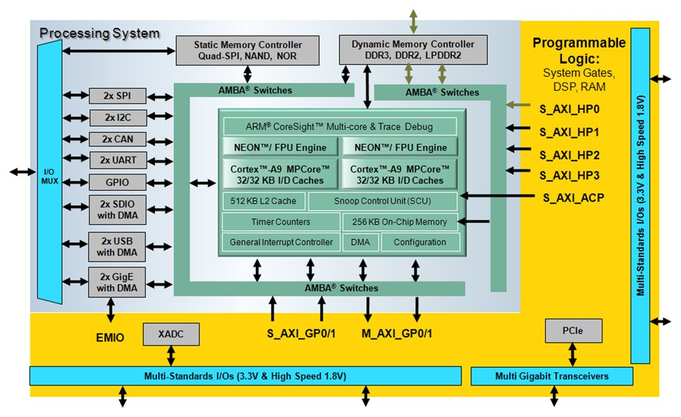
PS-PL Interface AXI Ports
2 general-purpose master ports
2 general-purpose slave ports
4 high-performance slave ports
1 accelerator coherency port (ACP) slave port
Notes:
在这里只介绍SDSoC会用到的接口
Title
FirstName LastName – Activity / Group

Slide 5
General-Purpose Master Ports
Two identical 32-bit AXI master ports
  M_AXI_GP0
  M_AXI_GP1
Attaches to slave AXI ports in programmable logic via PL AXI interconnect
Mostly used for CPU and I/O peripheral block data movement to programmable logic
Why two ports?
  One for peripheral
  One for SDSoC Control

Slide 6
High-Performance Slave Ports
Asynchronous crossing between the PL clock domain and PS clock domain
  S_AXI_HP0，1，2，3
Provides initiator access from PL master to PS memory
Provides low latency access to DDR and OCM
Attaches to master AXI port in PL
  DMA controller
  MicroBlaze processor
  Custom master built in programmable logic
  Other third-party based IP

Slide 7
Accelerator Coherency Port (ACP) Slave Port
One accelerator coherence port (ACP)
  S_AXI_ACP
High-performance, coprocessor interface to PL
Provides low latency access to DDR and OCM
  Accelerators gain access to the CPU cache hierarchy
No drivers required for the ACP

Slide 8
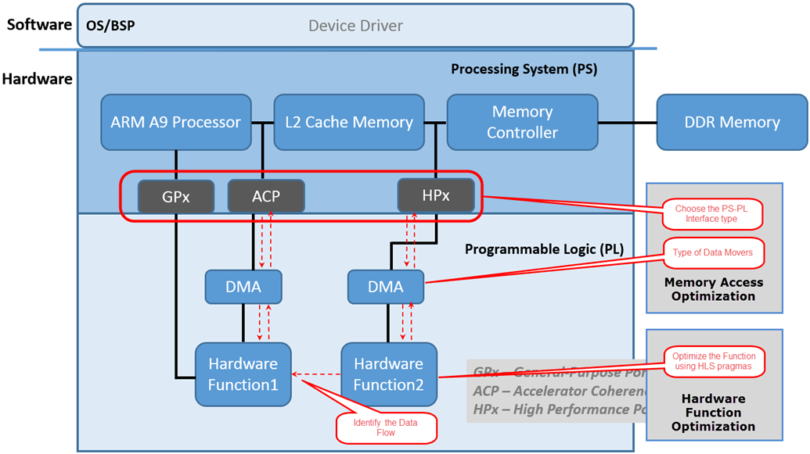
Data Movement in Zynq
Data may move between master/slave IP located in PL and memories located internal to the processor or external to the chip using the nine ports described in the previous section.
The decision is made by the SDSoC compiler after analyzing the software or following user’s directives
Notes:
Title
FirstName LastName – Activity / Group

Slide 9
Program Connectivity Implementation
Every connection with data movement between the software program and a hardware function requires a datamover
Program connections can have multiple possible implementations
  SDSoC compiler infers datamovers and system ports
  Datamover and system ports can be overridden with pragma
Datamover inference is based on payload size, payload memory attributes, and hardware function argument access pattern
  #pragma SDS data data_mover(arg:<DM_TYPE>) // SIMPLE/SG
  #pragma SDS data sys_port(arg:<Port_TYPE>) //ACP/HP/GP
  #pragma SDS data copy/zero_copy(arg:<Length>)
  #pragma SDS data access_pattern (A:SEQUENTIAL|RANDOM)

Slide 10
Program Connectivity Implementation
#define N 2048
#pragma SDS data copy(In[0:N],Out[0:N])
#pragma SDS data data_mover(In:AXIDMA_SG, Out:AXIDMA_SG)
#pragma SDS data access_pattern(In:SEQUENTIAL, Out:SEQUENTIAL)
#pragma SDS data sys_port(In:AFI, Out:AFI)
void IO(float* In, float* Out)
{
float Buffer [N];
for(int i=0;i<N;i++) Buffer[i]=In[i];//Load data from DDR to PL
for(int i=0;i<N;i++) Out[i]=Buffer[i];//Write data from PL to DDR
}

Slide 11
Memory Models
sds_lib.h functions to “declare” memory properties
  sds_alloc(size_t size); // guaranteed physically continuous memory
  malloc(size_t size); // physically uncontinuous(paged) memory
 | Mem | Port | Datamover | copy | Setup | Transfer | Test | FF | LUT
1 | Continuous | ACP | SIMPLE | zero | 518 | 10890 | 48907 | 1197 | 1438
2 | Continuous | AFI | SIMPLE | zero | 11222 | 20675 | 110623 | 1197 | 1438
3 | Continuous | ACP | SG | zero | 518 | 10890 | 48891 | 1197 | 1438
4 | Continuous | AFI | SG | zero | 11222 | 20675 | 105411 | 1197 | 1438
5 | Continuous | ACP | SIMPLE | copy | 1120 | 10337 | 49912 | 130 | 161
6 | Continuous | AFI | SIMPLE | copy | 12454 | 10546 | 80345 | 130 | 161
7 | Continuous | ACP | SG | copy | 5202 | 15370 | 72418 | 130 | 161
8 | Continuous | AFI | SG | copy | 16242 | 15426 | 104536 | 130 | 161
9 | Paged | ACP | SG | copy | 28524 | 17532 | 321272 | 130 | 161
10 | Paged | AFI | SG | copy | 26624 | 18636 | 351497 | 130 | 161
11 | Continuous | GP | FIFO | zero | 518 | 10890 | 48941 | 1197 | 1438
12 | Continuous | GP | FIFO | copy | 396836 | 18636 | 580754 | 130 | 161
13 | Paged | GP | FIFO | copy | 396836 | 18636 | 573677 | 130 | 161
Notes:
提供了不同pragma组合的实测性能
Title
FirstName LastName – Activity / Group

Slide 12
SW/HW System Optimization
Data motion networks and optimization
HLS optimization
Notes:
Title
FirstName LastName – Activity / Group

Slide 13
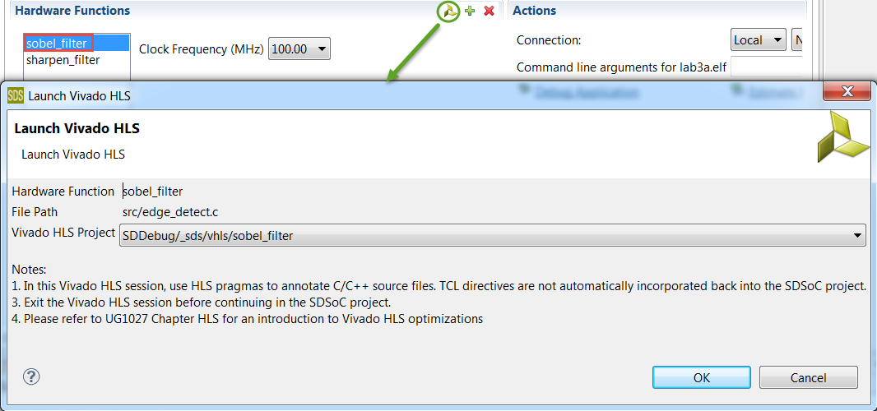
Relevant HLS Use Models
Vivado HLS as IP development environment
  Export IP from HLS and import as C-callable IP
Vivado HLS as Zynq PL cross-compiler
  Hardware function source code shared between SDSoC and VHLS and the only handoff files
  VHLS projects are automatically created
  by SDSoC and are temporary work
  products (no persistent state)
  Optionally launch HLS from SDSoC
    Optimize accelerator code
    Simulate hardware function

Slide 14
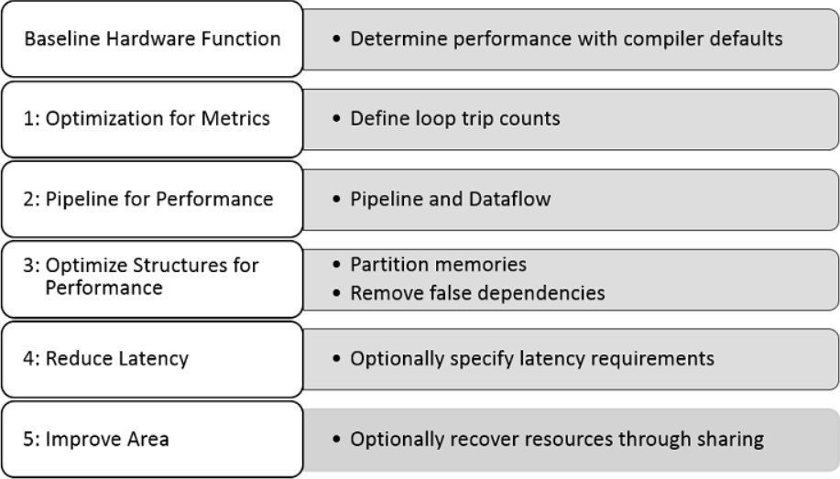
Optimization Methodology

Slide 15
Primary Optimization Techniques
Memory access can be the biggest performance bottleneck
  May have to restructure algorithm to optimize memory accesses for hardware (similar issues for GPU, DSPs)
  Pointers are an efficient way to pass ownership to software functions, but not necessarily to hardware functions
  Burst data into local arrays using memcpy or copy loops (e.g., line buffer, small matrices)
Increase local concurrency
  Pipeline and dataflow loops, function calls, and operations
  Enhance pipeline performance

Slide 16
HLS Optimization Pragmas
Directives and Configurations | Description
PIPELINE | Reduces the initiation interval by allowing the concurrent execution of operations within a loop or function
DATAFLOW | Enables task level pipelining, allowing functions and loops to execute concurrently. Used to minimize interval
INLINE | Inlines a function, removing all function hierarchy. Used to enable logic optimization across function boundaries and improve latency/interval by reducing function call overhead
UNROLL | Unroll for-loops to create multiple independent operations rather than a single collection of operations
ARRAY_PARTITION | Partitions large arrays into multiple smaller arrays or into individual registers, to improve access to data and remove block RAM bottlenecks
Notes:
Title
FirstName LastName – Activity / Group

Slide 17


Loop and Function Pipelining
Without Pipelining
void foo(...) {
op_Read;
op_Compute;
op_Write;
}
With Pipelining
RD
CMP
WR
Loop:for(i=1;i<3;i++) {
op_Read;
op_Compute;
op_Write;
}
RD
CMP
WR
Initiation Interval = 3 cycles
Initiation Interval = 1 cycle
RD
CMP
WR
RD
CMP
WR
RD
CMP
WR
RD
CMP
WR
Latency = 3 cycles
Latency = 3 cycles
Loop Latency = 6 cycles
Loop Latency = 4 cycles
for (index_b = 0; index_b < B_NCOLS; index_b++) {
#pragma HLS PIPELINE II=1
float result = 0;
for (index_d = 0; index_d < A_NCOLS; index_d++) {
float product_term = in_A[index_a][index_d] * in_B[index_d][index_b];
result += product_term;
}
out_C[index_a * B_NCOLS + index_b] = result;
}

Slide 18





Dataflow
Default behavior
  Complete a function or loop iteration before starting next function or loop iteration
  Datamover and system ports can be overridden with pragma
Dataflow
  Start next function or loop iteration as soon as “ready” and data is available
  Initiation interval (II) represents number of clocks between ‘starts’
  Increased concurrency
Apply dataflow within a function but not at the top level
//This memory is turned into a FIFO during optimization
rgb_pixel inter_pix[MAX_HEIGHT][MAX_WIDTH];
// Primary processing functions
sepia_filter(in_pix,inter_pix);
sobel_filter(inter_pix,out_pix2);
Sepia Filter
Sobel Filter
Finish all writes to inter_pix[N]…
Then Sobel can start to access inter_pix[N]
Sepia Filter
Sobel Filter
Sepia Filter
[0]
[1]
[2]
[3]
…
Sobel Filter

Slide 19
Array Partitioning
Program connections can have multiple possible implementations
Divided into blocks: N-1/factor elements
0
1
…
(N/2-1)
access
block
N/2
…
N-2
N-1
array1[N]
Divided into blocks: 1 word at a time
(like “dealing cards”)
cyclic
0
2
…
N-2
0
1
…
N-1
1
…
N-3
N-1
Individual elements: Break a RAM into registers (no “factor” supported)
complete
0
N-3
1
N-1
N-2
…
2
void mmult_kernel(float in_A[A_NROWS][A_NCOLS], float in_B[A_NCOLS][B_NCOLS], float out_C[A_NROWS*B_NCOLS])
{
#pragma HLS INLINE self
#pragma HLS array_partition variable=in_A block factor=16 dim=2
#pragma HLS array_partition variable=in_B block factor=16 dim=1
// snip
}

Slide 20
SW/HW System Optimization
Data motion networks and optimization
HLS optimization
Notes:
Title
FirstName LastName – Activity / Group

