Slide 1

EE216 Reconfigurable Computing
Topic 11：Programming for SDSoC
Prof. Yajun Ha
ShanghaiTech University
Shanghai, China
Notes:
Title
FirstName LastName – Activity / Group

Slide 2

Programming for SDSoC
Create, Build and Run a SDSoC Project
SDSoC Execution and Building
Programming for SDSoC
Notes:
Title
FirstName LastName – Activity / Group

Slide 3









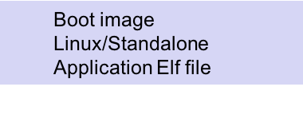

Development Flow
C/C++ Application running on ARM
Specify platform
Specify OS
Specify functions to move to HW
Specify monitor points
Profile Application
Optimize data transfer and parallelism using SDSoC guidelines
User-assisted SW-HW partitioning based on profiling
Select functions to move to HW
Optimize accelerator code
Run fast estimation
Analyze performance
Build application to generate software and hardware
SD Card Image
Run on the board

Slide 4
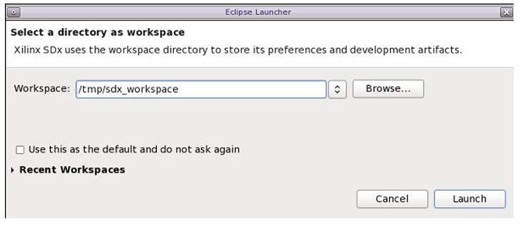
Step 1: Using an SDx Workspace

Slide 5
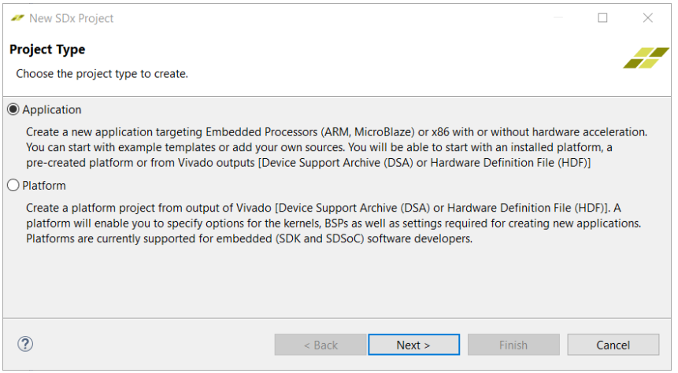
Step 1: Selecting Project Types
© Copyright 2017 Xilinx

Slide 6
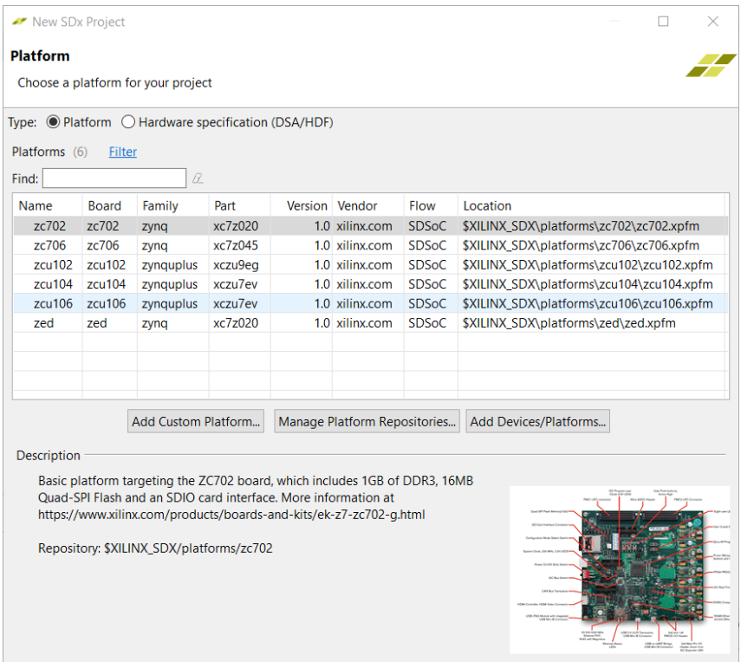
Step:1 Selecting a Platform

Slide 7
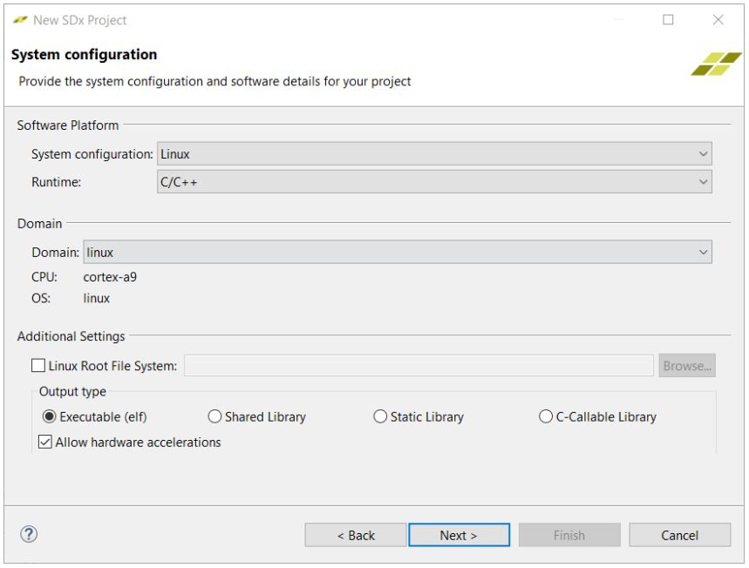
Step 1: System Configuration

Slide 8
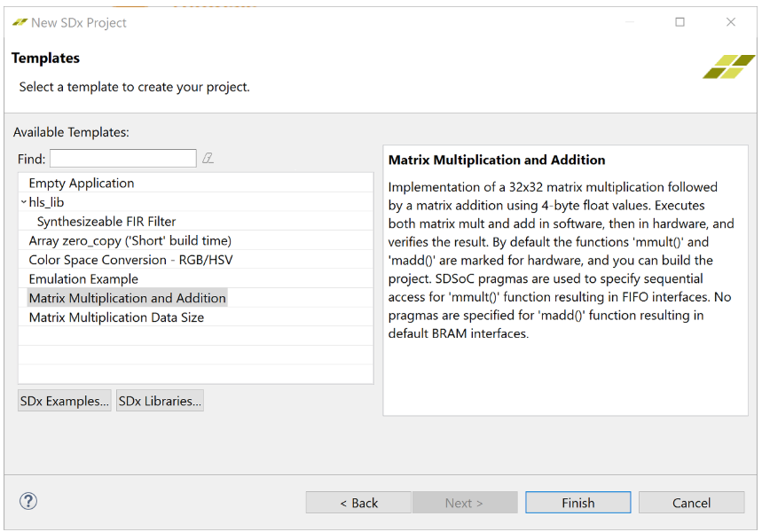
Step 1: Selecting a Template

Slide 9
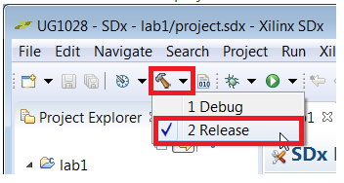
Step 1: Build Configuration

Slide 10
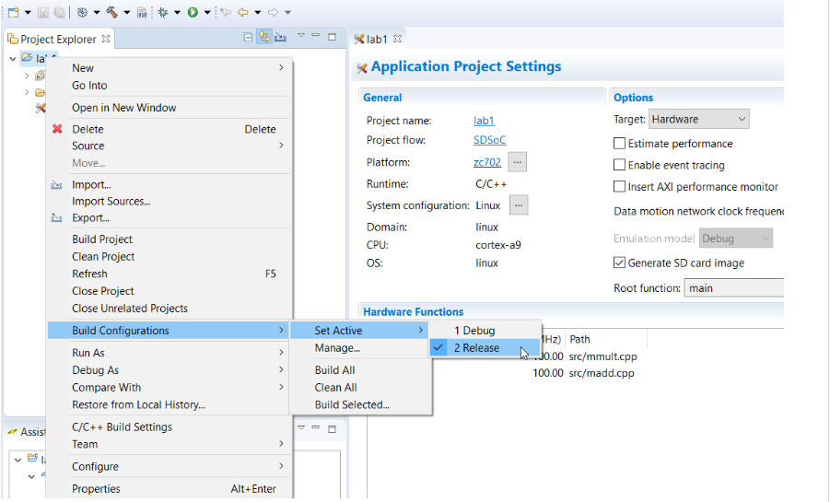
Step 1: Set Active Build Configuration

Slide 11

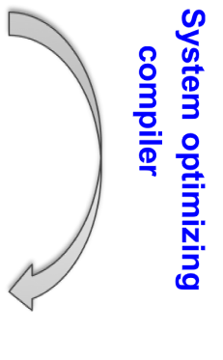

A SDSoC Design for an Algorithm
madd(inA,inB,out){
}
main(){
init(A,B,C);
mmult(A,B,D);
madd(C,D,E);
consume(E);
}
mmult(inA,inB,out){
}
Optimized RTL IP
HLS
cross-
compiled
C-callable IP
Synthesizable
C/C++
Fast performance estimation
App
SW
PS
PL
A,B
mmult
SW glue code
D
C
madd
E
OS, BSP
Target Board
Compiler infers data communication, uses data mover IP
System linker generates hardware system, software stubs, APIs and configuration
Boot image incl. ELF+.BIT
Platform (can incl. PL)

Slide 12
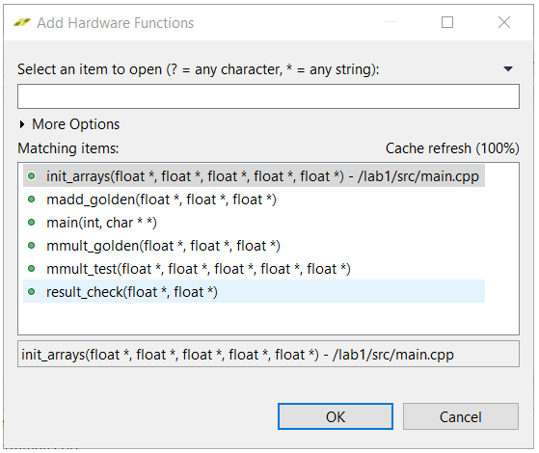
Step 2: Add Hardware Functions

Slide 13
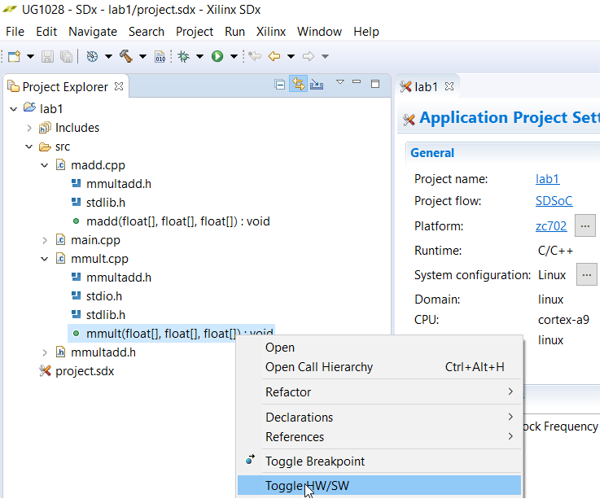
Step 2: Alternative Way to Add Hardware Functions

Slide 14
Step 3: Build a Design

Slide 15
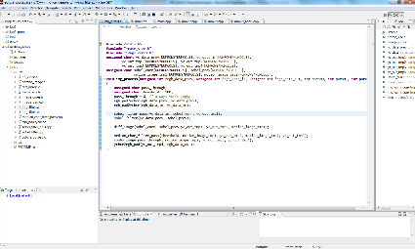
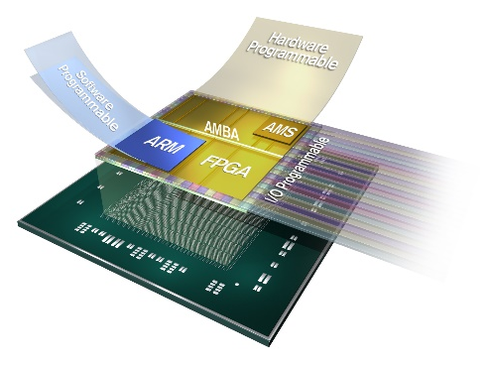
Step 3: Build a Design
C/C++
SDSoC Environment
SDSoC calls all sub-tools to build a design
Vivado
HLS
IP Integrator
HSM
ARM Compiler
Proven design tools and technologies
SW Code
PS
PL
A complete C to system flow!
IP
IP
Connectivity
Generated driver
IP
IP
OS, BSP
Target Board
Platform

Slide 16
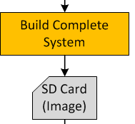
Building the Complete System
Building a project is where SDSoC does all the heavy lifting
  Three basic methods to run the build process
    Through the IDE, using a makefile, directly from the command line
  It is during this step that SDSoC calls upon its internal framework and several sub-executables to accomplish
    (1) system compilation, (2) system analysis, (3) system generation
Activate the Release build configuration for a fully optimized build
A successful build will result in several output products including the following key items
  Application program in ELF format
  Bitstream (optional)
  SD card image (optional)
  Design projects (e.g. Vivado Design Suite and Vivado HLS tool)

Slide 17
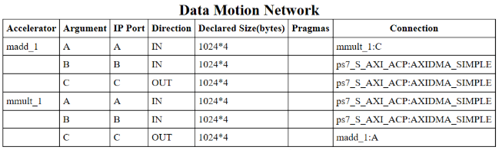
Step 3: Data Motion Network

Slide 18
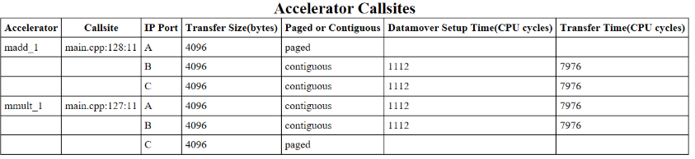
Step 3: Accelerator Callsite
Open the lab1/Release/_sds/swstubs/mmult.cpp file, to see how the SDx system compiler replaced the original mmultfunction with one named _p0_mmult_1_noasync that performs transfers to and from the FPGA using cf_send_i and cf_wait functions. The SDx system compiler also replaces calls to mmult with _p0_mmult_1_noasync in lab1/Release/_sds/swstubs/main.cpp. The SDx system compiler uses these rewritten source files to build the ELF that accesses the hardware functions.

Slide 19
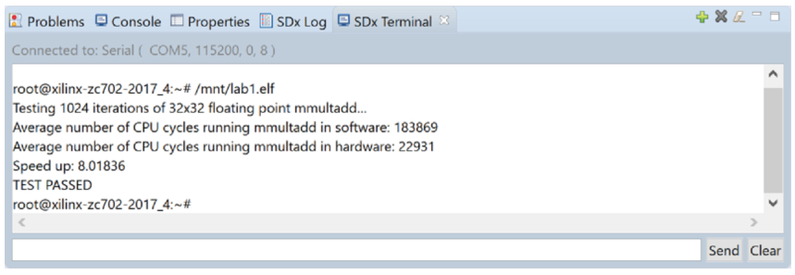
Step 4: Run the Project
The speedup is 8 times faster, when the function is accelerated in hardware. The application running on the processor takes about 184K cycles while the application running on both the processor and the FPGA takes about 22K cycles.

Slide 20
Summary
After completing this tutorial, you should be able to do the following:
Create a new SDSoC environment project for your application from a number of available platforms and project templates.
Mark a function for hardware implementation.
Build your project to generate a bitstream containing the hardware implemented function and an executable file that invokes this hardware implemented function.

Slide 21
Programming for SDSoC
Create a SDSoC Project
SDSoC Execution and Building
Programming for SDSoC
Notes:
Title
FirstName LastName – Activity / Group

Slide 22
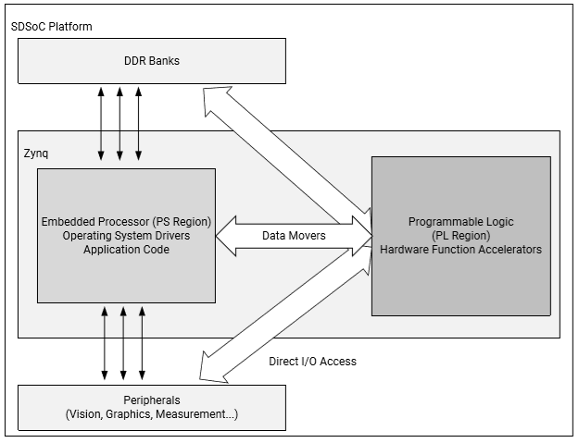
Execution Model of an SDSoC Application
Notes:
Title
FirstName LastName – Activity / Group

Slide 23
How C++ Executable Interfaces to Hardware
Hardware functions within a program is compiled into hardware accelerators that are accessed with the standard C runtime through calls into these functions.
Each hardware function call invokes the accelerator as a task and each of the arguments to the function is transferred between the CPU and the accelerator.
Data transfers between memory and accelerators are accomplished through data movers, such as a DMA engine, automatically inserted into the system by the sds++ system compiler.

Slide 24
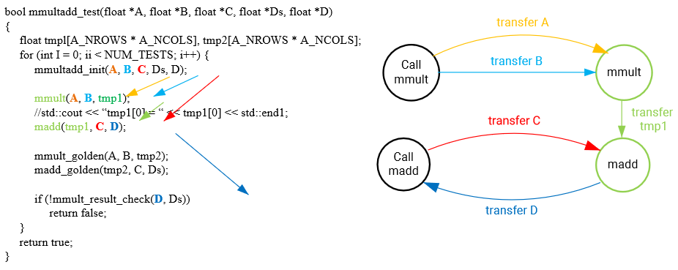
Hardware/Software Connectivity

Slide 25
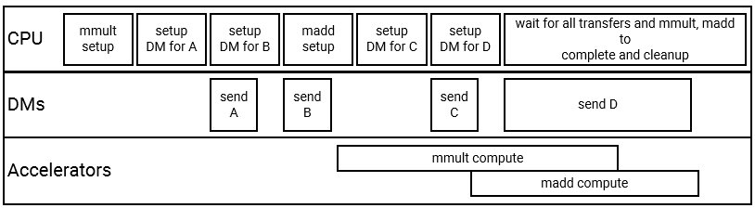
Timeline for Function Calls

Slide 26
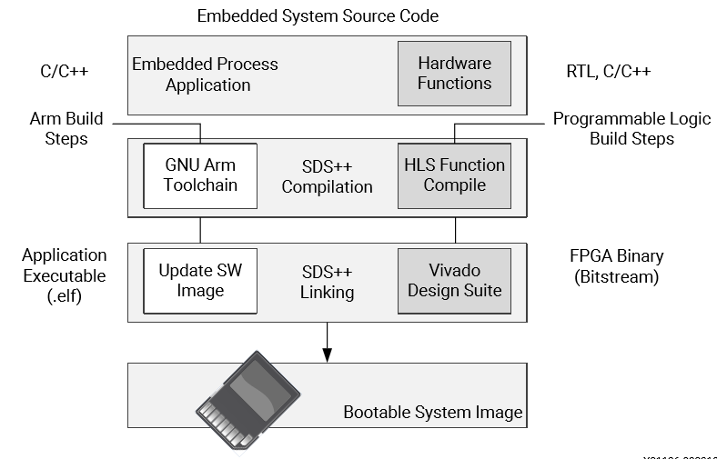
SDSoC Build Process

Slide 27
Build Compilation Process
The compilation process includes the following tasks:
Analyzing the code and running a compilation for the main application on the Arm core, as well as a separate compilation for each of the hardware accelerators.
Compiling the application code through standard GNU Arm compilation tools with an object (.o) file produced as final output.
Running the hardware accelerated functions through the HLS tool to start the process of custom hardware creation with an object (.o) file as output.

Slide 28
Build Linking Process
After compilation, the linking process includes the following tasks:
Analyzing the data movement through the design and modifying the hardware platform to accept the accelerators.
Implementing the hardware accelerators into the programmable logic (PL) region using the Vivado Design Suite to run synthesis and implementation, and generate the bitstream for the device.
Updating the software images with hardware access APIs to call the hardware functions from the embedded processor application.
Producing an integrated SD card image that can boot the board with the application in an Executable and Linkable Format (ELF) file.

Slide 29
Programming for SDSoC
Create a SDSoC Project
SDSoC Execution and Building
Programming for SDSoC
Notes:
Title
FirstName LastName – Activity / Group

Slide 30
Development Flow
C/C++ Application running on ARM
Specify platform
Specify OS
Specify functions to move to HW
Specify monitor points
Profile Application
Optimize data transfer and parallelism using SDSoC guidelines
User-assisted SW-HW partitioning based on profiling
Select functions to move to HW
Optimize accelerator code
Run fast estimation
Analyze performance
Build application to generate software and hardware
SD Card Image
Run on the board

Slide 31
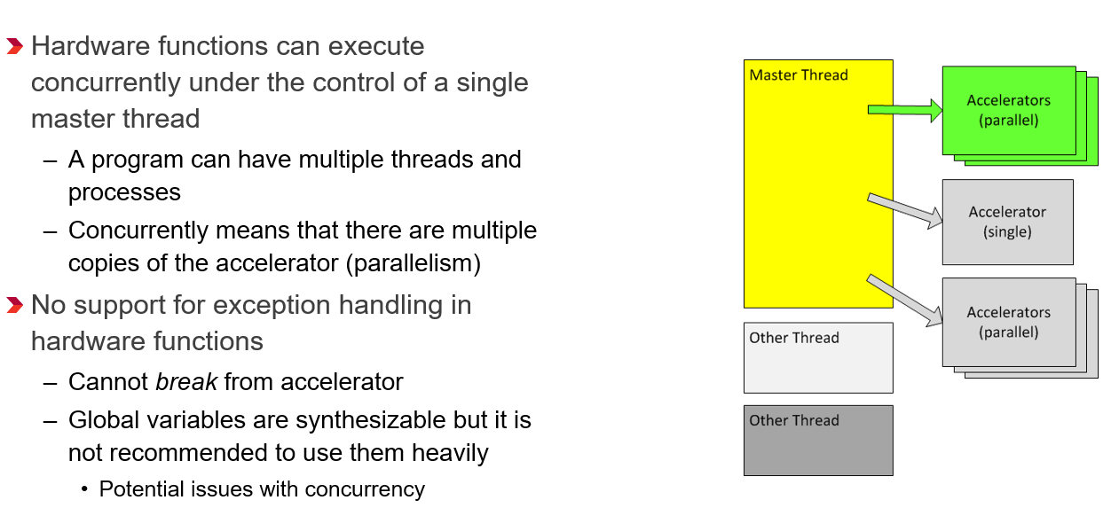
General C/C++ Guidelines

Slide 32
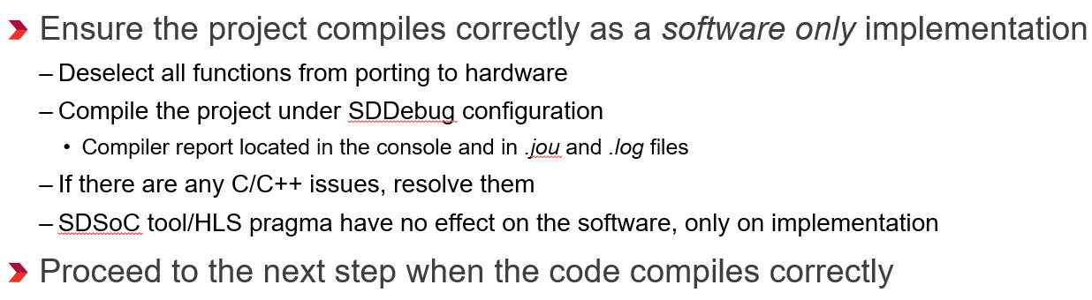
Basic Compile

Slide 33
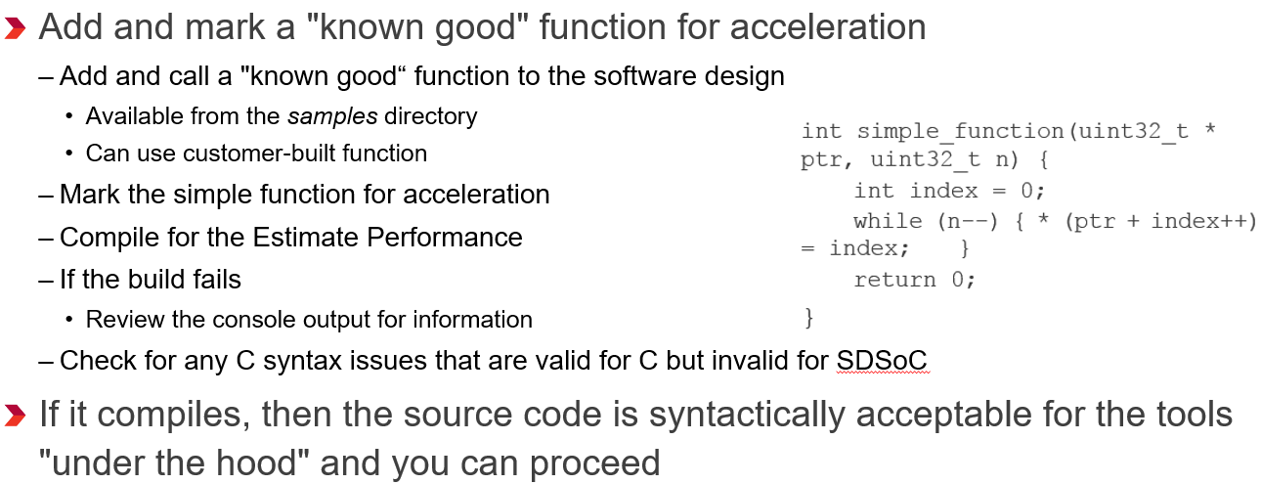
Verify Tool Operation for Dummy Hardware Function

Slide 34
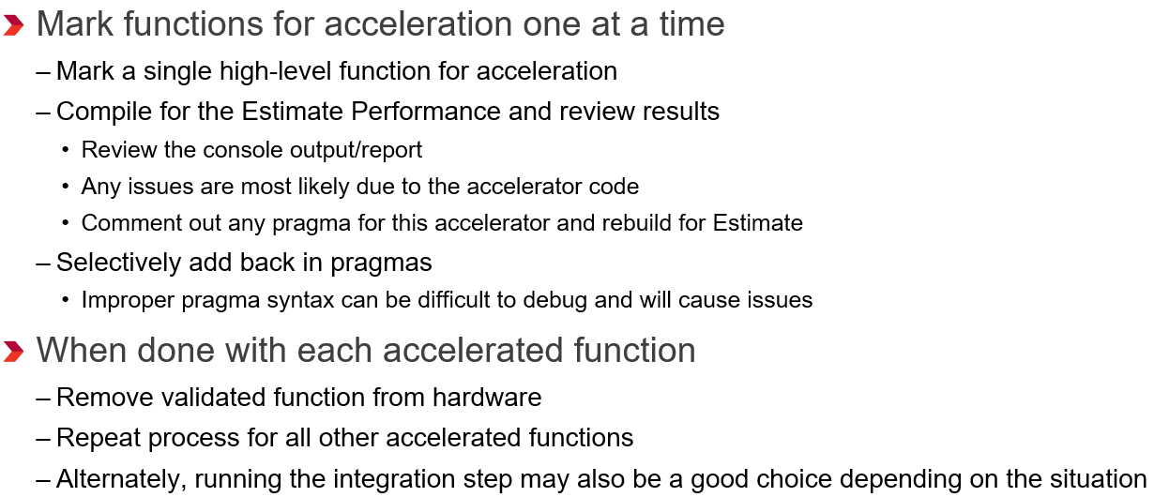
Verify Synthesizability of Individual Functions

Slide 35
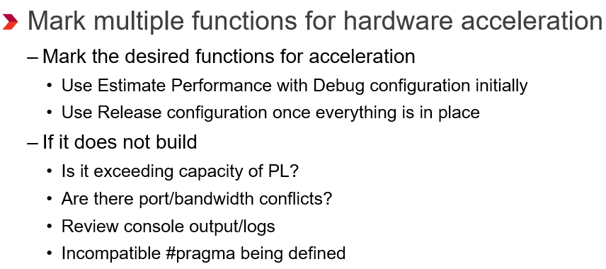
Integration – Putting All Together

