Slide 1

EE216 Reconfigurable Computing
Topic 13：Programming Applications and
Hardware Functions
Prof. Yajun Ha
ShanghaiTech University
Shanghai, China
Notes:
Title
FirstName LastName – Activity / Group

Slide 2

Programming Applications and Hardware Functions
Programming Applications
Programming Hardware Functions
Notes:
Title
FirstName LastName – Activity / Group

Slide 3
Programming the Application
Identifying the appropriate function(s) in the processor application for acceleration in the programmable logic (PL) region.
Allocating memory for the embedded processor application code and software functions running on the processing system (PS), and for the accelerated function(s) running on the PL regions of the device.
Enabling task-level parallelism with multiple accelerators running concurrently to optimize system performance.
Validating the software-to-hardware function code conversion, to insure things work as intended.
Notes:
在这里只介绍SDSoC会用到的接口
Title
FirstName LastName – Activity / Group

Slide 4
Identifying the Appropriate Hardware Functions
To identify the functions that should be accelerators or turned into hardware functions:
Functions where large amounts of data are computed, or modified, would be good candidates for hardware functions.
Functions written for a typical processor application might not benefit from hardware acceleration in the SDSoC environment, and might need to be restructured to get real performance improvements from acceleration.
Notes:
Title
FirstName LastName – Activity / Group

Slide 5
Memory Allocation
Although you might not typically allocate memory for standard processor applications, leaving it to the compiler to define, when programming for hardware acceleration you should manually define the memory allocation in the code. The hardware functions require physically contiguous memory to meet the performance requirements of the hardware.
int MatA[1024] = (int*)sds_alloc(1024*sizeof(int)); int MatB[1024] = (int*)sds_alloc(1024*sizeof(int)); int MatC[1024] = (int*)sds_alloc(1024*sizeof(int));
Notes:
Title
FirstName LastName – Activity / Group

Slide 6
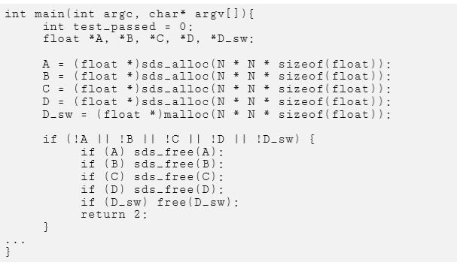
Free Memory
Using sds_free() or free() to free the memory allocated as appropriate.
Notes:
Title
FirstName LastName – Activity / Group

Slide 7
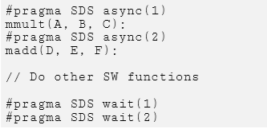
Multiple Accelerators
mmult() and madd() execute concurrently
The advantage of using async / wait is that it lets the application perform other operations while the hardware functions are running; and lets you hold the application at the appropriate point to wait for a hardware function to return.

Slide 8
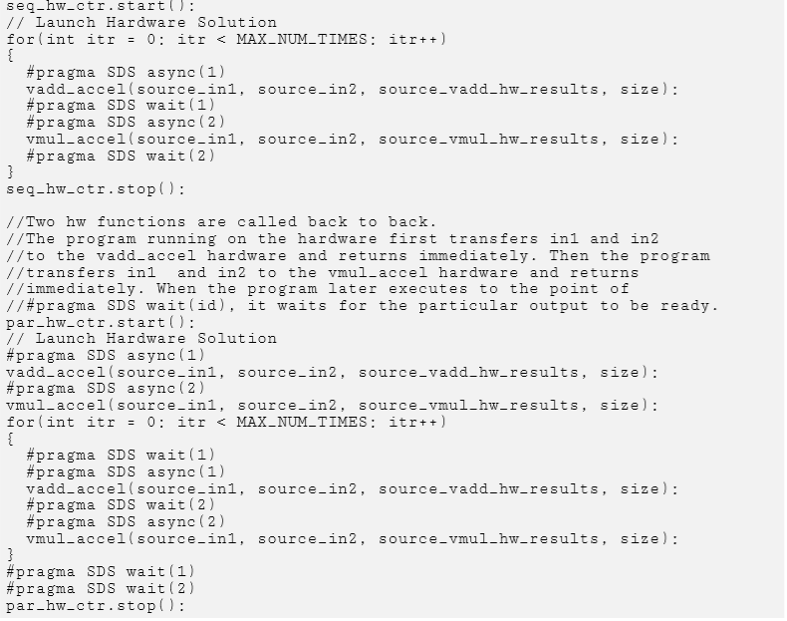
Sequential/Parallel Accelerator Execution
mmult() and madd() execute sequentially
mmult() and madd() execute concurrently

Slide 9
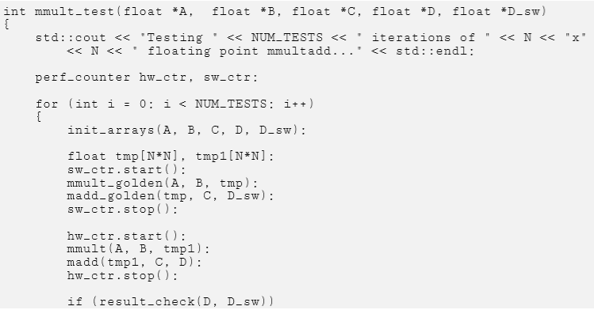
Validating the Software to Hardware Conversion
For an application that has multiple accelerators, it is best to do a bottom-up testing approach, testing each accelerator individually, and then testing all accelerators together. This should shorten debug time.

Slide 10
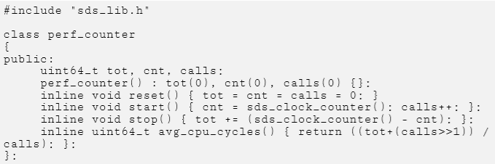
Performance Estimation
Knowing the wall-clock time of the functions that can be turned into hardware functions.
Accurately measure the execution time of functions by using special SDSoC API calls that measure the free running clock of the ARM processor.
The API functions log the start and end times of a function.
The function sds_clock_counter() returns the value of the free running clock register, while the function sds_clock_frequency() returns the speed in ticks/second of the Arm processor.

Slide 11
Data Motion Network and Optimization
Programming Applications
Programming Hardware Functions
Notes:
Title
FirstName LastName – Activity / Group

Slide 12
Hardware Function Interfaces
Defining the function interface: the data types of inputs and outputs, and data transfers.
What kind of memory access the function will have: DMA (interfacing with DDR) or FIFOs.
How will the data be accessed: contiguous or non-contiguous.
How will the data be processed: loops, arrays.

Slide 13
Programming Hardware Functions
After determining the function interfaces and the data transfer mechanism, the body of a hardware function should not be all that different from a function written for the processor.
However, a key point to remember is that there are opportunities to improve the performance of the accelerator, and of the overall application. To this end, you can examine and rewrite the structure of hardware functions to
Use bit-accurate data types;
Increase instruction-level;
Increase task-level parallelism;
Manage loop unrolling and pipelining, and overall dataflow.

Slide 14

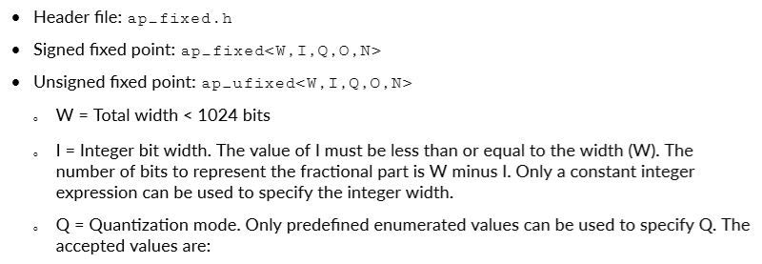
Arbitrary Precision Data Types
Arbitrary Integer Data Type
Arbitrary Precision Fixed-Point Data Type

Slide 15
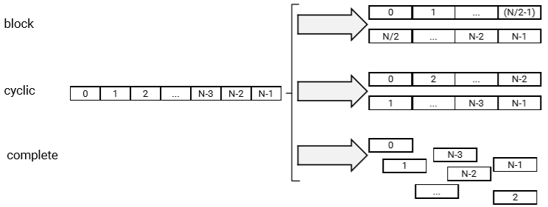
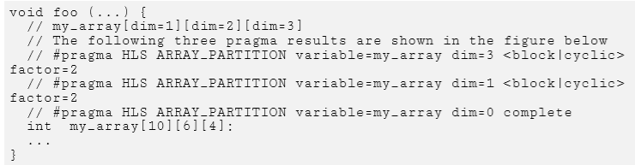
Array Configuration

Slide 16
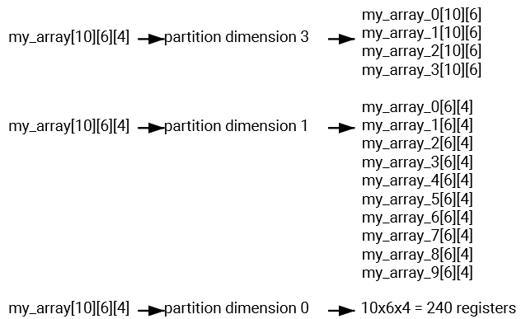
Array Partition
The examples in the figure demonstrate how partitioning dimension 3 results in four separate arrays and partitioning dimension 1 results in 10 separate arrays. If 0 is specified as the dimension, all dimensions are partitioned.

Slide 17
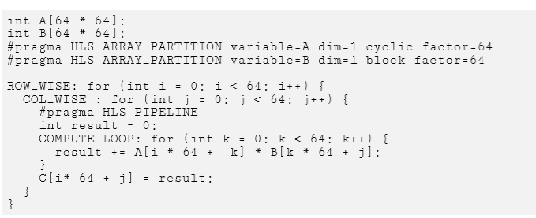
Choose a Dimension to Partition
To access each column of matrix A and each row of matrix B in parallel, cyclic and block partitions are used as shown in the above example.

Slide 18
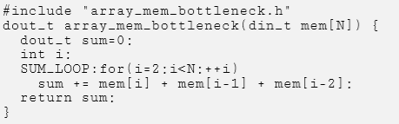
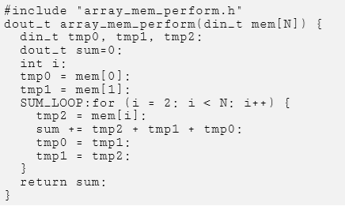
Minimizing Array Accesses with Caching
Before
After

Slide 19


Loop and Function Pipelining
Without Pipelining
void foo(...) {
op_Read;
op_Compute;
op_Write;
}
With Pipelining
RD
CMP
WR
Loop:for(i=1;i<3;i++) {
op_Read;
op_Compute;
op_Write;
}
RD
CMP
WR
Initiation Interval = 3 cycles
Initiation Interval = 1 cycle
RD
CMP
WR
RD
CMP
WR
RD
CMP
WR
RD
CMP
WR
Latency = 3 cycles
Latency = 3 cycles
Loop Latency = 6 cycles
Loop Latency = 4 cycles
for (index_b = 0; index_b < B_NCOLS; index_b++) {
#pragma HLS PIPELINE II=1
float result = 0;
for (index_d = 0; index_d < A_NCOLS; index_d++) {
float product_term = in_A[index_a][index_d] * in_B[index_d][index_b];
result += product_term;
}
out_C[index_a * B_NCOLS + index_b] = result;
}

Slide 20





Dataflow
Default behavior
  Complete a function or loop iteration before starting next function or loop iteration
  Datamover and system ports can be overridden with pragma
Dataflow
  Start next function or loop iteration as soon as “ready” and data is available
  Initiation interval (II) represents number of clocks between ‘starts’
  Increased concurrency
Apply dataflow within a function but not at the top level
//This memory is turned into a FIFO during optimization
rgb_pixel inter_pix[MAX_HEIGHT][MAX_WIDTH];
// Primary processing functions
sepia_filter(in_pix,inter_pix);
sobel_filter(inter_pix,out_pix2);
Sepia Filter
Sobel Filter
Finish all writes to inter_pix[N]…
Then Sobel can start to access inter_pix[N]
Sepia Filter
Sobel Filter
Sepia Filter
[0]
[1]
[2]
[3]
…
Sobel Filter

