Slide 1

EE216 Reconfigurable Computing
Topic 15：Accelerating Sobel Filter in SDSoC
Prof. Yajun Ha
ShanghaiTech University
Shanghai, China
Notes:
1

Slide 2
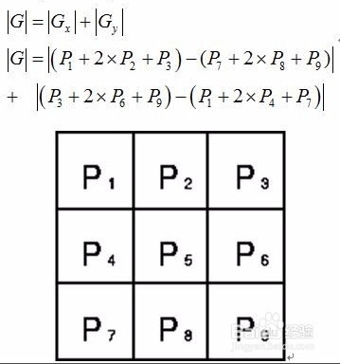
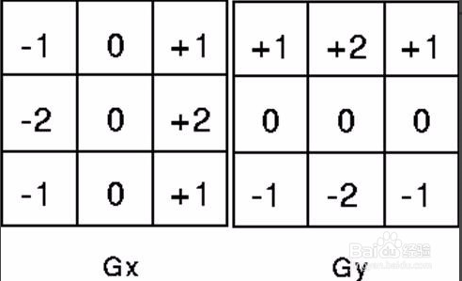
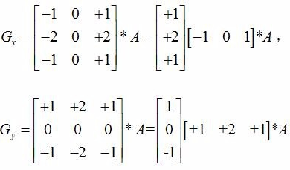


Sobel Filter Algorithm
The Sobel function Computes the gradients of input image in both x and y direction by convolving the kernel with input image being processed.

Slide 3
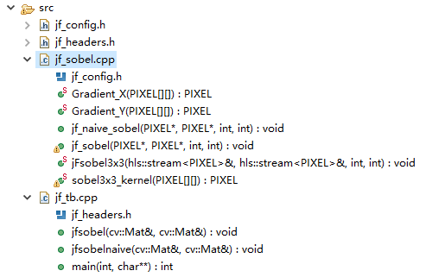
Sobel Filter Code
Load image
int main(int argc, char** argv)
{
cv::Mat image, sobel;
image = cv::imread(argv[1], 0);
sobel.create(image.rows,image.cols,CV_8UC1);
sobel.data =(PIXEL*)sds_alloc(sizeof(PIXEL)*image.rows*image.cols);
jf::sobel(image, sobel);
cv::imwrite("hw_sobel.jpg", sobel);
return 0;
}
Apply an Sobel Filter
Save image

Slide 4
Naïve Sobel Filter Implementation
void jf_naive_sobel(PIXEL* src, PIXEL* dst, int rows, int cols)
{
int row, col;
PIXEL image_window[3][3];
for(row = 0; row < rows+1; row++)
{
for(col = 0; col < cols+1; col++)
{
PIXEL _sobel;
if(row<=1 || col<=1 || row>(rows-1) || col>(cols-1))
_sobel = 0;
else
{
for(int i=0; i<3; i++)
{
for(int j=0; j<3; j++)
{
image_window[i][j] = src[(row+i-1)*cols+(col+j-1)];
}
}
_sobel = sobel3x3_kernel(image_window);
}
if(row>1 && col>1)
dst[(row-1)*cols+(col-1)] = _sobel;
}
}
}
Iterate over an input image
Load image window
Applying 3x3 Sobel filter
Writing to output image

Slide 5
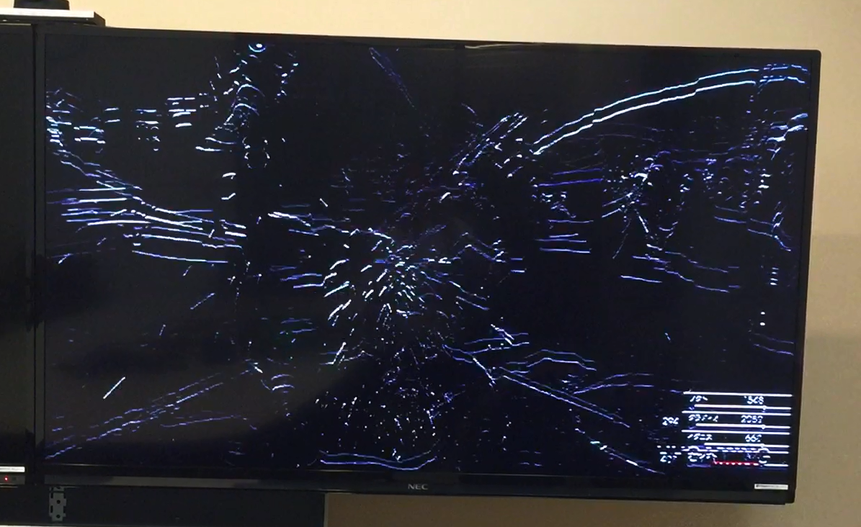

Run the Naïve Sobel on a Zynq Board
1180ms@ 720p, 300MHz

Slide 6
Problem 1: Non-Sequential Overlapped Memory Access
void jf_naive_sobel(PIXEL* src, PIXEL* dst, int rows, int cols)
{
int row, col;
PIXEL image_window[3][3];
for(row = 0; row < rows+1; row++)
{
for(col = 0; col < cols+1; col++)
{
PIXEL _sobel;
if(row<=1 || col<=1 || row>(rows-1) || col>(cols-1))
_sobel = 0;
else
{
for(int i=0; i<3; i++)
{
for(int j=0; j<3; j++)
{
image_window[i][j] = src[(row+i-1)*cols+(col+j-1)];
}
}
_sobel = sobel3x3_kernel(image_window);
}
if(row>1 && col>1)
dst[(row-1)*cols+(col-1)] = _sobel;
}
}
}
9 memory access per iteration

Slide 7
Problem 1: Non-Sequential Overlapped Memory
Read 9 pix

Slide 8
Problem 1: Non-Sequential Overlapped Memory
Read 9 pix

Slide 9
Problem 1: Non-Sequential Overlapped Memory
Read 9 pix

Slide 10
Problem 1: Non-Sequential Overlapped Memory
Read 9 pix

Slide 11
Problem 1: Non-Sequential Overlapped Memory
Read 9 pix
Memory Access: 9 * 48 = 432 pixels
For 720p: 1278*718*9 = 8258436 pixels

Slide 12
Solution 1: Direct Stream Using Line and Window Buffers
Shift line buffer
Read 1 pix

Slide 13
Solution 1: Direct Stream Using Line and Window Buffers
Shift line buffer
Read 1 pix

Slide 14
Solution 1: Direct Stream Using Line and Window Buffers
Shift line buffer
Read 1 pix

Slide 15
Solution 1: Direct Stream Using Line and Window Buffers
Processing Window
Shift line buffer
Read 1 pix

Slide 16
Solution 1: Direct Stream Using Line and Window Buffers
Shift line buffer
Read 1 pix
Processing Window

Slide 17
Solution 1: Direct Stream Using Line and Window Buffers
Processing Window
Shift line buffer
Read 1 pix
Memory Access: 1 * 80 = 80 pixels
With 1080p, 2,073,600 pixels (9x less!))

Slide 18
Line Buffer and Window Buffer in HLS
static void jFsobel3x3 (
hls::stream<PIXEL>& src,
hls::stream<PIXEL>& dst,
int rows, int cols)
{
PIXEL _sobel;
PIXEL LineBuffer[3][WIDTH];
PIXEL WindowBuffer[3][3];
ap_uint<13> row, col;
ap_uint<2> lb_r_i;
ap_uint<2> top, mid, btm;//linebuffer row index
for(col = 0; col < cols; col++)
{
LineBuffer[0][col] = 0;
LineBuffer[1][col] = src.read();
}
Init the line buffer

Slide 19
Line Buffer and Window Buffer in HLS
lb_r_i = 2;
for(row = 1; row < rows + 1; row++)
{
if(lb_r_i == 2) top = 0; mid = 1; btm = 2;
else if(lb_r_i == 0) top = 1; mid = 2; btm = 0;
else if(lb_r_i == 1) top = 2; mid = 0; btm = 1;
WindowBuffer[top][0] = WindowBuffer[top][1] = 0;
WindowBuffer[mid][0] = WindowBuffer[mid][1] = 0;
WindowBuffer[btm][0] = WindowBuffer[btm][1] = 0;
for(col = 0; col < cols; col++)
{
if(row < rows) LineBuffer[btm][col] = src.read();
Else LineBuffer[btm][col] = 0;
WindowBuffer[0][2] = LineBuffer[top][col];
WindowBuffer[1][2] = LineBuffer[mid][col];
WindowBuffer[2][2] = LineBuffer[btm][col];
_sobel = sobel_kernel(WindowBuffer);
WindowBuffer[0][0] = WindowBuffer[0][1];
WindowBuffer[1][0] = WindowBuffer[1][1];
WindowBuffer[2][0] = WindowBuffer[2][1];
WindowBuffer[0][1] = WindowBuffer[0][2];
WindowBuffer[1][1] = WindowBuffer[1][2];
WindowBuffer[2][1] = WindowBuffer[2][2];
dst.write(_sobel);
}
lb_r_i++;
if(lb_r_i == 3) lb_r_i = 0;
}
Shift the line buffer by rotating the index
Init the window buffer
fill the line buffer
fill the window buffer
Apply dilate operation
update the window buffer
export the result
update the index

Slide 20
Buffer Initialization
image
for(col = 0; col < cols; col++)
{
LineBuffer[0][col] = 0;
LineBuffer[1][col] = src.read();
}
Init the line buffer
WindowBuffer[top][0] = WindowBuffer[top][1] = 0;
WindowBuffer[mid][0] = WindowBuffer[mid][1] = 0;
WindowBuffer[btm][0] = WindowBuffer[btm][1] = 0;
Init the window buffer

Slide 21
Fill and Update Buffer (1)
col = 0, top = 0, mid = 1, btm = 2
for(col = 0; col < cols; col++)
{
if(row < rows)
LineBuffer[btm][col] = src.read();
Else
LineBuffer[btm][col] = 0;
fill the line buffer
top = 0, mid = 1, btm = 2
WindowBuffer[0][2] = LineBuffer[top][col];
WindowBuffer[1][2] = LineBuffer[mid][col];
WindowBuffer[2][2] = LineBuffer[btm][col];
fill the window buffer
_sobel = sobel_kernel(WindowBuffer);
WindowBuffer[0][0] = WindowBuffer[0][1];
WindowBuffer[1][0] = WindowBuffer[1][1];
WindowBuffer[2][0] = WindowBuffer[2][1];
WindowBuffer[0][1] = WindowBuffer[0][2];
WindowBuffer[1][1] = WindowBuffer[1][2];
WindowBuffer[2][1] = WindowBuffer[2][2];
update the window buffer

Slide 22
Fill and Update Buffer (2)
col = 1, top = 0, mid = 1, btm = 2
for(col = 0; col < cols; col++)
{
if(row < rows)
LineBuffer[btm][col] = src.read();
Else
LineBuffer[btm][col] = 0;
fill the linebuffer
top = 0, mid = 1, btm = 2
WindowBuffer[0][2] = LineBuffer[top][col];
WindowBuffer[1][2] = LineBuffer[mid][col];
WindowBuffer[2][2] = LineBuffer[btm][col];
fill the windowbuffer
_sobel = sobel_kernel(WindowBuffer);
WindowBuffer[0][0] = WindowBuffer[0][1];
WindowBuffer[1][0] = WindowBuffer[1][1];
WindowBuffer[2][0] = WindowBuffer[2][1];
WindowBuffer[0][1] = WindowBuffer[0][2];
WindowBuffer[1][1] = WindowBuffer[1][2];
WindowBuffer[2][1] = WindowBuffer[2][2];
update the windowbuffer

Slide 23
Fill and Update Buffer (3)
col = 0, top = 1, mid = 2, btm = 0
for(col = 0; col < cols; col++)
{
if(row < rows)
LineBuffer[btm][col] = src.read();
Else
LineBuffer[btm][col] = 0;
fill the linebuffer
top = 1, mid = 2, btm = 0
WindowBuffer[0][2] = LineBuffer[top][col];
WindowBuffer[1][2] = LineBuffer[mid][col];
WindowBuffer[2][2] = LineBuffer[btm][col];
fill the windowbuffer
_dilate = dilate_kernel(WindowBuffer);
WindowBuffer[0][0] = WindowBuffer[0][1];
WindowBuffer[1][0] = WindowBuffer[1][1];
WindowBuffer[2][0] = WindowBuffer[2][1];
WindowBuffer[0][1] = WindowBuffer[0][2];
WindowBuffer[1][1] = WindowBuffer[1][2];
WindowBuffer[2][1] = WindowBuffer[2][2];
update the windowbuffer

Slide 24
Run the Solution 1 on a Zynq Board
15.8ms@ 720p, 300MHz
74x SpeedUp

Slide 25
Problem 2: Loop Iterations Are Sequential
lb_r_i = 2;
for(row = 1; row < rows + 1; row++)
{
if(lb_r_i == 2) top = 0; mid = 1; btm = 2;
else if(lb_r_i == 0) top = 1; mid = 2; btm = 0;
else if(lb_r_i == 1) top = 2; mid = 0; btm = 1;
WindowBuffer[top][0] = WindowBuffer[top][1] = 0;
WindowBuffer[mid][0] = WindowBuffer[top][1] = 0;
WindowBuffer[btm][0] = WindowBuffer[top][1] = 0;
for(col = 0; col < cols; col++){
if(row < rows) LineBuffer[btm][col] = src.read();
Else LineBuffer[btm][col] = 0;
WindowBuffer[0][2] = LineBuffer[top][col];
WindowBuffer[1][2] = LineBuffer[mid][col];
WindowBuffer[2][2] = LineBuffer[btm][col];
_sobel = sobel3x3_kernel(WindowBuffer);
WindowBuffer[0][0] = WindowBuffer[0][1];
WindowBuffer[1][0] = WindowBuffer[1][1];
WindowBuffer[2][0] = WindowBuffer[2][1];
WindowBuffer[0][1] = WindowBuffer[0][2];
WindowBuffer[1][1] = WindowBuffer[1][2];
WindowBuffer[2][1] = WindowBuffer[2][2];
dst << _sobel;
}
lb_r_i++;
if(lb_r_i == 3) lb_r_i = 0;
}
Executing sequentially

Slide 26
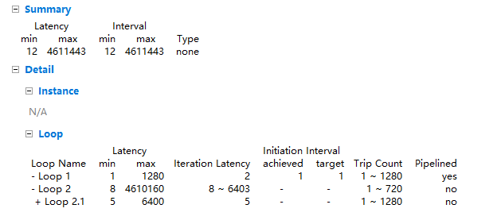
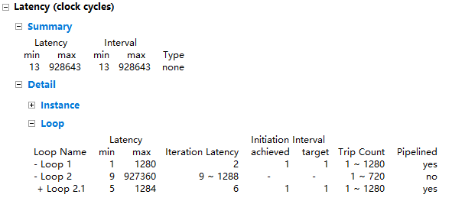
Solution 2: Pipeline Loop Iterations
…
Without pipelining
With pipelining
5 cycles / loop iteration
5x speedup

Slide 27
Solution 2: Pipeline Loop Iterations
lb_r_i = 2;
for(row = 1; row < rows + 1; row++)
{
if(lb_r_i == 2) top = 0; mid = 1; btm = 2;
else if(lb_r_i == 0) top = 1; mid = 2; btm = 0;
else if(lb_r_i == 1) top = 2; mid = 0; btm = 1;
WindowBuffer[top][0] = WindowBuffer[top][1] = 0;
WindowBuffer[mid][0] = WindowBuffer[top][1] = 0;
WindowBuffer[btm][0] = WindowBuffer[top][1] = 0;
for(col = 0; col < cols; col++){
#pragma HLS pipeline II=1
if(row < rows) LineBuffer[btm][col] = src.read();
Else LineBuffer[btm][col] = 0;
WindowBuffer[0][2] = LineBuffer[top][col];
WindowBuffer[1][2] = LineBuffer[mid][col];
WindowBuffer[2][2] = LineBuffer[btm][col];
_sobel = sobel3x3_kernel(WindowBuffer);
WindowBuffer[0][0] = WindowBuffer[0][1];
WindowBuffer[1][0] = WindowBuffer[1][1];
WindowBuffer[2][0] = WindowBuffer[2][1];
WindowBuffer[0][1] = WindowBuffer[0][2];
WindowBuffer[1][1] = WindowBuffer[1][2];
WindowBuffer[2][1] = WindowBuffer[2][2];
dst << _sobel;
}
lb_r_i++;
if(lb_r_i == 3) lb_r_i = 0;
}
Specify pipelining of loop iterations with Initiation Interval = 1

Slide 28
Solution 2: Pipeline Loop Iterations
static void jFsobel3x3 (
hls::stream<PIXEL>& src,
hls::stream<PIXEL>& dst,
int rows, int cols)
{
PIXEL _sobel;
PIXEL LineBuffer[3][WIDTH];
#pragma HLS ARRAY_PARTITION variable=LineBuffer complete dim=1
PIXEL WindowBuffer[3][3];
#pragma HLS ARRAY_PARTITION variable=WindowBuffer complete dim=0
ap_uint<13> row, col;
ap_uint<2> lb_r_i;
ap_uint<2> top, mid, btm;//linebuffer row index
for(col = 0; col < cols; col++)
{
#pragma HLS pipeline
LineBuffer[0][col] = 0;
gray >> LineBuffer[1][col];
}
The linebuffer should provides 3 pixels per cycle, thus expand the array in dimension 1 will be ok
The window buffer should provides 9 pixels per cycle, thus the windowbuffer has to be unrolled completely

Slide 29
Run the Solution 1 on a Zynq board
3.7ms@ 720p, 300MHz
4.2x SpeedUp

Slide 30
Summary
 | latency
A naïve Sobel filter implementation | 1181ms
Problem 1: Non-sequential overlapped memory accesses Solution 1: Reducing memory access by 9x using line and window buffers | 15.8ms
Problem 2: Sequential loop iteration Solution 2: Pipeline loop iteration using the pipeline pragma | 3.7ms
319x Speedup

