Slide 1
Interface
User Interface
REST Interface
Development Tools
Deployment Tools
Type Management and Scripting
Object Store
Script Execution
Type Compilation
Object Cache
Object Database

Slide 2
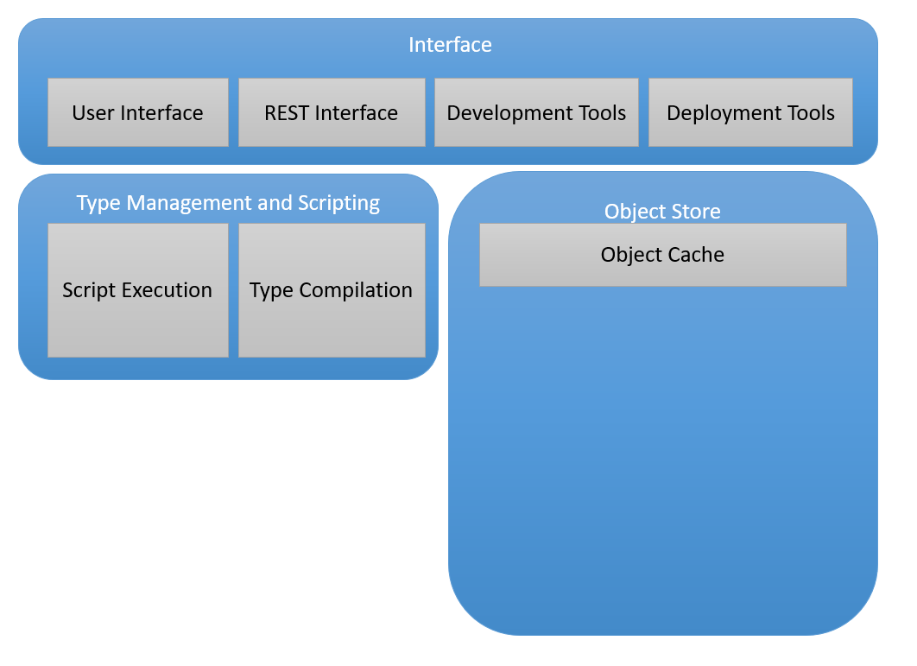
Cache Updates
Object Database

Slide 3
Interface
User Interface
REST Interface
Development Tools
Deployment Tools
Type Management and Scripting
Object Store
Script Execution
Type Compilation
Object Cache
Object Database

Slide 4
Interface
User Interface
REST Interface
Development Tools
Deployment Tools
Type Management and Scripting
Object Store
Script Execution
Type Compilation
Object Cache
Object Database

Slide 5
Interface
User Interface
REST Interface
Development Tools
Deployment Tools
Type Management and Scripting
Object Store
Script Execution
Type Compilation
Object Cache
Object Database

Slide 6
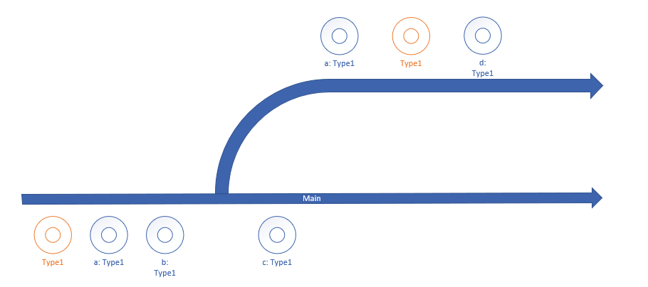

Slide 8
P2
Commit order P1/P2/P5
Ready to commit:
P1
P1.List
P2
P2.TO
P5
P5.List
P5.TO1/2/3/4
Commit:
P1
P1.List
P2
P2.TO
P5
P5.List
P5.TO1/2/3/4
P1
P3
P4
P5

Slide 9
Tesseract.Common
Types shared between API and UI
references
references
Tesseract.Core
Object store
Type Compiler and Script Execution
Interface
DevOps support
Tesseract.API
REST API
Tesseract.UI
Web User Interface
references
calls
This implies that UI is server app and signalR stuff works well and we accept a little bit of double hop-latency or…
We use blazor web assembly

Slide 10
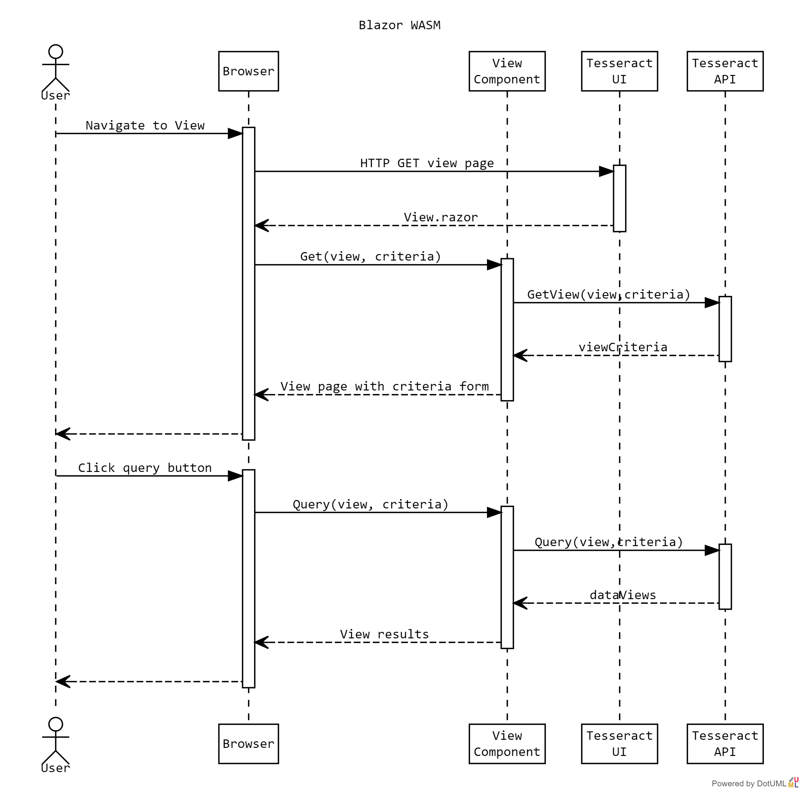
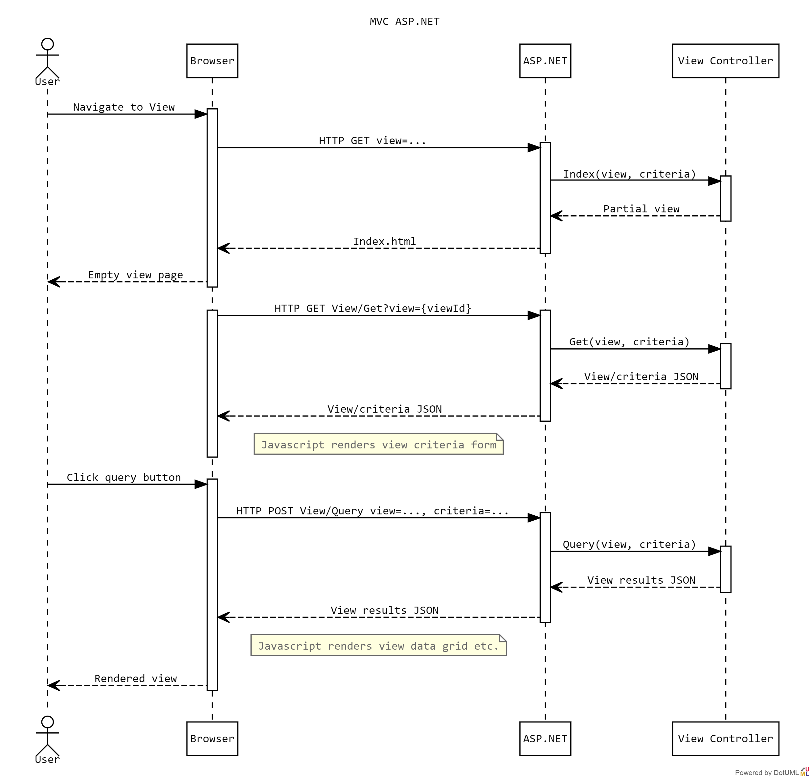

Slide 11
Parent Component
<p>@parentMessage</p>
private string parentMessage
Bind
Child Component
<p>@ChildMessage</p>
Parameter: public string/Event ChildMessage
Property: public BoundValue
Bind
Grandchild Component
<p>@GrandchildMessage</p>
Parameter: public string/Event GrandchildMessage

