Slide 1
Interface
User Interface
REST Interface
Development Tools
Deployment Tools
Type Management and Scripting
Object Store
Script Execution
Type Compilation
Object Cache
Object Database

Slide 2
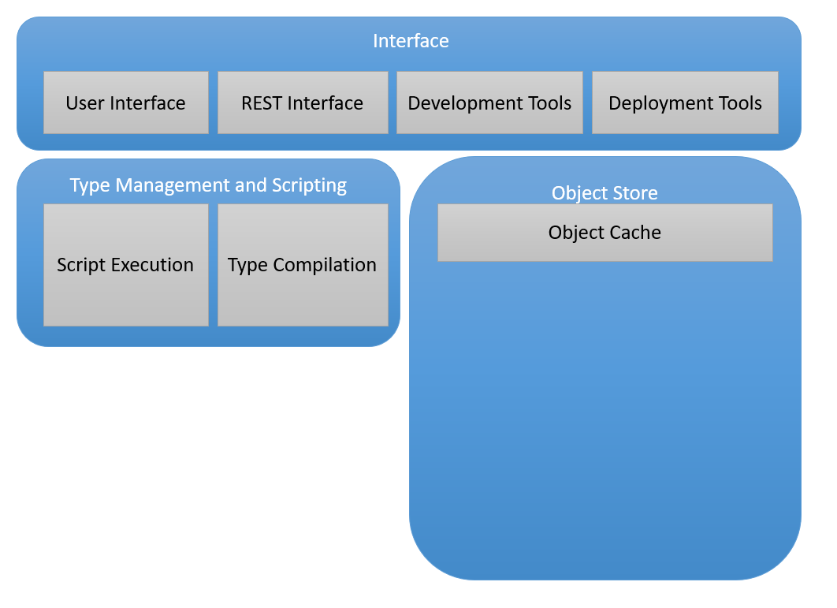
Cache Updates
Object Database

Slide 3
Interface
User Interface
REST Interface
Development Tools
Deployment Tools
Type Management and Scripting
Object Store
Script Execution
Type Compilation
Object Cache
Object Database

Slide 4
Interface
User Interface
REST Interface
Development Tools
Deployment Tools
Type Management and Scripting
Object Store
Script Execution
Type Compilation
Object Cache
Object Database

Slide 5
Interface
User Interface
REST Interface
Development Tools
Deployment Tools
Type Management and Scripting
Object Store
Script Execution
Type Compilation
Object Cache
Object Database

Slide 6
