Slide 1
Tesseract
Next Generation Platform for Business Solutions

Slide 2
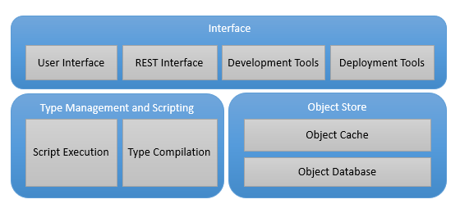
Architecture
In-memory object store with persistence to SQL database
Dynamic type definition and script evaluation – using off the shelf .NET technology (Roslyn)
Dynamically generated user and integration interfaces
Integrated development and deployment tools
Business Analysts can quickly build solutions for bespoke customers without compromises
Source control for Business Objects – point if time view for data and types

Slide 3
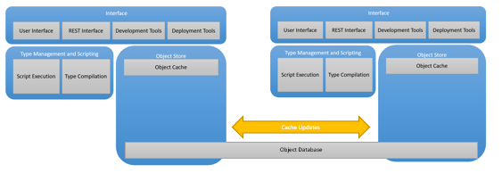
Scalable
Multiple instances coordinate through cache updates
Object Cache manages memory usage
In memory transactions with optimistic locking at object level mean a responsive system

Slide 4
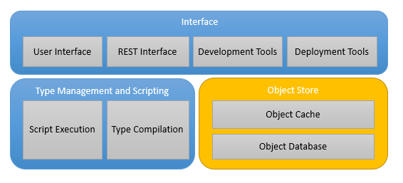
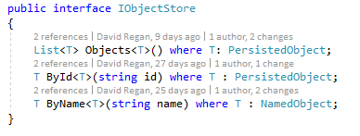
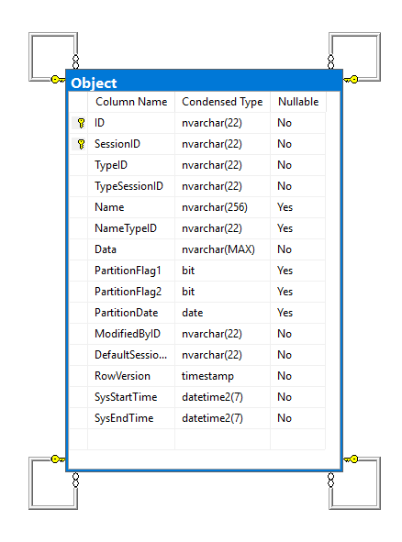
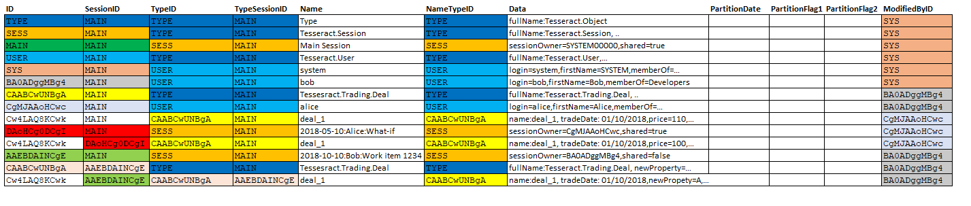
Object STORE

Slide 5
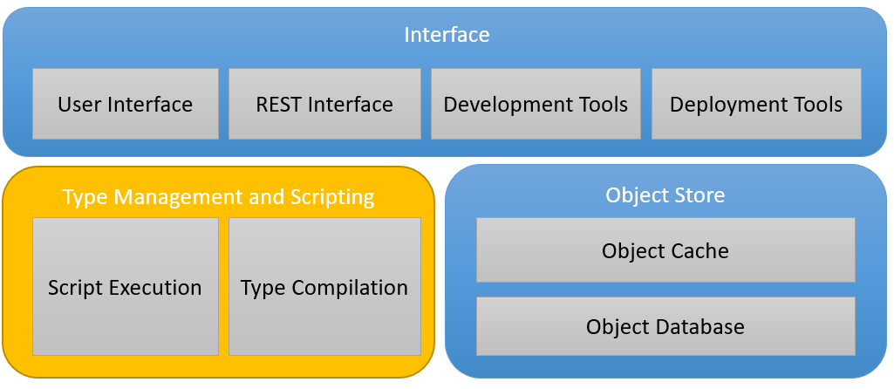
Type Management and Scripting

Slide 6
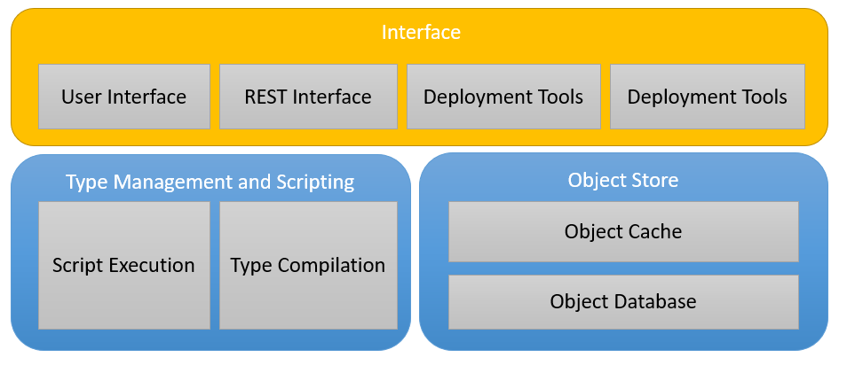
Interface

Slide 7

Anglo INTEGRATION
Tesseract CSS aligned with CORE2 CSS for Anglo instance
Access Tesseract UI via CORE 2 links/embedding
Azure App on Anglo Azure instance
Market data, scenarios, deal feeds
CORE 2 on Azure
Reporting results
Calc’d market data

Slide 8
The Proposal
Anglo install Tesseract instance in their Azure infrastructure (Azure Apps and SQL resource)
DMR works ½ time on Risk/Optimization projects to build functionality in Tesseract
Anglo provides full time developer for Tesseract features – primarily the UI development
IP for Tesseract remains with DMR for: Platform & foundational starter kit modules
Foundational starter kit is: RBAC module; market data module; basic pricing & valuation
Anglo has access to full source code of Tesseract and can modify there own branch but mustn’t sell technology commercially
Anglo provides resource for managing Azure elements

