Slide 1
OpenTURNS day
Overview of recently developed features in Persalys
Antoine Dumas + Aurélie Ladier, Julien Schueller
June 7, 2019

Slide 2
Bring Uncertainty Methodology to Engineers
4 years ago
EDF MRI (now PRISME) wants to maximize the use of OpenTURNS® by its engineer/researcher (and improve an existing GUI) => develop a GUI to make more easy to use
Phimeca has already developed an “OpenTURNS GUI” (PhimecaSoft®) which satisfy some needs of EDF R&D but not all.
EDF R&D and Phimeca decide to start a specific partnership in order to develop a new GUI based on OpenTURNS® and “Salome Tools” : Paraview, Yacs, ...
Persalys (previously OT GUI) is available, on Salome website, in EDF Specific Salome version and commercialized by Phimeca

Slide 3
Some expectations regarding the GUI
As easy to use as possible and, when it is possible, a GUI which can guide the user
Possibility to use it inside Salome Platform to
Use supercomputing resources (e.g. Gaïa, 3 052 Tflops peak, 41 000 cores)
Connect to EDF numerical code users (Code_Aster for example)
Take benefit from the advanced visualization capability from Paraview
Drive the GUI from a python script usable in an “expert” mode

Slide 4
What’s recently added?
Screening with Morris
Optimization
Dependence structure (definition and inference)
Field 1D
Distributed evaluations

Slide 5
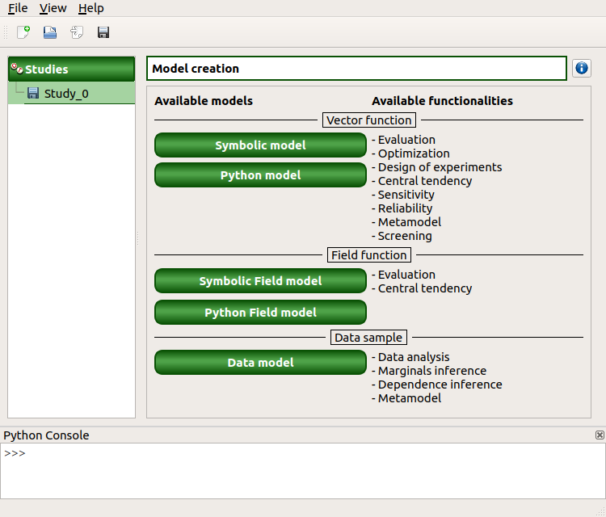
Opening Persalys
Functionality of Persalys
Documentation (links from the interface)
For the graphical interface
For the Python interface
Links to the OpenTURNS documentation
Example of a cantilever beam

Slide 6
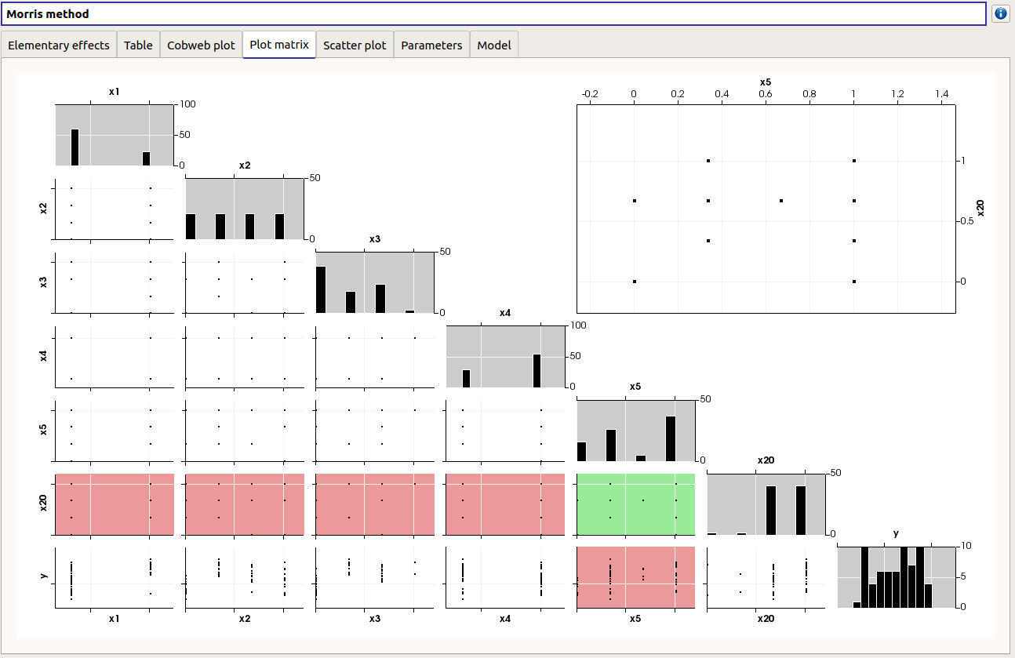
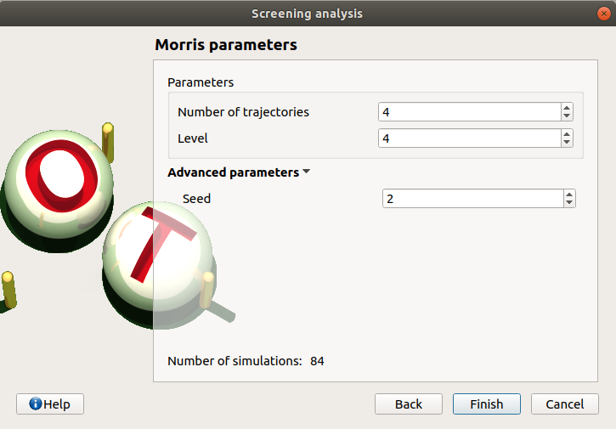
Screening method
Morris method
Definition of the grid and number of trajectories
Visualization of the generated design of experiments

Slide 7
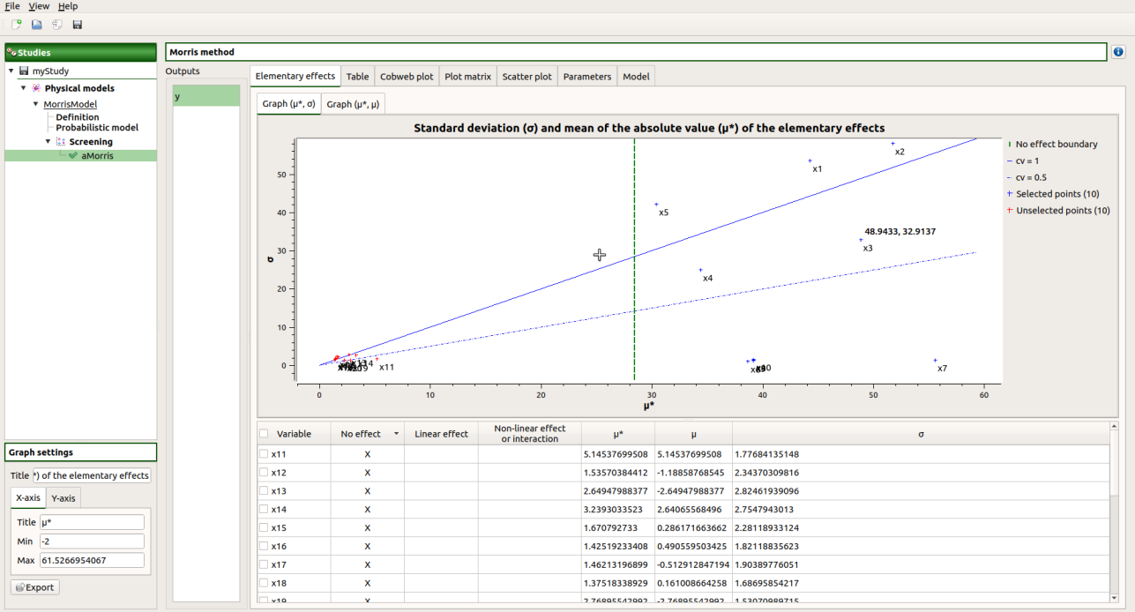
Screening method
Morris method
Sort the variables into three groups :
no effect
linear effect
non linear effect or interaction
Selection of the influent parameters
Move the vertical selection cursor
Tick the selection box
Order the table

Slide 8
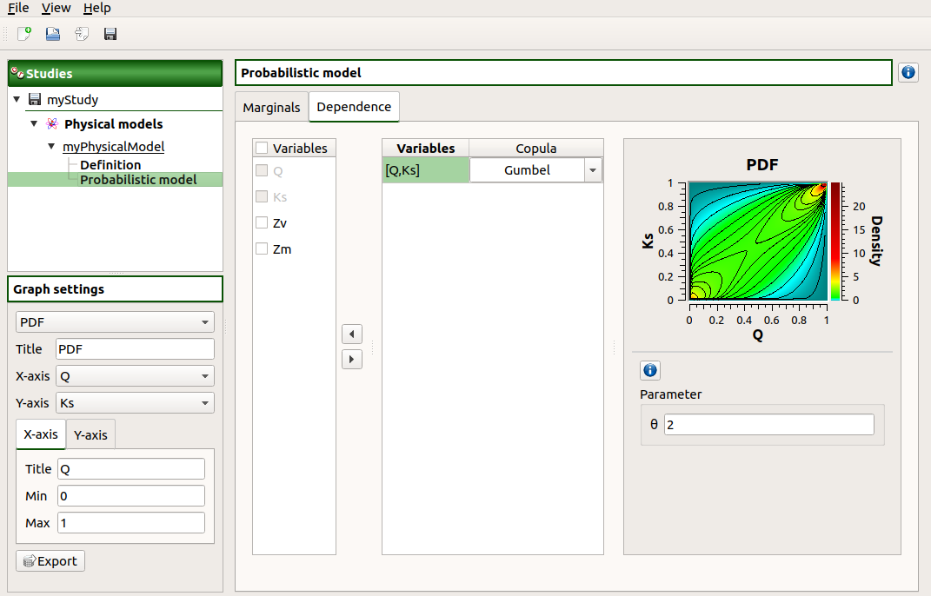
Correlated input variables
Correlation is added using copulas
Define arbitrary groups of dependent variables

Slide 9
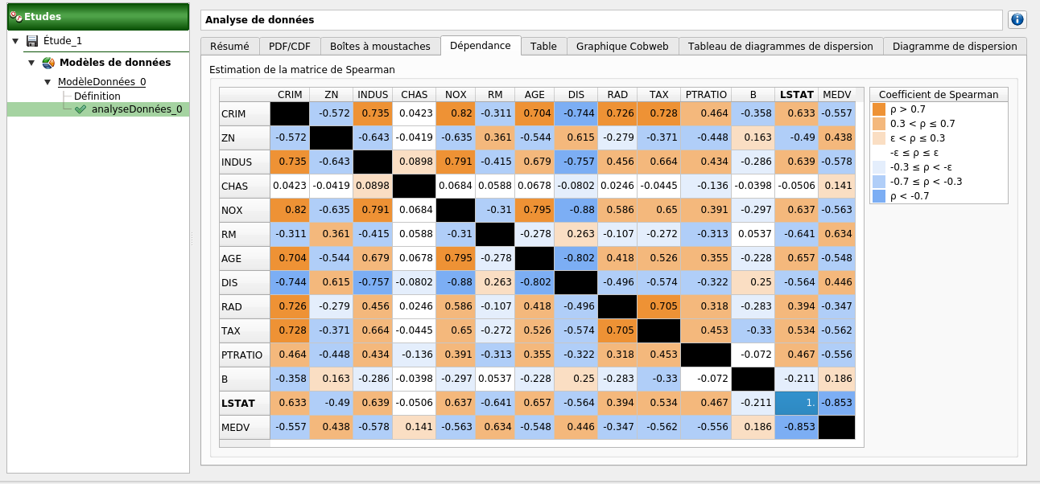
Dependence of a sample
Analysis of the correlation of the sample

Slide 10
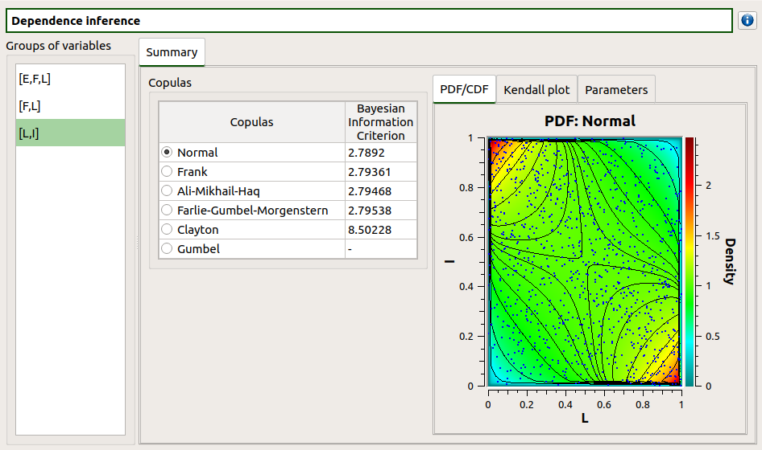
Dependence of a sample
Inference of the dependence of the sample
Guided choice according to the BIC

Slide 11
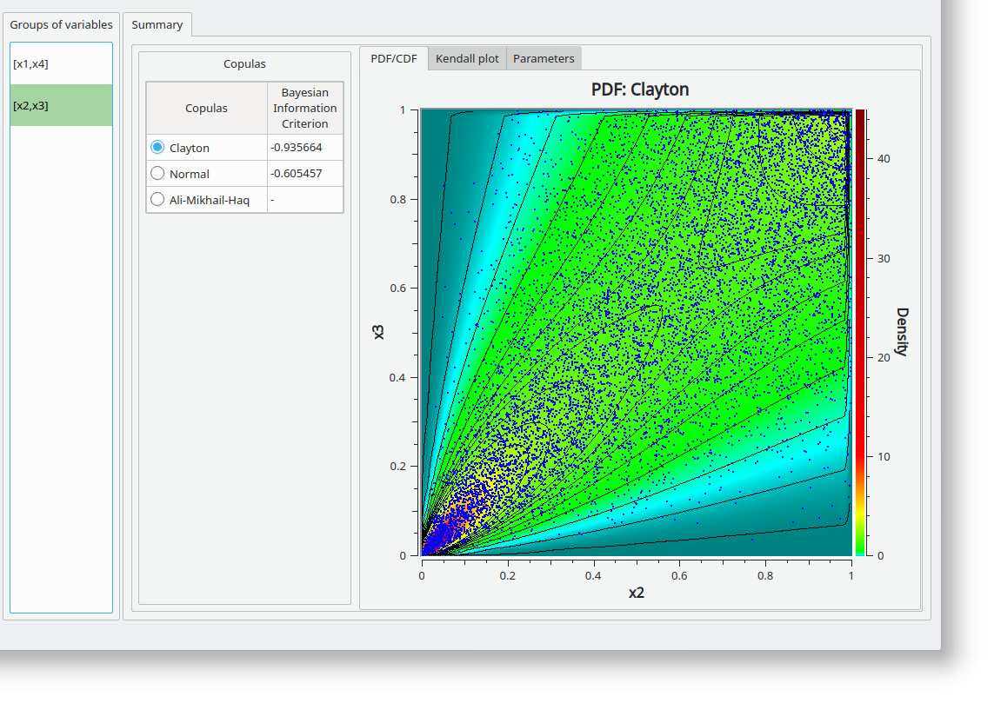
Dependence of a sample
Inference of the dependence of the sample
Guided choice according to the BIC

Slide 12
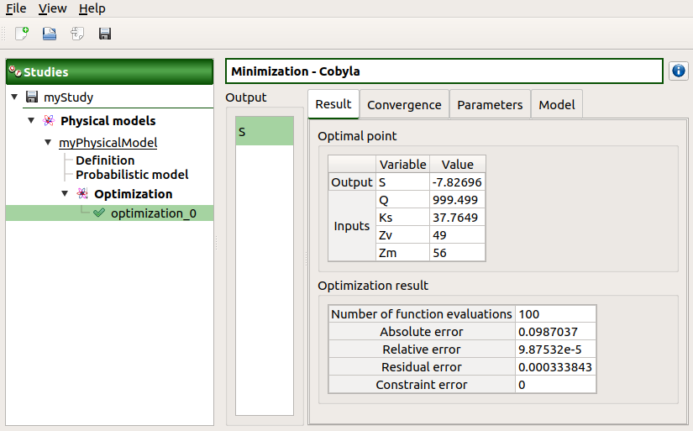
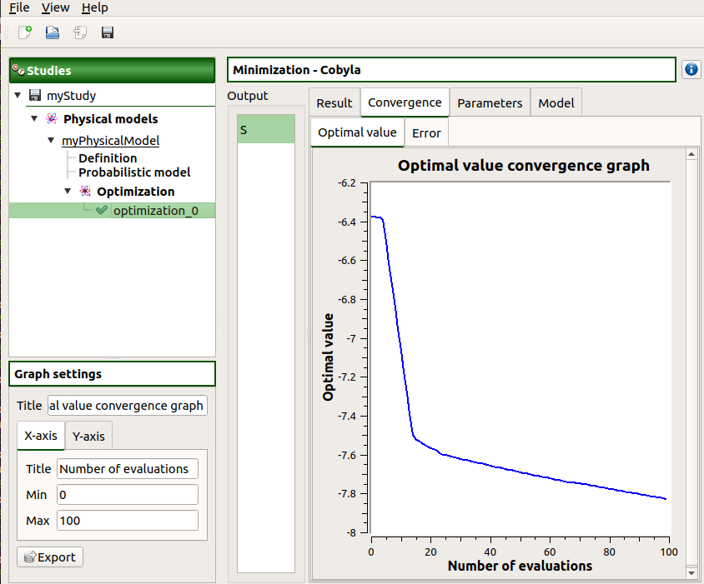
Optimization
Bounded optimization of an output without functional constraints
Algorithms : TNC, Cobyla, NLopt (more than 40 algorithms)
Future work : parameter calibration (least square fit and Bayesian)

Slide 13
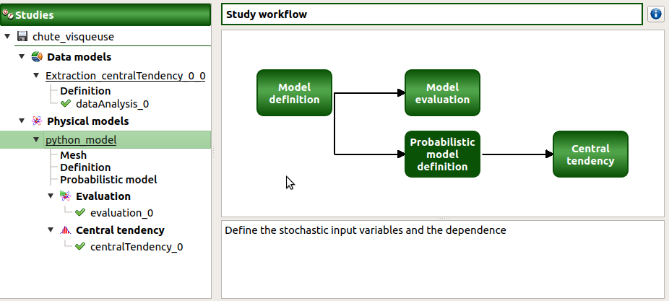
Field 1D
Workflow of the field study

Slide 14
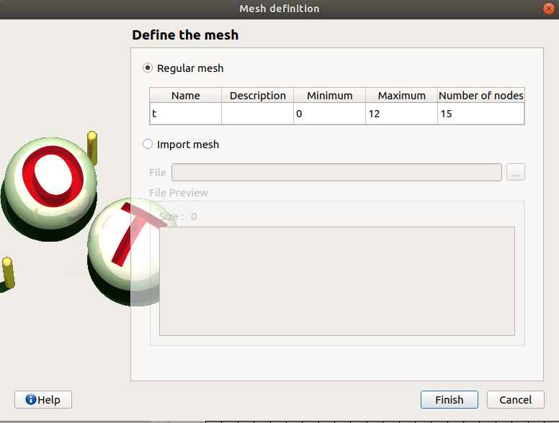
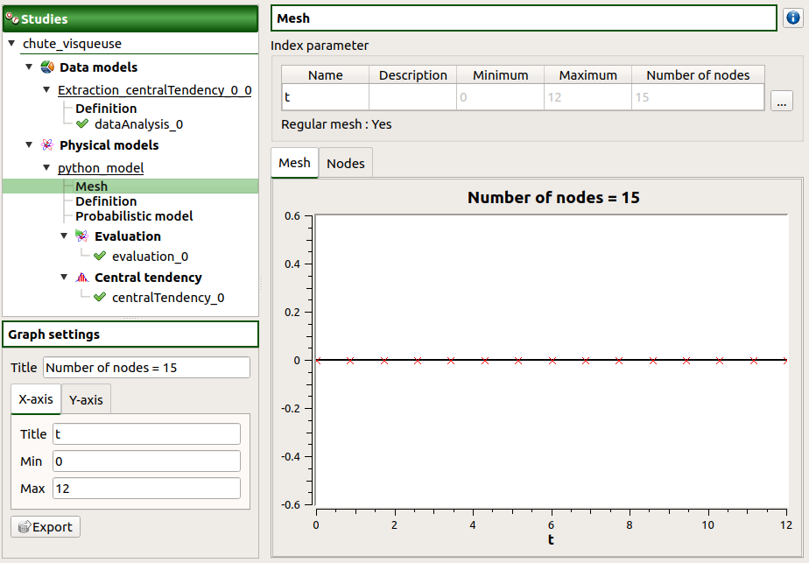
Field 1D
Mesh definition and visualization
Possible import from text or csv file

Slide 15
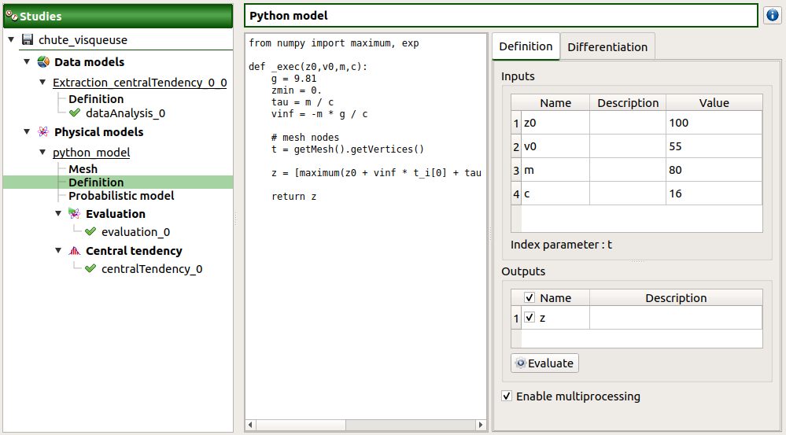
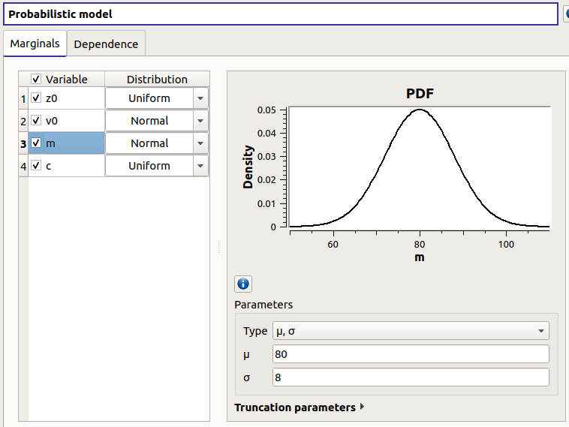
Field 1D
Functional model definition and probabilistic model
Python or symbolic

Slide 16
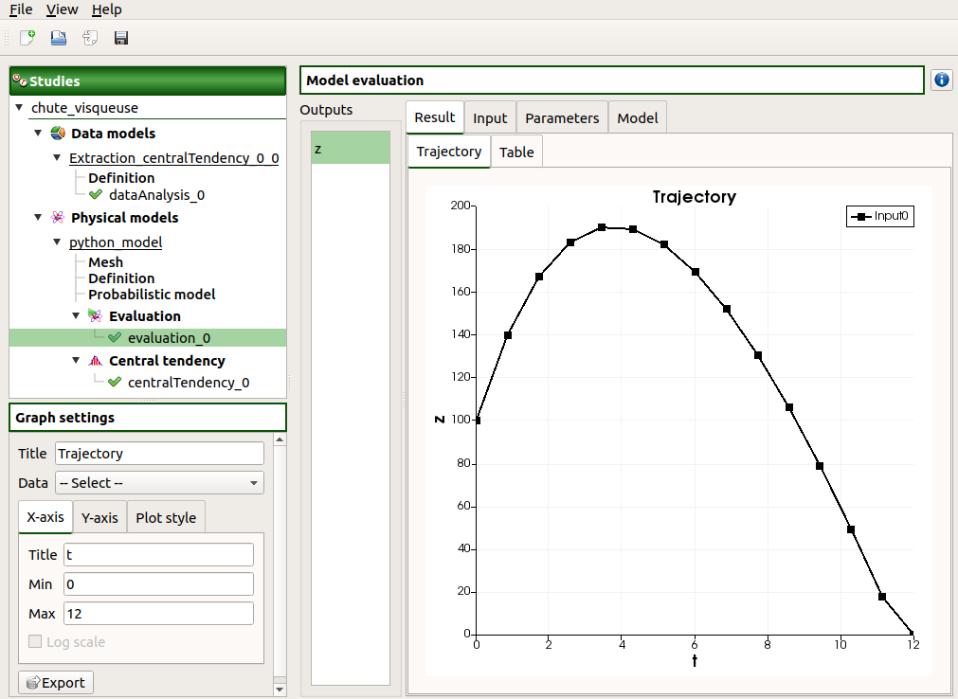
Field 1D
Evaluation for a specific value
Validation of the model

Slide 17
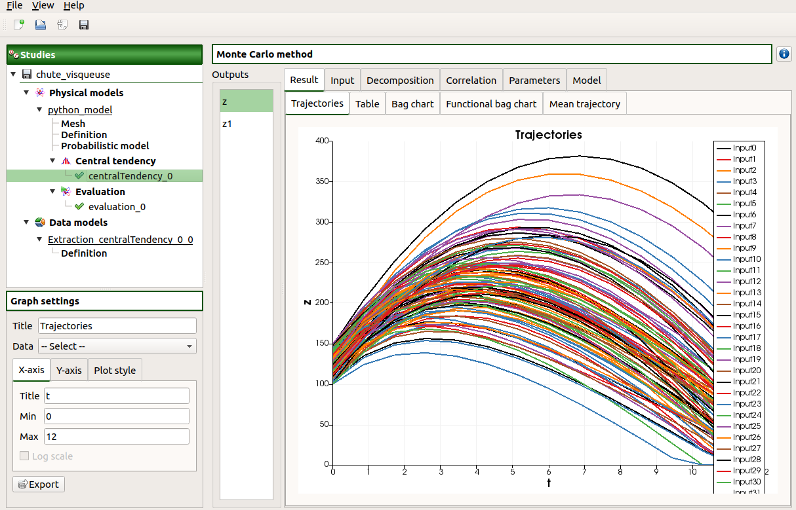
Field 1D
Uncertainty propagation

Slide 18
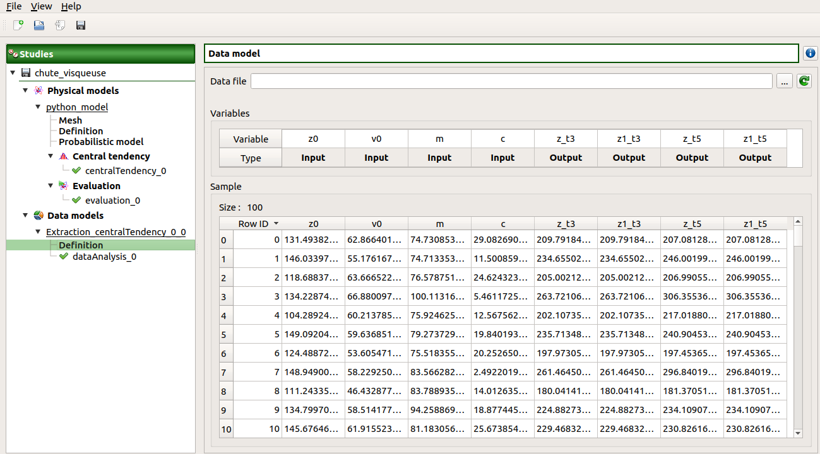
Field 1D
Extract values at some nodes as data model
Here extraction of values at nodes 3 and 5

Slide 19
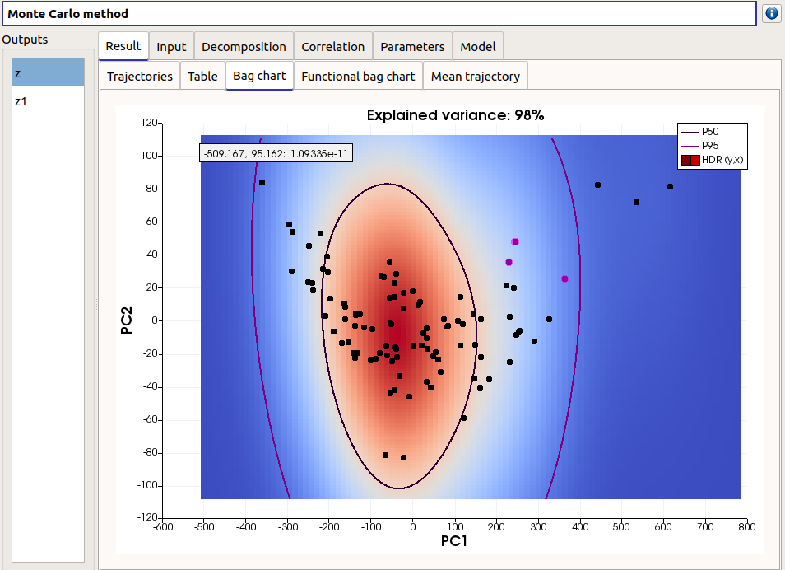
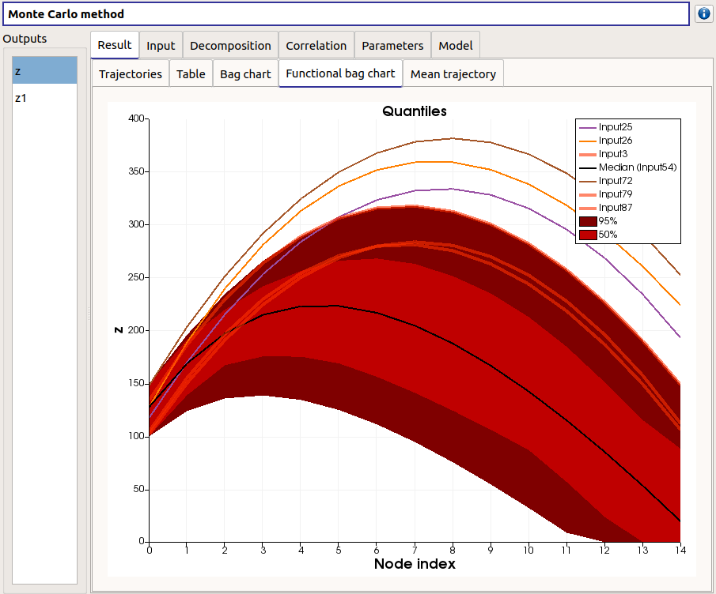
Field 1D
BagChart (from Paraview)
Shared selection of trajectories between graphs
Future work : PCA of dimension > 2

Slide 20
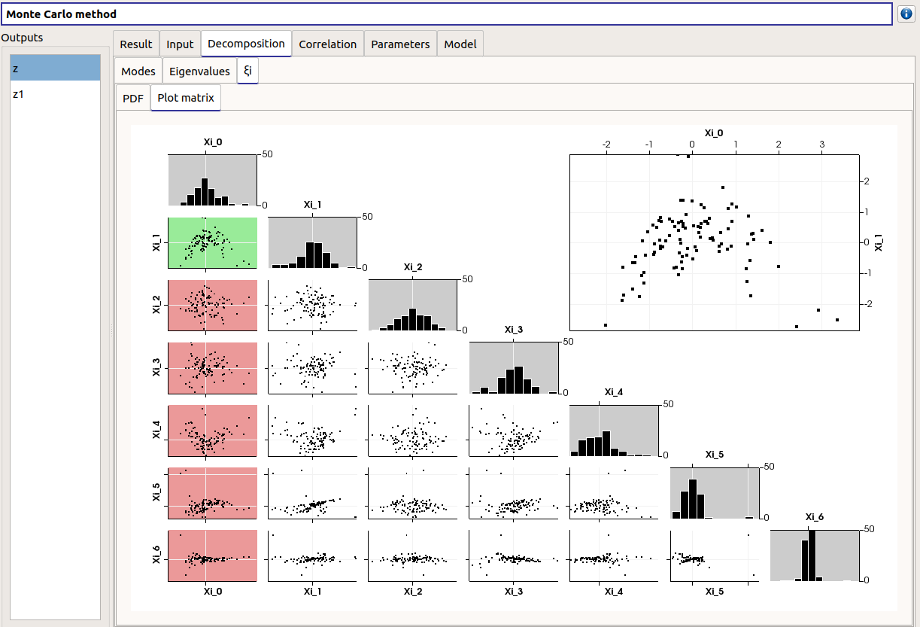
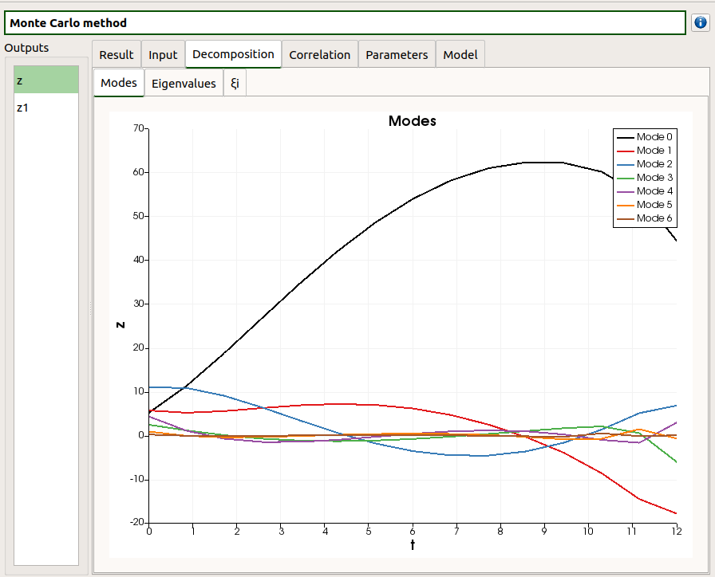
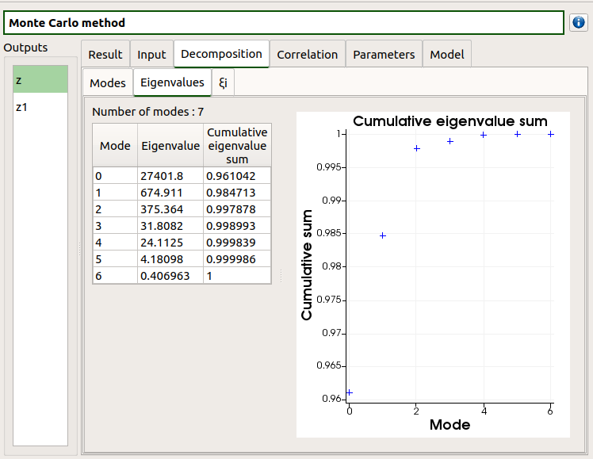

Field 1D
Karhunen-Loève decomposition
Show modes, eigenvalues and $ξ_{i}$

Slide 21
Distributed evaluations
Multiprocessing available for Python model
In local host if on your personal computer
On cluster if used within Salome Meca using YACS

Slide 22
Future work
Parameter calibration
Least square and Bayesian
Field 1D
Improve the BagChart with a PCA of dimension > 2
Study with 2D field

