Slide 1
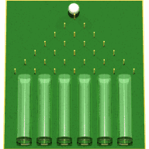
OpenTURNS User’s Day #8
Friday, the 12 ^{th}, June 2015
Notes:
toto

Slide 2
OpenTURNS User’s Day #8
Contents
9h30 - 10h→
Reception at EDF R&D Clamart
Ouverture: I. Terrasse (Airbus Group)
Open TURNS :
  Identity card, Objectives, Consortium
  Diffusion results
  Trainings
New features of the 1.5 & 1.6 releases (to come)
  Scientific and Technologic New Features
  A New User Manual
Perspectives
Open TURNS and HPC
  « H-Matrices methods principles. Applications to OpenTURNS » (1h) : T. Abboud (IMACS)
  « The H-Matrices in Open TURNS v1.5 » (30’) : D. Barbier (IMACS)
Studies using Open TURNS
  « Probabilité de Détection de Défaut (POD) » (30’) : L. Le Gratiet (EDF R&D)
  « Dispersion de polluants dans l’atmosphère » (30’) : F. Aguirre (PhiMECA)
  « Risque de crue en hydraulique fluviale » (30’) N. Goutal (EDF R&D)
  « Incertitudes en Prévision de consommation d’électricité » (30’) : X. Brossat et V. Fritsch (EDF R&D)
  « Quantification des incertitudes relatives aux caractéristiques modales d'une pompe » (30’): K. Macocco (PhiMECA)
Discussion & conclusion
10h – 11h15
11h15 – 12h45
14h – 16h30
16h30 – 17h
Notes:
toto
toto

Slide 3
OpenTURNS : Identity card
OpenTURNS is a scientific library
  written in C++,
  portable windows – unix (mainly linux) and MacOS
  proposes objects that maps many probabilistic and statistical concepts
The C++ OpenTURNS library can be used
  As a module offering probabilistic and statistical capabilities to an existing scientific framework (ex: Salome at EDF)
  As the numerical core of a specific software with a dedicated IHM
OpenTURNS is also a python module
  For quick prototyping to solve uncertainty management studies (modeling, propagation, …)
  Well integrated into a rich community of python modules dedicated to data analysis, numerics and visualisation: sci-kit-learn, pandas, matplotlib, vtk, scipy, numpy, …
  Why python? Modern langage, open, portable, with a large and active
  community
Notes:
toto
toto

Slide 4
OpenTURNS : Objectives
Objective 1: Be the software implementation of the « Global Uncertainty Treatment Methodology »
  Methodology formalized by EDF R&D a few decades ago and enriched by the OpenTURNS partners
  Diffuse the methodology and the tool
  Unify the threatment of uncertainties ➔ improve them
  Ease the communication between teams
Objective 2: Be the receptacle of research works
  Always proposes the most adapted models, the most efficient one, …
Objective 3:
  « Reproducible Science »: enables anyone to reproduce results obtained using OpenTURNS
  Audit and Control from regulation entities
  Large diffusion and large community of Users: bug reports, requests for enhancements, …
  Open source license: LGPL for the code and FDL for the documentation
Notes:
toto
toto

Slide 5
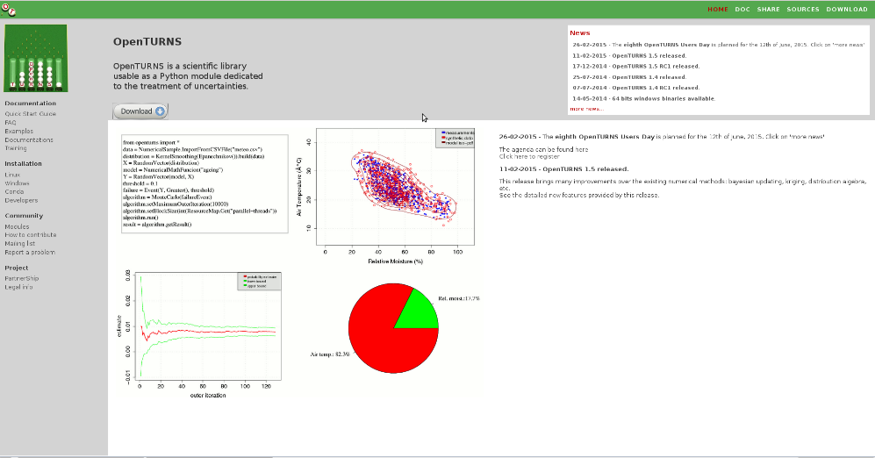
OpenTURNS : Consortium
Partners 2005 – 2015 :
  EDF – R&D
  Airbus Group
  PhiMECA
  IMACS
Now:
  Nearly 9000 downloads from Sourceforge (not accounting for linux packages)
  From more than 80 countries
  The OpenTURNS platform has been packaged for the major linux distributions (Debian, Ubuntu, Redhat, Suse) for 5 years
www.openturns.org
Notes:
toto

Slide 6
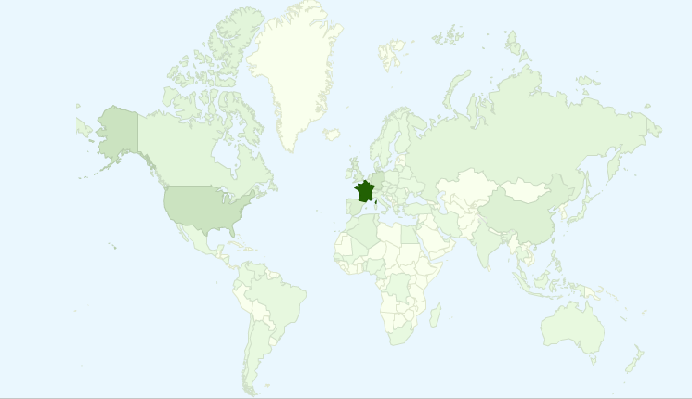
OpenTURNS : Worldwide diffusion
Since june 2007: nearly 9000 downloads from Sourceforge
  Windows versions and source package
  Not including packages for linux distributions
Top country: France (55% of downloads)
Top OS: Windows (60% of downloads)
Notes:
toto

Slide 7
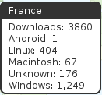
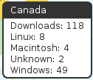
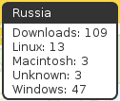
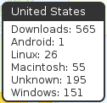
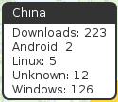


OpenTURNS : Worldwide diffusion
  All around the world...
Notes:
toto

Slide 8
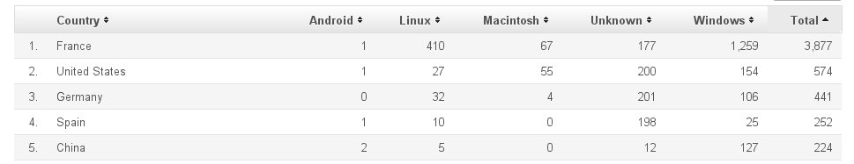
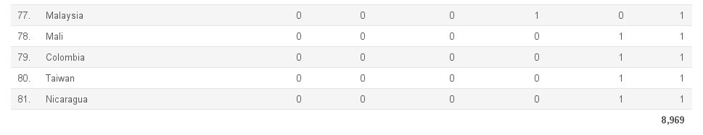
OpenTURNS : Worldwide diffusion
.
.
.
Notes:
toto

Slide 9
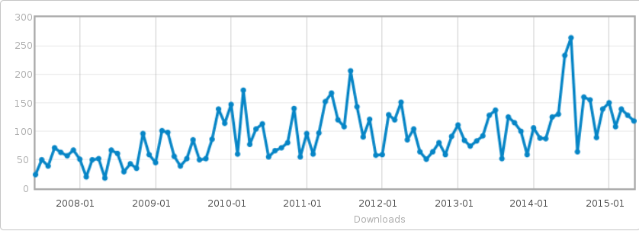
OpenTURNS : Diffusion
  Download history and OpenTURNS releases
V 1.4
V 0.14 & 0.15
V 0.13.2
(V 1.3)
V 1.5
V 1.1
V 1.2
?
V 1.0
Stochastic processes
  Kriging
First Windows package
Random fields h-mat
Polynomial Chaos Expansion (G. Blatman PhD)
  Bayesian calibration
  Standardization of modules
Notes:
toto

Slide 10
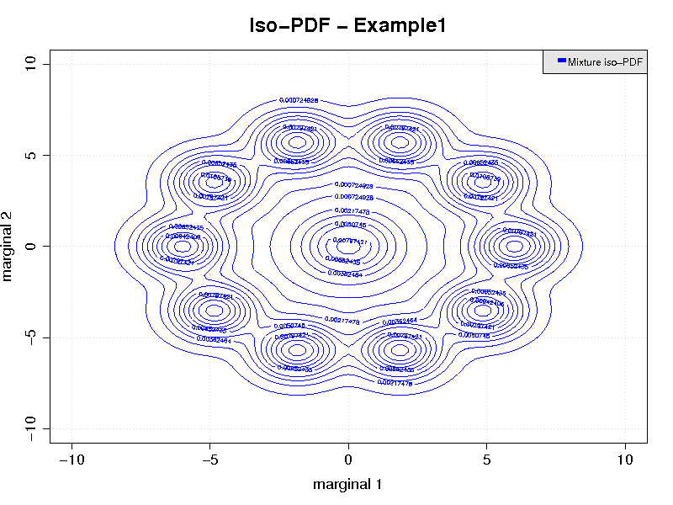
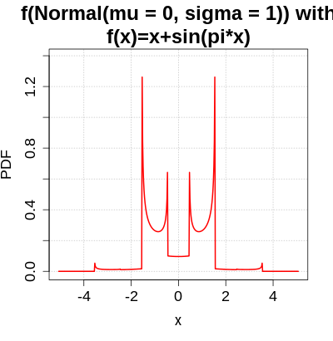

OpenTURNS : Scientific aspects
Coherence of the data model, focused on the following concepts:
  Probability distributions (univariate and multivariate)
  Numerical functions
  Processes
  Random vectors
2 levels of abstraction:
  Formal level:
      It prevents the User to compound incoherent concepts
      It allows for the exact resolution of a problem in many cases
      Ex: algebra of functions up to second order (gradient & Hessian) including composition of functions, sum and product
      Ex: algebra of independent random variables including nonlinear transformations, sum, product, maximum
      Ex: It is possible to evaluate the exact distribution of:
No samples
needed!
Machine precision
Notes:
toto
toto

Slide 11
OpenTURNS : Scientific advanced aspects
2 levels of abstraction :
  Numerical level:
      OpenTURNS implements efficient numerical methods (accuracy and speed)
      Coming from latest research or original research
      Constant preoccupation of the development team
From external research:
High-performance random generator (Mersenne-Twister, 2007)
Special functions (Faddeeva, 2012)
Exact statistics (Kolmogorov, 2013, Kendall, 2010)
…
From original research by the partners:
Maximum entropy order statistics distributions: PhD going on at EDF R&D, R. Fischer
Sparse chaos expansion polynomials : PhD EDF R&D, 2010, G. Blatman
Accelerated simulation algorithm for rare events : PhD EDF R&D, 2012, M. Munoz
Sensitivity analyses for imbricated models: PhD Phimeca, 2012, Y. Caniou
Fast and accurate algorithm for discrete interval probabilities: PhD Airbus, 2013, R. Lebrun
Order statistics distributions with given marginals: PhD Airbus, 2013, R. Lebrun
Generalized Nataf transformation for elliptical copulas: 2009, A. Dutfoy
…
Notes:
toto
toto

Slide 12
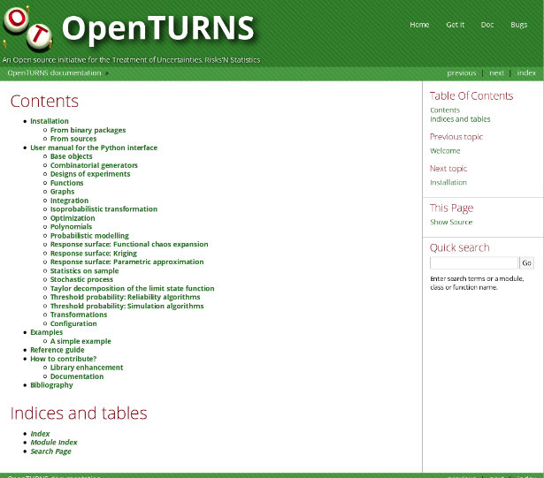
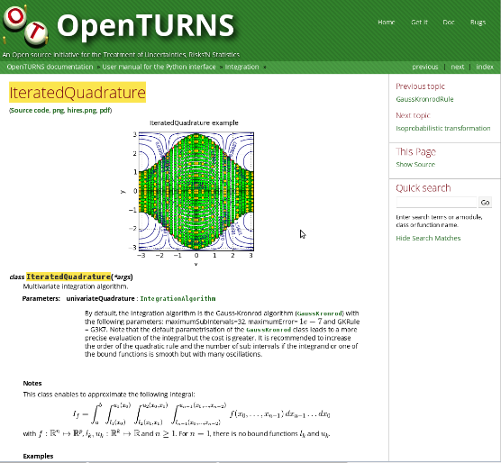
OpenTURNS : Scientific advanced aspects
OpenTURNS has a large base of tests and validation:
    More than 430 tests
    Distributed with the software
    Validation using Maple, Matlab, R, …
    Under constant improvement
OpenTURNS has a rich documentation
    Online and offline user manual
    Methodology and scientific guides
    More than 1000 pages
    Modern technology for the User Manual:
      docstrings for the inline help
      Sphinx for the interactive documentation
Notes:
toto
toto

Slide 13
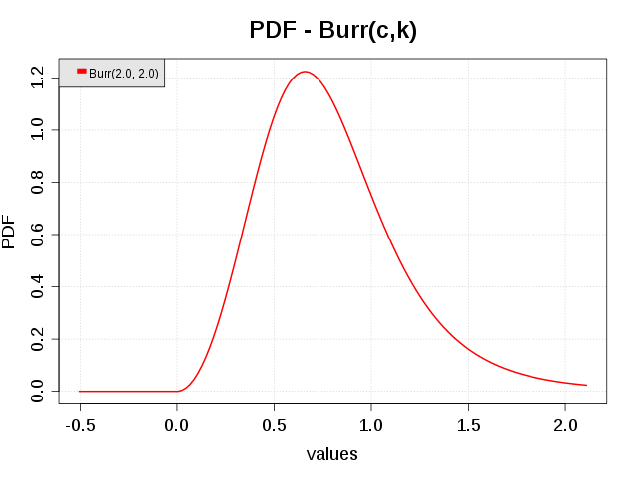
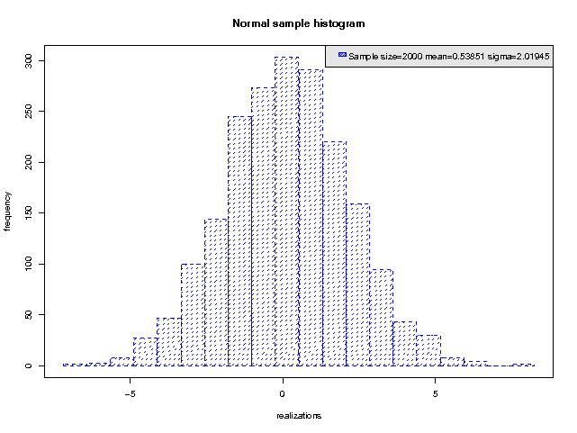
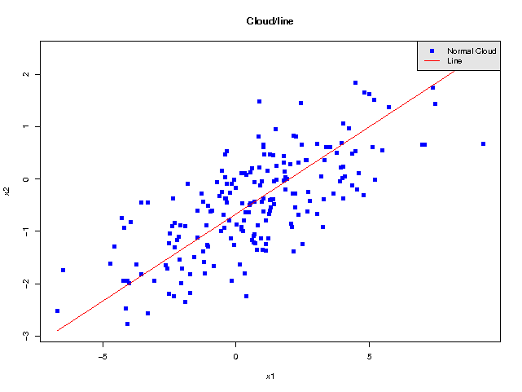
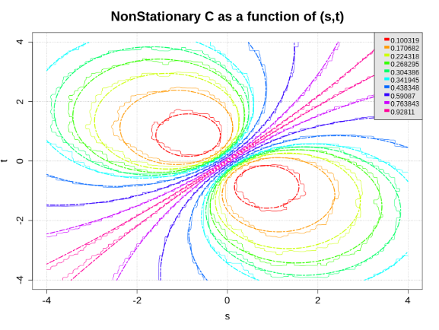
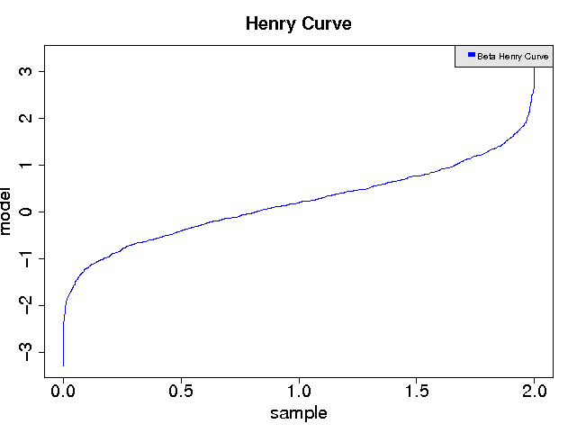
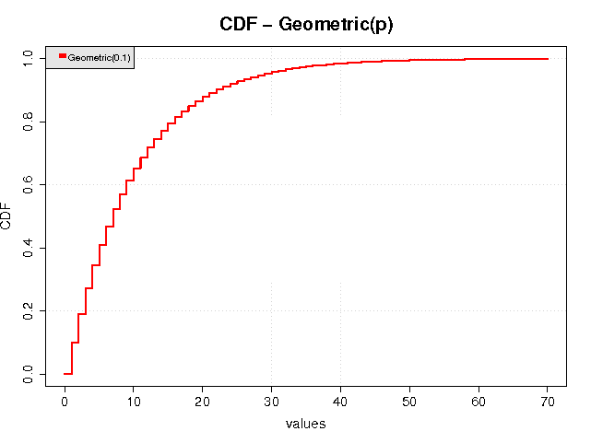
OpenTURNS in pictures
Notes:
toto

Slide 14
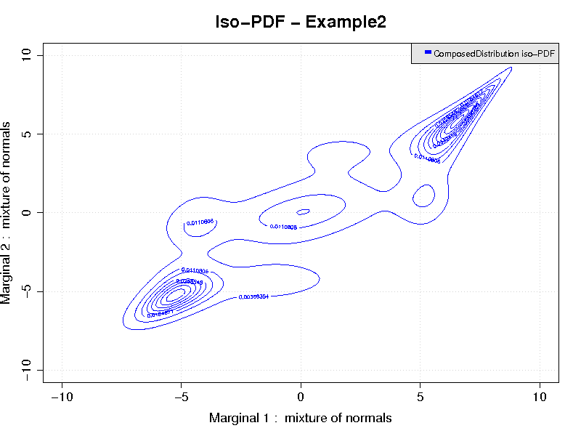
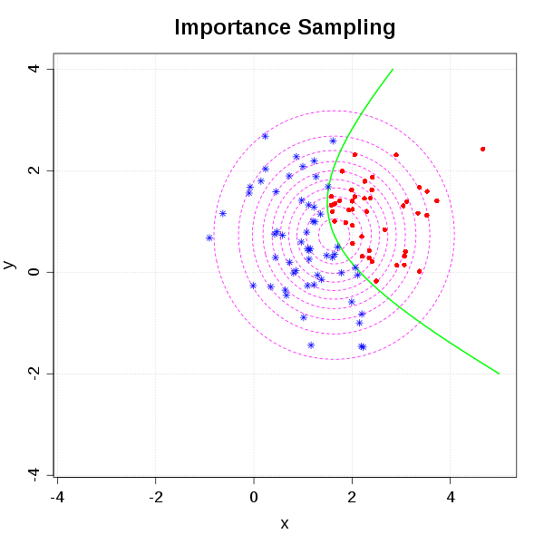
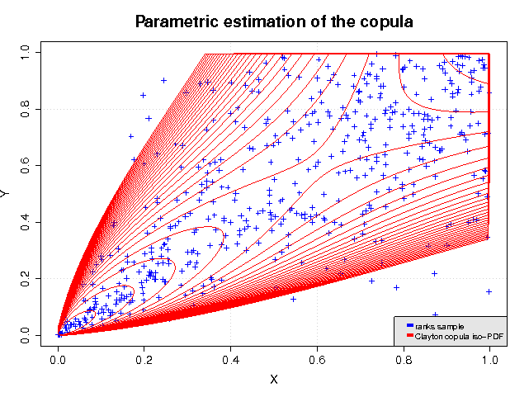
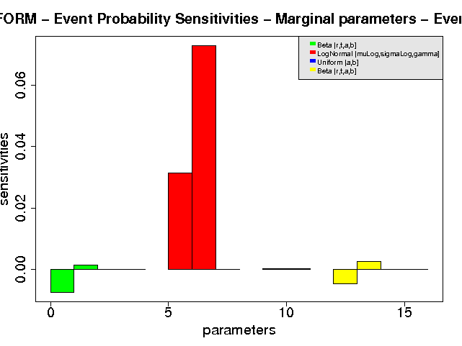
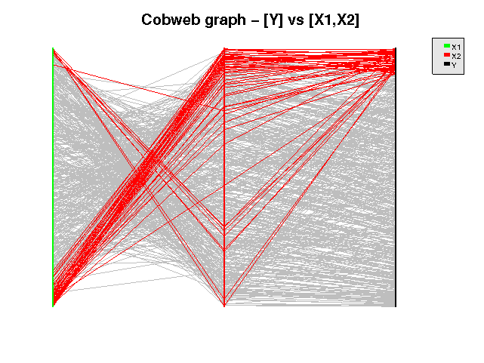
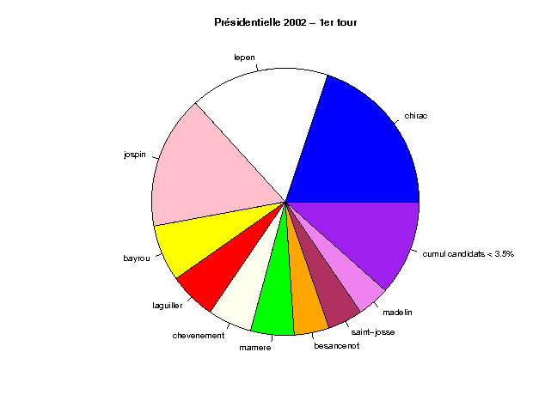
OpenTURNS in pictures
Notes:
toto

Slide 15
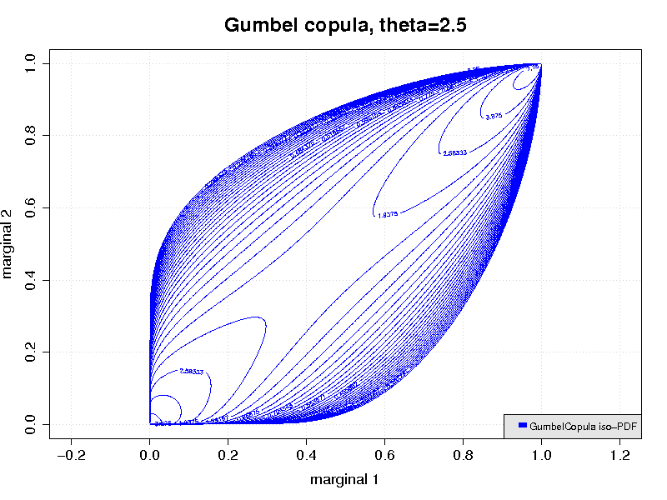
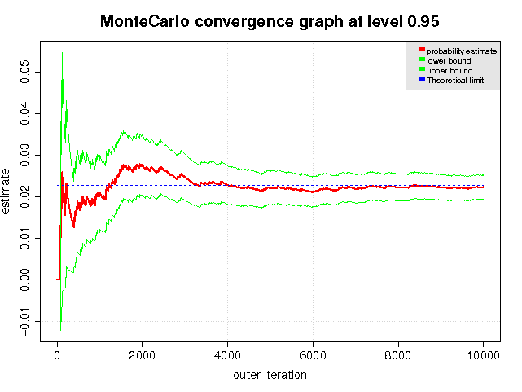
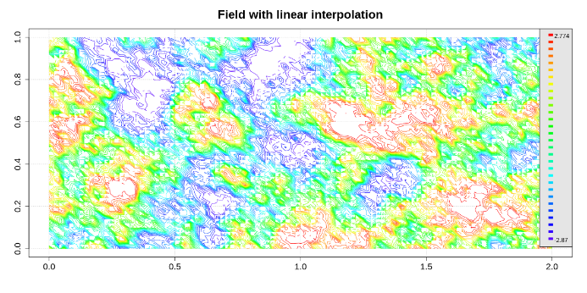
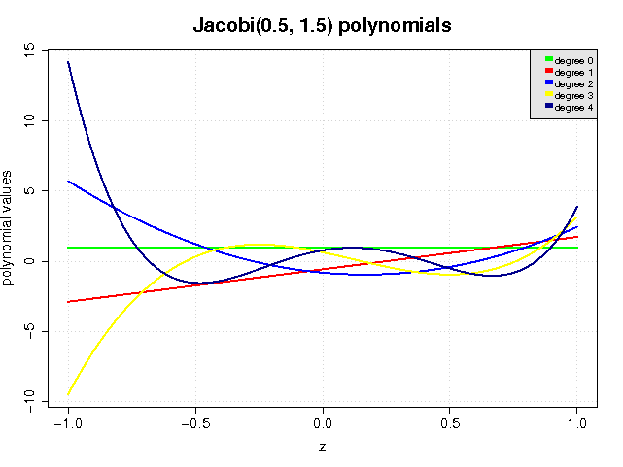
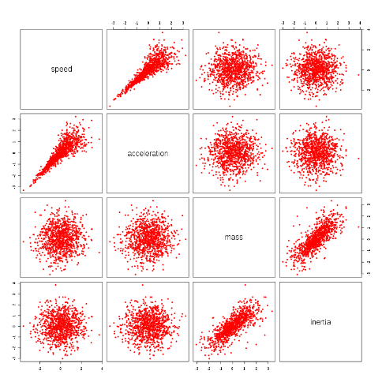
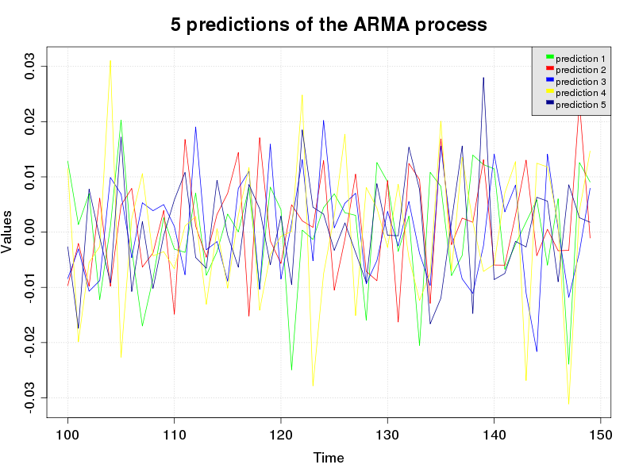
OpenTURNS in pictures
Notes:
toto

Slide 16
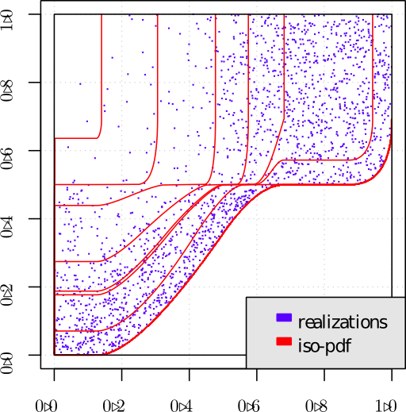
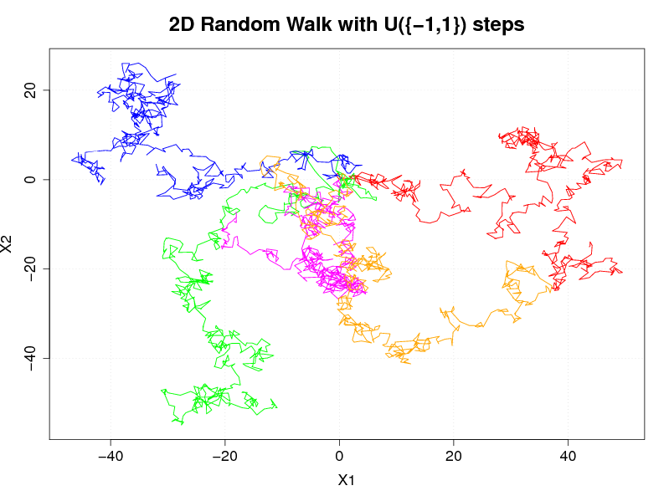
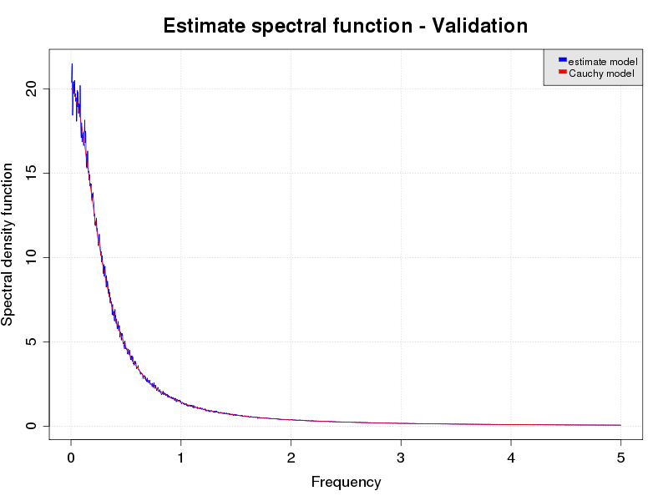
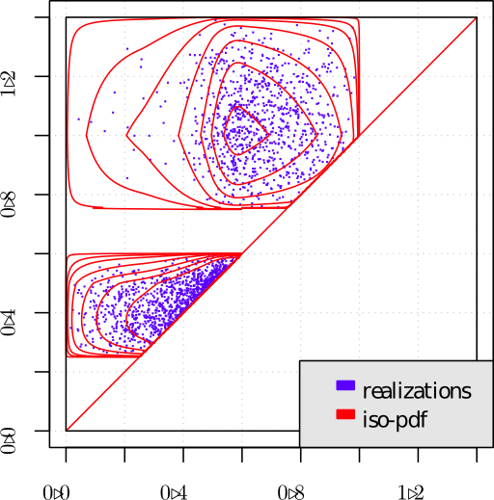
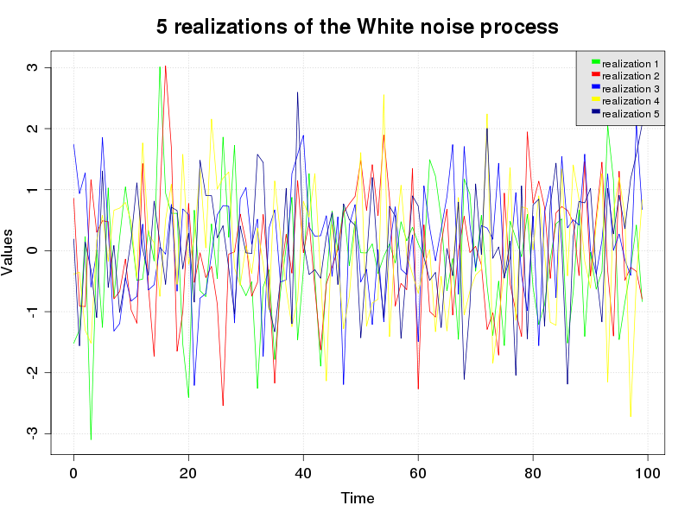
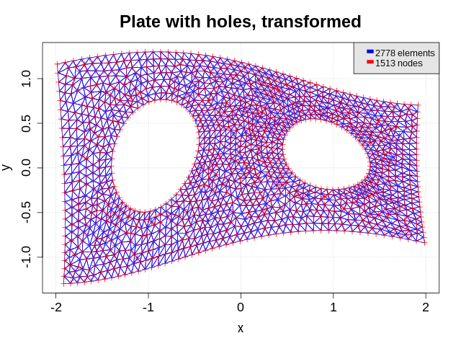
OpenTURNS in pictures
Notes:
toto

Slide 17
Open TURNS – Trainings
EDF
    contact : Corine Tripet : 01 47 65 58 41
  « Uncertainty Management : Open TURNS »
    3 days to learn the use of Open TURNS : python TUI, wrapping aspects, application of the methodologie from step A to step C & C’
    next session : 7-9/09/2015, ITECH ref : 4888
  « Uncertainty Management : Methodology »
    3 days to learn the Uncertainty Methodology
    next session : 2-4/09/2015, ITECH ref : 4888
PhiMECA : 2 sessions each year for each modulus
www.phimeca.com contact : Thierry YALAMAS : 06 80 83 59 29
Probability & Statistics
  Response Surfaces Models : 2 days
  Uncertainty propagation methods for sensitivity & dispersion analysis : 2 days
  Uncertainty propagation methods for reliability evaluation : 3 days
  Introduction to the use of OpenTURNS : 2 days
  Introduction to the use of PimecaSoft : 2 days
  Python for statistics : 3 + 2 days → New
PRACE
  1 session annuelle à la Maison de la Simulation (Saclay)
  3 jours
  Méthodologie + TP sur OpenTURNS ou Uranie
Notes:
toto

Slide 18
New features of the 1.5 & 1.6 releases
Last Releases : 1.4 in July 2014; 1.5 in April 2015; 1.6 in July 2015
New shiny user manual
  see the wiki on the website www.openturns.org
New capabilities (modeling, quantification, analysis):
  Distributions
  Processes
  Numerical functions
  Calibration
  Quantification
  Sensitivity analysis
Notes:
toto

Slide 19
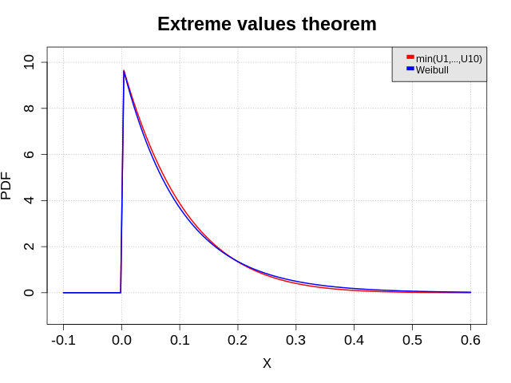
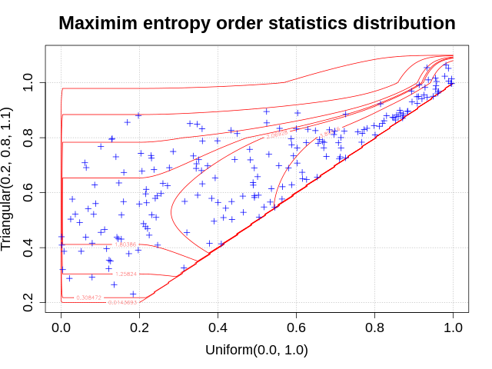
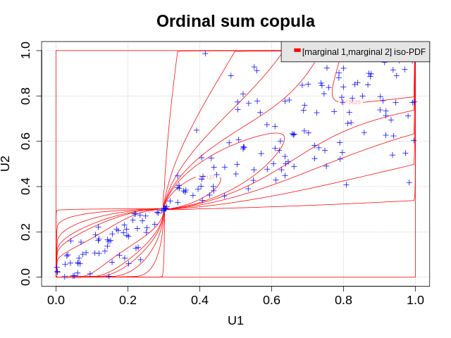
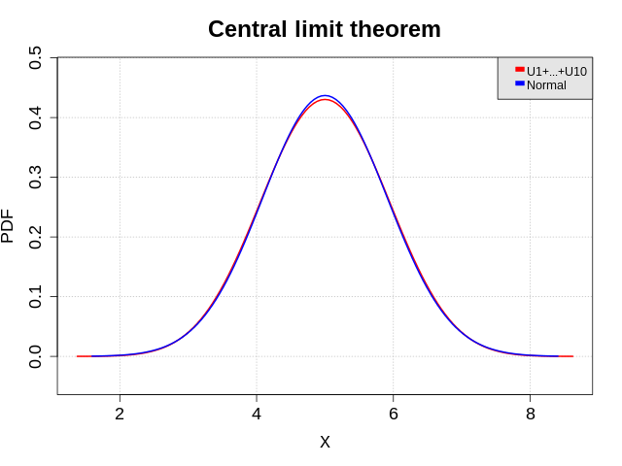
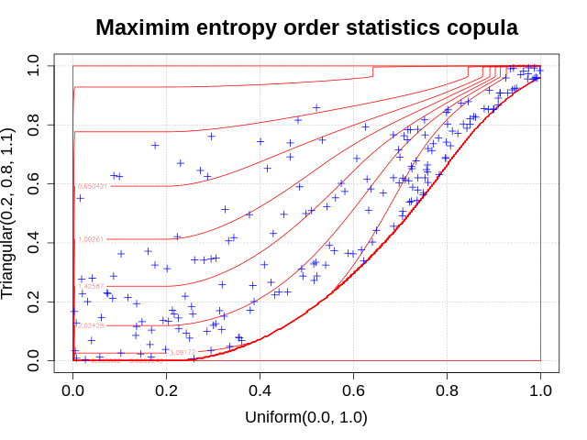
New features of the 1.5 & 1.6 releases
Distributions
  Frechet, MaximumDistribution → Extreme values modeling
  RatioDistribution, RandomMixture, ProductDistribution → Arithmetic of independent random variables
  InverseChiSquare, InverseGamma, NormalGamma, BayesDistribution, ConditionalDistribution → Bayesian modeling
  OrdinalSumCopula, MaximumEntropyOrderStatisticsDistribution, OrderStatisticsMarginalChecker, MaximumEntropyOrderStatisticsCopula → Constrained dependence structures
  VonMises, MarginalDistribution → Circular distribution, projection
Notes:
toto

Slide 20
New features of the 1.5 & 1.6 releases
Processes
  AggregatedProcess → To feed a dynamical function with many processes
  MaternModel, ProductStationaryCovarianceModel, nugget factor → New covariance models for process modeling including kriging
  IntervalMesher extended to 3D.
Numerical functions
  Arithmetic of functions
  Unification of Basis and FunctionalBasis → To reuse functions from polynomial chaos for universal kriging
  PythonDynamicalFunction → To wrap external codes based on processes
Calibration
  History of the Markov Chain in MCMC → To check for convergence
  Intrinsic uncertainty in RandomWalkMetropolisHastings → To take into account uncertainties in measurements
Notes:
toto

Slide 21
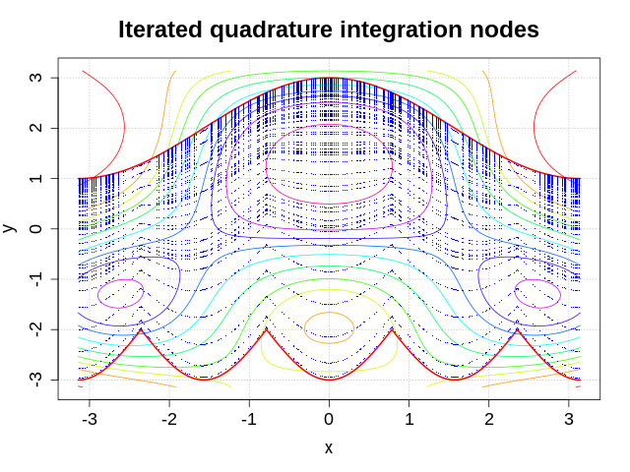
New features of the 1.5 & 1.6 releases
Quantification
  Extension of FORM/SORM algorithms to events based on intervals
  IteratedQuadrature: fully adaptive multidimensional quadrature algorithm → To compute with high accuracy low dimensional integrals
  Extension of GaussKronrod to vector-valued functions
Sensitivity analysis
  FAST method to compute Sobol indices
  ANCOVA for sensitivity analysis with dependent inputs
Notes:
toto

Slide 22
New features of the 1.5 & 1.6 releases
Sensitivity analysis
  ANCOVA [caniou2012]
    ANOVA generalization
    Correlated inputs
    Sets of physical & correlated parts of variance
    Polynomial chaos decomposition
  FAST [saltelli1999]
    ANOVA decomposition
    Fourier series (FFT)
    First order and total order indices
Notes:
toto

Slide 23
New features of the 1.5 & 1.6 releases
Polynomial chaos performance enhancement 1/2
  Reference : optimized PenalizedLeastSquareAlgorithm to solve normal equation (1.4)
  Design matrix caching (1.5, 1.6)
  Reuse matrix decomposition in sequential sparse metamodel validation for regression (1.6)
  Incremental matrix decomposition wrt columns (1.6)
Notes:
toto

Slide 24
New features of the 1.5 & 1.6 releases
Polynomial chaos performance enhancement 2/2
  Reference : optimized PenalizedLeastSquareAlgorithm to solve normal equation (1.4)
  Ongoing work: incremental matrix decomposition wrt rows (1.6)
t
Notes:
toto

Slide 25
New features of the 1.5 & 1.6 releases
Improved Python wrapping of functions (1.5)
Python function gradient & hessian
def a_exec(X):
Y = [0.]
Y[0] = X[0]**2 - X[1]
return Y
def a_grad(X):
dY = [[2.*X[0]], [-1.]]
return dY
myFunc = PythonFunction(in_dim, out_dim, a_exec, gradient=a_grad)
Python dynamical function
def a_exec(X):
mesh = X.getMesh()
Y = ot.Field(mesh, ot.Normal().getSample(mesh.getVerticesNumber()))
return Y
myFunc = ot.PythonDynamicalFunction(in_dim, out_dim, spatial_dim, a_exec)
Notes:
toto

Slide 26
New features of the 1.5 & 1.6 releases
Conda package manager
  userland python package manager
  focus on numerical & data analysis libraries
  cross-platform
  binstar.org repositories
Python 3
  working condition since 1.2
  binaries available (debian, windows, conda) for 1.5
  unit-tests conversion using __future__ module for 1.6
Notes:
toto

Slide 27
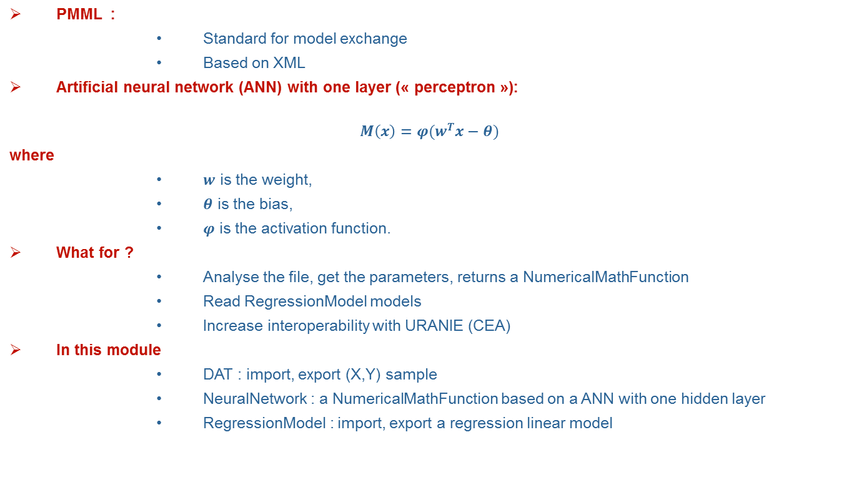
The PMML Module

Slide 28

The PMML Module
>>> from otpmml import NeuralNetwork
>>> model = NeuralNetwork("myPMMLFile.pmml")
>>> print (model)
Implementation :
        EDF internship : prototype Python
        IMACS
    http://trac.openturns.org/wiki/Modules
        EDF internship : prototype Python
Notes:
toto

Slide 29
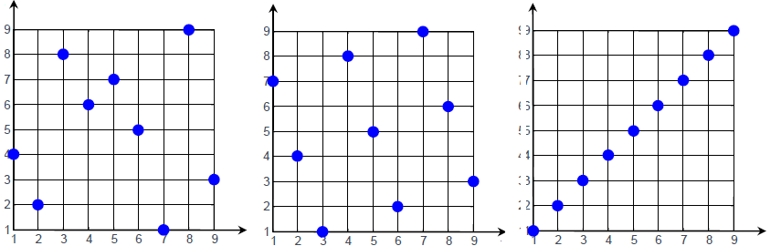
The LHS module
LHS module
Goal : create Latin Hypercube Sampling (LHS) designs with good space filling properties
What for ?
    Central tendency : estimate mean, standard variation
    Create meta-models, e.g. Polynomial chaos, Kriging, etc…
In this module :
    Types of designs : centered or randomized
    Criteria : C2, mindist, φp
    Algorithms : simulated annealing (or Monte-Carlo)
    Limitation : independent copula

Slide 30
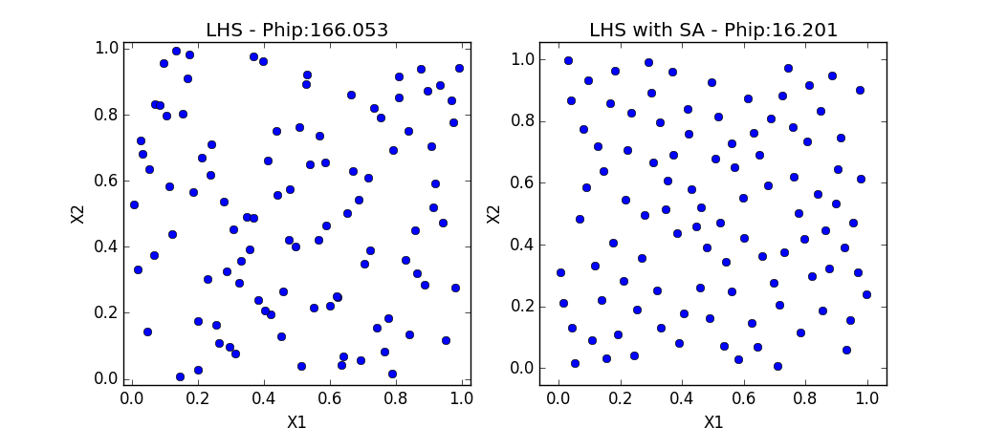
The LHS module
>>> import openturns as ot
>>> import otlhs
# Fix the uniform bounds (0 ,1)^2, size = 100
>>> Bounds = ot.Interval(2)
>>> lhs = otlhs.LHSDesign (bounds, 100)
# Fix criterion
>>> crit_sf = otlhs.SpaceFillingPhiP ()
# Defining a temperature profile (10,0.95,2000)
>>> temp_prof = otlhs.GeometricProfile ()
>>> algo = otlhs.SimulatedAnnealingLHS (lhs , temp_prof , crit_sf )
>>> result = algo.generate ()
# Retrieve optimal design
>>> design = result.getOptimalDesign()

Slide 31
Perspectives 2015-2016: main ongoing works
Kriging functionalities:
    Implement the kriging algorithm with fully multidimensional covariance models
    Get the multivariate conditionnal distribution of gaussian processes
    Get some post-processing from the conditionnal distribution: conditional variance, best expected improvement …
    Partially in v1.6, achieved in v1.7
  Parameterization and estimation:
    Possibility to choose alternative parameterization sets for a distribution
    Estimate from a sample in the alternative parameterization
    Get the multivariate (exact or asymptotic or from Boostrap) distribution of the parameters estimator and not only the best estimate
    Distribution of the empirical moments and quantiles, …
    Partially in v1.6, achieved in v1.7
  User Manual documentation: switch to docstring/sphinx done by the end of 2015
  Optimization:
    Specify an optimization problem
    Choose an adapted optimization solver
    Provide extensive results
    link with external optimization libraries
    Partially in v1.7, achieved in v1.8
Notes:
toto

Slide 32
Open TURNS and the HPC
« H-Matrices methods principles. Applications to OpenTURNS»: T. Abboud (IMACS)
« The H-Matrices in Open TURNS v1.5 »: D. Barbier (IMACS)
Notes:
toto

Slide 33
Studies with Open TURNS
Study 1 : « Probabilité de Détection de Défaut (POD) » - L. Le Gratiet- EDF R&D
Study 2 : « Dispersion de polluants dans l’atmosphère » – F. Aguirre- PhiMECA
Study 3 : « Risque de crue en hydraulique fluviale » - N. Goutal – EDF R&D
Study 4 : « Incertitudes en Prévision de consommation d’électricité» – X. Brossat, V. Fritsch- EDF R&D
Study 5 : « Quantification des incertitudes relatives aux caractéristiques modales d'une pompe » – K. Macocco- PhiMECA
Notes:
toto

Slide 34

OpenTURNS event
2005 - 2015: OpenTURNS is 10 years old
Great meeting : 24th of september 2015
Inscriptions as usual
Partners’ experience ….
Diffusion in industries …
Academics ….
Final debate ….oD
Notes:
toto

Slide 35
The end ....
Thanks for your participation ... and see you next year !
Notes:
toto

