Slide 1

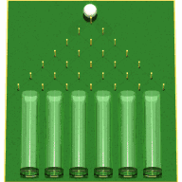
OpenTURNS User’s Day #9
Friday, the 21 ^{th}, June 2016
Notes:
toto

Slide 2

OpenTURNS User’s Day #9
Contents
9h30 - 10h →
Reception at EDF R&D Chatou
Welcome speech: Th. Yalamas (PhiMeca)
Open TURNS
  « Usages All around the World » : A. Dutfoy (EDF)
  New features of the 1.7 & 1.8 releases (to come): R. Lebrun (Airbus)
On going & future developments: Th. Yalamas (PhiMeca)
Open TURNS and the Low Rank Tensor Approximations
  « Low Rank Tensor Approximations » (1h) : A. Nouy / M. Chevreuil (Centrale Nantes)
  « The Low Rank Tensor Approximations in OpenTURNS v1.8 » (30’) : J. Schueller (PhiMeca)
Studies using Open TURNS
  «Polynomial Chaos expansion as a surrogate to hydraulic modeling - Estimation of covariances for reduced cost data assimilation » (30’) : S. Ricci (CERFACS)
  « Non parametric inference of dependence structures in high dimension with graphical models : an aGrUM/OpenTURNS interaction » (30’): PH Wuillemin (LIP6)
  « otrobopt : a new OpenTURNS module dedicated to robust optimization» (30’) : N. Rachdi (Airbus Group Innovation / IRT)
  « A new graphical interface for OpenTUNRS in the Salome environment » (30’): (EDF/Phimeca)
  « Studies with OpenTURNS at the CEA DAM» (30’): G. Defaux (CEA)
  « otwrapy: your distributed wrapper in less than 1 hour! » (30’): F. Aguirre (Phimeca)
10h – 11h15
11h15 – 12h45
LUNCH
14h – 17h
Notes:
toto
toto

Slide 3
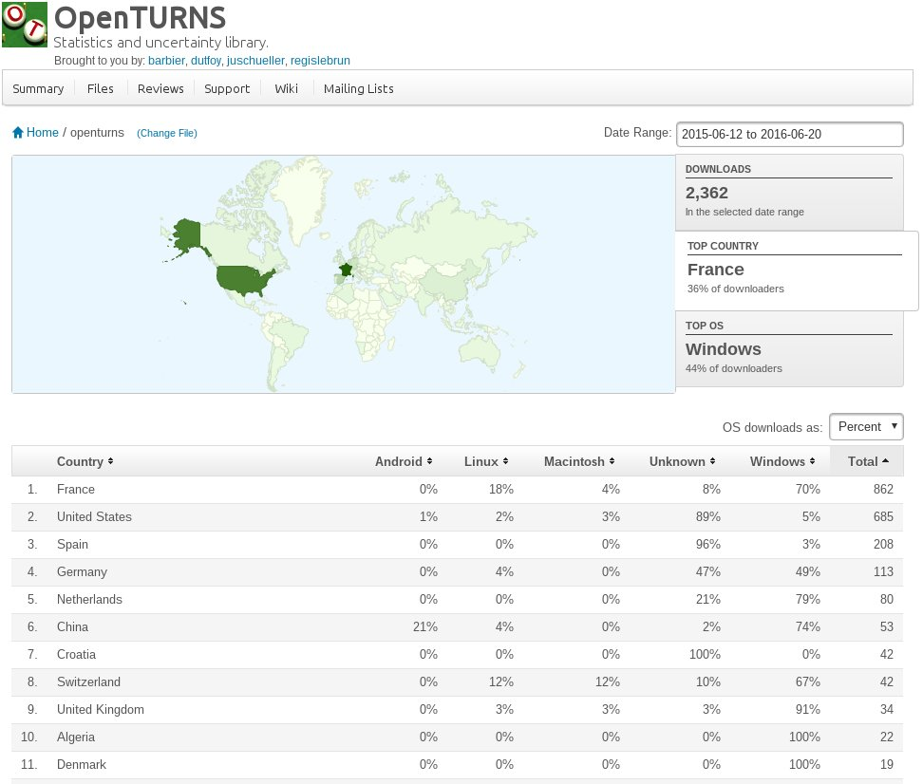
OpenTURNS : Worldwide diffusion
Since June 2015:
  2362 downloads from Sourceforge (Windows versions and source package, not including packages for linux distributions)
  622 downloads Conda (https://anaconda.org/openturns/openturns)
Top country: France (36% of downloads)
Top OS: Windows (44% of downloads)
Notes:
toto

Slide 4
OpenTURNS : Usages all aroung the world
Name: Katerina RIPPI
Function: Junior advisor/researcher at Deltares (https ://www.deltares.nl/en/)
Location: Delft, Provincie Zuid-Holland, Netherlands
Domain: Civil Engineering
Used OpenTURNS for her Master graduation thesis
Master thesis project: Reliability Analysis of dikes with sheet piles â€“ Coupling Finite Elements with Reliability methods
Main Activity: “Investigating the reliability and the soil stability of dikes reinforced with sheet pile wall modeled by a Finite Element Model (Plaxis 2D). The system reliability is going to be evaluated after coupling the results of Finite Element Model with a reliability method coded in Python software. Soil as well as structural parameters of the sheet pile wall are going to be accounted for the analysis and their participation in system failure is to be evaluated. Finally, the probability of failure of the system is to be calculated after considering parameters as stochastic. A comparison also among the different reliability methods is carried out in terms of their computational effort and available results.”
Main capabilities used: FORM/SORM, DirectionalSampling, distributed function
Notes:
toto

Slide 5
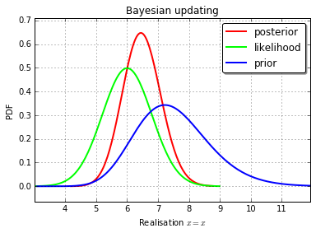
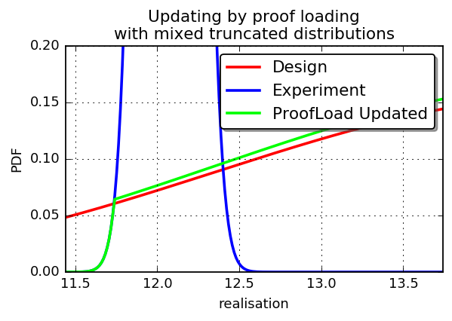
OpenTURNS : Usages all aroung the world
Name: Henning Bruske
Function: PhD student
Location: Technical University of Denmark, Denmark
Domain: Civil Engineering
Used OpenTURNS for his PhD
PhD subject: Probabilistic simulations of logical & Daniels systems
Main capabilities used: Complex mixtures including extreme distributions for the upper tail, Bayesian updating
Henning est motivé pour nous aider à mettre en place des scripts Quick Start
Il envisage d’introduire OpenTURNS comme support pour un cours de Master 2 d’un semestre en 2017
Notes:
toto

Slide 6
OpenTURNS : Usages all aroung the world
Name: Lisa RIVALIN
Function: PhD Student
Location: Mines ParisTech / MDE (CES - Centre Efficacité énergétique des Systèmes)
Domain: Energie
Used OpenTURNS for her PhD
PhD subject : “Vers une démarche de garantie des consommations énergétiques dans les bâtiments neufs: Méthodes d‘évaluation des incertitudes associées à la simulation thermique dynamique dans le processus de conception et de réalisation .”
“Before the construction of a building, an energy performance guarantee consists in predicting the energy required for user comfort. To do that, it is necessary to […] identify the key parameters […] and the uncertain parameters. This PhD thesis aims to develop a method of uncertainty quantification during the design step and construction process of a new building. […] The central part of this PhD thesis is dedicated to an exhaustive comparison of methods to select a fast uncertainty propagation and sensitivity analysis method.”
Main capabilities used: FORM/SORM, TaylorExpansionMoments, OptimizationSolver, Distribution...
Notes:
toto

Slide 7
OpenTURNS : Usages all aroung the world
Name: Jon Gould
Function: Senior Technical Consultant at Floating Systems, Asia Pacific, Peritus International
Location: Perth, Australia
Domain: Reliability
Used OpenTURNS for advanced UQ analyses
Main Activity: “This is my first time with OpenTURNS. I have been looking at using OpenTURNS software from a structural reliability the point of view. In my case the vector the random variable vector(X) has two elements representing wave height(h) and wave period(t). I have built myself a simple two variable response function that calculates a critical response of a floating structure. I have built two simple distributions Weibull and LogNormal to represent the wave height and wave period and if the variable are uncorrelated I can use the FORM example to calculate the Design Point of the system. Now I’d like to make it more complicated. I’dlike to include the correlation between h and t. The relationship is defined in terms of a conditional relationship ie P(Tz | Hs) = F(t, h) I have a function for that.”
Main capabilities used: BayesDistribution, FORM, complex probabilistic modelling
Notes:
toto

Slide 8
OpenTURNS : Usages all aroung the world
Name: Antoine Gautier
Function: Managing Director (from 2009) Solamen SAS: ‘Solamen is a young and innovative engineering company at the crossroads of mechanichal engineering, environmental design and building physics’
Location: Nantes, France
Domain: Civil Engineering
Used OpenTURNS to develop a software allowing for data fusion
“The main objective is to develop a software allowing for data fusion based on:
  discrete space/time measurements of a physical quantity
  continuous space/time simulation of the physical process taking into account uncertainties in the parameters of the model.
The ongoing developments are based on the results of several years of research in the field of civil engineering health monitoring. The global methodology has already been validated on a representative industrial case: the calibration of physical constants of a wall based on non-intrusive external inspection in natural condition.
The main capabilities of the software we develop are:
  the generation of an optimal scheme to monitor the energetic performance (DoE)
  the capitalization and treatment of measurement data
  the data fusion to automate the calibration of the computer model
  the sensitivity analysis and uncertainty management on energy consumption based on the calibrated model
Main capabilities used: FunctionalChaosAlgorithm, RandomWalkMetropolisHastings
Notes:
toto

Slide 9
Open TURNS – Trainings
EDF
    contact : Corine Tripet : 01 78 19 40 32
  « Uncertainty Management : Open TURNS »
    3 days to learn the use of Open TURNS : python TUI, wrapping aspects, application of the methodologie from step A to step C & C’
    next session : 5-7/09/2015, ITECH
    EDF Lab Paris-Saclay
  « Uncertainty Management : Methodology »
    3 days to learn the Uncertainty Methodology
    next session : 12-14/09/2016, ITECH
    EDF Lab Chatou
PhiMECA : 2 sessions each year for each modulus
www.phimeca.com contact : Thierry YALAMAS : 06 80 83 59 29
Probability & Statistics
  Response Surfaces Models : 2 days
  Uncertainty propagation methods for sensitivity & dispersion analysis : 2 days
  Uncertainty propagation methods for reliability evaluation : 3 days
  Introduction to the use of OpenTURNS : 2 days
  Introduction to the use of PimecaSoft : 2 days
  Python for statistics : 3 + 2 days → New
PRACE
  1 session annuelle à la Maison de la Simulation (Saclay)
  3 jours
  Méthodologie + TP sur OpenTURNS ou Uranie
Notes:
toto

Slide 10
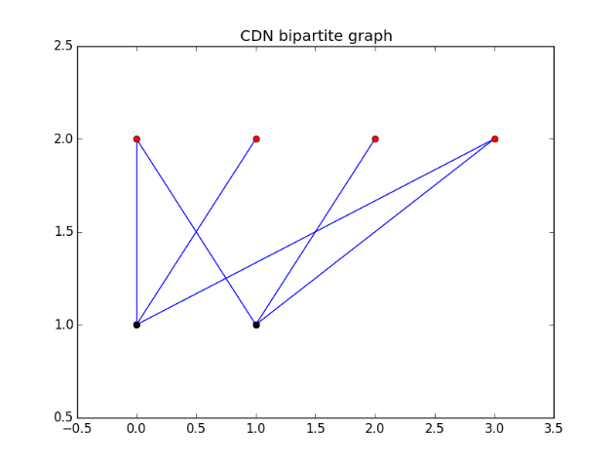
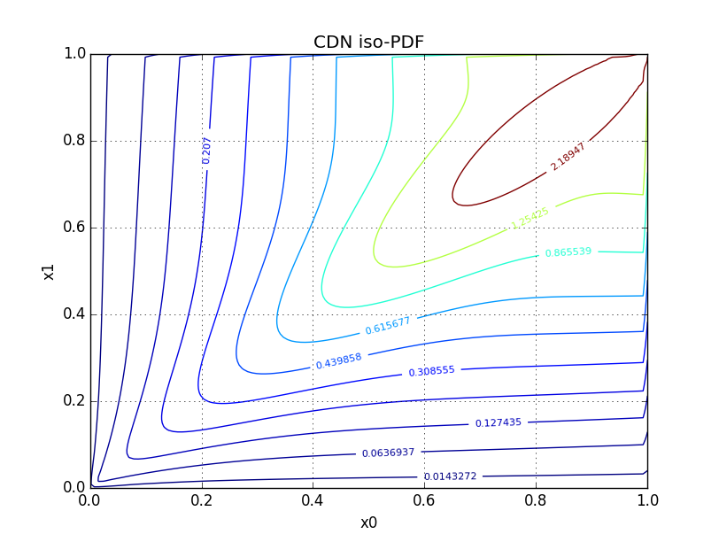
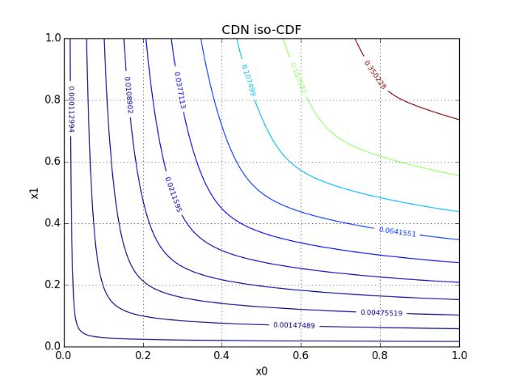
New features of the 1.7 & 1.8 releases
New Releases : 1.7 January 27th, 2016; 1.8 July 2016
Major rework of the documentation:
  The official user manual is based on docstring/sphinx (it was experimental last year)
  The LaTeX version has been deprecated
  It covers nearly 80% of the functionalities (25% last year)
  All the embedded examples are part of the test suite
  See openturns.github.io for the latest version (updated at each commit in the master project)
Probabilistic modelling:
  CumulativeDistributionNetwork: allows to define high-dimensional distributions based on lower dimensional distributions. Useful to model eg the joint distribution of Karhunen Loeve decomposition coefficients.
Notes:
toto

Slide 11
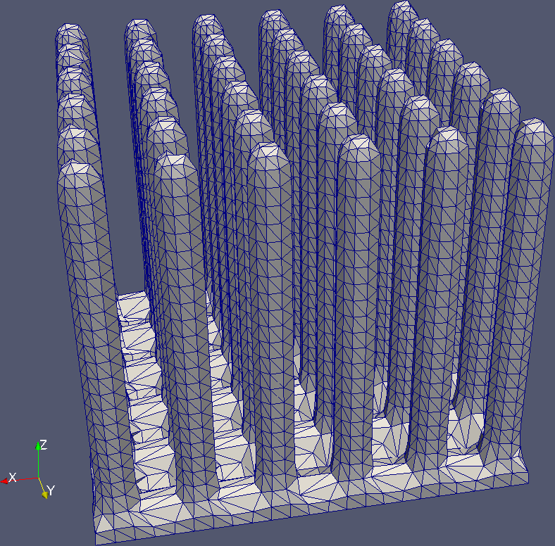
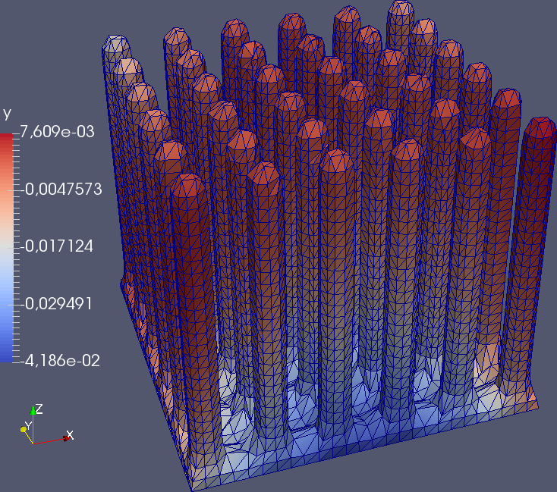
New features of the 1.7 & 1.8 releases
Processes
  Karhunen-Loeve decomposition of covariance models: KarhunenLoeveP1Factory, KarhunenLoeveQuadratureFactory
  New parameterization of covariance models
  New covariance models: DiracCovarianceModel, TensorizedCovarianceModel
  New discretization algorithm: LevelSetMesher
  Mesh: level set {(x,y,z) | 2(cos(3x/2)^2+cos(3y/2)^2)+(z/5)^21<1}
Notes:
toto

Slide 12
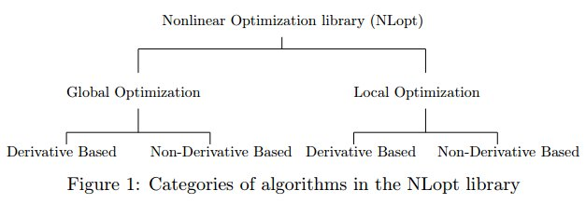
New features of the 1.7 & 1.8 releases
Optimization
  New interface to optimization. 3 steps approach: create an OptimizationProblem, solve it using an OptimizationSolver, get an OptimizationResult as a result.
  Al the Nlopt solvers are available
  Can be used in FORM/SORM analysis
  See ”Benchmarking NLopt and state-of-art algorithms for Continuous Global Optimization via Hybrid IACOR”, Udit Kumar, Sumit Soman, Jayavdeva (https://arxiv.org/pdf/1503.03175.pdf) for an extensive presentation of the Nlopt algorithms.
Notes:
toto

Slide 13
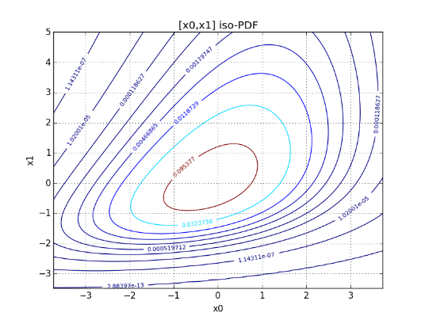
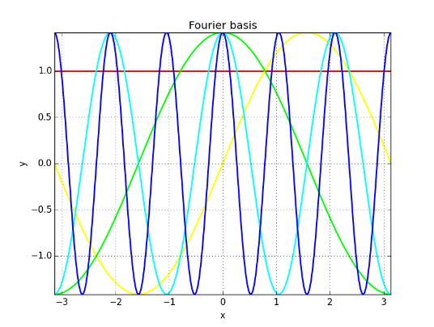
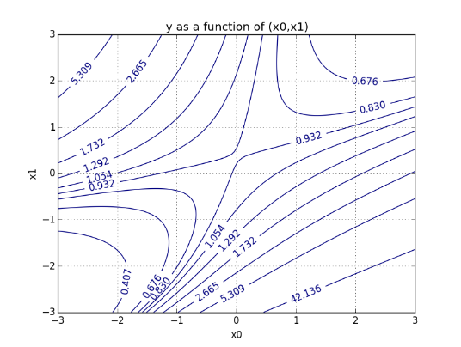
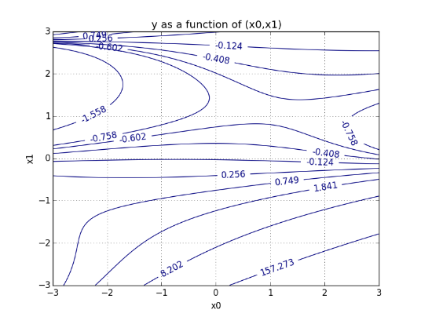
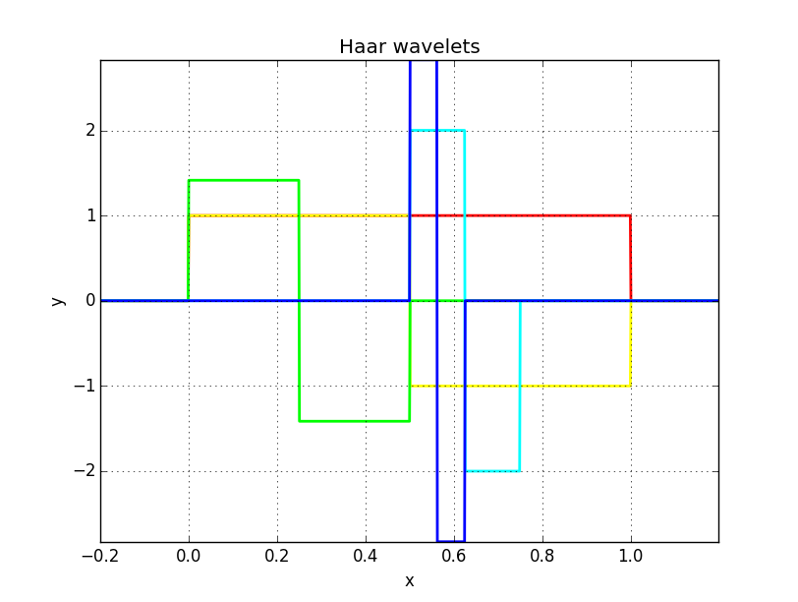
New features of the 1.7 & 1.8 releases
Orthogonal bases
  New univariate orthogonal bases: FourierBasis, HaarWaveletBasis
  Arbitrary distribution univariate orthonormal polynomials: AdaptiveStieltjesAlgorithm
  New multivariate orthogonal bases: OrthogonalProductFunctionFactory, SoizeGhanemFactory
  Low rank tensors
Notes:
toto

Slide 14
New features of the 1.7 & 1.8 releases
Meta-modelling
  GeneralizedLinearModelAlgorithm: least squares with known basis and parametric correlated Gaussian noise
  Box-Cox transformation: Power transformation of a generalized linear model
  KrigingAlgorithm: interpolatory with known basis and parametric correlated Gaussian noise
  Sparse low rank tensor approximation: see the dedicated presentation
Statistical inference
  Generic maximum likelihood estimation
  Nonparametric copula estimation
Rare event quantification
  SubsetSampling and AdaptiveDirectionalSampling are now in the core library (no more as a module)
Notes:
toto

Slide 15
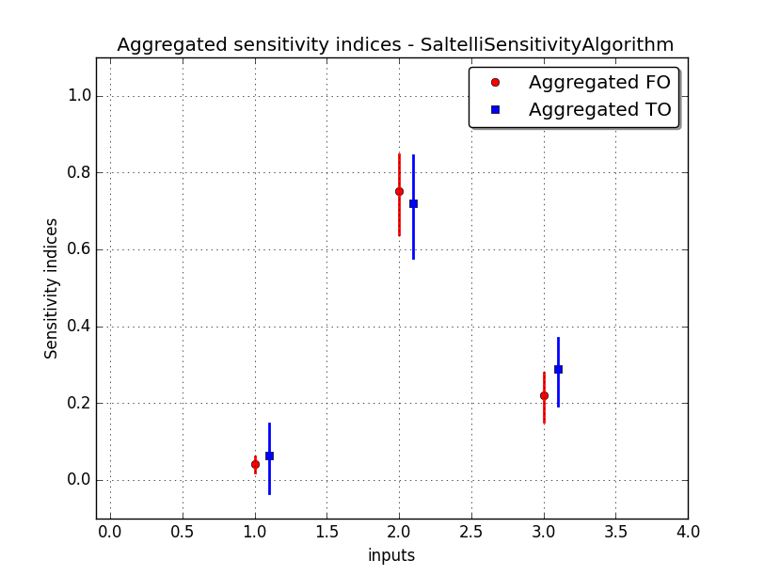
New features of the 1.7 & 1.8 releases
Sensitivity analysis
  New algorithms to compute Sobol’ indices:
    Saltelli, Jansen, MauntzKucherenko, Martinez
    First and second order, total indices
    Bootstrap confidence intervals or asymptotic intervals (Martinez)
    Graphical vizualisation
Notes:
toto

Slide 16
Perspectives 2016-2017: main ongoing works
  Parameterization and estimation: Confidence domains for the estimator of a vector of parameters, Distribution of the empirical moments and quantiles, …
  Chaos polynomial meta model: make it easier!
  Kriging meta model: new algorithms for the adaptative experiment: EGO and AEI
  Sensitivity analyses for functional inputs and outputs : new Sobol indices based on Karhunen Loeve decompostion and polynomial chaos meta model
  Uncertainties in imbricated systems: define the model, propagate uncertainties, sensitivity analyses
  H-Mat library: extend its use for covariance matrices and Karhunen Loeve problem
  Copula Bayesian Networks: in order to create a dependance structure in high dimension
  User Manual documentation: Quick Start documentation
Notes:
toto

Slide 17
Open TURNS and the Low Rank Tensor Approximations
« Low Rank Tensor Approximations»: A. Nouy / M. Chevreuil (Centrale Nantes)
« Low Rank Tensor Approximations in OpenTURNS v1.8 (& 1.9) »: J. Schueller (PhiMeca)
Notes:
toto

Slide 18
Studies with Open TURNS
Study 1 : « Polynomial Chaos expansion as a surrogate to hydraulic modeling - Estimation of covariances for reduced cost data assimilation» - S. Ricci (CERFACS)
Study 2 : « Non parametric inference of dependence structures in high dimension with graphical models : an aGrUM/OpenTURNS interaction » - PH Wuillemin (LIP6)
Study 3 : « otrobopt : a new OpenTURNS module dedicated to robust optimization» - N. Rachdi (Airbus Group Innovation / IRT)
Study 4 : « A new graphical interface for OpenTUNRS in the Salome environment » – Th. Yalamas (PhiMeca) – M. Baudin, A. L. Popelin (EDF R&D)
Study 5 : « Studies with OpenTURNS at the CEA DAM» - G. Defaux (CEA)
Study 6 : « otwrapy: your distributed wrapper in less than 1 hour! » - F. Aguirre (PhiMeca)
Notes:
toto

Slide 19
The end ....
Thanks for your participation ... and see you next year !
Notes:
toto

