Slide 1
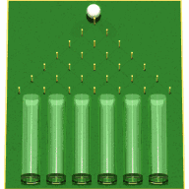
OpenTURNS Users’ Day #10
Tuesday, the 6 ^{th}, June 2017
Notes:
toto

Slide 2
OpenTURNS User’s Day # 10
Contents
9h30 - 10h →
Reception at EDF R&D Chatou
Welcome speech: A. Caruso (EDF)
Open TURNS
  Diffusion: A. Dutfoy (EDF)
  New features of the 1.8 & 1.9 releases: J. Schueller (Phimeca), R. Lebrun (Airbus)
On going & future developments: Th. Yalamas (PhiMeca)
« Scikit-Learn: Simple and efficient tools for data mining and data analysis »: A. Gramfort (Telecom ParisTech), G. Varoquaux (ENS)
  Presentation of the open source library
  Discussion
Studies using Open TURNS
  «Paraview et OpenTURNS» : M. Westphal (Kitware), M. Baudin (EDF)
  « Improving Surrogate Model-based Uncertainty Quantification in a Costly Numerical Environment » : P. Roy (CERFACS)
  « Modèles de vent atmosphérique: application aux lanceurs»: M. Ganet (ASL), V. Feuillard (AGI)
Gastronomy break (30’)
  « Métamodélisation de modèles de booster » : J. Richard (ASL), Q. Hallier (ASL), R. Lebrun (Airbus)
  « Construction de courbes de fragilité » M. Marcilhac (PhiMeca)
  « Evaluation du productible électrique d’une centrale solaire à concentration :
  JF Brau (EDF MFEE), L. Le Gratiet (EDF PRISME), G. Rachinel (EDF EN)
10h – 11h
11h – 12h
LUNCH
13h45 – 17h
Notes:
toto
toto

Slide 3
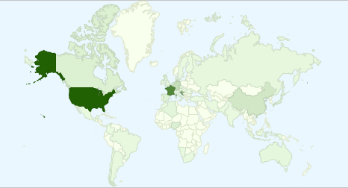
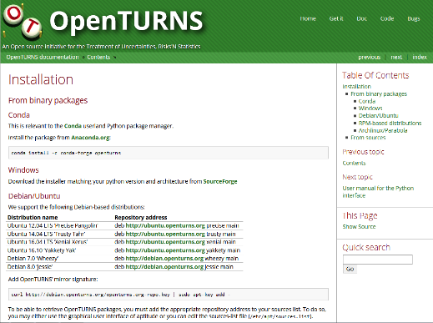

Où trouver OpenTURNS?
Sourceforge:
  Sources: for those who want to compile
  Windows Python Module (architectures 32 et 64 bit + 3 python versions)
  Native Windows Library
Sous Linux:
  distributions Debian, Ubuntu, CentoS, Fedor, openSUZE, Archlinux, Parabola
  compiled packages installed by the package manager (care: Administrative privilege)
Conda:
  installation of python without privilege (USERS)
  Python Module python on anaconda (https: //anaconda.org/openturns/openturns) since v1.7 (2016): windows / linux, several architectures, …
Téléchargements:
  2 700 downloads from Sourceforge since june 2016
  10 900 downloads Conda since the beginning of 2016
  + all the others!
Notes:
toto

Slide 4
Open TURNS – Trainings
EDF
    contact : Corine Tripet : 01 78 19 40 32
  « Uncertainty Management : Open TURNS »
    3 days to learn the use of Open TURNS : python TUI, wrapping aspects, application of the methodologie from step A to step C & C’
    next session : 11-13/09/2017, ITECH
    EDF Lab Paris-Saclay
  « Uncertainty Management : Methodology »
    3 days to learn the Uncertainty Methodology
    next session : 4-6/09/2017, ITECH
    EDF Lab Chatou
PhiMECA : 2 sessions each year for each modulus
www.phimeca.com contact : Thierry YALAMAS : 06 80 83 59 29
Probability & Statistics
  Response Surfaces Models : 2 days
  Uncertainty propagation methods for sensitivity & dispersion analysis : 2 days
  Uncertainty propagation methods for reliability evaluation : 3 days
  Introduction to the use of OpenTURNS : 2 days
  Introduction to the use of PimecaSoft : 2 days
  Python for statistics : 3 + 2 days → New
PRACE
  1 annual training at Maison de la Simulation (Saclay)
  3 days
  Méthodology + Practice on OpenTURNS or Uranie (CEA)
Notes:
toto

Slide 5
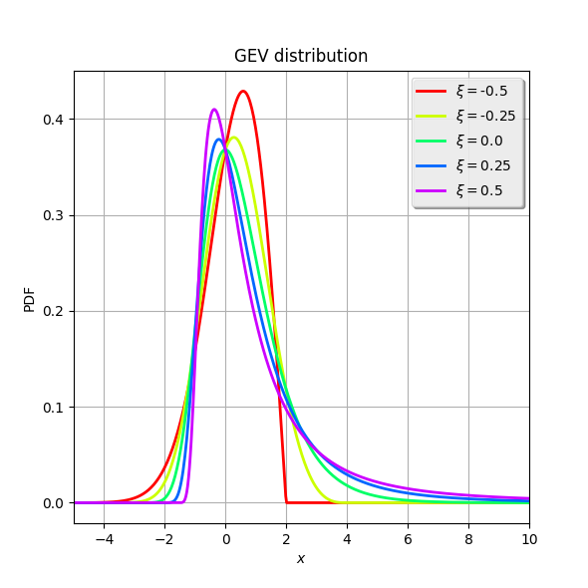
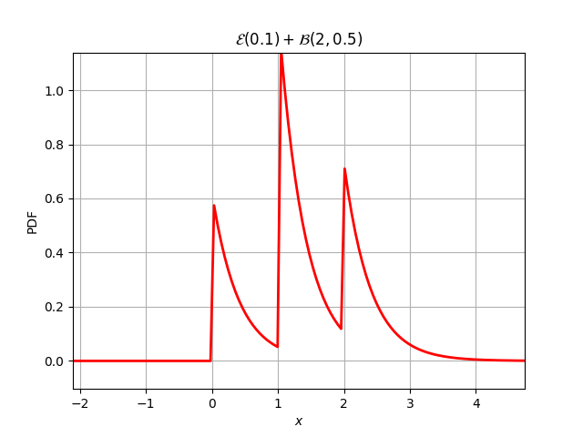
New features of the 1.8 & 1.9 releases
New Releases : 1.8 November 18th, 2016; 1.9 May 10th, 2017
Probabilistic modelling:
  GeneralizedExtremeValueDistribution
  Major improvement in RandomMixture
    Now it supports fully discrete distribution (all atoms are discrete)
    The simplification mechanism has been greatly improved to cover all the analytic 2 atoms cases
Binomial(4, 0.5) + Binomial(6, 0.5) + Bernoulli(0.5) = RandomMixture(Binomial(n = 11, p = 0.5))
Poisson(0.2) + Poisson(2.7) = RandomMixture(Poisson(lambda = 2.9))
Gamma(5, 0.5) + ChiSquare(8) = RandomMixture(Gamma(k = 9, lambda = 0.5, gamma = 0))
Uniform(-1.0, 2.0) + 3*Uniform(1.0, 2.0) = RandomMixture(Triangular(a = 2, m = 5, b = 8))
Exponential(0.1) + Binomial(2, 0.5) = RandomMixture(Mixture((w = 0.25, d = RandomMixture(Exponential(lambda = 2.5, gamma = 0))), (w = 0.5, d = RandomMixture(1 + Exponential(lambda = 2.5, gamma = 0))), (w = 0.25, d = RandomMixture(2 + Exponential(lambda = 2.5, gamma = 0)))))
Notes:
toto

Slide 6
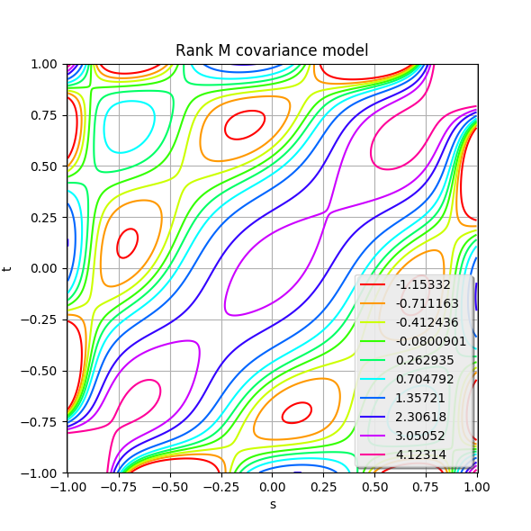
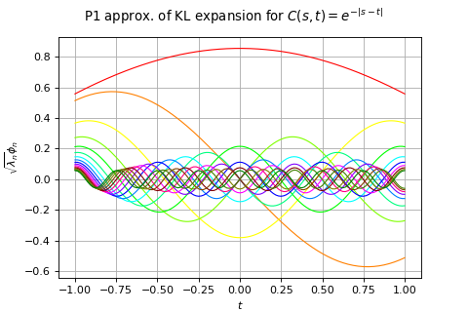
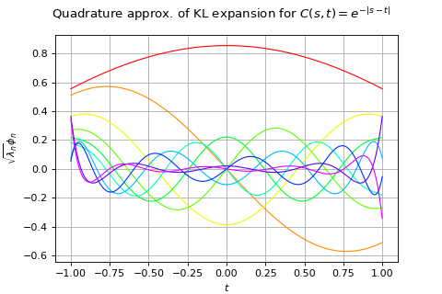
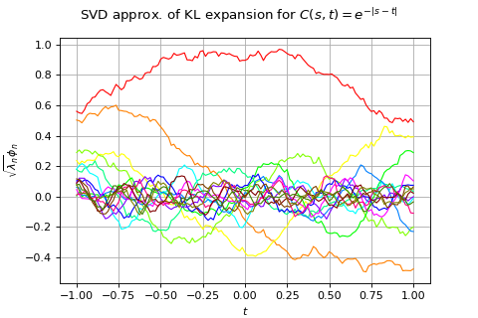
New features of the 1.8 & 1.9 releases
Processes
  Karhunen-Loeve decomposition of covariance models and process samples: KarhunenLoeveP1Algorithm, KarhunenLoeveQuadratureAlgorithm, KarunenLoeveSVDAlgorithm, KarhunenLoeveResult
  More details this afternoon!
  New covariance model: RankMCovarianceModel
Notes:
toto

Slide 7
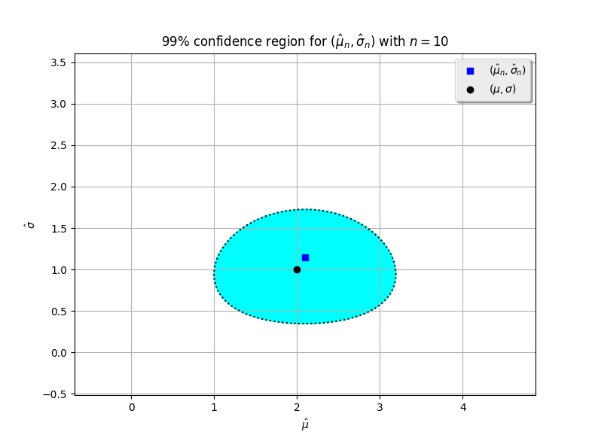
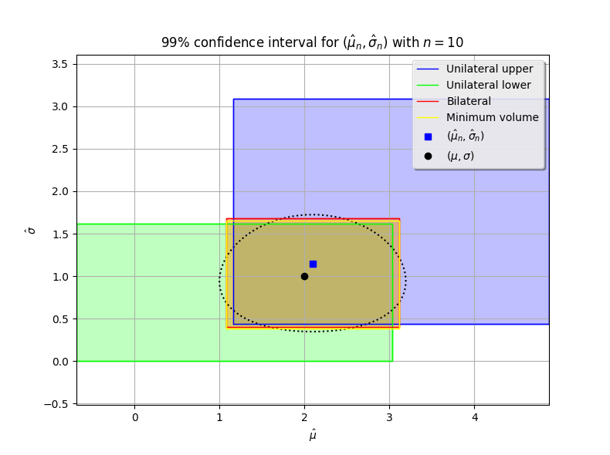
New features of the 1.8 & 1.9 releases
Parametric estimation
  Generic implementation of the method of moments
  New buildEstimator() method in DistributionFactory. It allows to build the distribution of the parameter estimator as well as the best estimate within th parametric family.
  Based on this estimator distribution, several kind of confidence regions can be computed:
    Minimum volume set based on density level
    Cartesian product of minimum volume intervals
    Cartesian product of unilateral (either side) or bilateral confidence intervals
  See computeMinimumVolumeLevelSet(), computeMinimumVolumeConfidenceInterval(), computeUniLateralConfidenceInterval(), computeBilateralConfidenceInterval() and their extended forms.
Notes:
toto

Slide 8
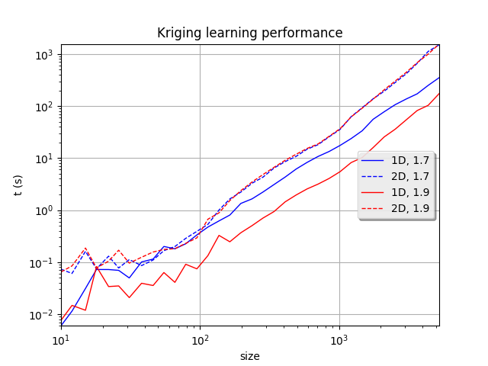
New features of the 1.8 & 1.9 releases
Kriging
  Consistency of the covariance model parameterization
  Ability to optimize the covariance parameters in full generality (no restriction to scale/amplitude parameters)
  Analytic expression of the variance for 1D covariance models
  Speed improvement (but more to come, wait for the 1.10 release)
Notes:
toto

Slide 9
New features of the 1.8 & 1.9 releases
New module for stepwise linear model estimation & selection
  It implements the R lm and step algorithms, to build a general linear model (lm) with basis adaptation (step) based on information criterion (AIC, BIC)
  It allows to build a general linear model based on two datasets by successively adding or removing a basis function among a predefined set of functions, based on an information criterion (AIC or BIC).
  -> This is more than a meta-modelling algorithm as it supposes a Gaussian residual to compute AIC or BIC
  -> Thanks to the LinearModelAnalysis class, a thorough analysis of the model is proposed
Basis( [1,X1,X2,(X1) * (X2),X3,(X1) * (X3),(X2) * (X3),X4,(X1) * (X4),(X2) * (X4),(X3) * (X4)]#11 )
Coefficients:
| Estimate | Std Error | t value | Pr(>|t|) |
---------------------------------------------------------------------
1 | 14.0624 | 0.831115 | 16.9199 | 5.40182e-30 |
(X1) * (X3) | 15.101 | 2.37858 | 6.34875 | 8.09972e-09 |
X2 | -33.8546 | 2.24399 | -15.0868 | 1.2953e-26 |
X4 | -5.20533 | 2.3893 | -2.1786 | 0.031917 |
(X1) * (X2) | 24.1669 | 2.55698 | 9.45135 | 3.25697e-15 |
(X2) * (X3) | 13.2848 | 2.57514 | 5.15887 | 1.42112e-06 |
(X1) * (X4) | -5.94499 | 2.39778 | -2.47937 | 0.0149823 |
(X3) * (X4) | 6.59239 | 2.66278 | 2.47576 | 0.0151251 |
---------------------------------------------------------------------
Residual standard error: 2.4069 on 92 degrees of freedom
F-statistic: 175.84 , p-value: 0
---------------------------------
Multiple R-squared | 0.930453 |
Adjusted R-squared | 0.925162 |
---------------------------------
---------------------------------
Normality test | p-value |
---------------------------------
Anderson-Darling | 0.338595 |
Chi-Squared | 0.100783 |
Kolmogorov-Smirnov | 0.868443 |
---------------------------------
Notes:
toto

Slide 10
New features of the 1.8 & 1.9 releases
Statistical tolerance
  Exact computation of two-sided covering intervals with given covering probability and given confidence for a Normal population (DistFunc.kFactor) or for Normal populations with common standard deviation (DistFunc.kFactorPooled)
  -> Some authors are still trying hard to compute it (eg a presentation at the Journées de la Conception Robuste et Fiable, 10th of May, 2017)
  -> The exact formulation is openly available, but its accurate and efficient implementatio is not obvious.
Notes:
toto

Slide 11
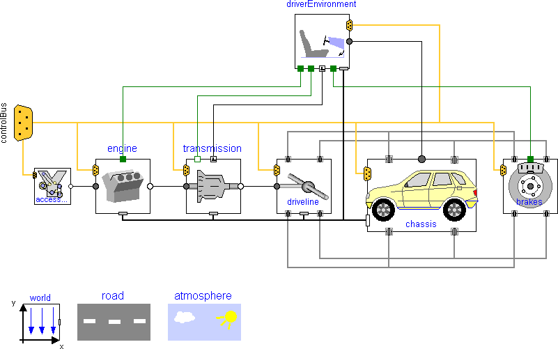
New features of the 1.9 release
Optimization
  Efficient Global Optimization : sequential stochastic optimization based on kriging (for costly models)
Functional modelling
  New classes dedicated to each specific concept : SymbolicFunction, LinearFunction, ComposedFunction, ParametricFunction… instead of just as much constructors of the same class
  API simplifications : NumericalMathFunction→ Function, NumericalSample→ Sample, etc
New otfmi module
  Allows to evaluate object system models in the FMI standard
  MFU binaries from Modelica langage simulation like OpenModelica
  Python / PyFMI based module→FMUFunction
Notes:
toto
toto

Slide 12
Documentation rework
Migration from LaTeX to ReST
- Easier to track API documentation
- Ensures correctness of examples
Timeline
  2015 : initial sphinx documentation (API)
  2016 : completed API, developer documentation
  2017 : new web site , new short examples section
  2017+ : theoric section (aka Reference Guide), more examples (Use Cases Guide)
Notes:
toto
toto

Slide 13
Perspectives 2017-2018: main ongoing works
  Algorithm performance : less memory and CPU ressource
    Full (but structured) matrix storage Stockage (covariance),
    Use of the H-Mat library
    Ex: for the Krigeage algorithms
  Rare quantile simulation algorithms:
    Monte carlo estimators
    Importance sampling estimators
    ➔ travaux du projet ANR Chorus portés par J. Garnier
  Process:
    Karhunen Loeve developments : use of ARPACK (sparse matrix)
    Confidence regions containing x% of the trajectories
  Sensitivity analyses
    new Sobol indices for functional inputs and outputs based on Karhunen Loeve decompostion and polynomial chaos meta model
    new sensitivity analyses based on the Csiczar divergence
  New functions:
    Propagation vector / process→ vector / process
  Uncertainties in imbricated systems: define the model, propagate uncertainties, sensitivity analyses
  Site web and documentation: More interactive documentation, examples, quick start, …
Notes:
toto

Slide 14
Scikit-Learn & OpenTURNS
« Scikit-Learn: Simple and efficient tools for data mining and data analysis»: A. Gramfort (Telecom ParisTech), G. Varoquaux (ENS)
Notes:
toto

Slide 15
Studies with Open TURNS
Study 1 : «Paraview et OpenTURNS» : M. Westphal (Kitware), M. Baudin (EDF)
Study 2 : « Improving Surrogate Model-based Uncertainty Quantification in a Costly Numerical Environment » : P. Roy (CERFACS)
  Study 3 : « Atmospheric wind models: application to launchers»: M. Ganet (ASL), V. Feuillard (AGI)
  Study 4 : « Métamodélisation de modèles de booster » : J. Richard (ASL), Q. Hallier (ASL), R. Lebrun (Airbus)
  Study 5 : « Construction de courbes de fragilité » M. Marcilhac (PhiMeca)
  Study 6 : « Evaluation du productible électrique d’une centrale solaire à concentration : JF Brau (EDF MFEE), L. Le Gratiet (EDF PRISME), G. Rachinel (EDF EN)
Notes:
toto

Slide 16

The end ....
Notes:
toto

