Slide 1







how does openVALIDATION work?
1. input
2. preprocess
3. parse
4. generate
5. output
preprocessor
Implementation
C# templates
C#
keyword aliases
Framework
validation.cs
translation
lexer
includes
parser
Java templates
Implementation
Java
Framework
if the applicant's age is less than 18
then you have to be at least 18 years
old to apply
antlr parser tree
validation.java
entry point
JavaScript templates
Implementation
JavaScript
AST-Builder
Framework
validation.js
cli
service
abstract syntax tree
api
schema

Slide 2



how openVALIDATION works?
how to use openVALIDATION
3. Business Analyst uses DSL
to create Validation Rules
4. Developer integrates
Validation Rules in their Projects
if the applicant's age is less than 18
then you have to be at least 18 years
old to apply
rules definition as *.vrd File
Model as
Json Schema
Production
entry point
C#
java
js
Imple-mentation
Imple-mentation
Imple-mentation
cli
api
service
Frame-work
Frame-work
Frame-work
Validation Rule CLI
generates validation
runtime code
preprocessor
Code Generator
MyRules.js
Build & deploy
to Production
templates
MyRules.cs
includes
keyword aliases
MyRules.java
translations
Project
compiles validation rules as
separately artifacts
Business Logic
parser
Parser (antlr.g4)
MyRules.js
Service/Consumer Layer
antlr parser tree
AST-Builder
abstract syntax tree
MyRules.dll
lexer
MyRules.jar
Validation Rules
parser

Slide 3
input
process
output
openVALIDATION
the applicant's age should not
be less than 18 years
preprocessor
parser
AST
validation
generator
rule
</code>
schema
converter
schema
{ age : 0 }

Slide 4
preprocessor
parser
AST
validation
generator
Schema converter
input
process
output
preprocessor
1. Alias Resolution
the applicant's age
should not be
less than 18 years
the applicant's age
ʬconstraintʬmustnotʬshould_20_not be ʬoperatorʬless_20_thanʬless than 18 years
2. Include Resolution
3. …

Slide 5
preprocessor
parser
AST
validation
generator
Schema converter
input
process
output
schema converter
io.openvalidation.common.data.DataSchema
{ age : 0 }
SchemaConverterFactory
List<DataPropertyBase> _properties
DataProperty
{
"$schema": "http://json-schema.org/...",
"type": "object",
"properties": {
“age": {
"type": “number",
}
}
}
name : age
type : decimal
ISchemaConverter
DataVariableReference

Slide 6
preprocessor
parser
AST
validation
generator
Schema converter
input
process
output
parser
io.openvalidation.common.ast.ASTModel
1. ANTLR Parser
rule
the applicant's age
ʬconstraintʬmustnotʬshould_20_not be ʬoperatorʬless_20_thanʬless than 18 years
condition
2. Parse Tree Transformer
left operand : age
comparison operator : less
right operand : 18
3. Post Processing
error : „the applicant‘s age…“

Slide 7
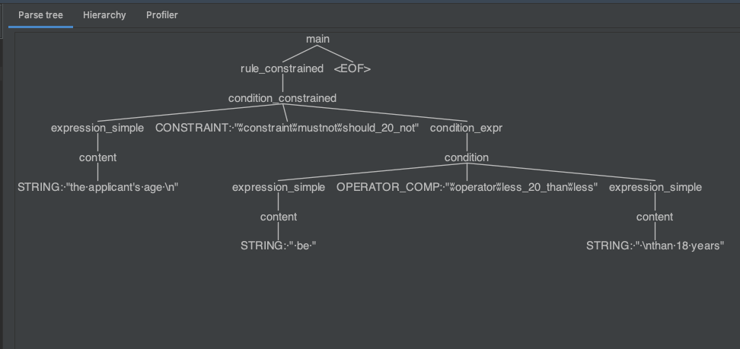
ANTLR Parser
Parse Tree Transformers
+
Post Processors
io.openvalidation.common.ast.ASTModel
rule
the applicant's age
ʬconstraintʬmustnotʬshould_20_not
be
ʬoperatorʬless_20_thanʬless
than 18 years
condition
left operand : age
comparison operator : less
right operand : 18
error : „the applicant‘s age…“
preprocessed rule
ANTLR Parse Tree
AST Model

Slide 8
preprocessor
parser
AST
validation
generator
Schema converter
input
process
output
validation
io.openvalidation.common.ast.ASTModel
rule
ValidatorFactory
Errors : [„missing element in rule..“]
yes
condition
has
Errors?
left operand : age
comparison operator : less
ValidatorBase validate()
right operand : 18
AST
generator
generate code…
error : „the applicant‘s age…“
no

Slide 9
preprocessor
parser
AST
validation
generator
Schema converter
input
process
output
generator
io.openvalidation.common.model
OpenValidationResult
io.openvalidation.common.ast.ASTModel
rule
Handlebars Templates
if ( age < 18 ) {
throw
Error(„the applicant‘s age…“)
}
condition
left operand : age
comparison operator : less
right operand : 18
framework
error : „the applicant‘s age…“
validatorfactory

Slide 10
...
x-ov-rules:
rule: |
the Name SHOULD
NOT be EMPTY
...
custom openVALIDATION-OpenAPI Generator
Service STUB
Validation
Rules
OpenAPI Generator
openVALIDATION
Rule Generation
OpenAPI Java Spring Generator
OpenAPI Csharp
Generator
Client Proxy
OpenAPI xxx
Generator
Validation
Rules
OpenAPI.spec.yaml

Slide 11
...
x-ov-rules:
rule: |
der Name DARF NICHT
LEER sein
...
custom openVALIDATION-OpenAPI Generator
Service STUB
Validierungs-regeln
OpenAPI Generator
openVALIDATION
Regel Generator
OpenAPI Java Spring Generator
OpenAPI Csharp
Generator
Client Proxy
OpenAPI xxx
Generator
Validierungs-regeln
OpenAPI.spec.yaml

Slide 12


Rule Set
humanized
rules
preconditions
domain specific Operators
Domain Expert
Schema/Attribute Access
CLI Setup
Schema/data model
Code Integration
Developer
technical

Slide 13
Regelwerk
menschlich
Regeln
Vorbedingungen
domain spezifische Operatoren
Domain Experte
Schema/Attribut Zugriff
CLI Setup
Schema/Datenmodell
Code Integration
Entwickler
technisch

Slide 14

if ( age < 18 ){
throw new Exception(
„you have to be at
least 18 years old
to apply “);
}
if the applicant's age is less than 18
then you have to be at least 18 years
old to apply

Slide 15
if ( age < 18 ){
throw new Exception(
„Sie müssen mindestens 18 Jahre alt sein, um sich bewerben zu können.“);
}
wenn das Alter des Bewerbers KLEINER 18 ist
dann Sie müssen mindestens 18 Jahre alt sein,
um sich bewerben zu können.

Slide 16
if ( age < 18 ){
throw new Exception(
„applicant's age should not be less than 18 years”
);
}
applicant's age should not be less than 18 years
if ( age < 18 ){
throw new Exception(
„applicant's age should not be less than 25”
);
}

Slide 17
if ( age < 18 ){
throw new Exception(
„Das Alter des Bewerbers sollte nicht unter 25 Jahren liegen”
);
}
if ( age < 18 ){
throw new Exception(
„Das Alter des Bewerbers darf nicht unter 18 Jahren liegen”
);
}
Das Alter des Bewerbers darf nicht unter 18 Jahren liegen

Slide 18
custom openVALIDATION-OpenAPI Generator
Java Spring Boot
Service STUB
Validation
Rules
...
x-ov-rules:
rule: |
the applicant‘s location
MUST the Dortmund
...
Webapplication
html/js
JavaScript
Client Proxy
Validation
Rules
OpenAPI Generator
OpenAPI.spec.yaml

Slide 19
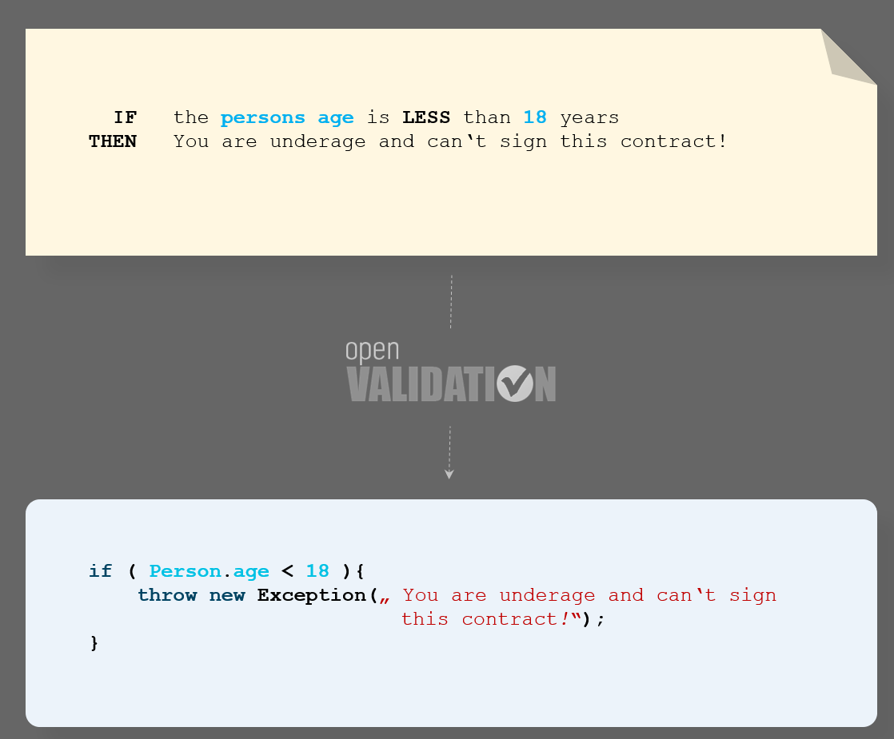
Das Alter des Bewerbers darf nicht unter 18 Jahren liegen
if ( age < 18 ){
throw new Exception(„Das Alter des Bewerbers darf nicht unter 18 Jahren liegen”);
}

Slide 20
applicant's age should not be less than 18 years
if ( age < 18 ){
throw new Exception(„applicant's age should not be less than 18 years”);
}

Slide 21
applicant's age should not be less than 25 years
if ( age < 18 ){
throw new Exception(
„applicant's age should not be less than 25 years”
);
}

Slide 22
custom openVALIDATION-OpenAPI Generator
Java Spring Boot
Service STUB
Validierungsregeln
...
x-ov-rules:
rule: |
der Ort des Bewerbers
MUSS Dortmund sein
...
Webapplication
html/js
JavaScript
Client Proxy
Validierungs-regeln
OpenAPI Generator
OpenAPI.spec.yaml

Slide 23
REST Service STUB
validation rules
title: „sample contract“
...
x-ov-rules:
rule: |
applicant‘s age should
not be less than 18
years
...
version: 1.0.0
OpenAPI Generator
REST Client Proxy
validation rules
OpenAPI.spec.yaml

Slide 24
Comparison Operator
Property of
Schema
Static Value - Operand
Keywords
IF the Power of Engine EXCEEDS 500 kW THEN it is not allowed to use this car in traffic
Error Message

Slide 25
semantic/grammatical
sugar
Vergleichsoperator
Schlüsselwörter
Operand
Schema-Attribut
WENN die Leistung des Motors 500 kW ÜBERSTEIGT DANN es ist nicht erlaubt das Fahrzeug im Straßenverkehr
zu benutzen
Fehlermeldung

Slide 26


Implementation.cs
WENN die Leistung des Motors 500 kW ÜBERSTEIGT DANN es ist nicht erlaubt das Fahrzeug im Straßenverkehr zu benutzen.
Framework.cs
IF the Power of Engine EXCEEDS 500 kW THEN it is not allowed to use this car
in traffic
Implementation.cs
Framework.cs
Implementation.cs
Framework.cs

Slide 27

openlidation.jar
ov-openapi-generator-cli.jar

Slide 28


Slide 29
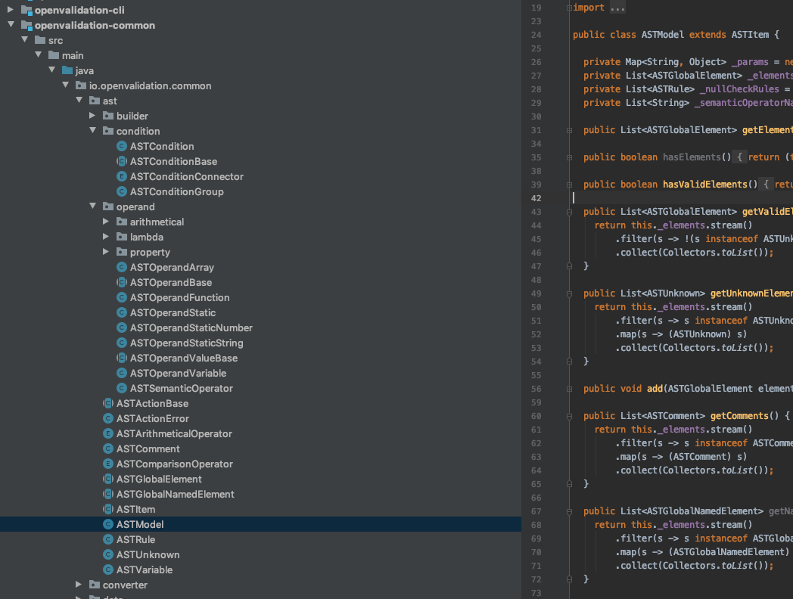

Slide 30
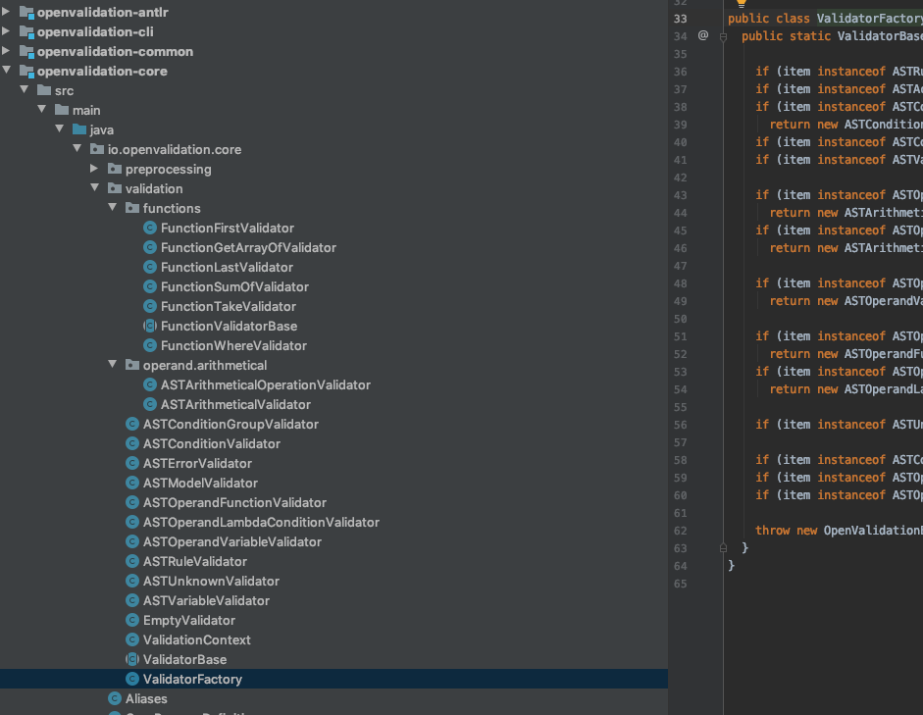

Slide 31
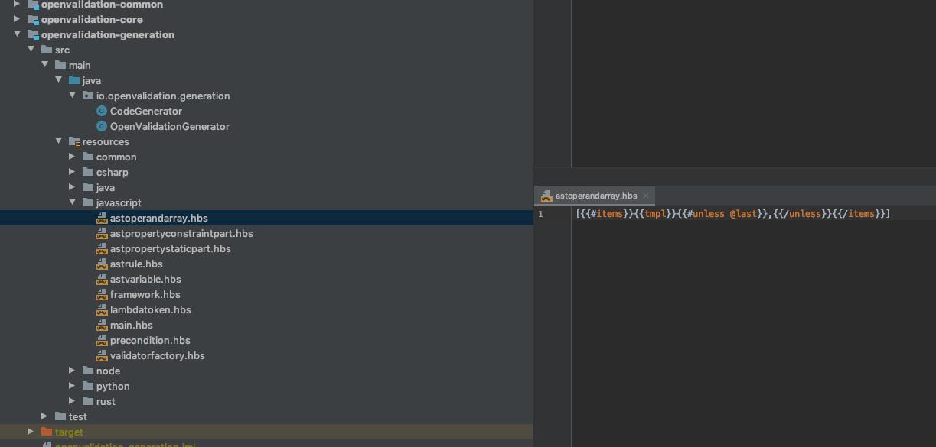

Slide 32
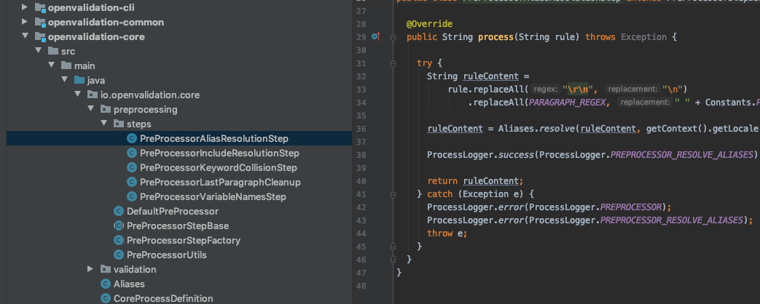

Slide 33
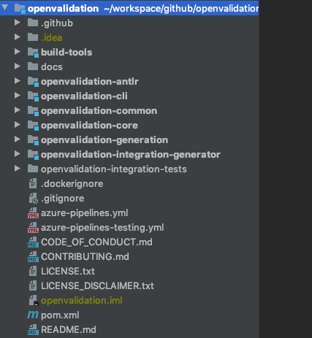
Parser, Grammar
Command Line Interface
Common, Models and Utils
Core Process, Preprocess, Validation
Code Generation
Integration Tests

Slide 34
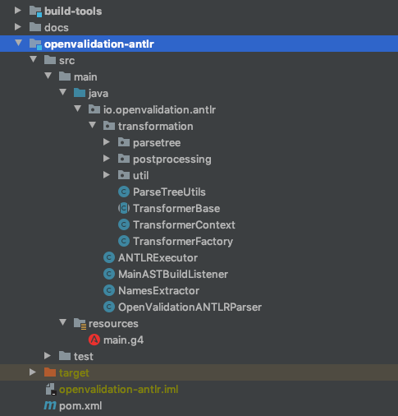
Transformation from
Parse Tree (ANTLR) to
Abstract Syntax Tree (Domain Model)
post transformation processing
Adjustment of AST
ANTLR Grammar
Aggregates and executes the
ANTLR generated Parser

Slide 35
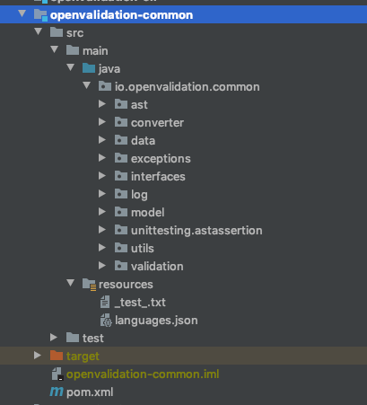
AST Model
DataSchema
(metadata of properties and variables)
Common Models
like Options or Results
Domain specific
assertion framework
for the AST
available output languages

Slide 36
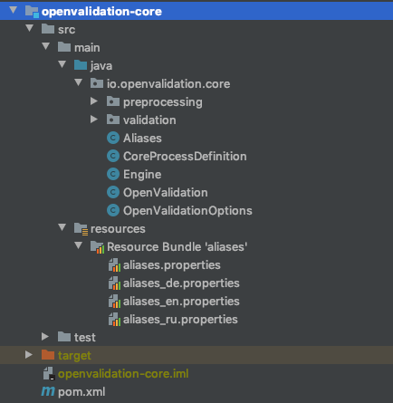
Preprocessors
Alias Model
includes
loading and resolution
AST validation
Main API Component
Entry Point for API usage
core process orchestration
Keyword Aliases

Slide 37
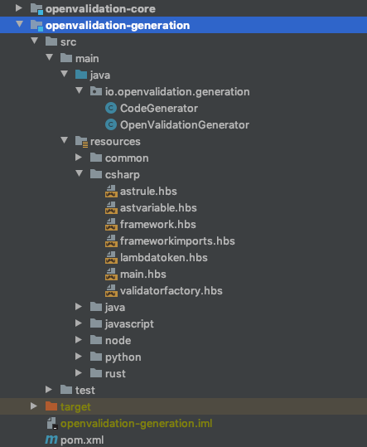
Handlebars Wrapper
provides some custom
helpers
Main
generation process
Handlebars Generator Templates

Slide 38
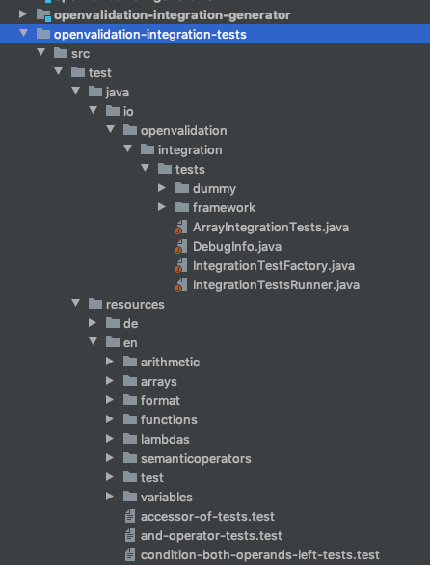
Integration test generator
generates Validation Rules and the corresponding models from custom Test Cases located in resources folder
IntegrationTestsRunner
loads the generated Rules and executes as data driven Unit Test
Integration Test Cases
Contains:
Schema, Rule, Expectations
Test Cases are localized

Slide 39



code generator
validator
AST
if ( age < 18 ){
throw new Exception(
„applicant‘s age
should not be less
than 18 years”
);
}
parser
</>
preprocessor
CLI
natural language
compiler
{ age : 0 }
applicant's age
should not be
less than 18 years

